Slide 1


Semicolons 2024
TEAM NAME : DATA DETECTIVES​
PS CODE : 4518A4DC-30AE-4133-862B-4F18A3CC9D6F​
PROBLEM STATEMENT : AI-powered probabilistic algorithm utilizing biological interactions
for confident variant annotations in cancer.

Slide 2




WHY CREATE A SCORING ALGORITHM TO PRIORITIZE VARIANTS?​
Several thousand to tens of thousands of variants
Therapies, trials available for about 20-50% variants
Patient
Hospital/clinic
Report
Without OncoAnalyticsML Prognosis
Huge Manual Effort
Considerable TAT
Large teams for handling reports
Curators, Doctors and other Medical Personnel rely on knowledge and manual search
With OncoAnalyticsML Prognosis
Reduced Manual Effort
Reduce TAT
Small teams can handle large number of reports

Slide 3
AI/ ML MODEL WORKFLOW
Data Collection​
Features/ Attributes
AI/ML Model
SVR​
ClinVar​
PubMed​
UniProt​
Ensembl
String
Synthetic data
Domain information​
(Kinase, Auto-inhibitory and other cancer specific domains)​
Cancer pathway networks​
Drugs/Therapies​
Trials association​
Availability of publications​
​
Result
Feature selection​
10 fold CV
Probability score for all variants in the report​

Slide 4
DEMO

Slide 5
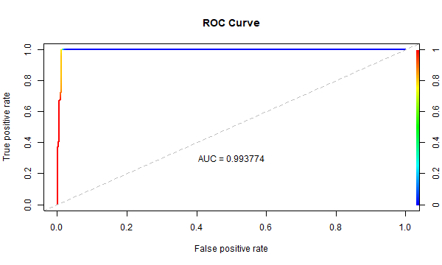
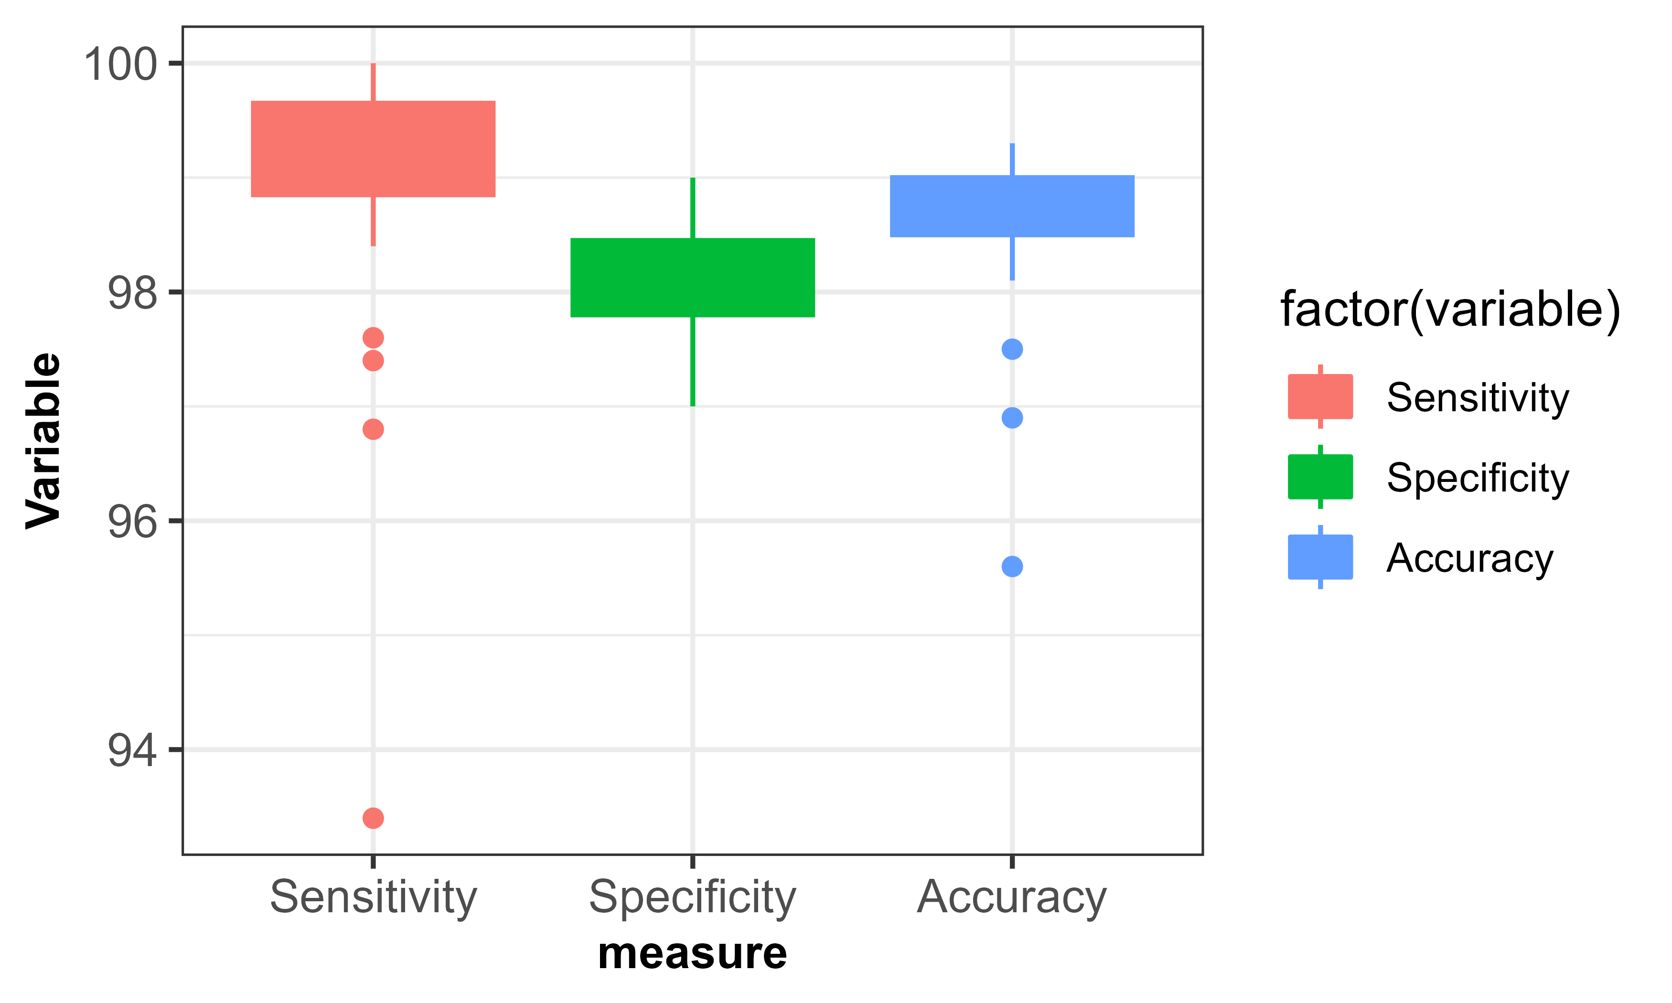
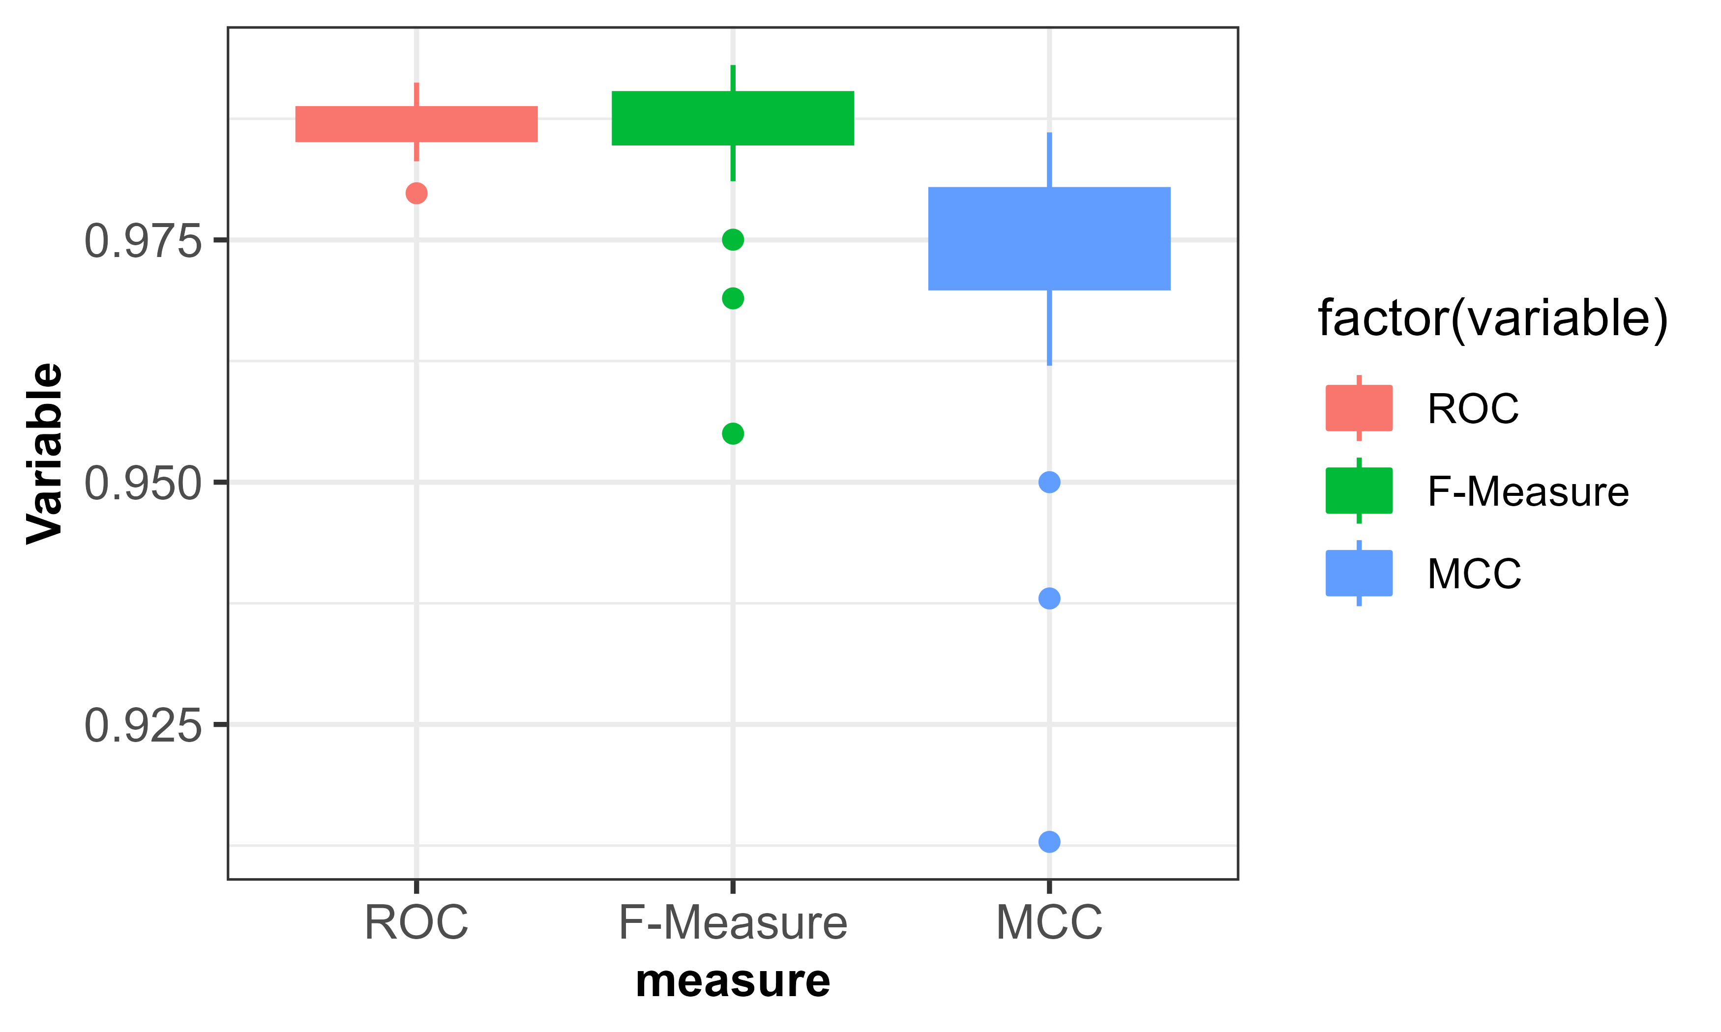
MODEL STATISTICS
Feature Score | Feature Name
0.117 | Protein Domain
0.1477 | AI Domain
0.0912 | Degree
0.0983 | Betweenness
0.2838 | Closeness
0.2453 | Cosmic Genes
0.1603 | Drugs
0.4138 | Trials
0.989 | Cancer genes
0.0954 | Publication
10-fold CV statistics
Correctly Classified Instances 994 99.4 %
Incorrectly Classified Instances 6 0.6 %
Kappa statistic 0.988
K&B Relative Info Score 95.2176 %
Mean absolute error 0.0284
Root mean squared error 0.0991
Total Number of Instances 1000

Slide 6



Business value
Reduces Manual Effort and TAT
Personalized reports Market size In 1.5 trillion USD CAGR Of 11.5% from 2021 To 2028
OPPORTUNITY FOR INNOVATION
No Other Software for scoring based on network pathway and gene interaction
Potential of creation of Intellectual property.
$1.5 trillion
$129.87 billion
~ $1+ million
Global personalized medicine market​
Global personalized medicine market for cancer treatment
Opportunity for PSL

Slide 7
Summary
User Experience
Automated and Easy to use​
Can be updated according to user needs specific to their institutes​
User will be able to easily identify important variants in report​
Business Value
Additional value to existing personalized report generation platforms​.
~ $1 M revenue for PSL.
Technology & Innovation​
UI and backend developed in Python3.​
Scoring algorithm based on gene network and pathways is developed.​
Execution
User Friendly
Reduces Manual effort considerably
Reduced TAT for report sign out

Slide 8
FUTURE ENHANCEMENTS
Models attuned to client needs​
Cloud Implementation
Add-on to existing report generation tools​ & Scalable for multiple report types
Better UI/UX

Slide 9







DATA DETECTIVES
Ashwani Jha
Mrigaya Mehra
Pradeep Phule
Ashish Pathak
Pallavi Jagtap
Darshan Galakatu
Shubham Chigure

Slide 10
Thank You!

