Slide 1
INVESTMENT ASSIGNMENT SUBMISSION
Name: Ashwani Kumar

Slide 2
Abstract
In this analysis, we are analysing CrunchBase start-up data set to identify potential investment sectors for Spark Funds by keeping the following constraints in mind
The company is interested in investing 5 to 15 million USD per round
The company is looking to invest only in countries where English is used in official capacity.
By the end of this presentation, we will a descent idea on the potential investment markets.

Slide 3
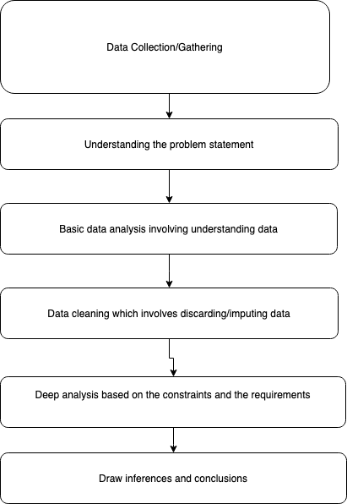
Problem solving methodology

Slide 4
High level analysis
Average funding amount of venture type | $11724222.69
Average funding amount of angel type | $971573.89
Average funding amount of seed type | $747793.68
Average funding amount of private equity type | $73938486.28
Suitable investment type considering investment limit of 5-15 million USD | Venture

Slide 5
Potential Markets (Countries)
Top English speaking country | United States (USA)
Second English speaking country | United Kingdom (GBR)
Third English speaking country | India (IND)

Slide 6
Detailed Analysis
Total number of Investments (count) | 12064 | 621 | 328
Total amount of investment (USD) | $107766584223 | $5379078691 | $2949543602
Top Sector name (no. of investment-wise) | Others | Others | Others
Second Sector name (no. of investment-wise) | Social, Finance, Analytics, Advertising | Social, Finance, Analytics, Advertising | Social, Finance, Analytics, Advertising
Third Sector name (no. of investment-wise) | Cleantech / Semiconductors | Cleantech / Semiconductors | News, Search and Messaging
Number of investments in top sector (3) | 2951 | 147 | 110
Number of investments in second sector (4) | 2714 | 133 | 60
Number of investments in third sector (5) | 2350 | 130 | 52
For point 3 (top sector count-wise), which company received the highest investment? | virtustream | electric-cloud | firstcry-com
For point 4 (second best sector count-wise), which company received the highest investment? | shotspotter | celltick-technologies | manthan-systems

Slide 7
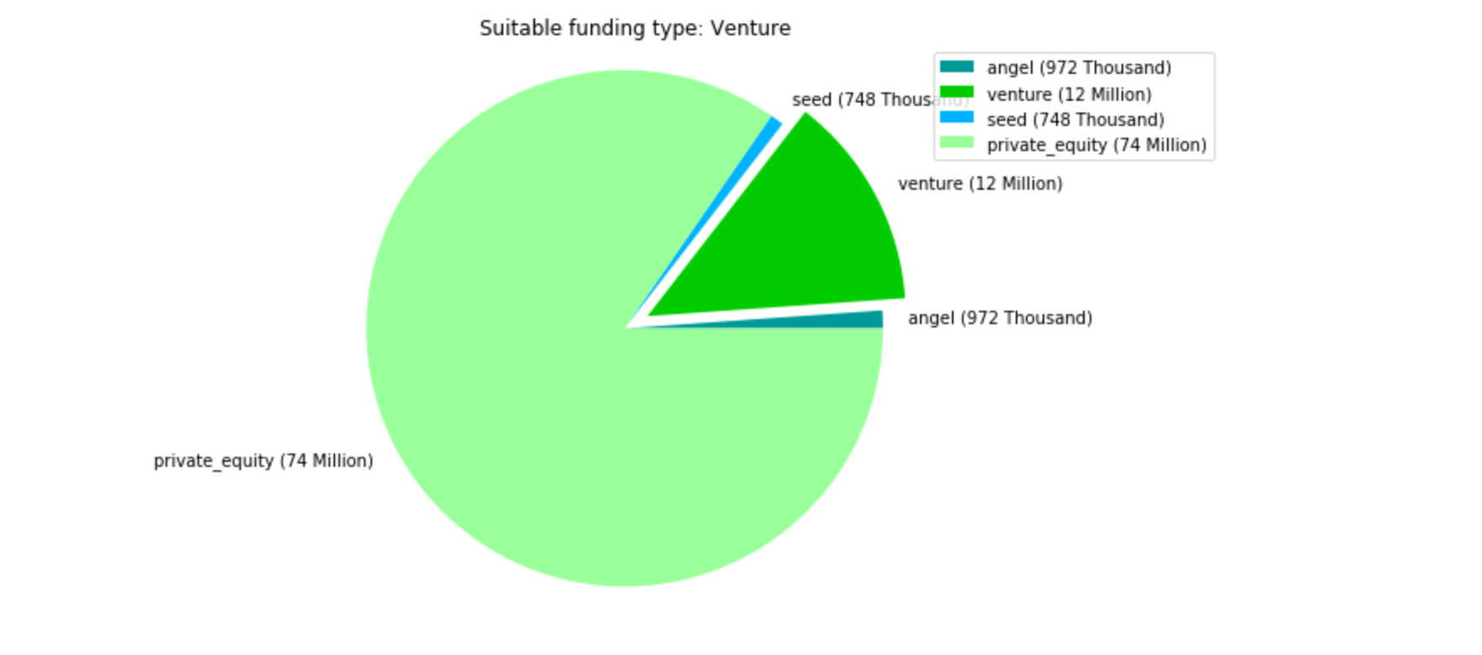
Suitable funding type
As we can see that, Venture is the most suitable funding type for Spark Funds.

Slide 8
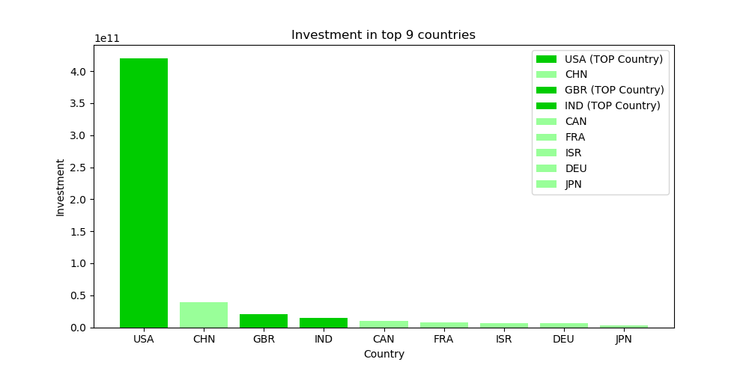
Top 9 countries based on the investment amount
USA, United Kingdom and India are the potential countries to invest in.

Slide 9
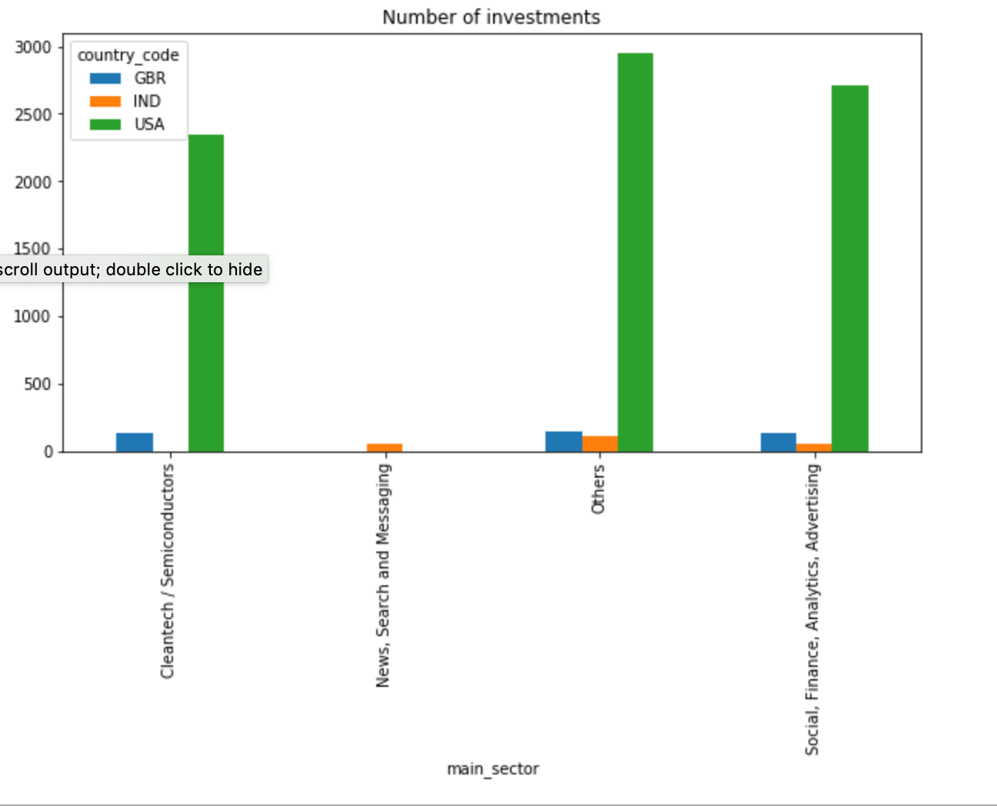
Sector wise investments in top 3 countries

Slide 10
Conclusions
As we can see that USA , United Kingdom and India are the most suitable countries to invest in from Spark Funds point of view. In USA, main sectors like Others, Social finance analytics advertising and clean tech/semi conductors are most suited for the investment. In UK, the same sectors are suitable for the investment. In India, however, we have one more sector News, search and messaging which is potentially viable investment sector.

