Slide 1
LENDING CLUB CASE STUDY SUBMISSION
Name: Ashwani Kumar & Deepak Kumar

Slide 2
Abstract
Lending Club is the largest online loan marketplace, facilitating personal loans, business loans, and financing of medical procedures. Borrowers can easily access lower interest rate loans through a fast online interface.
In this case study, we will present various factors and patterns which results in the loan defaults and can be used to create business models to predict the defaulters.

Slide 3
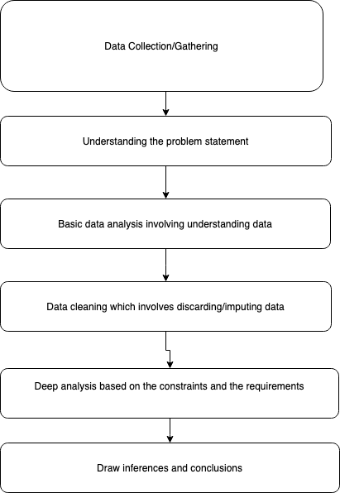
Problem solving methodology

Slide 4
High level analysis
% of defaulted loans | 14.2
Preferred loan term | 36 Months
Most borrowers are experienced between (0-4 years)
Most preferred purpose for loan | Debt consolidation
Most preferred loan amount | Medium range ($5000-$15000)

Slide 5
Detailed Analysis
Loan term which is defaulted most | 60 Months
Income range of the most defaulters | < $30000
State with most loans | California
State with most defaulted loans | Nevada
Most defaulted purpose to which loans belong to | Other
Loan amount for the most defaulted | > $15000
Most preferred loan size | $5000-$15000
Most loans are issued in the later half of the year, with Dec being the highest.

Slide 6
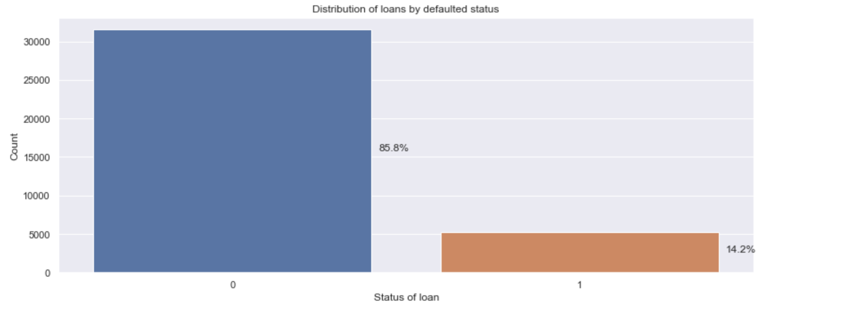
Defaulted loans
As we can see that around 14% loans defaulted

Slide 7
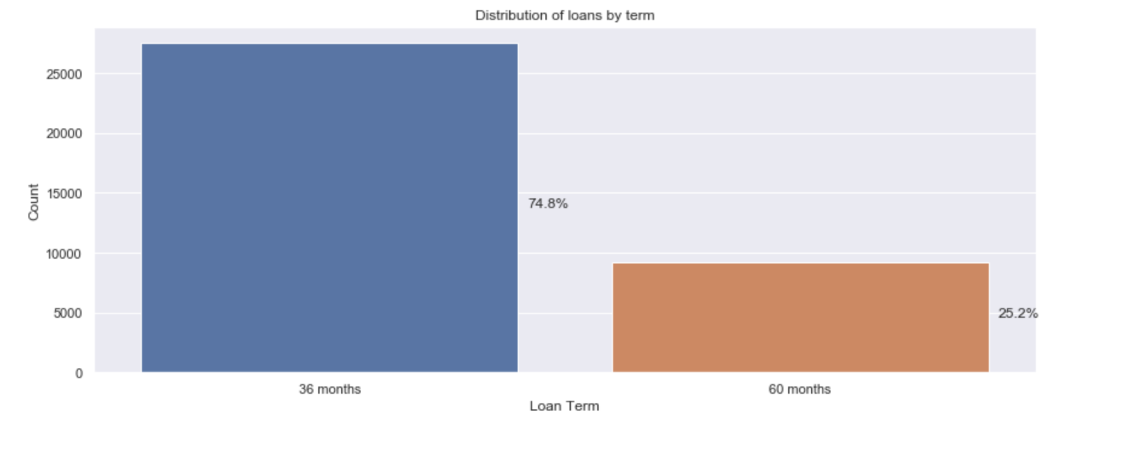
Suitable loan term
As we can see that, 36 months loan are the most preferred ones

Slide 8
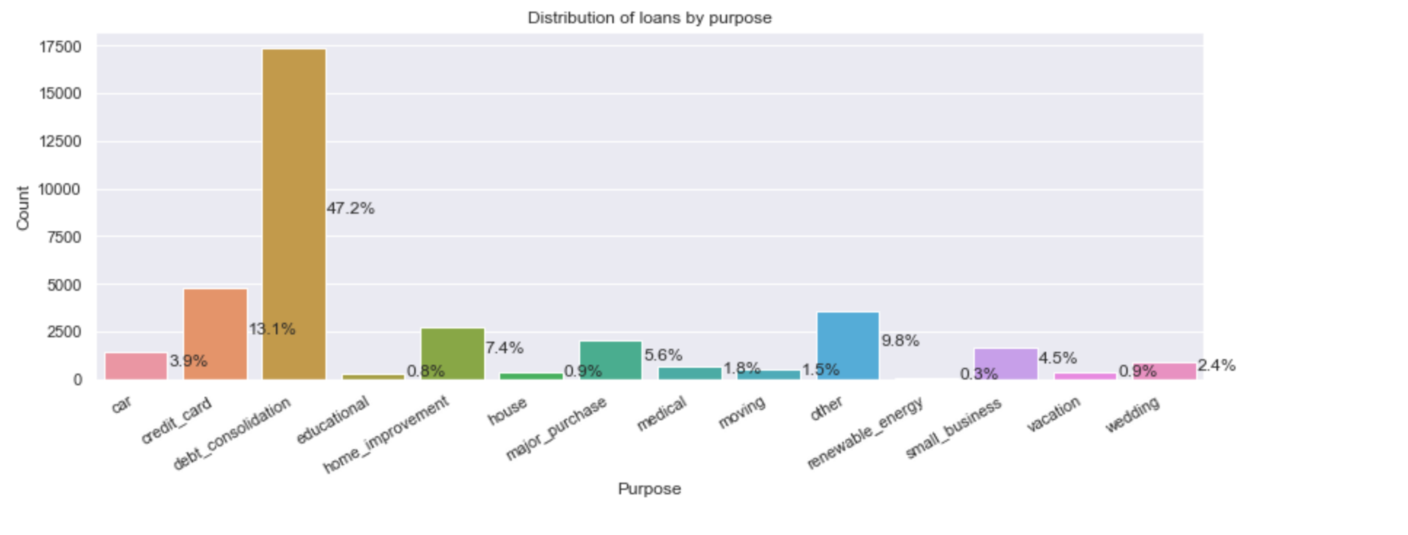
Preferred purpose of the loan
Debt consolidation followed by credit card are the most selected purposes for the loans

Slide 9
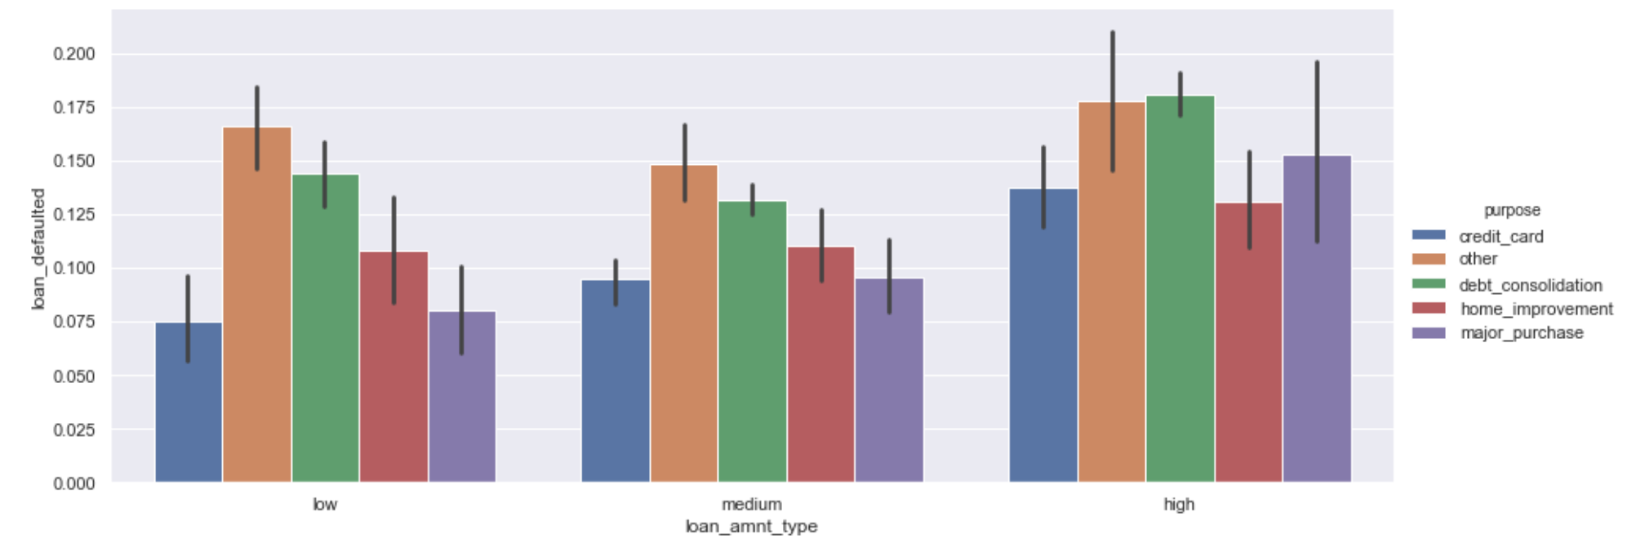
Impact of loan amount on the defaulters

Slide 10
Conclusions
We can see that Other purposes constitutes the most number of the defaulted loans. However, if we ignore Other purposes, Debt consolidation followed by credit card are the most defaulted loans. Loans given to the borrowers with low income are also prone to defaulting. Also, as the amount of loan increases the risk of defaulting also increases.

