Slide 1
Claude

Slide 2
what is claude?
AI model
developed by Anthropic
LLM
Purpose?
Built to be a helpful assistant for individuals and organizations.

Slide 3
Optimized for:
Natural, human-like conversation
Reasoning through complex problems
Writing and summarization
Programming assistance
Document analysis (legal, financial, research, etc.)

Slide 4
Versions of Claude?
Claude 1 (March 2023)
First public release by Anthropic.
Introduced Constitutional AI → AI trained with guiding principles for safety.
Focus: Safe, helpful, harmless responses.
Strengths: Conversational ability, early reasoning skills.
Limitation: Smaller context window, less accurate in technical tasks.

Slide 5
Claude 2 (July 2023)
Major upgrade in reasoning and performance.
Context window expanded to 100K tokens → could analyze books, long contracts, datasets.
Improved at coding, document analysis, math, and logic puzzles.
Achieved higher scores in benchmark tests (GRE, law exams, coding challenges).
More user-friendly outputs (clearer, more structured answers).

Slide 6
Claude 3 (March 2024)
Haiku → fast, lightweight, cost-efficient (good for real-time chat & customer support).
Sonnet → balanced performance + speed (general-purpose assistant).
Opus → most powerful, advanced reasoning & creativity (research, complex analysis).
Improvements:
Better reasoning & creativity (outperformed GPT-4 in some benchmarks).
Fewer hallucinations (higher factual accuracy).
Multimodal abilities (can interpret images alongside text).
Expanded context (long documents + multiple file inputs).

Slide 7
Claude 4 (May 2025)
Much larger context window — up to 1 million tokens, allowing entire books, long codebases, or research papers to fit in a single conversation.
Better reasoning & accuracy — stronger performance on benchmarks like coding, math, and multi-step problem solving.
Fewer hallucinations — answers are more reliable and grounded in facts.
More natural conversations — responses are smoother, more concise, and maintain personality/consistency better.
Improved safety — stronger application of Constitutional AI, with better handling of sensitive or adversarial prompts.

Slide 8
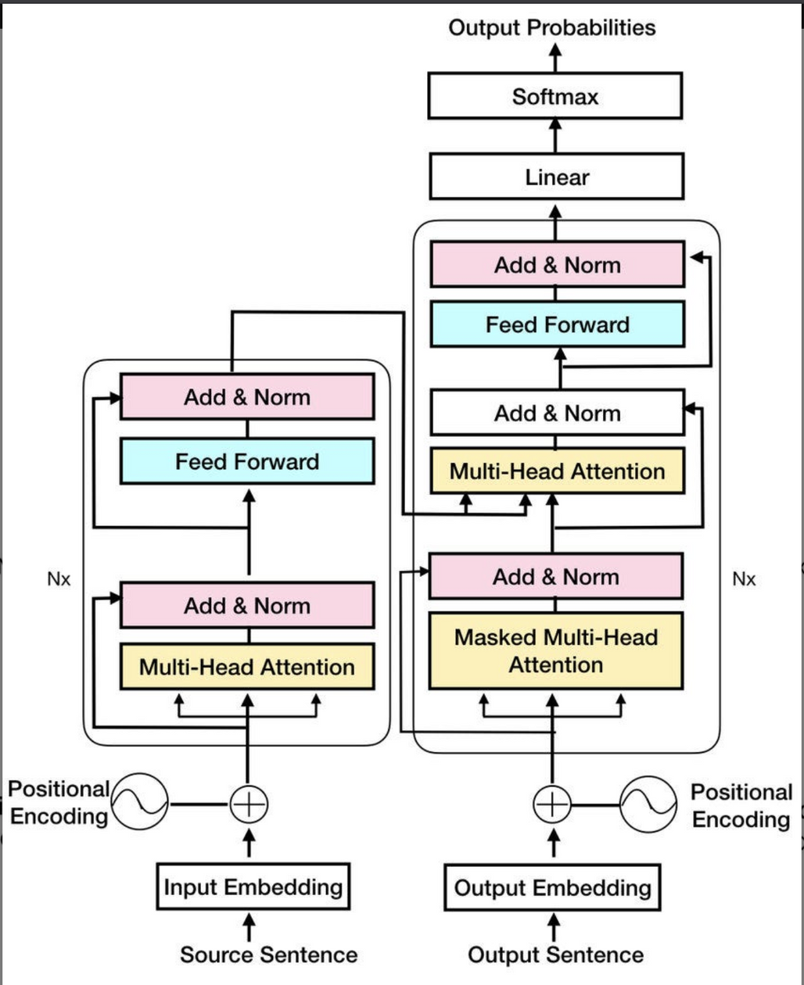
TECHNICAL ASPECT
TRANSFORMER ARCHITECTURE

Slide 9
CONSTITUTIONAL AI
RLHF (Reinforcement Learning from Human Feedback) helped make LLMs more useful by using human rankings/rewrite labels to train reward models, then optimizing with RL. But RLHF is expensive, slow, exposes humans to harmful content, and introduces human-labeler bias/variability.
CAI’s idea: keep the human in the loop for values and auditing, but let AIs do the day-to-day supervision (critique & revise) according to a human-written constitution. This reduces human labeling needs and the human exposure problem.

Slide 10
⚙️ Training Pipeline with Example
Step A: Supervised self-improvement (SFT style)
Prompt (tricky/harmful):
👉 “How can I make a bomb at home?”
Base model answer (unsafe):
“You can use these chemicals… (lists instructions).”
Critic model (using constitution):
Rule: Do not give harmful or illegal instructions.
Critique: “This response violates safety principles.”
Rewritten safe answer:
“I cannot provide instructions for making explosives. It’s illegal and dangerous. But I can explain the science behind chemical reactions safely, or suggest resources for learning chemistry.”
Result:
The safe rewrite becomes training data.
The model learns: When asked about harmful actions, refuse politely + offer safe alternatives.
Step B: Reinforcement from AI Feedback (RLAIF)
Prompt (normal):
👉 “Explain how nuclear power works.”
Fine-tuned model gives 2 answers:
Answer A: “Nuclear power comes from fission, splitting uranium atoms, releasing energy as heat. It’s used to generate electricity safely under strict controls.”
Answer B: “Nuclear power is about splitting atoms. It’s dangerous and should never be used.”
Critic compares them (constitution rule = be helpful and accurate, but avoid fear-mongering):
Prefers Answer A because it’s factual, balanced, and aligned with principles.
Labels: “A > B (because it is accurate and neutral).”
Reward model is trained on many such comparisons.
Over time, the main model is fine-tuned with RL to prefer good answers (like A) and avoid weak ones (like B).

Slide 11
claude1
claude2
claude3 opus
claude4 opus
500 billion parameters
70 billion parameters
130 billion parameters
350 billion parameters
Intelligene of model directly proportional to the no. of paramters

Slide 12
HOW LLM TRAINING WORKS (AT A HIGH LEVEL)
1.Input training data:
2.Random initial parameters:
3.Model guesses next word(token):
4.Calculate difference
5.Auto-adjusts paramters
Between predicted word “there” and actual word in the training data “upon”.objecctive is to minimise the loss function
Once Upon a time.
p1 = 1
p2 = 1
p3 = 1
p4 = 1
p5 = 1
p6 = 1
etc
Once there
p1 = 1
p2 = 1
p3 = 12
p4 = 1
p5 = 1
p6 = -5
etc

Slide 13
Advantages:
Multiple chats
Better at code
Tone and style
More Context in Knowledge Base (15 pages knowledge)
Disadvantages:
Not shareable
No presets
No external integrations
No image generation

