Slide 1
V
Vellum AI
Multi-modal AI document verification and credential forensic intelligence
BCSE306L Artificial Intelligence | Course project prototype
VIT Vellore | Fall Semester 2026-27

Slide 2
The problem
Institutions receive thousands of uploaded documents and check each one by hand
What happens today
What Vellum does
Students upload certificates, grade sheets and letters as photos or PDFs
Many uploads are the wrong file: a selfie, an invoice, a random screenshot
Staff open each file to check what it is and copy the name, register number and CGPA by hand
Slow, error prone, and it does not scale at admission or placement time
1. Accepts anything: any image format or a multi-page PDF, and rejects unsupported files with a clear message
2. Decides what it is: certificate, academic record, unrelated document, or not a document
3. Reads it: OCR plus field extraction pulls out name, register number, institution, CGPA, dates and the course table

Slide 3
Four classes
Two are relevant credentials, two are rejected
1
2
3
4
Certificate
Academic record
Unrelated document
Not a document
Degree, course completion, internship, participation, provisional certificates
Grade sheet, mark sheet, CGPA statement, transcript, completion and bonafide letters, LORs
A real document that is not a credential: invoice, form, memo, article, statement
A random photo from the internet: people, animals, scenes, objects
Relevant
Relevant
Rejected
Rejected

Slide 4
How the model works
One upload goes through five stages
1
2
3
4
5
Intake
OCR
Three classifiers
Fusion
Field extraction
Magic-byte check. Images decoded with EXIF rotation, PDF pages rendered at 300 DPI
RapidOCR (PaddleOCR models on ONNX Runtime) reads every text line with its box
Fine-tuned CNN on pixels, zero-shot CLIP on pixels, TF-IDF model on the OCR text
Weighted average of the three probability vectors decides the class
For relevant documents only: layout-aware rules pull out the fields
Stack: PyTorch, torchvision, Hugging Face Transformers, scikit-learn, RapidOCR, PyMuPDF, FastAPI backend, React + Vite + Tailwind frontend

Slide 5
Why three models
Each one covers a weakness of the others
Image CNN
EfficientNet-B0, ImageNet pretrained, fine-tuned 12 epochs on our dataset
100.0% test
16.7% real scans
CLIP zero-shot
ViT-B/32 trained on 2 billion real image-text pairs, never saw our data
87.1% test
100.0% real scans
OCR text model
TF-IDF word and character n-grams + logistic regression on the OCR text
96.7% test
reads the words
Fused
Weights image 0.45, CLIP 0.45, text 0.1
100.0% test
100.0% real scans

Slide 6
Training data
Built for this project, split before augmentation so no copy leaks across splits
Certificates: synthetic degree, completion, internship and participation certificates with varied templates, fonts, seals
Academic records: synthetic grade sheets and mark sheets, completion and bonafide letters, 120 rendered LORs
Unrelated documents: RVL-CDIP subset (15 document types), FUNSD forms, synthetic invoices, menus, articles
Random photos: Flickr30k test photos and Imagenette
Augmentation: phone-photo simulation (perspective, desk background, shadow, blur) and photocopy effects
1944
Train images
407
Validation images
448
Test images

Slide 7
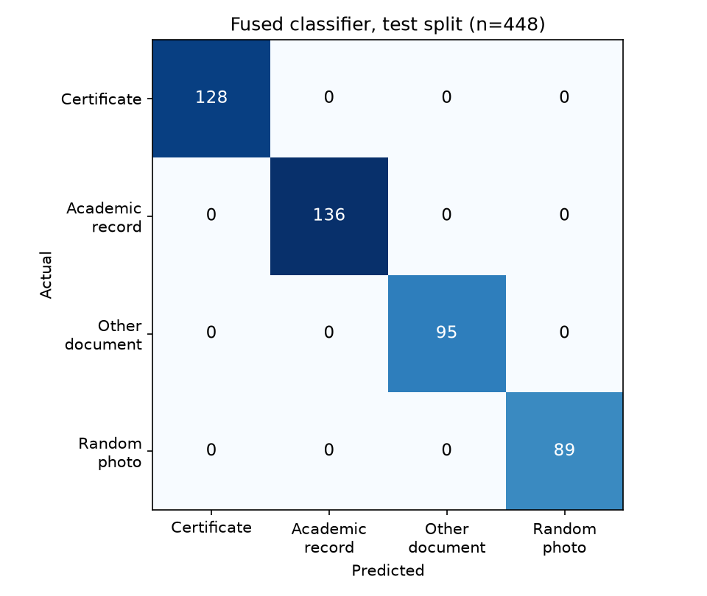
Results
Measured on held-out data. The real-world set is only 6 scans and the fusion weights were tuned on these sets, so treat it as a sanity check.
100.0%
Test split accuracy, 448 images
100.0%
Real-world scans, 6 genuine diplomas and records

Slide 8
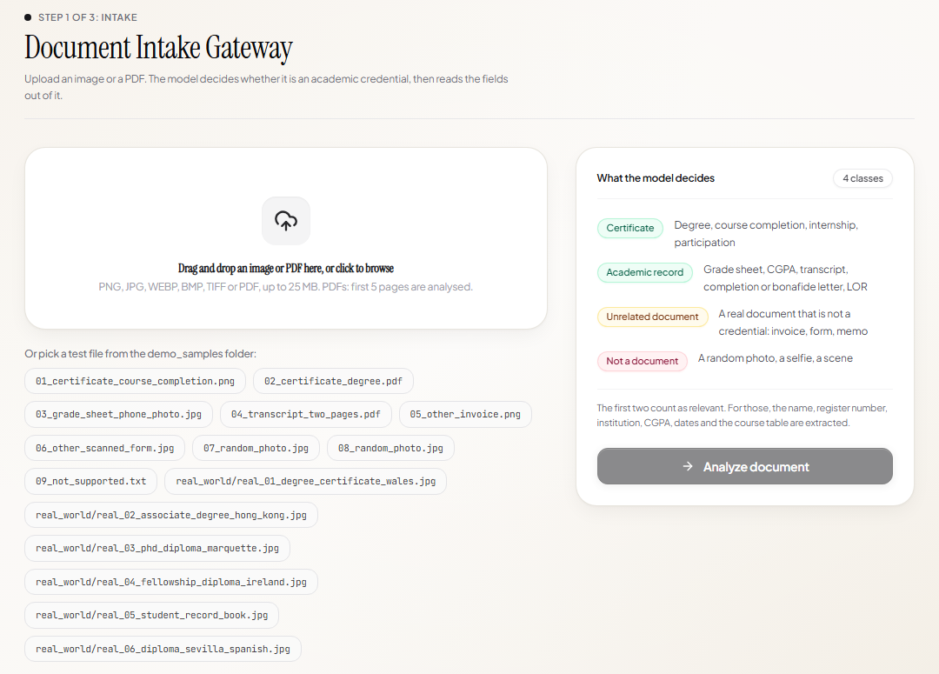
Step 1: Upload
Drag in any image or PDF, or pick a file from the demo_samples folder

Slide 9
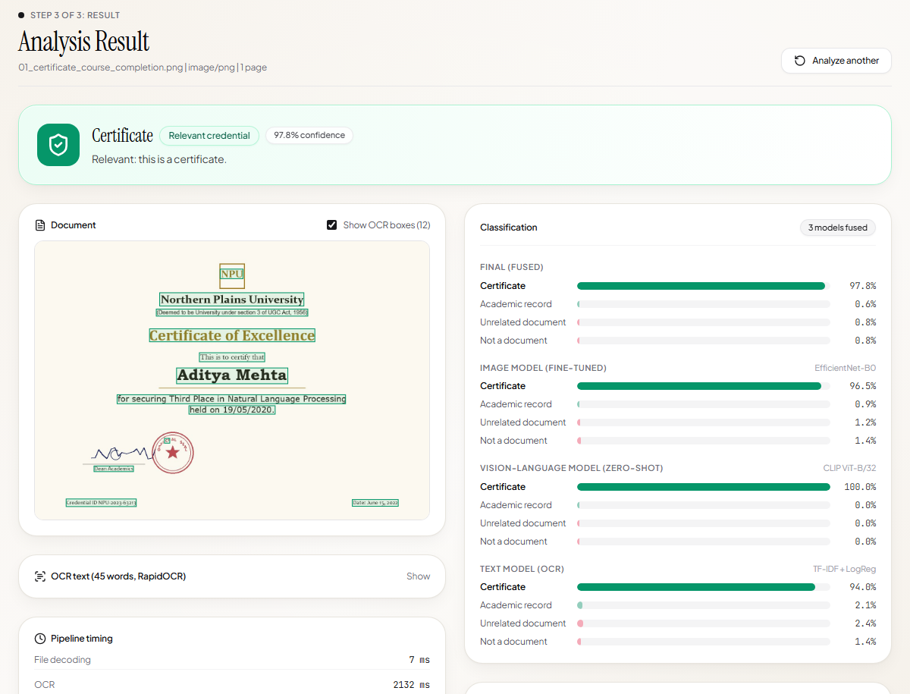
Class 1: Certificate
A course completion certificate is recognised and its fields are read out

Slide 10
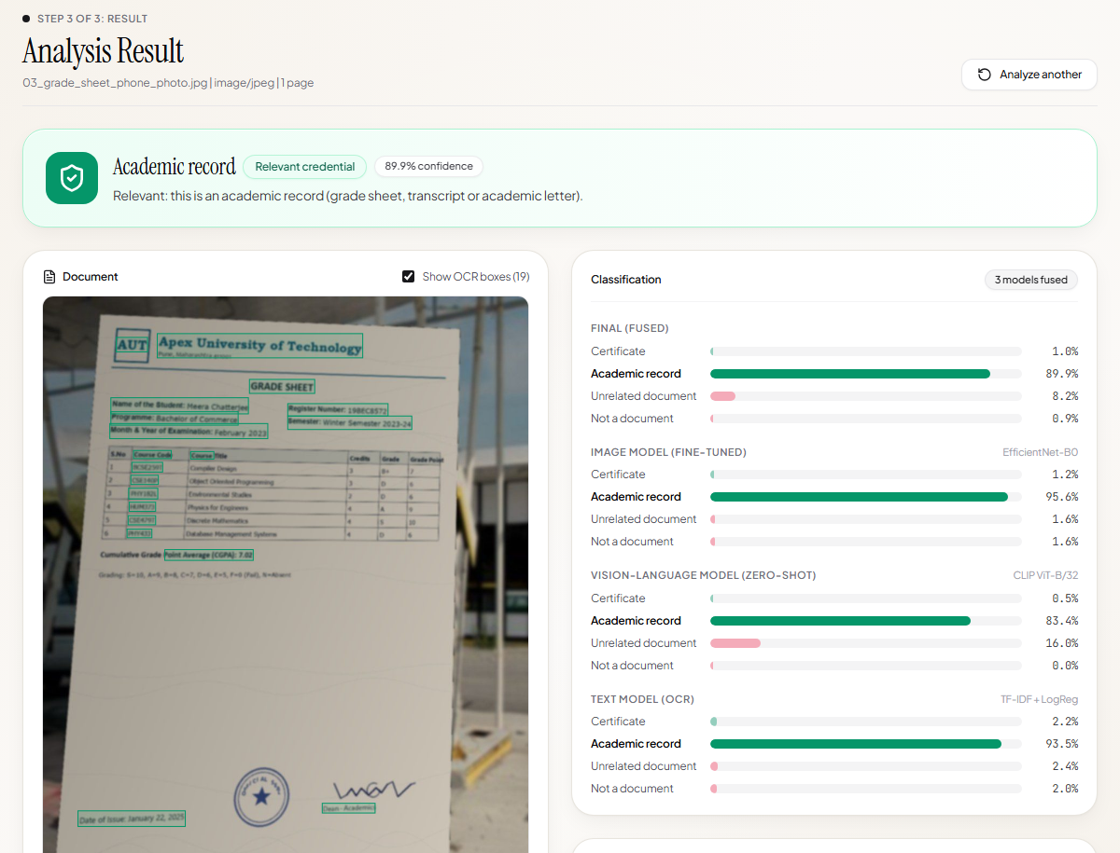
Class 2: Academic record
A phone photo of a grade sheet: register number, semester, CGPA and course table extracted

Slide 11
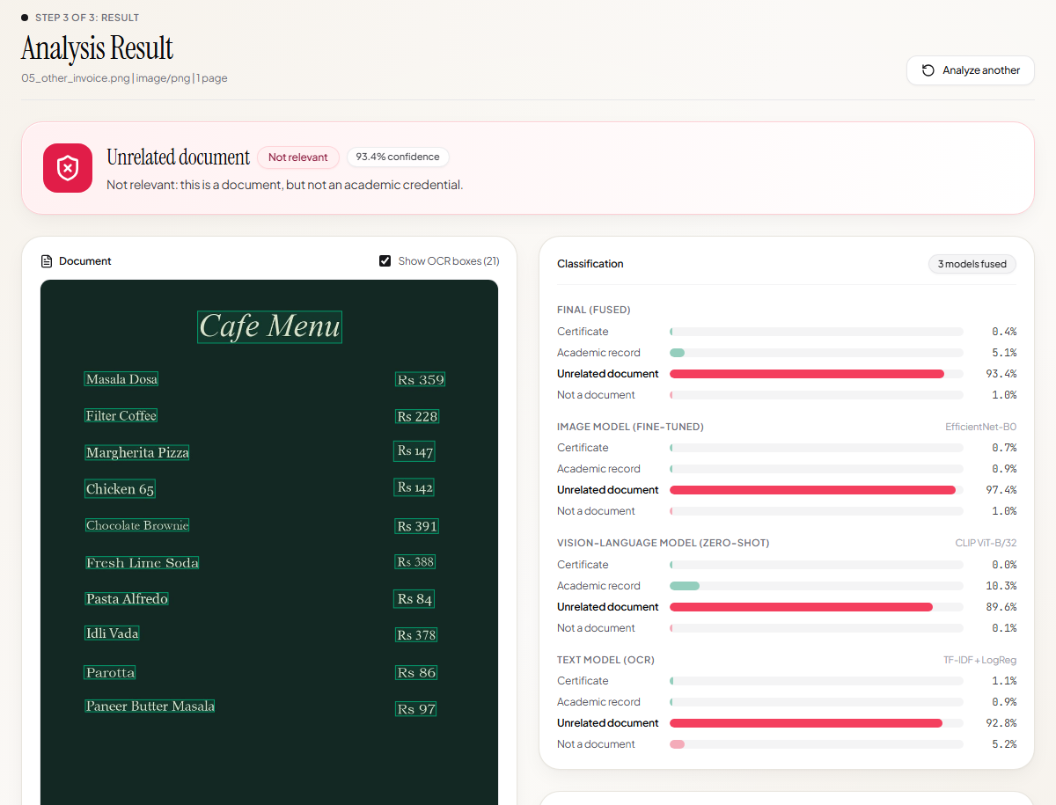
Class 3: Unrelated document
An invoice is a real document, but not a credential, so it is rejected

Slide 12
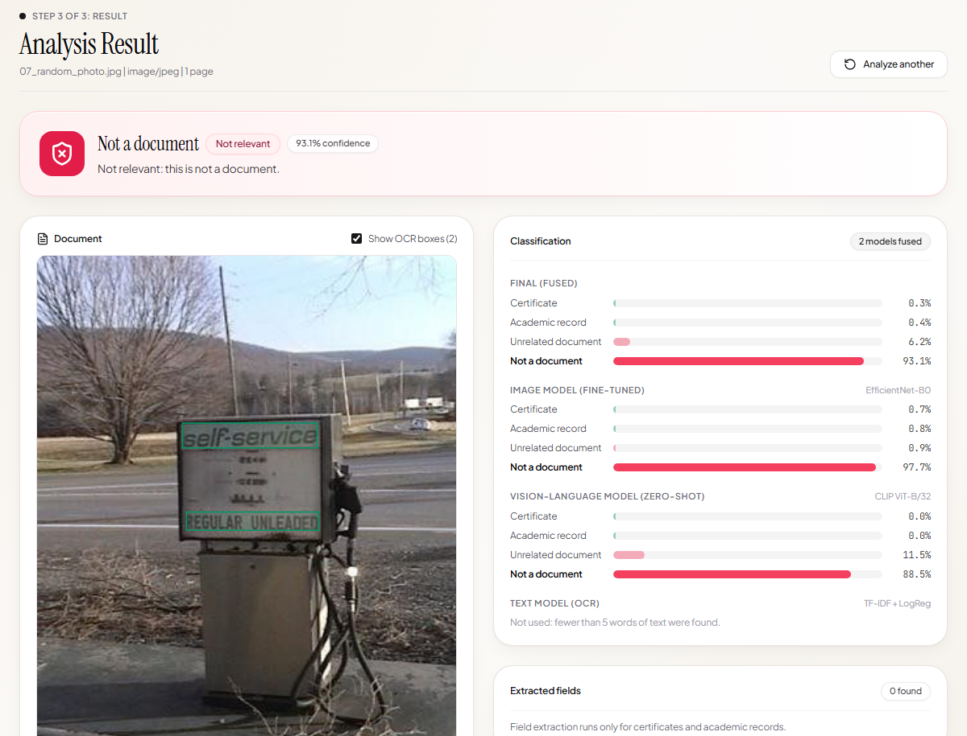
Class 4: Not a document
A random photo is rejected before any field extraction

Slide 13
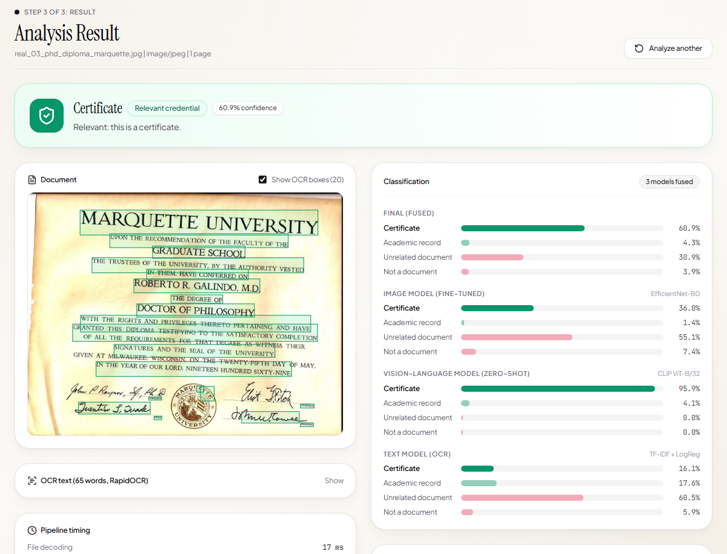
Real-world scan
A genuine university diploma the model has never seen, classified correctly

Slide 14
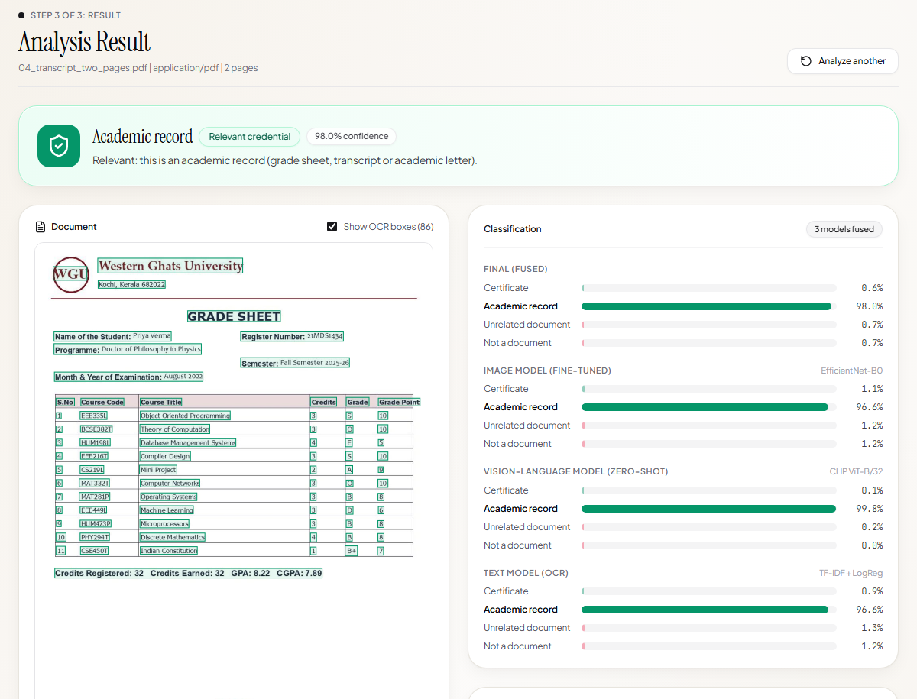
Multi-page PDF
PDF uploads are rendered page by page and every page is classified

Slide 15
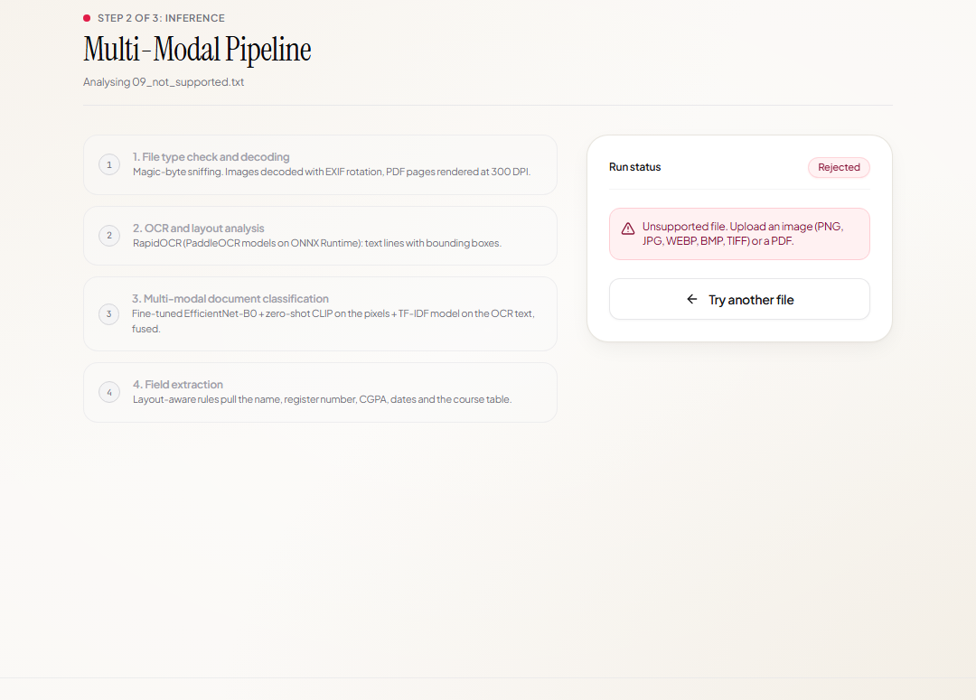
Unsupported file
Anything that is not an image or a PDF gets a clear error instead of a crash

Slide 16
Live demo: test files
All in demo_samples/, one click each on the upload page
01_certificate_course_completion.png
Certificate
02_certificate_degree.pdf
Certificate (PDF)
03_grade_sheet_phone_photo.jpg
Academic record
04_transcript_two_pages.pdf
Academic record (2 pages)
05_other_invoice.png
Unrelated document
06_other_scanned_form.jpg
Unrelated document
07 / 08_random_photo.jpg
Not a document
09_not_supported.txt
Rejected: unsupported file
real_world/ (6 real scans)
Certificate / Academic record

Slide 17
What we built
A working end-to-end prototype: upload, classify, extract, show
Three models fused: fine-tuned CNN, zero-shot CLIP, OCR text classifier
Handles images, phone photos and multi-page PDFs, rejects everything else
Every accuracy number on these slides was measured on held-out data
Next steps
Train on real university documents
Tampering and forgery detection
Cross-document consistency checks
Verification against issuer records
Thank you

