Slide 1

CDIS – Y25
Department of CSE
B.Tech. CSE Trimester -5
Roll Number: 2520030081 Name: S.Ashwanth Reddy
Cloud Infrastructure and Services
25CS2206E
LAB RECORD 2026

Slide 2
CDIS – Y25
Experiment -1
AIM: To create an AWS free tier account to provision the resources. Description:
Amazon Web Services (AWS) is a cloud computing platform provided by Amazon. It offers several free services through the AWS Free Tier, allowing students, developers, and beginners to learn and experiment with cloud technology without investing much money.
The free benefits of AWS include:
Free Computing: Run virtual servers using Amazon EC2.
Free Storage: Store files, images, and documents using Amazon S3.
Free Databases: Create and manage databases using Amazon RDS and DynamoDB.
Website Hosting: Host websites using AWS services.
Free Networking: Deliver website content using Amazon CloudFront.
Monitoring: Monitor applications using Amazon CloudWatch.
Security: Manage user access and protect cloud resources.
Serverless Computing: Run code using AWS Lambda.
Free Learning: Access tutorials, documentation, and training resources.
Application Development: Build, test, and deploy cloud-based applications.
Steps:
  Open Google Chrome and visit https://aws.amazon.com/.
  Click on Sign in to the Console.
  If you are a new user, select the option to create a new AWS account.
  Enter your email address and AWS account name.
  Verify your email address using the OTP.
  Create a strong password for your account.
  Enter your personal details and contact information.
  Provide the required payment information.

Slide 3
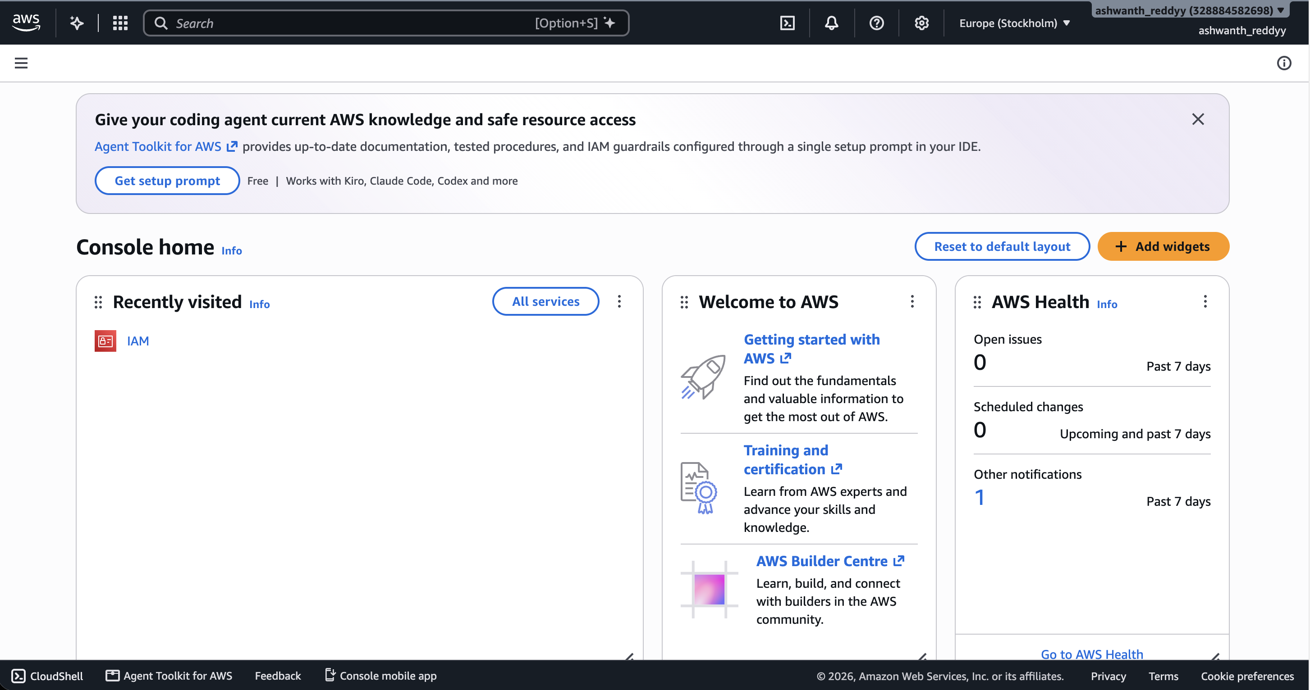
CDIS – Y25
Complete phone number verification.
Select the available Free Support plan.
Sign in to the AWS Management Console using your registered email and password.
Explore AWS services such as EC2, S3, RDS, and Lambda.
Output:

