Slide 1

Title: Luxury Stay - Hotel Booking Web Application
Student Name: S. Ashwanth Reddy
Student ID:2520030081
Cluster:3
Section:10
Under the Guidance
of
Supervisor Name: Surekha
Assistant Professor
Department of CSE

Slide 2
OUTLINE
Abstract
Existing System
Proposed System
System Architecture
Project Modules
Objectives
Co’s Attainments - FWD
Co1
Co2 …….. 5. Co5
Co’s Attainments - DSA
Co1
Co2 …….. 5. Co5
Screen Shots for FWD & DSA
Conclusion
Geo-Tagged Photos

Slide 3
Abstract
Luxury Stay is a full-stack hotel booking web application designed to provide a seamless, premium experience for travelers across India.
FWD (Front-End Web Development):
Built using HTML, CSS, and JavaScript with a multi-page architecture including a login/register system, a main landing page, 22 hotel property listings, room booking wizard, gallery, and contact form.
DSA (Data Structures and Algorithms):
Implemented in Java, mirroring the website logic using HashMap, LinkedList, Stack, Queue, ArrayList, Binary Search, and Polynomial Rolling Hash for authentication, session management, navigation, and notifications.
The system covers user registration, login with brute-force protection, password strength validation, sorted user search, and session-based access control — all mapped to real-world DSA concepts.

Slide 4
Existing System
Existing hotel booking systems have several limitations:
Static Websites: Most hotel sites are static HTML with no real-time booking or user authentication
Manual Booking: Reservations via phone/email — no automated confirmation or session management
No Personalization: No login system; repeat guests must re-enter all details every visit
No Filtering/Search: Hotel portfolios shown as flat lists with no region or category filtering
Weak Data Management: User data in unstructured formats without efficient O(1) lookup
No Security: Passwords stored in plain text, no brute-force protection, no session tokens
Limited Feedback: No toast notifications or real-time form validation for users

Slide 5
Proposed System
Luxury Stay addresses all existing limitations with a modern, feature-rich web application:
Multi-Page Architecture: Separate login.html and index.html with session-based authentication guard
Authentication System: Login, Register, Forgot Password with demo users, social login, and guest access
22 Hotel Properties: Filterable by region (North/South/East/West), category (Beach/Heritage), with search
Room Booking Wizard: 4-step booking flow — Stay details, Guest info, Payment, Confirmation
DSA-Backed Backend (Java): HashMap for O(1) user lookup, Stack for navigation, Queue for notifications
Password Security: Polynomial rolling hash + strength meter (Weak/Fair/Good/Strong) with brute-force lock
Responsive Design: Mobile-first with smooth animations, preloader, scroll reveal, and testimonial slider

Slide 6
System Architecture
Frontend Layer (Client-Side):
login.html / login.css / login.js — Authentication page with tab switching, form validation, session storage
index.html / style.css / script.js — Main site with navbar, hero, rooms, hotels grid, gallery, contact, booking modal
Data Layer (sessionStorage):
ls_auth — Boolean flag for session validity; ls_user — JSON object with name, email, role, loginTime
DSA Layer (Java — LuxuryStayDSA.java):
UserStore (HashMap) → SessionManager (HashMap) → LoginHistory (LinkedList) → NavigationStack (Stack) → NotificationQueue (Queue)
AuthGate ties all DSA components into a unified login/register/logout flow mirroring the frontend logic

Slide 7
Project Modules
Module 1 — Authentication (login.js + Java AuthGate):
Sign In with email/password validation, Register with strength check, Forgot Password, Social Login (Google/Facebook), Guest Access
Module 2 — Hotel Portfolio (index.html + script.js):
22 hotel cards across India, filterable by 6 region/type categories, searchable by name/city, with Book Now action
Module 3 — Room Booking Wizard:
4-step modal: Room selection → Guest details (check-in/out, guests) → Payment (card/UPI/netbanking) → Confirmation with booking ID
Module 4 — DSA Implementation (LuxuryStayDSA.java):
8 classes: User (POJO), PasswordHasher, UserStore, SessionManager, LoginHistory, NavigationStack, NotificationQueue, AuthGate with 15 test cases

Slide 8
Objectives
FWD Objectives:
Build a responsive multi-page hotel website using HTML5, CSS3, and vanilla JavaScript with no frameworks
Implement a complete authentication flow with login, register, forgot password, social login, and guest access
Design 22 hotel property cards with dynamic filtering, search, and booking functionality
Create a 4-step booking wizard modal with form validation and simulated payment gateway
DSA Objectives:
Map frontend logic to Java DSA: HashMap for user/session storage (O(1)), LinkedList for login history, Stack for navigation
Implement polynomial rolling hash for password hashing and binary search on sorted user list (O(log n))
Demonstrate brute-force lockout, password strength scoring, and FIFO notification queue in Java

Slide 9
Co’s Attainments - FWD
CO1 — Apply knowledge of computing to design web-based solutions:
Designed a responsive multi-page hotel booking site (login.html + index.html) using HTML5, CSS3, JS with animations, preloader, and scroll reveal
CO2 — Identify, analyze, and solve complex computing problems:
Solved UX challenges: session-based auth guard, 22-property dynamic filter with search, 4-step booking wizard with form validation
CO3 — Design and implement software systems with appropriate techniques:
Implemented modular JavaScript with event-driven architecture, sessionStorage state management, and reusable UI components
CO4 — Demonstrate professional ethics and communication:
Semantic HTML, accessible form patterns, clean code with structured comments across login.js, script.js, and style.css
CO5 — Identify and use emerging technologies:
Used Intersection Observer API for scroll reveal, CSS custom properties, keyframe animations, and CSS Grid/Flexbox layouts

Slide 10
Co’s Attainments - DSA
CO1 — Apply DSA knowledge to real-world problems:
HashMap for O(1) email-based user lookup and session token validation, directly mirroring login.js sessionStorage logic
CO2 — Analyze time and space complexity:
UserStore: O(1) register/authenticate; Binary Search on sorted ArrayList: O(log n); LinkedList prepend for login history: O(1)
CO3 — Design and implement algorithms:
Polynomial Rolling Hash for password security; Comparator-based sort for user list; brute-force lockout after 5 failed attempts
CO4 — Demonstrate systematic testing and validation:
15 test cases: valid login, wrong password, admin login, new user register, duplicate check, forgot password, brute-force lock, logout
CO5 — Connect theory to practice:
All 8 Java DSA classes (UserStore, SessionManager, LoginHistory, NavigationStack, NotificationQueue, AuthGate) map 1:1 to JS functions

Slide 11
Screenshots for FWD & DSA
FWD Screenshots:
1. Login Page — Split-panel with sign in/register tabs, floating member card, gold-themed form, password strength meter
2. Main Landing Page — Hero parallax, animated stats strip (120 rooms, 98% satisfaction, 25 yrs, 22 hotels)
3. Hotel Portfolio — 22 property cards with region/type filter and live search, rating badges, price/night
4. Booking Wizard — 4-step modal (Stay > Details > Payment > Confirm) with animated progress indicator
DSA Output (Java Console):
5. Auth Test — Successful login shows session token, user role, timestamp via HashMap O(1) lookup
6. Brute Force Lock — Account locked after 5 failed attempts; login history printed via LinkedList traversal

Slide 12
Conclusion
Luxury Stay successfully demonstrates an end-to-end hotel booking platform integrating FWD and DSA concepts.
FWD Achievements:
Delivered a fully responsive, multi-page hotel website with 22 properties, real-time filtering, session-based authentication, and a 4-step booking wizard using only HTML, CSS, and JavaScript
DSA Achievements:
Implemented 8 Java DSA classes with HashMap (O(1) lookup), doubly LinkedList (login history), Stack (navigation), Queue (notifications), Binary Search (O(log n)), and Polynomial Hashing — validated through 15 test cases
Key Learning:
The project established a clear mapping between frontend JavaScript patterns and core data structures, demonstrating that DSA is the backbone of real applications
Future Scope: Integration with a live database (MySQL/Firebase), real payment gateway (Razorpay/Stripe), and mobile app using React Native

Slide 13
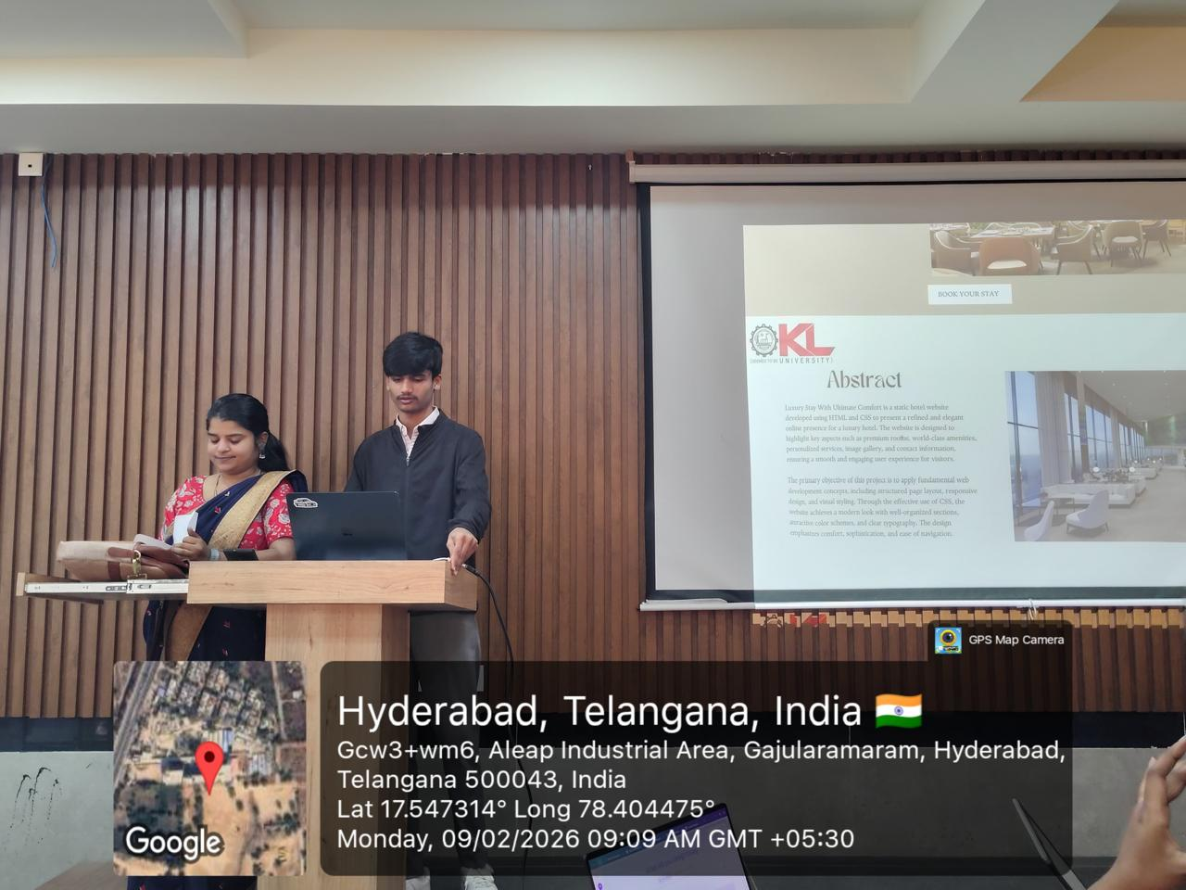
Geo- Tag Photos

Slide 14
THANK YOU

