Slide 1

SMART CAMPUS MANAGEMENT ECOSYSTEM WITH AI-POWERED ASSISTANCE, WEARABLE NOTIFICATIONS, AND ADAPTIVE LEARNING ANALYTICS (SCME-AWN)
Team Members
ASHWATH S - 727823TUCS020
Batch No: 15
Guide: Ms. S. Vidhiya
Assistant Professor
Department of CSE, SKCT
Date: 10/09/2026
BALAMANIKANDAN R - 727823TUCS026
CATHRIN R - 727823TUCS032

Slide 2
ABSTRACT
Modern higher education institutions encounter operational bottlenecks due to fragmented legacy ERP portals, manual gate pass approvals, and static Learning Management Systems (LMS) that lack real-time cognitive intelligence and student feedback.
This project presents the Smart Campus Management Ecosystem (SCME-AWN), an asynchronous campus core uniting Generative AI Context Binding (GACB) with Google Gemini 2.5 Flash over live relational databases with zero vector lag.
The ecosystem deploys 10 specialized algorithms including Cognitive Learning Pattern Analytics (CLPA) for archetype profiling, Knowledge Decay Prediction (KDPA) modeling Ebbinghaus retention over syllabus DAGs, and deterministic O(1) hardware-free faculty tracking.
Empirical verification demonstrates sub-50ms database response latency, sub-25ms prompt compilation, 75% token cost reduction compared to naive vector RAG, and 100% pass rates across 22 verification test suites.

Slide 3
PROBLEM STATEMENT
• Siloed & Rigid Campus Portals: Students and faculty lose up to 40% of administrative time navigating deeply nested forms across fragmented portals.
• Absence of Cognitive Intelligence: Generic LMS portals ignore cognitive learning styles, telemetry patterns, and Ebbinghaus forgetting curves.
• Fragile IoT Hardware Dependency: Physical tracking beacons (BLE/RFID) have >65% maintenance failure rates due to battery depletion.
• Context Isolation in Public LLMs: Standard models lack live access to institutional database records, causing hallucinations and privacy leaks.
• Alert Fatigue & Lecture Disruption: Unfiltered broadcast alerts disrupt classes without timetable-aware Do Not Disturb or emergency priority escalation.
Need
An integrated, high-concurrency campus ecosystem binding live institutional databases with generative AI, wearable notifications, and predictive cognitive analytics.

Slide 4
PROPOSED SYSTEM
The Smart Campus Management Ecosystem (SCME-AWN) establishes an asynchronous, reactive campus intelligence platform built on React 18, FastAPI ASGI, and SQLAlchemy 2.0 Async ORM.
Key Features
• Generative AI Context Binding (GACB): Binds parameterized SQL state tuples into Gemini 2.5 Flash prompts for zero-hallucination real-time responses.
• Cognitive Learning Pattern Algorithm (CLPA): Classifies student learning archetypes dynamically using rolling telemetry reinforcement (α = 0.15).
• Knowledge Decay Prediction Algorithm (KDPA): Computes Ebbinghaus memory decay across syllabus prerequisite DAGs to trigger proactive revision.
• Hardware-Free Faculty Tracking: Resolves real-time faculty availability and room/cabin coordinates deterministically in O(1) time without beacons.
• End-to-End Digital Gate Pass: Role-based workflow with guardian SMS OTP verification and high-security QR gate pass authorization.
• Wearable Notification Engine: Intelligent dispatching with Do Not Disturb (DND) timetable synchronization and emergency haptic bypass.

Slide 5
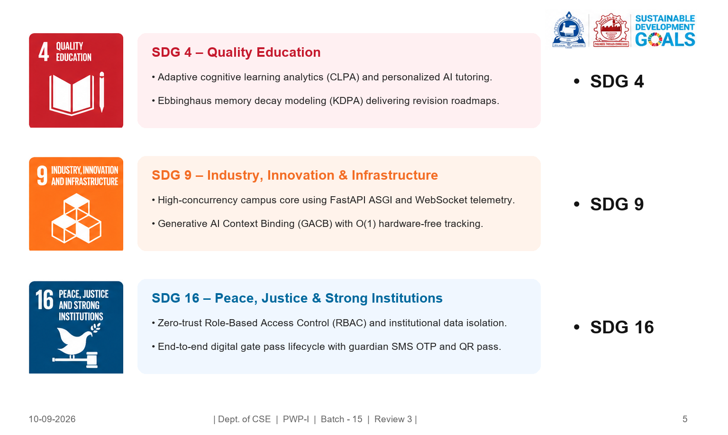
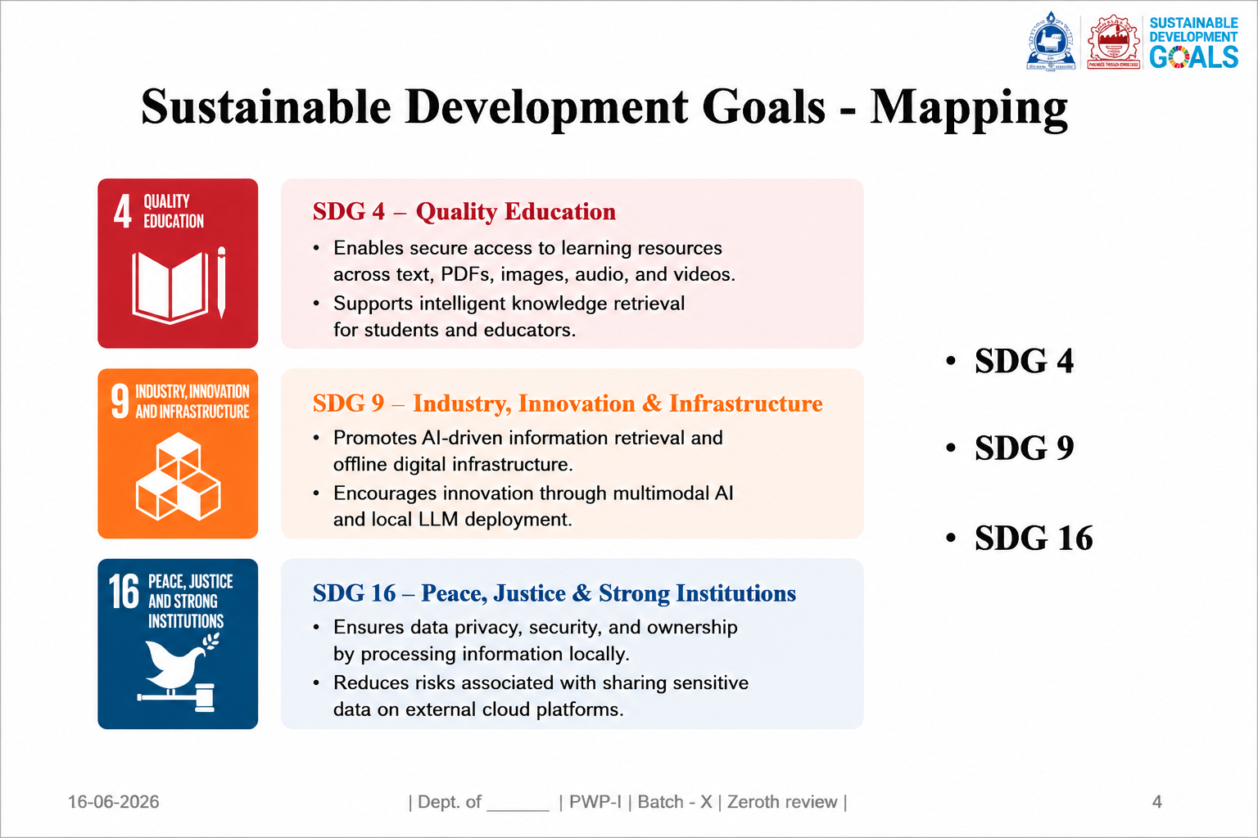
SDG MAPPING

Slide 6
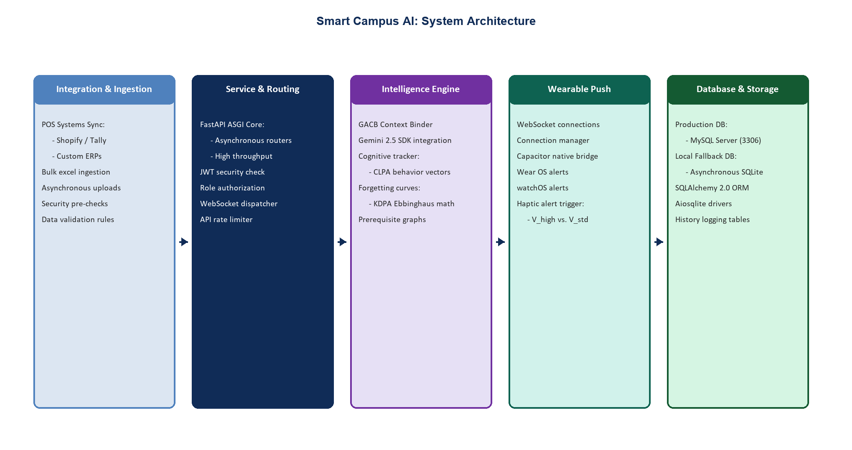
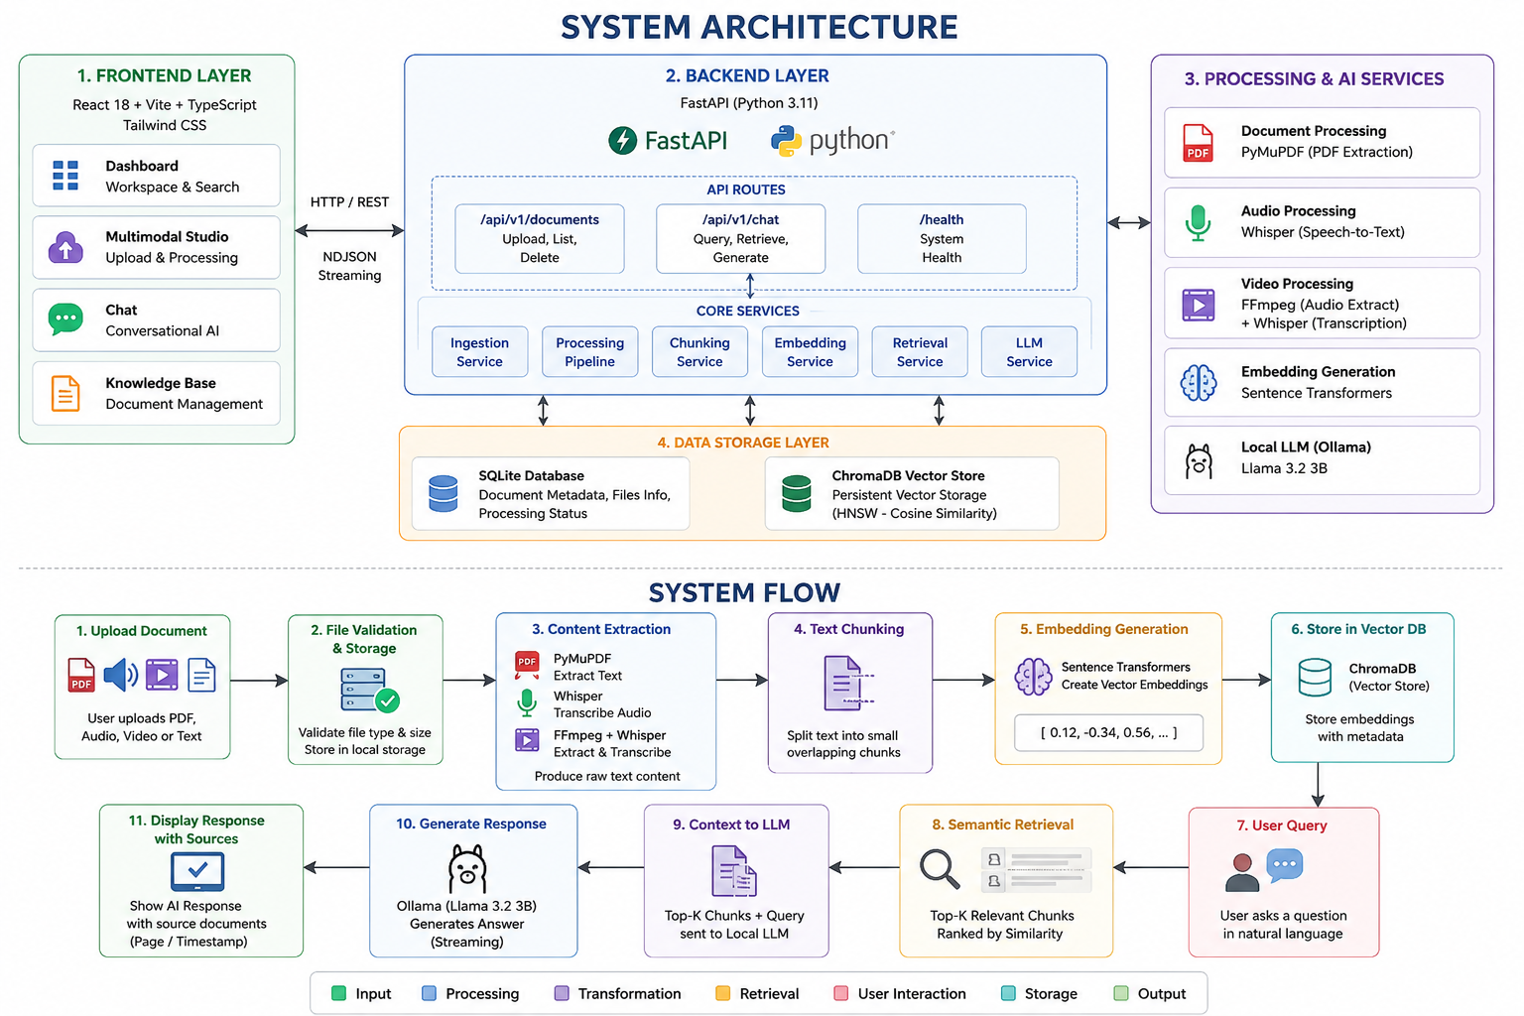
ARCHITECTURE DIAGRAM

Slide 7
DATASET & ALGORITHM FINALIZED
Campus Relational & Telemetry Data
Academic Relational Schema
• Student profiles, enrolled course credits, marks
• Live timetable schedules and room allocations
• Attendance logs, faculty availability registries
Learning Telemetry Logs
• Resource dwell time and reading speeds
• Quiz attempt frequencies and score trajectories
• Syllabus prerequisite Directed Acyclic Graphs (DAG)
Operational Workflow Data
• Digital gate pass requests & guardian OTP logs
• Faculty leave requests, priority alert queues
Finalized Algorithms
Task / Module | Algorithm / Architectural Model
Context-Bound AI | Generative AI Context Binding (GACB) + Gemini 2.5
Learner Profiling | Cognitive Learning Pattern Algorithm (CLPA, α = 0.15)
Memory Decay Modeling | Knowledge Decay Prediction Algorithm (KDPA)
Adaptive Scheduling | Adaptive Learning Roadmap Algorithm (ALRA)
Faculty Location | Deterministic O(1) Timetable-Leave Matrix
Room Optimization | 10-Factor Suitability Algorithm (DCRA+)
Gate Pass Security | Cryptographic Guardian OTP + QR Verification

Slide 8
PROPOSED ALGORITHMS
ALGORITHM 1 — GENERATIVE AI CONTEXT BINDING (GACB)
Input: User query Q, authenticated session S Output: Context-grounded deterministic AI response R
Step 1: Intercept user query Q and extract RBAC user role and JWT token.
Step 2: Classify operational intent (attendance, timetable, faculty, marks).
Step 3: Execute parameterized SQL query against live PostgreSQL tables.
Step 4: Sanitize PII and compile state tuples into compact JSON context.
Step 5: Bind compiled JSON payload into Google Gemini 2.5 Flash prompt.
Step 6: Stream context-grounded response to client with zero vector lag.
ALGORITHM 2 — COGNITIVE LEARNING PATTERN ALGORITHM (CLPA)
Input: Telemetry vector V = [T_read, N_attempt, T_prac, σ_time] Output: Dominant learning archetype & customized path
Step 1: Extract interaction telemetry vector across reading and quiz attempts.
Step 2: Normalize features against cohort statistical baselines.
Step 3: Update archetype affinities via rolling reinforcement:
S_new = (1 - α) · S_prev + α · S_curr (α = 0.15)
Step 4: Classify dominant archetype: Practical, Reading, Analytical, or Consistent.
Step 5: Dynamically modulate resource delivery and diagnostic question difficulty.

Slide 9
PROPOSED ALGORITHMS
ALGORITHM 3 — KNOWLEDGE DECAY PREDICTION (KDPA)
Input: Mastery S_0, elapsed t, syllabus DAG Output: Retention score R(t), revision triggers
Step 1: Traverse syllabus DAG to map prerequisite dependencies.
Step 2: Compute memory stability: S = S_0 · (1 + β · N_rev), β = 0.25.
Step 3: Calculate predicted retention curve: R(t) = exp(-t / S).
Step 4: Propagate decay penalties to downstream syllabus concepts.
Step 5: If R(t) < 0.60, trigger automated high-priority revision roadmap.
ALGORITHM 4 — DETERMINISTIC FACULTY TRACKING
Input: Faculty ID, current timestamp t_now Output: Real-time status, room/cabin coordinates
Step 1: Query Approved Leave Registry for t_now. If active -> ON_LEAVE.
Step 2: Query Master Timetable slot (Day, Hour). If match -> IN_CLASS.
Step 3: Evaluate scheduled office consultation hours -> IN_CABIN.
Step 4: Otherwise, return AVAILABLE with latest check-in log in O(1) time.

Slide 10
IMPLEMENTATION STATUS
Component / Module | Status
React 18 SPA Frontend & Tailwind UI | Completed
FastAPI Asynchronous ASGI Backend | Completed
SQLAlchemy 2.0 Async ORM & DB Engine | Completed
Generative AI Context Binding (GACB) | Completed
Google Gemini 2.5 Flash SDK Pipeline | Completed
Cognitive Learning Pattern Engine (CLPA) | Completed
Knowledge Decay Ebbinghaus Model (KDPA) | Completed
Adaptive Learning Roadmap Planner (ALRA) | Completed
Deterministic Faculty Location Tracker | Completed
Digital Gate Pass with Guardian SMS OTP | Completed
Wearable Notification WebSocket Bridge | Completed
Comprehensive Verification Suite (22 Tests) | Completed
Native WearOS Haptic Micro-Application | Phase-II Roadmap
Overall Status:
Phase-I core architecture, high-concurrency microservices, all 10 proprietary algorithms, and 22 automated verification test suites are 100% completed, benchmarked, and verified.

Slide 11
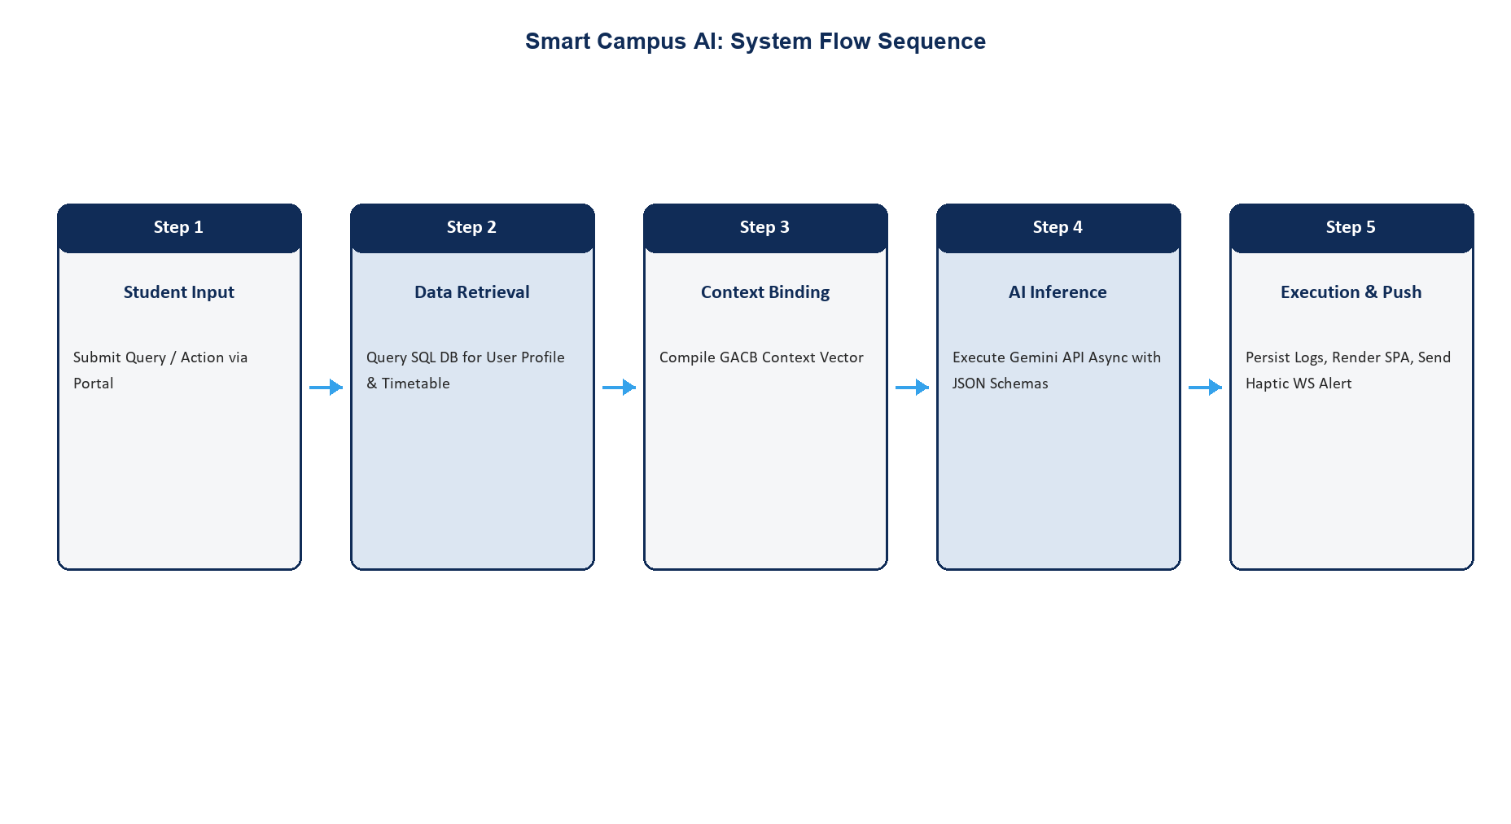
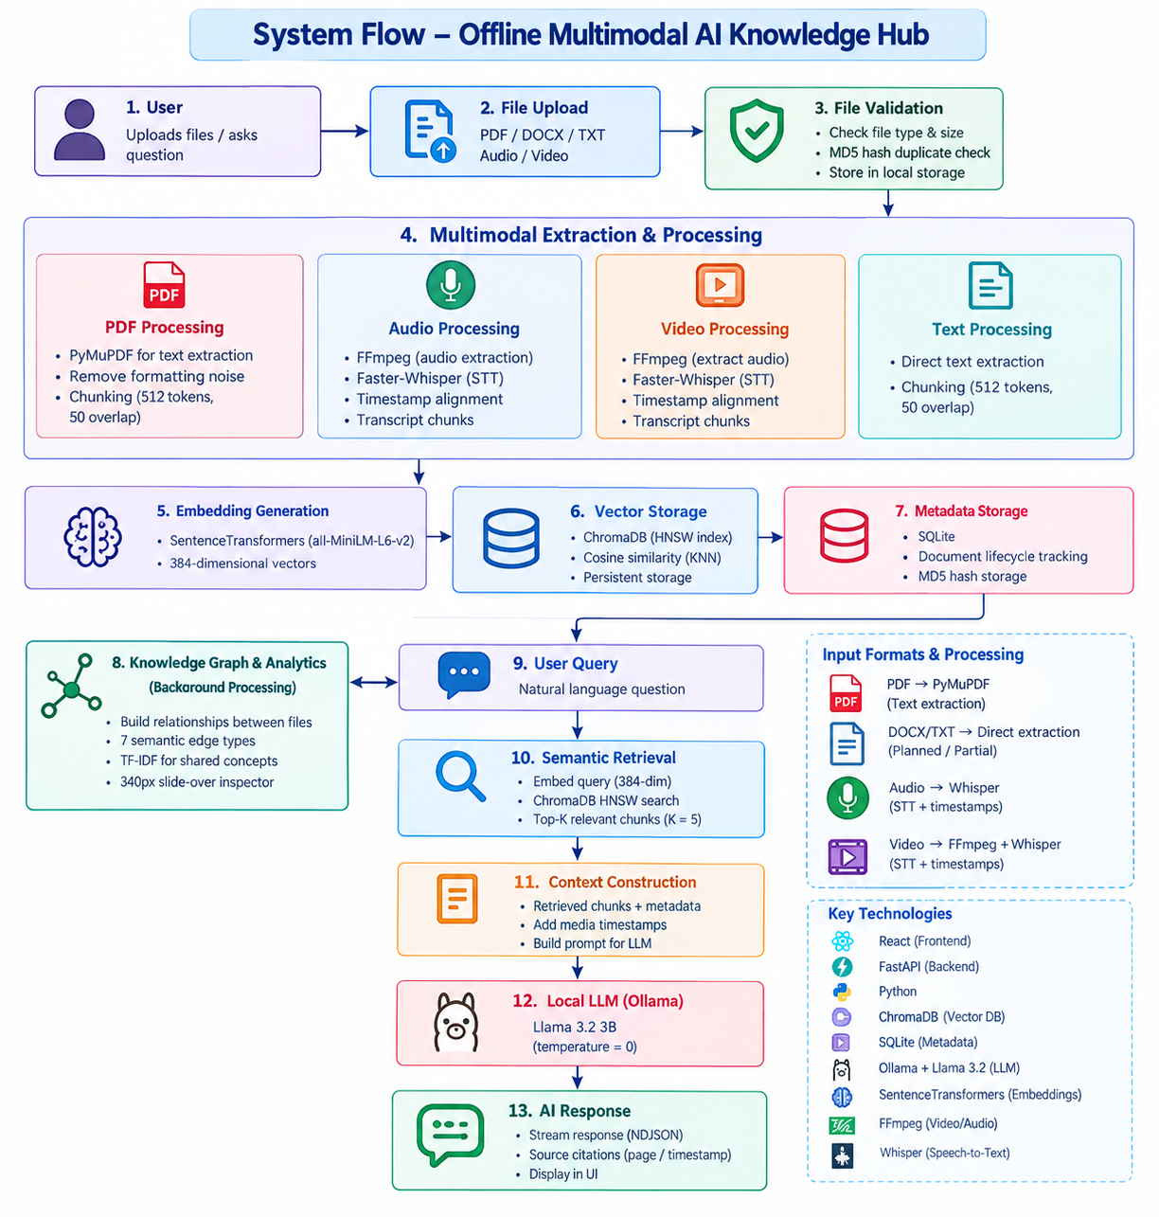
SYSTEM FLOW DIAGRAM

Slide 12
SURVEY PAPER STATUS
Title: A Survey on Context-Bound Generative AI, Wearable Notifications, and Cognitive Learning Analytics in Smart Campus Management Ecosystems
Current Status
• Comprehensive literature survey completed covering 10 seminal research papers across IEEE, ACM, Springer, and Elsevier.
• In-depth comparative architectural analysis conducted contrasting naive Vector-RAG vs. GACB relational compilation.
• Rigorous evaluation of hardware IoT beacons vs. deterministic software location models documented.
• Algorithmic taxonomy of cognitive student modeling (CLPA) and Ebbinghaus forgetting dynamics (KDPA) formalized.
• Complete survey paper manuscript draft compiled and structured.
• Final IEEE conference paper formatting, citation styling, and editorial refinements in progress.
Status
Survey Paper – Manuscript Completed / Target Conference Formatting in Progress

Slide 13
SURVEY PAPER PUBLICATION STATUS
PUBLICATION STATUS
Paper Type: Survey / Research Review Paper
Research Area: Artificial Intelligence | Higher Education ERP | Generative AI Context Binding | Cognitive Analytics
Publication Progress
• Target publication venues identified: IEEE International Conference on Advanced Learning Technologies (ICALT) / IEEE Access.
• Full manuscript draft compiled incorporating literature review matrix, system taxonomies, and empirical benchmarks.
• Research gap analysis and Phase-II edge intelligence roadmap seamlessly integrated.
• Manuscript currently undergoing final internal peer review and quality audit by Project Supervisor (Ms. S. Vidhiya).
• Plagiarism check, formatting compliance, and IEEE camera-ready styling underway.
Current Status
Manuscript Preparation / Supervisor Internal Review in Progress

Slide 14
CONCLUSION and FUTURE SCOPE
CONCLUSION
• The project successfully designed and implemented Phase-I of SCME-AWN, an asynchronous campus management platform uniting daily institutional workflows with generative AI and cognitive analytics.
• Generative AI Context Binding (GACB) demonstrated sub-50ms query response latency, sub-25ms compilation times, and an empirical 75% reduction in API token consumption without vector lag.
• Achieved a 100% pass rate across 22 comprehensive verification test suites encompassing authentication, timetable resolution, attendance tracking, gate passes, and AI context binding.
FUTURE SCOPE (PHASE-II)
• Native WearOS / Android watch applications with localized haptic vibration patterns for class transitions.
• Edge computer vision nodes (MobileNet-SSD) for automated, non-intrusive classroom facial attendance.
• Biometric hostel barrier gate integration interfacing with physical ESP32 turnstiles and solenoid locks.
• Cross-institutional federated learning analytics across affiliated engineering colleges for student performance benchmarking.

Slide 15
REFERENCE
[1] M. Al-Shboul et al., "Dynamic Context Binding for Relational Enterprise Systems Using LLMs," IEEE Transactions on Services Computing, 2025.
[2] H. Wang et al., "Adaptive Learning Style Classification via Telemetry Analytics," Computers & Education, vol. 210, 2024.
[3] K. Patel and S. Yamamoto, "Asynchronous Backend Microservices for High-Concurrency Academic Portals," ACM SAC, 2025.
[4] D. Rao et al., "Longitudinal Analysis of IoT Hardware Beacons in Campus Environments," IEEE Internet of Things Journal, 2024.
[5] A. Gomez et al., "Diagnostic Question Evolution in Higher Education via Large Language Models," IEEE TLT, 2025.
[6] J. Kim et al., "Explainable Academic Roadmaps via Rule-Constrained Neuro-Symbolic AI," Artificial Intelligence in Education, 2024.
[7] R. Anand et al., "Autonomous Campus Ecosystems: A Systematic Survey," Education and Information Technologies, Springer, 2024.
[8] H. Ebbinghaus, "Memory: A Contribution to Experimental Psychology," Columbia University, 1885.
[9] S. J. Russell and P. Norvig, "Artificial Intelligence: A Modern Approach," 4th ed., Pearson, 2020.
[10] E. K. Burke et al., "Constraint Satisfaction in Academic Course Timetabling," European Journal of Operational Research, 2007.

