Slide 1
Defensive Secure Coding
Ashwath Halemane

Slide 2
Content
Why secure coding?
Context of secure coding
Principles of secure coding
Prototyping a login system
Coding exercises

Slide 3
Why securing coding?
Program defensively:
Could someone deliberately try to break the program?
Could someone accidentally or unintentionally break the program?
Ask yourself:
What is the environment in which your program runs?
Understand the procedures under which your program is run.

Slide 4
Context of secure coding
Robust - handle unexpected situations without crashing.
Secure - protecting from security vulnerabilities.
Example: Buffer overflow
Where do policies and procedures fit in?

Slide 5
Secure coding design principles
Principle of least privilege
Fail-safe defaults
Principle of economy of mechanism
Principle of complete mediation
Separation of privilege
Principle of open design
Principle of least astonishment

Slide 6
Principle of least privilege
This principle states that each part of a program (whether it’s a process, user, or function) should have only the minimum privileges necessary to perform its tasks.
Secure coding implications:
Minimize permissions
Separation of duties
Use of least-privileged accounts

Slide 7
Fail safe defaults
A fail-safe system is one where, in the event of an error or unexpected situation, the default behavior is secure.
The system should never default to a vulnerable or insecure state.
Secure coding implications:
Graceful error handling
Safe state on failure
Least exposure

Slide 8
Principle of Economy of Mechanism
Keep systems simple and minimalistic.
The simpler a system, the fewer opportunities there are for attackers to exploit potential weaknesses.
Secure coding implications:
Simplicity
Minimize attack surface
Minimal dependencies

Slide 9
Principle of Complete Mediation
Every access to every resource in the system is checked for authorization, not just once, but at every point of access.
It prevents attackers from bypassing security checks.
Secure Coding Implications:
Access control at every point.
No trust assumptions
Secure APIs

Slide 10
Separation of Privilege
You should require more than one condition to be true in order for an action to be performed.
This is a form of redundancy designed to increase security, by requiring multiple distinct factors or permissions before a sensitive operation is allowed.
Secure Coding Implications:
Multiple approvals for sensitive actions

Slide 11
Principle of Open Design
Open design states that the security of a system should not depend on keeping the design secret. Instead, security should depend on the strength of the design and the implementation.
Secure Coding Implications:
Transparency
Public peer review
Clear documentation

Slide 12
Example: Login system
Requirements:
Only allow authorized user into the system.
Restrict user’s privileges to those allowed to that user.
Log information to reconstruct any unauthorized logins.

Slide 13
Exercise
Methodologies
String matching/grep for bugs.
Following user inputs.
Reading source code randomly.
Read all the code.
Check one functionality at a time (login, password reset...).
Download: https://github.com/PentesterLab/cr/
If you have git installed: git clone https://github.com/PentesterLab/cr

Slide 14
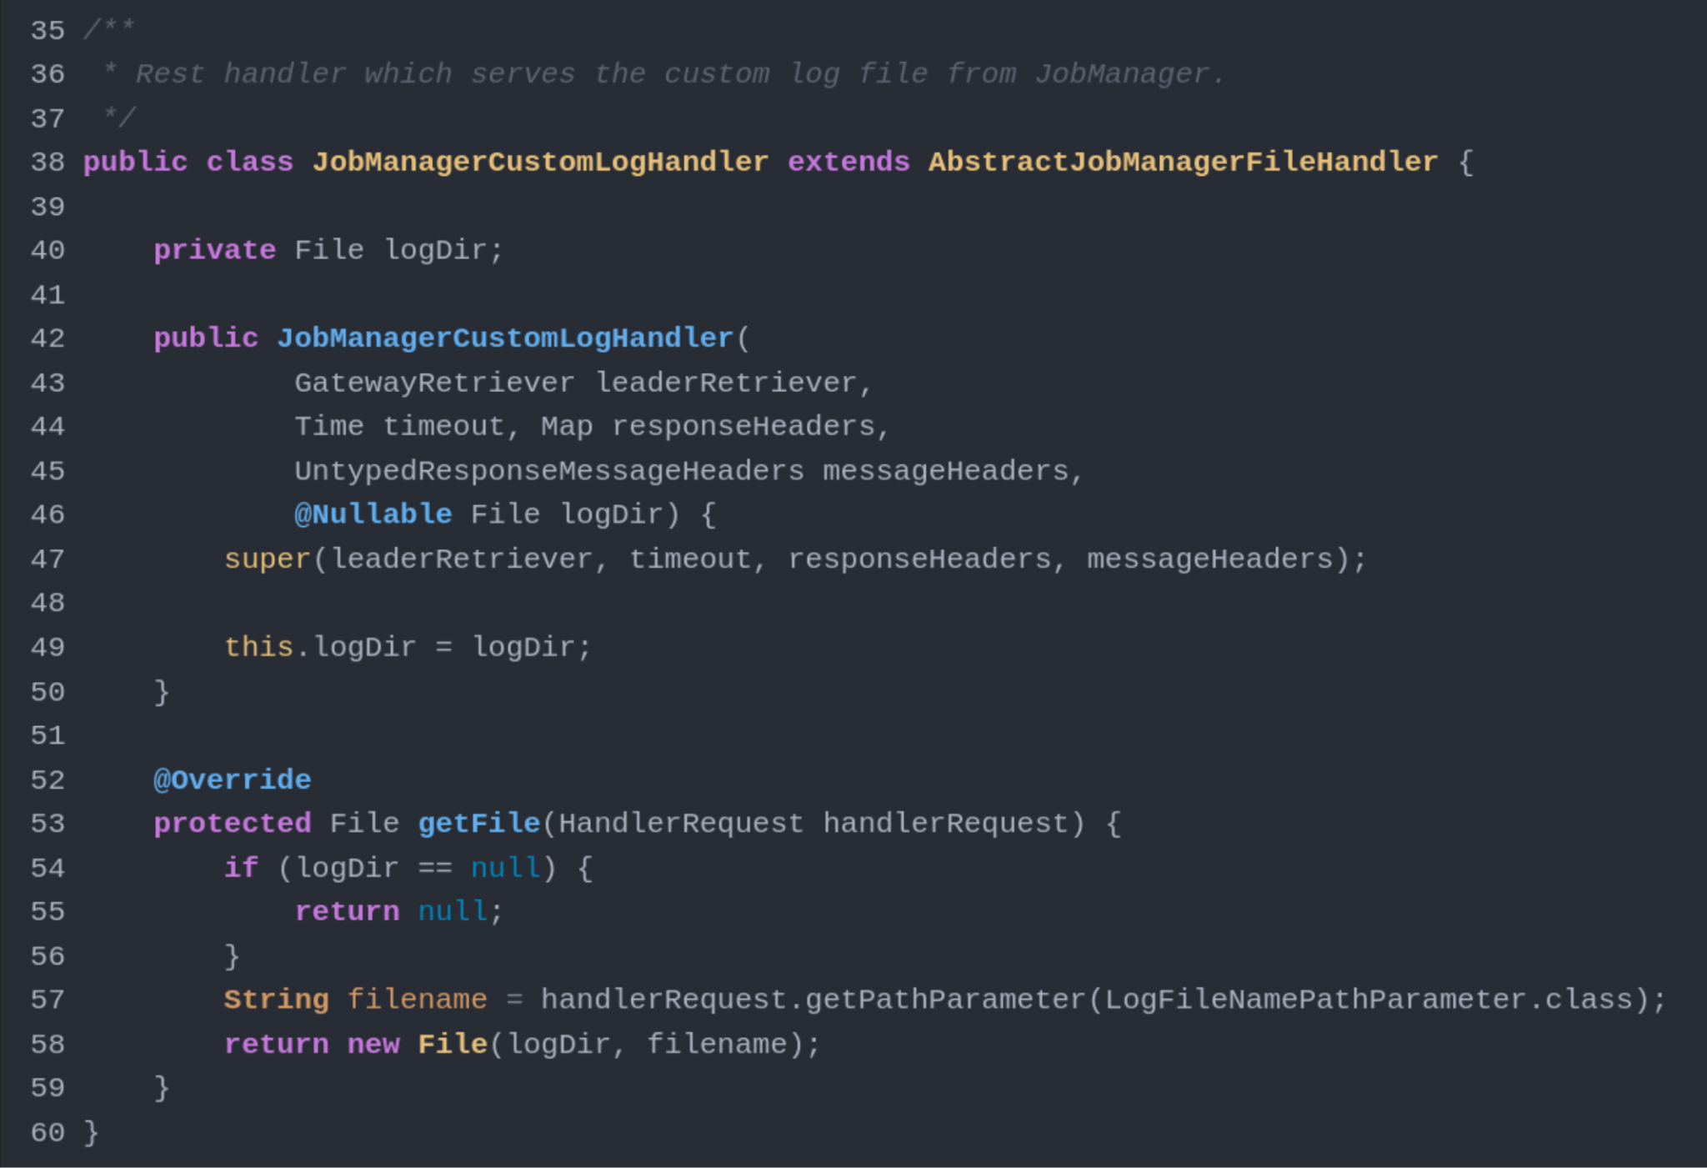
Exercise: Apache Flink
logDir = "/var/logs"
filename = "../../etc/passwd"
Notes:
How Directory Traversal Works in This Context:
Directory Traversal Vulnerability: Directory traversal occurs when an attacker can manipulate the filename in such a way that it allows the attacker to escape the intended directory and access files outside of it. This is often done by inserting special sequences like ../ (dot-dot-slash) into the path.
In your code, the filename parameter is directly concatenated with the logDir, forming a file path. For example, if logDir is /var/logs and the filename is provided as ../../etc/passwd, the final path becomes /var/logs/../../etc/passwd, which would resolve to /etc/passwd, bypassing the intended restriction and exposing sensitive files.

Slide 15
Exercise
Apache Flink is an open source stream processing framework with powerful stream- and batch-processing capabilities.
Check out the code: https://github.com/apache/flink/blob/master/flink-runtime/src/main/java/org/apache/flink/runtime/rest/handler/cluster/JobManagerCustomLogHandler.java#L41

Slide 16
Further reading
https://securecodingdojo.owasp.org/public/index.html
https://owasp.org/www-project-developer-guide/release

