Slide 1
Secure data hiding in image using steganography
CAPSTONE PROJECT
Presented By:
Student Name : ASHWATHI SURESH
College Name & Department : Ramaiah Institute of Technology , Computer Science ( Cyber Security )

Slide 2
OUTLINE
Problem Statement
Technology used
Wow factor
End users
Result
Conclusion
Git-hub Link
Future scope

Slide 3
Problem Statement
In today's digital world, securing sensitive information is crucial.
This project presents an Image-Based Steganography System that allows users to hide secret messages within images using Least Significant Bit (LSB) encoding. The system includes two applications: Image Encryptor, which embeds a secret message into an image with password protection, and Image Decryptor, which extracts the hidden message only upon entering the correct password. This ensures secure and concealed communication, making it useful for confidential data transmission.

Slide 4
Technology used
Programming Language: Python
Libraries:
cv2 (OpenCV) – For image processing and manipulation
os – For file handling and system operations
tkinter – For GUI (Graphical User Interface) development
filedialog – For selecting files via GUI
messagebox – For displaying error and success messages
Technology: Least Significant Bit (LSB) Steganography for message encoding
Platform: Windows (but can be adapted for other OS)
IDE: Any Python-compatible environment (e.g., PyCharm, VS Code, Jupyter Notebook)

Slide 5
Wow factors
LSB Steganography Implementation – Uses Least Significant Bit (LSB) encoding to hide messages inside images, making the changes imperceptible to the human eye.
Dual-Layer Security – Unlike basic steganography, this project requires a password for decryption, ensuring that only authorized users can retrieve the hidden message.
User-Friendly GUI – Built with Tkinter, allowing even non-technical users to encrypt and decrypt messages with a simple, interactive interface.
Automated Image Selection & Processing – Users can choose any image format (JPG, PNG, JPEG) and the program automatically processes it without manual conversions.
Error Handling & Validation – Includes checks for image compatibility, password correctness, and message size limitations, preventing data loss or corruption.
Cross-Platform Adaptability – Can be modified for different operating systems, making it accessible beyond just Windows users.
Practical Real-World Applications – Useful for secure communication, watermarking, and protecting confidential information in industries like cybersecurity, journalism, and law enforcement.

Slide 6
End users
Cybersecurity Enthusiasts & Researchers – Individuals interested in data security and cryptography who want to explore steganography techniques for secure communication.
Journalists & Whistleblowers – Professionals who need a discreet method to share confidential information without drawing attention.
Government & Law Enforcement Agencies – Can be used for secure intelligence communication to transmit sensitive data covertly.
Students & Educators – Useful for learning steganography concepts in computer science, cybersecurity, and cryptography courses.
5. Corporate & Business Professionals – Companies can use it for secure document transmission, preventing data leaks during internal communications.
General Users Concerned About Privacy – Anyone who wants to protect personal messages from unauthorized access in an era of increasing digital surveillance.

Slide 7
Conclusion
In an era where data security and privacy are of utmost importance, this Image-Based Steganography System provides a secure, efficient, and user-friendly method to hide sensitive messages within images. By utilizing Least Significant Bit (LSB) encoding along with password protection, the project ensures that only authorized users can access the hidden information. The dual-layer security, intuitive GUI, and robust error handling make it a practical solution for individuals and organizations that require covert communication.
This project not only demonstrates the power of steganography in cybersecurity but also highlights its real-world applications in journalism, law enforcement, and corporate security. By addressing the problem of secure and concealed communication, it stands as a reliable and innovative approach to safeguarding sensitive data.

Slide 8
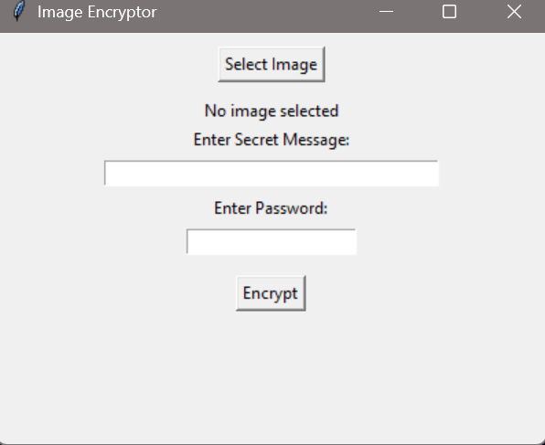
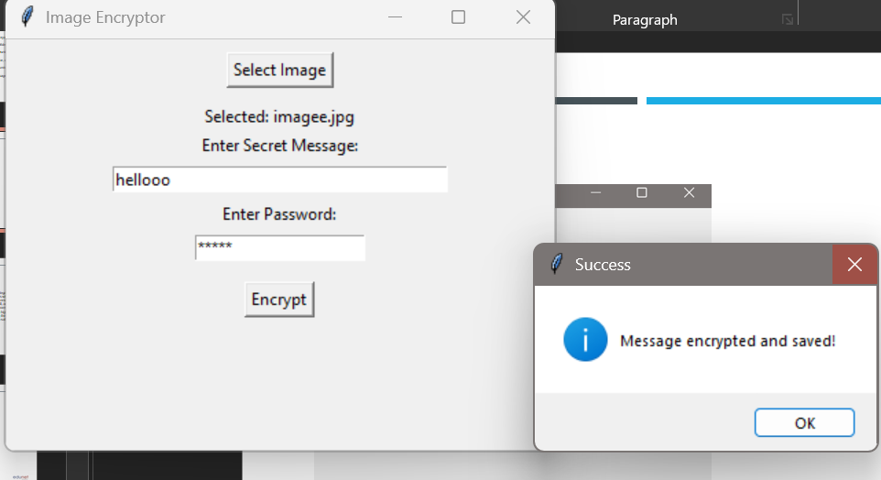
Results

Slide 9
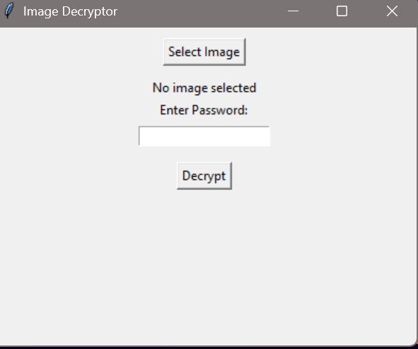
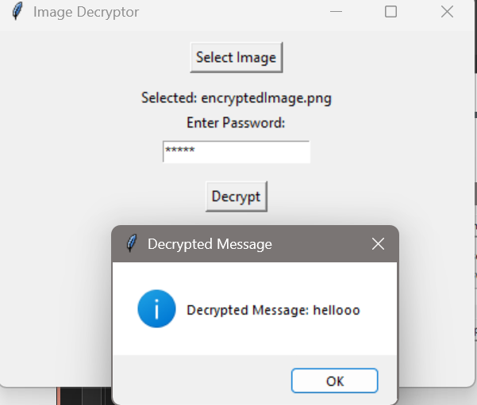
Results

Slide 10
GitHub Link
https://github.com/ashwathi-1730/SecureDataHidingInImageUsingSteganography

Slide 11
Future scope
1. Enhanced Encryption Mechanisms – Implement AES or RSA encryption along with steganography to further strengthen security, ensuring even if the image is intercepted, the message remains unreadable without decryption.
Support for Multiple Image Formats – Extend compatibility to include BMP, TIFF, and GIF formats, providing users with more flexibility.
Mobile and Web-Based Version – Develop a mobile app (Android/iOS) or web-based application so users can encrypt and decrypt messages from anywhere without relying on a desktop application.
Adaptive Steganography – Implement AI-based steganography to intelligently embed messages while minimizing distortion, making detection even harder.
Multi-Level Security Authentication – Introduce two-factor authentication (2FA) or biometric security (fingerprint/face recognition) for added protection before decryption.
Batch Processing for Large-Scale Use – Allow multiple images to be processed at once for enterprise-level applications, such as confidential data exchange in large organizations.
Cloud Integration – Enable cloud-based storage for encrypted images, allowing users to securely store and share their encoded files online.
Reverse Steganography Detection – Implement a steganalysis tool that can detect and prevent unauthorized steganographic attacks, making the project useful for cybersecurity professionals.

Slide 12
THANK YOU

