Slide 1
Compression
Digital Image Processing
In-class Exercise 18
Shwet Shah (800904562)

Slide 2
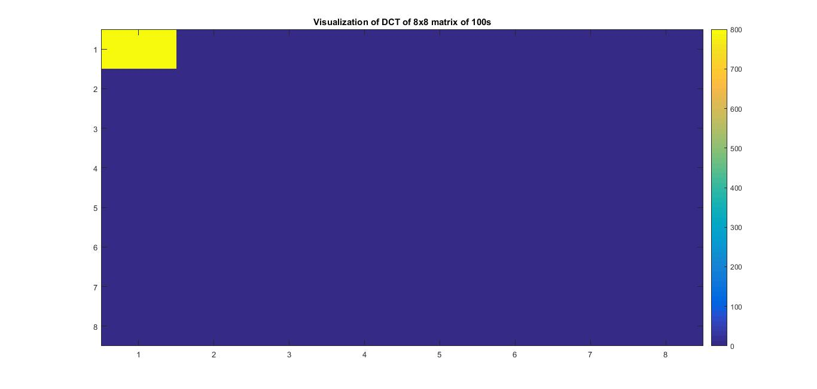
Visualization of DCT of 8x8 matrix of 100's

Slide 3
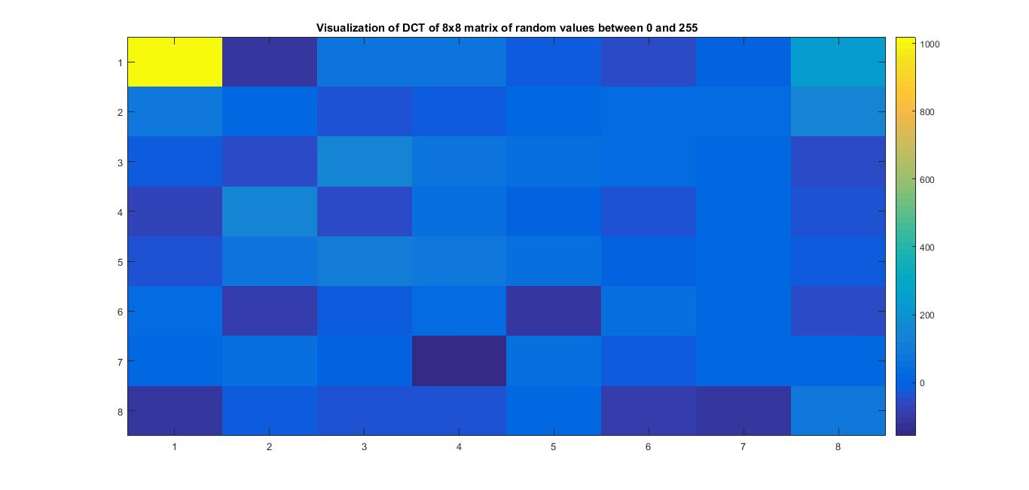
Visualization of DCT of 8x8 matrix of random values between 0 and 255.

Slide 4
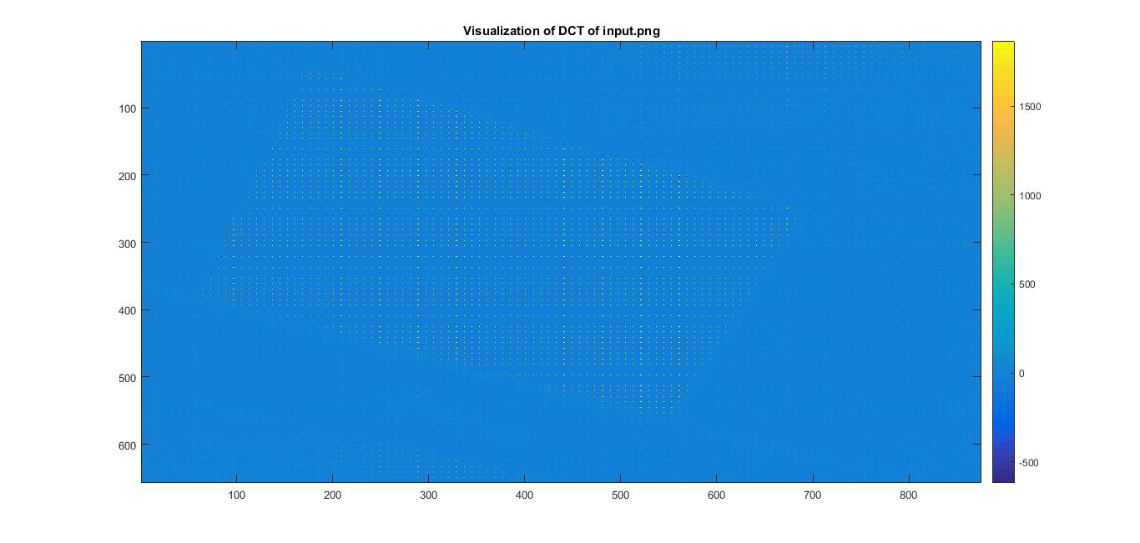
Visualization of DCT of input.png

