Slide 1
Hough-2
Digital Image Processing
In-class Exercise 13
Shwet Shah (800904562)

Slide 2
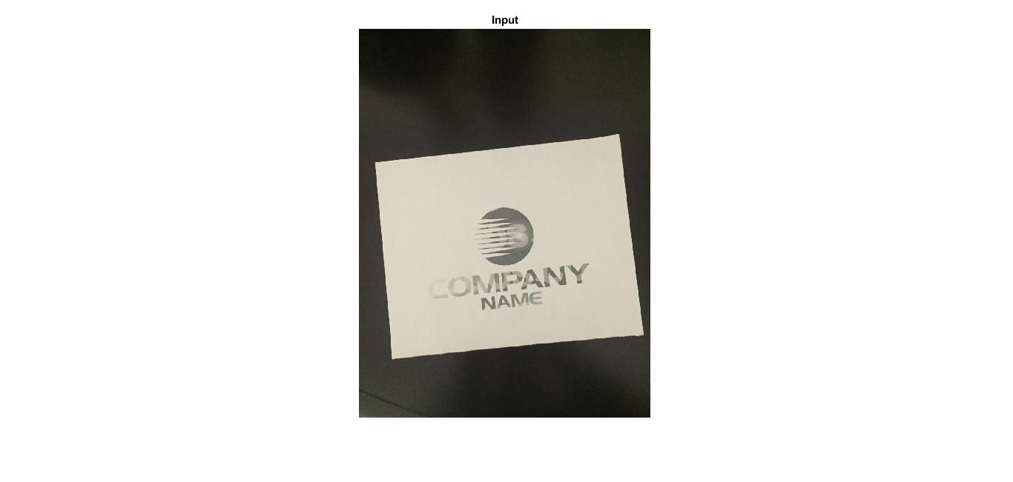
Input Image

Slide 3
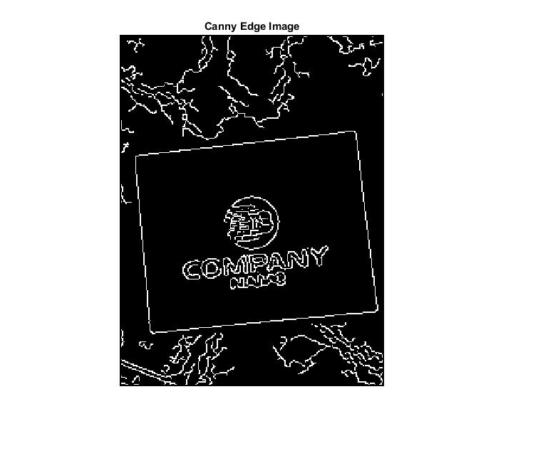
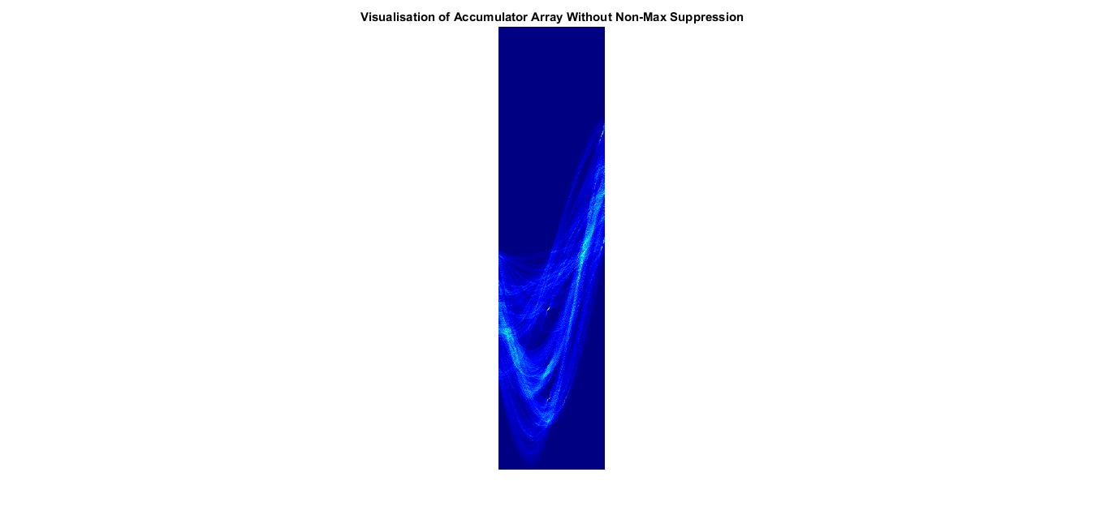
before non-max suppression

Slide 4


Output: before Non-max suppression

Slide 5
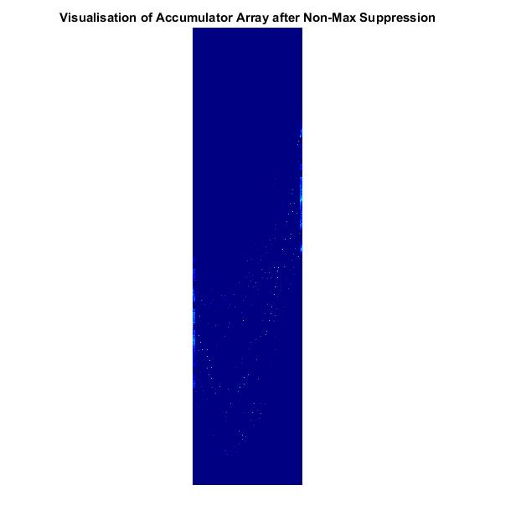
After Non-max suppression

Slide 6
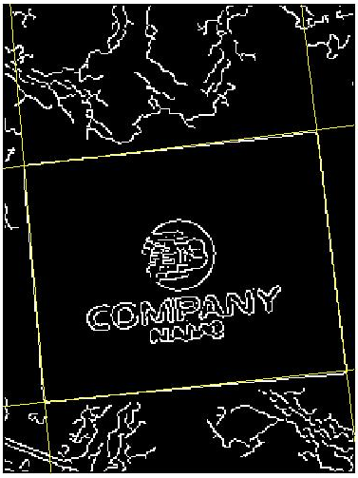
Output: After Non-max suppression

