Slide 1
Challenge-3 How many? Presentation
Digital Image Processing
Fall-16
Shwet Shah (800904562)

Slide 2
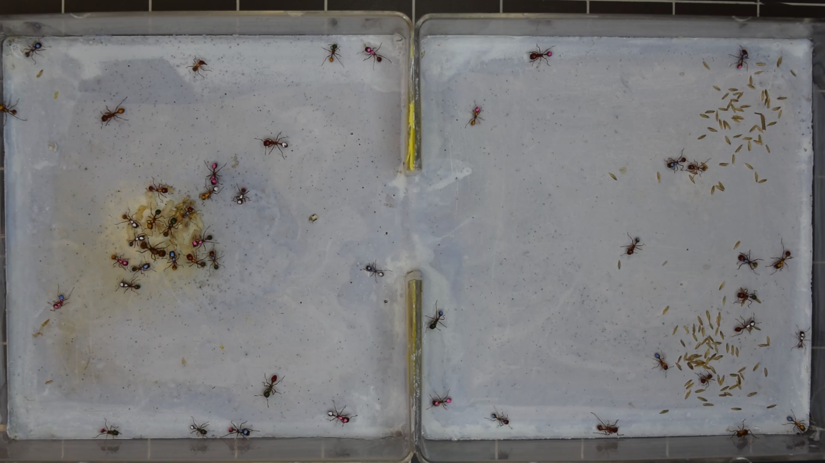
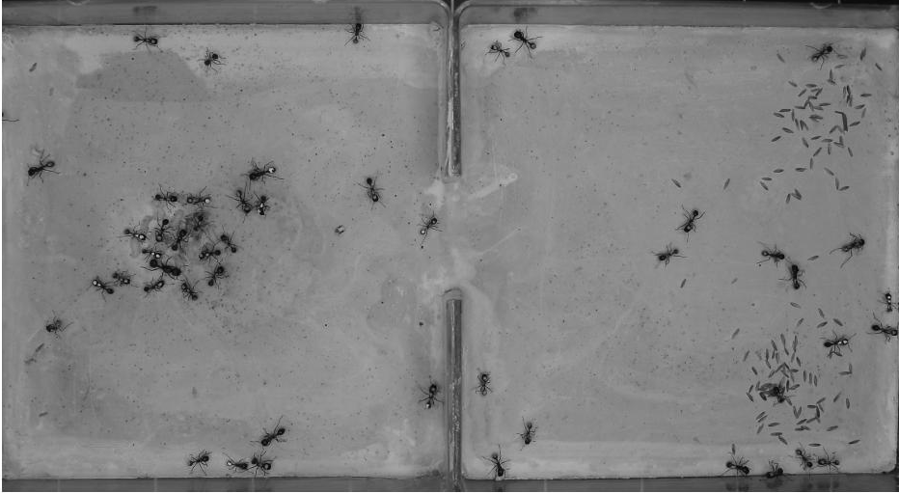
Approach:1 cropping
Before Crop
After Crop of 30 pixels

Slide 3
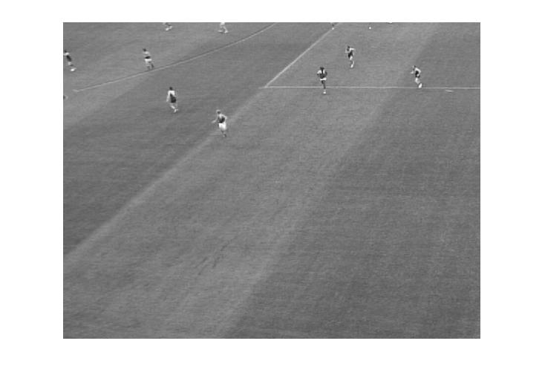
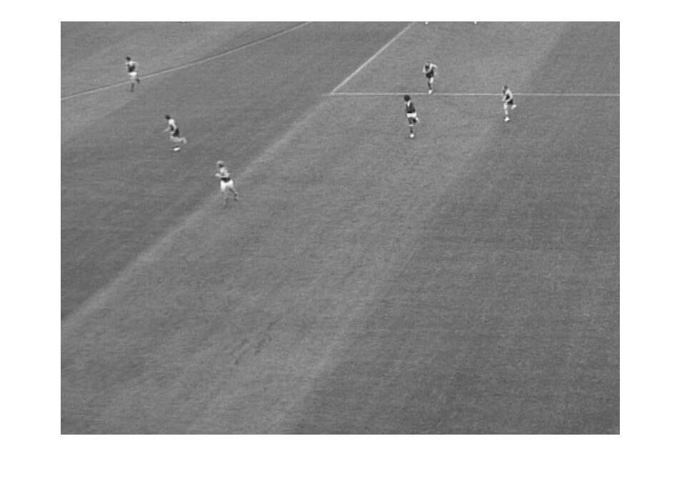
Approach
Before Crop
After Crop of 30 pixels

Slide 4
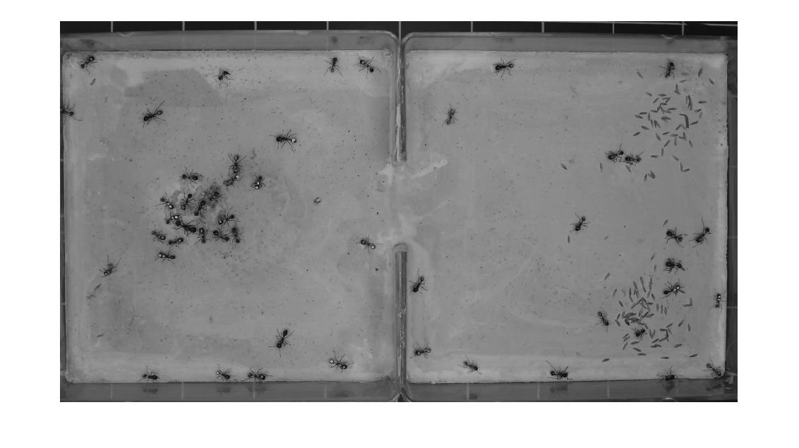
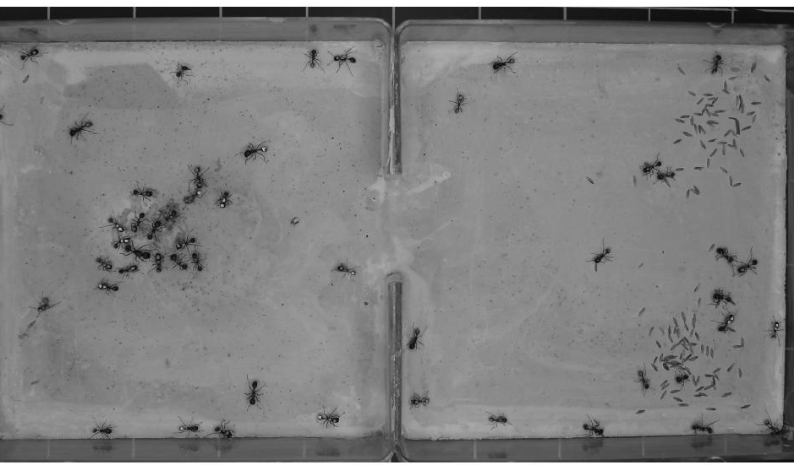
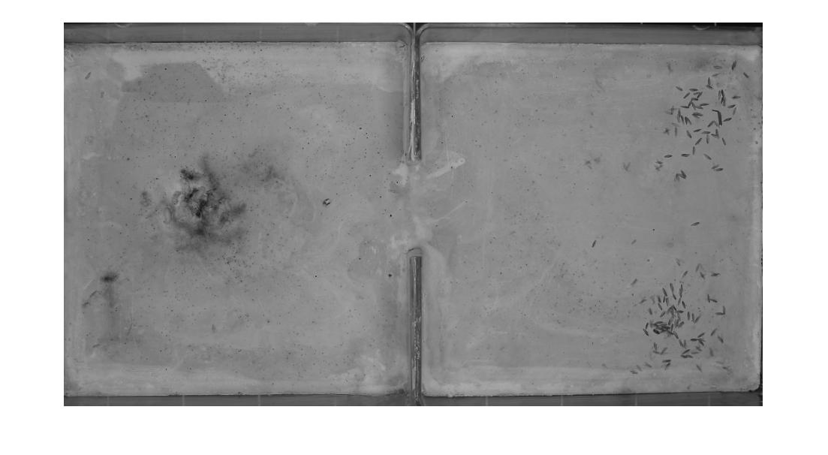


Approach:2 Background abstraction
Total Number of Image

Slide 5
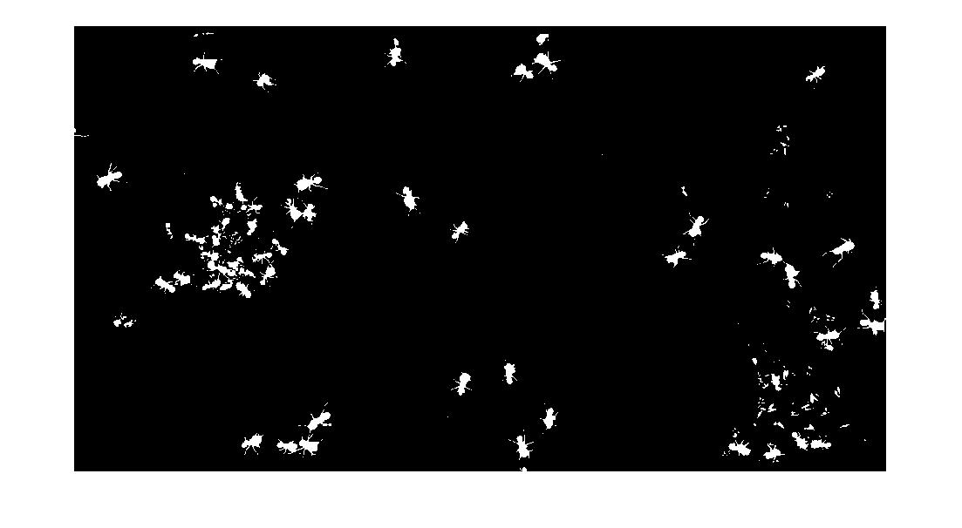
Approach

Slide 6
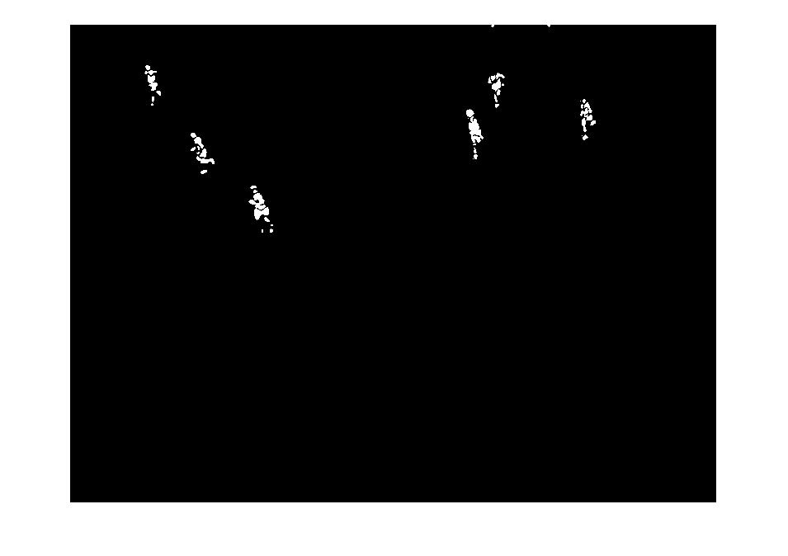

Approach

Slide 7
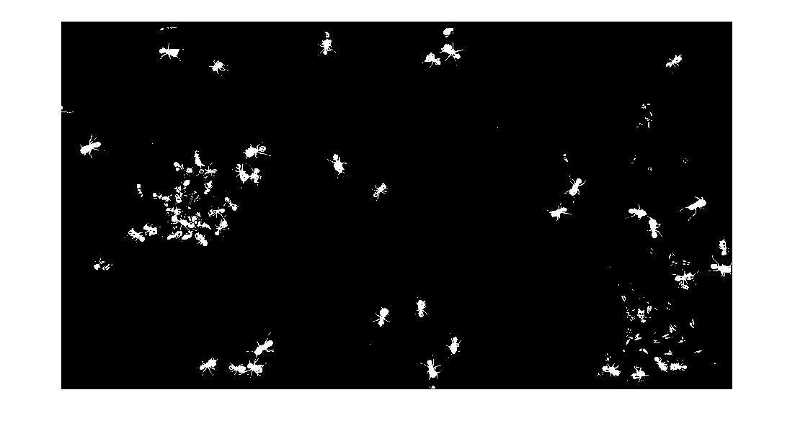
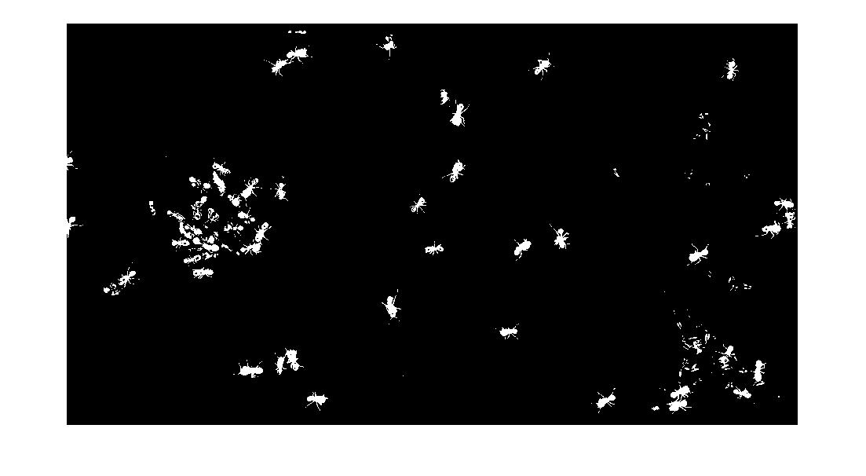
Approach:3 morphing

Slide 8

Approach

Slide 9
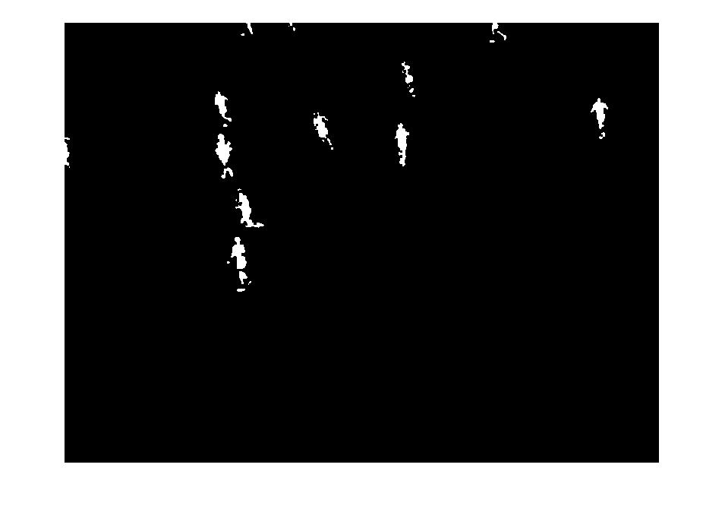
Final set of images

Slide 10
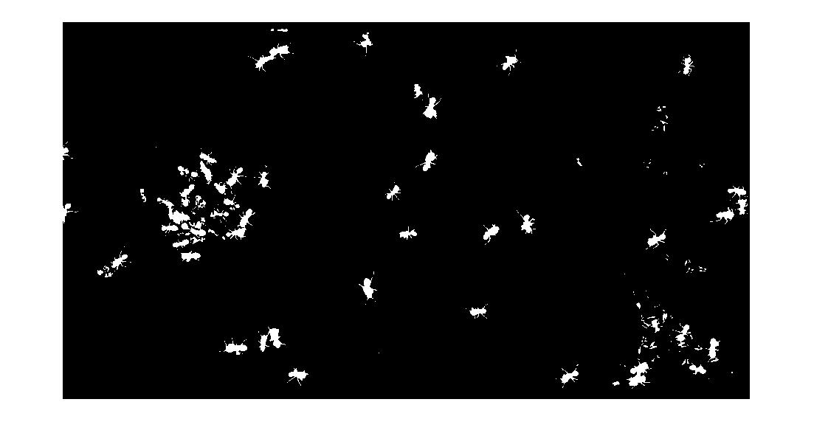
Problematic images

Slide 11
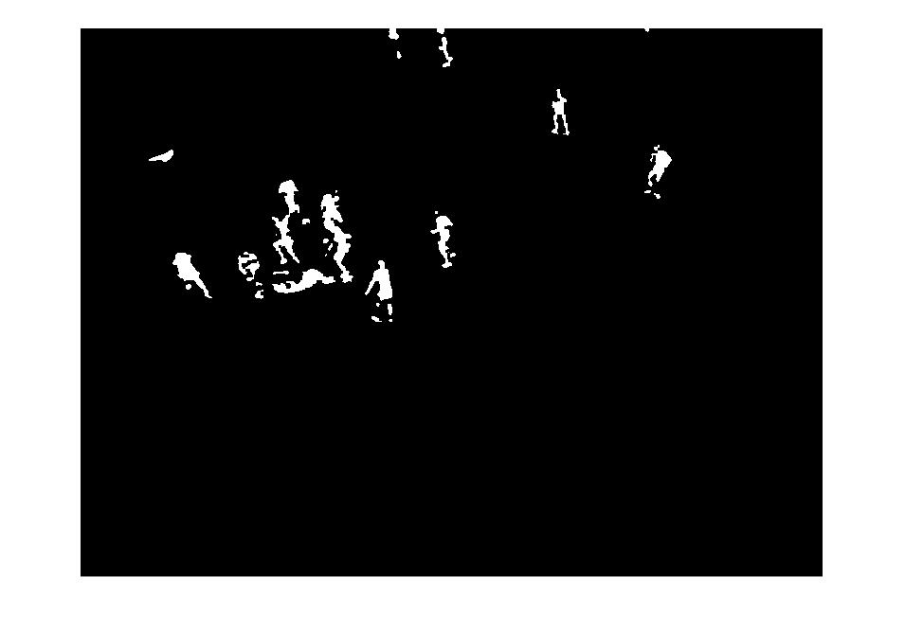
Problematic images

