Slide 1
Representation
Digital Image Processing
In-class Exercise 15
Shwet Shah (800904562)

Slide 2
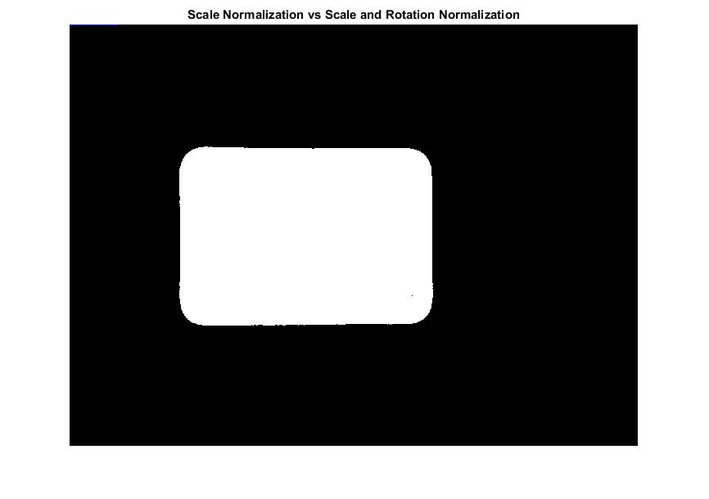
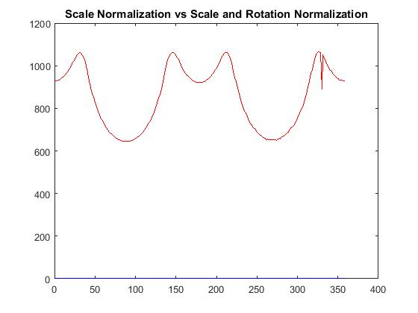
Binary image containing just largest and Centroid distance function of that region

Slide 3
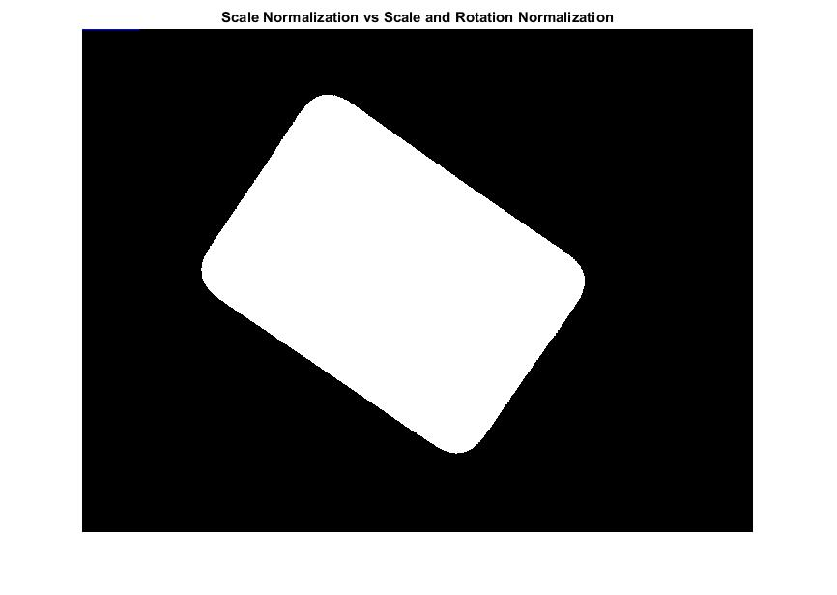
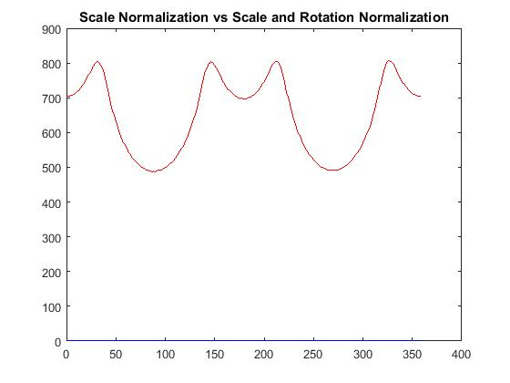
Binary image containing just largest and Centroid distance function of that region

Slide 4
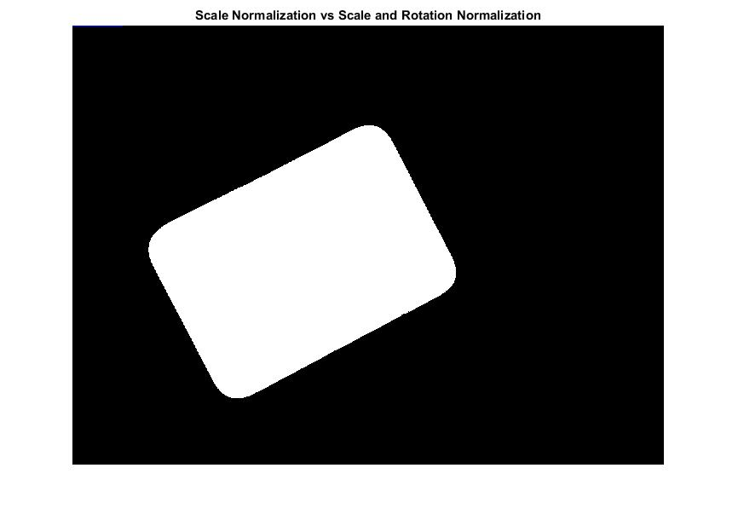
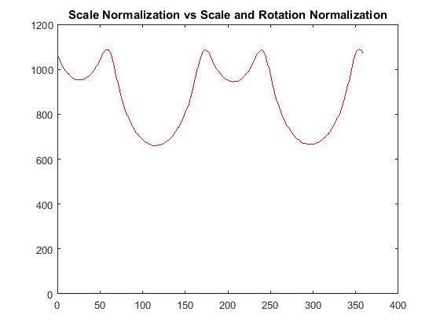
Binary image containing just largest and Centroid distance function of that region

Slide 5
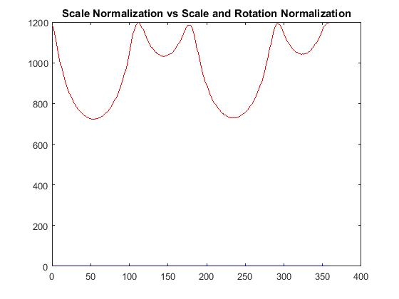
Binary image containing just largest and Centroid distance function of that region

Slide 6
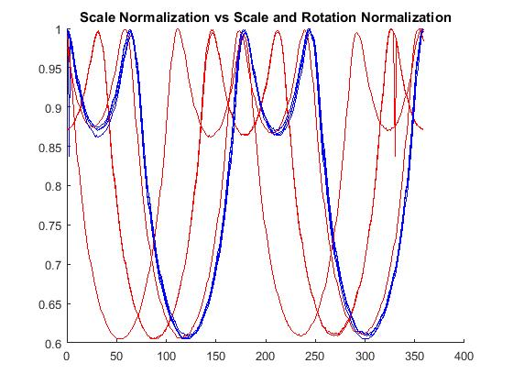
Scale Normalization vs Scale and Rotation Normalization

