Slide 1
Split
Digital Image Processing
In-class Exercise 16
Shwet Shah (800904562)

Slide 2

quad.png with Threshold = 100

Slide 3

diamond.png with Threshold = 20

Slide 4
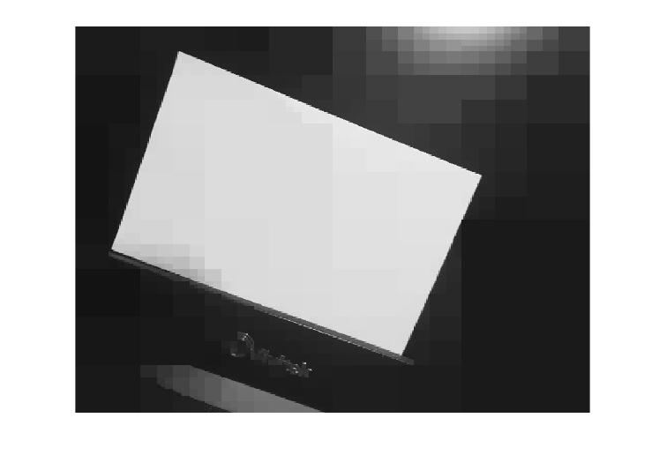
input.png with Threshold = 10

Slide 5
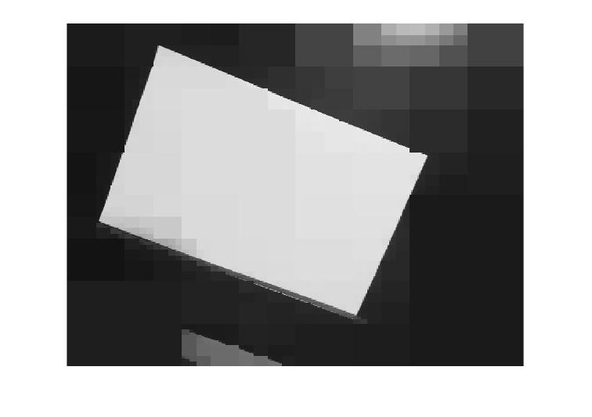
input.png with Threshold = 20

