Slide 1
EE462L, Fall 2012
PI Voltage Controller for DC-DC Converters

Slide 2
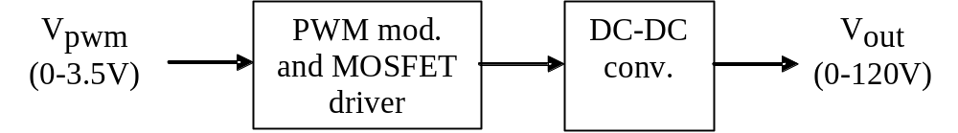
PI Controller for DC-DC Boost Converter Output Voltage
!
Open Loop, DC-DC Converter Process
Hold to 90V
error
V
pwm
PI
PWM mod.
DC
-
DC
V
set
controller
and MOSFET
conv.
V
out
+
driver
–
(scaled down
to about 1.3V)
DC-DC Converter Process with Closed-Loop PI Controller

Slide 3
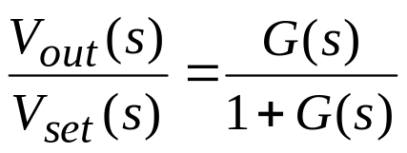
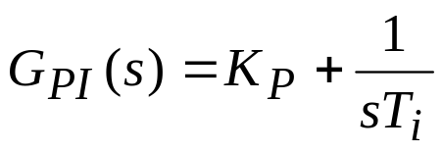
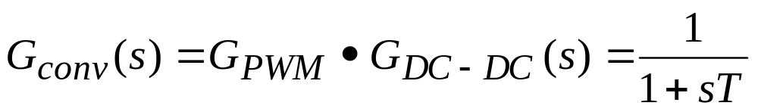
The Underlying Theory
Hold to 90V
error
V
pwm
PI
PWM mod.
DC
-
DC
V
set
controller
and MOSFET
conv.
V
out
+
driver
–
(scaled down
to about 1.3V)
Proportional
Integral
Our existing boost process

Slide 4
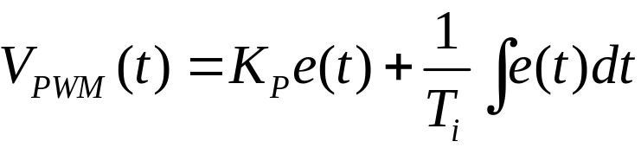
!
Theory, cont.
error e(t)
V
pwm
PI
PWM mod.
DC
-
DC
V
set
controller
and MOSFET
conv.
V
out
+
driver
–
Proportional term: Immediate correction but steady state error (V_{pwm} equals zero when there is no error (that is when V_{set} = V_{out})).
Integral term: Gradual correction
      Consider the integral as a continuous sum (Riemman’s sum)
      Thank you to the sum action, V_{pwm} is not zero when the e = 0
      Has some “memory”

Slide 5
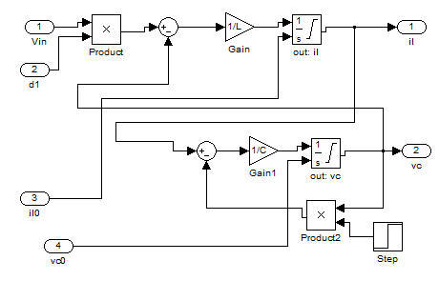
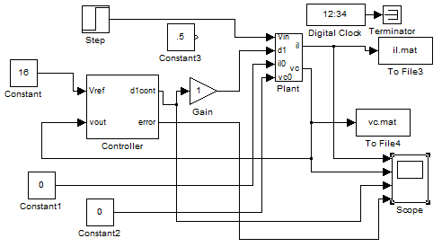
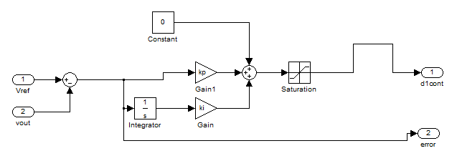
E.g. Buck converter
Vin = 24 V
Vout = 16 V (goal)
L = 200 uH, C = 500 uF, R = 2 Ohm

Slide 6
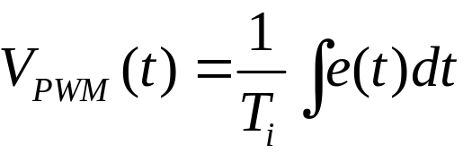
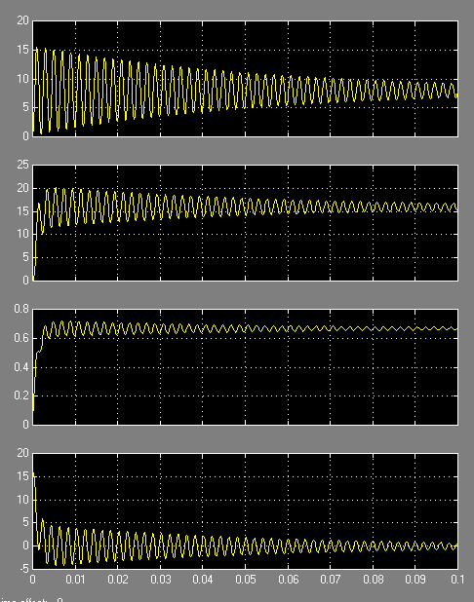
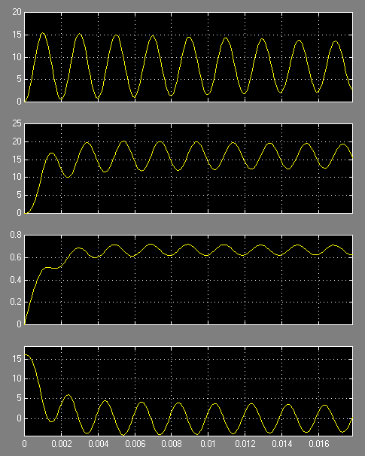
!
E.g. Buck converter
Vin = 24 V
Vout = 16 V (goal)
L = 200 uH, C = 500 uF, R = 2 Ohm
Ki = 40, Kp = 0
iL
vC
d
e

Slide 7
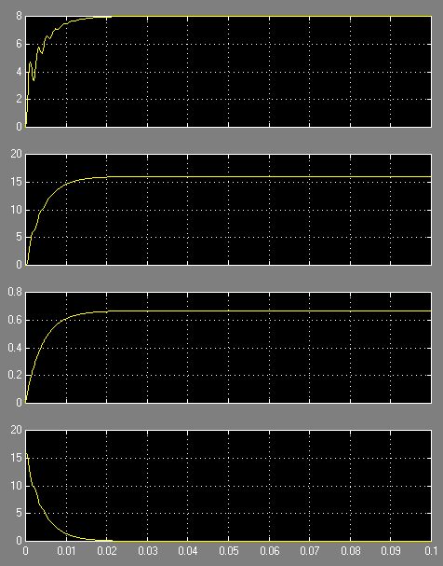
!
E.g. Buck converter
Vin = 24 V
Vout = 16 V (goal)
L = 200 uH, C = 500 uF, R = 2 Ohm
Ki = 10, Kp = 0
iL
vC
d
e

Slide 8

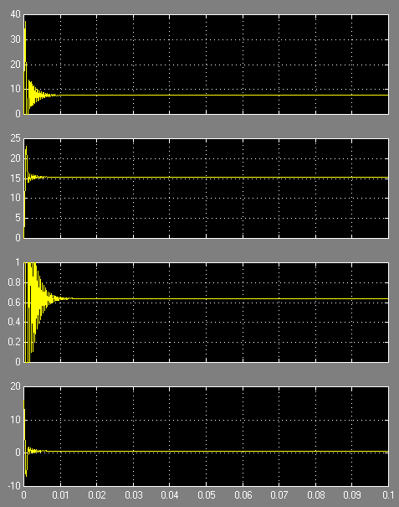
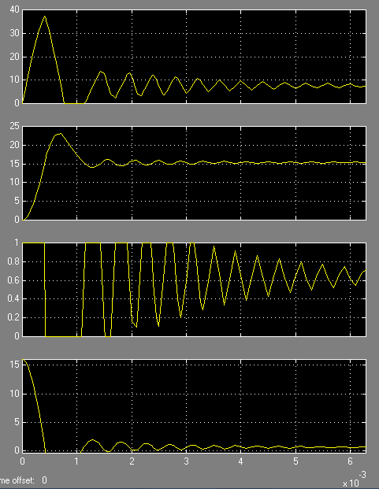
!
E.g. Buck converter
Vin = 24 V
Vout = 16 V (goal)
L = 200 uH, C = 500 uF, R = 2 Ohm
Ki = 0, Kp = 1
iL
vC
d
e

Slide 9
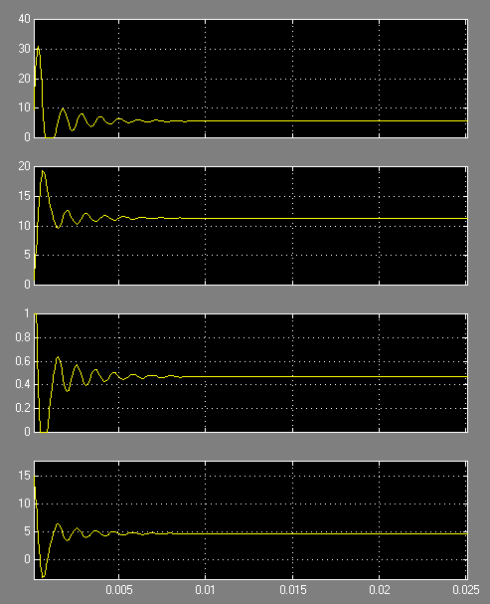
!
E.g. Buck converter
Vin = 24 V
Vout = 16 V (goal)
L = 200 uH, C = 500 uF, R = 2 Ohm
Ki = 0, Kp = 0.1
iL
vC
d
e

Slide 10
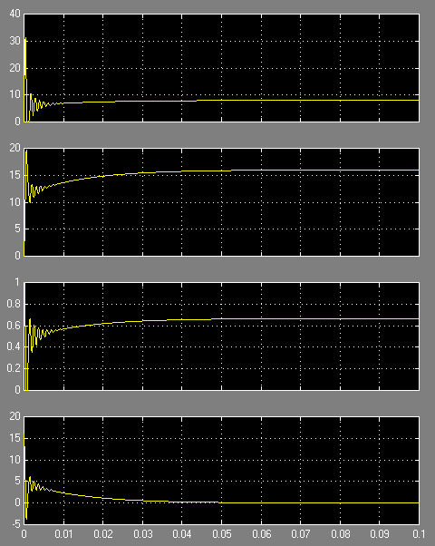
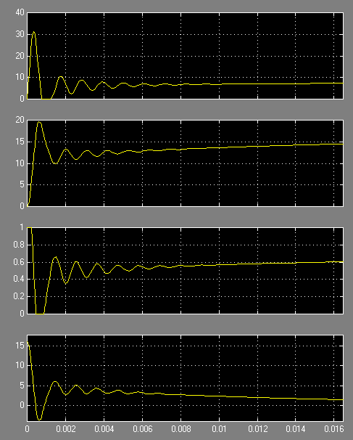
!
E.g. Buck converter
Vin = 24 V
Vout = 16 V (goal)
L = 200 uH, C = 500 uF, R = 2 Ohm
Ki = 10, Kp = 1
iL
vC
d
e

Slide 11

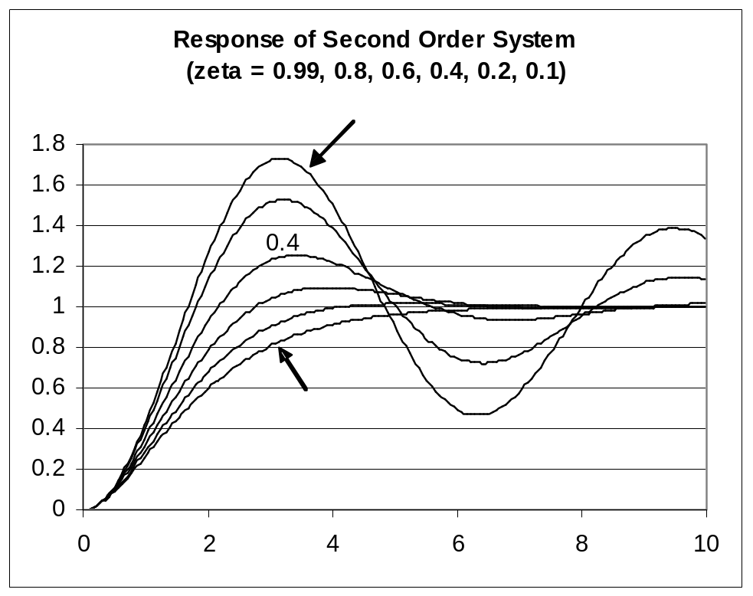
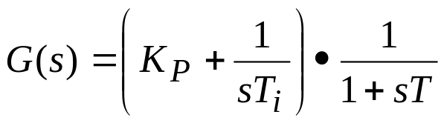
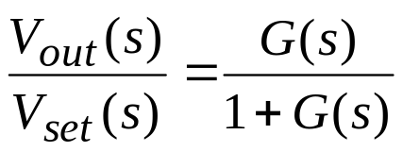
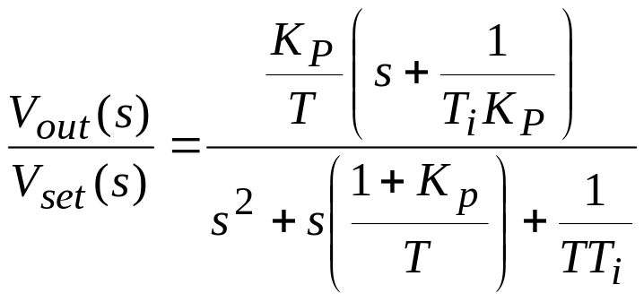
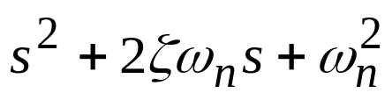
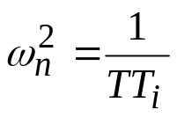
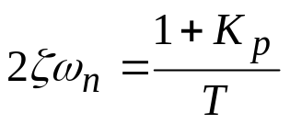
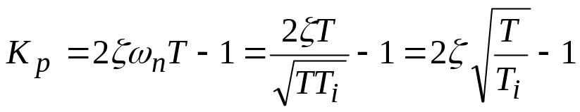
Theory, cont.
work!
=
Recommended in PI literature
T
i
0
.
8
T
ζ
=
0
.
65
K
p
=
0
.
45
From above curve – gives some overshoot

Slide 12
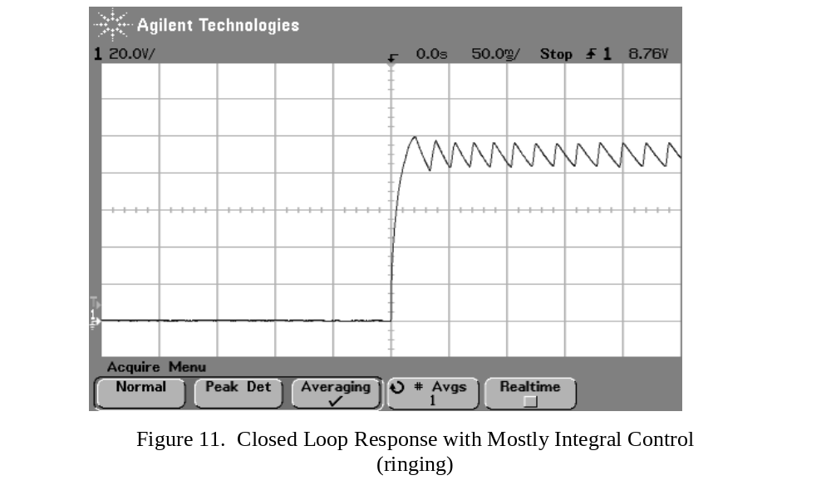
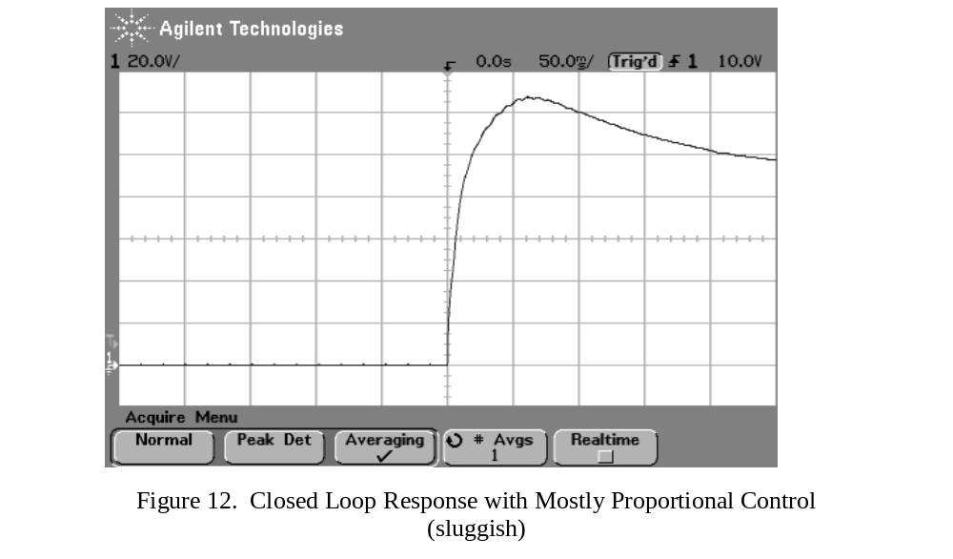
Improperly Tuned PI Controller
Mostly Proportional Control – Sluggish, Steady-State Error
Mostly Integral Control - Oscillation
90V
90V

Slide 13
Op Amps
!
I
−
V
−
–
V
out
I
+
V
+
+
Assumptions for ideal op amp
•
V
out
= K(V
+
− V
−
), K large
(hundreds of
thousands
, or one million
)
•
I
+
= I
−
= 0
•
Voltages are with respect to power supply ground
(not shown)
•
Output current is not limited

Slide 14
Example 1. Buffer Amplifier
(converts high impedance signal to low impedance signal)
!
V
=
K
(
V
−
V
) = K(V_{in} – V_{out})
out
+
−
–
V
out
V
+
KV
=
KV
V
in
+
out
out
in
V
(
1
+
K
)
=
KV
out
in
K
V
=
V
•
out
in
1
+
K
K is large
V
=
V
out
in

Slide 15
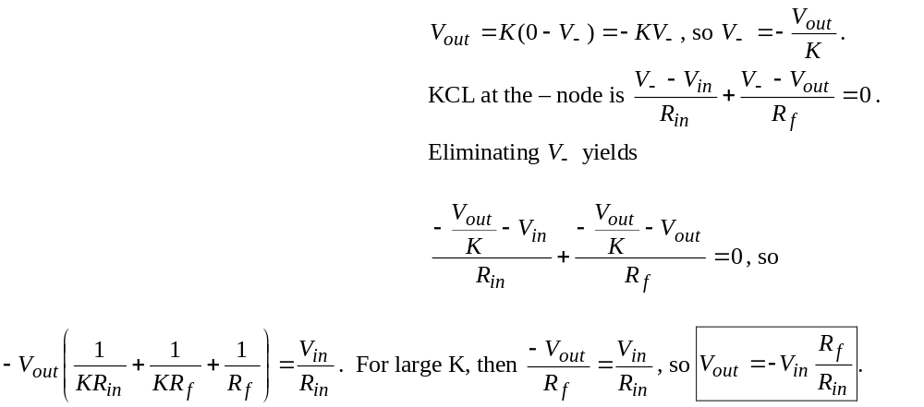
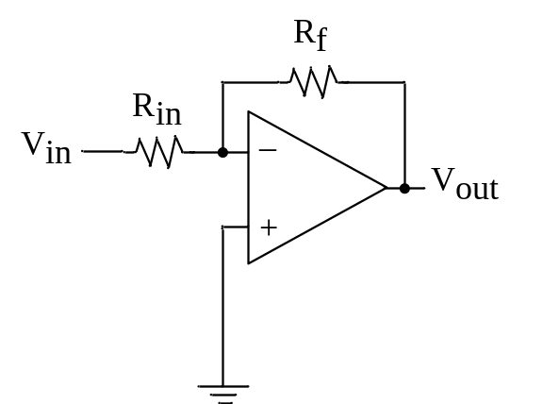
Example 2. Inverting Amplifier
(used for proportional control signal)
!

Slide 16
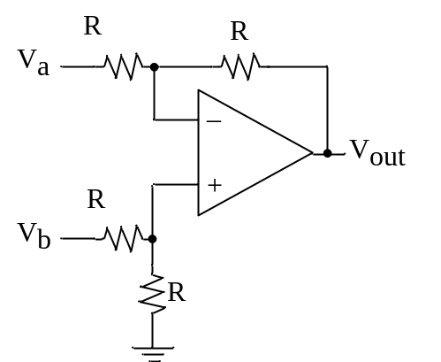
Example 3. Inverting Difference
(used for error signal)
!
=
−
=
⎛
V
b
−
⎞
V
out
K
(
V
+
V
−
)
K
⎜
V
−
⎟
,
so
⎝
2
⎠
=
V
b
−
V
out
V
−
.
2
K
V
−
−
V
a
V
−
−
V
out
KCL at the
–
node is
+
=
0
, so
R
R
V
a
+
V
out
V
−
−
V
a
+
V
−
−
V
out
=
0
, yielding
V
−
=
.
2
Eliminating
V
−
yields
⎛
V
b
V
a
+
V
out
⎞
V
out
⎛
V
b
−
V
a
⎞
⎛
K
⎞
⎛
V
b
−
V
a
⎞
V
out
=
K
⎜
−
⎟
, so
V
out
+
K
=
K
⎜
⎟
, or
V
out
⎜
1
+
⎟
=
K
⎜
⎟
.
⎝
2
2
⎠
2
⎝
2
⎠
⎝
2
⎠
⎝
2
⎠
V
=
−
(
−
)
For large
K
,
then
out
V
a
V
b

Slide 17
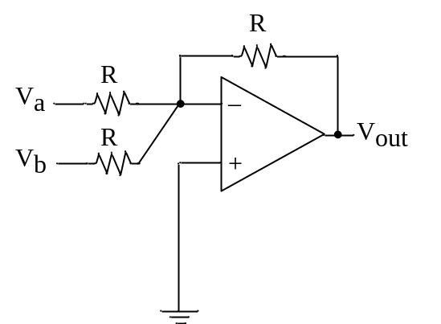
Example 4. Inverting Sum
(used to sum proportional and integral control signals)
!
−
V
out
V
out
=
K
(
0
−
V
−
)
=
−
KV
−
, so
V
−
=
.
K
KCL at the
–
node is
V
−
−
V
a
V
−
−
V
b
V
−
−
V
out
+
+
=
0
, so
R
R
R
3
V
−
=
V
a
+
V
b
+
V
out
.
⎛
−
V
out
⎞
⎛
−
3
⎞
Substituting
for
V
−
yields
3
⎜
⎟
=
V
a
+
V
b
+
V
out
, so
V
out
⎜
−
1
⎟
=
V
a
+
V
b
.
⎝
K
⎠
⎝
K
⎠
Thus, for large
K
,
V
=
−
(
V
+
V
)
out
a
b

Slide 18
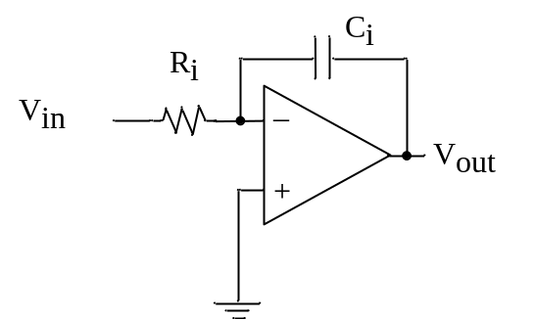
Example 5. Inverting Integrator
(used for integral control signal)
!
Using phasor
analysis,
~
=
−
~
V
out
K
(
0
V
−
)
,
so
~
~
=
−
V
out
.
KCL
at the
− node
is
V
−
K
~
−
~
~
−
~
V
−
V
in
+
V
−
V
out
=
0
.
R
i
1
j
ω
C
−
~
V
out
−
~
~
~
V
in
⎛
−
V
~
⎞
Eliminating
V
yields
K
+
j
ω
C
⎜
out
−
V
⎟
=
0
.
Gathering terms yields
−
R
⎜
K
out
⎟
i
⎝
⎠
⎛
−
⎞
~
⎛
−
⎞
~
⎜
1
−
ω
⎛
1
+
⎞
⎟
=
V
in
~
⎜
1
−
ω
⎛
1
+
⎞
⎟
=
~
V
out
⎜
j
C
⎜
1
⎟
⎟
, or
V
out
⎜
j
R
i
C
⎜
1
⎟
⎟
V
in
For
large
K
, the
⎝
KR
i
⎝
K
⎠
⎠
R
i
⎝
K
⎝
K
⎠
⎠
−
~
~
(
−
ω
)
=
~
~
=
V
in
expression reduces to
V
out
j
R
i
C
V
in
, so
V
out
(thus,
negative
integrator action).
j
ω
R
i
C
~
For a given frequency
and fixed
C
, increasing
R
i
reduces the
magnitude of
V
out
.

Slide 19
Op Amp Implementation of PI Controller
Signal flow
–
error
R
p
αV
o
ut
+
–
–
+
15kΩ
–
V
pwm
–
Difference
+
V
set
(Gain =
−1)
Proportional
+
+
(Gain
=
−
K
)
Summer
p
(Gain =
−1
1)
Buffers
(Gain = 1)
C
i
R
i
R
i
is a 500kΩ pot, R
p
is a 100kΩ pot, and all other
–
resistors shown are 100kΩ, except for the 15kΩ
resistor.
+
The 500kΩ pot is marked “504” meaning 50 • 10
4
.
Inverting Integrator
4
(Time Constant = T
i
)
The 100kΩ pot is marked “104” meaning 10 • 10
.
(Note
–
net gain K
p
is unity when, in the open loop condition and with the integrator disabled,
V
pwm
is at the desired value)

