Slide 1

DEPARTMENT OF ARTIFICIAL INTELLIGENCE AND DATA SCIENCE ACADEMIC YEAR 2025 - 2026 SEMESTER III ARTIFICIAL INTELLIGENCE LABORATORY MINI PROJECT REVIEW Connect Four Game using Minimax Algorithm
REGISTER NUMBER | 2117240070027
NAME | ASHWIN KUMAAR B
YEAR | 2
SECTION | A
FACULTY IN-CHARGE | Mrs. M. Divya

Slide 2
PROBLEM STATEMENT
Overview: Artificial Intelligence enables machines to simulate human decision-making through search and optimization algorithms. Game-playing is a classical AI domain demonstrating strategic reasoning.
Topic Introduction: Connect Four is a two-player strategy game where players alternately drop colored discs into a vertical grid to connect four in a row. Developing an AI for this game demonstrates search-tree exploration, evaluation heuristics, and adversarial reasoning.
Why It Matters: The project applies Minimax with Alpha-Beta pruning — a foundational technique in AI used in chess, tic-tac-toe, and other strategy games. It helps understand how AI can evaluate optimal moves efficiently.
Objective: To build an intelligent agent that plays Connect Four optimally against a human player using the minimax algorithm with alpha-beta pruning for faster computation.
Expected Result: A console-based Connect Four game where the AI opponent makes intelligent, strategic moves that are challenging for the player to beat.

Slide 3
THEORETICAL BACKGROUND
Concepts Involved:
Artificial Intelligence in Games – Simulating intelligent decision-making.
Search Algorithms – Exploring possible game states.
Adversarial Search – Competing against an opponent (maximizing vs. minimizing outcomes).
Literature Review:
Classic algorithms like Minimax, Negamax, and Monte Carlo Tree Search are used in board games.
Minimax is effective for deterministic games with perfect information.
Why Minimax with Alpha-Beta Pruning:
Minimax ensures optimal play assuming a rational opponent.
Alpha-Beta pruning reduces computational effort by pruning irrelevant branches, allowing deeper searches.
Algorithm Explanation:
Generate all possible moves for both players.
Recursively evaluate resulting board states up to a certain depth.
Assign heuristic scores based on board evaluation (e.g., 3 in a row = +5, block opponent = −4).
Choose the move with the highest minimax value for AI.
Alpha-Beta pruning skips branches that cannot influence the final decision.
Example:
The AI looks ahead several moves, predicts human responses, and selects the move leading to the most favorable outcome.

Slide 4
IMPLEMENTATION AND CODE
Link to code in Git-hub Repository
List | Git-hub Repository Links
Implementation of Code Link | https://github.com/ashwin-kumaar-b/ai_miniproject
Word Document Report Link | _link_
PPT Link

Slide 5
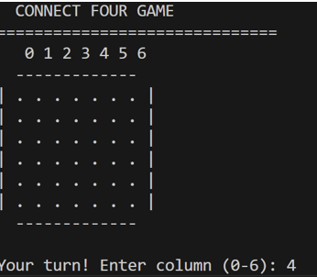
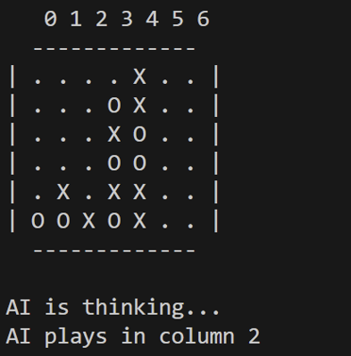
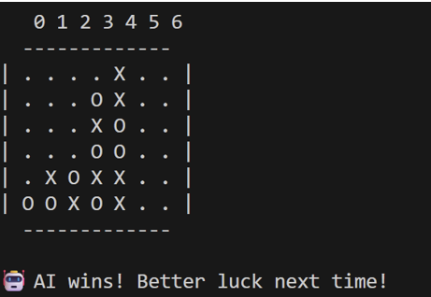
OUTPUT AND RESULTS

Slide 6
OUTPUT AND RESULTS
Explanation:
The console displays the board after each move.
The AI responds intelligently by blocking player threats and creating opportunities.
The heuristic and pruning enable the AI to play efficiently.
Results:
The AI consistently avoids losing moves.
The minimax depth-4 search balances difficulty and response time.
Demonstrates effective use of heuristic evaluation in real-time play.
Future Enhancements:
Add GUI using tkinter or pygame.
Implement adjustable AI difficulty levels.
Introduce reinforcement learning to improve heuristics.

Slide 7
REFERENCES
Russell, S., & Norvig, P. (2020). Artificial Intelligence: A Modern Approach (4th Ed.). Pearson.
GeeksforGeeks – Minimax Algorithm in Game Theory.
Medium Article – Alpha-Beta Pruning Explained with Examples.
Python Docs – List and Control Structures.
Wikipedia – Connect Four Game Mechanics.

