Slide 1

Secure Dual-Stack Hospital Network
IPv4-to-IPv6 Transition, Redundant IPsec VPN & Campus High Availability
CIE3 Computer Networks Mini Project | Cisco Packet Tracer (v5_final.pkt)

Slide 2
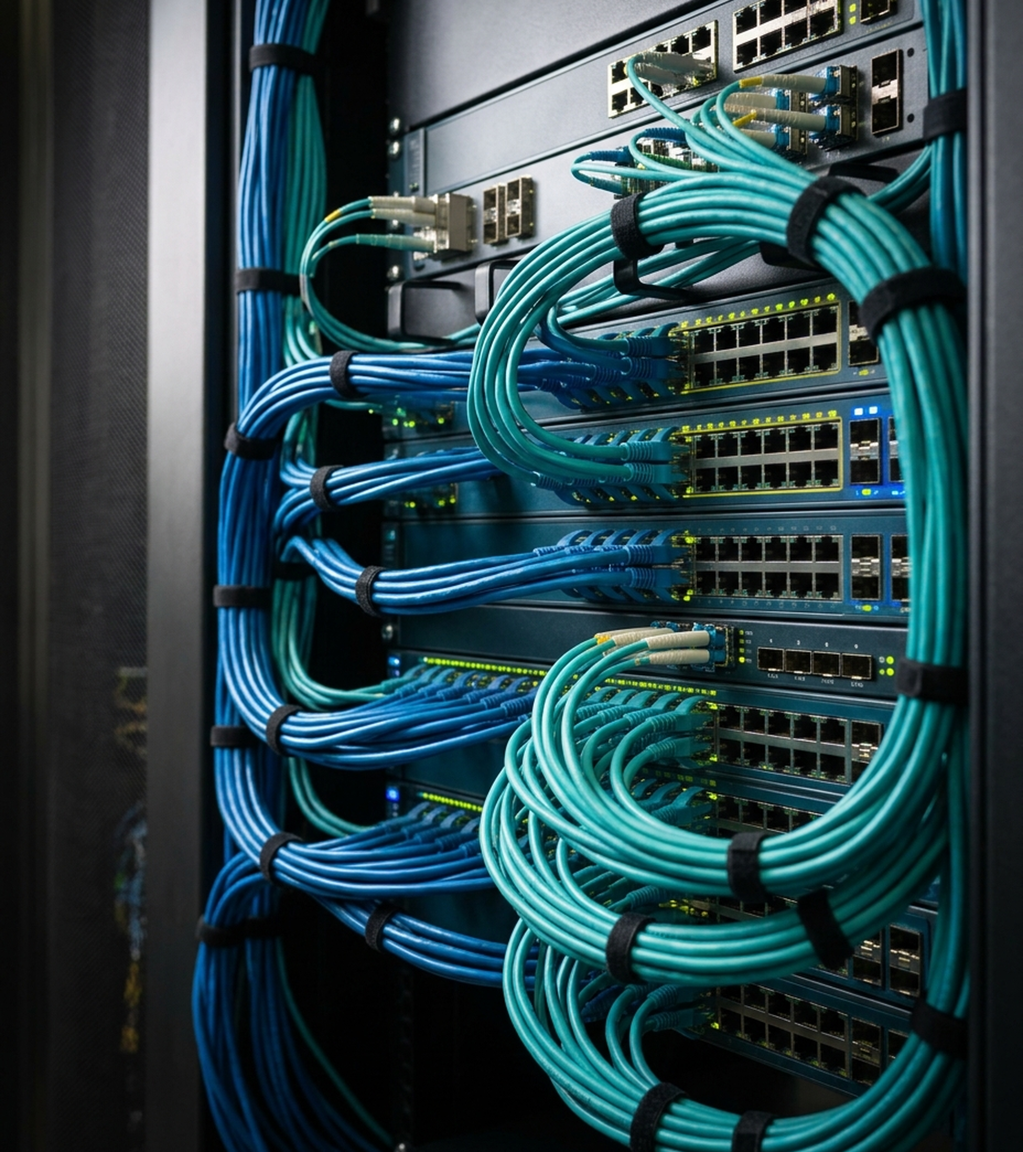
PART 1 — SPEAKER 1 (ASHWIN)
Dual-Homed Campus Topology
17 Network Nodes & 5 Subnets
Core & Edge Routers: R-HQ1, R-HQ2, R-CLINIC over ISP1 & ISP2
Two-Tier Switching: DS1 & DS2 distribution; AS1, AS2, SW-CLINIC access
Segmented Hospital Zones: VLAN 10 Doctors, 20 Nurses/VoIP, 30 Patient, 40 EMR
Source: Project Topology & Addressing Plan (v5_final.pkt) | Slide 2

Slide 3
PART 2 — SPEAKER 1 (ASHWIN)
Layer 2 Resilience & HSRP Gateway Failover
LACP EtherChannel
Port-channel1: Bundles Fa0/23-24 between DS1 and DS2
Active Mode: 802.3ad LACP trunk at 200 Mbps
Rapid-PVST+ Root
Primary Root: DS1 priority 24576 on VLANs 1-40
Backup Root: DS2 priority 28672 for fast failover
HSRP Gateway
Virtual IP .1: R-HQ1 Active (110), R-HQ2 Standby (100)
WAN Tracking: Track 1 drops priority by 20 on outage
Source: DS1, DS2, R-HQ1 & R-HQ2 Running Configurations (v5_final.pkt) | Slide 3

Slide 4
PART 3 — SPEAKER 1 (ASHWIN)
DHCP Relay, Port Security & VoIP Telephony
DHCPv4 & DNS
Central Relay: ip helper-address 10.0.40.10 on HQ
Local Survival: CLINIC-LAN pool on R-CLINIC router
Port Security
Sticky MAC: Locks first MAC on AS1, AS2, SW-CLINIC
Shutdown Mode: Rogue MAC puts port in err-disabled
VoIP Fix (7960)
Voice VLAN 20: Enabled voice vlan 20 on AS1 Fa0/8-9
CME Phones: Extensions 1001 and 1002 on R-HQ1
Source: SRV-DHCP, AS1 & R-HQ1 Telephony Configurations (v5_final.pkt) | Slide 4

Slide 5

PART 4A — SPEAKER 2
Dual-Stack IPv6 & 6in4
IPv6 Over IPv4-Only ISP Core
SLAAC + DHCPv6: HQ hosts auto-configure via R-HQ1 RA; O-flag on Clinic
RFC 4213 6in4 Mode: Uses tunnel mode ipv6ip (MTU 1476) across IPv4 WAN
Dual Tunnel Paths: Tunnel0 (2001:DB8:FF1::/64) & Tunnel1 (FF2::/64)
Source: R-HQ1, R-HQ2 & R-CLINIC IPv6 Configurations (v5_final.pkt) | Slide 5

Slide 6
PART 4B — SPEAKER 3
Redundant IPsec VPN & Automated WAN Failover
Encryption & Failover Flow
IKEv1 & ESP AES-256: Pre-shared key HospVPN123, SHA-1 HMAC, DH Group 2
Crypto ACL Fix: Matches outer IPv4 endpoints via permit ip host rules
Floating Static AD 200: ISP1 outage shifts traffic to Tunnel1 & R-HQ2 automatically
Source: IPsec Crypto Maps & Floating Static Routes (v5_final.pkt) | Slide 6

Slide 7
PART 5 — SPEAKER 3
Patient Zone Isolation ACLs, PAT & Verification
Dual-Stack ACLs
DNS Permitted: Allows UDP 53 to SRV-DHCP (10.0.40.10)
EMR Blocked: Denies VLAN 30 Patient to VLAN 40
NAT/PAT Overload
VPN Exempted: NAT-ACL excludes tunnel & clinic IPs
PAT Overload: Translates 10.0.0.0/16 to WAN g0/1
20/20 Tests Passed
4 Live Demos: DHCP, IPv6 tunnel, ACL, WAN failover
Ready to Open: All configs saved in v5_final.pkt
Source: Part 5 Security Policies & 20-Item Verification Table (v5_final.pkt) | Slide 7

Slide 8
Resilient Dual-Stack Clinical Connectivity.
Thank You | Questions & Live Packet Tracer Demonstration
CIE3 Computer Networks Mini Project — v5_final.pkt

