Slide 1
StaySmart AI
Java 21
JAVA PROGRAMMING MINI-PROJECT
Spring Boot 3
StaySmart AI
React 19 + TS
An AI-Powered Vacation Rental Platform — inspired by Airbnb
PostgreSQL
PRESENTED BY
PROGRAM
[Team Member Names]
B.Tech IT · 2nd Year · Semester [__]
LangChain4j AI
INSTITUTION
GUIDE
[College / Institution Name]
[Faculty Guide Name]
College Mini-Project · Built full-stack with Java, Spring Boot, React & LangChain4j

Slide 2
OVERVIEW
Agenda
1
Problem Statement & Objectives
6
AI-Powered Features (7 modules)
2
Technology Stack
7
Live Application Walkthrough
3
System Architecture
8
AI Usage Analytics
4
Database Design
9
Security, Testing & Deployment
5
Core Platform Modules
10
Future Scope & Conclusion
StaySmart AI
02 / 15

Slide 3
MOTIVATION
Problem Statement & Objectives
The Problem
Our Objectives
— Guests manually sift through hundreds of listings with no personalised guidance on what actually fits their trip.
— Search stays keyword-only — there's no natural-language way to ask for "a cozy beach house in Goa for 4 under ₹5000".
— Hosts write descriptions and judge pricing manually, with no assistant to speed up listing creation.
— Itinerary planning and budgeting happen on separate apps, disconnected from the booking flow.
— Build a complete Airbnb-style booking platform — auth, listings, search, bookings, reviews — end to end.
— Weave 7 practical AI features into the real booking journey with LangChain4j, not as a bolt-on demo.
— Keep the platform fully usable without AI: a missing API key degrades gracefully, it never crashes.
— Apply production-grade practice for a college project: layered architecture, JWT security, automated tests, Docker deployment.
StaySmart AI
03 / 15

Slide 4
ENGINEERING
Technology Stack
Backend
Java 21 · Spring Boot 3 · Spring Security · Spring Data JPA · Hibernate · Maven
Database
PostgreSQL 16 · Flyway migrations (schema + seed data)
Auth
Stateless JWT (access + rotating refresh) · BCrypt hashing · roles USER / HOST / ADMIN
Artificial Intelligence
LangChain4j · OpenAI (GPT-4o-mini) — pluggable with Gemini / Claude
Frontend
React 19 · TypeScript · Vite · Tailwind CSS v4 · React Router · TanStack Query · Axios
Docs & API
springdoc-openapi (Swagger UI) · Markdown + Mermaid diagrams
Testing & Ops
JUnit 5 · Mockito · H2 (test scope) · Docker Compose · Nginx
StaySmart AI
04 / 15

Slide 5
DESIGN
System Architecture — Modular Monolith
One Java package per business capability; every module follows the same internal layering.
React SPA (Frontend)
REST / JSON (Axios)
Controller
Service
Repository
PostgreSQL
6 business modules — user · property · booking · review · ai · admin — each layered exactly this way
Cross-Cutting Concerns (wrap every module)
security
config
exception
common
JWT issuing / validation, auth filter
Spring Security, CORS, OpenAPI, LangChain4j bean
Typed exceptions + one global @RestControllerAdvice
Base entity (audit fields), ApiResponse/PageResponse
StaySmart AI
05 / 15

Slide 6
DATA MODEL
Database Design
PostgreSQL · 12 tables · schema + seed data managed by 4 Flyway migrations.
users
users
properties
properties
bookings
bookings
Users & Auth
users · refresh_tokens
Properties
properties · property_images · amenities · property_amenities · availability_blocks
ai_usage_logs / ai_chat_messages
ai_usage_logs / ai_chat_messages
availability_blocks
availability_blocks
reviews
reviews
Bookings
bookings
Key design choices: bookings snapshot price/nights at creation time; a half-open availability_blocks range backs both search and booking overlap checks; reviews are gated 1-per-completed-booking with a cached avg_rating on properties.
Reviews
reviews · review_images
AI
ai_usage_logs · ai_chat_messages
StaySmart AI
06 / 15

Slide 7
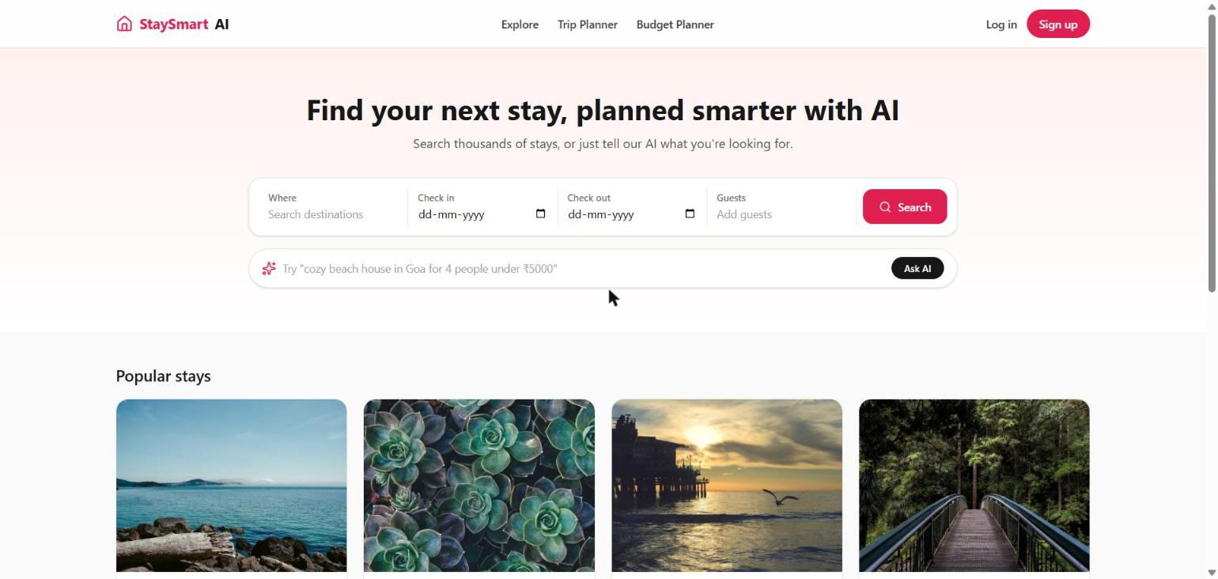
PLATFORM
Core Modules
1
User Authentication
Registration & login, stateless JWT (access + rotating refresh), BCrypt hashing, roles USER / HOST / ADMIN.
2
Property Management
CRUD listings, multi-image upload, amenity catalog, location fields, and a per-property availability calendar.
3
Booking System
Filtered search (city, dates, guests, price, type, amenities), instant booking with server-side overlap checks, cancellation.
4
Review System
Star ratings + comments + photos, one review per completed booking, cached average rating kept in sync automatically.
Home — search + AI Smart Search bar
StaySmart AI
07 / 15

Slide 8
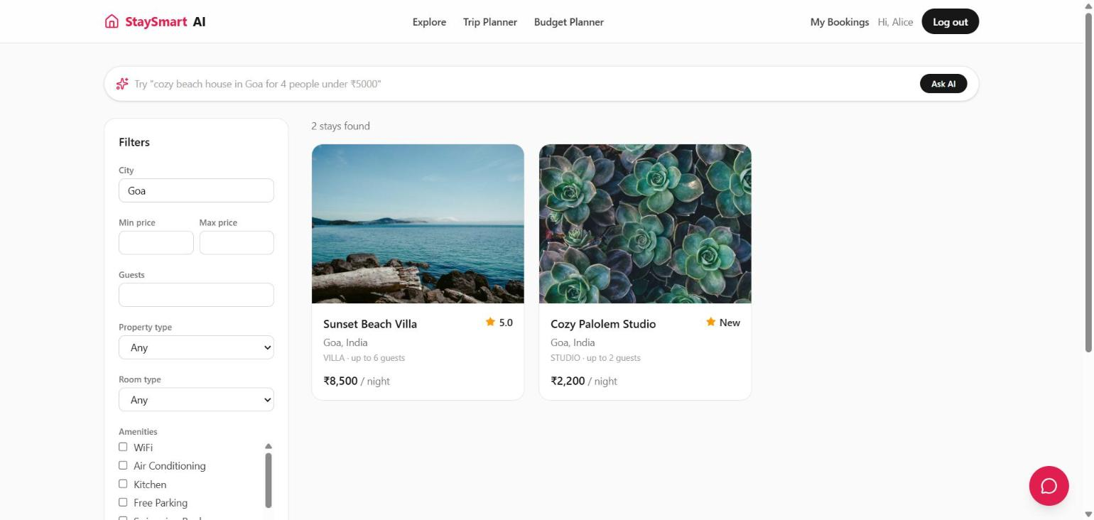
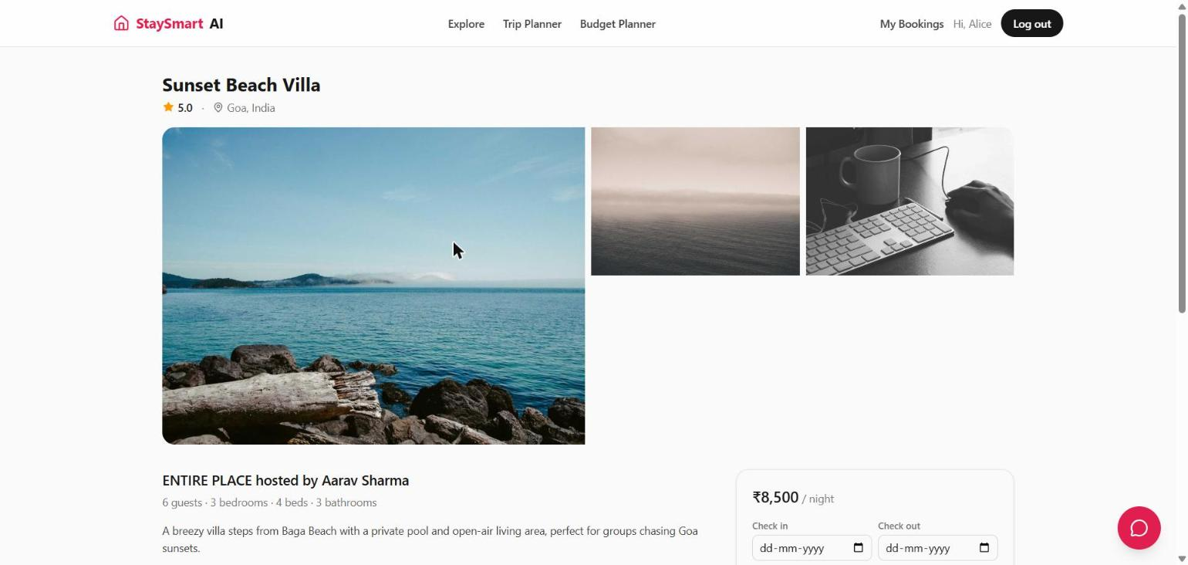
LIVE DEMO
Guest Journey — Search & Discover
Filtered search (city, price, room type, amenities)
Property details with live booking widget
Search reuses the exact same code path whether the filters come from the UI form or from the AI Smart Search bar parsing a natural-language query.
StaySmart AI
08 / 15

Slide 9
ARTIFICIAL INTELLIGENCE
7 AI-Powered Features
Built with LangChain4j; every call is logged for the admin AI usage dashboard.
Property Recommendation
Builds a candidate pool from top-rated stays and asks the LLM to explain personalised picks.
Review Summarization
Condenses a property's reviews into overall sentiment, pros, cons and a verdict.
Chat Assistant
Multi-turn concierge widget; conversation history persisted per session.
Trip Planner
Day-by-day itinerary for a destination, dates, party size, interests & budget level.
Description Generator
Drafts a listing description from structured property details for hosts.
Budget Planner
Category-wise trip budget, grounded in the platform's real average nightly price.
Smart Search
Parses a natural-language query into structured filters for the regular search.
No OPENAI_API_KEY configured? AI endpoints return a clean “not configured” error — the rest of the platform stays fully usable.
StaySmart AI
09 / 15

Slide 10
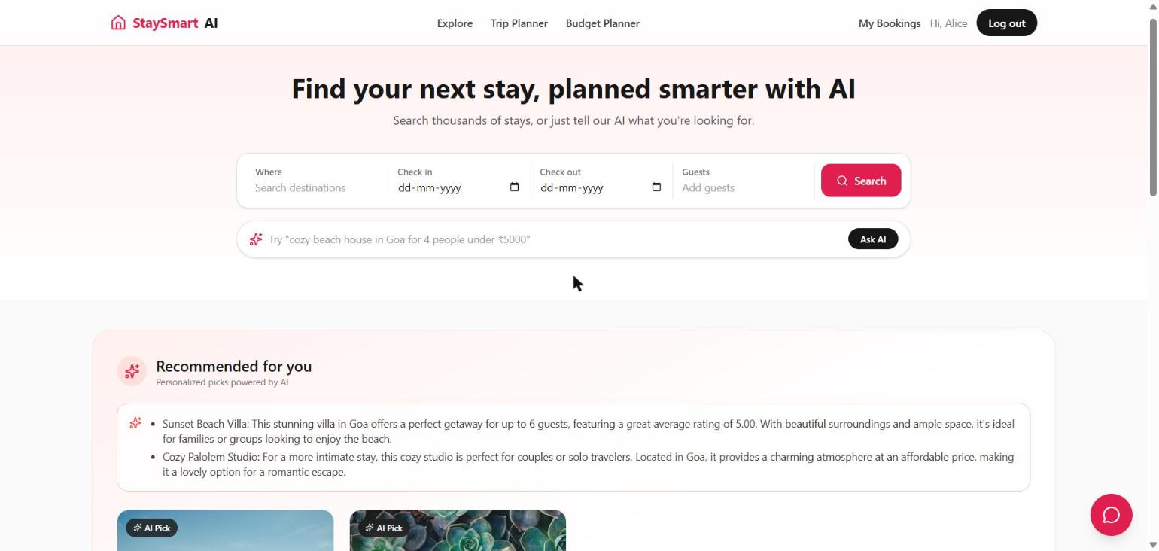
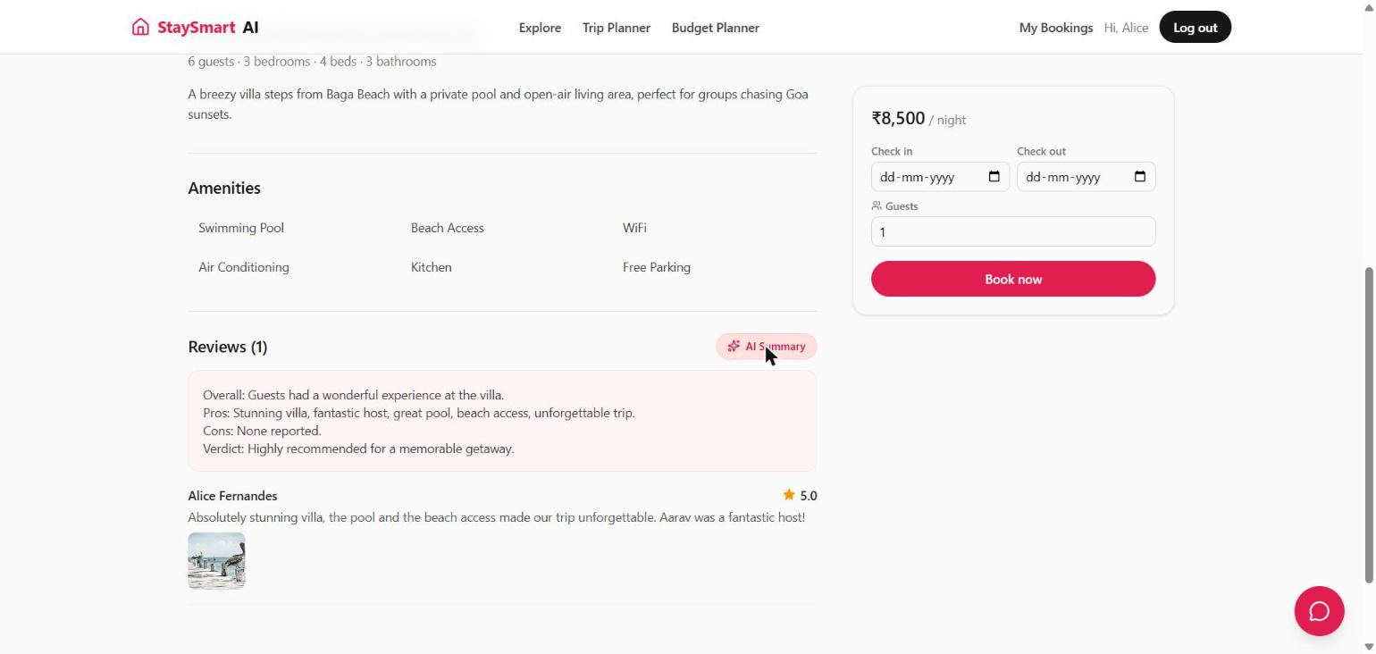
LIVE DEMO
AI in Action — Recommendations & Reviews
Personalised “Recommended for you” picks
AI review summary: overall / pros / cons / verdict
Both screenshots are live model output captured from the running app — not mockups — generated by GPT-4o-mini via LangChain4j.
StaySmart AI
10 / 15

Slide 11
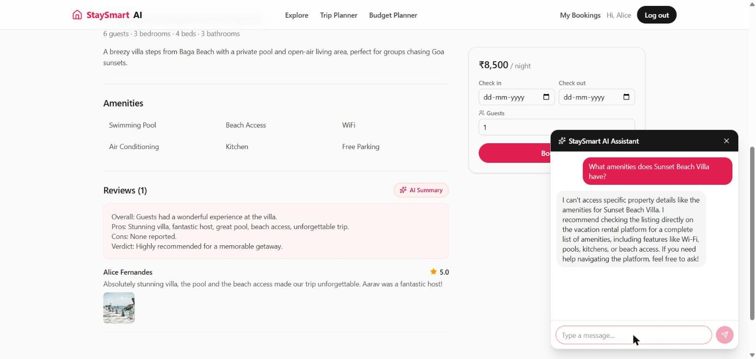
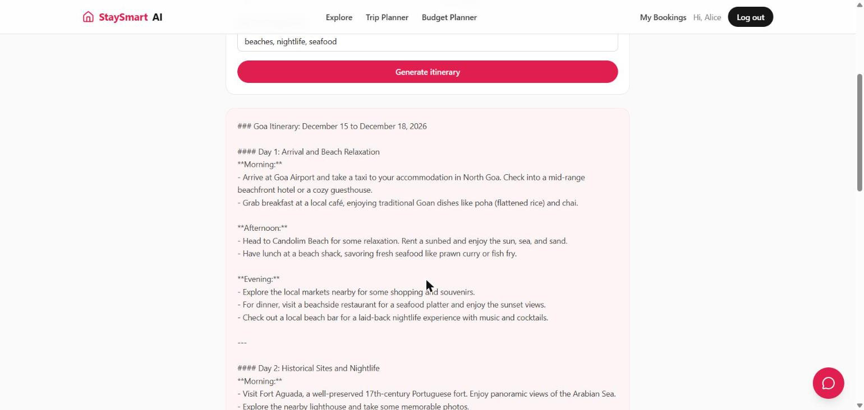
LIVE DEMO
AI in Action — Chat & Trip Planning
Floating AI chat assistant (multi-turn)
AI-generated day-by-day trip itinerary
The chat widget and trip planner both call the same underlying ChatLanguageModel bean, configured once in the config module and reused across every AI feature.
StaySmart AI
11 / 15

Slide 12
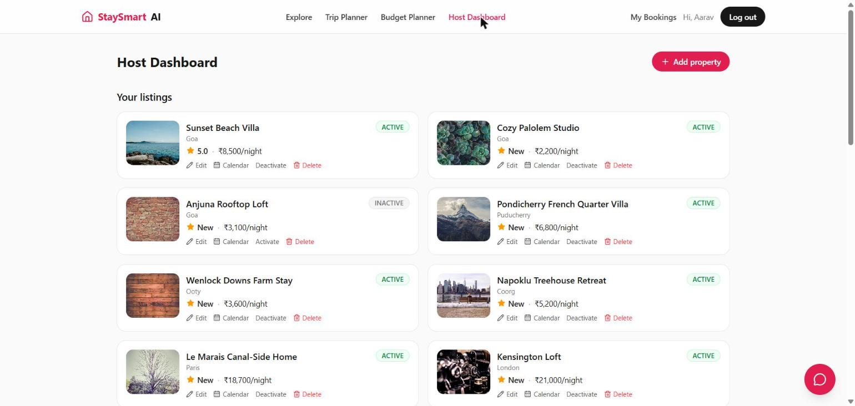
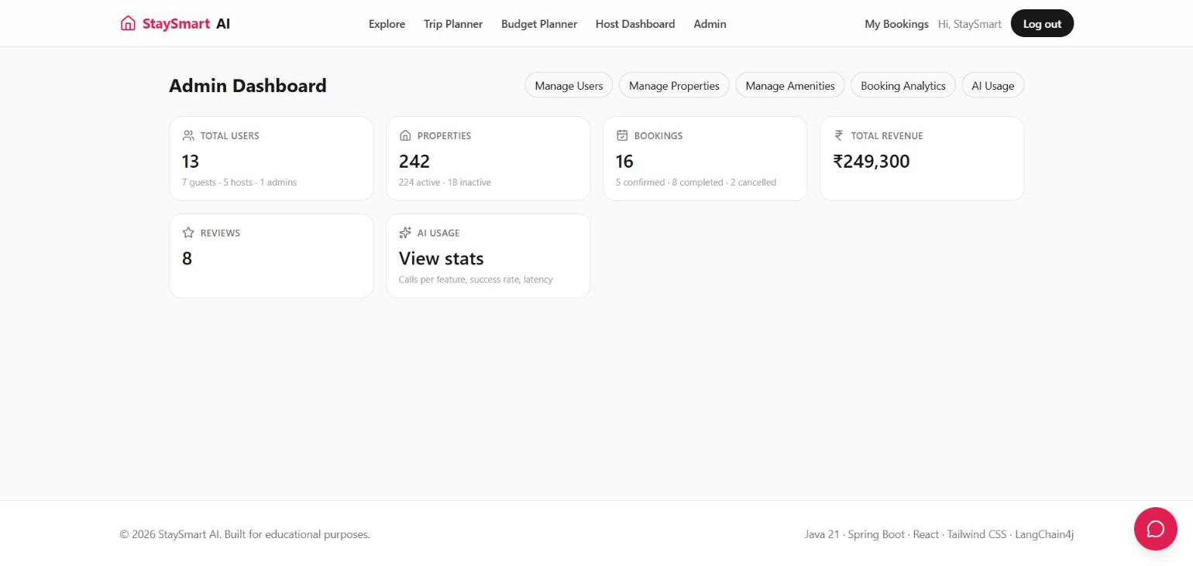
LIVE DEMO
Host & Admin Experience
Host Dashboard — manage listings, calendar, status
Admin Dashboard — platform-wide stats
The seeded demo dataset spans 242 properties, 13 users across all three roles, and 16 bookings — enough to make every dashboard meaningful out of the box.
StaySmart AI
12 / 15

Slide 13
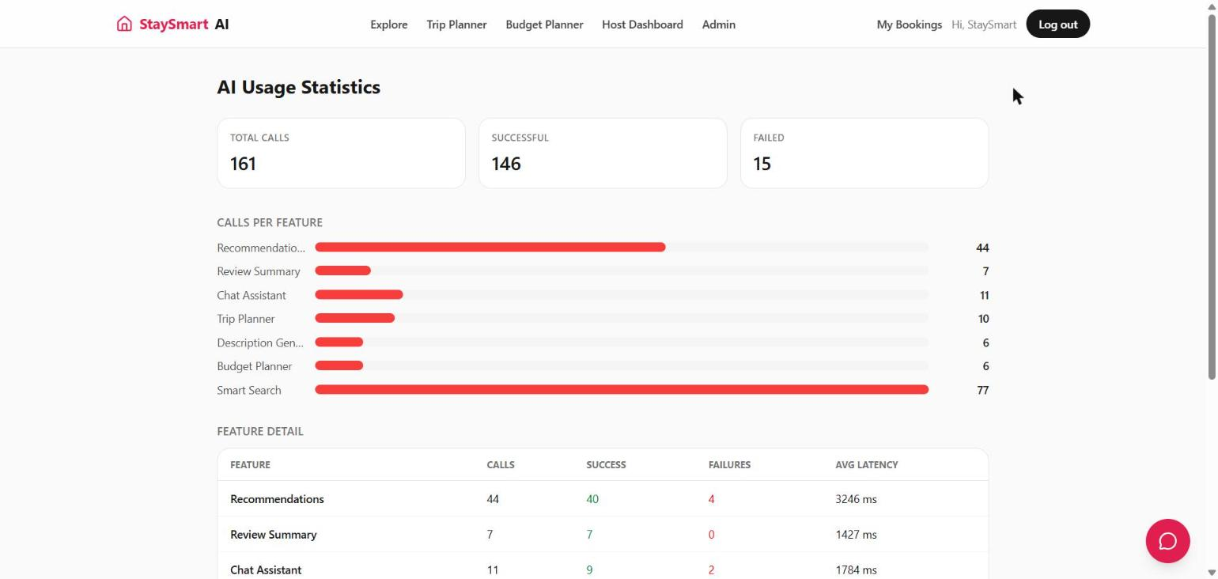
OBSERVABILITY
AI Usage Analytics
Every AI call is logged (feature, success/failure, latency) — powering this live admin dashboard.
161
146
15
Total Calls
Successful
Failed
Admin → AI Usage: calls per feature, success rate, avg latency
StaySmart AI
13 / 15

Slide 14
QUALITY & OPS
Security, Testing & Deployment
Security
Testing
Deployment
— JWT access + rotating refresh tokens
— BCrypt password hashing
— Role-based access — USER / HOST / ADMIN
— Scoped CORS configuration
— JUnit 5 + Mockito unit tests
— H2 in-memory DB for test scope
— springdoc-openapi — live Swagger UI
— Global @RestControllerAdvice error shape
— Docker Compose — Postgres + backend + frontend
— Flyway-managed schema migrations
— Environment-based config via .env
— Nginx serving the built React SPA
StaySmart AI
14 / 15

Slide 15
CLOSING
Future Scope & Conclusion
Future Enhancements
— Real payment gateway integration (Razorpay / Stripe) for actual checkout
— Wishlist / favourites and real-time booking notifications
— Host payouts, multi-currency pricing, and dynamic pricing suggestions from AI
— Vector-search-powered recommendations (embeddings over listings & reviews)
— Native mobile app (React Native) reusing the same REST API
Conclusion
StaySmart AI shows that a 2nd-year Java course project can carry a real layered architecture, JWT security, automated tests, Docker deployment, and genuinely useful AI — end to end, not just a demo.
Thank You
Questions & Feedback Welcome
[Team Email / GitHub Repository Link]
StaySmart AI
15 / 15

