Slide 1
IPsec VPN Traffic Analyzer
Rate a VPN's security and see what runs inside it, from one packet capture
Smart India Hackathon 2026 | Problem Statement 26160
Notes:
Introduce the team and the problem statement. One sentence: we analyse an IPsec capture and answer two questions - how well is it secured, and what traffic is inside it - without decrypting anything.

Slide 2
The problem: encrypted does not mean understood
Is the VPN configured well?: Cipher, key exchange group, forward secrecy, tunnel vs transport mode.
What is inside the tunnel?: Web, video, voice, file transfer, ping - without decrypting.
Hard part: only the first IKE message (IKE_SA_INIT) is readable; everything after it is encrypted.
Our stance: never present a guess as a measurement - every value is tagged observed / declared / unknown.
Notes:
IPsec hides the payload. But defenders still need to know if the VPN is configured safely, and what kind of traffic crosses it. Both must be answered from a passive capture.

Slide 3
What we built
Security score 0-100: LOW / MEDIUM / HIGH, capped by assessment completeness so unknowns never read as 100 / LOW
Passive ESP fingerprint: cipher family, integrity-tag candidates, tunnel vs transport, replay and rekey evidence - from sizes and sequence numbers only
Traffic classification: Random Forest on 1-second windows, calibrated confidence, 'unrecognised' for unknown traffic
Recommendations: prioritised fixes, a generated strongSwan snippet (unverified), before / after score
What-if + replay: defence simulator; replay of a capture file (not live sniffing)
Reports: executive summary and technical report, HTML and PDF; plain-English mode
Notes:
Walk through the four capabilities and the dashboard.

Slide 4
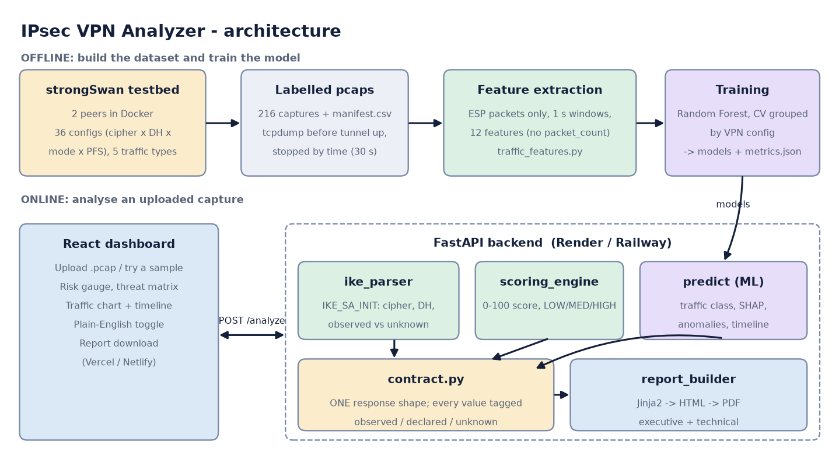
Architecture
Notes:
Offline: testbed to pcaps to features to a trained model. Online: React talks to FastAPI; the backend combines the IKE parser, scoring, the ML model and the report builder behind one API contract.

Slide 5
How the security score works
Factor | Weight | Strong | Medium | Weak
Cipher | 0.4 | AES-GCM, AES-256 | AES-CBC-128 | 3DES
DH group | 0.4 | 19, 20, 21, 31, 16 | 14, 15 | 1, 2, 5
PFS | 0.2 | fresh DH | - | none
Base score = weighted average of the rated factors; risk: >= 80 LOW, >= 50 MEDIUM, else HIGH
Assessment completeness: every finding is observed / inferred / declared / unknown; the final score is capped at 35 + 65 x completeness
Real finding: none of our 216 captures contains a readable IKE_SA_INIT, so a real testbed file reads 64 / MEDIUM (44 % complete), not 100 / LOW
Notes:
The parser walks the IKE_SA_INIT exchange by hand from RFC 7296 and validates every header. Values that are not visible stay unknown: excluded from the base score (never counted as weak) but they lower the completeness percentage and therefore the cap.

Slide 6
Traffic classification: what we feed the model
12 features per 1-second window: packets/s, bytes/s, packet-size stats, inter-arrival stats, direction ratios
ESP only: IKE and the decrypted copies present in tunnel-mode files are excluded
Dropped on purpose: packet_count, total_bytes, duration: they reflect when tcpdump stopped
Data: 180 captures, 1,027 windows, 36 VPN configurations
Model: Random Forest, class-weighted; SHAP explains each prediction
Notes:
Only ESP packets, because that is what an eavesdropper sees. Decrypted duplicates in tunnel-mode captures are removed. Windows are fixed at one second. We removed packet_count, total_bytes and duration.

Slide 7
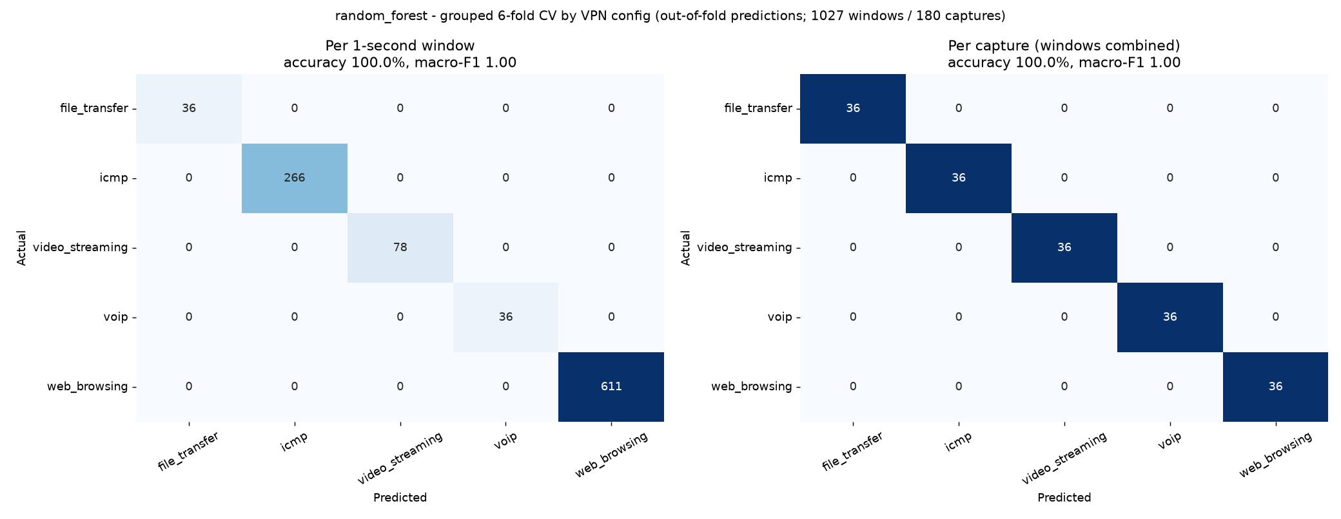
Honest evaluation: tested on VPN configs it never saw
Check | Result
Random Forest, per 1-second window | 100 %
Random Forest, per capture | 100 %
Majority-class baseline (window) | 59.5 %
Shuffled labels (window) | 46.3 %
Without rate features | 100 %
OLD shortcut: packet_count alone | 100 %
Very high because the scripted traffic types differ a lot; lab data, not real-world proof.
Notes:
Cross-validation is grouped by VPN configuration so every test fold contains unseen configurations. The 100 percent says the five scripted traffic types are easy to tell apart. It is not a claim about real user traffic.

Slide 8
What we found in our own data
No readable IKE_SA_INIT: the 'handshake' captures held only encrypted keep-alives; most likely tcpdump was killed by a container restart
PFS labels meaningless: pfs-on and pfs-off configs were byte-identical; template fixed
The 100 % was a shortcut: capture length (tcpdump -c N) alone predicts the class
Plaintext leaked into captures: tunnel-mode files include decrypted copies; ESP-only now
Fixed testbed not yet re-run: Docker was unavailable; command order is tested with a fake Docker
Notes:
These are the things a reviewer would otherwise discover. We found them, fixed what we could, and documented the rest.

Slide 9
New: passive ESP fingerprinting from sizes only
Passive inference (grouped CV, 180 captures) | Result
Cipher family: answered / correct when answered | 144 / 144 (100 %)
Cipher family: abstains (all ICMP, constant size) | 36 captures
Tunnel vs transport: accuracy (all) | 96.7 %
Tunnel vs transport: when it commits (coverage) | 100 % (89.4 %)
Shuffled-label control (chance 50 %) | 45.4 %
Also: SPI / sequence analysis: replay evidence, gaps, duplicates, reordering, rekeys
Not observable: AES-128 vs 256, PFS, auth method, SA lifetime without a rekey: reported unknown
Lab data: scripted traffic, one strongSwan version
Notes:
No file names, no keys. The ESP length modulo 16 separates CBC (one residue) from GCM (several). The rule abstains on constant-size streams such as ICMP instead of guessing. Say clearly what is not observable: AES-128 vs 256, PFS, authentication method, lifetime unless a rekey is seen.

Slide 10
New: honest confidence, and a defence what-if
Defence (simulated) | Naive attacker | Adaptive | Extra bandwidth
Pad packets to size buckets | 100 % | 100 % | +10 %
Pad every packet to full size | 42.8 % | 100 % | +223 %
Constant-rate dummy traffic | 60 % | 100 % | +72 %
Random delay (timing jitter) | 99.4 % | 100 % | +0 %
Combined | 60 % | 100 % | +119 %
Unrecognised traffic: 100 % of held-out-class captures rejected; 94.7 % of known accepted
Lab limit: five very different classes; real unknowns will be harder
Defences: no defence stopped an adaptive attacker here
Notes:
Calibration can only soften confidence (temperature floored at 1). Open-set test: each traffic class was held out entirely and shown as unknown traffic. The defence table is a simulation: padding and dummy traffic fool a naive attacker, but an attacker who retrains is back to about 100 percent on this data.

Slide 11
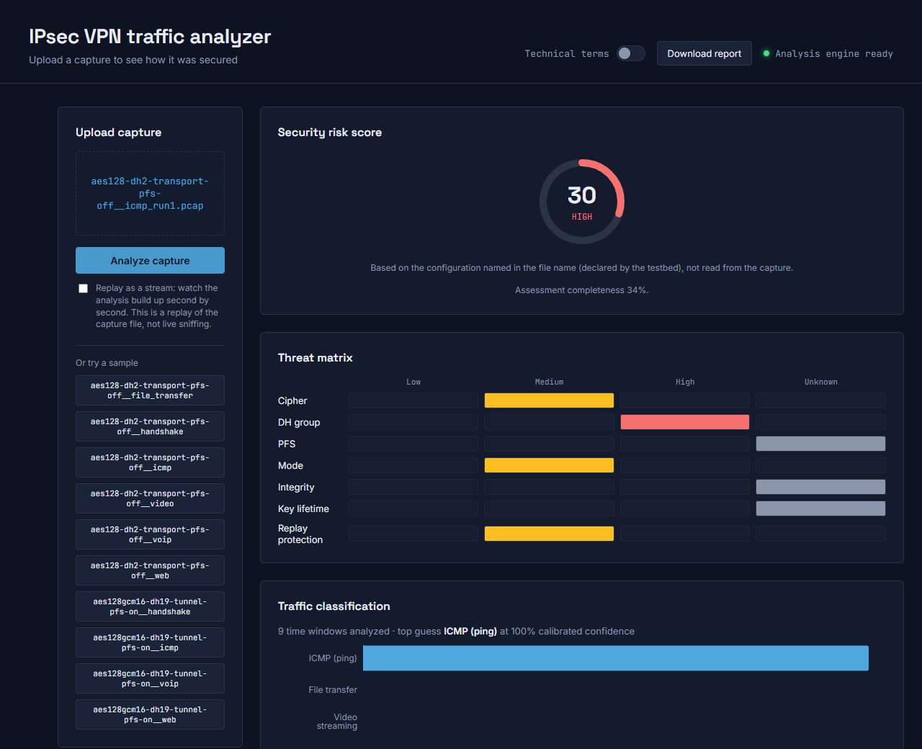
The dashboard
Notes:
Live demo: upload a capture, read the gauge, threat matrix, traffic chart and timeline. The yellow badges show which values came from the file name.

Slide 12
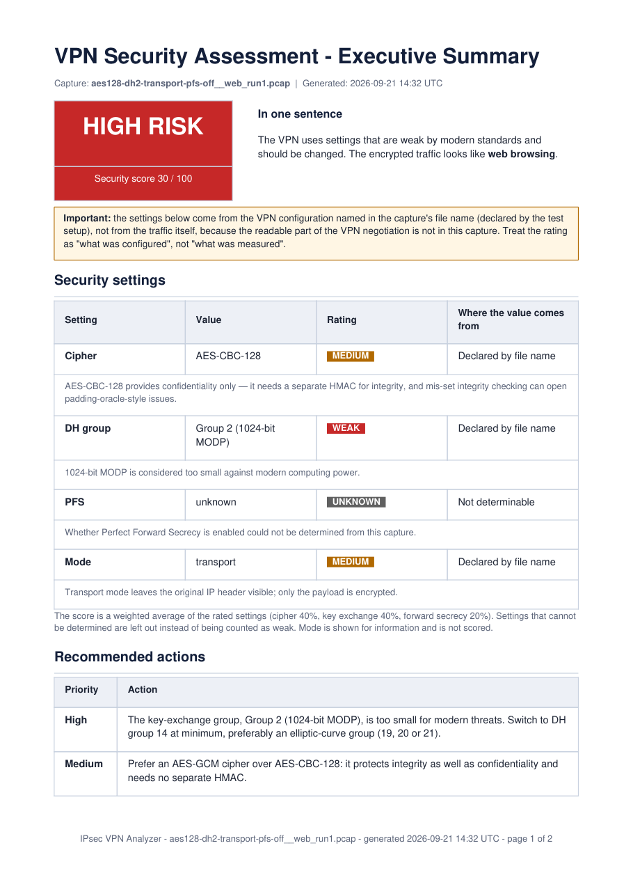
Real reports, generated on demand
Executive summary: risk box, plain-language settings table, rule-based recommendations, what the report cannot tell you
Technical report: score arithmetic, IKE parse facts, class probabilities, SHAP, timeline, anomalies, model validation
Windows-safe: pure-Python PDF engine: installs with pip, runs on hosting
Notes:
One click generates an executive summary or a technical report as HTML or PDF (Jinja2 to HTML to PDF with xhtml2pdf, no system dependencies).

Slide 13
Quality and deployment
Automated tests: 243 pytest tests (synthetic IKE / ESP / IPv6 / AH fixtures, scoring, ML, API, replay, reports, testbed) + real-browser end-to-end check
One API contract: schema 1.1: score + cap, findings with status, recommendations, fingerprint, sequence, defence simulation
Packaging: Dockerfiles, docker-compose, Render / Railway / Vercel / Netlify configs, click-by-click DEPLOY.md
Measured: ~320 MB RAM for the API after an analysis plus a PDF report
Notes:
Everything runs locally and in Docker; deployment configs are provided. Deploying needs the team's own Vercel and Render logins, and we say so.

Slide 14
Limitations and next steps
Limits: one capture per config and class; scripted traffic; short captures for file transfer, VoIP, video; SIP only for VoIP
Synthetic only: IKE_SA_INIT, IPv6, AH and rekey behaviour are tested on hand-built fixtures; strongSwan snippet not run (no Docker)
Replay, not live: replay mode streams a capture file; live sniffing is not implemented
Next: re-run the fixed testbed (real handshakes, real PFS labels, 30 s captures, repeats)
Next: non-scripted traffic, IKEv1, authentication and rate limiting for a public deployment
Notes:
Be upfront: this is a lab dataset. The next milestone is re-running the fixed testbed.

