Slide 1
PROJECT REVIEW PRESENTATION
Learning Management System (LMS) Lite
A secure, role-based platform for course delivery, assessment, and learning analytics
STUDENT NAME(S)
Ashwin Krishna V
REGISTER / ROLL NUMBER
727824TUCS031
CLASS / SECTION
CSE-E
COURSE / SUBJECT
Application Development

Slide 2
01
Project Overview
INTRODUCTION
PROBLEM ADDRESSED
PURPOSE
LMS Lite is a standalone Spring Boot + React web application that lets educational institutions deliver online learning, manage courses and content, run assessments, and track student progress end to end.
Institutions need one streamlined, secure system to deliver courses, assess learners, and generate educational insights — instead of juggling disconnected tools for content, grading, and communication.
Give instructors, content creators, TAs, and administrators role-appropriate tools to run academic operations digitally, while keeping student data secure and FERPA / WCAG 2.1 compliant.
Project Review · Ashwin
01

Slide 3
02
Problem Statement
EXISTING PROBLEM
LIMITATIONS OF CURRENT APPROACH
WHY THIS PROJECT IS REQUIRED
Course delivery, enrollment, grading, and student communication are typically handled through fragmented, manual, or generic tools with no unified academic workflow.
No education-specific role hierarchy (Admin, Instructor, Content Creator, TA, Student, Guest), no built-in learning analytics, weak compliance (FERPA / accessibility), and no automated grading or academic integrity checks.
A single platform is needed that scales to 50,000+ users and 10,000+ courses, supports 2,000+ concurrent users, and bakes in JWT security, RBAC, and compliance from the ground up.
Project Review · Ashwin
02

Slide 4
03
Objectives
KEY OBJECTIVES
EXPECTED OUTCOMES
Build a secure JWT-based authentication and RBAC system for 6 user roles
Enable complete CRUD course, content, and enrollment management
Automate assessment creation, grading, and academic integrity checks
Deliver real-time progress tracking and learning analytics
99.9% uptime with sub-second authentication and grading response times
Platform scaling to 50,000+ users and 10,000+ courses
Full FERPA and WCAG 2.1 accessibility compliance
Minimum 85% automated test coverage across backend and frontend
Project Review · Ashwin
03

Slide 5
04
Proposed Solution
HOW IT WORKS
A Spring Boot + Spring Security backend exposes JWT-secured REST APIs consumed by a React.js frontend. Role-based dashboards route each of the six user types to the course, content, assessment, and analytics tools they're permitted to use.
MAJOR FEATURES
Role-based access control across 6 user types
Course & content management with versioning
Assessment engine with automated grading
Progress tracking & predictive analytics
Communication & collaboration tools
WHY THIS SOLVES THE PROBLEM
It replaces fragmented manual processes with one compliant, auditable platform — automated grading and real-time analytics cut instructor workload while RBAC and encryption protect academic data.
Project Review · Ashwin
04

Slide 6
05
Technology Stack
FRONTEND
BACKEND
DATABASE
React.js with protected routes, mobile-responsive design (port 8081)
Spring Boot 3.x with Spring Security, Java 17+ (port 8080)
JPA-compatible relational database, database-agnostic design
APIS / LIBRARIES / FRAMEWORKS
DEVELOPMENT TOOLS
OTHER
Secured REST APIs, JWT authentication, WebSocket for real-time updates
JUnit (backend testing), React Testing Library (frontend testing), Docker
Cloud-ready (AWS / Azure / GCP), LTI & SCORM integration support
Project Review · Ashwin
05

Slide 7
06
System Architecture
Frontend
→
Backend
→
Database
→
External Services
React.js SPA · role-based dashboards
Spring Boot REST API · Spring Security (JWT)
JPA / relational store · Users, Courses, Enrollments, Assessments
Email · Zoom / Teams · Drive / OneDrive · plagiarism check · LTI / SCORM
DATA FLOW DESCRIPTION
1. User authenticates through the React frontend; credentials are validated and a JWT is issued.
2. The frontend attaches the JWT to every REST request sent to the Spring Boot backend.
3. Spring Security validates the token and enforces role-based access control for the requested operation.
4. Authorized requests hit JPA repositories, which read/write course, enrollment, and assessment data.
5. Responses return as JSON; WebSocket connections push real-time notifications and live updates back to the client.
Project Review · Ashwin
06

Slide 8
07
Modules / Features
Module | Purpose
Authentication & Account Management | Secure registration, login, and JWT-based session management
Role-Based Access Control | Enforce permissions across Admin, Instructor, Content Creator, TA, Student, Guest
Course & Content Management | Create, structure, and version courses and multimedia learning content
Assessment & Evaluation | Build quizzes/assignments, automate grading, ensure academic integrity
Progress & Analytics | Track learning progress and surface predictive, at-risk insights
Communication & Collaboration | Discussions, messaging, announcements, and video conferencing
Administrative & Reporting | User/course administration and institutional compliance reporting
Module
Purpose
Project Review · Ashwin
07

Slide 9
08
Database / Data Model
Users
Courses
Enrollments
id (PK)
username, email, role
studentId, institutionId
department, isActive
id (PK)
courseCode, title, credits
instructorId (FK → Users)
status, maxEnrollment
id (PK)
courseId, studentId
enrollmentDate, status
grade, completionDate
KEY RELATIONSHIPS
Users (instructors) create Courses; Students enroll via Enrollments, linking Users ↔ Courses. Each Course owns CourseContent, Assessments, and Discussions. Assessments produce AssessmentSubmissions and Grades; DiscussionPosts thread under Discussions; Notifications reference the owning User and Course.
Project Review · Ashwin
08

Slide 10
09
Application Workflow
Start
→
Register / Login
(JWT issued)
→
Browse & Enroll
in a Course
→
Access Content /
Complete Assessment
→
Track Progress
on Dashboard
→
End
A user registers or logs in and receives a JWT session. They browse the course catalog and enroll (subject to prerequisites and capacity). Once enrolled, they access course content, submit assignments, and take assessments through role-scoped endpoints. Automated and instructor grading feed the student's progress dashboard, where grades, completion, and analytics are tracked in real time until course completion.
Project Review · Ashwin
09

Slide 11
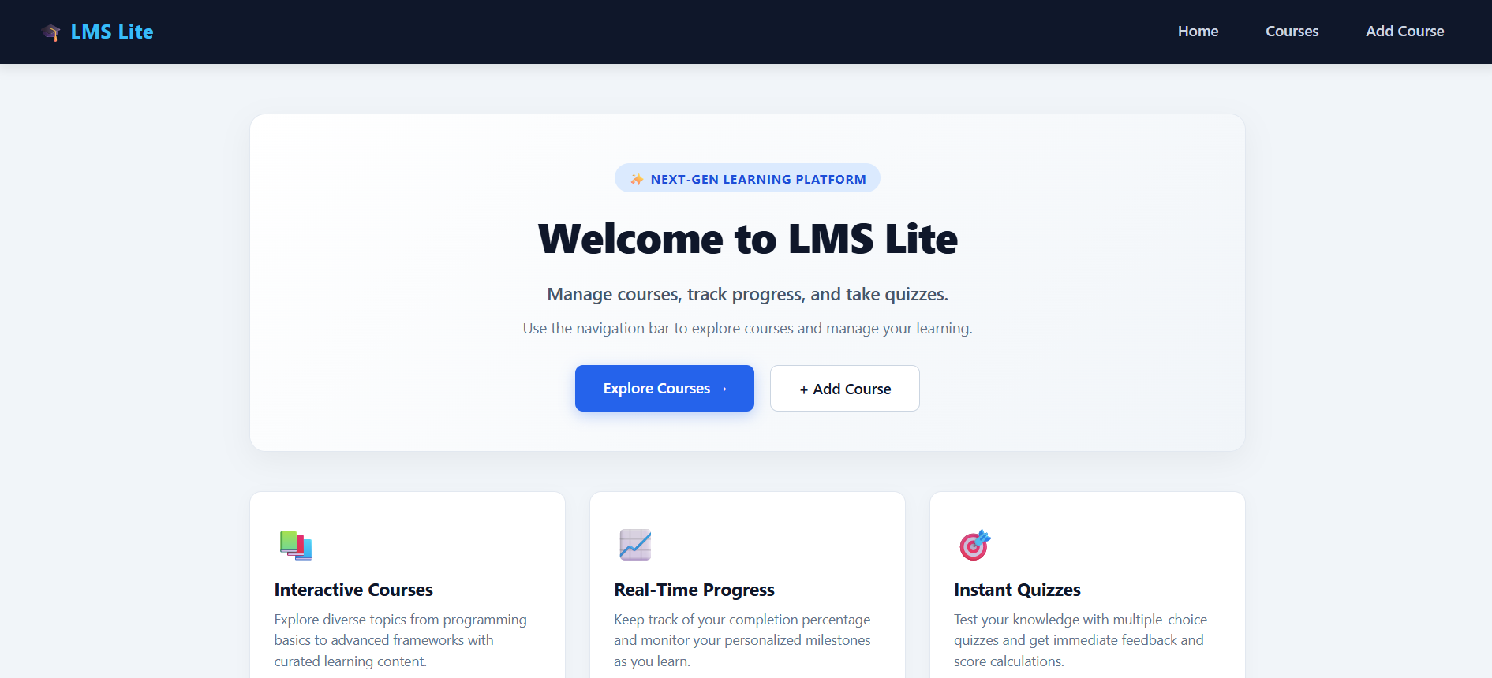
10
Key Functionality — Course & Assessment Management
WHAT THE USER CAN DO
Create and structure courses with modules, lessons, and multimedia content
Build quizzes and assignments with multiple question types and grading rubrics
Track grades, submission status, and progress through a unified dashboard
SCREENSHOT PLACEHOLDER
Insert screenshot of this functionality here
HOW IT WORKS
Instructors submit course/content and assessment data via JWT-secured REST endpoints. Spring Security enforces RBAC before Spring Boot persists changes through JPA. Students interact with role-scoped endpoints to view content and submit work, with automated and manual grading results feeding the analytics engine.
Project Review · Ashwin
10

Slide 12
11
Challenges & Solutions
Challenge
Solution
Enforcing differentiated access across 6 user roles | JWT-based RBAC with function-level permission checks for every operation
Delivering real-time notifications and live interactions at scale | WebSocket connections engineered for under 1-second update latency
Meeting FERPA and WCAG 2.1 compliance for academic data | AES-256 encryption at rest/in transit, full audit trails, accessibility validation
Supporting 2,000+ concurrent users without performance loss | Scalable architecture with load balancing and efficient JPA querying
Project Review · Ashwin
11

Slide 13
12
Testing
TESTING APPROACH
Unit testing with JUnit (backend) and React Testing Library (frontend), integration testing of REST API flows, plus security penetration testing and load testing for 2,000+ concurrent users — targeting a minimum of 85% code coverage.
Test case
Expected result
Actual result
Status
[To be Updated] | [To be Updated] | [To be Updated] | [To be Updated]
[To be Updated] | [To be Updated] | [To be Updated] | [To be Updated]
[To be Updated] | [To be Updated] | [To be Updated] | [To be Updated]
Project Review · Ashwin
12

Slide 14
13
Future Enhancements
1
Native Mobile Apps
2
AI-Powered Learning
iOS and Android native applications — additional features
AI recommendations and predictive analytics for personalized learning paths
3
Advanced Security
4
Next-Gen Experiences
Blockchain-based credential verification and advanced proctoring — production-level hardening
VR classrooms and AI teaching assistants for immersive learning
Project Review · Ashwin
13

Slide 15
14
Conclusion
14
SUMMARY
KEY ACHIEVEMENTS
LMS Lite is a secure, standards-compliant Spring Boot and React platform that unifies course delivery, assessment, and learning analytics for educational institutions at scale — replacing fragmented tools with one auditable, role-based system.
Designed a role-based access control system spanning 6 distinct user roles
Architected a FERPA- and WCAG 2.1-compliant secure REST API with JWT authentication
Defined a scalable data model supporting 50,000+ users and 10,000+ courses
Thank you

