Slide 1
TNSDC-Generative AI
Fasion MINIST Image Generation - GAN
Presented by :ASHWIN S,
au211521104015,
Pre-Final Year Student,
Computer Science and Engineering,
Panimalar Institute of Technology.

Slide 2

OUTLINE
Problem Statement
Proposed Solution
System Approach
Algorithm
Result
Conclusion
References

Slide 3
PROBLEM STATEMENT
This project aims to develop a Generative Adversarial Network (GAN) capable of generating high-resolution, color images of fashion dresses resembling those found in the Fashion MINIST dataset. Key challenges include dataset augmentation to enhance diversity, style transfer for user customization, ensuring realism and coherence in generated designs, and establishing robust evaluation metrics for objective assessment.

Slide 4
PROPOSED SOLUTION
A specialized Generative Adversarial Network (GAN) is at the core of our approach for fashion dress image generation. GANs consist of two neural networks: a generator and a discriminator, which are trained simultaneously in a competitive manner.
The generator learns to create realistic images of fashion dresses from random noise input, while the discriminator learns to distinguish between real images from the Fashion MINIST dataset and fake images generated by the generator. Through this adversarial training process, the generator improves its ability to produce high-quality, realistic images that closely resemble real fashion garments.
To tailor the GAN specifically for fashion dress image generation, we will customize the architecture and training process to capture the intricate details and nuances of diverse fashion styles, patterns, and textures. Additionally, we will integrate style transfer mechanisms to allow users to customize generated dresses according to their preferences, enhancing the versatility and interactivity of the model.

Slide 5
SYSTEM APPROACH
Hardware:
CPU: A multi-core processor with a clock speed of at least 2 GHz is recommended for handling the computational demands of CNN training and inference.
Memory: A minimum of 8 GB RAM is necessary for smooth operation, particularly during model training with large datasets.
GPU: A powerful graphics card, such as the NVIDIA RTX 4070, with CUDA cores is essential for accelerating image rendering tasks, particularly in deep learning applications like CNN training and inference.
Internet Speed: A stable broadband connection with a minimum download speed of 5 Mbps and upload speed of 1 Mbps is required for package downloads, updates, and web application serving.

Slide 6
SYSTEM APPROACH – CONT.
Software:
Jupyter: Enables interactive development and experimentation through Notebooks, facilitating Python code execution.
TensorFlow: Popular machine learning framework for implementing CNN architectures, handling training, and inference tasks.
NumPy: Fundamental for scientific computing, it manages multidimensional arrays and executes mathematical operations within TensorFlow.
Matplotlib: Facilitates data visualization and plotting, aiding in analyzing and interpreting model performance and results.
Scikit-learn: Offers various machine learning algorithms and tools for model evaluation and validation, complementing TensorFlow for comprehensive model development.

Slide 7
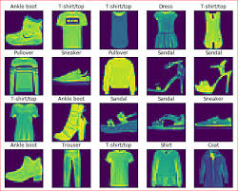

ALGORITHM
Phase 1: Loading Dataset
Load the Fashion MINIST dataset containing images of fashion items, including dresses.
Phase 2: Pre-Processsing
Reshape images to the desired dimensions.
Convert grayscale images to RGB format if necessary.
Normalize pixel values to the range [-1, 1] to ensure numerical stability during training.

Slide 8
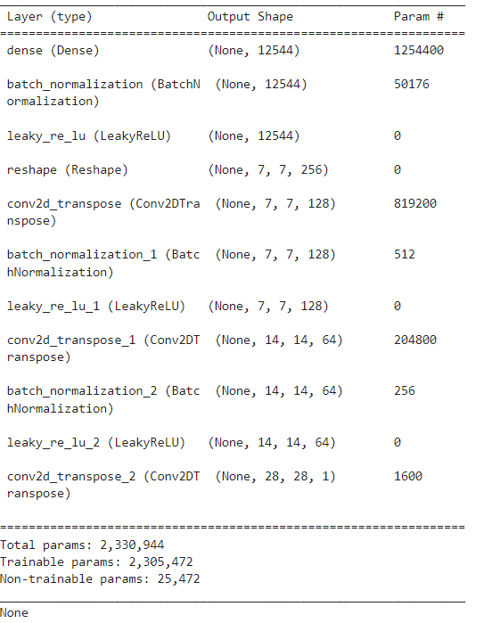
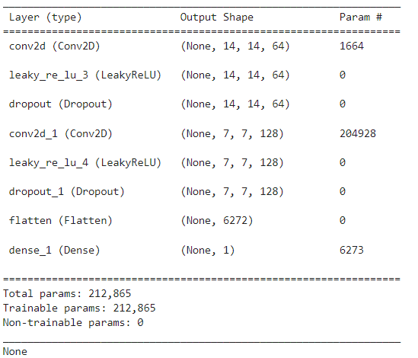
ALGORITHM - CONT.
Phase 3: Build Generative and Discriminator Models
Design the layers of the generator to transform random noise into realistic fashion dress images.
Design the layers of the discriminator to distinguish between real and fake images.
Generator Layers
Discriminator Layers

Slide 9
ALGORITHM - CONT.
Phase 4:Training Loop
For each epoch, iterate over mini-batches of the training dataset.
Train the discriminator:
Feed real images through the discriminator and compute the loss.
Feed fake images generated by the generator through the discriminator and compute the loss.
Update the discriminator's weights using backpropagation.
Train the generator:
Generate fake images using random noise input.
Feed generated images through the discriminator and compute the loss.
Update the generator's weights using backpropagation.
Monitor training progress and loss values.

Slide 10
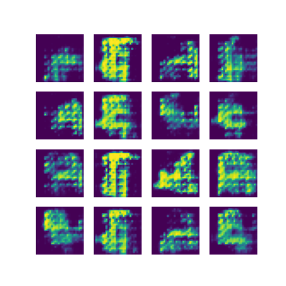
ALGORITHM - CONT.
Phase 5:Generate Image
Input random noise into the generator network.
Obtain generated images as output.
Optionally, post-process generated images for visualization or user feedback.

Slide 11
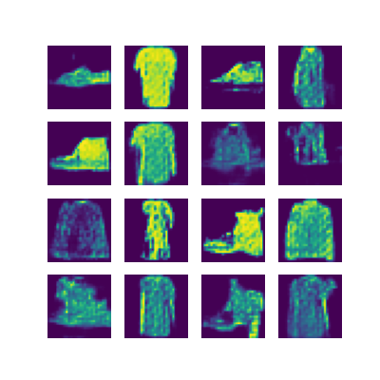
RESULT
Generation of image
Final Generated Image

Slide 12
Conclusion
In conclusion, the proposed algorithm outlines a systematic approach for training a Generative Adversarial Network (GAN) to generate fashion dress images. Beginning with data loading and preprocessing, including reshaping and color conversion, the algorithm progresses to the construction of the generator and discriminator models. Loss functions and optimizers are initialized before entering the training loop, where the models are iteratively trained to generate realistic images. Finally, the trained generator is utilized to produce new fashion dress images. This algorithm provides a structured framework for developing a GAN-based system capable of generating diverse and realistic fashion designs.

Slide 13
REFERENCES
Goodfellow, Ian, et al. "Generative adversarial nets." Advances in neural information processing systems. 2014.
Zhang, Han, et al. "Self-Attention Generative Adversarial Networks." International Conference on Machine Learning. 2019.
Karras, Tero, et al. "A Style-Based Generator Architecture for Generative Adversarial Networks." IEEE/CVF Conference on Computer Vision and Pattern Recognition. 2019.

