Slide 1
Beam Splitters
and Single Photon Sources
PROJECT PRESENTATION
Ashwin Shenai
(180156)
Shivam Goel
(180714)
EE683A
Fall 2019

Slide 2
SINGLE PHOTON SOURCE
A light source which emits light as single photons.
The frequency of photons emitted can be time dependent.
We have modeled three types of distributions
Uniform
Exponential
Logarithmic
Source: Google Images

Slide 3


IMPLEMENTATION
We used a random number generator
Picks a number between 0 to 1 from a uniform distribution
Works for the uniform distribution
For the other distributions, probability is time dependent
Our time-axis is the length of the array
Set probability of getting 1 for each instant
Toss a biased ‘coin’ with above probability of getting 1
If you get 1, pick a random number between 0.5 and 1
If you get 0, pick a random number between 0 and 0.5
Above randomization is destroyed by digitization
Digitization - discretize distribution using a threshold
We used a threshold of 0.5
Values above 0.5 become 1, others become 0
Threshold value affects total probability of getting a 1
numpy.random.uniform
numpy.random.choice

Slide 4
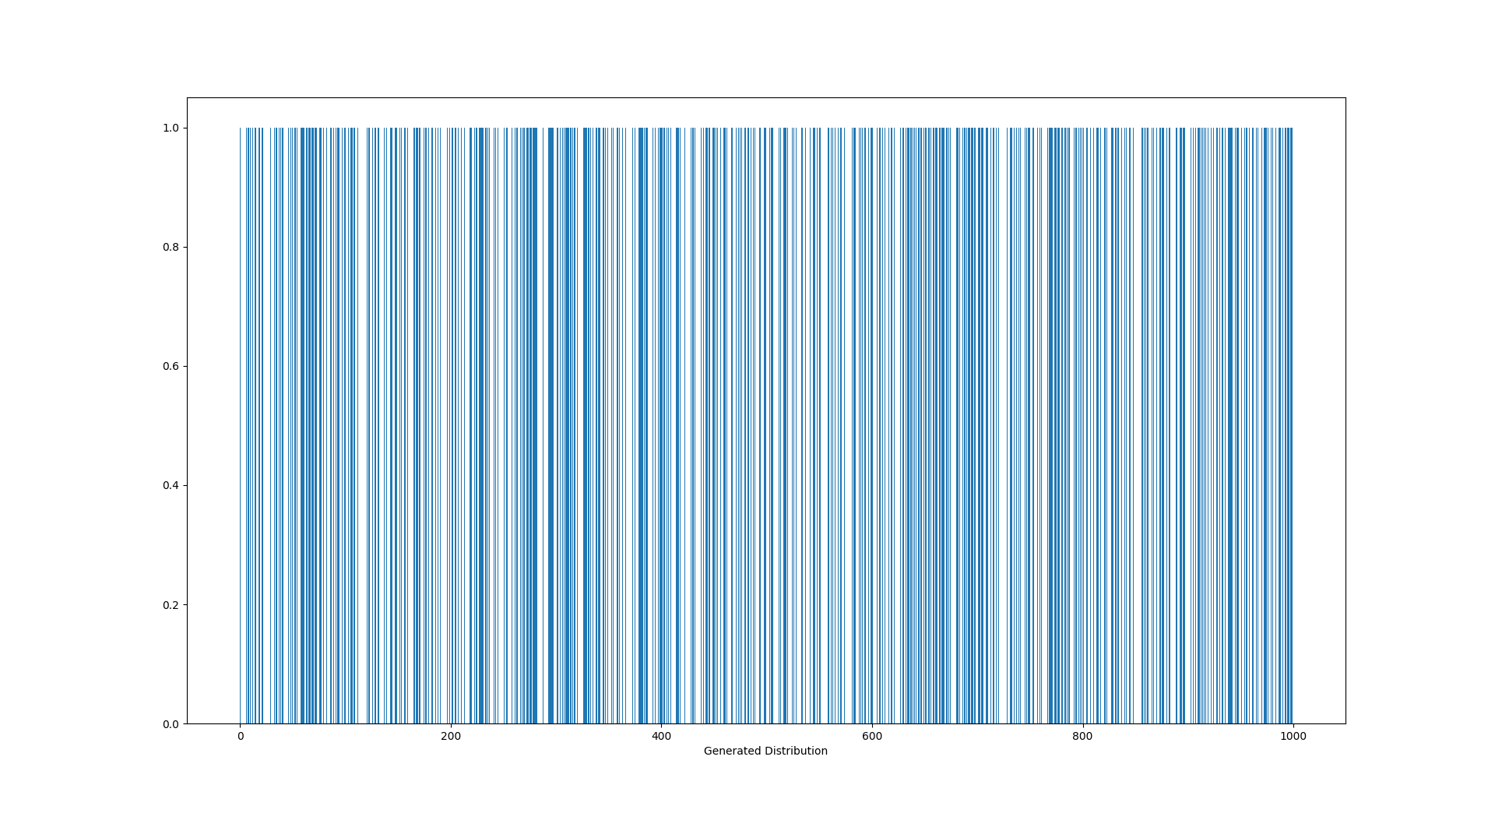
UNIFORM DISTRIBUTION

Slide 5
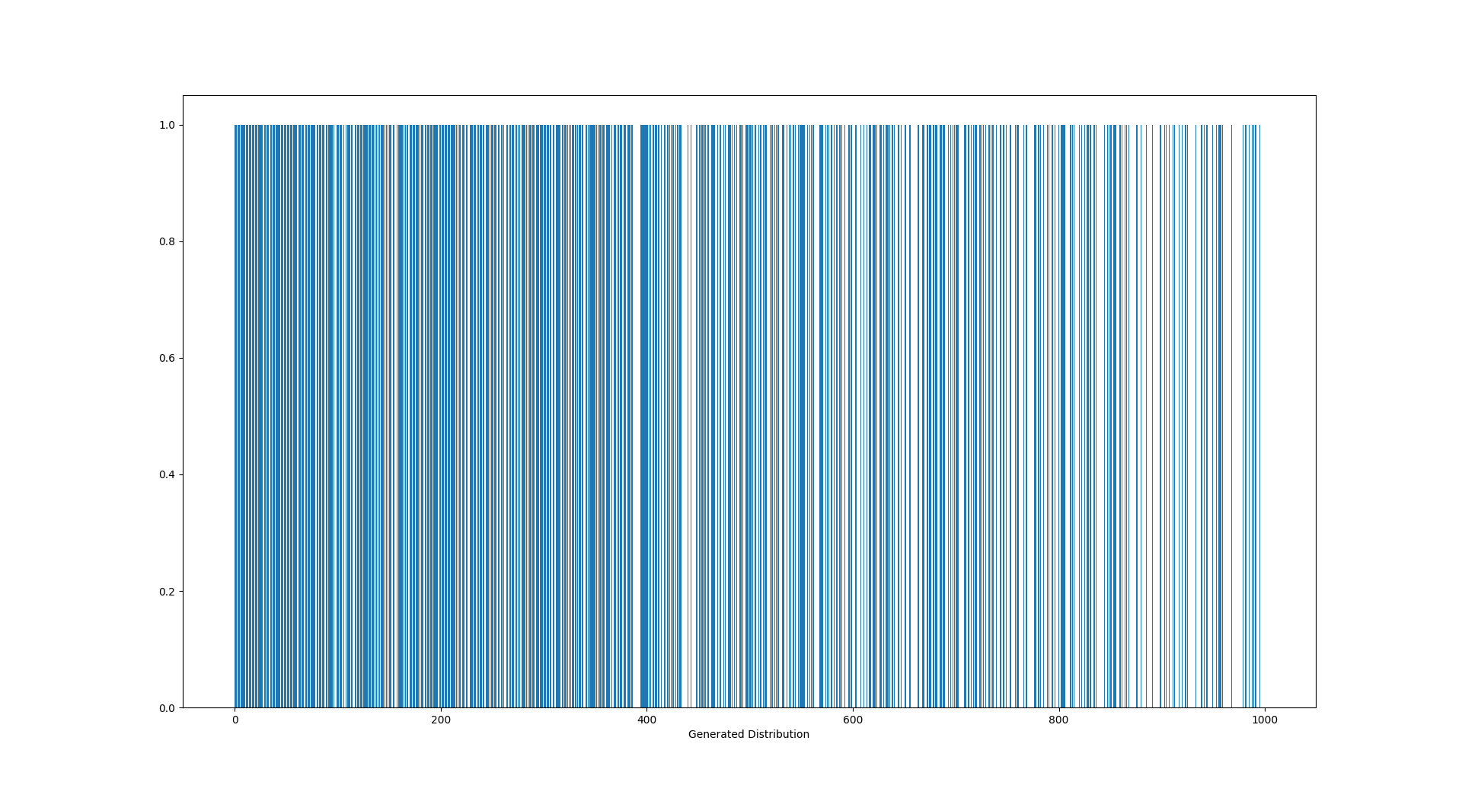
EXPONENTIAL DISTRIBUTION

Slide 6
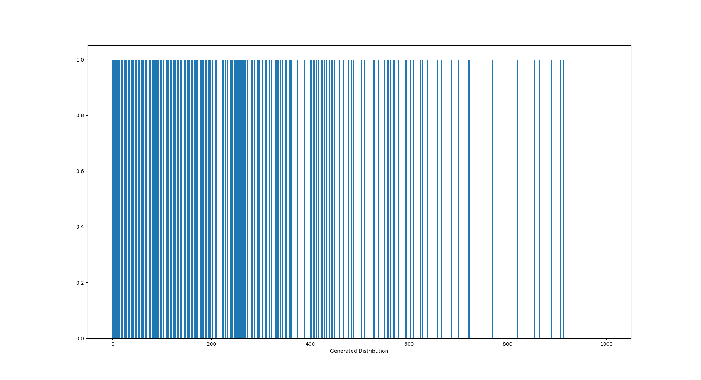
LOGARITHMIC DISTRIBUTION

Slide 7
PROBLEM
How do you differentiate an SPS from other light sources?

Slide 8
THE SOLUTION
You can split waves, but you can’t split photons.

Slide 9
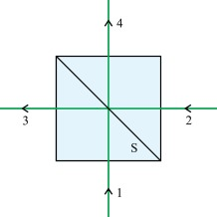
BEAM SPLITTER
Splits beams
Can take two inputs
Combines the two inputs to give two outputs
Define transmittance and reflectance
Transmittance - probability that input beam passes through
Reflectance - probability that input beam gets reflected
Evidently sum to 1
For a 50-50 beam splitter, reflectance is 0.5
We assume our splitter to be lossless
Source: Google Images

Slide 10
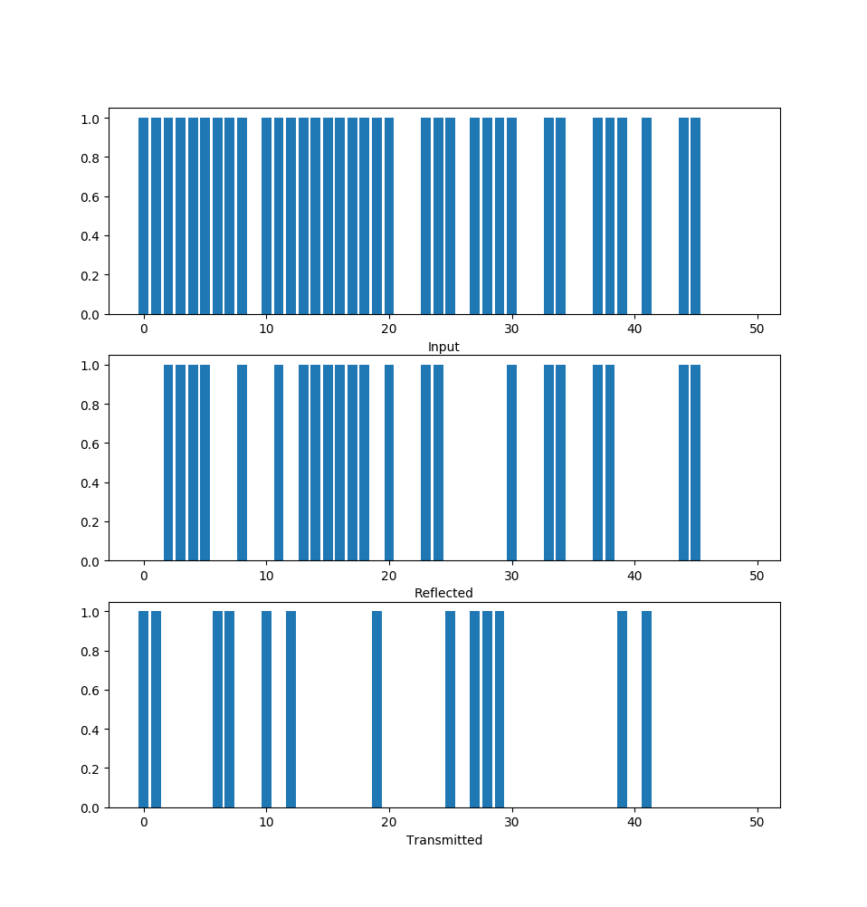
IMPLEMENTATION
INPUT - EXPONENTIAL DISTRIBUTION
Again, we used an RNG
Picks a random number between 0 and 1
From a uniform distribution
Set threshold equal to specified reflectance
If value less than threshold, send input to ‘reflect’ output
If value greater than threshold, send input to ‘transmit’ output
Set output of the SPS as one input. Note:
At any instant only one of the two outputs can have a 1
This is called antibunching
SPS must show antibunching - photon cannot be at both outputs at the same time

Slide 11
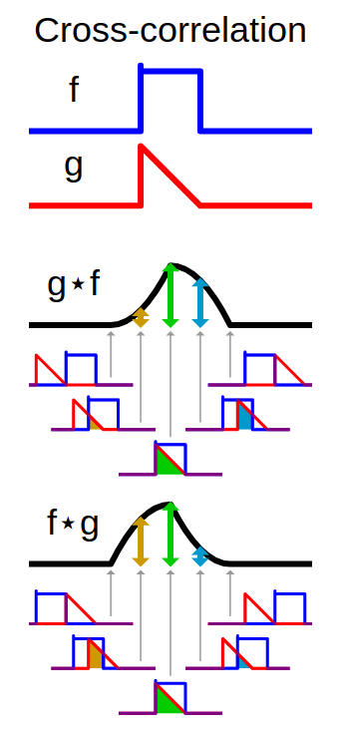




CROSS-CORRELATION
Sliding dot product of two functions - just like convolution
Acts as a measure of similarity, of overlap between two functions
Its value is directly proportional to the amount of overlap
The output photon streams can be treated as electromagnetic waves
We define first-order correlation as cross-correlation between the electric field amplitudes
Then we define second-order correlation as
cross-correlation between the intensities of the waves
For an SPS we expect
as at any instant the photon cannot
be at both outputs
ANTIBUNCHING:
Source: Wikipedia

Slide 12
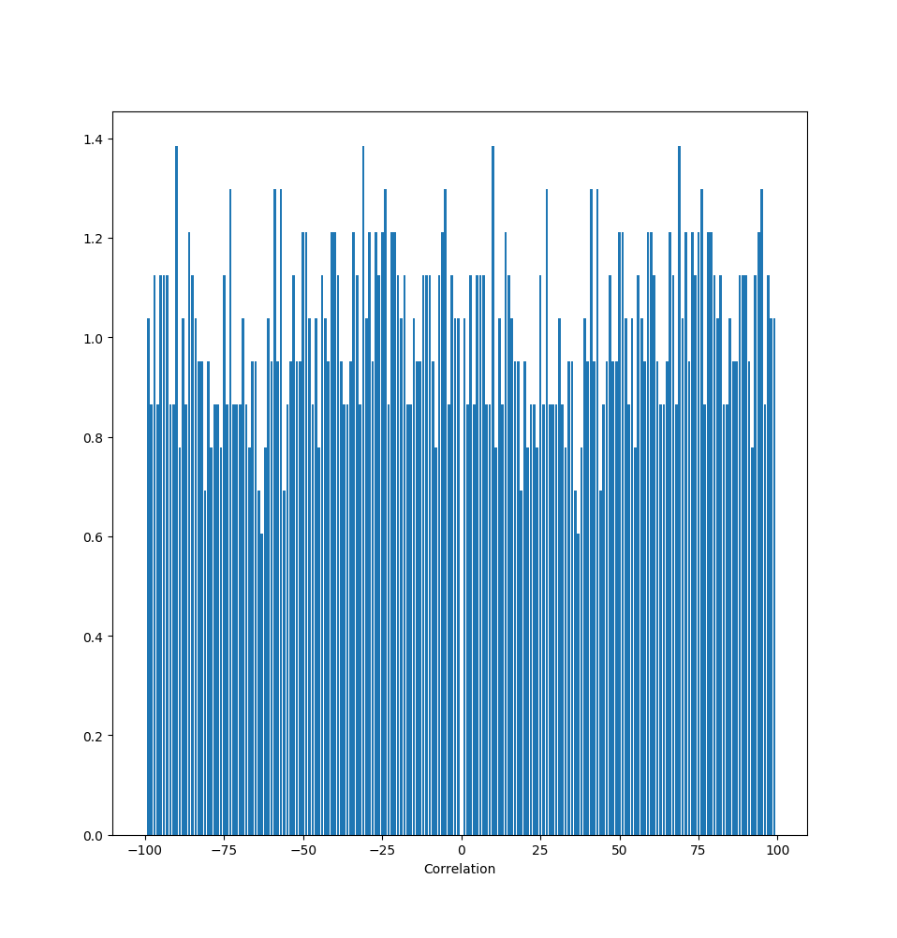



CALCULATING CORRELATION
INPUT - EXPONENTIAL DISTRIBUTION
Intensity is directly proportional to square of electric field
Using we get
The number distributions are what we get as outputs - put them in

Slide 13
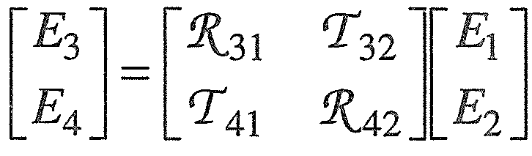
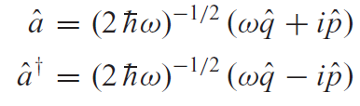
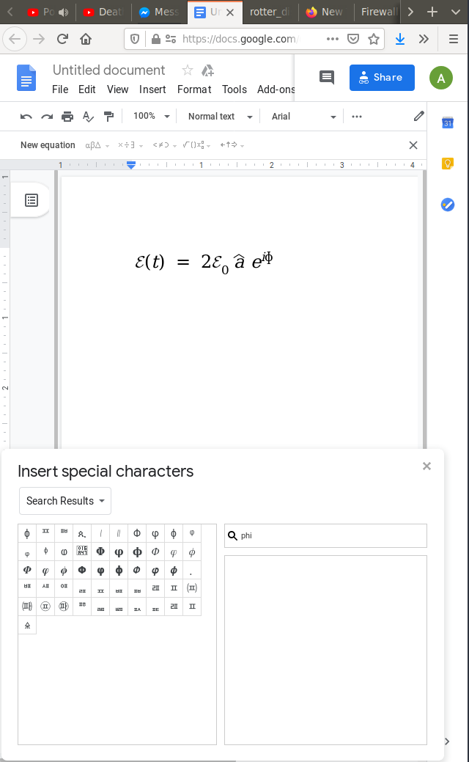



BEAM SPLITTER OPERATOR
This matrix is called the beam splitter matrix. R and T respectively denote the reflectance and the transmittance of the splitter.
Equating the incoming energy with the outgoing energy and then the real and the imaginary parts, we get
which makes the matrix unitary
The hamiltonian of the system comes out to be
Thus we can define our creation and annihilation operators as
For an electric field of the form ,
the operator B comes out to be
where
Ref: Quantum Theory Of Light, Gerry and Knight

Slide 14
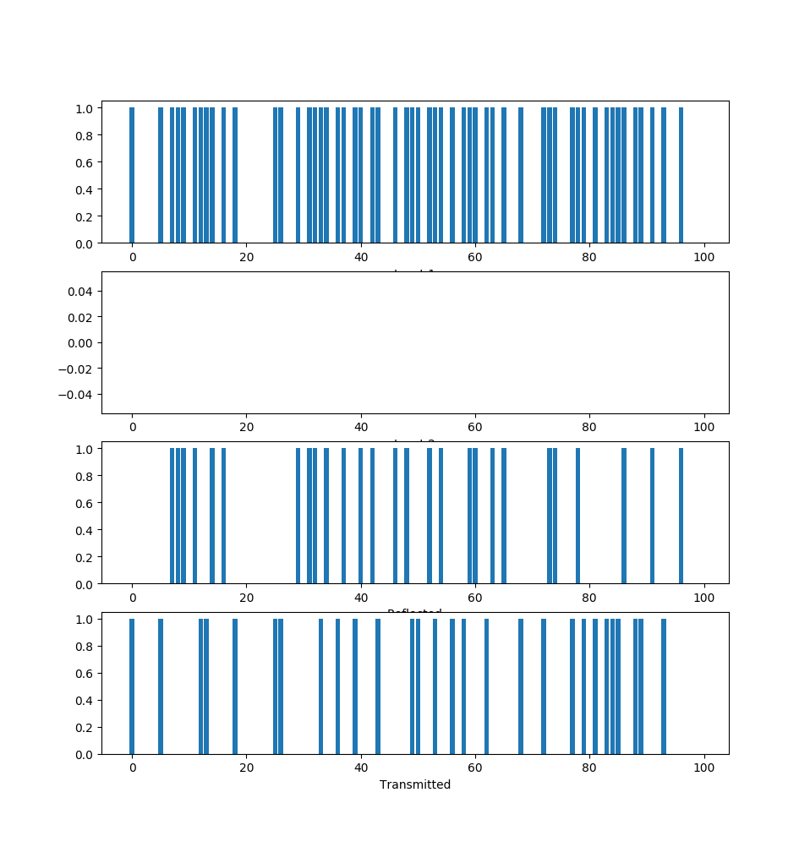
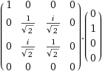

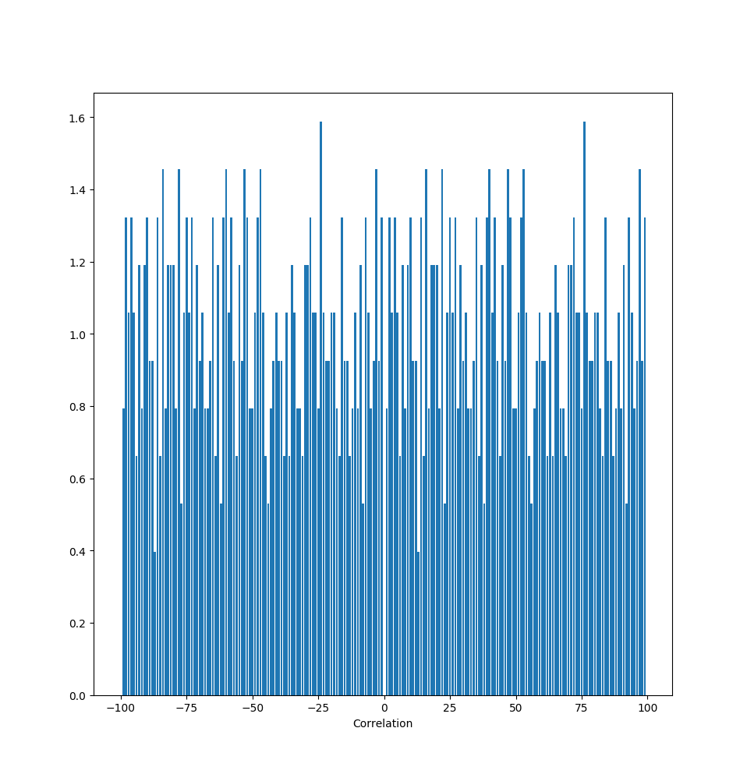
ONE SINGLE PHOTON INPUT
INPUT - UNIFORM DISTRIBUTION
Output as seen previously
Equal probability for |0,1> and |1,0>
Both states out of phase
Antibunching
CORRELATION

Slide 15
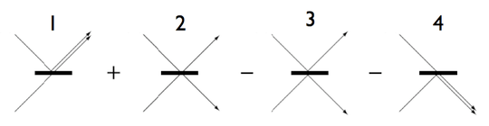
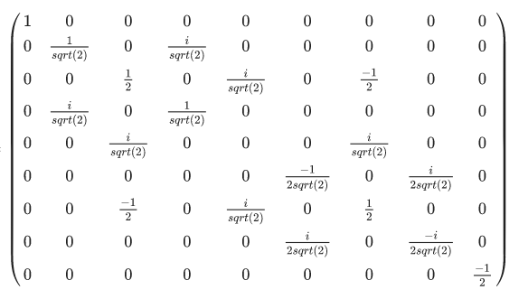


TWO SINGLE PHOTON INPUTS - HONG-OU-MANDEL EFFECT
Ref: Wikipedia
Two photons may enter together
Four possibilities
Excitation is possible
Possibilities 2 and 3 are never actually observed
Their probabilities are zero
Both photons will always exit in the same mode.
Outputs antibunched

Slide 16
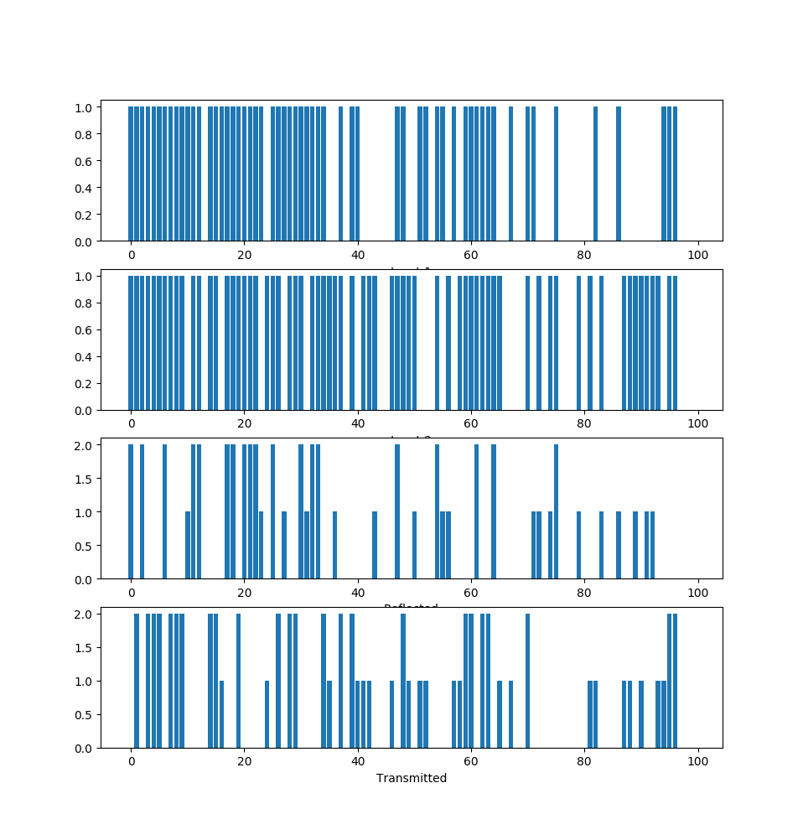
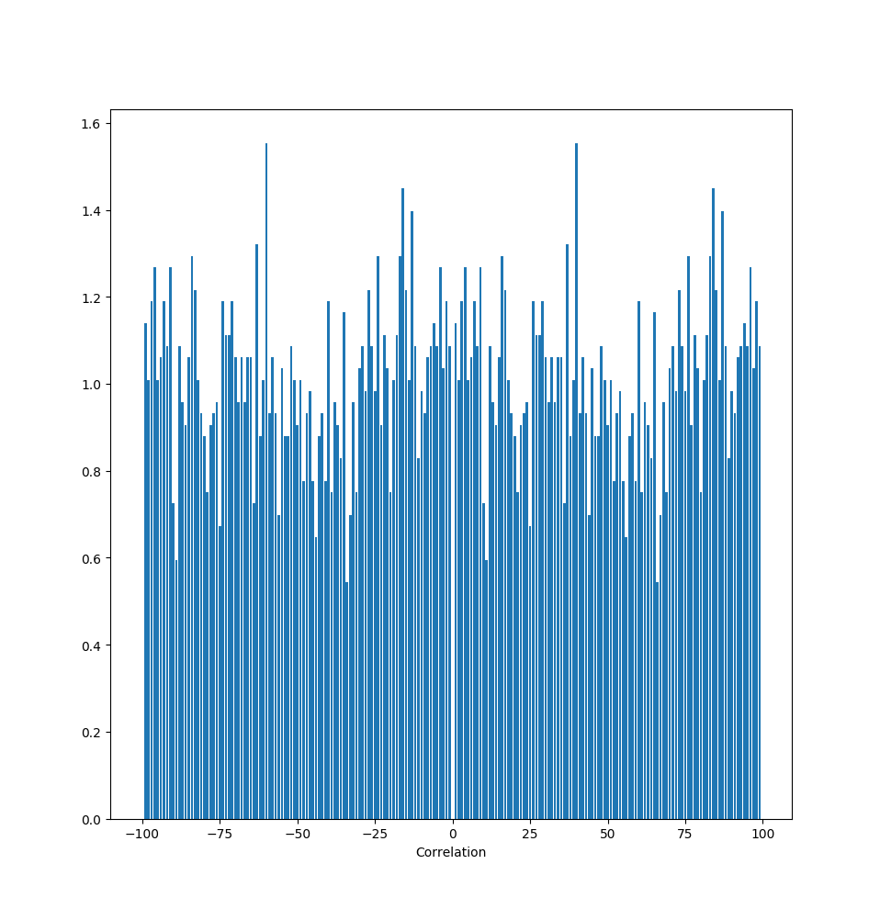
INPUT - EXPONENTIAL DISTRIBUTION
CORRELATION

Slide 17
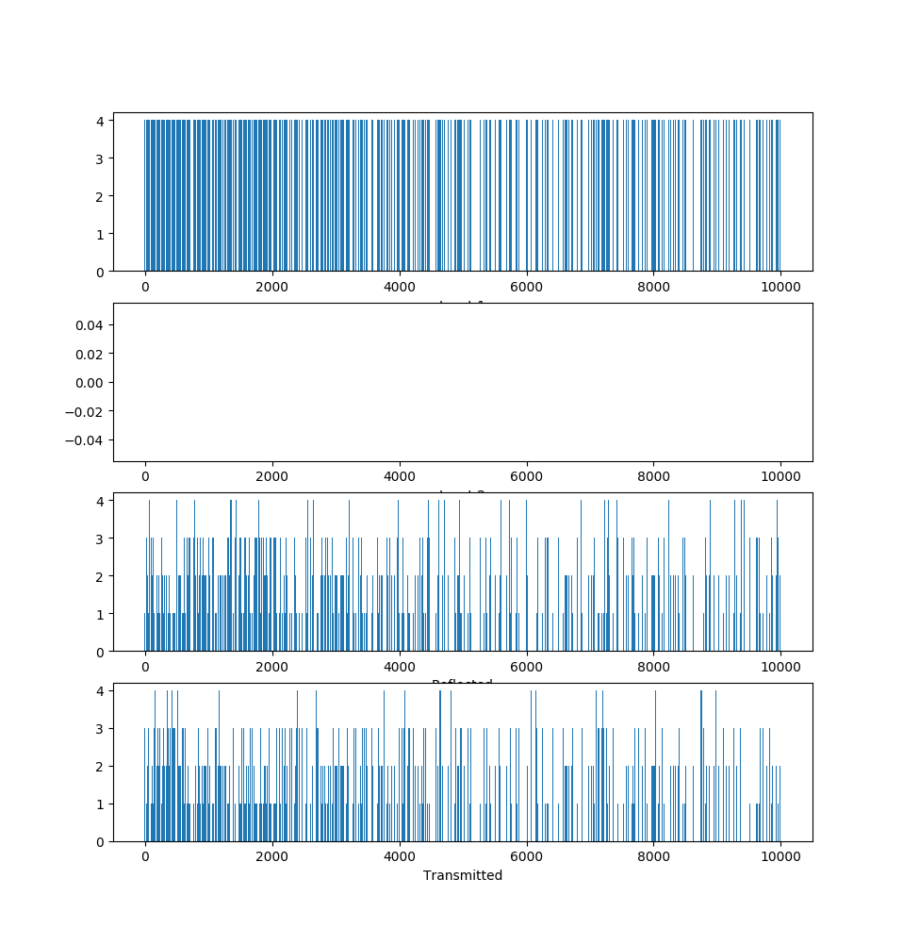
n-PHOTON INPUT
INPUT - UNIFORM DISTRIBUTION, n = 4
n photons can leave through either output in n ways
Probability depends on operator elements
Turns out to be Poisson distribution
No. of photons is conserved
Evidently antibunching absent

Slide 18
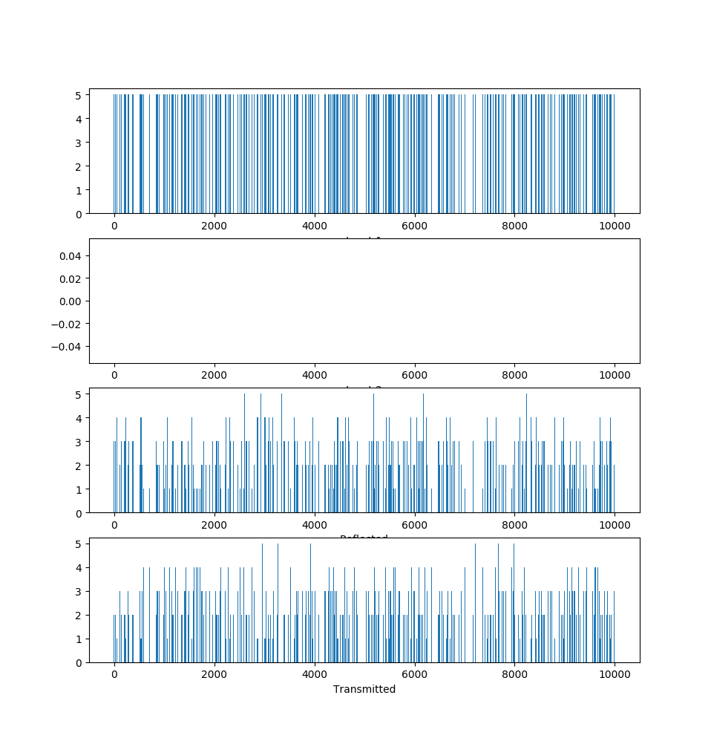
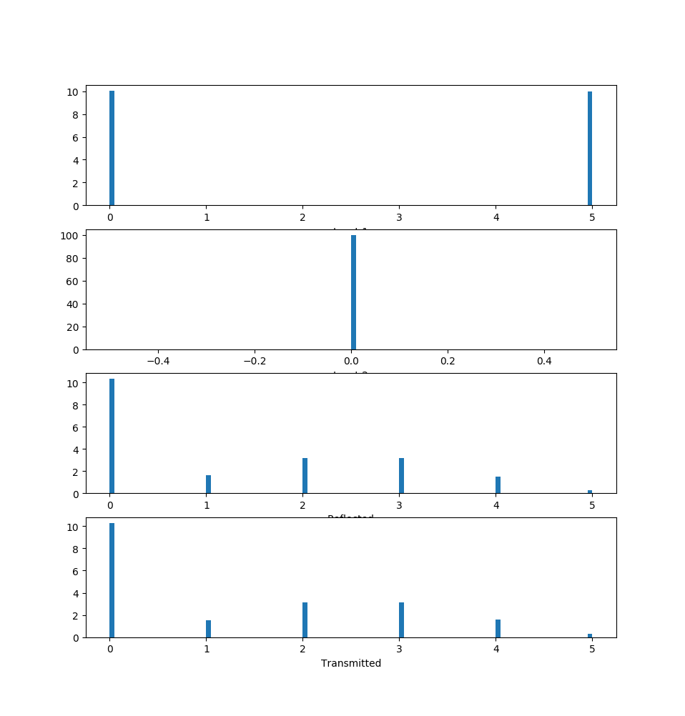
INPUT - UNIFORM DISTRIBUTION, n = 5
HISTOGRAM

Slide 19
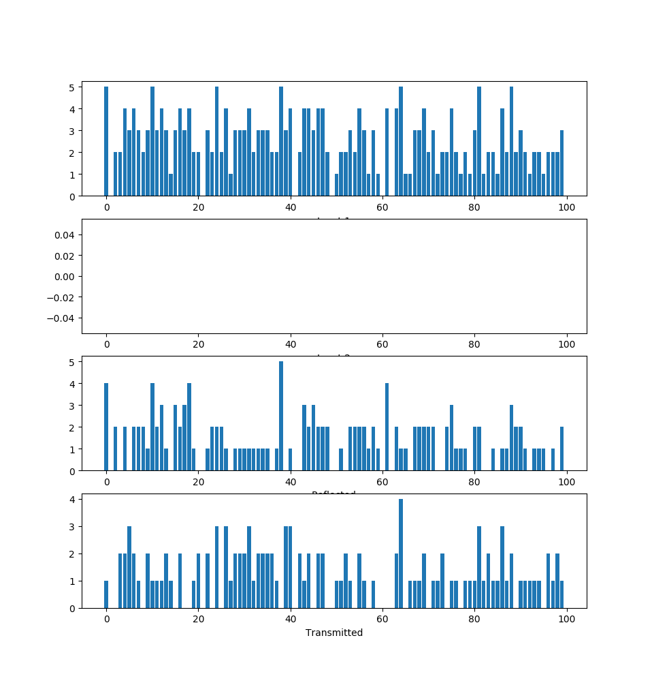



COHERENT STATE INPUT
6 STATES ALLOWED, N = 3
Laser model
Mixture of all eigenstates
Poisson probability distribution
Outputs have Poisson distribution
Peak is shifted to a lower state
No antibunching observed
Uniform second-order correlation

Slide 20
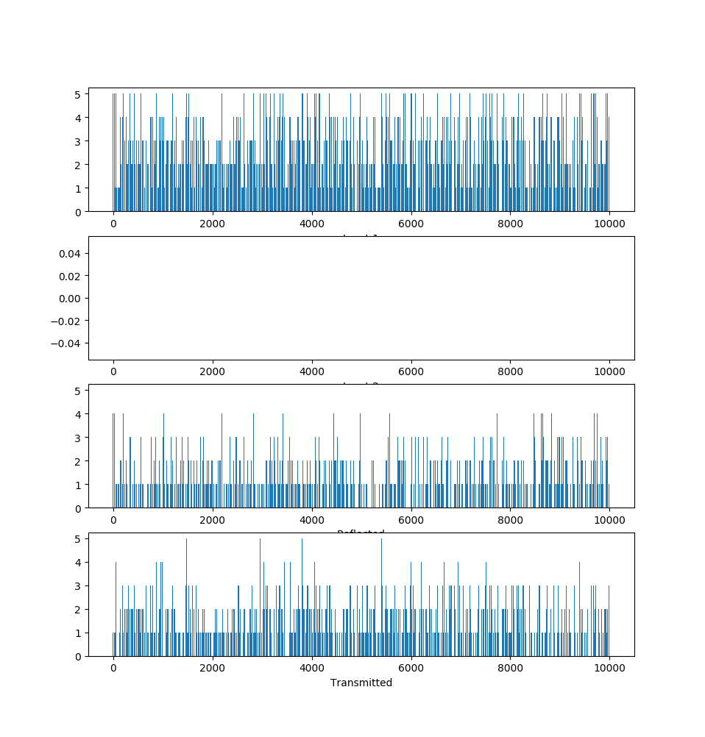
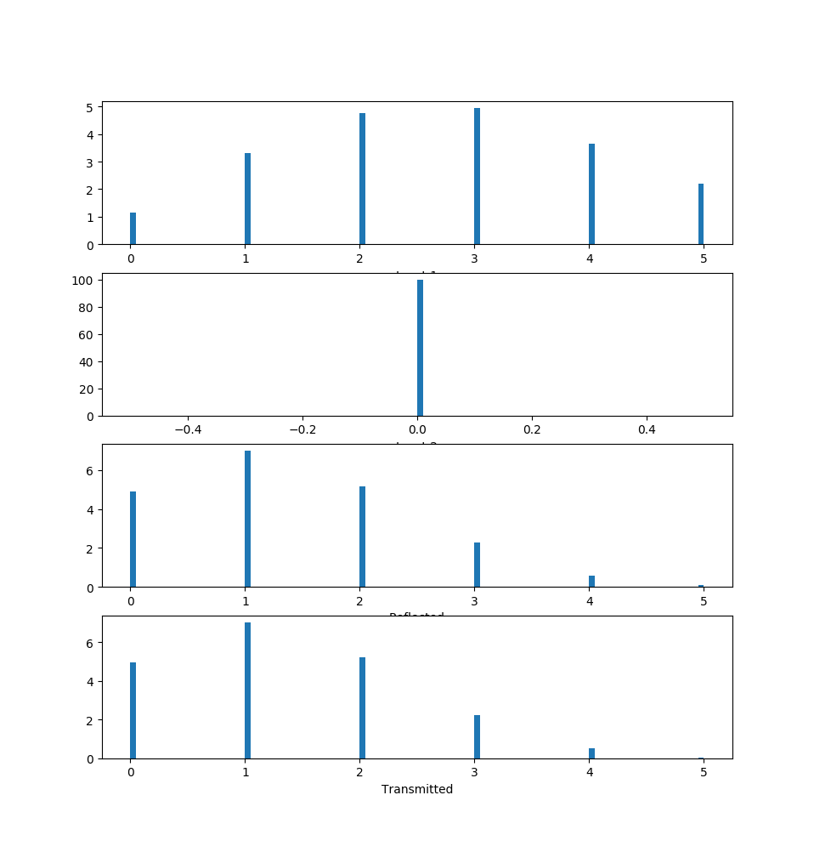
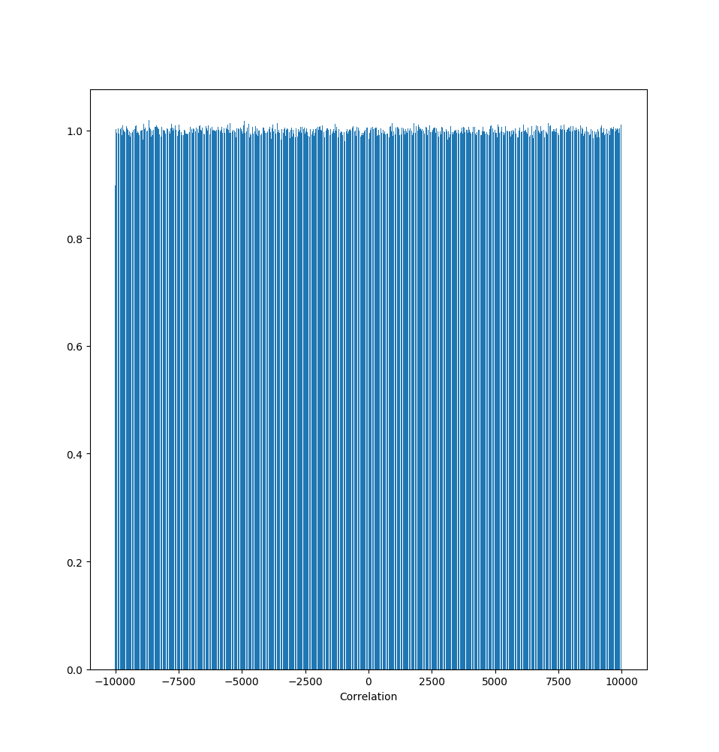
HISTOGRAM
6 STATES ALLOWED, N = 3
CORRELATION

