Slide 1
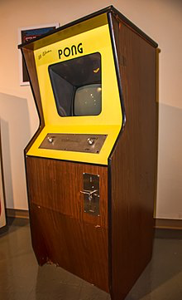
PONG
With a dash of AI

Slide 2
Overview
Problem Statement
Project Goals
The Implementation
Demo

Slide 3
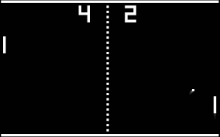
The Problem Statement
Something Just Like This
To build a python-based app
from scratch that plays pong
Interfaces:
Player vs Player
Player vs Computer

Slide 4
Project Goals
Build a GUI
Create the game interface
Create AI models
Train the AI models

Slide 5
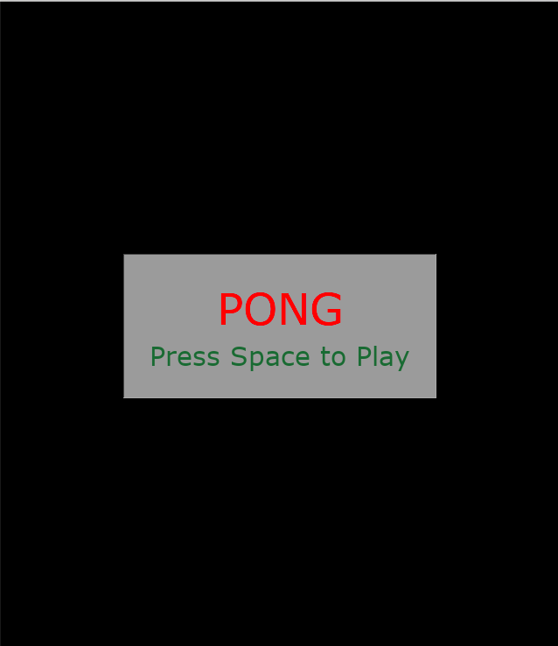
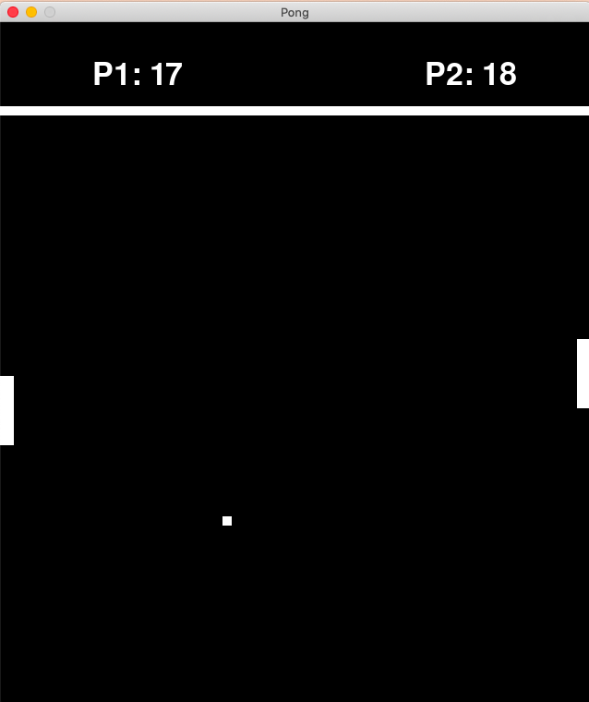
The Implementation

Slide 6
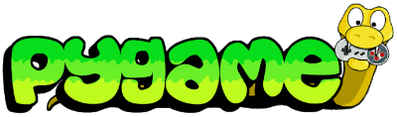
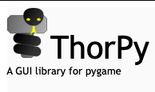
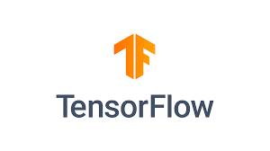

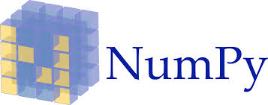
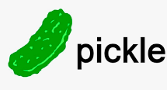
LIBRARIES
os
shutil
random
sys
math
importlib

Slide 7
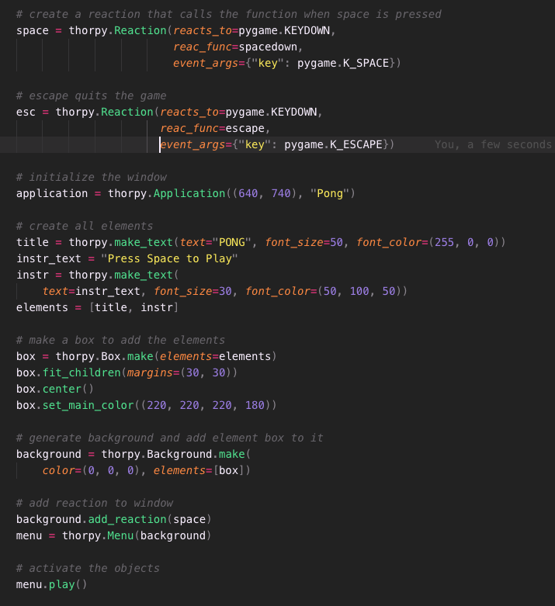
Building the GUI
Reactions, text, buttons
added using Thorpy

Slide 8
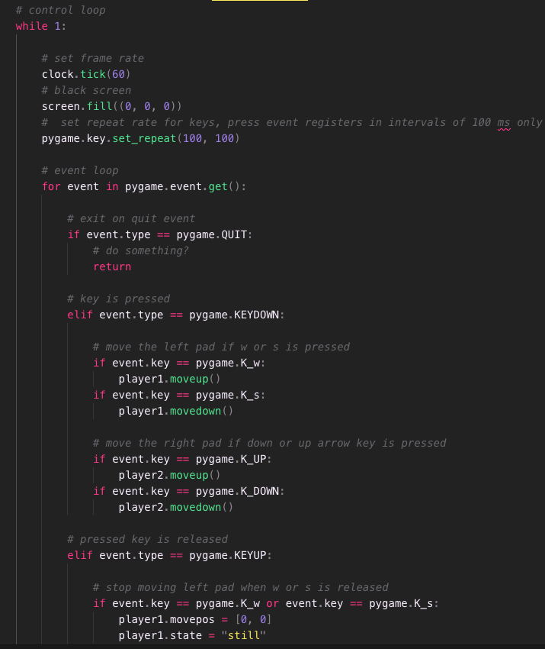
Creating the game interface
Key events, moving objects using Pygame

Slide 9
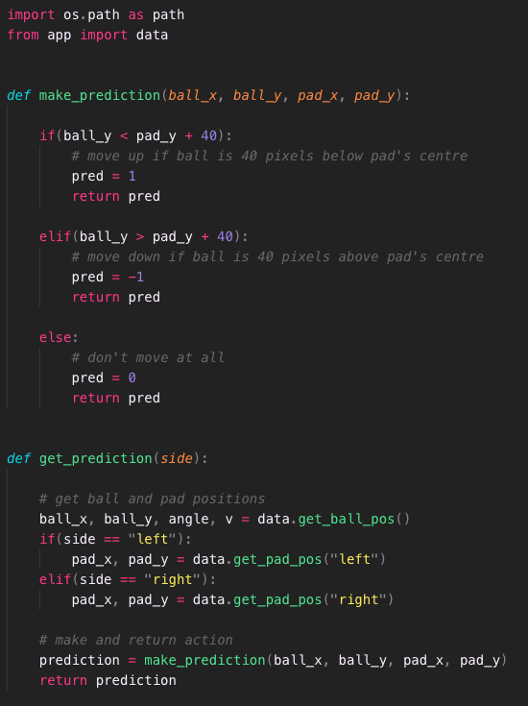
Creating the AI models
5 Models:
Random movement
2 Ball following
2 RL based

Slide 10
Reinforcement Learning
Teaching the AI how to play by rewarding it for the correct action
Can be done using different algorithms: Policy Gradients, Q-Learning
Policy Gradients:
Start with random actions
Play a few games
Collect rewards
Modify actions to maximize reward
Repeat

Slide 11

Training the AI models
Train the RL based AI models using the other AI models or with the player

Slide 12
DEMO

Slide 13
Next Steps
More training
More models
Convert to executables for smooth distribution across all systems

Slide 14


Slide 15
Questions?

