Slide 1
PGRKAM Smart Assistant: An LLM-Powered Conversational Platform for Job Seekers
CSE7101- Capstone Project
Review-5
Batch Number: CAI_36
Under the Supervision of,
Mr. Jai Kumar B
Assistant Professor
School of Computer Science and Engineering
Presidency University
Roll Number | Student Name
20221CAI0042 | ASHWIN R
20221CAI0026 | SACHIN S
20221CAI0017 | HARSHIT B
Name of the Program: B.Tech CAI
Name of the HoD: Dr. Zafar Ali Khan N
Name of the Program Project Coordinator: Ms. Suma N G
Name of the School Project Coordinators: Dr. Sampath A K , Dr. Geetha A

Slide 2
Organization Background
Name : “Punjab Ghar Ghar Rozgar (PGRKAM)”
Government initiative to:
Provide employment services
Spread awareness of schemes
Support skill development in Punjab

Slide 3
Problem Statement Number: PSCS_17
Organization: “Government of Punjab”
Category (Hardware / Software / Both) : “Software”
Problem Description: “The Employment Department at present has a digital platform www.pgrkam.com and its mobile application to provide almost all services offered to job seekers and employers through digital means. The portal has multiple modules like private sector jobs, government jobs, self-employment avenues, foreign jobs, foreign study, counseling, guidance, induction into armed forces, job melas, etc. Currently, when a user visits the portal/app, there is no hand-holding mechanism to help the user get to the part of the digital platform which will resolve his queries. The user is required to navigate across multiple modules on the portal/ app to search for answers.”

Slide 4
Problem Statement Number: PSCS_17
In summary:
Job & scheme data is scattered and difficult to search
Mostly available in English
Rural users face language & digital barriers
No voice-enabled conversational assistant available

Slide 5
Objectives
Build an AI-powered multilingual chatbot
Provide govt & private job search
Support English & Punjabi
Text + Voice interaction
Use RAG for accuracy

Slide 6
Key Features
Multilingual Chat
Automatic Translation
Voice Input
Job Search
Scheme Information
RAG Architecture
Real-time Chat

Slide 7
Technology Stack
Frontend: React, TypeScript, Vite, Tailwind CSS
Backend: FastAPI (Python)
AI Services: Sarvam AI
Database: MongoDB
Vector DB: ChromaDB
Search: Hybrid Search(BM25 + Dense)

Slide 8
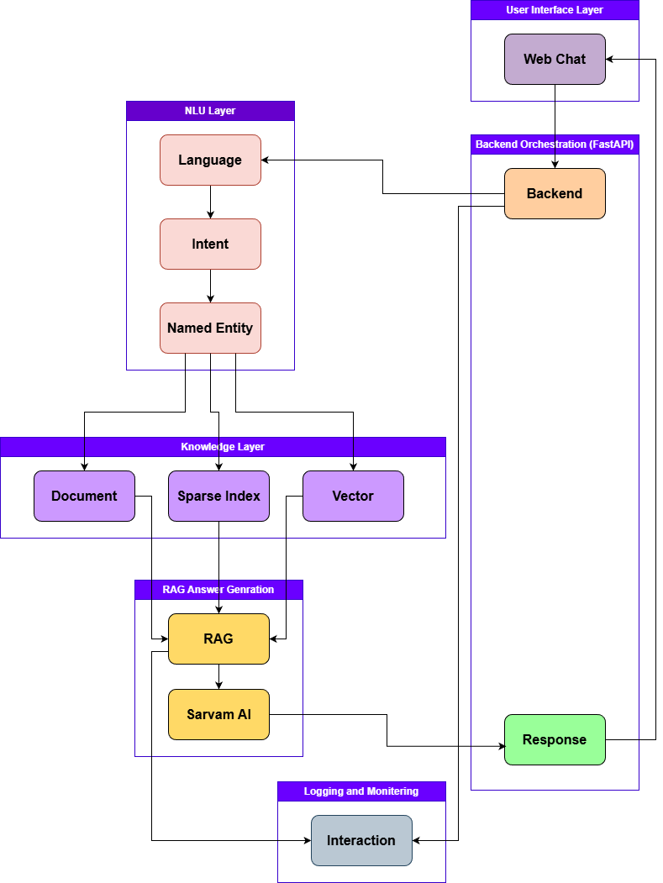
Architecture Diagram

Slide 9
RAG Workflow
Query → Embedding
Vector Search in ChromaDB
Keyword Filtering
Relevant Docs Retrieved
Final AI Response Generated

Slide 10
Multilingual & Voice Processing
English & Punjabi support
Punjabi speech-to-text
Automatic translation
Responses returned in user language

Slide 11
API Design
Endpoint: POST /chat
Input: message, language, session ID, history
Output: response, intent, time, timestamp

Slide 12
Project Structure
backend/app/api → Routes
backend/app/nlu → Intent & Entity
backend/app/rag → Retriever & Generator
chatbot-ui/web → UI
start scripts

Slide 13
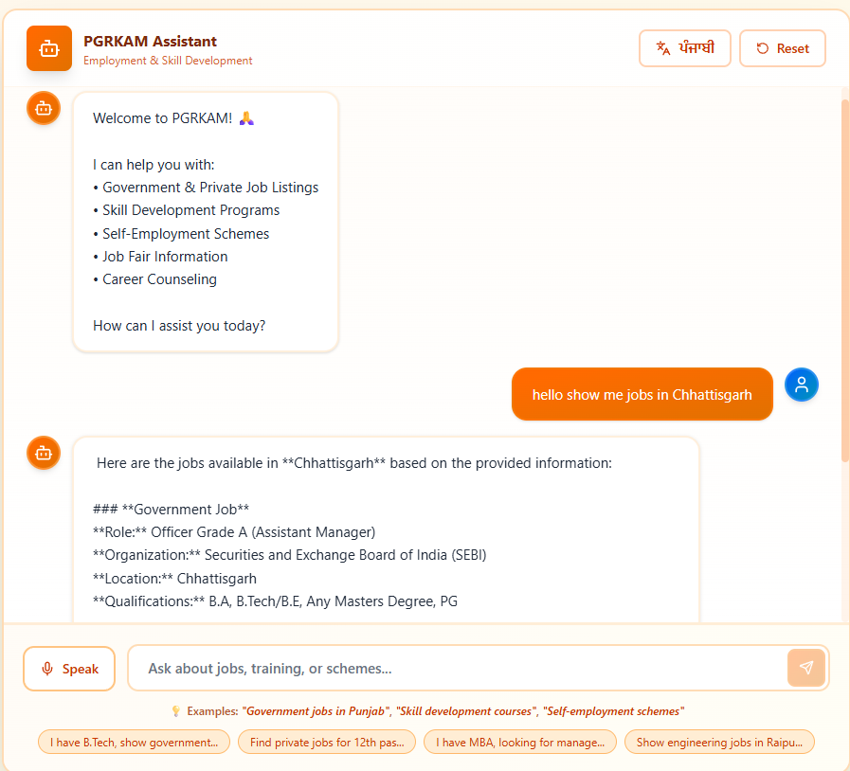
Results observed
Multilingual chatbot working
Accurate job & scheme search
Voice input working
Frontend-Backend integrated

Slide 14
Challenges Faced
Punjabi language handling
API integration
RAG optimization
Vector tuning
Synchronization

Slide 15
Conclusion
Multilingual voice-enabled chatbot built
Uses RAG for accuracy
Highly useful for Punjab employment ecosystem
Github Link: https://github.com/ashwin2947/PGRKAM-Smart-Assistant

Slide 16


