Slide 1
PGRKAM Smart Assistant: An LLM-Powered Conversational Platform for Job Seekers
CSE7101- Capstone Project
Review-2
Batch Number: CAI_36
Under the Supervision of,
Mr. Jai Kumar B
Assistant Professor
School of Computer Science and Engineering
Presidency University
Roll Number | Student Name
20221CAI0042 | ASHWIN R
20221CAI0026 | SACHIN S
20221CAI0017 | HARSHIT B
Name of the Program: B.Tech CAI
Name of the HoD: Dr. Zafar Ali Khan N
Name of the Program Project Coordinator: Dr. Afroz Pasha
Name of the School Project Coordinators: Dr. Sampath A K , Dr. Geetha A

Slide 2
Problem Statement Number: PSCS_17
Organization: “Government of Punjab”
Category (Hardware / Software / Both) : “Software”
Problem Description: “The Employment Department at present has a digital platform www.pgrkam.com and its mobile application to provide almost all services offered to job seekers and employers through digital means. The portal has multiple modules like private sector jobs, government jobs, self-employment avenues, foreign jobs, foreign study, counseling, guidance, induction into armed forces, job melas, etc. Currently, when a user visits the portal/app, there is no hand-holding mechanism to help the user get to the part of the digital platform which will resolve his queries. The user is required to navigate across multiple modules on the portal/ app to search for answers.”

Slide 3
Abstract
The PGRKAM platform lacks an effective guidance system, making it difficult for users to find job notifications, skill programs, and career resources. This project develops an AI-powered conversational assistant to provide intelligent, task-oriented guidance. Using LLMs with retrieval-augmented generation (RAG), the system delivers accurate, context-aware, and multilingual responses. The assistant integrates intent recognition, entity extraction, dialogue management, and knowledge retrieval to streamline information discovery and enhance user experience.

Slide 4
Literature Survey
Overview
This section reviews existing research relevant to building intelligent conversational agents for government job portals. The focus is on document understanding, information retrieval, dialogue management, multilingual processing, and privacy—each addressing specific challenges in delivering accurate, accessible, and trustworthy services to citizens.
1. Document Understanding for Job Notifications
Research on layout-aware document models (LayoutLM, TILT).
Importance of OCR + table extraction for structured data from scanned PDFs.
Gap: most job notices are low-quality scans requiring robust preprocessing.

Slide 5
Literature Survey
2. Information Retrieval and Retrieval-Augmented Generation
Dense Passage Retrieval (DPR) and ColBERT for semantic matching.
RAG framework combining retrieval + generation to reduce hallucinations.
Application: answering user queries with precise, source-backed content.
3. Task-Oriented Dialogue and State Tracking
MultiWOZ dataset as benchmark for multi-domain dialogue systems.
Dialogue state tracking methods for intent slots (e.g., job role, deadline).
Application: enabling multi-turn flows like “Check eligibility → Apply → Track status.”

Slide 6
Literature Survey
4. Intent Classification and Entity Recognition
Transformer-based joint intent + slot filling models.
NER for extracting job titles, dates, qualifications, and departments.
Application: mapping user free-text queries into structured system actions.
5. Question Answering Across Multiple Notices
Extractive QA methods (SQuAD) vs. multi-hop QA (HotpotQA).
Need to consolidate conflicting or scattered job information.
Application: user asks “How many vacancies are open in Police Department 2025?”

Slide 7
Literature Survey
6. Multilingual and Code-Switched Queries
XLM-R and cross-lingual embeddings for multi-language handling.
Code-switching challenges in Indian contexts (English + regional languages).
Application: user query like “Punjab Police ki last date kya hai?”
7. Privacy, Explainability, and Human-in-the-Loop Approaches
Differential privacy for protecting user PII.
Provenance and explainability (showing document sources).
Active learning for iterative improvements from real user queries.

Slide 8
Literature Survey
Summary of Gaps and Relevance
While prior research provides strong foundations in retrieval, dialogue, and document understanding, few studies apply these techniques directly to government employment portals. Our approach builds on these methods, emphasizing factual accuracy, multilingual support, and explainability—key for citizen trust in e-governance systems.

Slide 9
Content
Problem Statement
The current PGRKAM digital platform lacks an effective intelligent guidance system, forcing users to manually navigate multiple modules to locate information. This leads to poor user experience, inefficiency, and increased cognitive load. The platform does not provide a conversational interface that can assist users in real time, understand natural language queries (including multilingual and code-switched inputs), and streamline the discovery of relevant details about government jobs, skill development, or foreign counseling. Consequently, users spend excessive time and effort searching for information, highlighting the need for an AI-driven, interactive solution.
Goal:
Develop an AI-driven conversational assistant for the PGRKAM portal to improve user experience, efficiency, and accessibility.

Slide 10
Objectives
Intelligent Information Retrieval:
Implement a hybrid search system combining semantic embeddings and keyword-based search to retrieve accurate and relevant information from job notices, skill development modules, and foreign counseling resources.
Conversational Guidance (Interactive Chatbot):
Design a multi-turn dialogue system that maintains context, understands natural language queries (including multilingual and code-switched inputs), and guides users through tasks such as job application tracking or resource discovery.
Task-Oriented Assistance:
Enable users to complete goal-directed tasks efficiently, such as finding deadlines, eligibility criteria, or skill programs, reducing manual navigation across portal modules.

Slide 11
Objectives
4. Explainability and Provenance:
Provide transparent responses with references to source documents or official notifications, ensuring user trust and compliance with government standards.
5. Continuous Learning & Improvement:
Integrate a feedback loop where user interactions are logged (without compromising privacy) to improve retrieval accuracy, intent classification, and dialogue fluency over time.

Slide 12
Background and Related work for title Selection
The title, “PGRKAM Smart Assistant: An LLM-Powered Conversational Platform for Job Seekers” was carefully chosen to reflect both the technological foundation and the practical purpose of the project.
Platform Context (PGRKAM): The project focuses on the PGRKAM digital platform, a government portal for job seekers, skill development, and career guidance. The inclusion of the platform name emphasizes the domain-specific applicability of the solution.
Core Technology (LLM-Powered): The system leverages Large Language Models (LLMs), enabling natural language understanding, contextual dialogue management, and retrieval-augmented generation (RAG). This highlights the project’s reliance on state-of-the-art AI research for conversational interfaces.
Purpose (Conversational Platform for Job Seekers): The solution is designed to provide task-oriented guidance, streamline information discovery, and enhance user experience for individuals navigating complex government resources.

Slide 13
Background and Related work for title Selection
Relation to Existing Work:
The title situates the project within current trends in AI-powered public service assistants, distinguishing it from traditional rule-based chatbots or general-purpose AI assistants like Siri and Alexa.
It also reflects insights from prior research on domain-specific, multilingual, and task-oriented conversational agents, which emphasize accuracy, personalization, and accessibility for users in specialized domains.

Slide 14
Related works
Rule-Based Chatbots
Early FAQ or scripted bots.
Limitations: cannot handle multi-turn dialogues or unseen queries.
AI Assistants (Siri, Alexa, Google Assistant)
General-purpose conversational AI.
Limitations: not domain-specific, may provide inaccurate answers for specialized content.
Large Language Models (GPT-3, GPT-4, LLaMA)
Human-like responses, summarization, semantic understanding.
Limitations: hallucinations; need grounding in official documents.

Slide 15
Related Works
4. Domain-Specific Job/Recruitment Chatbots
Task-oriented systems for applications, eligibility, notifications.
Limitations: often lack multilingual support and structured document integration.
5. Document Understanding + QA Systems
Models like LayoutLM, TILT, DPR, ColBERT.
Enable retrieval of structured info from PDFs, tables, notices.

Slide 16
Existing Methods and Drawbacks
Intelligent Search and Filtering
  Description: Uses advanced search algorithms and AI-powered filters to help users locate relevant information quickly.
  Drawbacks:
    Irrelevant matches due to ambiguous queries.
    Inadequate personalization—cannot adapt to a user’s preferences or prior searches.
Interactive Chatbots and Virtual Assistants
  Description: Conversational systems provide “hand-holding” by guiding users through tasks via natural dialogue.
  Drawbacks:
    Limited scope—may not cover all portal functionalities or updates.
    Poor user experience if responses are inaccurate or ungrounded in official sources.

Slide 17
Existing Methods and Drawbacks
Personalized Dashboards and Recommendations
  Description: Uses user profiles, past searches, or saved jobs to create a tailored interface.
  Drawbacks:
    Privacy concerns due to storage of personal data.
    Data fragmentation—insights are often scattered across modules, reducing effectiveness.
Career Guidance and Upskilling Tools
  Description: Provides skill assessments and suggests learning pathways or courses to improve employability.
  Drawbacks:
    Cost and accessibility—many tools are paid or require internet connectivity.
    Lack of standardization—recommendations may vary in quality and credibility.

Slide 18
Proposed Method
Proposed Method: “ AI-Powered Conversational Assistant ”
The proposed solution for the PGRKAM digital platform is an AI-powered Conversational Assistant (chatbot) designed to provide intelligent guidance to users. Key features include:
Natural Language Understanding (NLU):
  The assistant uses NLP and machine learning to comprehend user queries in free-form, multilingual, or code-switched language.
  This allows users to ask questions naturally without needing to know specific keywords or menu structures.
Retrieval-Augmented Generation (RAG):
  Combines document retrieval from official notices, skill modules, and career resources with LLM-based response generation.
  Ensures that responses are accurate, factual, and grounded in verified sources, addressing the hallucination problem of generic LLMs.

Slide 19
Proposed Method
Task-Oriented Guidance:
  Supports users in performing tasks such as finding deadlines, checking eligibility, tracking applications, or discovering skill programs.
  Reduces the need for manual navigation, improving efficiency and user experience.
Personalization & Context Management:
  Maintains conversation context and leverages user history/preferences (without compromising privacy) to provide relevant recommendations.
Feedback-Driven Learning:
  Integrates a feedback loop to continually improve accuracy, intent recognition, and response relevance based on real user interactions.

Slide 20
Feasibility Study
Justification:
Implementing a conversational AI assistant addresses the core challenges of the PGRKAM platform:
Enhanced User Experience: Users receive personalized, real-time guidance, reducing the need for manual navigation across multiple modules.
Improved Efficiency: Automated responses streamline information retrieval, saving users time and effort.
Scalability: AI assistants can handle a large volume of queries simultaneously, ensuring consistent service availability.
These benefits align with findings from various studies highlighting the effectiveness of AI assistants in public service platforms.

Slide 21
Feasibility Study
Technology Feasibility:
Key technologies essential for the AI assistant include:
Intent Recognition: Enables the system to understand user queries and determine the appropriate response.
Entity Extraction: Identifies specific data points within user inputs, such as job titles or deadlines.
Dialogue Management: Manages the flow of conversation, ensuring context is maintained throughout interactions.
These technologies are foundational in creating a responsive and intelligent assistant capable of handling diverse user queries effectively.

Slide 22
Feasibility Study
Cost and Resource Feasibility:
Low-Cost Approach (Third-Party Platforms):
  Subscription-Based Models: Platforms like Convin.ai offer conversational AI services with pricing models ranging from $50 to $5,000 per month, depending on features and usage.
  Pay-As-You-Go Models: Some services charge approximately $0.006 per interaction, providing flexibility for varying usage volumes.
High-Cost Approach (Custom Development):
  Development Costs: Building a custom AI assistant can range from $75,000 to over $500,000, influenced by factors such as complexity, scalability, and customization.
  Ongoing Maintenance: Custom solutions require continuous updates and support, contributing to long-term costs.

Slide 23
Feasibility Study
Considering the budget constraints typical of government projects, a hybrid approach utilizing third-party platforms for core functionalities, supplemented by custom development for specialized features, may offer an optimal balance between cost and functionality.
Conclusion:
The implementation of an AI-powered conversational assistant for the PGRKAM platform is both technologically feasible and cost-effective. By leveraging existing AI technologies and adopting a hybrid development approach, the platform can significantly enhance user experience, improve operational efficiency, and ensure scalability to meet future demands.

Slide 24
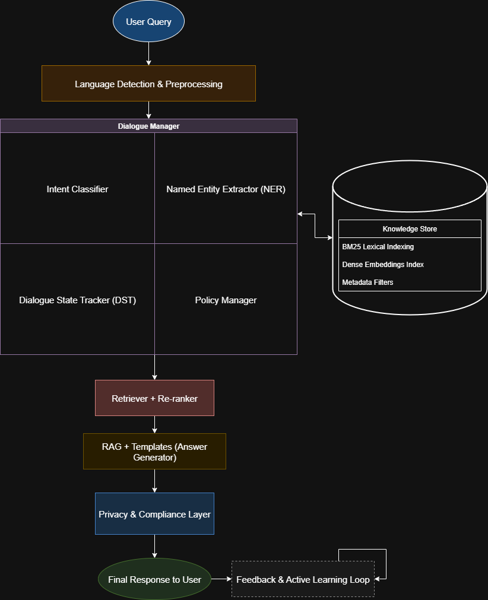
Architecture Diagram

Slide 25
Modules
Module Name | Core Functionality
Private Sector Jobs | Listing and application portal for jobs in private companies.
Government Jobs | Provides information and application links for public sector and government positions.
Self-Employment Avenues | Offers resources and guidance for users interested in starting their own businesses.
Foreign Jobs | Details and application processes for employment opportunities abroad.
Foreign Study | Information related to international educational opportunities and courses.

Slide 26
Software and Hardware Requirements
Software:
Programming Languages:
  Python: For AI model integration, NLP processing, and backend logic.
  JavaScript / TypeScript: For frontend development and interactivity.
Web Frameworks:
  Flask or FastAPI: Lightweight frameworks for API development and backend services.
AI / NLP Components:
  LLM API: GPT-3, GPT-4, or LLaMA for language understanding and response generation.
  Retrieval Tools: BM25 or vector-based search libraries (e.g., FAISS, Pinecone) for document retrieval.
  NLP Libraries: spaCy, NLTK, or Hugging Face Transformers for entity extraction, intent recognition, and preprocessing.

Slide 27
Software and Hardware Requirements
Database and Storage:
  MongoDB / PostgreSQL: To store structured and unstructured data, user sessions, and logs.
  Optional: Vector databases for embeddings storage (e.g., Pinecone, Weaviate).
Version Control & Collaboration:
  Git / GitHub / GitLab: For source control, collaboration, and CI/CD pipelines.
Other Tools:
  Docker: For containerization and easier deployment.
  Cloud Platforms: AWS, GCP, or Azure for hosting, scalability, and GPU access.

Slide 28
Software and Hardware Requirements
Hardware Requirements:
Development Machines:
  Standard laptops/desktops with 8–16 GB RAM, modern CPU, and internet access for testing and development.
Server / Deployment Requirements:
  Cloud-based server with sufficient CPU cores (4–8 cores recommended) and 16–32 GB RAM for backend and API hosting.
  GPU (Optional but recommended): NVIDIA GPU with at least 8–16 GB VRAM for running embedding models, fine-tuning, or local LLM inference.
Storage:
  Sufficient disk space for logs, user data, PDFs, and embeddings, typically 100 GB+ depending on dataset size.

Slide 29
Github Link
Github Link:
https://github.com/ashwin2947/PGRKAM-Smart-Assistant

Slide 30
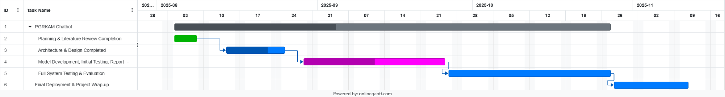
Timeline of the Project (Gantt Chart)

Slide 31
References (IEEE Paper format)
[1] Y. Xu et al., “LayoutLM: Pre-training of Text and Layout for Document Image Understanding,” ACL, 2020.
[2] T. Powalski et al., “Going Full-TILT Boogie on Document Understanding with Text-Image-Layout Transformer,” NAACL, 2021.
[3] M. Li et al., “TableBank: Table Benchmark for Image-based Table Detection and Recognition,” ICDAR, 2019.
[4] V. Karpukhin et al., “Dense Passage Retrieval for Open-Domain Question Answering,” EMNLP, 2020.
[5] P. Lewis et al., “Retrieval-Augmented Generation for Knowledge-Intensive NLP Tasks,” NeurIPS, 2020.
[6] O. Khattab and M. Zaharia, “ColBERT: Efficient and Effective Passage Search via Contextualized Late Interaction over BERT,” SIGIR, 2020.

Slide 32
References (IEEE Paper format)
[7] P. Budzianowski et al., “MultiWOZ: A Large-Scale Multi-Domain Wizard-of-Oz Dataset for Task-Oriented Dialogue Modelling,” EMNLP, 2018.
[8] C. Wu et al., “Transferable Multi-Domain State Generator for Task-Oriented Dialogue Systems,” ACL, 2019.
[9] Q. Chen et al., “BERT for Joint Intent Classification and Slot Filling,” NAACL, 2019.
[10] Y. Lin et al., “A Survey on Named Entity Recognition: From Deep Learning to Low-Resource Languages,” TACL, 2020.
[11] P. Rajpurkar et al., “SQuAD: 100,000+ Questions for Machine Comprehension of Text,” EMNLP, 2016.
[12] Z. Yang et al., “HotpotQA: A Dataset for Diverse, Explainable Multi-hop Question Answering,” EMNLP, 2018.

Slide 33
References (IEEE Paper format)
[13] A. Conneau et al., “Unsupervised Cross-lingual Representation Learning at Scale,” ACL, 2020.
[14] K. Bali et al., “Challenges in Code-Mixed Indian Social Media Text,” ICON Workshop, 2014.
[15] M. Lyu et al., “Differentially Private Language Models for Text Generation,” ICML, 2020.
[16] B. Settles, “Active Learning Literature Survey,” University of Wisconsin-Madison, Tech. Report, 2009.

Slide 34


