Slide 1
A Deep Learning-Based Computer Vision System for Livestock Breed Classification and Physical Trait Estimation
CSE7302- University Project
Review-1
Batch Number: CAI_26
Under the Supervision of,
Mr. Jai Kumar B
Assistant Professor
School of Computer Science and Engineering
Presidency University
Roll Number | Student Name
20221CAI0042 | ASHWIN R
20221CAI0026 | SACHIN S
20221CAI0017 | HARSHIT B
Name of the Program: B.Tech CAI
Name of the HoD: Dr. Zafar Ali Khan N
Name of the Program Project Coordinator: Dr. Afroz Pasha
Name of the School Project Coordinators: Dr. Sampath A K , Dr. Geetha A

Slide 2
Problem Statement Number: SIH25004
Organization: “Department of Animal Husbandry & Dairying, Government of India”
Category (Hardware / Software / Both) : “Software”
Problem Description: “Accurate identification of livestock breeds and assessment of physical traits are essential for effective livestock management, breeding programs, and maintaining national animal databases. Currently, this process is largely manual, relying on visual inspection by experts, which is time-consuming, subjective, and difficult to scale. The problem statement focuses on developing a software-based intelligent system that can automatically identify livestock breeds and analyze physical traits from images using modern artificial intelligence techniques.”

Slide 3
Content
Problem Statement
Automated, scalable, and reliable systems have yet to be developed that correctly identify livestock breeds or determine their physical characteristics from visual data. The existing manual methods are subject to human error, inconsistency, and high operating costs. This project is an attempt to create an automated, efficient, computer vision deep learning approach to classify livestock breeds from photographic images and derive other relevant physical characteristics.

Slide 4
Content
Objectives
The primary objectives of this project are:
To design and develop a deep learning based computer vision system for livestock breed classification.
To implement a multi-task learning framework that simultaneously performs breed classification and physical trait estimation.
To evaluate and compare different transfer learning models for performance and efficiency.
To integrate explainable AI techniques to interpret and visualize model predictions.
To provide a scalable and deployable software solution aligned with government and agricultural use cases.

Slide 5
Content
Background and Related work for title Selection
The identification of breeds and phenotype evaluation of livestock is essential for the development of efficient breeding practices, the assessment of livestock productivity, and the maintenance of national livestock databases. Currently, there is a heavy reliance on manual, human experts to perform these tasks through visual inspection of animals. Unfortunately, this method is inefficient (time-consuming), subjective, and challenging to implement across large numbers of livestock. Additionally, inconsistencies and errors can occur when using manual methods due to the volume and variability of data collected.

Slide 6
Content
Background and Related work for title Selection
The emergence of deep learning and computer vision methods, especially convolutional neural networks (CNNs), has allowed for the successful application of these techniques to numerous classification problems using images with very high levels of accuracy. Utilizing this technology will enable automatic, accurate, and scalable classifications of livestock by breed, while also producing estimates of key phenotypes based on imagery of livestock. Thus, the title “A Deep Learning-Based Computer Vision System for Livestock Breed Classification and Physical Trait Estimation” exemplifies the desire to supersede traditional manual methods currently in use, with an automated intelligent system using image-based inputs which is consistent with emerging research and meeting the requirements of the agricultural community.

Slide 7
Content
Related Work:
Several research studies have explored animal classification using computer vision techniques:
CNN-based models have been used for animal species classification, demonstrating high accuracy with transfer learning.
Some studies have applied deep learning for cattle identification, focusing mainly on single-task breed classification.
Limited works have explored physical trait estimation or explainable AI in livestock applications.
However, most existing works lack:
Multi-task learning approaches
Explainability mechanisms
Comparative evaluation of multiple deep learning architectures
This project aims to bridge these gaps.

Slide 8
Analysis of Problem Statement
Technology Stack Components:
Machine Learning & Computer Vision
Python
Deep Learning Framework: PyTorch / TensorFlow
CNN Architectures: ResNet, EfficientNet, MobileNet
OpenCV for image preprocessing
Backend
FastAPI for inference APIs
RESTful services
Deployment & Tools
Docker for containerization
Git/GitHub for version control

Slide 9
Analysis of Problem Statement (contd...)
Software and Hardware Requirements:
Software:
Operating System: Windows / Linux
Python 3.x
PyTorch / TensorFlow
OpenCV
FastAPI
Docker
Hardware:
Minimum 8 GB RAM
CPU with multi-core support
GPU (NVIDIA CUDA-enabled) – optional but recommended for training
Storage: Minimum 20 GB

Slide 10
Innovation & Novel Contributions
The innovative features of this project are:
Utilizing a Multi-Task Learning framework that combines both physical trait prediction and breed classification.
Conducting comparative analysis of deep learning architectures applied to livestock photos.
Implementing Explainable AI using Grad-CAM to visually show the underlying results of model decisions.
Emphasizing an architecture that can be deployed directly into government agriculture management systems as opposed to only being for training models.

Slide 11
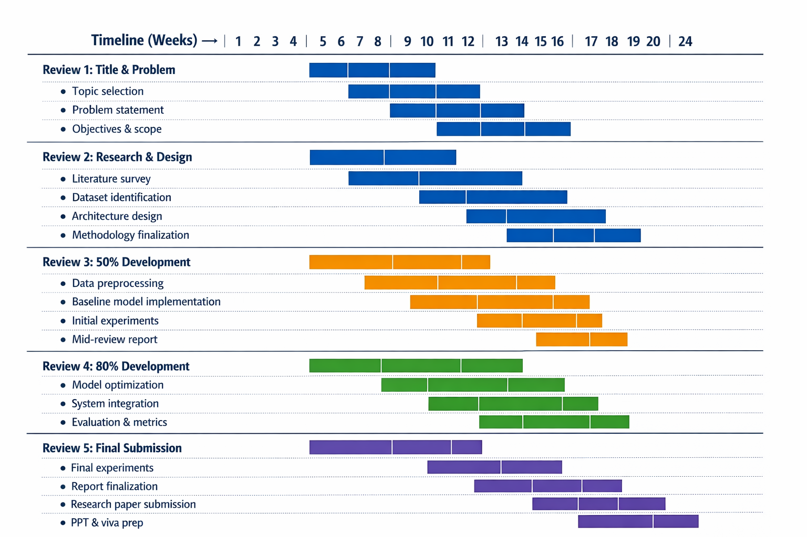
Timeline of the Project (Gantt Chart)

Slide 12
Github
Github Repository Link:
https://github.com/ashwin2947/cattle-ai

Slide 13
References (IEEE Paper format)
Krizhevsky, A., Sutskever, I., & Hinton, G. E., “ImageNet Classification with Deep Convolutional Neural Networks,” IEEE, 2012.
He, K., Zhang, X., Ren, S., & Sun, J., “Deep Residual Learning for Image Recognition,” CVPR, 2016.
Tan, M., & Le, Q., “EfficientNet: Rethinking Model Scaling for CNNs,” ICML, 2019.
Selvaraju, R. R. et al., “Grad-CAM: Visual Explanations from Deep Networks,” ICCV, 2017.
Kamilaris, A., & Prenafeta-Boldú, F. X., “Deep Learning in Agriculture: A Survey,” Computers and Electronics in Agriculture, 2018.

Slide 14


