Slide 1
Cattle AI - Intelligence System
CSE7302- University Project
Review-2
Batch Number: CAI_22
Under the Supervision of,
Mr. Jai Kumar B
Assistant Professor
School of Computer Science and Engineering
Presidency University
Roll Number | Student Name
20221CAI0042 | ASHWIN R
20221CAI0026 | SACHIN S
20221CAI0017 | HARSHIT B
Name of the Program: B.Tech CAI
Name of the HoD: Dr. Zafar Ali Khan N
Name of the Program Project Coordinator: Ms. Suma N G
Name of the School Project Coordinators: Dr. Sampath A K

Slide 2
Problem Statement Number: SIH25004
Organization: “Department of Animal Husbandry & Dairying, Government of India”
Category (Hardware / Software / Both) : “Software”
Problem Description: “Accurate identification of livestock breeds and assessment of physical traits are essential for effective livestock management, breeding programs, and maintaining national animal databases. Currently, this process is largely manual, relying on visual inspection by experts, which is time-consuming, subjective, and difficult to scale. The problem statement focuses on developing a software-based intelligent system that can automatically identify livestock breeds and analyze physical traits from images using modern artificial intelligence techniques.”

Slide 3
Abstract
Accurate livestock breed identification and physical trait assessment are essential for effective breeding management and productivity optimization in precision livestock farming. Conventional approaches rely on manual observation and physical measurements, which are time-consuming, labor-intensive, and prone to inconsistency. This project proposes a deep learning-based computer vision system for automated livestock breed classification and physical trait estimation using image data. The system leverages transfer learning with convolutional neural networks to extract robust visual features from cattle images. A multi-task learning framework is employed to simultaneously perform breed classification and regression-based estimation of physical traits such as body weight, height, and body length.

Slide 4
Abstract
The proposed model is trained and evaluated on annotated livestock image datasets using standard classification and regression metrics. By enabling non-contact, scalable, and efficient analysis, the system aims to support data-driven decision-making in livestock management and promote the adoption of intelligent technologies in modern agricultural practices.

Slide 5
Literature Survey
Overview
This section reviews existing research related to automated livestock analysis using computer vision and deep learning techniques. The focus is on image-based livestock breed classification, physical trait and weight estimation, multi-task learning frameworks, segmentation and keypoint-based measurement techniques, and deployment challenges in real-world farming environments. These studies collectively address the need for non-contact, scalable, and accurate livestock monitoring systems, which form the foundation of the proposed deep learning-based livestock breed classification and physical trait estimation system.

Slide 6
Literature Survey
1. Computer Vision in Precision Livestock Farming
Recent advancements in precision livestock farming have demonstrated the effectiveness of computer vision techniques in automating livestock monitoring tasks such as identification, health assessment, and growth analysis. Several survey studies highlight the role of deep learning models in reducing manual labor and improving measurement accuracy in large-scale farming environments. Vision-based systems are particularly valued for their non-invasive nature and ability to operate continuously under real farm conditions.
Research Gap:
Most existing systems focus on a single task such as monitoring or detection, limiting their applicability for comprehensive livestock assessment.

Slide 7
Literature Survey
2. Livestock Breed Classification Using Deep Learning
Multiple studies have explored image-based cattle breed classification using convolutional neural networks. Early approaches relied on handcrafted features such as texture and color descriptors, while recent methods adopt deep CNNs with transfer learning to improve robustness against variations in pose, lighting, and background. Recent research also investigates real-time and explainable deep learning models to enhance usability and trust.
Research Gap:
Many breed classification systems are designed as standalone classifiers and do not integrate physical trait estimation, reducing their practical value for breeding and productivity analysis.

Slide 8
Literature Survey
3. Physical Trait and Weight Estimation from Images
A significant body of research focuses on estimating livestock body weight and physical dimensions using 2D images, silhouettes, depth data, or 3D point clouds. Segmentation-based approaches combined with regression models have shown promising results in predicting body weight without direct contact. Reviews indicate that body dimensions such as height and length are strong predictors of weight.
Research Gap:
Most trait estimation studies operate independently of breed identification and often require controlled imaging conditions or specialized sensors.

Slide 9
Literature Survey
4. Multi-Task Learning for Joint Classification and Regression
Multi-task learning has been widely applied in computer vision to enable a single model to perform multiple related tasks by sharing learned representations. Recent studies demonstrate that joint learning of classification and regression tasks improves generalization and computational efficiency. Such frameworks are particularly suitable for livestock analysis, where breed and physical traits are closely related.
Research Gap:
Despite its advantages, multi-task learning has been underexplored in livestock applications, with very few studies integrating breed classification and trait estimation into a unified framework.

Slide 10
Literature Survey
5. Segmentation and Keypoint-Based Livestock Measurement
Advanced research employs instance segmentation and pose estimation techniques to extract precise body contours and anatomical keypoints from livestock images. These methods enable accurate measurement of body dimensions and improve robustness to occlusions and background noise. Segmentation-assisted pipelines are often used as a preprocessing step for regression tasks.
Research Gap:
Such approaches are computationally intensive and are rarely combined with end-to-end multi-task deep learning models suitable for real-time deployment.

Slide 11
Literature Survey
6. Deployment Challenges and Practical Considerations
Several studies emphasize challenges such as data scarcity, class imbalance, environmental variability, and hardware limitations when deploying livestock vision systems in real-world settings. Recent works explore lightweight architectures and edge deployment to enable mobile and on-farm applications.
Research Gap:
There is a lack of integrated, deployable systems that balance accuracy, efficiency, and scalability while addressing multiple livestock assessment tasks simultaneously.

Slide 12
Literature Survey
Summary of Research Gaps
Based on the reviewed literature, it is evident that:
Most studies address either breed classification or trait estimation, but not both.
Multi-task deep learning approaches are rarely applied in livestock computer vision.
Existing systems often require controlled environments or specialized hardware.
There is a need for a unified, non-contact, and scalable framework for comprehensive livestock analysis.

Slide 13
Project Objectives
To design and develop an image-based deep learning system capable of automatically classifying livestock breeds using convolutional neural networks, achieving a minimum classification accuracy benchmark on a curated cattle image dataset.
To estimate key physical traits of livestock, including body weight, height, and body length, from visual data using regression-based deep learning models, and to evaluate performance using standard metrics such as Mean Absolute Error (MAE) and Root Mean Squared Error (RMSE).
To implement a multi-task learning framework that jointly performs breed classification and physical trait estimation within a single model, and to analyze its effectiveness compared to training separate task-specific models.

Slide 14
Project Objectives
To apply data preprocessing and augmentation techniques to improve model robustness against variations in lighting, pose, background, and image quality commonly encountered in real-world farming environments.
To experimentally evaluate the proposed system on annotated livestock image datasets and report quantitative results through accuracy, confusion matrices, and regression error analysis.
To develop a deployable inference pipeline that enables non-contact livestock assessment from uploaded images, demonstrating the feasibility of real-time or near real-time usage in practical agricultural settings.
To analyze system limitations and identify future enhancements, including segmentation-assisted measurement and edge-device deployment, to support scalability and real-world adoption.

Slide 15
Related Work
Several research studies have explored animal classification using computer vision techniques:
CNN-based models have been used for animal species classification, demonstrating high accuracy with transfer learning.
Some studies have applied deep learning for cattle identification, focusing mainly on single-task breed classification.
Limited works have explored physical trait estimation or explainable AI in livestock applications.
However, most existing works lack:
Multi-task learning approaches
Explainability mechanisms
Comparative evaluation of multiple deep learning architectures
This project aims to bridge these gaps.

Slide 16
Existing Methods and Drawbacks
Manual Livestock Identification and Measurement
Description:
Relies on human experts to identify livestock breeds and measure physical traits such as weight, height, and body length using manual tools and visual inspection.
Drawbacks:
Time-consuming and labor-intensive
Prone to human error and subjectivity
Causes stress to animals due to physical handling
Not scalable for large herds or frequent monitoring

Slide 17
Existing Methods and Drawbacks
Traditional Computer Vision with Handcrafted Features
Description:
Uses manually engineered visual features such as texture, color, and shape descriptors combined with classical machine learning classifiers for livestock breed recognition.
Drawbacks:
Poor performance under varying lighting and background conditions
Limited ability to capture complex visual patterns
Requires extensive feature engineering
Low robustness in real-world farm environments

Slide 18
Existing Methods and Drawbacks
3. Deep Learning-Based Livestock Breed Classification Systems
Description:
Applies convolutional neural networks with transfer learning to classify livestock breeds from images, achieving improved accuracy compared to traditional methods.
Drawbacks:
Focused solely on breed classification
Does not estimate physical traits
Often trained on small or controlled datasets
Limited practical applicability for comprehensive livestock analysis

Slide 19
Existing Methods and Drawbacks
4. Image-Based Physical Trait and Weight Estimation Methods
Description:
Estimates livestock body weight and physical dimensions using 2D images, silhouettes, depth data, or 3D point clouds combined with regression models.
Drawbacks:
Requires controlled imaging setups or specialized sensors
Sensitive to pose variation and occlusion
Operates independently of breed identification
Complex preprocessing pipelines increase system complexity

Slide 20
Existing Methods and Drawbacks
5. Segmentation and Keypoint-Based Livestock Measurement
Description:
Employs instance segmentation or pose estimation techniques to extract anatomical landmarks and body contours for precise measurement of physical traits.
Drawbacks:
Computationally intensive
Increased inference time
Difficult to deploy on edge or mobile devices
Rarely implemented as end-to-end learning systems

Slide 21
Existing Methods and Drawbacks
6. Single-Task Learning Frameworks
Description:
Uses separate models to perform individual tasks such as breed classification or physical trait estimation.
Drawbacks:
Redundant computation across models
Inefficient utilization of shared visual features
Increased deployment and maintenance complexity
Poor scalability for multi-objective livestock systems

Slide 22
Existing Methods and Drawbacks
7. Lightweight and Edge-Deployable Livestock Vision Systems
Description:
Utilizes lightweight CNN architectures to enable deployment on mobile or edge devices for on-farm usage.
Drawbacks:
Trade-off between computational efficiency and accuracy
Limited support for multi-task learning
Reduced robustness in complex real-world environments

Slide 23
Proposed Method
Proposed Method: “Deep Learning-Based Computer Vision System for Livestock Analysis”
The proposed solution is a deep learning-based computer vision system designed to automatically perform livestock breed classification and physical trait estimation from images in a non-contact and scalable manner. The system integrates transfer learning and multi-task learning to deliver a unified framework for comprehensive livestock assessment.
Image-Based Data Acquisition
The system accepts RGB images of livestock captured using standard cameras or mobile devices in farm environments. Images may be collected from different viewpoints and lighting conditions to ensure real-world applicability.
This approach eliminates the need for physical handling of animals and specialized sensing equipment, making the solution practical for on-farm deployment.

Slide 24
Proposed Method
Deep Feature Extraction Using Transfer Learning
A pretrained convolutional neural network (e.g., ResNet or EfficientNet) is used as a feature extractor to learn high-level visual representations from livestock images.
Transfer learning enables effective training even with limited labeled data while improving convergence speed and model generalization.
Multi-Task Learning Framework
The system adopts a multi-task learning architecture in which shared visual features are jointly used for:
Breed classification using a softmax-based output layer
Physical trait estimation (body weight, height, and body length) using regression heads
This unified framework reduces redundancy, improves computational efficiency, and leverages the inherent relationship between breed characteristics and physical traits.

Slide 25
Proposed Method
Model Training and Evaluation
The model is trained on annotated livestock datasets using data augmentation to improve robustness against environmental variations. Performance is evaluated using standard classification and regression metrics such as accuracy, precision, MAE, and RMSE.
Deployment and User Interaction
The trained model is deployed through a lightweight inference pipeline that allows users to upload livestock images via a web or mobile interface and receive real-time predictions.

Slide 26
Feasibility Study
Technical Feasibility
The proposed system leverages mature and widely adopted deep learning frameworks such as TensorFlow or PyTorch, along with pre trained CNN models. The architecture is compatible with standard GPUs and can be optimized for edge deployment using model compression techniques, making it technically feasible for real-world applications.
Economic Feasibility
The solution relies on open-source tools and publicly available datasets, significantly reducing development costs. Since the system operates using standard cameras or smartphones, there is no requirement for expensive hardware such as depth sensors or weighing equipment, ensuring cost-effectiveness for farmers and institutions.

Slide 27
Feasibility Study
Resource Feasibility
The project can be developed using commonly available computational resources such as cloud-based GPUs (e.g., Google Colab) and modest local systems. Human resource requirements are limited to basic expertise in machine learning and computer vision, making the project feasible within academic and institutional constraints.
Operational Feasibility
The system is designed to integrate seamlessly into existing farm workflows without disrupting daily operations. Its non-invasive nature and ease of use promote adoption by farmers, agricultural organizations, and livestock management agencies.

Slide 28
Feasibility Study
Conclusion
The proposed deep learning-based livestock analysis system is technically sound, economically viable, and operationally practical. By combining breed classification and physical trait estimation within a single multi-task framework, the solution addresses key limitations of existing methods while offering a scalable and farmer-friendly approach to intelligent livestock management.

Slide 29
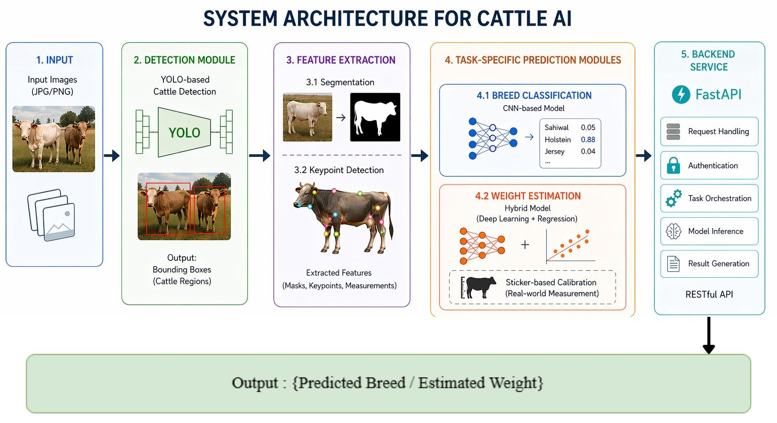
Architecture Diagram

Slide 30
Modules
1. Image Acquisition Module
Functionality: Captures or accepts livestock images through cameras, mobile devices, or file uploads.
Outcome: Raw livestock image input for analysis.
2. Data Preprocessing Module
Functionality: Performs image resizing, normalization, and basic augmentation to improve robustness against environmental variations.
Outcome: Standardized images ready for model processing.

Slide 31
Modules
3. Feature Extraction Module
Functionality: Uses a pretrained convolutional neural network with transfer learning to extract high-level visual features from livestock images.
Outcome: Discriminative feature representations for multiple tasks.
4. Multi-Task Learning Module
Functionality: Implements a unified deep learning framework with shared features and task-specific output heads for:
Breed classification
Physical trait estimation
Outcome: Joint learning and prediction of multiple livestock attributes.

Slide 32
Modules
5. Breed Classification Module
Functionality: Classifies livestock images into predefined breed categories using a softmax-based output layer.
Outcome: Predicted livestock breed.
6. Physical Trait Estimation Module
Functionality: Estimates key physical traits such as body weight, height, and body length using regression-based outputs.
Outcome: Quantitative trait predictions.

Slide 33
Modules
7. Model Training & Evaluation Module
Functionality: Trains the model using annotated datasets and evaluates performance using classification and regression metrics.
Outcome: Validated and optimized deep learning model.
8. Deployment & Inference Module
Functionality: Deploys the trained model for real-time inference through APIs or user interfaces.
Outcome: End-user access to predictions via web or mobile platforms.

Slide 34
Analysis of Problem Statement
Technology Stack Components:
Machine Learning & Computer Vision
Python
Deep Learning Framework: PyTorch / TensorFlow
CNN Architectures: ResNet, EfficientNet, MobileNet
OpenCV for image preprocessing
Backend
FastAPI for inference APIs
RESTful services
Deployment & Tools
Docker for containerization
Git/GitHub for version control

Slide 35
Analysis of Problem Statement (contd...)
Software and Hardware Requirements:
Software:
Operating System: Windows / Linux
Python 3.x
PyTorch / TensorFlow
OpenCV
FastAPI
Docker
Hardware:
Minimum 8 GB RAM
CPU with multi-core support
GPU (NVIDIA CUDA-enabled) – optional but recommended for training
Storage: Minimum 20 GB

Slide 36
Innovation & Novel Contributions
The innovative features of this project are:
Utilizing a Multi-Task Learning framework that combines both physical trait prediction and breed classification.
Conducting comparative analysis of deep learning architectures applied to livestock photos.
Implementing Explainable AI using Grad-CAM to visually show the underlying results of model decisions.
Emphasizing an architecture that can be deployed directly into government agriculture management systems as opposed to only being for training models.

Slide 37
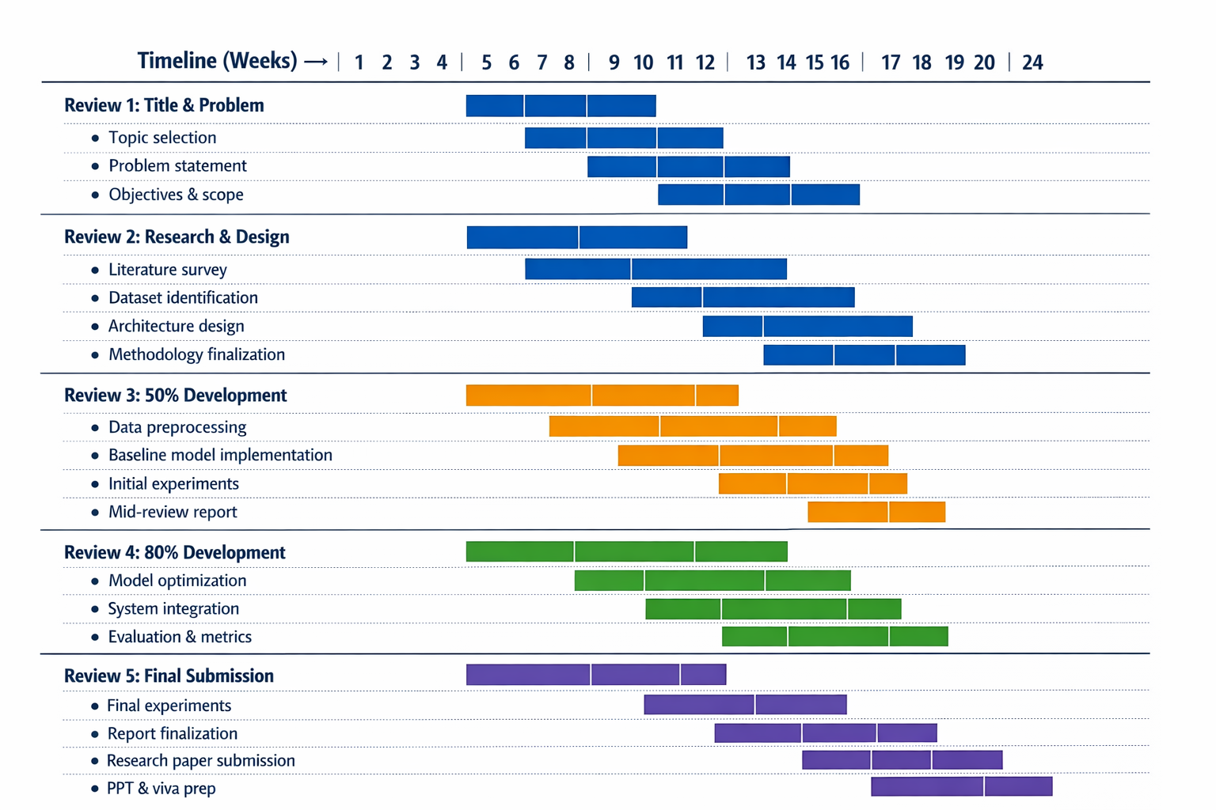
Timeline of the Project (Gantt Chart)

Slide 38
Github
Github Repository Link:
https://github.com/ashwin2947/livestock-breed-classification

Slide 39
References (IEEE Paper format)
Krizhevsky, A., Sutskever, I., & Hinton, G. E., “ImageNet Classification with Deep Convolutional Neural Networks,” IEEE, 2012.
He, K., Zhang, X., Ren, S., & Sun, J., “Deep Residual Learning for Image Recognition,” CVPR, 2016.
Tan, M., & Le, Q., “EfficientNet: Rethinking Model Scaling for CNNs,” ICML, 2019.
Selvaraju, R. R. et al., “Grad-CAM: Visual Explanations from Deep Networks,” ICCV, 2017.
Kamilaris, A., & Prenafeta-Boldú, F. X., “Deep Learning in Agriculture: A Survey,” Computers and Electronics in Agriculture, 2018.

Slide 40


