Slide 1
Cattle AI - Intelligence System
CSE7302- University Project
Review-2
Batch Number: CAI_22
Under the Supervision of,
Mr. Jai Kumar B
Assistant Professor
School of Computer Science and Engineering
Presidency University
Roll Number | Student Name
20221CAI0042 | ASHWIN R
20221CAI0026 | SACHIN S
20221CAI0017 | HARSHIT B
Name of the Program: B.Tech CAI
Name of the HoD: Dr. Zafar Ali Khan N
Name of the Program Project Coordinator: Ms. Suma N G
Name of the School Project Coordinators: Dr. Sampath A K

Slide 2
Problem Statement Number: SIH25004
Organization: “Department of Animal Husbandry & Dairying, Government of India”
Category (Hardware / Software / Both) : “Software”
Problem Description: “Accurate identification of livestock breeds and assessment of physical traits are essential for effective livestock management, breeding programs, and maintaining national animal databases. Currently, this process is largely manual, relying on visual inspection by experts, which is time-consuming, subjective, and difficult to scale. The problem statement focuses on developing a software-based intelligent system that can automatically identify livestock breeds and analyze physical traits from images using modern artificial intelligence techniques.”

Slide 3
Abstract
Accurate livestock breed identification and physical trait assessment are essential for effective breeding management and productivity optimization in precision livestock farming. Conventional approaches rely on manual observation and physical measurements, which are time-consuming, labor-intensive, and prone to inconsistency. This project proposes a deep learning-based computer vision system for automated livestock breed classification and physical trait estimation using image data. The system leverages transfer learning with convolutional neural networks to extract robust visual features from cattle images. A multi-task learning framework is employed to simultaneously perform breed classification and regression-based estimation of physical traits such as body weight, height, and body length.

Slide 4
Abstract
The proposed model is trained and evaluated on annotated livestock image datasets using standard classification and regression metrics. By enabling non-contact, scalable, and efficient analysis, the system aims to support data-driven decision-making in livestock management and promote the adoption of intelligent technologies in modern agricultural practices.

Slide 5
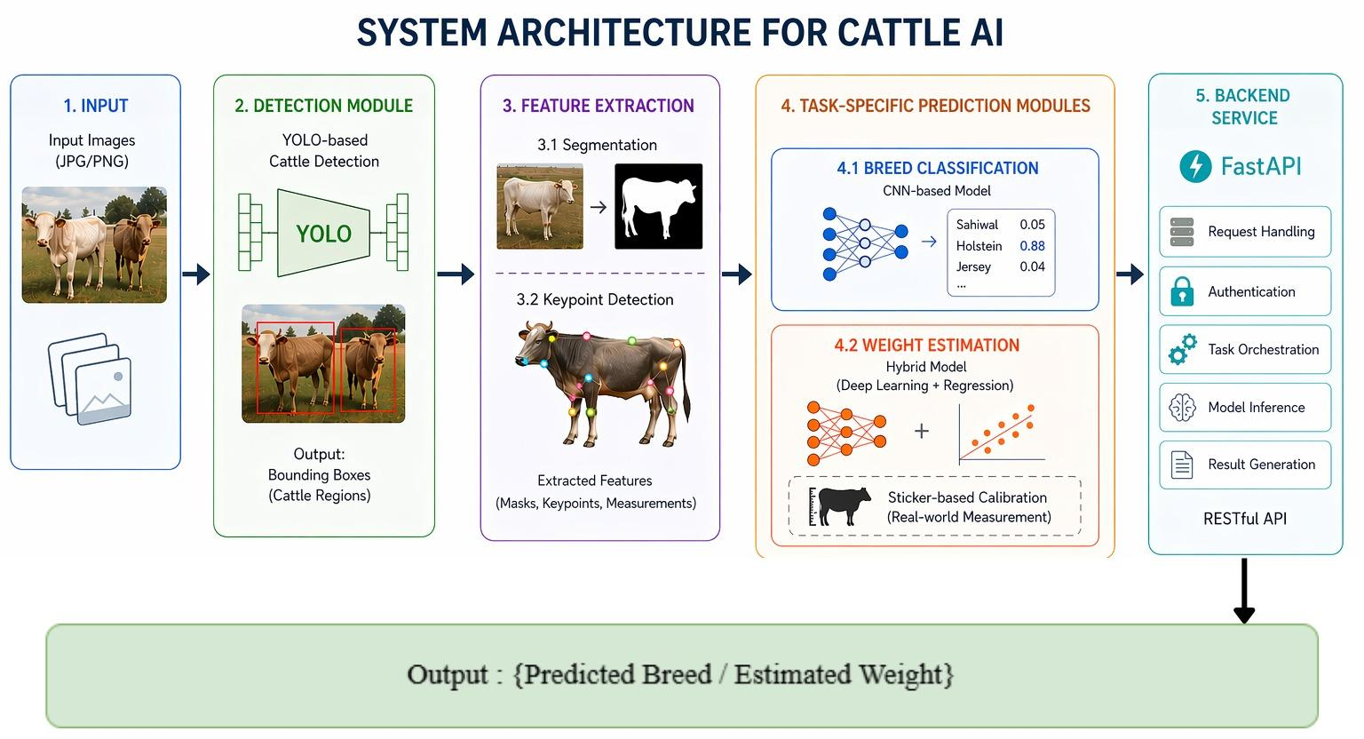
Architecture Diagram

Slide 6
Algorithm Details - Multi-Task Model Training
Input: Image I
Output: Breed C, Weight W
Pseudocode :
Algorithm Cattle_Analysis_System
Input:
Image I
Detection model D
Segmentation model S
Classification model C_model
Regression model R_model

Slide 7
Algorithm Details - Multi-Task Model Training
Output:
Breed C
Weight W
Steps:
1. Detect cattle bounding box using model D
2. Crop cattle region from image
3. Apply segmentation model S and binary body mask

Slide 8
Algorithm Details - Multi-Task Model Training
4. Extract morphometric features:
body_length_pixels
body_height_pixels
body_area
5. Estimate scale using expected cattle height
6. Convert measurements to real units
7. Predict breed using classification model
8. Estimate weight using regression model
9. Return
breed class, estimated weight

Slide 9
Analysis of Problem Statement
Technology Stack Components:
Machine Learning & Computer Vision
Python
Deep Learning Framework: TensorFlow
CNN Architectures: EfficientNet, MobileNet
OpenCV for image preprocessing
Backend
FastAPI for inference APIs
RESTful services
Deployment & Tools
Docker for containerization
Git/GitHub for version control

Slide 10
Analysis of Problem Statement (contd...)
Software and Hardware Requirements:
Software:
Operating System: Windows
Python 3.11.9
PyTorch
OpenCV
FastAPI
Hardware:
Minimum 8 GB RAM
CPU with multi-core support
GPU (NVIDIA CUDA-enabled)
Storage: Minimum 20 GB

Slide 11
Innovation & Novel Contributions
The innovative features of this project are:
Utilizing a Multi-Task Learning framework that combines both physical trait prediction and breed classification.
Conducting comparative analysis of deep learning architectures applied to livestock photos.
Implementing Explainable AI using Grad-CAM to visually show the underlying results of model decisions.
Emphasizing an architecture that can be deployed directly into government agriculture management systems as opposed to only being for training models.

Slide 12
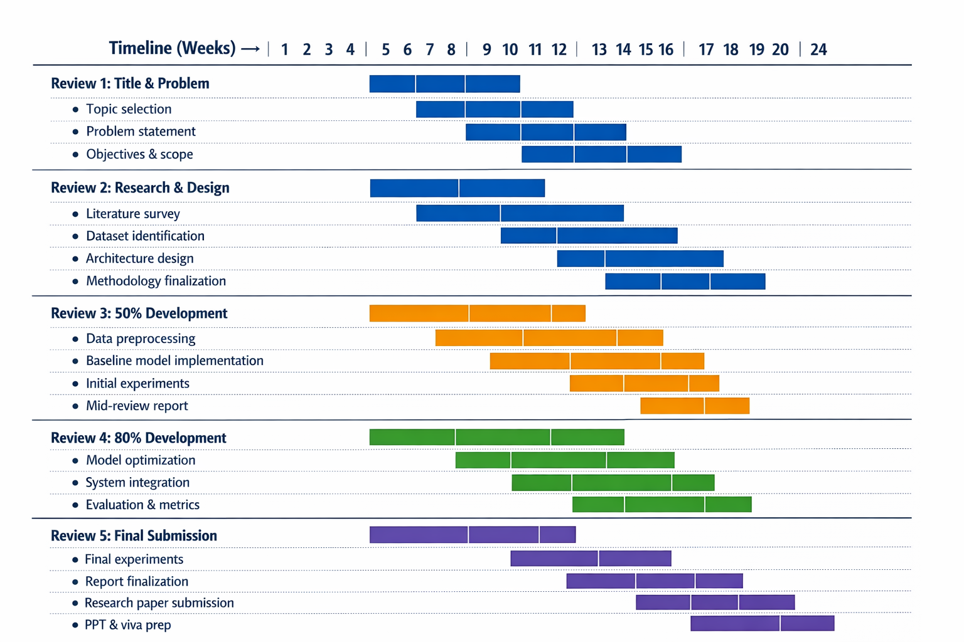
Timeline of the Project (Gantt Chart)

Slide 13
Github
Github Repository Link:
https://github.com/ashwin2947/cattle-ai

Slide 14
References (IEEE Paper format)
Krizhevsky, A., Sutskever, I., & Hinton, G. E., “ImageNet Classification with Deep Convolutional Neural Networks,” IEEE, 2012.
He, K., Zhang, X., Ren, S., & Sun, J., “Deep Residual Learning for Image Recognition,” CVPR, 2016.
Tan, M., & Le, Q., “EfficientNet: Rethinking Model Scaling for CNNs,” ICML, 2019.
Selvaraju, R. R. et al., “Grad-CAM: Visual Explanations from Deep Networks,” ICCV, 2017.
Kamilaris, A., & Prenafeta-Boldú, F. X., “Deep Learning in Agriculture: A Survey,” Computers and Electronics in Agriculture, 2018.

Slide 15


