Slide 1
FlowSight
“AI-powered Predictive Project Intelligence Dashboard”

Slide 2
Problem Statement
According to the Project Management Institute (PMI), 35% of projects fail to meet their original goals and 45% experience delays or budget overruns due to poor visibility and lack of predictive insight.
McKinsey’s research shows that large IT projects run 45% over budget and 7% over schedule on average — leading to billions in lost productivity annually.
Most PMs and analysts still rely on retrospective metrics (e.g., burndown charts, velocity history), not predictive analytics, to identify upcoming risks.
Causes:
Gallup (2023) found that 76% of employees experience burnout due to misaligned workloads and unclear delivery timelines.
A Slack Future Forum survey revealed that teams with better data visibility into project progress have 32% higher productivity and lower stress levels.
Teams use multiple disconnected platforms — Jira for tickets, Slack for communication, Excel for reporting, Power BI for analytics — but lack one unified intelligence layer.

Slide 3
FlowSight
Solution Overview
FlowSight integrates sprint metrics, resource data, and communication trends to forecast potential project risks and recommend preventive actions before problems occur. It transforms scattered project data into a predictive, actionable dashboard — bridging analytics and decision-making for managers and teams alike.
:Goal:
To predict delivery risks, identify bottlenecks, and measure team productivity & morale using project and sprint data — integrating analytics + ML + visualization.

Slide 4
Core Features
3. Forecast Dashboard
Improves planning accuracy by 20–30%.. Enables dynamic sprint goal-setting.
Expected sprint velocity next week: 33 (vs current 27). if current trend continues
Uses historical velocity data and current story load Applies forecasting models Displays trendline graphs of projected vs actual performance.
A time-series forecast model that predicts future sprint velocity expected completion trends
1. Predictive Sprint Risk Engine
An AI-Powered system that analyzes past sprint data to predict the probability of delay in upcoming sprints
It takes inputs like sprint velocity, points, team size, avg task delay , breakdown rate to analyze
Uses Machine learning model to delay likelihood and displays risks as High / Medium / Low along with factors
Gives advance visibility into likely delays & Enables proactive interventions (reallocation, rescoping).
2.Team Health & Burnout Index
A composite score that measures team morale, workload balance, and communication patterns to prevent burnout.
Reduces team burnout incidents by up to 40%. Helps to make human-centric decisions with data.
Tracks task load per person, task churn rate, average completion time, and time since last sprint break.
4.Resource Optimization Engine
An intelligent system that recommends task reallocation and team balancing to improve productivity. AI recommends task reallocation and workload balancing
Analyzes per-member task count, velocity, and average delay. Detects over-assigned members or underutilized ones. Increases average team utilization efficiency by 12–15%. Balances workload
Shift 2 story points from Team A (velocity 22) to Team B (velocity 34) i.e. reduces sprint delay risk by 15%

Slide 5
Continue…
FlowSight connects with tools already used by teams, Jira, Slack, Trello, and Power BI. Collects data from various sources.
Enables one-click deployment across existing workflows. 60% reduction in manual report preparation time.
5. Smart Alerts & Early Warnings
Automated alert system for real-time sprint risk detection and decision reminders.
Sets thresholds for velocity drop, story rollover %, or team health index. Sends proactive warnings via emails
Reduces last-minute surprises. Increases decision response speed by ~40%. Sprint Delay Probability >70%. Alert: Action Required
6. Integration Layer (Cross-Tool Compatibility)

Slide 6
Jira, Trello, GitHub, Excel, Slack, Teams
Data Sources
Sprint metadata (start & end dates, sprint goals, backlog size)
Story-level details (story points, status, priority, tags).
Developer velocity (task completion time, historical patterns)
External factors (holidays, dependencies, blockers)
Data Processing
Missing story points, duplicate tickets, incomplete logs.
Predictive Engine Analytics
Sprint Delay Predictor, Velocity Forecast Model, Burnout Detection Algorithm
Visualization Dashboard
KPI Displayed, BI dashboard with Risk Meter Health Heatmap
Performance Forecast Graph
Continuous Feedback Loop
Actions feed back into system → improves future accuracy.
Decision & Alerts Layer
AI Recommendations like reassign 2 tasks to reduce sprint scope by 10%. Smart alerts

Slide 7
KEY PERFORMANCE INDICATORS (KPI)
2. Sprint Performance KPIs
Average Sprint Velocity
Completed story points / sprint with target of 10-20% increase
3. Team Efficiency & Health KPIs
1. Predictive Accuracy KPIs
On-Time Sprint Completion Rate
Task Redistribution Impact
Prediction Accuracy
Sprints finished on or before deadline with target of ≥ 85%
Change in workload balance after AI suggestions with a target of lesser than 20% deviation
% of sprints where predicted completion time matched actual outcome. With a target of 80% improvement
Commitment Reliability
Context Switching Index
Risk Alert Precision
(Delivered / Committed story points) × 100 with a target of 90%
Avg. task type changes per member with a target of reducing it
% of “high-risk” alerts that actually led to delay
Recall (Sensitivity / True Positive Rate)
Sprint Burndown Consistency
Out of 25 real risky sprints, your model detected 20 i.e. Recall = 80%.
% of days following planned burndown curve with a target of increasing it

Slide 8
KPI Metrics Pyramid
4. Business / Strategic KPIs
Sprint Performance KPIs
Predictive Accuracy KPIs
Team KPIs
Business
KPIs
Delivery Predictability Index
Variance B/W planned vs actual release timeline, reduction of 50%
Stakeholder Satisfaction (CSAT)
It is measured post-sprint with a target of increasing it
Time-to-Delivery (TTD)
= Date Released to Production − Date Planned in Sprint. With a target of reducing it.
Sprint Cost Efficiency
Evaluates if the sprint investment is yielding proportionate output. Factors like hours, avg cost/hr. FlowSight increases efficiency by improving predictability and reducing rework.

Slide 10
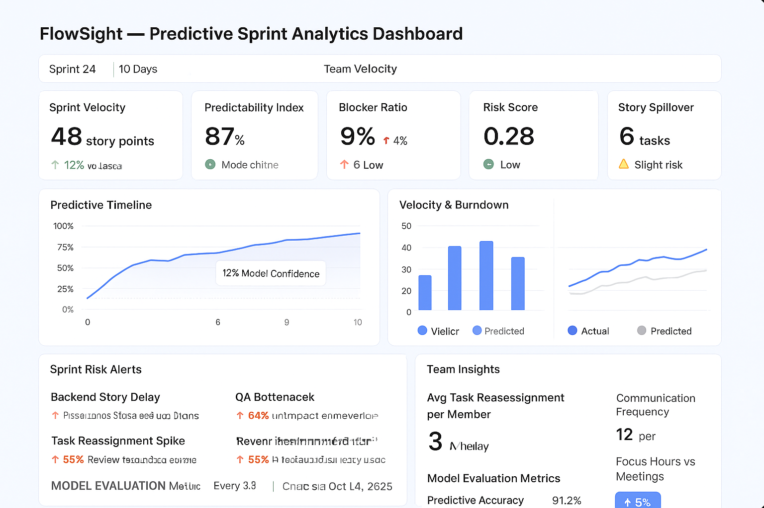

Slide 11
Sprint 24
10 Days
Team Velocity
Story Velocity
Predictability Index
Blocker Ratio
Risk Score
Story Spillover
45Story points
87%
8%
0.28%
6 tasks

Slide 12
Business Impact of FlowSight
Impact Area | Before FlowSight | After FlowSight | Change
On-time Sprint Delivery | 68% | 87% | +19% improvement
PM Time spent on manual tracking/reporting weekly | 12 hrs/week | 3.5 hrs/week | ~70% reduction
Sprint Rework / reopened tasks | 22% of tasks | 9% of tasks | -13% improvement
Average sprint blocker resolution time | 8.4 hours | 5.2 hours | -38% faster unblock
Story spillover across sprints | 11 tasks per sprint | 5 tasks per sprint | 54% reduction
Release cycle / feature go-live time | 28 days average | 21 days average | -25% faster time to value

Slide 13
🧱 Data Sources
(Jira, Slack, GitHub, Excel)
⬇️
🧮 Data Processing
(Cleaning + Structuring)
⬇️
🤖 Predictive Analytics Engine
(Delay Prediction + Velocity Forecast)
⬇️
📊 Visualization Dashboard
(Power BI / Figma UI)
⬇️
🧠 Decision & Alerts Layer
(Recommendations + Notifications)
⬇️
🔁 Continuous Feedback Loop
(Self-Learning System)

Slide 14
Core Features
Predictive Completion Rate: Uses regression and time-series models to forecast whether current sprints or projects will meet deadlines.
Bottleneck Detection: Identifies tasks or people that are causing workflow slowdowns using dependency graphs.
Sentiment & Team Health Tracker: NLP model analyzes comments and communications (Slack, Jira, Confluence, etc.) to detect burnout or low morale.
AI Recommendations: Suggests optimal team distribution, sprint length, or backlog prioritization.
Custom KPIs: Flexible KPIs depending on the company’s nature (e.g., customer churn risk for PayPal vs. developer productivity for Atlassian).

Slide 15
Feature | Description | Example Insight
🔮 Predictive Sprint Risk | Uses past sprint velocity, delays, and story points to forecast delay probability | “Sprint 25 has 73% delay likelihood — cause: velocity drop 15%, 20% story rollover.”
🧑‍🤝‍🧑 Team Health Score | Combines workload, task churn, and communication lag to measure team stress | “Backend team load 25% above optimal. Redistribute tasks.”
📊 Forecast Dashboard | Time-series forecasts of completion and efficiency | “Projected completion: 12 days ahead of plan if current trend continues.”
📢 Smart Alerts | Sends proactive warnings to PMs (via email/Slack/Teams) | “Risk alert: sprint performance dropping below average threshold.”
💼 Resource Optimization | AI recommends task reallocation and workload balancing | “Shift 2 story points to Team B to balance velocity.”

Slide 16
🧩 1. CORE MODULES / COMPONENTS
Module | Description | Example Features
1. Data Integration Layer | Collect data from various sources. | Jira, Trello, Slack, GitHub, Workfront, Asana APIs
2. Data Warehouse / Storage | Store and preprocess data for analysis. | PostgreSQL / MySQL / Google BigQuery
3. Analytics & ML Engine | Perform predictive modeling, trend analysis, and sentiment detection. | Time Series Forecasting, NLP Sentiment Analysis, Regression Models
4. Visualization Dashboard | Display real-time insights and forecasts interactively. | Streamlit / Power BI / Tableau / React dashboard
5. Recommendation Engine (optional) | Suggest actions to improve performance. | Reassign tasks, extend sprint, adjust workloads

Slide 17
Progress Against Goals
Summary of key financial results.
  Revenue
  Profit
  Key spending areas
  Headcount

Slide 18
Revenue and Profit
Forecast vs. actual
Gross margin
Important trends
Compare company to rest of market.
Use multiple slides to break out meaningful detail.

Slide 19
Key Spending Areas
R&D
Sales and marketing.
General and administration.
Areas of improvement.
Areas needing attention/caution.

Slide 20
Headcount
Goals
Results

Slide 21
Goals for Next Period
Strategic undertakings
Financial goals
Other key efforts

Slide 22
Summary
Summarize key successes/challenges.
Reiterate key goals.
Thanks

