Slide 1
Bluestock Mutual Fund Analytics
Capstone Project Final Presentation
Analytics Team
September 2026

Slide 2
Problem & Objective
Problem Statement: Fragmented, raw mutual fund data lacks actionable insights.
  Objectives:
    Build an automated ETL pipeline
    Calculate performance (Sharpe, Alpha) & risk (VaR) metrics
  Why it matters: Empowers data-driven investment decisions rather than emotion-based trading.

Slide 3
Data Sources
10 Datasets Integrated:
1. Scheme Master & NAV (Daily tracking)
2. Benchmark Indices (NIFTY 50, NIFTY 100)
3. AUM & SIP Inflows
4. Investor Demographics & Transactions
Data Coverage: Highly granular daily data covering multiple market cycles, enabling deep quantitative analysis.

Slide 4
Architecture & ETL Pipeline
Data Flow:
Raw CSVs -> Pandas Cleaning -> SQLite Database -> Jupyter/Python Analytics -> Power BI
Key Transformations:
  Date standardization
  NAV forward-filling (excluding weekends for return calcs)
  Star Schema creation (Fact & Dim tables)

Slide 5
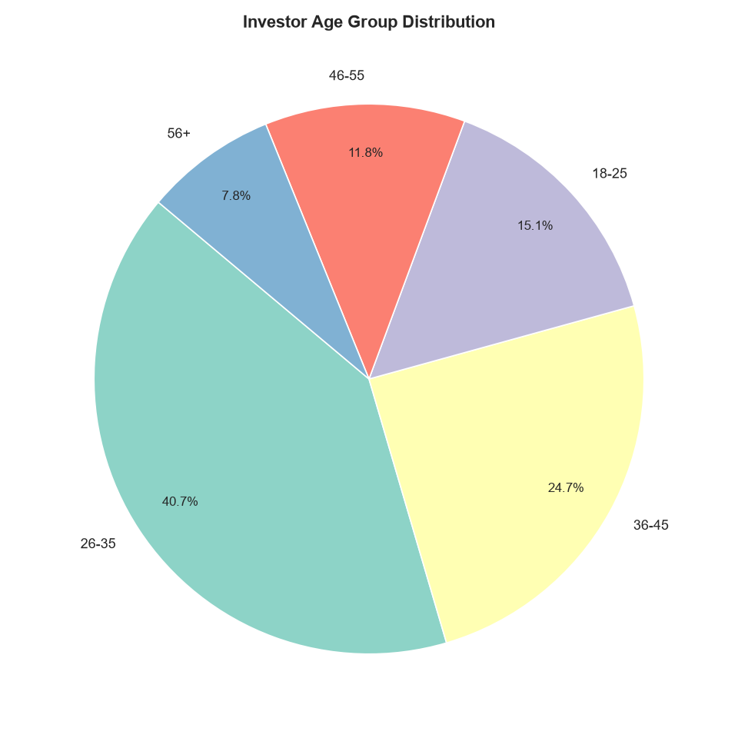
EDA Highlights I: Demographics
Insight:
- '26-35' age group dominates (40.7%)
- Mutual fund adoption is heavily driven by younger, working-age adults.

Slide 6
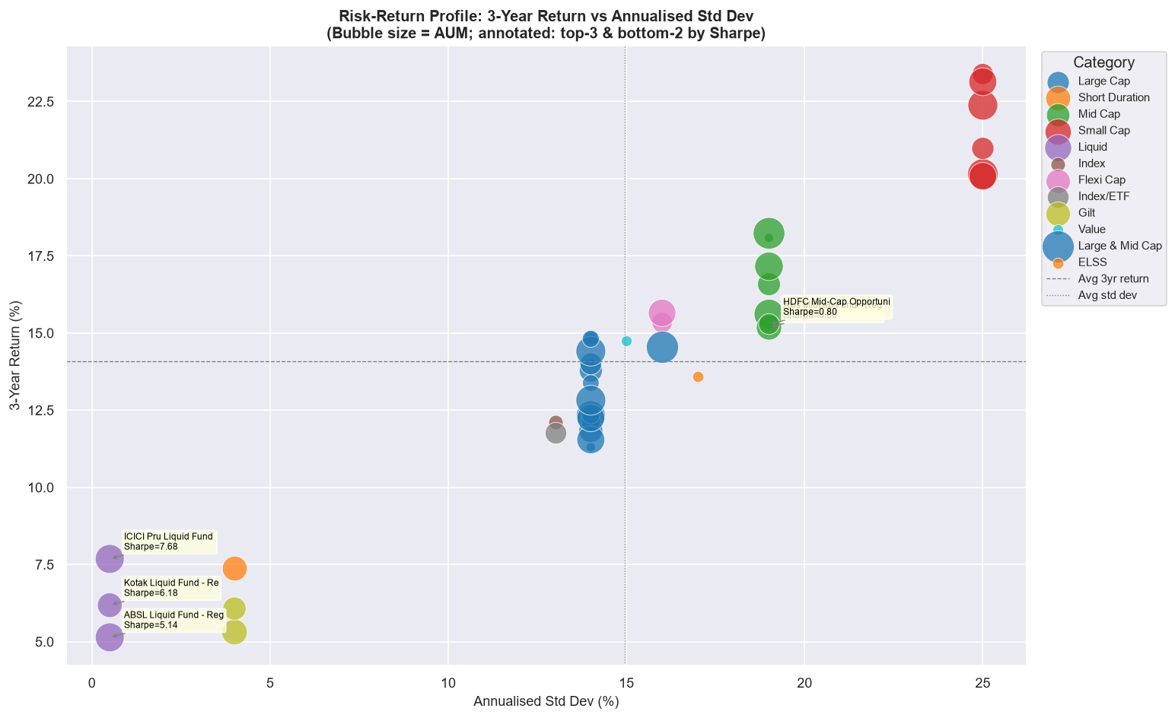
EDA Highlights II: Risk vs Return
Insight:
- Classic risk-reward trade-off is visible.
- Some funds achieve higher returns without proportionally higher standard deviation (better Sharpe).

Slide 7
Performance Metrics I
Return & Risk Evaluated:
- CAGR computed for 1, 3, and 5-year horizons.
- Sharpe Ratio calculated against a 6.5% Risk-Free Rate.
- Sortino Ratio utilized to specifically isolate downside volatility.
- Finding: High absolute returns do not always correlate with high risk-adjusted returns.

Slide 8
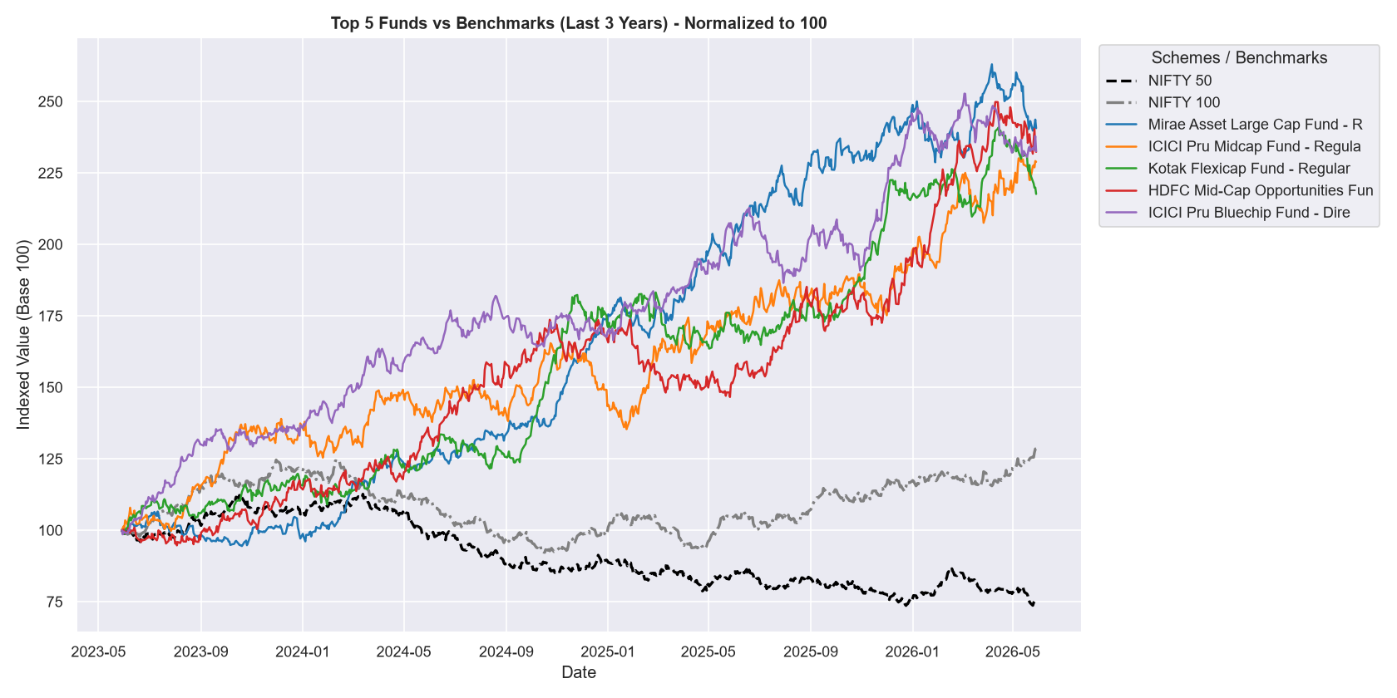
Performance Metrics II
Alpha & Benchmarking:
- Top 5 Scorecard funds successfully beat NIFTY 100.
- Maximum drawdown metrics identified funds vulnerable to severe market corrections.

Slide 9
Power BI Dashboard (Overview & Performance)
Pages 1 & 2:
Overview Page: High-level KPI aggregations including Total AUM, overall SIP inflows, and top-line investor counts.
Fund Performance Page: Drill-down into specific scheme CAGRs, Sharpe ratios, and our custom composite Scorecard.
[Note: Dashboard deployed via bluestock_mf.pbix]

Slide 10
Power BI Dashboard (NAV & Trends)
Pages 3 & 4:
NAV Details Page: Interactive time-series visualisations allowing dynamic date slicing of historical NAV trends.
SIP & Market Trends Page: Visual heatmaps of category inflows and cohort behavioral analytics.
All pages include cross-filtering and dynamic slicers for intuitive exploration.

Slide 11
Key Findings & Recommendations
Key Findings:
Top funds exhibit significant sector concentration (High HHI).
SIP continuity analysis reveals critical 'at-risk' investors with >35 day gaps.
Recommendations:
Investors: Rely on the risk-adjusted Scorecard rather than chasing 1-year yield.
Business: Trigger automated retention campaigns for at-risk SIP cohorts.

Slide 12
Thank You
Questions & Discussion

