Slide 1
Coursework
Dr Sarah Morgan
R250: Applications of ML to Psychiatry
09/02/2021

Slide 2
Task: Write a research proposal applying machine learning tools to new data from the PSYSCAN project
(using legacy data to develop your ideas and run preliminary experiments)

Slide 3
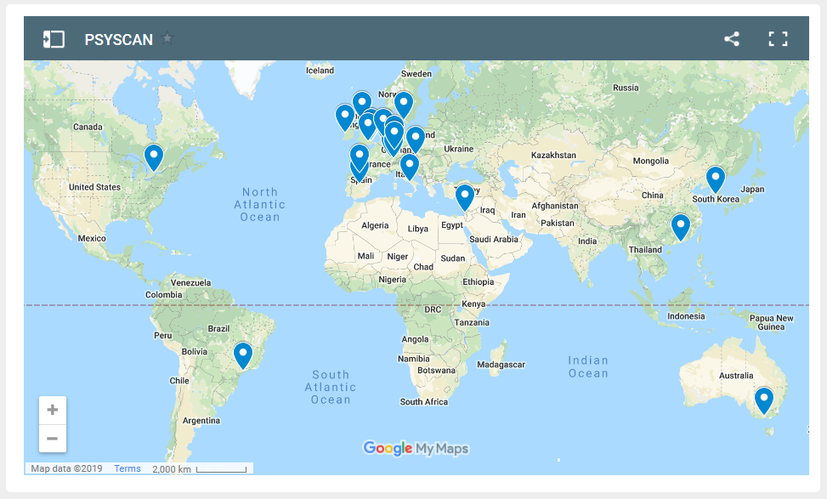

PSYSCAN project- “translating neuroimaging findings from research into clinical practice”
Multi-site, EU funded project (led by KCL)
Currently collecting longitudinal data from early stage psychosis patients

Slide 4
New data:
Structural T1w and resting state fMRI scans from N=250 First Episode Psychosis patients at baseline and longitudinally after 1 year.
Also clinical symptom scores and demographics including age, sex, IQ, years in education. Again, all at baseline and after 1 year. (There will also be a range of other cognitive/clinical measures, plus bloods- if you’re interested in something else please ask me!)
The subjects will be recruited and scanned at 14 different sites

Slide 5
Legacy data:
This is the data I’m giving you, to develop your ideas/run preliminary experiments
Cobre dataset- 81 healthy volunteers and 67 patients with chronic schizophrenia, all from a single site
Structural T1w and resting state fMRI scans. From the former I’ve extracted cortical thickness at 308 brain regions for you to use. For the later I’ve given you fMRI connectivity matrices (if it’s helpful, these are actually covariance matrices, estimated from regional timeseries, using sparse inverse covariance estimation).
Also clinical symptom scores (PANSS total) and basic demographics- age, sex.
Downloaded from: http://schizconnect.org/ (for interest, no need to download raw images yourself , just use pre-processed data I give you!)
Read the README.txt file!!

Slide 6

Example clinical questions of interest
Can you use brain imaging data (and symptoms etc) at baseline to predict symptoms after 1 year?
Does change in brain connectivity over 1 year predict change in symptoms?
Does combining functional brain connectivity and structural brain measures help predict symptoms?
Are there different sub-groups in the data with different outcomes?
… Plus many others!

Slide 7

Over to you!
(Please feel free to email me if you have any questions, or want to know anything else about the data- sem91@cam.ac.uk)

