Slide 1
Hydrodynamics of Fractal Aggregates
By Ashwin Amalaruban
193020020
Guided by Prof. Jyoti Seth

Slide 2
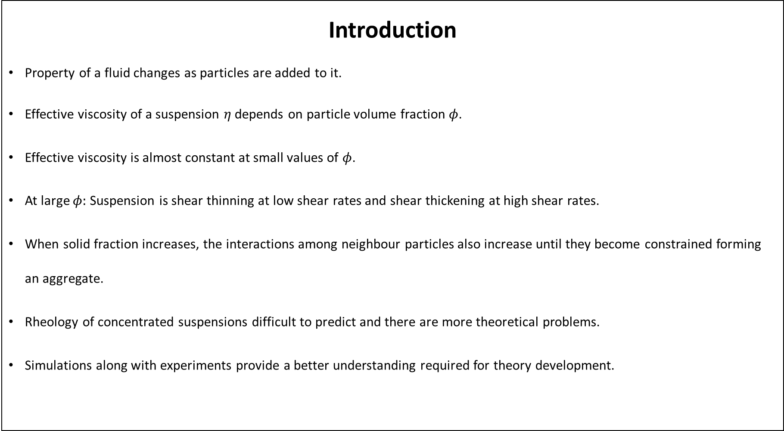
Introduction
Property of a fluid changes as particles are added to it.
Effective viscosity of a suspension $η$ depends on particle volume fraction $φ$.
Effective viscosity is almost constant at small values of $φ$.
At large $φ:$ Suspension is shear thinning at low shear rates and shear thickening at high shear rates.
When solid fraction increases, the interactions among neighbour particles also increase until they become constrained forming an aggregate.
Rheology of concentrated suspensions difficult to predict and there are more theoretical problems.
Simulations along with experiments provide a better understanding required for theory development.

Slide 3
Overview of simulation methods
Few methods for simulating suspensions:
Boundary integral equation method
Lattice Boltzmann Method
Dissipative Particle Dynamics
Collocation technique by Ganatos
Young’s method
Hydrodynamic interactions between particles in a suspension: Long range interactions and lubrication interactions.
Lubrication interactions are not included in these methods directly.
Lubrication interactions are important as the particle concentration increases.
Why Stokesian Dynamics? It includes both long-range and short-range interactions.

Slide 4
Scope of this project
To study the method of Stokesian dynamics.
To understand the basics of hydrodynamics.
Aggregate of any shape is broken down into constitutive spheres.
Green’s function gives the disturbance velocity field by a point force.
- It is integrated over all the particle surfaces to give the velocity field.
Faxen’s laws gives the velocity of individual particles.
The force and velocity moments are related using a Resistance matrix and a Mobility matrix.
The components of these matrices and their properties are studied.
The study is also extended to infinite domain using Ewald sum.

Slide 5


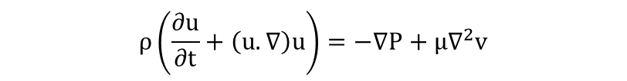
Governing equations
Navier-Stokes equation and continuity equation
Stokes equation
$$ρ\left(\frac{∂u}{∂t}+\left(u.∇\right)u\right)=−∇P+μ∇^{2}v$$
Re << 1
$$0=−∇P+μ∇^{2}u$$
(1)
$$∇.(ρu)=0$$
$$∇.(u)=0$$
Assumptions:
1.Newtonian and Incompressible fluid.
2.Low Reynolds number flow → Inertial effects are negligible.
3.No explicit time dependence → Quasi-static
Flow is determined by the Boundary conditions - > Particle configuration, external force/torque, no slip
Linearity of the Stokes equation means the ambient velocity field given by principle of superposition.
(2)

Slide 6
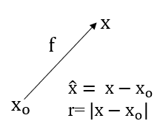

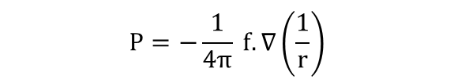

Green’s function
Velocity disturbance caused by a point force
Stokes equation forced with a delta function
$$−∇P + f δ(x−x_{o}) + μ∇^{2}u =0$$
(1)
(2)
(3)
(4)
(5)
Response of a viscous fluid with a single point force
$$u_{i}=\frac{1}{8πμ} J_{ij}(x−x_{o}) f_{j}$$
Delta function found out to be $δ\left(\hat{x}\right)=−∇^{2}\left(\frac{1}{4πr}\right)$
Balancing the dimension of pressure term with that of the delta function
$$P=−\frac{1}{4π} f.∇\left(\frac{1}{r}\right)$$
Solution for (1) $u=\frac{1}{μ}f.(∇∇−I∇^{2})H$
$H=\frac{−r}{8π}$ satisfies forced biharmonic equation
$$∇^{4}H=0$$
$u_{i}=\frac{1}{8πμ}\left(\frac{δ_{ij}}{r}+\frac{{\hat{x}}_{i}{\hat{x}}_{j}}{r^{3}}\right)$ $f_{j}$ → $J_{ij}=\frac{δ_{ij}}{r}+\frac{{\hat{x}}_{i}{\hat{x}}_{j}}{r^{3}}$
Linearity allows us to use Green’s function to solve the Stokes equation.

Slide 7
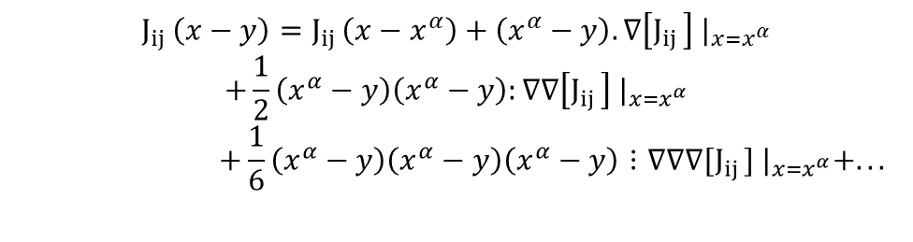

Multipole expansion
Presence of particles create a disturbance field.
Velocity field at any point ‘x’ in the fluid → sum of ambient velocity and the disturbance field.
$u_{i}\left(x\right)=u_{i}^{∞}\left(x\right)$+ ${u′}_{i}\left(x\right)$
Disturbance field ${u′}_{i}\left(x\right)=\frac{1}{8πμ}J_{ij}(x−y)f_{j}(y)$
$$u_{i}\left(x\right)=u_{i}^{∞}\left(x\right)−\frac{1}{8πμ}\sum_{α=1}^{N}{\int_{Sα}{J_{ij }(x−y) f_{j} {dS}_{y}}}$$
Force at any point on a particle surface $f_{j}(y)=σ_{jk}(y)n_{k}$
Oseen tensor integrated over the surface area 𝑆_{𝛼} for the particle $α$ and summed over N particles.
Number of unknowns increases as the number of particles increases.
Oseen tensor is Taylor expanded about particle centre $x^{α}$:
(1)
(2)
(3)
(4)
$$J_{ij }\left(x−y\right)=J_{ij }\left(x−x^{α}\right)+\left(x^{α}−y\right).∇\left[J_{ij }\right]{ |}_{x=x^{α}}$$
$$+\frac{1}{2}\left(x^{α}−y\right)\left(x^{α}−y\right):∇∇\left[J_{ij }\right]{ |}_{x=x^{α}}$$
$$+\frac{1}{6}\left(x^{α}−y\right)\left(x^{α}−y\right)\left(x^{α}−y\right)⋮∇∇∇[J_{ij }]{ |}_{x=x^{α}}+...$$

Slide 8
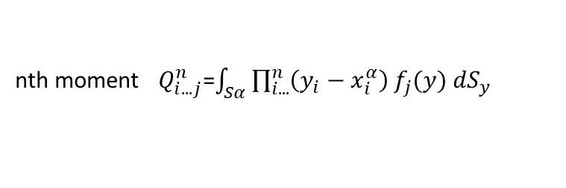
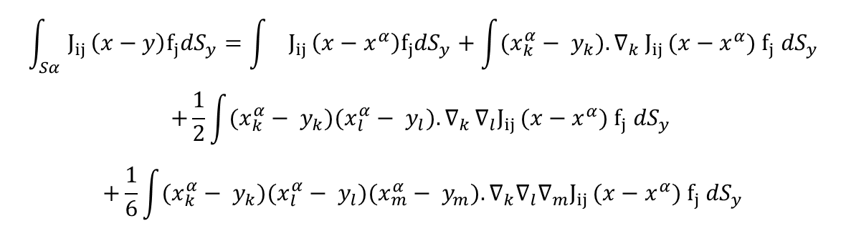
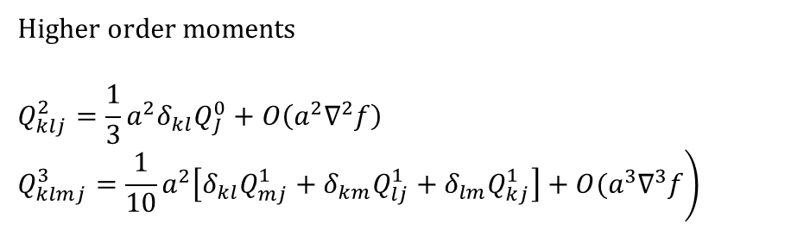

The integral becomes
$$\int_{Sα}{J_{ij }\left(x−y\right)f_{j}{dS}_{y}=\int{J_{ij }\left(x−x^{α}\right)f_{j}{dS}_{y}+\int{(x_{k}^{α}}− y_{k}){.∇}_{k}J_{ij }(x−x^{α}) f_{j} {dS}_{y}}}$$
$$+\frac{1}{2}\int{(x_{k}^{α}}− y_{k})(x_{l}^{α}− y_{l}){.∇}_{k}∇_{l}J_{ij }(x−x^{α}) f_{j} {dS}_{y}$$
$$+\frac{1}{6}\int{(x_{k}^{α}}− y_{k})(x_{l}^{α}− y_{l})(x_{m}^{α}− y_{m}).∇_{k}{∇_{l}∇_{m}J}_{ij }(x−x^{α}) f_{j} {dS}_{y}$$
(5)
(6)
Green’s function expanded as moments of force distribution.
nth moment $Q_{i...j}^{n}$=$\int_{Sα}{\prod_{i...}^{n}{\left(y_{i}−x_{i}^{α}\right)}}f_{j}(y) {dS}_{y}$
Such moments are
$Q_{j}^{o}=−\int_{Sα}{f_{j}{ dS}_{y}}$ =O(f)
$Q_{kj}^{1}=−\int_{Sα}{{{(x}_{k}^{α}− y_{k})f}_{j}{ dS}_{y}}$ =O(a$∇f)$
$Q_{klj}^{2}=−\int_{Sα}{(x_{k}^{α}− y_{k})(x_{l}^{α}− y_{l})}f_{j}{ dS}_{y}$ =O($a^{2}∇^{2}f)$ when k≠l
$$Q_{klmj}^{3}=−\int_{Sα}{(x_{k}^{α}− y_{k})(x_{l}^{α}− y_{l}){(x}_{m}^{α}− y_{m})}f_{j}{ dS}_{y}$$
Higher order moments
$$Q_{klj}^{2}=\frac{1}{3}a^{2}δ_{kl}Q_{J}^{0}+O\left(a^{2}∇^{2}f\right)$$
$$\left.Q_{klmj}^{3}=\frac{1}{10}a^{2}\left[δ_{kl}Q_{mj}^{1}+δ_{km}Q_{lj}^{1}+δ_{lm}Q_{kj}^{1}\right]+O(a^{3}∇^{3}f\right)$$

Slide 9
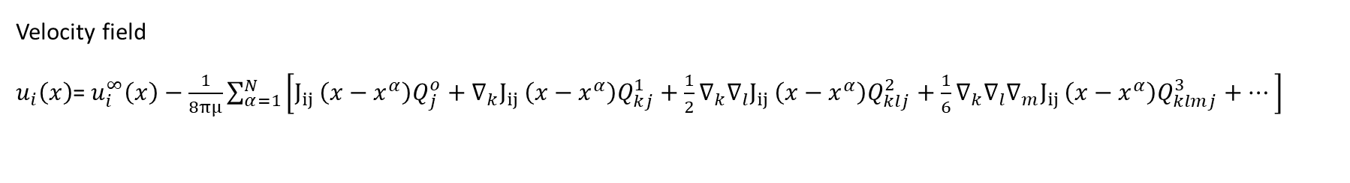


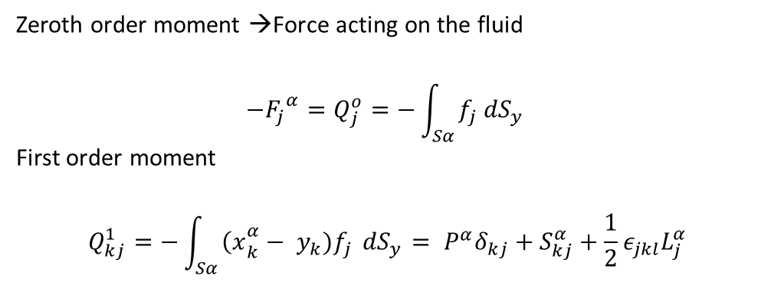
$$L_{i}=\int_{Sα}{ε_{ijk}{{(x}_{j}^{α}− y_{j})f}_{K}{ dS}_{y}}$$
$$S_{ij}=\frac{1}{2}\int_{Sα}{\left[{{(x}_{i}^{α}− y_{i})f}_{K}+{{(x}_{j}^{α}− y_{j})f}_{K}−\frac{2}{3}δ_{ij}{{(x}_{k}^{α}− y_{k})f}_{K}\right]}{ dS}_{y}$$
Zeroth order moment →Force acting on the fluid
$$−{F_{j}}^{α}=Q_{j}^{o}=−\int_{Sα}{f_{j}{ dS}_{y}}$$
First order moment
$$Q_{kj}^{1}=−\int_{Sα}{{{\left(x\right.}_{k}^{α}− y_{k})f}_{j}{ dS}_{y} = P^{α}δ_{kj}+S_{kj}^{α}+\frac{1}{2}ε_{jkl}L_{j}^{α}}$$
Velocity field
$u_{i}\left(x\right)$= $u_{i}^{∞}\left(x\right)−\frac{1}{8πμ}\sum_{α=1}^{N}{\left[J_{ij }\left(x−x^{α}\right)Q_{j}^{o}+∇_{k}J_{ij }\left(x−x^{α}\right)Q_{kj}^{1}+\frac{1}{2}{∇_{k}∇_{l}J}_{ij }\left(x−x^{α}\right)Q_{klj}^{2}+\frac{1}{6}∇_{k}∇_{l}∇_{m}J_{ij }\left(x−x^{α}\right)Q_{klmj}^{3}+…\right]}$
On truncating at O(a$∇$f)
$$u_{i} \left(x\right)=u_{i}^{∞}\left(x\right)− \frac{1}{8πμ}\sum_{α}{\left[−\left\{1+ \frac{1}{6}a^{2}∇^{2}\right\}J_{ij}(x−x^{α})F_{j}^{α} + \frac{1}{2}∈_{jkl}∇_{k}J_{il}(x−x^{α})L_{j}^{α}+\left\{1+\frac{1}{10}a^{2}∇^{2}\right\}∇_{k}J_{ij}(x−x^{α})S_{jk}^{α}\right]}$$
Disturbance velocity caused by all the particles .
Depends on force, torque and stresslet on each particle caused by all other particles.

Slide 10


Faxen’s laws
Motion of a single particle 𝞪 immersed in a flow field
Correction to Stokes law.
Obtained using Lorentz reciprocal theorem.
$$\oint_{S}{u_{1}.\left(σ_{2}.n\right)}dS = \oint_{S}{u_{2}.\left(σ_{1}.n\right)} dS$$
$$U_{i}^{α}−u_{i}^{∞}(x^{α})=\frac{F_{i}^{α}}{6πμa}+\left(1+\frac{1}{6}a^{2}∇^{2}\right){u′}_{i}\left(x^{α}\right)$$
$$Ω_{i}^{α}−Ω_{i}^{∞}=\frac{L_{i}^{α}}{{8πμa}^{3}}+\frac{1}{2}ε_{ijk}∇_{j}{u′}_{k}\left(x^{α}\right)$$
$$−E_{ij}^{∞}=\frac{S_{ij}^{α}}{20πμ{a^{3}}/3}+\left(1+\frac{a^{2}}{10}∇^{2}\right){e′}_{ij}\left(x^{α}\right)$$
Particle translating in an ambient translating field.
Particle rotating in an ambient rotating field.
Stresslet on a particle in a rate of strain field
Rate of strain tensor
$$E=\frac{1}{2}\left[∇u+{\left(∇u\right)}^{T}\right]$$
Particles are rigid, there is no rate of strain inside the particle.
Truncated expansion along with the Faxen’s laws give us a far-field approximation
.

Slide 11
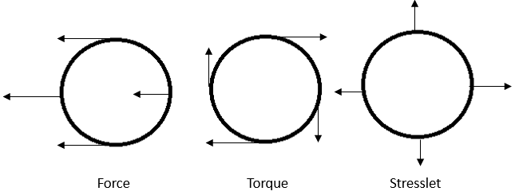
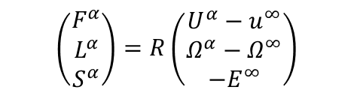
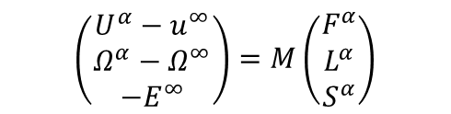
Resistance and mobility formulation
Linearity of the Stokes equation gives us a linear relationship of the force and velocity moments.
Resistance problem:
Mobility problem:
$$\left(\begin{matrix}F^{α} \\ L^{α} \\ S^{α}\end{matrix}\right)=R\left(\begin{matrix}U^{α}−u^{∞} \\ Ω^{α}−Ω^{∞} \\ {−E}^{∞}\end{matrix}\right)$$
$$\left(\begin{matrix}U^{α}−u^{∞} \\ Ω^{α}−Ω^{∞} \\ {−E}^{∞}\end{matrix}\right)=M\left(\begin{matrix}F^{α} \\ L^{α} \\ S^{α}\end{matrix}\right)$$
Properties of the grand resistance matrix, R and grand mobility matrix, M:
1.Configuration dependent
2.Symmetric
3.Positive definite.
S and E are both symmetric and traceless.
Hydrodynamic force and torque are of dimension 6N and stresslet has 5N independent vectors.

Slide 12

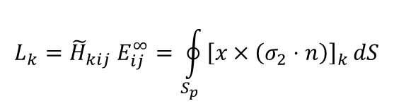
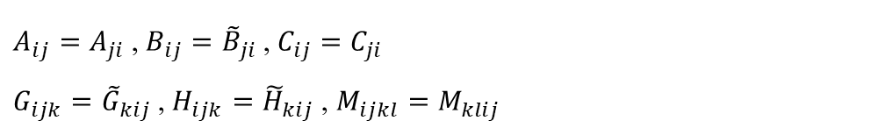
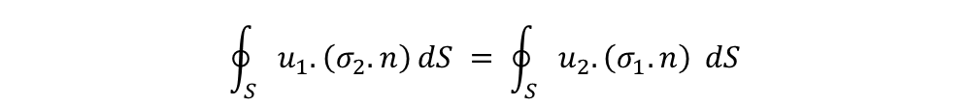
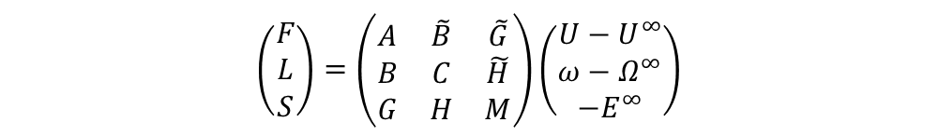
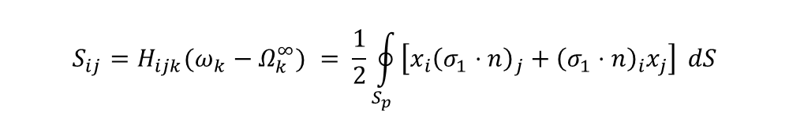

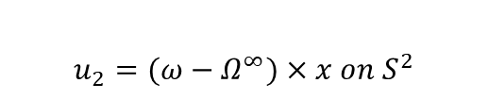
Resistance matrix is symmetric
$$\left(\begin{matrix}F \\ L \\ S\end{matrix}\right)=\left(\begin{matrix}A & \tilde{B} & \tilde{G} \\ B & C & \tilde{H} \\ G & H & M\end{matrix}\right)\left(\begin{matrix}U−U^{∞} \\ ω−Ω^{∞} \\ {−E}^{∞}\end{matrix}\right)$$
Resistance formulation
(1)
(2)
(3)
(4)
(6)
$A_{ij}=A_{ji}$, $B_{ij}={\tilde{B}}_{ji}$ , $C_{ij}=C_{ji}$
$G_{ijk}={\tilde{G}}_{kij}$, $H_{ijk}={\tilde{H}}_{kij}$ , $M_{ijkl}=M_{klij}$
$$\oint_{S}{u_{1}.\left(σ_{2}.n\right)}dS = \oint_{S}{u_{2}.\left(σ_{1}.n\right)} dS$$
Lorentz reciprocal theorem
Velocity field on two spheres
$$L_{k}={\tilde{H}}_{kij} E_{ij}^{∞}=\oint_{S_{p}}{{\left[x×\left(σ_{2}⋅n\right)\right]}_{k}}dS$$
$$u_{1}= −E^{∞}.x on S^{1}$$
$$u_{2}=(ω−Ω^{∞})×x on S^{2}$$
$$S_{ij}=H_{ijk}({ω_{k}−Ω}_{k}^{∞}) = \frac{1}{2}\oint_{S_{p}}{\left[x_{i}{\left(σ_{1}⋅n\right)}_{j}+{\left(σ_{1}⋅n\right)}_{i}x_{j}\right]} dS$$
$$−{E_{ij}^{∞} H}_{ijk}\left(Ω_{k}^{∞}−ω_{k}\right)=−\left(Ω_{k}^{∞}−ω_{k}\right){\tilde{H}}_{kij} E_{ij}^{∞}$$
$H_{ijk}={\tilde{H}}_{kij}$

Slide 13

$R={\left(M\right)}^{−1}$ if all moments from multipole expansion included.
Mobility matrix is of O(11N x 11N) calculation.
Truncated expansion with Faxen’s laws gives us only $M^{∞}$ →Far-field approximation
Interactions divided into far-field and near-field.
$R=$ $R^{ff}$+ $R^{nf}$
Far-field resistance $R^{ff}=$ ${\left(M^{∞}\right)}^{−1}$
Near-field interactions are due to the relative motion between the spheres.
$R^{nf}$ calculates two body interactions $R_{2B}$within a cutoff radius, r*.
To avoid double counting, remove far-field interactions ${R_{2B}}^{∞}$ within r*.
Grand resistance matrix
$$R={\left(M^{∞}\right)}^{−1}+R_{2B}−{R_{2B}}^{∞}$$

Slide 14
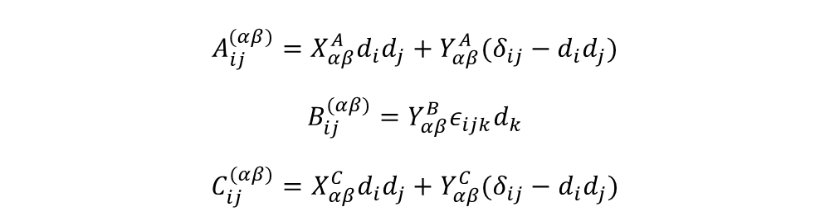
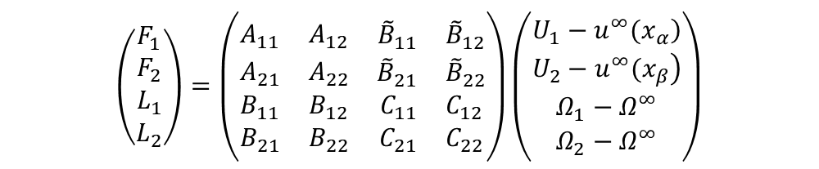
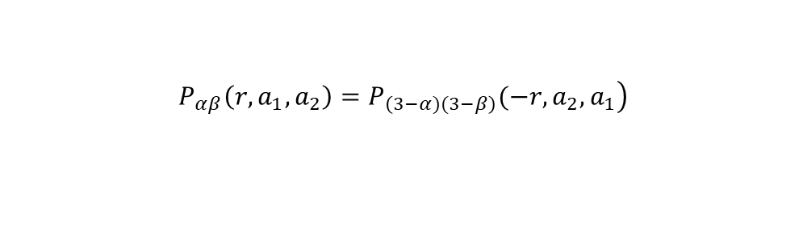
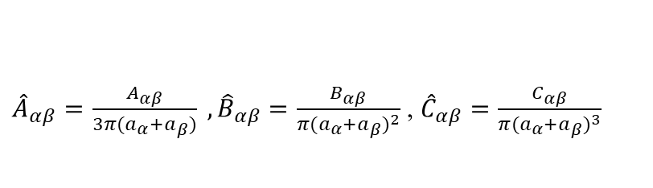
Components of resistance matrix for two spheres
F-T version of the linear relationship
$$\left(\begin{matrix}F_{1} \\ F_{2} \\ \begin{matrix}L_{1} \\ L_{2}\end{matrix}\end{matrix}\right)=\left(\begin{matrix}A_{11} & A_{12} & \begin{matrix}{\tilde{B}}_{11} & {\tilde{B}}_{12}\end{matrix} \\ A_{21} & A_{22} & \begin{matrix}{\tilde{B}}_{21} & {\tilde{B}}_{22}\end{matrix} \\ \begin{matrix}B_{11} \\ B_{21}\end{matrix} & \begin{matrix}B_{12} \\ B_{22}\end{matrix} & \begin{matrix}\begin{matrix}C_{11} & C_{12}\end{matrix} \\ \begin{matrix}C_{21} & C_{22}\end{matrix}\end{matrix}\end{matrix}\right)\left(\begin{matrix}\left.U_{1}−u^{∞}(x_{α}\right) \\ \left.U_{2}−u^{∞}(x_{β}\right) \\ \begin{matrix}Ω_{1}−Ω^{∞} \\ Ω_{2}−Ω^{∞}\end{matrix}\end{matrix}\right)$$
Each component tensor P given by three quantites r=$x_{2}−x_{1}, a_{1}and a_{2}.$
$$\left.P_{αβ}\left(r,a_{1},a_{2}\right)=P_{\left(3−α)(3−β\right)}(−r,a_{2},a_{1}\right)$$
Each tensor P in the matrix contains scalar functions and for axisymmetric particles.
$$A_{ij}^{(αβ)}=X_{αβ}^{A}d_{i}d_{j}+Y_{αβ}^{A}(δ_{ij}−d_{i}d_{j})$$
$$B_{ij}^{(αβ)}=Y_{αβ}^{B}ε_{ijk}d_{k}$$
$$C_{ij}^{(αβ)}=X_{αβ}^{C}d_{i}d_{j}+Y_{αβ}^{C}(δ_{ij}−d_{i}d_{j})$$
${\hat{A}}_{αβ}=\frac{A_{αβ}}{3π(a_{α}+a_{β})} ,{\hat{B}}_{αβ}=\frac{B_{αβ}}{π{(a_{α}+a_{β})}^{2}}$ , ${\hat{C}}_{αβ}=\frac{C_{αβ}}{π{(a_{α}+a_{β})}^{3}}$
Non-dimensionalization
Unit vector along line of centres d=r/r

Slide 15
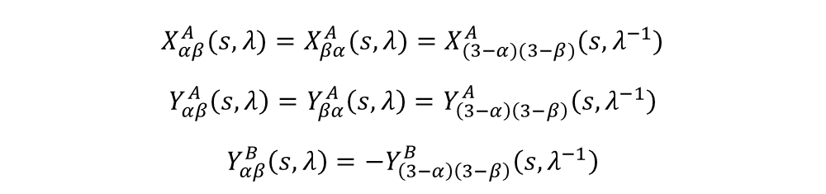
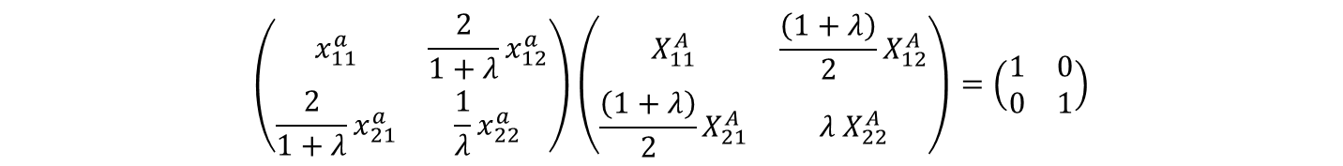

$$s=\frac{2r}{\left. (a_{1}+a_{2}\right)} and size ratio, λ=\frac{a_{2}}{a_{1}}$$
Non-dimensional variables
2⩽s ⩽$∞$, 0⩽ $λ$ ⩽$∞$
$$X_{αβ}^{A}(s, λ)=X_{βα}^{A}(s, λ)=X_{(3−α)(3−β)}^{A}(s, λ^{−1})$$
$$Y_{αβ}^{A}\left(s,λ\right)=Y_{βα}^{A}\left(s,λ\right)=Y_{\left(3−α\right)\left(3−β\right)}^{A}\left(s,λ^{−1}\right)$$
$$Y_{αβ}^{B}\left(s,λ\right)=−Y_{\left(3−α\right)\left(3−β\right)}^{B}\left(s,λ^{−1}\right)$$
Properties of scalar functions
𝑋-functions relate to terms that are parallel to the line of centres.
𝑌-functions relate to perpendicular terms.
Similarly, we have component tensors of mobility matrix and respective scalar function.
Relation between scalar functions of resistance and mobility equations.
$$\left(\begin{matrix}x_{11}^{a} & {\frac{2}{1+λ}x}_{12}^{a} \\ {\frac{2}{1+λ}x}_{21}^{a} & \frac{1}{λ}x_{22}^{a}\end{matrix}\right)\left(\begin{matrix}X_{11}^{A} & \frac{\left(1+λ\right)}{2}X_{12}^{A} \\ {\frac{\left(1+λ\right)}{2}X}_{21}^{A} & {λ X}_{22}^{A}\end{matrix}\right)=\left(\begin{matrix}1 & 0 \\ 0 & 1\end{matrix}\right)$$

Slide 16
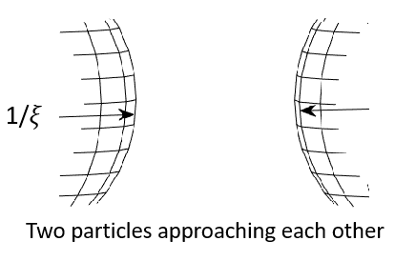
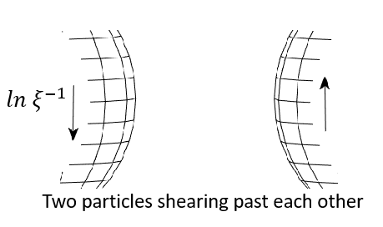
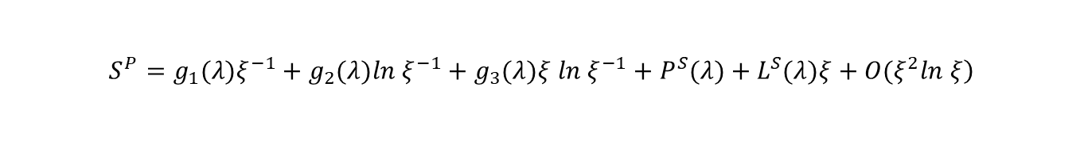

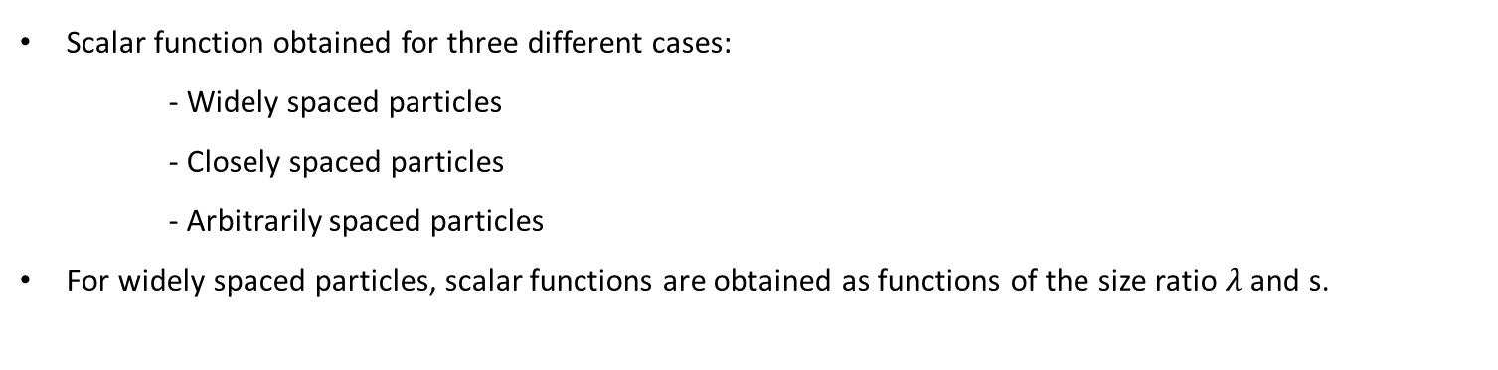

Scalar function obtained for three different cases:
- Widely spaced particles
- Closely spaced particles
- Arbitrarily spaced particles
For widely spaced particles, scalar functions are obtained as functions of the size ratio $λ$ and s.
Closely spaced particles:
Any scalar function S for a resistance matrix tensor P
$$\left.S^{P}=g_{1}(λ)ξ^{−1}+g_{2}(λ)ln ξ^{−1}+g_{3}(λ)ξ ln ξ^{−1}+P^{S}(λ)+L^{S}(λ)ξ+O(ξ^{2}ln ξ\right)$$
a$ξ$
$$ξ=s−2$$
$$non−dimensional gap.$$

Slide 17

Swan’s(2011) code algorithm
Steps involved:
Initialize all variables.
No. of particles, hydrodynamic force and torque, time step and simulation run time.
Initial position of particles.
Distance between particle pairs computed..
Far-field mobility matrix is generated and inverted.
Lubrication interactions are added to the inverted $M^{∞}$.
Calculation of the velocity of the individual particles, assembly and the connectivity tensor.
New position of the particles obtained.

Slide 18
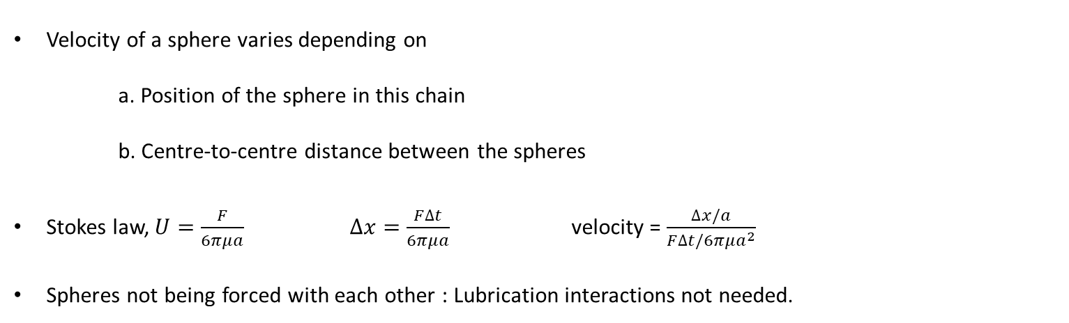
Problem of sedimenting particles
A linear chain of seven spheres of unit radii falling vertically.
Spheres placed horizontally with equal centre-to-centre distance.
Unit force is given in a direction perpendicular to the plane of the sphere.
Velocity of a sphere varies depending on
a. Position of the sphere in this chain
b. Centre-to-centre distance between the spheres
Stokes law, $U=\frac{F}{6πμa}$ $∆x=\frac{F∆t}{6πμa}$ velocity = $\frac{∆x/a}{{F∆t/6πμa}^{2}}$
Spheres not being forced with each other : Lubrication interactions not needed.

Slide 19
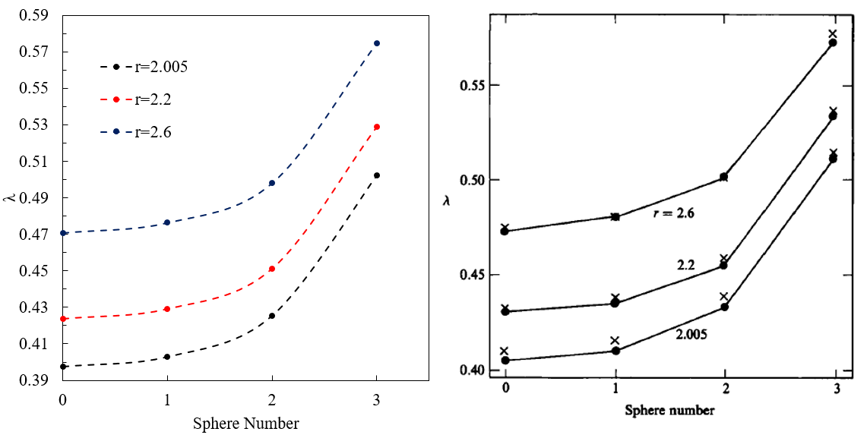
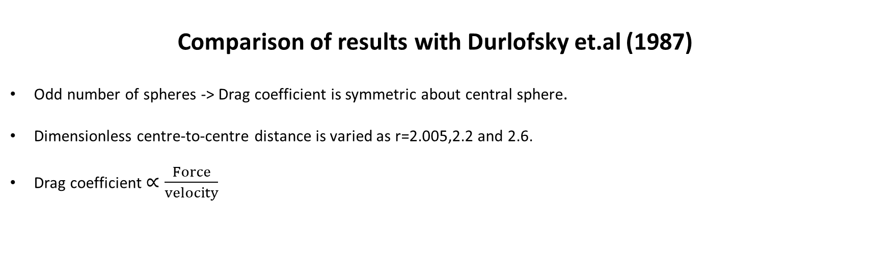
Comparison of results with Durlofsky et.al (1987)
Odd number of spheres -> Drag coefficient is symmetric about central sphere.
Dimensionless centre-to-centre distance is varied as r=2.005,2.2 and 2.6.
Drag coefficient $∝\frac{Force}{velocity}$
Conclusion:
Drag coefficient at the ends of the chain is more compared to the particles near the center.
Spheres closer together, particles fall faster.
Particles at the center fall faster.

Slide 20
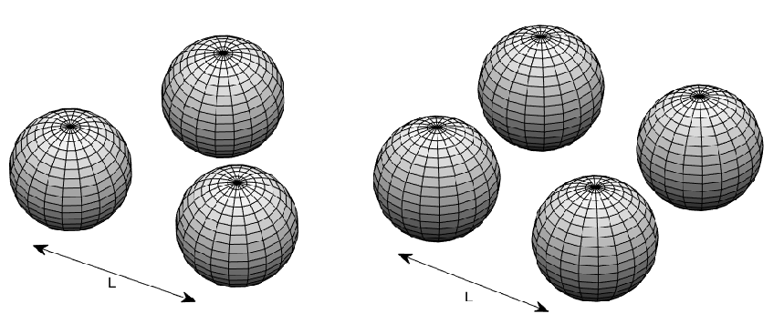
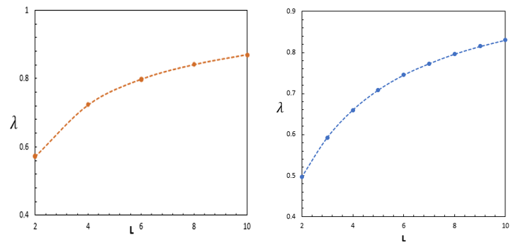
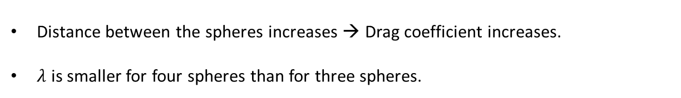
Drag coefficient of spheres at the vertices of an equilateral triangle of side L and at the corners of a square of side L.
Distance between spheres varied as L=2 to L=10 and spheres are falling vertically.
Triangle Square
Distance between the spheres increases → Drag coefficient increases.
$λ$ is smaller for four spheres than for three spheres.

Slide 21
Aggregates
→Hexagonal arrangement: Six branches of equal number of spheres with a sphere at the centre joining the branches.
→Another arrangement of two branches with equal number of spheres and having a sphere at the centre joining the branches.
→The number of spheres in each branch, N is increased from N=2 to N=6
→Aggregates in these two forms fall vertically in the ‘z’ direction with a unit force given in ‘z’ direction.

Slide 22
Comparison of drag coefficient for cross arrangement and hexagon arrangement.
Drag coefficient of spheres in hexagon arrangement is more than that of cross.
N=4 in hexagon form will give us 25 spheres and N=6 in cross arrangement will give us 25 spheres.
𝜆=6.1 for 25 spheres in hexagon and 𝜆=7 for 25 spheres in a cross arrangement. Drag coefficient is less for the hexagonal arrangement.
Conclusion: Velocity of spheres in hexagon arrangement higher for the same number of spheres than the spheres in a cross arrangement.

Slide 23
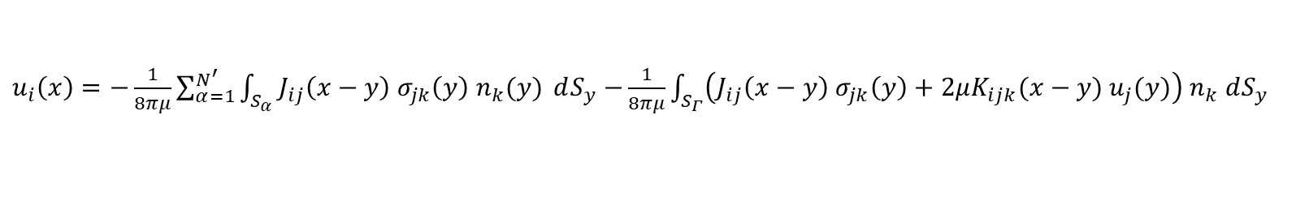
Ewald summation
To model infinite nature of the system using periodic boundary conditions.
O’Brien’s renormalization scheme:
To account for the changes in an infinite medium.
Size of the system increases, the sum of long-range interaction converges very slowly.
Integral representation of Stokes equation:
$u_{i}\left(x\right)=−\frac{1}{8πμ}\sum_{α=1}^{N^{′}}{\int_{S_{α}}{J_{ij}\left(x−y\right){ σ}_{jk}\left(y\right) n_{k}(y)} dS_{y}}$ $−\frac{1}{8πμ}\int_{S_{Γ}}{\left(J_{ij}\left(x−y\right){ σ}_{jk}\left(y\right)+2μK_{ijk}(x−y){ u}_{j}(y)\right)}$ $n_{k}$ $dS_{y}$
Why Ewald sum?
Reduce the number of particles needed to model a system.
To accelerate the convergence.
To ensure mobility matrix stays positive definite.

Slide 24
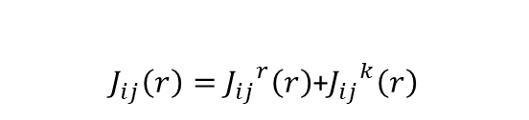
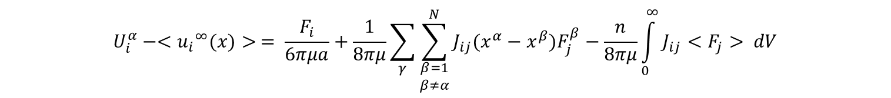
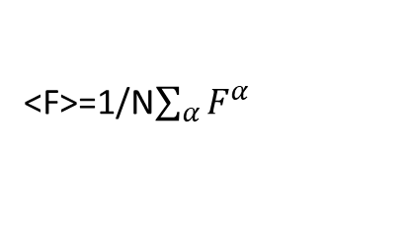

System is assumed to be dilute.
Each sphere feels only zeroth moment interaction of other spheres.
$$U_{i}^{α}−<{u_{i}}^{∞}(x)> = \frac{F_{i}}{6πμa}+\frac{1}{8πμ}\sum_{γ}{\sum_{\begin{matrix}β=1 \\ β≠α\end{matrix}}^{N}{J_{ij}(x^{α}−x^{β})F_{j}^{β}}}−\frac{n}{8πμ}\int_{0}^{∞}{J_{ij}}<F_{j}> dV$$
<F>=1/N$\sum_{α}{F^{α}}$
$J_{ij}\left(r\right)=$ ${J_{ij}}^{r}\left(r\right)$+${J_{ij}}^{k}\left(r\right)$
Oseen’s tensor is split into two
$$J_{ij}\left(r\right)=\left[δ_{ij}∇^{2}−∇_{i}∇_{j}\right]\left(r\right)$$
$${J_{ij}}^{r}\left(r\right)=\left[δ_{ij}∇^{2}−∇_{i}∇_{j}\right]\left(r erfc(λr\right))$$
$${J_{ij}}^{k}\left(r\right)=\left[δ_{ij}∇^{2}−∇_{i}∇_{j}\right]\left(r erf (λr\right))$$
Converges quickly in real space.
Fourier transformed and converges quickly in reciprocal space.
Accurate for far-field interactions in an infinite media.

Slide 25

Recent developments in Stokesian Dynamics
Avoid both the costly construction of the far-field mobility matrix of O(N²)
Inversion of the mobility matrix O(N³) calculations.
Iterative solvers to find required particle velocities by O(N²)
Eliminate fluid velocity -> Calculate mobility matrix
Calculate $F_{i}^{n}$ by iteration.
Initial value of $F_{i}^{n}$ assumed.
Fluid velocity determined using multipole expansion.
Use corrected value of $F_{i}^{n}$.
Accelerated Stokesian dynamics with calculations of O(N log N).

Slide 26
Thank you

