Slide 1
Hydrodynamics of Fractal Aggregates
M.Tech Thesis Defense
7th July 2021
Ashwin - 193020020
Supervisor: Prof. Jyoti Seth Co-Supervisor: Prof. Y.S. Mayya

Slide 2
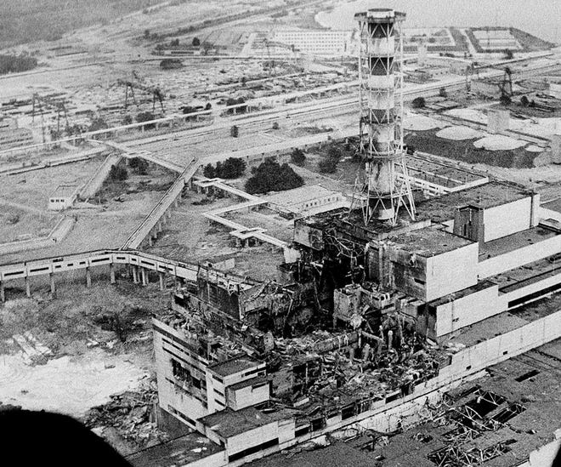
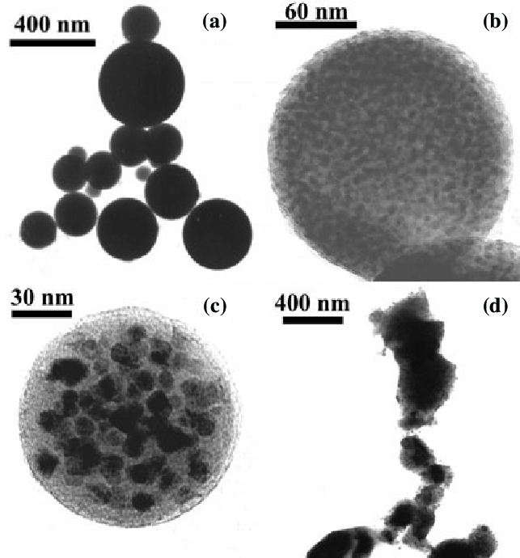
MOTIVATION
Release of nuclear aerosols can have health, environmental and geopolitical implications
It is important to understand the deposition kinetics to design the containment zone
To obtain the drag force acting on these aggregates.
Extent of fractality (compact, rarefied and highly rarefied) would depend on
Concentration and chemical nature of materials release, and
Process conditions in the containment.
Accounting for the fractal nature of aggregates will be a valuable input in aerosol safety codes.
Chernobyl disaster
Aggregates cannot be modelled as spherical!

Slide 3
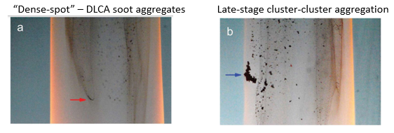
WHY ARE FRACTAL AGGREGATES DIFFERENT?
As surface area is high, drag force experienced also increases.
Affects the settling properties.
Released in wet and dry conditions.
Wet: Surface area/volume ratio will be minimized.
Dry: Surface area minimization does not happen.
OTHER APPLICATIONS
Bouyancy-opposed flame(BOF) aerosol reactor
Sythesizing carbon and silica aerosol gels.
Soot particles trapped in the flame recirculation
Forest fire: Aerosols generated have fractal dimension of 2.6
Wastewater treatment: Sedimentation of flocculated solids.

Slide 4
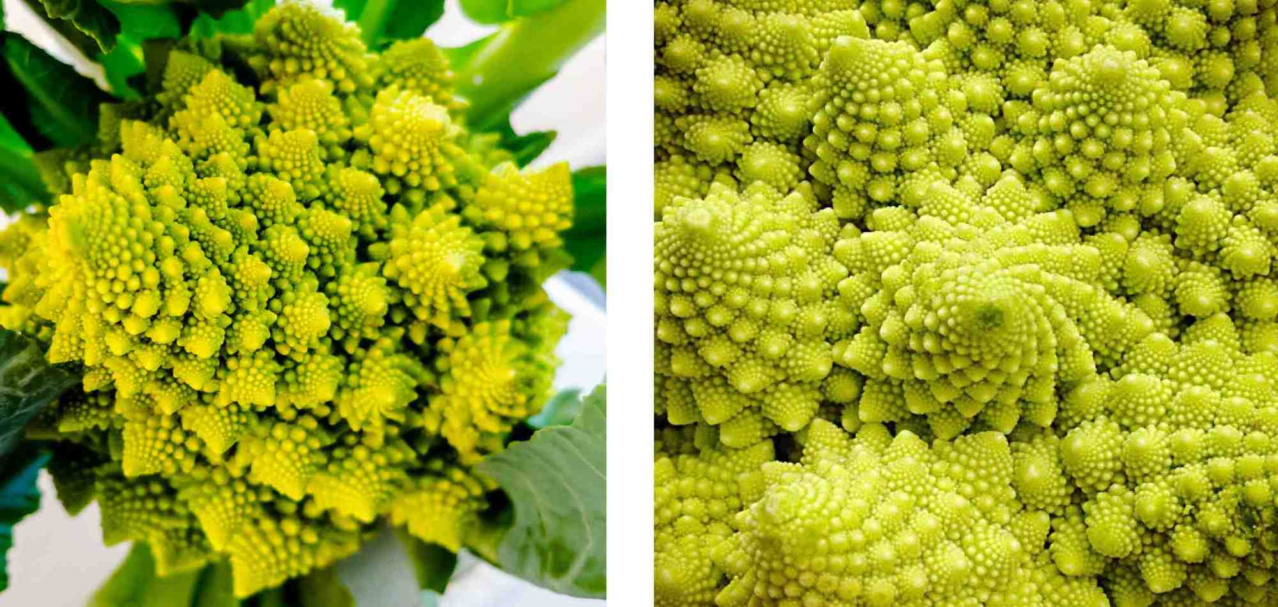
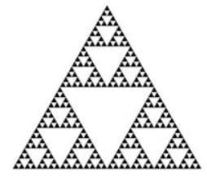
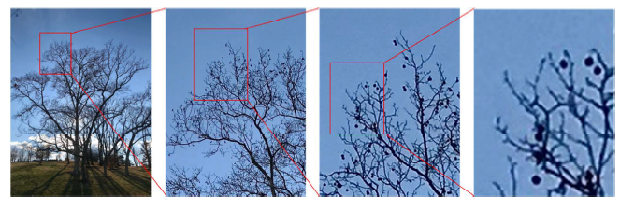
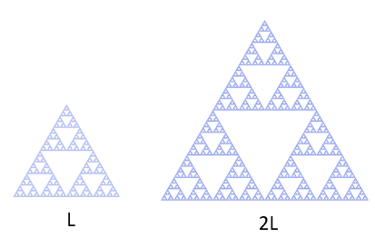
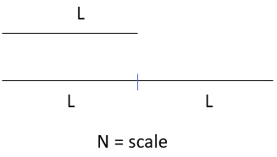
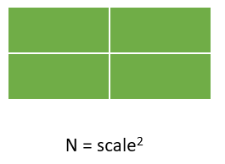
Fractals
Fractus – Broken or Fractured
More complex structure
Cannot be explained by Euclidean geometry.
Mandelbrot (1975) developed the concept of fractal geometry.
Properties:
Self-similar
Scale-invariance
In nature:
In geometry:
Scaling invariance in a tree
Fractal dimension = Fractional dimension
3
3 = 2^{D}→D = 1.58 where D < d
1
2
Euclidean objects
*Mandelbrot(1975)

Slide 5
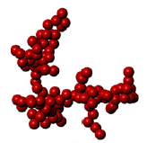
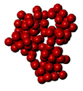


FRACTAL AGGREGATES – Properties and Characterization
- Aggregates have complex structure and can be described by fractal geometry.
Number of monomers within radial distances, $N(r)\sim r^{D_{f}}$
Fractal dimension: Space filling capacity of a pattern
1.5 ⩽ $D_{f}$⩽ 3
Scaling law: $N=k_{f}{\left(\frac{R_{g}}{a}\right)}^{D_{f}}$
where $k_{f}$:prefactor, $R_{g}$: Radius of gyration, $D_{f}$:Fractal dimension and a:Monomer radius
Radius of Gyration: Quantify the mass distribution within an object.
$${R_{g}}^{2}=\frac{1}{N}\sum_{i=1}^{N}{{\left(r_{i}−r_{cm}\right)}^{2}} and centre of mass,{ r}_{cm}=\frac{1}{N}\sum_{i=1}^{N}{r_{i}}$$
Pre-factor$,k_{f}$ is a function of packing fraction.
(1)
(2)
Df =1.8 Df = 2.5 Df = 3
-Fractal dimension increases, compactness increases.
*Sorenson(2011)

Slide 6

*(#no of slides)
CONTENTS
Stokesian Dynamics (4): Governing equations - Obtaining Force velocity relation
Application to rigid aggregates (2): Velocity of individual particles – Rigidity check
Aggregation models (6): DLA – DLCCA – Tunable CCA – N vs $R_{g}$
Hydrodynamics (8) :
Mobility radius – close-range interactions included – Relation with $R_{g}$ - $R_{m}/R_{g}$=$f\left(D_{f}\right)$ - Dependent on N?
Velocity studies (17):
Single sphere – Effect of close-range interactions – Penetration depth$(δ^{∗})$ - $δ^{∗}$ and N - $δ^{∗}$ and $R_{m}/R_{g}$
Deformable aggrgegates (3):
Three particle system
Conclusion (1)

Slide 7

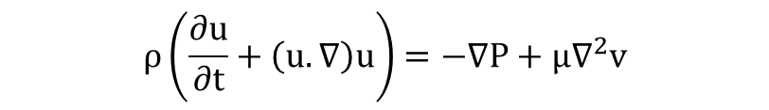
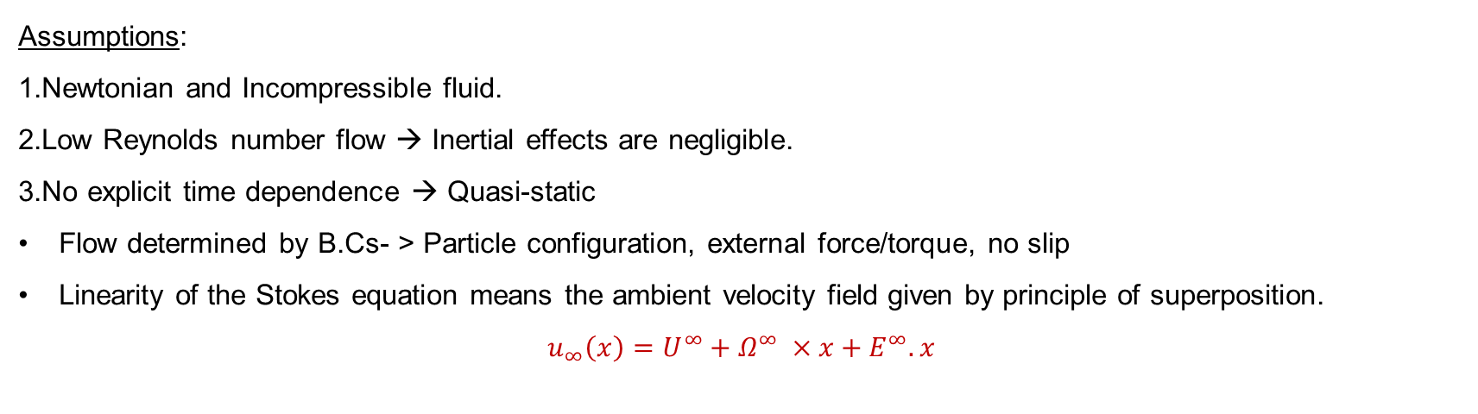
Governing equations
Navier-Stokes equation and continuity equation
Stokes equation
$$ρ\left(\frac{∂u}{∂t}+\left(u.∇\right)u\right)=−∇P+μ∇^{2}v$$
Re << 1
$$0=−∇P+μ∇^{2}u$$
(1)
$$∇.(ρu)=0$$
$$∇.(u)=0$$
Assumptions:
1.Newtonian and Incompressible fluid.
2.Low Reynolds number flow → Inertial effects are negligible.
3.No explicit time dependence → Quasi-static
Flow determined by B.Cs- > Particle configuration, external force/torque, no slip
Linearity of the Stokes equation means the ambient velocity field given by principle of superposition.
$$u_{∞}\left(x\right)=U^{∞}+Ω^{∞} ×x+E^{∞}.x$$
(2)

Slide 8


Stokesian Dynamics
Significance: Lubrication interactions are easily included unlike other methods.
Fractals discretised into spheres.
Linear relationship between the velocity and force moments.
$$\left(\begin{matrix}F^{α} \\ T^{α} \\ S^{α}\end{matrix}\right)=R\left(\begin{matrix}U^{α}−u^{∞} \\ Ω^{α}−Ω^{∞} \\ {−E}^{∞}\end{matrix}\right)$$
Resistance matrix accounts for near field and far-field interactions.
$R={\left(M^{∞}\right)}^{−1}+R_{2B}−{R_{2B}}^{∞}$ $(R=R^{ff}+R^{nf})$
- Configuration dependent , Symmetric, Positive definite.
- Near-field: $R_{2B}$= $f\left(s,λ\right) and s=\frac{2r}{\left. (a_{1}+a_{2}\right)} and λ=\frac{a_{2}}{a_{1}}$
- Far-field: Green’s function – multipole expansion – Faxen’s law
$$m.\frac{dU}{dt}=F^{H}+F^{E}+F^{B}$$
$$F^{H}=−F^{E}$$
$$F^{H}→Hydrodynamic force$$
$$F^{E}→External force$$
$$F^{B}→Brownian force$$
*Brickell(2012)

Slide 9
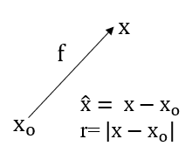
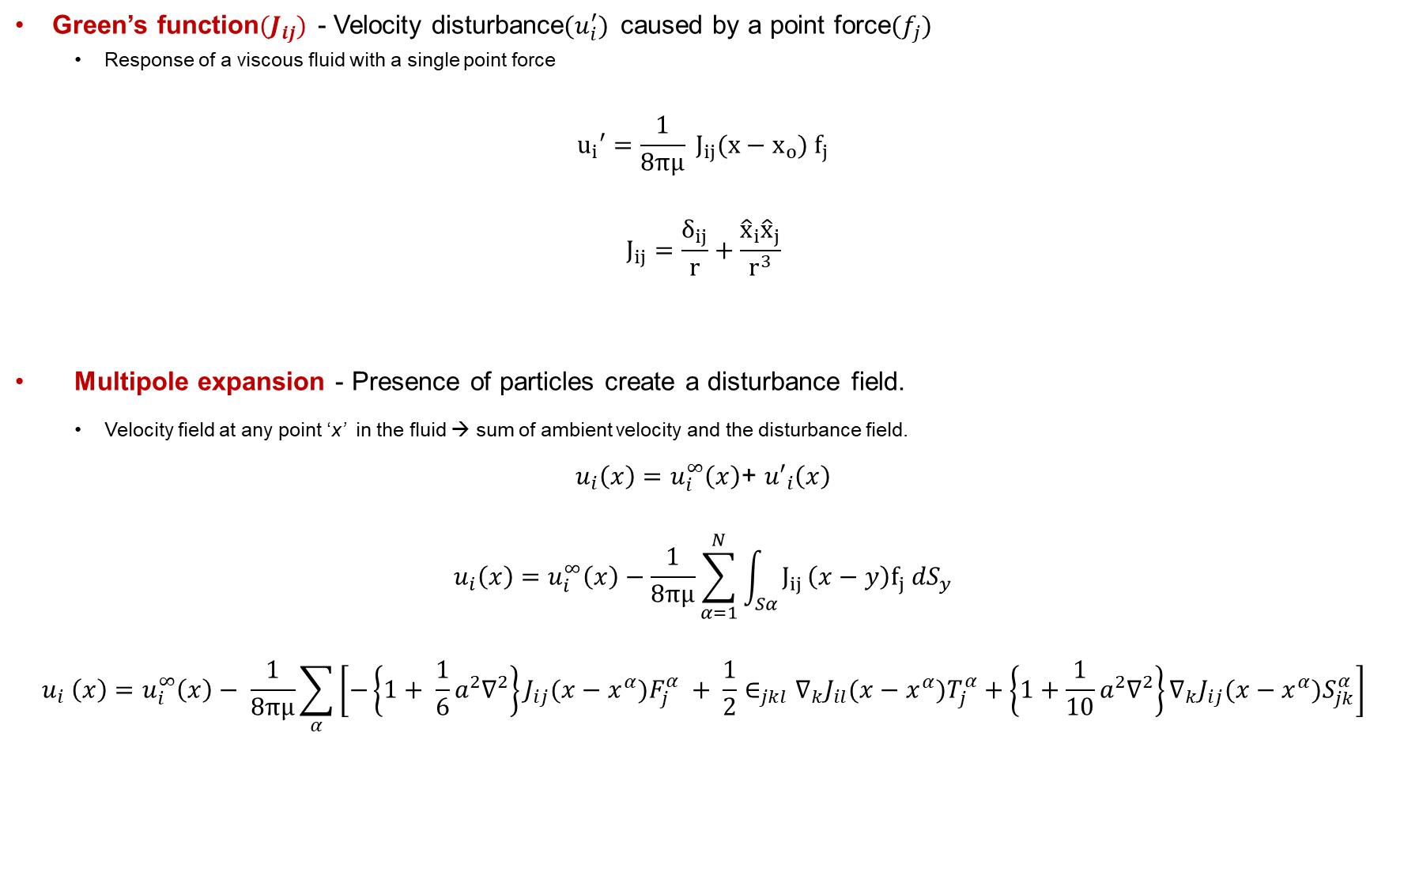


Green’s function${(J}_{ij})$ - Velocity disturbance$(u_{i}^{′})$ caused by a point force${(f}_{j})$
Response of a viscous fluid with a single point force
$$u_{i}′=\frac{1}{8πμ} J_{ij}(x−x_{o}) f_{j}$$
$$J_{ij}=\frac{δ_{ij}}{r}+\frac{{\hat{x}}_{i}{\hat{x}}_{j}}{r^{3}}$$
Multipole expansion - Presence of particles create a disturbance field.
Velocity field at any point ‘x’ in the fluid → sum of ambient velocity and the disturbance field.
$u_{i}\left(x\right)=u_{i}^{∞}\left(x\right)$+ ${u′}_{i}\left(x\right)$
$$u_{i}\left(x\right)=u_{i}^{∞}\left(x\right)−\frac{1}{8πμ}\sum_{α=1}^{N}{\int_{Sα}{J_{ij }\left(x−y\right)f_{j} {dS}_{y}}}$$
$$u_{i} \left(x\right)=u_{i}^{∞}\left(x\right)− \frac{1}{8πμ}\sum_{α}{\left[−\left\{1+ \frac{1}{6}a^{2}∇^{2}\right\}J_{ij}(x−x^{α})F_{j}^{α} + \frac{1}{2}∈_{jkl}∇_{k}J_{il}(x−x^{α})T_{j}^{α}+\left\{1+\frac{1}{10}a^{2}∇^{2}\right\}∇_{k}J_{ij}(x−x^{α})S_{jk}^{α}\right]}$$
$x→$point in fluid
$x^{α}→$ Centre of particle $α$
$y→$Point on the particle surface
$a→$Particle radius
$F_{j},T_{j},S_{jk}→$Force, Torque, Stresslet
Taylor’s expansion about particle centre, $x^{α}$
*Brickell(2012)

Slide 10
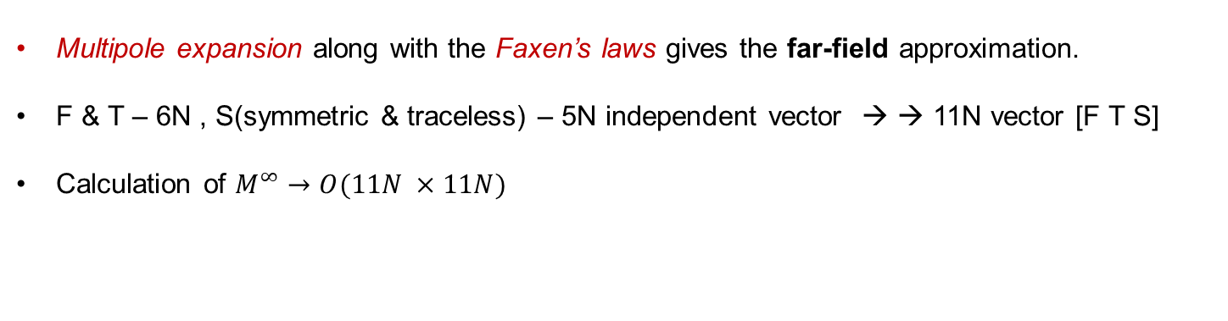

Faxen’s laws - Motion of a single particle 𝞪 immersed in a flow field
Correction to Stokes law.
$$U_{i}^{α}−u_{i}^{∞}(x^{α})=\frac{F_{i}^{α}}{6πμa}+\left(1+\frac{1}{6}a^{2}∇^{2}\right){u′}_{i}\left(x^{α}\right)$$
$$Ω_{i}^{α}−Ω_{i}^{∞}=\frac{T_{i}^{α}}{{8πμa}^{3}}+\frac{1}{2}ε_{ijk}∇_{j}{u′}_{k}\left(x^{α}\right)$$
$$−E_{ij}^{∞}=\frac{S_{ij}^{α}}{20πμ{a^{3}}/3}+\left(1+\frac{a^{2}}{10}∇^{2}\right){e′}_{ij}\left(x^{α}\right)$$
Particle translating in an ambient translating field.
Particle rotating in an ambient rotating field.
Stresslet on a particle in a rate of strain field
Multipole expansion along with the Faxen’s laws gives the far-field approximation.
F & T – 6N , S(symmetric & traceless) – 5N independent vector → → 11N vector [F T S]
Calculation of $M^{∞}→O(11N ×11N)$
*Brickell(2012)

Slide 11

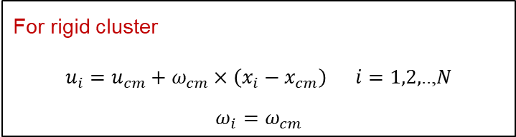


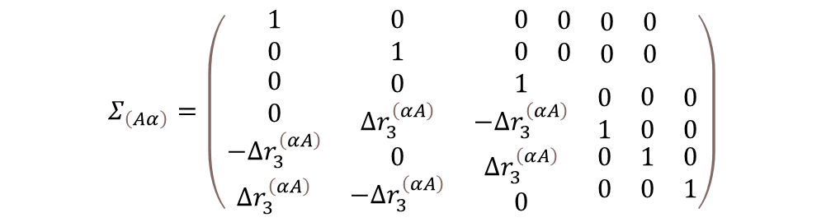
Rigid aggregates
Normally we have $U=R_{FU}^{−1}.F^{E}$
Velocity of each particle in a rigid body $U= Σ^{T}.\hat{U}$
Velocity of an aggregate $\hat{U}={\left(Σ.R_{FU}.Σ^{T}\right)}^{−1}. Σ.F^{E}$
For each particle in an aggregate
For rigid cluster
$u_{i}=u_{cm}+ω_{cm}×\left(x_{i}−x_{cm}\right) i=1,2,$..,$N$
$${ω_{i}=ω}_{cm}$$
$$R={\left(M^{∞}\right)}^{−1}+R_{2B}−{R_{2B}}^{∞}$$
$$R={\left(M^{∞}\right)}^{−1}$$
$$Σ_{\left(Aα\right)}=\left(\begin{matrix}1 & 0 & \begin{matrix}0 & \begin{matrix}0 & \begin{matrix}0 & 0\end{matrix}\end{matrix}\end{matrix} \\ 0 & 1 & \begin{matrix}0 & \begin{matrix}0 & \begin{matrix}0 & 0\end{matrix}\end{matrix}\end{matrix} \\ \begin{matrix}0 \\ 0 \\ \begin{matrix}−∆r_{3}^{\left(αA\right)} \\ ∆r_{3}^{\left(αA\right)}\end{matrix}\end{matrix} & \begin{matrix}0 \\ ∆r_{3}^{\left(αA\right)} \\ \begin{matrix}0 \\ −∆r_{3}^{\left(αA\right)}\end{matrix}\end{matrix} & \begin{matrix}\begin{matrix}1 \\ −∆r_{3}^{\left(αA\right)} \\ \begin{matrix}∆r_{3}^{\left(αA\right)} \\ 0\end{matrix}\end{matrix} & \begin{matrix}\begin{matrix}0 \\ 1 \\ \begin{matrix}0 \\ 0\end{matrix}\end{matrix} & \begin{matrix}\begin{matrix}0 \\ 0 \\ \begin{matrix}1 \\ 0\end{matrix}\end{matrix} & \begin{matrix}0 \\ 0 \\ \begin{matrix}0 \\ 1\end{matrix}\end{matrix}\end{matrix}\end{matrix}\end{matrix}\end{matrix}\right)$$
$${∆r}^{\left(αA\right)}=x^{\left(α\right)}−x^{\left(A\right)}$$
and
Centre of mass of aggregate
Distance between the centre of particle 𝞪 and centre of mass of an aggregate A
Rigid body matrix
*Swan(2011)

Slide 12
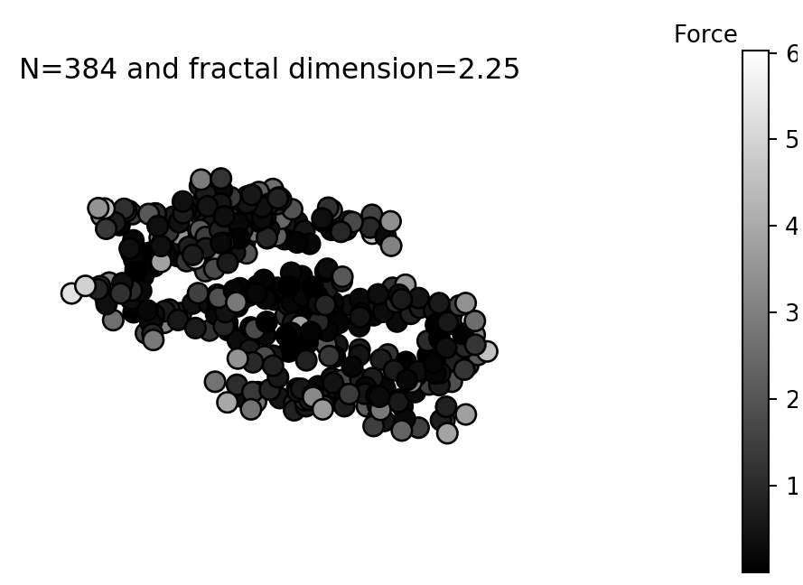

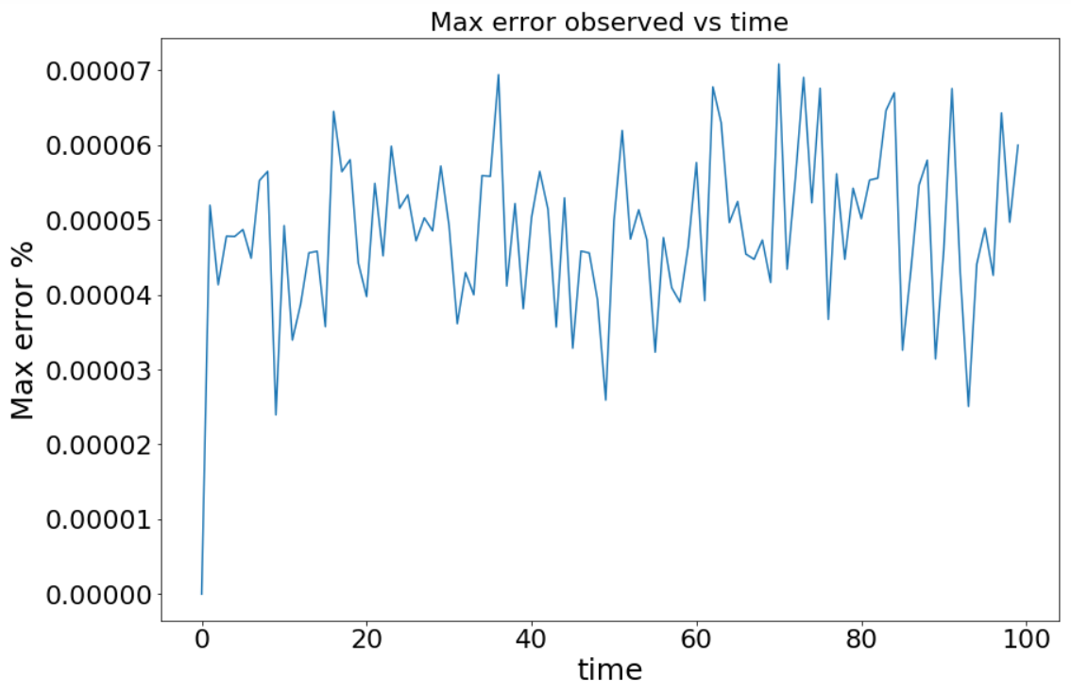
Check for rigidity
If unit force is given on N particles(say x dir), the aggregate experiences force of (N*1) overall in x dir.
Inter-particle distance stays same throughout.
Check for rigidity
Force distribution
-DLA N=100 experiences 1/N force on each particle.
-Max error is the maximum of all the error in inter-particle distance.

Slide 13
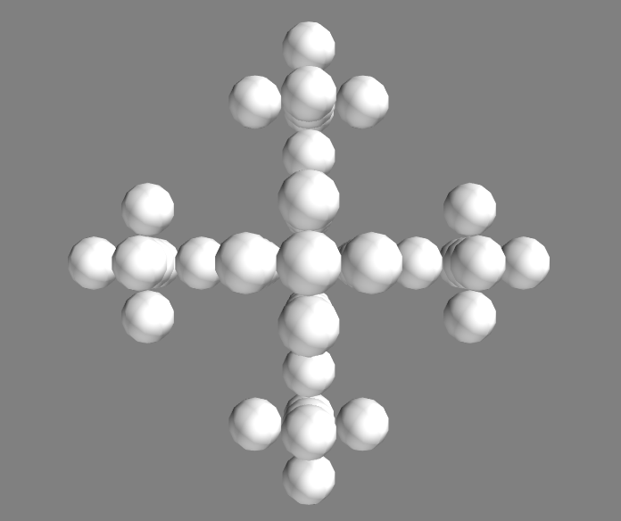
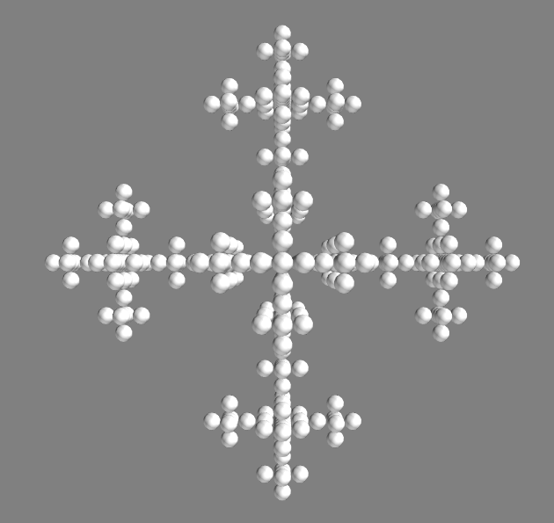
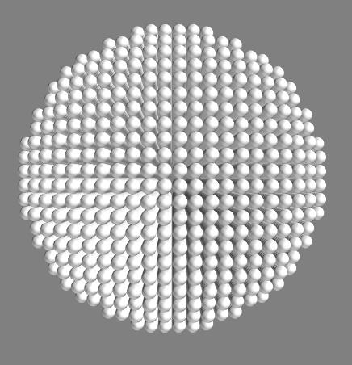
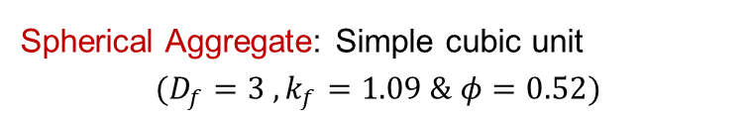
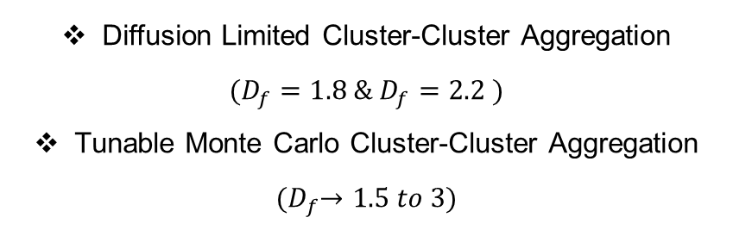
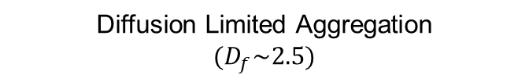
Aggregation Models
Based on particle-cluster and cluster-cluster aggregation
Statistical fractals
Diffusion Limited Cluster-Cluster Aggregation
$$(D_{f}=1.8 \& D_{f}=2.2 )$$
Tunable Monte Carlo Cluster-Cluster Aggregation
$${(D}_{f}→1.5 to 3)$$
Diffusion Limited Aggregation
$$(D_{f}\sim 2.5)$$
Mathematical fractal: Vicsek
Spherical Aggregate: Simple cubic unit
$$(D_{f}=3 ,k_{f}=1.09 \& φ=0.52)$$

Slide 14
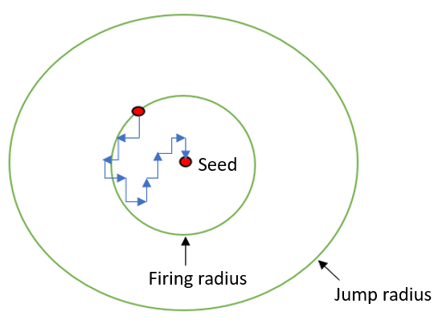
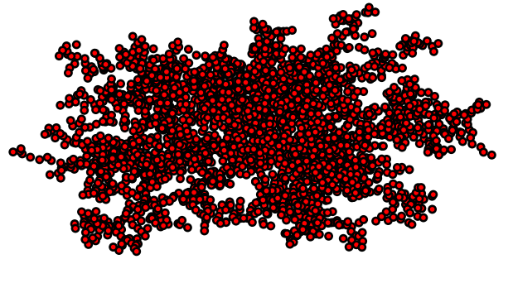
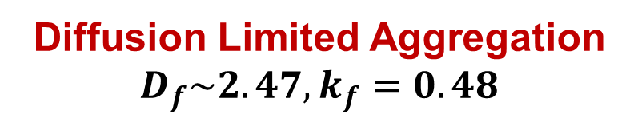
Diffusion Limited Aggregation
$$D_{f}\sim 2.47,k_{f}=0.48$$
*Off-lattice aggregation
Steps involved –Random walk model
Seed particle placed at centre
New particle fired from any point on the firing radius.
Makes several random walks. Collision check is done.
Near seed particle, sticks (Sticking probability ~1)
Newly added particle leaves the jump circle → Discarded.
Dendritic structure
DLA N=1000 and df =2.45
*Witten and Sander(1981)

Slide 15
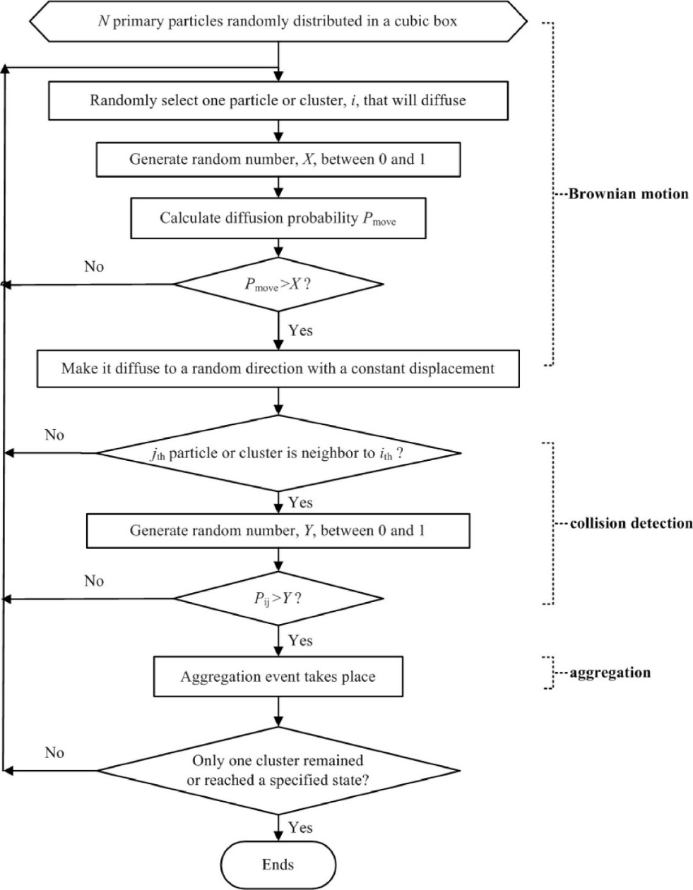
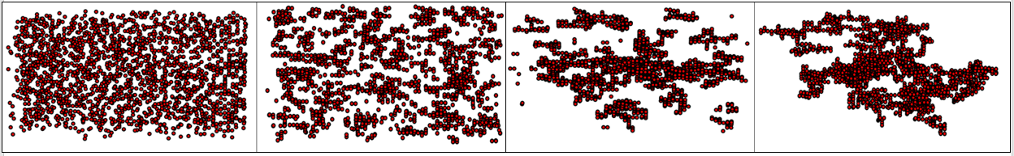


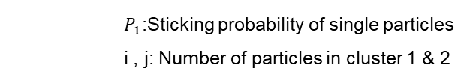

Diffusion Limited Cluster-Cluster Aggregation (DLCCA)
Flowchart - Xiong et.al (2014)
*On-lattice aggregation
Obtained by varying initial concentration in the algorithm.
N = C * L³
They move in random motion, colliding and forming clusters.
Probability to move
$P_{move}=\frac{D_{i}}{D_{max}}$
Probability to stick
$$P_{ij}=P_{1}×{\left(i×j\right)}^{σ}$$
Diffusion coefficient of any cluster with ‘i’ particles
$$D_{i}=D_{1}×S^{γ}$$
$D_{1}$:Diffusion coefficient of single particle = f(T)
$D_{max}$:Maximum diffusion coefficient of any cluster
S: Mass of a cluster given by Number of monomers.
$P_{1}$:Sticking probability of single particles
i , j: Number of particles in cluster 1 & 2
Growth of a DLCCA cluster: N=2048 and Df = 2.2
*Meakin(1983)

Slide 16
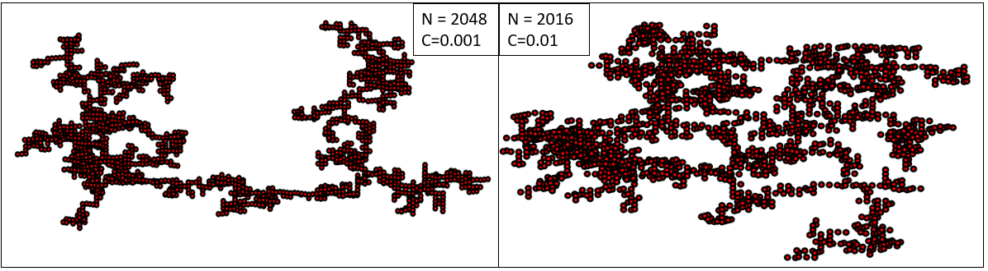
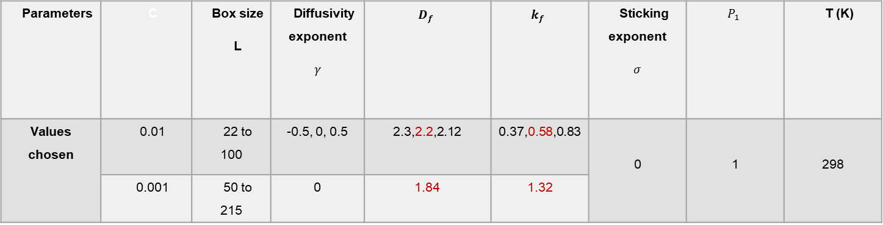


DLCCA –Fractals generated
Parameters | C | Box size L | Diffusivity exponent $$γ$$ | $$D_{f}$$ | $$k_{f}$$ | Sticking exponent $$σ$$ | $$P_{1}$$ | T (K)
Values chosen | 0.01 | 22 to 100 | -0.5, 0, 0.5 | 2.3,2.2,2.12 | 0.37,0.58,0.83 | 0 | 1 | 298
 | 0.001 | 50 to 215 | 0 | 1.84 | 1.32
Sticks easily
Fractals with C=0.001 and C=0.01
$$D_{f}=1.84$$
$$D_{f}=2.2$$
*Meakin(1983)

Slide 17
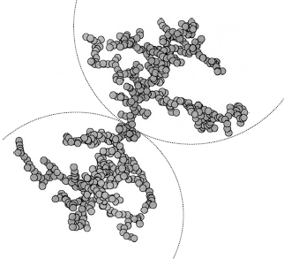
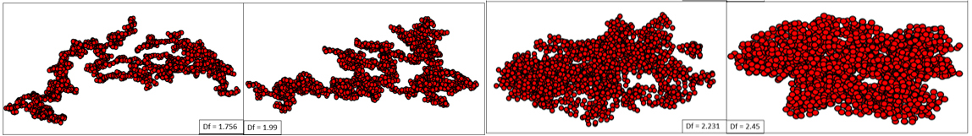

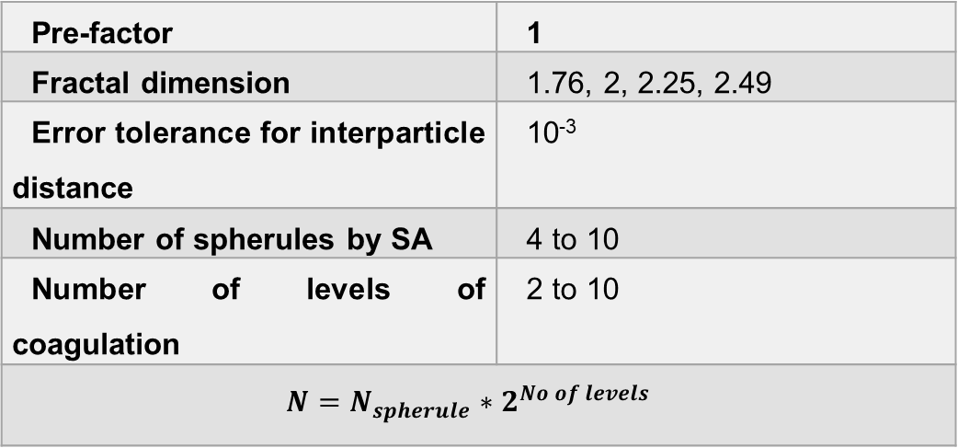
‘Tunable’ Monte Carlo CCA
Cluster-cluster aggregation
*Off-lattice aggregation
‘Tuned’ to have fixed $D_{f}$and $k_{f}$
Sequential algorithm(particle-cluster aggregation):
Generate clusters with 4 to 10 spherules → Scaling laws are satisfied
Centre of clusters placed at a geometric distance → Scaling laws are satisfied.
Clusters rotated until they have one contact point and no overlap.
In the end, only one aggregate is left.
Pre-factor | 1
Fractal dimension | 1.76, 2, 2.25, 2.49
Error tolerance for interparticle distance | 10⁻³
Number of spherules by SA | 4 to 10
Number of levels of coagulation | 2 to 10
$$N=N_{spherule}∗2^{No of levels}$$
N=2000
$D_{f}=1.76 to 2.49$ with $k_{f}=1$
*Filippov (2000)]

Slide 18
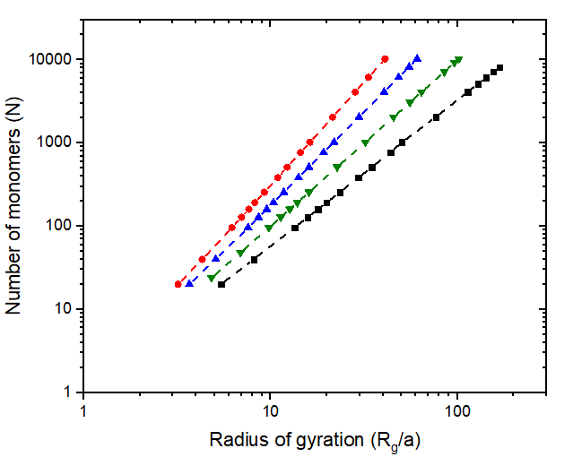

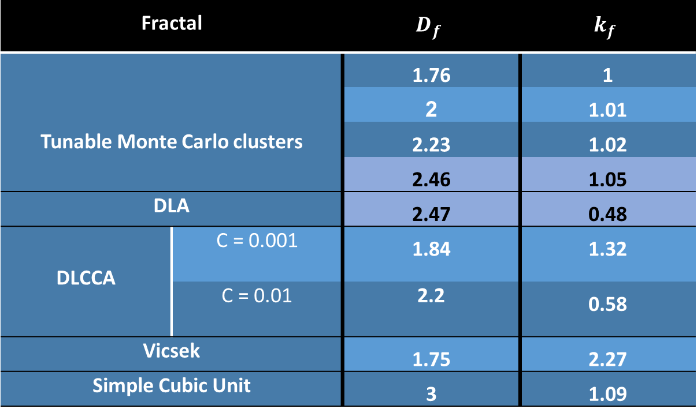
Summary of fractal dimension and prefactor
$$N=k_{f}{\left(\frac{R_{g}}{a_{o}}\right)}^{D_{f}}$$
Fractal |  | $$D_{f}$$ | $$k_{f}$$
Tunable Monte Carlo clusters |  | 1.76 | 1
 |  | 2 | 1.01
 |  | 2.23 | 1.02
 |  | 2.46 | 1.05
DLA |  | 2.47 | 0.48
DLCCA | C = 0.001 | 1.84 | 1.32
 | C = 0.01 | 2.2 | 0.58
Vicsek |  | 1.75 | 2.27
Simple Cubic Unit |  | 3 | 1.09
Tunable Monte Carlo Clusters
$$●−D_{f}=2.46$$
$$▲−D_{f}=2.23$$
$$▼ −D_{f}=1.99$$
$$∎−D_{f}=1.76$$

Slide 19



Hydrodynamic Properties of Interest
Mobility radius: Mobility radius in each direction is obtained by
$R_{mi}=\frac{F_{i}}{{\hat{U}}_{i}}$
Mobility radius: $R_{m}$ obtained by three direction average.
Hydrodynamic Ratio: Ratio of mobility radius to radius of gyration.
-Confirmed to increase with fractal dimension.
-Prediction with Kirkwood-Riseman(1948) theory →$R_{m}/R_{g}$ independent with N.
-Porous sphere models shows $R_{m}/R_{g}$ depends on N.
-Nyugen(2007) showed $R_{m}/R_{g}$ is independent of N → But does not reach a constant value.
-This study strongly establishes the ratio to be independent of N.
$$D_{f}=2.46$$
N=1024
*Van Sarloos(1987)

Slide 20





Mobility radius and Radius of gyration
Lubrication interactions included
N varies from 20 to 10240.
Wiltzus et. al(1982) predicted R_{M} is directly proportional to R_{G}
As fractal dimension increases, mobility radius is overestimated.
Overestimate $R_{m}\sim R_{G}^{y}$
Only when there is a relative motion between the spheres, lubrication forces are necessary. [Swan (2011)]
With lubrication interactions, estimated velocity is comparatively small.
Fractals | Tunable Monte Carlo Clusters |  |  |  | Simple cubic unit
$$D_{f}$$ | 1.76 | 2 | 2.23 | 2.46 | 3
$$y$$ | 1.07 | 1.24 | 1.38 | 1.40 | 2.41
□$−D_{f}=3$
$$●−D_{f}=2.46$$
$$▲−D_{f}=2.23$$
$$▼ −D_{f}=1.99$$
$$∎−D_{f}=1.76$$
N |  | 1024 | 10240
Aggregate velocity $$(D_{f}=2.23)$$ | With lubrication | 27 | 51.3
 | Without lubrication | 43.5 | 153.4
*Brady & Bossis (1991)
*Lattuada et.al (2001)

Slide 21



Mobility radius & Radius of gyration
Excluding lubrication interactions
$$R_{m}∝R_{g}$$
Tunable Monte Carlo clusters
Fractal |  | $$D_{f}$$ | Rm/Rg
Tunable Monte Carlo clusters |  | 1.76 | 0.7934 ± 0.0029
 |  | 1.99 | 0.9435 ± 0.0021
 |  | 2.23 | 1.0842 ± 0.0028
 |  | 2.46 | 1.173 ± 0.0027
DLCCA | C = 10⁻³ | 1.84 | 0.9389 ± 0.0159
 | C = 10⁻² | 2.2 | 1.089 ±0.0101
DLA |  | 2.47 | 1.238 ± 0.0059
Vicsek |  | 1.75 | 1.011 ± 0.0084
Simple Cubic Unit |  | 3 | 1.29 ± 0.0029
Small error
$$●−D_{f}=2.46$$
$$▲−D_{f}=2.23$$
$$▼ −D_{f}=1.99$$
$$∎−D_{f}=1.76$$

Slide 22



Hydrodynamic ratio and fractal dimension
$$\frac{R_{m}}{R_{g}} increases with D_{f}$$
Increases as fractal dimension increases
DLCCA($▲$) and Tunable CCA($●$)
Simple cubic unit($◻$): Exactly 1.29 as in all literatures when $D_{f}=3$.
$\frac{R_{m}}{R_{g}}=\sqrt{\frac{D_{f}+2}{D_{f}}}$ for spherical aggregates
Vicsek($○$): Similar behavior observed by Filippov(2000) and exact values obtained by Seto et.al(2011)-SD
DLA($◇$): More branches at the exterior leading to higher values.
$◻−simple cubic unit ○−Vicsek ◇−DLA ▲−DLCCA\left(γ=0\right)$ $●−Tunable Monte Carlo$
▶ $−DLCCA\left(γ=−0.5\right)$◀ $−DLCCA\left(γ=0.5\right)$
*Gmachowski(1995)

Slide 23




Hydrodynamic ratio and fractal dimension
Comparison with previous works
Numerical simulations, Kirkwood-Riseman, porous sphere models, experiments
Numerical simulations
Kirkwood-Riseman
-Chen(1988)
Porous sphere model: Gmachowski(1995) - CCA
Experiment:
-Wiltzus(1972) was first to determine experimentally with $\frac{R_{m}}{R_{g}}=0.72$ for $D_{f}=2.1$
- Wang(1999) values are close at $D_{f}=2.15$
Chopard et.al (2006) | LBM | Tunable CCA | $$100≤N≤20000$$
Lattuada(2010) | SD |  | N<1000
Fellay(2013) | SD
DLA | $$D_{f}=2.44$$ | $$100≤N≤900$$ | Our value – 1.24
RLA | $$D_{f}=2.1$$ | $$100≤N≤400$$
DLCCA | $$D_{f}=1.8$$ | $$50≤N≤350$$ | Our value – 0.94

Slide 24


Hydrodynamic ratio and number of particles
Simple cubic unit: 1.29 for large N and slightly low as they are not completely spherical
DLA: Slow approach to asymptotic regime at N=2000
DLCCA: Aymptotic regime approaches faster when compared to DLA.
Diffusion Limited Clusters
$\frac{R_{m}}{R_{g}}=αN^{β}$ can be used to test independent nature
Fractal | Fractal dimension | $$β$$
Simple cubic unit | 3 | 0.0015
DLA | 2.47 | 0.0295
DLCCA | 1.84 | 0.0054
 | 2.2 | 0.0354
$β$ values are very small (<0.04)
□$−simple cubic unit, ◇−DLA,△−DLCCA D_{f}=2.2,○ −DLCCA D_{f}=1.84$
*Warren(1994)

Slide 25




Hydrodynamic ratio and number of particles
$D_{f}<2$ shows slight decrease for small N.
Almost constant for all $D_{f}$
$\frac{R_{m}}{R_{g}}=αN^{β}$ can be used to test independent nature
Tunable Monte Carlo Clusters
Fractal | Fractal dimension | $$β$$
Tunable Monte Carlo clusters | 1.76 | -0.008
 | 1.99 | -0.004
 | 2.23 | 0.0041
 | 2.46 | 0.0044
$β$ values are very small (<0.01) when compared to other fractals.
“Tuned” fractals exhibit high degree of fractality
$$●−D_{f}=2.46, ▲−D_{f}=2.23 ,▼ −D_{f}=1.99 ,∎−D_{f}=1.76$$

Slide 26




Hydrodynamic ratio and size
Comparison with previous works
DLCCA$(D_{f}=1.84)$
Less variations than Nyugen(2007)
Confirms that $R_{m}/R_{g}$ is independent of N.
DLA$(D_{f}=2.47)$
Exactly matches for most cases.
Shows the steady increase for small N.

Slide 27




Velocity field within an aggregate
Ambient fluid velocity in one-direction is unity.
Stokesian Dynamics: Forces acting on spheres
$$\left(\begin{matrix}F^{α} \\ T^{α}\end{matrix}\right)=R\left(\begin{matrix}U^{α}−u^{∞} \\ Ω^{α}−Ω^{∞} \end{matrix}\right)$$
Fluid velocity from multipole expansion
$u\left(r_{i}\right)=u^{∞}+u′(r_{i},\sum_{α=1}^{N}{F},\sum_{α=1}^{N}{T})$
Fluid velocity
Large distance from the sphere
$$u→u^{∞}$$
Finite at centre of mass, $u≠0$
Disturbance field decays as 1/r.
$$u^{′}∝ J_{ij}\left(r\right)\sim \frac{1}{r}$$
$$D_{f}=2.23$$
N=1024
$$u^{∞}\left(z\right)=1$$

Slide 28



Velocity field for a single sphere
Stokesian Dynamics: Forces acting on sphere
$$\left(\begin{matrix}F^{α} \\ T^{α}\end{matrix}\right)=R\left(\begin{matrix}U^{α}−u^{∞} \\ Ω^{α}−Ω^{∞} \end{matrix}\right)$$
Fluid velocity from multipole expansion
$u\left(r_{i}\right)=u^{∞}+u′(r_{i},\sum_{α=1}^{N}{F},\sum_{α=1}^{N}{T})$
Fluid velocity
Large distance from the sphere
$$u→u^{∞}$$
Disturbance field decays as 1/r.
$$u^{′}∝ J_{ij}\left(r\right)\sim \frac{1}{r}$$
Particle with F=1 in positive z-direction
$xz$-plane
*Arrows indicate magnitude of velocity at starting point

Slide 29

Velocity field for a single sphere
Stokesian Dynamics: Forces acting on sphere
$$\left(\begin{matrix}F^{α} \\ T^{α}\end{matrix}\right)=R\left(\begin{matrix}U^{α}−u^{∞} \\ Ω^{α}−Ω^{∞} \end{matrix}\right)$$
Fluid velocity from multipole expansion
$u\left(r_{i}\right)=u^{∞}+u′(r_{i},\sum_{α=1}^{N}{F},\sum_{α=1}^{N}{T})$
Fluid velocity
Large distance from the sphere
$$u→u^{∞}$$
Disturbance field decays as 1/r.
$$u^{′}∝ J_{ij}\left(r\right)\sim \frac{1}{r}$$
Velocity disturbance from r=1 to r=10

Slide 30










$xz$-plane
Fluid flow with a single sphere
No slip B.Cs are satisfied
$$u_{fluid}=2;u_{sphere}=0$$
$$F_{D}=2$$
$$u_{fluid}=2;u_{sphere}=−1$$
$$F_{D}=3$$
$$u_{fluid}=0;u_{sphere}=− 2$$
$$F_{D}=2$$
Surface → $\left(1,0,0\right),\left(−1,0,0\right),\left(0,0,1\right),(0,0,−1)$
$$u\left(surface\right)=0$$
$$u\left(surface\right)=−1$$
$$u\left(surface\right)=−2$$
*Arrows indicate magnitude of velocity at starting point
*If zoomed in, it shows flow around sphere

Slide 31





Steps involved to obtain velocity profile
$$u^{∞}\left(z\right)=1$$
N=256 with $D_{f}$=2(top) and $D_{f}=2.23$(bottom)
r=14 to r=15
r=7 to r=8
Flow of events to obtain velocity field

Slide 32


Fluid velocity with ($∎$) and without Lubrication (▲)
Negative fluid velocities with lubrication.
Forces are overestimated with lubrication interactions.
N=100 - DLA
N=1000 - DLA
$$R_{c}→outer(cut−off) radius$$
*Brady & Bossis (1991)
*Lattuada et.al (2001)

Slide 33









$$D_{f}=1.76$$
$$D_{f}=2$$
Velocity field
N=256 and $u^{∞}\left(z\right)=1$
Flow around 4 different $D_{f}$
$D_{f}$=1.76
More fluid penetration
‘Rectilinear’ flow
$D_{f}$=2.46
Less fluid penetration
‘Curvilinear’ flow
$$D_{f}=2.23$$
$$D_{f}=2.46$$
x
y
z
*Obtained using mayavi

Slide 34









Fluid velocity for different fractal dimensions
Velocity :Exponential function of $r^{∗}(\frac{r}{R_{g}})$
$R_{max}^{∗}→\left(\frac{R_{c}}{R_{g}}\right)→1.5 to 1.9$ for all fratals
Decrease in velocity near $R_{max}^{∗}$
Fluid velocity ($u/u_{o})$
Fluid velocity is screened more.
Fluid velocity $∝$ Force
Radial distance from centre (r*)

Slide 35




Fluid velocity and r* relation
$u\left(r^{∗}\right)=u_{s} exp\left(−\frac{R_{c}^{∗}−r^{∗}}{δ^{∗}}\right)$
$u_{s}→$ Velocity at the surface $R_{c}^{∗}$
$δ^{∗}→$Penetration depth
Distance at which velocity reduces to 1/e of $u_{s}$
Relation reduces to $u=u_{i}\exp\left(\frac{r^{∗}}{δ^{∗}}\right)$
$δ^{∗}$ decreases as $D_{f}$ increases.
For N=1024
$$D_{f}$$ | 1.76 | 2 | 2.23 | 2.45
$$δ^{∗}$$ | 0.74 | 0.51 | 0.32 | 0.28
a < $r^{∗}$<b | 0.65< $r^{∗}$<1.15 | 0.25 < $r^{∗}$<1.15 | 0.27 < $r^{∗}$<1.15 | 0.62 < $r^{∗}$<1.4
% aggregate | 54 | 70 | 75 | 89
Exponential fits before
*Debye et.al(1948)
*Hwang et.al(2000)

Slide 36






Role of penetration depth
Particles at $δ^{∗}$ from $R_{c}^{∗}$ experiencing greater forces.
Number of particles experiencing majority of the fluid flow:
Force & Fluid velocity
$$D_{f}$$ | N
1.76 | 248
2 | 208
2.23 | 73
2.45 | 38
Radial distance from centre (r*)

Slide 37



Penetration depth & Number of monomers
Tunable Monte Carlo clusters
Changes with number of particles less for $D_{f}>2$
Variations for $D_{f}=1.76$ and 2
Structural behavior
Reaches an asymptotic value or the decrease becomes slow as N increases.
Fractal | $$D_{f}$$ | Average Penetration depth,$δ^{∗}$ | $δ_{e}^{∗}$
Tunable Monte Carlo | 1.76 | 0.6996 ± 0.081 | 0.76
 | 1.99 | 0.484 ± 0.067 | 0.42
 | 2.23 | 0.3523 ± 0.046 | 0.34
 | 2.46 | 0.2712 ± 0.053 | 0.24

Slide 38


Penetration depth and Hydrodynamic ratio
Tunable Monte Carlo clusters
Fluid penetrates more → More resistance to flow
Average penetration depth decays exponentially with $\frac{R_{m}}{R_{g}}$(also with $D_{f}$).
Observed only for Tunable cluster-cluster aggregates.
Velocity at r*=1 and r*=0.5 also show an exponential decay with $D_{f}$.
$δ^{∗}=(4.8±0.2) exp⁡\left(−\frac{R_{m}/R_{g}}{0.232}\right)$

Slide 39


Fluid velocity comparison at $R_{max}^{∗},r^{∗}=1 and r^{∗}=0.5$
Fluid velocity at different regions for a particular $D_{f}$ lie in close range (Irrespective of N)
Large decay in velocity with respect to $D_{f}$ as r* is decreased.
Tunable Monte Carlo clusters
Exponential fits at r*=1 and 0.5

Slide 40





Role of volume fraction of solids
$k_{f}\left(TMC\right)=1$ & $k_{f}\left(DLA\right)=0.48$
Pre-factor $k_{f}→$ Function of volume fraction of solids
Fluid flow different for DLA and Tunable CCA
DLA → More open structure → Fluid flow screened at the center
Tunable CCA → Fluid flow is screened by aggregating clusters
$$φ_{R}=N{\left(\frac{a}{R_{max}}\right)}^{3}$$
Fractal | $$D_{f}$$ | Average Penetration depth,$δ^{∗}$ | Average $u_{i}$
Tunable Monte Carlo clusters | 2.23 | 0.35 | 0.061
 | 2.46 | 0.27 | 0.0016
DLA | 2.47 | 0.3 | 0.003
$$δ_{D_{f}=2.23}^{∗}<δ_{DLA\left(D_{f}=2.47\right)}^{∗}<δ_{D_{f}=2.46}^{∗}$$

Slide 41



Permeability models
Volume fraction of solids
$$φ_{R}=N{\left(\frac{a}{R_{max}}\right)}^{3}→δ^{∗}=\frac{\sqrt{κ(φ_{R})}}{R_{g}}$$
$$φ_{R} \sim R_{g}^{D_{f}−3}$$
Scaling law: $R_{g}\sim N^{\frac{1}{D_{f}}}$
Permeability$(κ)$ | Source | $δ^{∗}$(N)
$$κ_{DL}=\frac{2a^{2}}{9φ}$$ | Happel and Brenner (1991) | $$C.N^{\frac{1−D_{f}}{2D_{f}}}$$ | 1
$$κ=\frac{a^{2}}{16φ^{1.5}\left(1+56φ^{3}\right)}$$ | Davies (1952) | $${C.N}^{\left(\frac{5}{4D_{f}} −\frac{3}{4}\right)}$$ | 2
Van Sarloos (1987) also predicted (1)
C was assumed to be unity (since one or two particles will be within 2a)
$\sqrt{κ}$ was called the penetration length.
All other permeability models are functions of $κ_{DL}$.
*Van Sarloos(1987)
*Veerapaneni(2000)

Slide 42






Comparison
Values are comparable to the ones obtained by Davies.
The decline slows down as N increases.
Approaches a constant value at large N
Other empirical models show a decline in $δ^{∗}$ as N increases.
Penetration depth ($δ^{∗})$
Number of monomers (N)
*Davies(1948)

Slide 43


Davies(1948) permeability expression and Kim et.al(2002) study
Davies(1948) equation
For fibrous porous media where fibers are clusters together realistically.
Appropriate for highly porous fractal aggregate [Kim et.al (2002)]
Kim et.al (2002) used Stokesian Dynamics to obtain fluid velocity indirectly.
Used “tracer” particle of radius ${10}^{−3}a$ flowing through the aggregate.
Davies(1948) expression (dotted lines) - velocity matching with Kim et.al(2002) near the ends of the cluster.
Velocity obtained by Kim et.al(2002) excellent agreement with Brinkman(1947) equation in conjunction with Davies permeability expression(straight line) for $D_{f}<2$.
*Kim et.al (2002)
*Kim et.al (2002)

Slide 44

Conclusion
Hydrodynamic studies
$R_{m}/R_{g}$ studied for a wide range of $D_{f}$ and fractal types.
$R_{m}/R_{g}$ relationship with $D_{f}$ established and few results match exactly with previous works.
Independent nature of $R_{m}/R_{g}$ with N clearly shown – with better results
Nyugen and Chopard(2007) – Used LBM to simulate till N = 20000 to show $R_{m}/R_{g}$ is independent with N.
Kirkwood-Riseman theory: $R_{m}/R_{g}$ was not shown for large N. Still conclusive $R_{m}/R_{g}$ does not depend on N.
Porous sphere models: $R_{m}/R_{g}$ varies with N.
Velocity studies
Penetration depth obtained from velocity varying radially
$δ^{∗}$ slowly approaches a constant value with N.
$δ^{∗}$ exponential relation with $R_{m}/R_{g}$

Slide 45
Thank you

Slide 46
Extras

Slide 47



Effect of parameters $γ$ and $σ$
$γ$ → Diffusivity exponent and$σ$ → Sticking probability exponent
GUI for DLCCA
Parameter | Effects
$γ$ < 0 | Small clusters diffuse faster than the larger ones.
$$γ=0$$ | Diffusion coefficient of large and small clusters are the same.
$γ$> 0 | Large clusters will diffuse faster than the smaller ones.
$$σ<0$$ | Sticking probability decreases as the cluster size increases.
$$σ=0$$ | Sticking probability independent of cluster size.
$$σ>0$$ | Sticking probability increases with increase in the cluster size.

Slide 48



Particle distribution
N=2000
DLA(◇) and TMC($●$)
Fractal | $$D_{f}$$ | $$k_{f}$$
TMC | 2.46 | 1.05
DLA | 2.47 | 0.48
Small pre-factor, particles widely distributed

Slide 49

Results Reproduced
Durlofsky et.al (1987)
Drag coefficient:
Linear chain of 7 spheres(In x direction) falling vertically(z direction) with inter-particle distance r = 2.005,2.2,2.6
Linear chain of 5,9,15 spheres falling vertically
Spheres at the end of square and vertices of a equilateral triangle.
Trajectory of three spheres at x=-5,0,7 falling vertically till t=600
-Each point indicates 10 dimensionless time units
-Difference because of the way resistance scalars are interpolated.
-Trajectory sensitive to initial configuration.

Slide 50




Algorithm used for Stokesian Dynamics
Time taken for TMC$(D_{f}=2.23)$
$$time\sim O(N^{2})$$

Slide 51

Problem of sedimenting particles
A linear chain of seven spheres of unit radii falling vertically.
Spheres placed horizontally with equal centre-to-centre distance.
Unit force is given in a direction perpendicular to the plane of the sphere.
Velocity of a sphere varies depending on
a. Position of the sphere in this chain
b. Centre-to-centre distance between the spheres
Stokes law, $U=\frac{F}{6πμa}$ $∆x=\frac{F∆t}{6πμa}$ velocity = $\frac{∆x/a}{{F∆t/6πμa}^{2}}$

Slide 52


Comparison of results with Durlofsky et.al (1987)
Odd number of spheres -> Drag coefficient is symmetric about central sphere.
Dimensionless centre-to-centre distance is varied as r=2.005,2.2 and 2.6.
Drag coefficient $∝\frac{Force}{velocity}$
Conclusion:
Drag coefficient at the ends of the chain is more compared to the particles near the center.
Spheres closer together, particles fall faster.
Particles at the center fall faster.

Slide 53


$R_{m}/R_{g}$ and interparticle distance
Interparticle distance | Pre-factor, $k_{f}$ | $$R_{m}/R_{g}$$
2.01 | 0.5266 | 1.1377
2.02 | 0.5202 | 1.1371
2.03 | 0.514 | 1.1365
2.1 | 0.4734 | 1.1325

Slide 54





Penetration depth ($δ^{∗})$
Number of monomers (N)

Slide 55


Does the penetration depth change as ambient fluid velocity increases?
Ambient fluid velocity${(u}^{∞})$ is increased from 1 to 2 and 3.
Fluid velocity within increases by a factor of 2 and 3.

Slide 56


Penetration depth for spherical aggregate

Slide 57


Deformable aggregates
Depending on the type of interparticle interaction, the structure can stay rigid or deform.
Interaction potentials depends either on centre-to-centre distance or surface separation distance
Spring-like interactions
$$F_{p }=k\sum_{j=1,j≠i}^{3}{\frac{\left(\left|r_{ij}\right|−r_{0}\right)r_{ij}}{\left|r_{ij}\right|}}$$
van der Waals + Born repulsion
$$F_{p}=\frac{\left[−\frac{A}{12ah^{2}}+\frac{A}{360a}{\left(\frac{σ}{a}\right)}^{6}\frac{1}{h^{8}}\right]}{6πηaU_{s}}$$
with minima at $h_{o}=0.5673\left(\frac{σ}{a}\right)$
New particle position obtained by
$$U=u_{∞}+R^{−1}[F_{p}+F_{e}]$$
$$h=\frac{surface to surface distance}{particle radius}$$
$$A=Hamakar constant(J)$$
$$a=monomer radius(m)$$

Slide 58







Three-particle system
Attaining equilibrium distances without fluid flowing ($u^{∞}=0$) or any forces acting.
Spring-like interactions
$$r_{12}=r_{13}=2.5$$
$r_{23}=2.113$
Equilibrium distance, $r_{o}=2.5$
Spring constant, $k=0.5$
van der Waals + Born repulsion
$$r_{12}=r_{13}=2.0113$$
$$r_{23}=2.1$$
Equilibrium distance, $r_{o}=2.0113$
$$A=1 ×{10}^{−20}J$$
$\frac{σ}{a}=0.02$ where $a=10 nm$

Slide 59




Three-particle system
Spring-like interactions
Particle 2 given a force in positive z-direction
Particle 3 given a force in negative-z direction
Pair 2-3 comes closer and 1-2 goes a little further away

