Slide 1
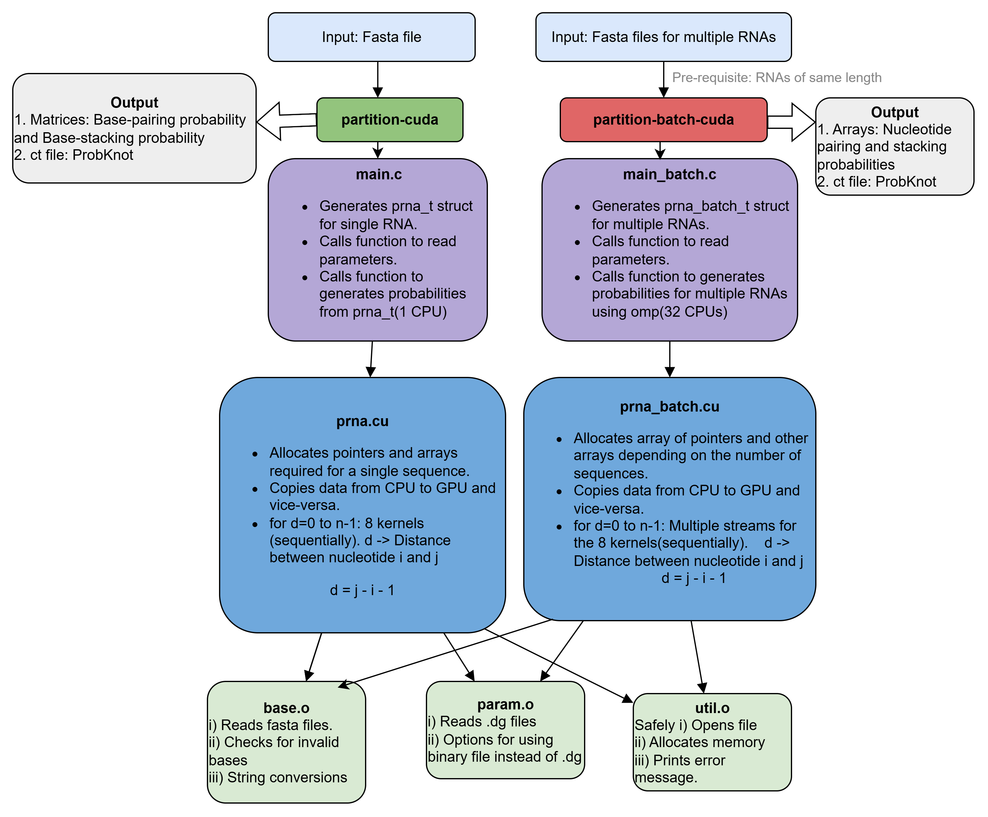
partition-cuda
vs
partition-batch-cuda (My code)

Slide 2
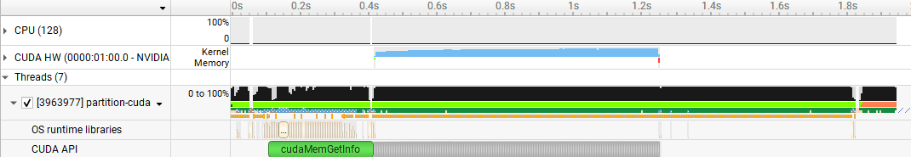
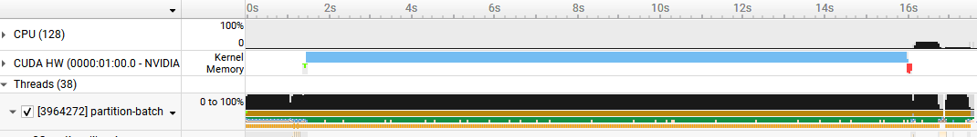
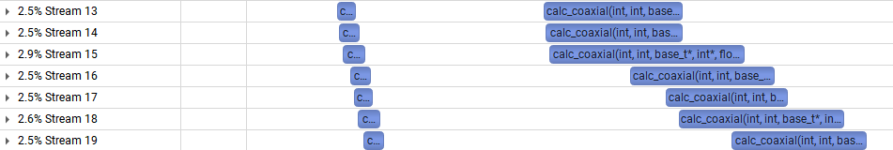
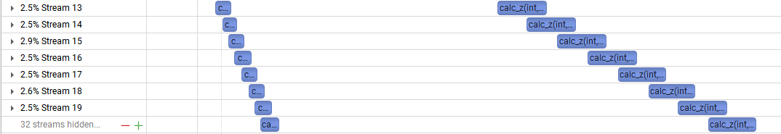
partition-cuda: Single RNA (fluc ~1916 nts)
Time taken to start
Processing to obtain probabilities output
Partition func calculation
partition-batch-cuda: 39 RNAs (fluc ~1916 nts)
Cuda streams to process multiple RNAs

Slide 3
Total time(~1916 nts)
-1 RNA: 770 ms
-39 RNAs: 13800 ms(18x)
Number of SMs: 108
NVIDIA A100

Slide 4
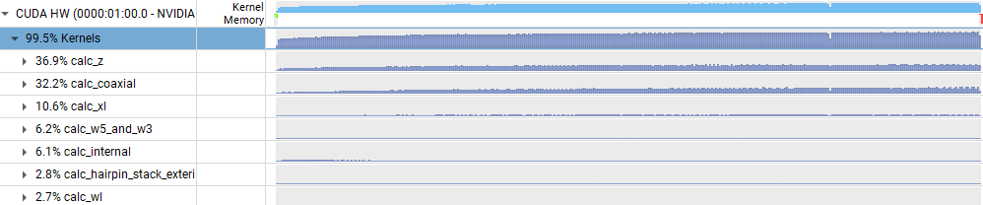
For one fluc RNA
Time taken to start
Processing to obtain probabilities output
Partition func calculation
GPU utilisation

Slide 5
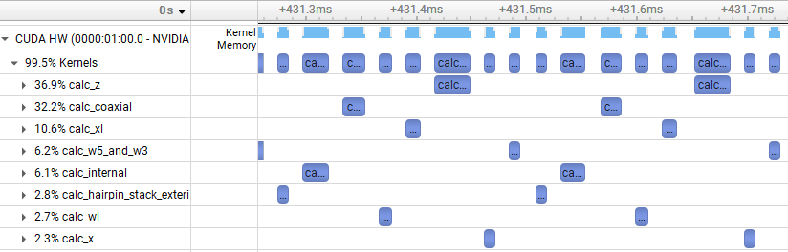
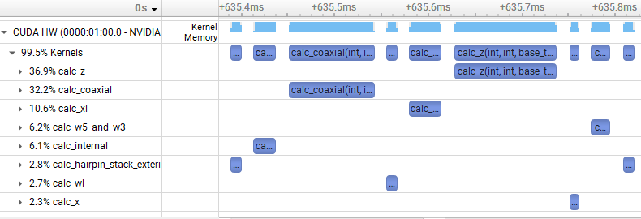
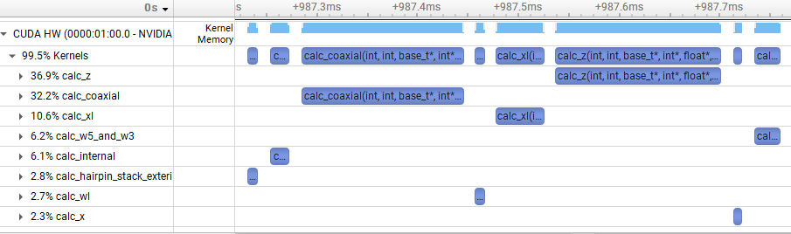
Progress from d=0 to d=n-1
d is the subsequence length (or location in the matrix with d=0 indicating the diagonal)
Around 400 ms
Around 600 ms
Around 1000 ms

Slide 6
Better GPU utilization later.
Around 400 ms
Around 600 ms
Around 1000 ms

