Slide 1
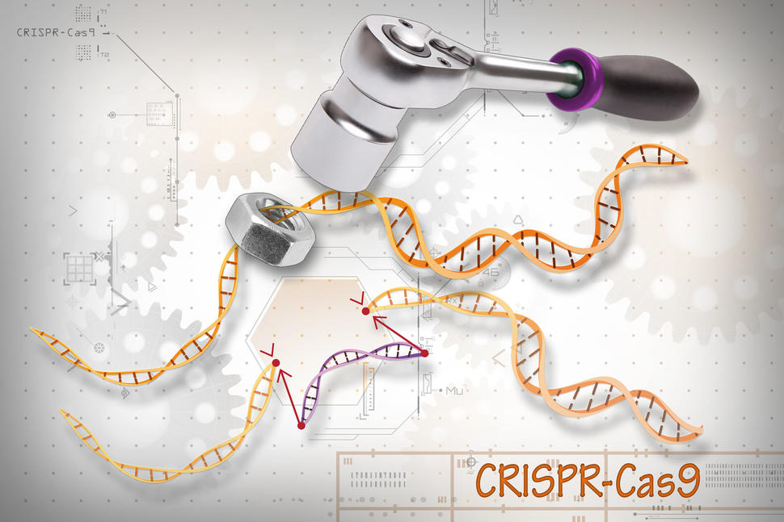
CRISPR-Cas9: Predictions with free energy model
Ashwin Amalaruban
BIM254 Presentation #1
Instructor: Dr.Sharon Aviran

Slide 2
Outline of the presentation
Section | Topic | Slides | Estimated Time(mm:ss)
A | CRISPR-Cas9 -Mechanism -What could go wrong? | 3-4 | 3:00
B | Binding energy model -Cas9 -Other Cas systems -Binding stability | 5-7 | 4:00
C | The paper -CRISPRoff -CRISPRspec | 8-9 | 3:00
D | Expected outcome | 10 | 1:30

Slide 3
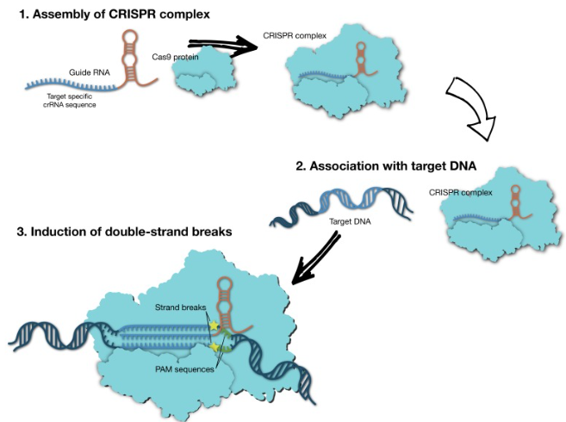
How does CRISPR-Cas9 work?
Clustered Regularly Interspaced Short Palindromic Repeats
Cas9 – CRISPER-associated protein 9
Adapted from defence mechanism against virus.
Cas9-dsDNA mechanism
Guide RNA (gRNA) and Cas9 protein → CRISPR complex.
Protospacer adjacent motif(PAM) on target DNA recognized. RNA-DNA interaction duplex forms.
Cas9 cleaves the DNA.
Costa et al.,2017
Notes:
(CRISPR) is an adaptive immune system in bacteria. To protect themselves against invaders like viruses, these microbes capture snippets of the intruder’s DNA and store them away as segments called CRISPRs, or clustered regularly interspersed short palindromic repeats. If the same germ tries to attack again, those DNA segments (turned into short pieces of RNA) help an enzyme called Cas find and slice up the invader’s DNA. From base editing, to prime editing, to RNA editing, there's a lot of ways that CRISPR can be used.
CRISPR tool consists of two main actors: a guide RNA and a DNA-cutting enzyme, most commonly one called Cas9. Scientists design the guide RNA to mirror the DNA of the gene to be edited (called the target).
Each Cas protein recognizes a unique PAM sequence, which serves as a signal for the Cas protein to bind to the DNA. This PAM site, comprising a short sequence of typically 2–3 nucleotides. Cleavage occurs only if the gRNA perfectly (or almost perfectly) matches the target DNA sequence.

Slide 4
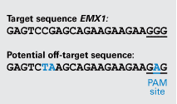
CRISPR-Cas9: Off-targeting
CRISPR sometimes cuts DNA outside of the target gene
Potential Consequences of Off-Target Effects: Unintended mutations
Off-target binding and cleavage highly dependent on selected guide RNA (gRNA).
Off-targets with fewer mismatches have more prominent binding and cleavage.
Off-target regions have up to six mismatches.
PAM Sequence Dependence: compatible PAM sequence (e.g., NGG for SpCas9), limits off-targets but does not eliminate them.
OFF-TARGET AND SPECIFICITY SCORING: BIOPHYSICAL MODELS USING FREE ENERGY PARAMETERS
Fu, Y. et al, 2013
Notes:
Cas9 complex also binds to other unintedended regions, off-targets. This might occur if researchers don't customize the guide RNA sequence for a unique DNA target but instead target a common sequence found in a family of genes. Such off-target effects could have negative outcomes on health. For example, if the guide RNA matches a gene that suppresses tumor growth, there is a risk that disabling it could turn the cell cancerous. Strategies to Minimize Off-Targeting
Designing gRNAs with higher specificity. Cleavage specificity, measured as the ratio of on- to off-target cleavage
“Off-target effects are just a drop in the ocean.” –Alison Van Eenennaam

Slide 5
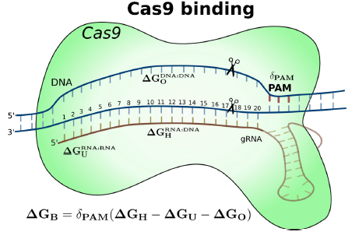
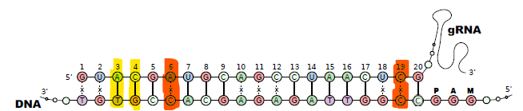
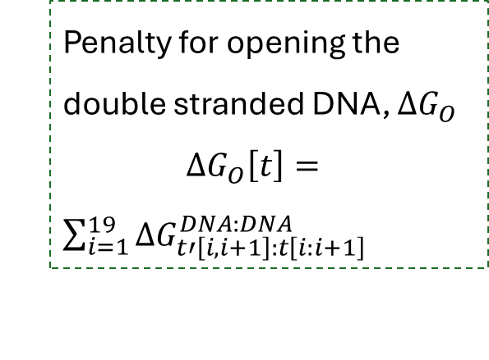


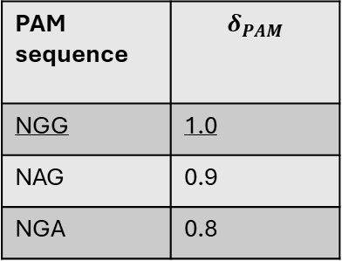


Binding energy model: Cas9-gRNA-DNA complex
Using Energy parameters for RNA-DNA, RNA-RNA and DNA-DNA duplexes.
PAM sequence | $$δ_{PAM}$$
NGG | 1.0
NAG | 0.9
NGA | 0.8
$$∆G_{B}=δ_{PAM}(∆G_{H}−∆G_{U}−∆G_{O})$$
Binding energy between gRNA and (off-)target DNA, $∆G_{H}$
$$∆G_{H}\left[g,t\right]=\sum_{i=1}^{19}{Γ_{Cas9}\left[i\right]×∆G_{g\left[i,i+1\right]:t\left[i:i+1\right]}^{RNA:DNA}}$$
Energy penalty for unfolding the gRNA , $∆G_{U}$
Penalty for opening the double stranded DNA, $∆G_{O}$
$∆G_{O}\left[t\right]=$ $\sum_{i=1}^{19}{∆G_{t′\left[i,i+1\right]:t\left[i:i+1\right]}^{DNA:DNA}}$
Final energy correction, $δ_{PAM}[t]$
Notes:
The PAM sequence in the target DNA region is assumed to be responsible for the initial Cas9 recognition but the stability of the Cas9–gRNA–DNA
complex is maintained through the RNA–DNA binding.
Therefore, we decided to introduce the effect of PAM sequence to the overall binding stability with a parameter
δPAM that influence the computed overall binding free energy. Values for δPAM have been selected arbitrarily for
Cas9, as 1.0, 0.9, and 0.8 for the PAM sequences of NGG,
NAG, and NGA, respectively. These values solely reflect
our observations in the literature for experimentally validated
off-targets of Cas9.

Slide 6

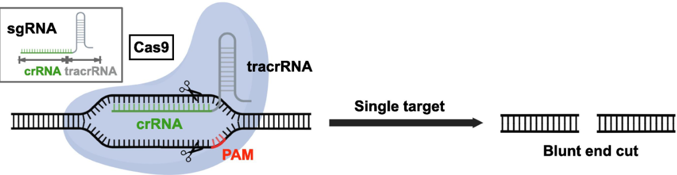
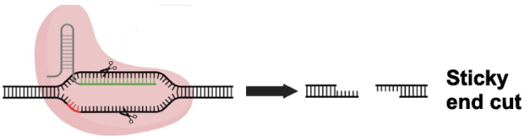
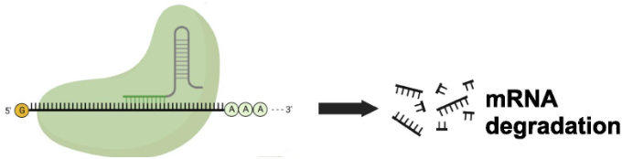
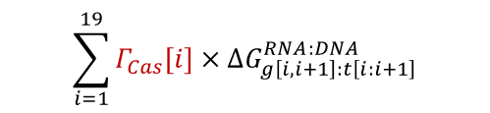

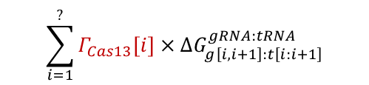

What about other Cas proteins?
Cas12 and Cas13 has genome editing potential
Cas9
PAM: NGG and others
Binding energy model
RNA:DNA Hybridization
RNA unfolding
DNA opening
$$∆G_{B}=δ_{PAM}(∆G_{H}−∆G_{U_{gRNA}}−∆G_{O_{tDNA}})$$
Target:DNA
Cas12
PAM: TTN or TTTN
$$\sum_{i=1}^{19}{Γ_{Cas}\left[i\right]×∆G_{g\left[i,i+1\right]:t\left[i:i+1\right]}^{RNA:DNA}}$$
$$\sum_{i=1}^{?}{Γ_{Cas13}\left[i\right]×∆G_{g\left[i,i+1\right]:t\left[i:i+1\right]}^{gRNA:tRNA}}$$
Cas13
PFS: A,U or C
Target:RNA
$$∆G_{B}=δ_{PFS}(∆G_{H}−∆G_{U_{gRNA}}−∆G_{U_{tRNA}})$$
$$Γ_{Cas}→Position specific binding weights$$
Bigini et al.,2023
Notes:
Nuclease Domains:Cas12a (Cpf1) has a single RuvC domain responsible for cleaving both DNA strands.
Cleavage Process:Cas12 first nicks the non-target strand.
The protein repositions and cleaves the target strand, resulting in staggered ends (sticky overhangs).
Cas13a platform is more versatile, including the potential easily to deliver multiple guides, knockdown nuclear RNAs, and further engineer and optimize the protein.

Slide 7

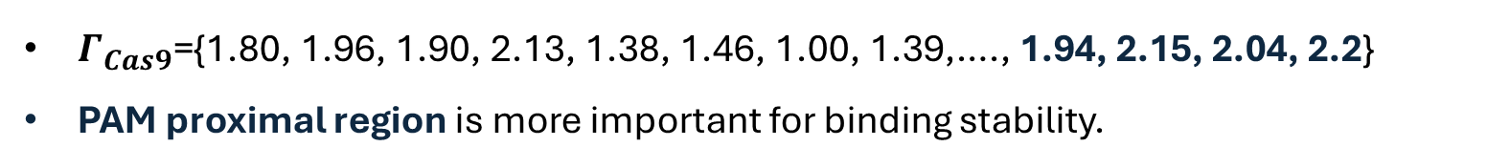
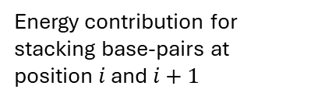
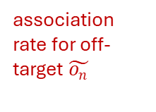

Binding energy model: Cas9-gRNA-DNA complex
$$\text{H}\text{ow} \text{different} \text{positions} \text{influence} \text{binding} \text{stability}\text{ (}Γ_{Cas}\text{)}$$
Different effects on binding due to how Cas9 interacts with each part of the complex.
Using biochemical profiling datasets to measure kinetics of different bindings. $Γ_{Cas9}\left[i\right]=log_{10}\left(\frac{W_{i}}{\min{W_{1}….W_{19}}}\right)+1$
$W_{i}=\sum_{n=1}^{|O|}{\tilde{a_{n}}×∆G_{\tilde{g}\left[i,i+1\right]:\tilde{o_{n}}\left[i:i+1\right]}^{RNA:DNA}}$ ($1≤i≤19$)
Highlight relative positional importance effectively.
.
association rate for off-target $\tilde{o_{n}}$
Energy contribution for stacking base-pairs at position $i$ and $i+1$
$Γ_{Cas9}$={1.80, 1.96, 1.90, 2.13, 1.38, 1.46, 1.00, 1.39,…., 1.94, 2.15, 2.04, 2.2}
PAM proximal region is more important for binding stability.
Notes:
Base pair stability at different positions impacted by Cas protein conformation.
The association rate (axa_xax​) of each off-target site δx\delta_xδx​, which reflects how strongly each off-target site interacts with the gRNA.
Logarithmic scaling compresses large differences in WiW_iWi​ values, making the range of normalized weights easier to interpret. For instance, if one position has a much higher WiW_iWi​ than others, the logarithmic transformation reduces its dominance while still reflecting its relative importance. Normalization makes the scores more interpretable by setting the lowest WiW_iWi​ as a baseline and scaling other positions relative to it.

Slide 8
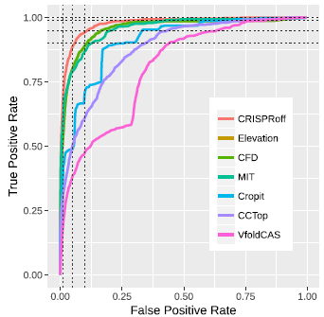

THE PAPER: CRISPR-Cas9 off-targeting assessment with nucleic acid duplex energy parameters
Alkan et al., Genome Biology, 2018
Introduces two prediction models, CRISPRoff and CRISPRspec.
CRSIPRoff:
Confidence score assigned to each predicted off-target site of a given gRNA.
$$CRISPRoff\left[g,t_{off}\right]=−∆G_{B}\left[g,t_{off}\right]=−δ_{PAM}\left(∆G_{H}\left[g,t_{off}\right]−∆G_{O}\left[t_{off}\right]−∆G_{U}\left[g\right]\right)$$
Dataset(Human genome): 650 off-target sequences reported for 31 different gRNAs
Low False Positive Rate (FPR) and High True Positive Rate (TPR).
Notes:
CRISPRoff assigns a confidence score to each predicted off-target site of a given gRNA. The score is based on the free energy differences that describe the binding stability between the gRNA and the DNA target. ROC Curves (Receiver Operating Characteristic curves) measure the performance of off-target prediction models by plotting: curves closer to the top-left corner indicate a better performance. True Positive Rate (TPR): How well the model identifies true off-targets.
False Positive Rate (FPR): How often the model incorrectly predicts off-targets.

Slide 9
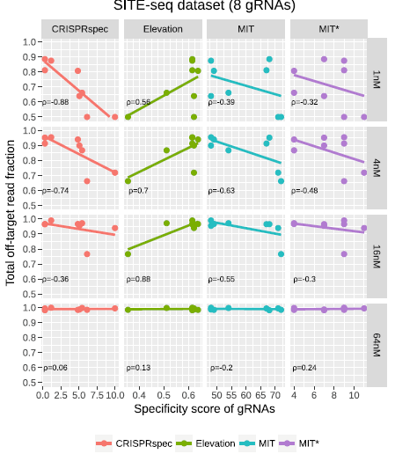

THE PAPER: CRISPR-Cas9 off-targeting assessment with nucleic acid duplex energy parameters
Alkan et al., Genome Biology, 2018
Strong negative correlation between the predicted specificity and off-target read counts.
CRISPRspec: Specificity score for a guided RNA using free energies of all possible bindings.
Partition function approach to model ensemble of all potential interactions.
$$CRISPRspec\left[g,T_{g}\right]=−\log_{10}\left(\frac{\sum_{∀t∈T_{g}\backslash [t_{on}]}{e^{−β∆G_{B}\left[g,t\right]}}}{\sum_{∀t∈T_{g}}{e^{−β∆G_{B}\left[g,t\right]}}}\right)$$
Summed probability of all potential off-target interactions.
Summed probability of all potential interactions.
Notes:
calculate the specificity score of a guide RNA (gRNA) by considering the relative probabilities of binding to on-target and off-target DNA sequences. It is
expected that gRNAs with higher specificity have a lower
fraction of off-target read counts.

Slide 10

To-do list
How does the binding stability ($Γ_{Cas}$) change? [Till 11/20]
For Cas12, Staggered cut compared to blunt cut by Cas9. Kinetic data available.
For Cas13, binding stability depends on base-pairing? No kinetic data.
Some sequences do not have a PFS.
Can the binding energy model predict off-targets with Cas12? [Till 11/30]
How does it compare with Cas9?
Brien et al.,2023 with deep learning models on Cas9 and Cas12 off-targeting predictions with different genomes.
.

Slide 11
Questions?

