Slide 1
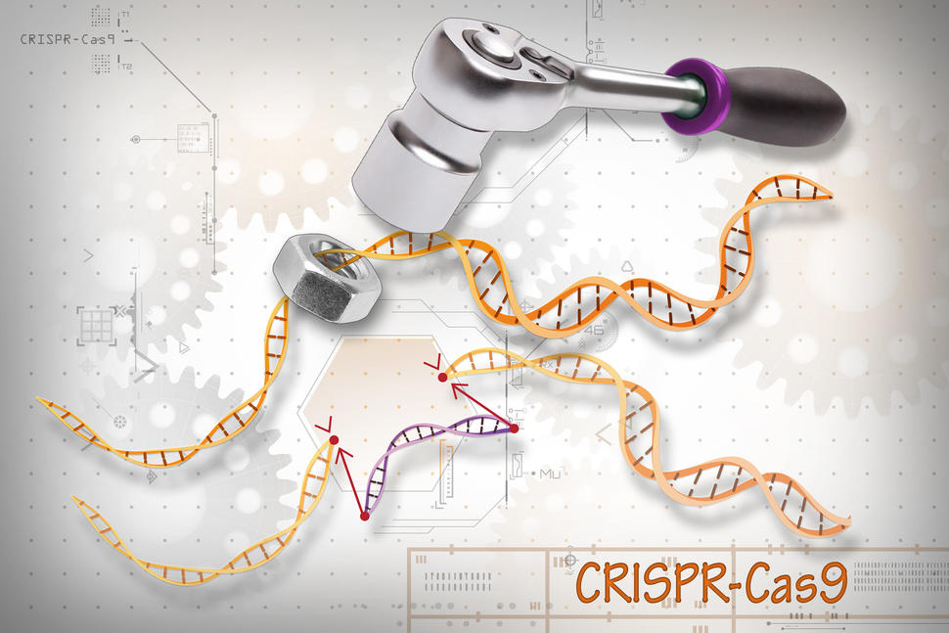
Binding stability of RNA-DNA interactions: CRISPR-Cas system
Ashwin Amalaruban
BIM254 Presentation #2
Instructor: Dr.Sharon Aviran

Slide 2
Outline of the presentation
Section | Topic
A | Recap -Binding energy model -Off-targeting parameters.
B | Binding stability and the kinetics -Mechanism of Cas9,Cas12a binding/unbinding -Do they matter? -Cas9 vs Cas12a

Slide 3
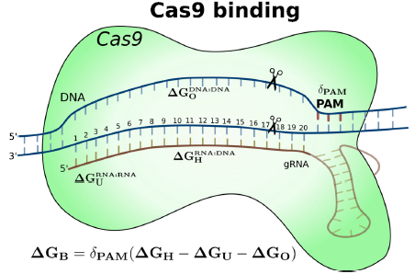
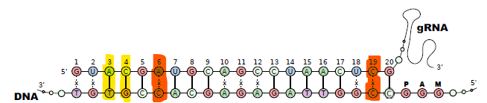
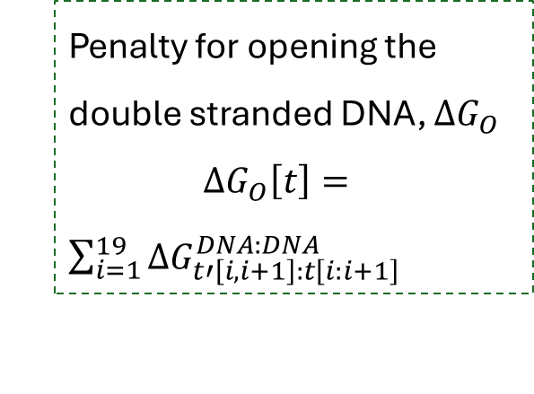


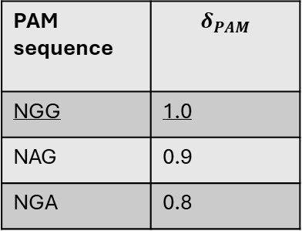


Binding energy model: Cas9-gRNA-DNA complex
Using Energy parameters for RNA-DNA, RNA-RNA and DNA-DNA duplexes.
PAM sequence | $$δ_{PAM}$$
NGG | 1.0
NAG | 0.9
NGA | 0.8
$$∆G_{B}=δ_{PAM}(∆G_{H}−∆G_{U}−∆G_{O})$$
Binding energy between gRNA and (off-)target DNA, $∆G_{H}$
$$∆G_{H}\left[g,t\right]=\sum_{i=1}^{19}{Γ_{Cas9}\left[i\right]×∆G_{g\left[i,i+1\right]:t\left[i:i+1\right]}^{RNA:DNA}}$$
Energy penalty for unfolding the gRNA , $∆G_{U}$
Penalty for opening the double stranded DNA, $∆G_{O}$
$∆G_{O}\left[t\right]=$ $\sum_{i=1}^{19}{∆G_{t′\left[i,i+1\right]:t\left[i:i+1\right]}^{DNA:DNA}}$
Final energy correction, $δ_{PAM}[t]$
Alkan et al.,2018
Notes:
The PAM sequence in the target DNA region is assumed to be responsible for the initial Cas9 recognition but the stability of the Cas9–gRNA–DNA
complex is maintained through the RNA–DNA binding.
Therefore, we decided to introduce the effect of PAM sequence to the overall binding stability with a parameter
δPAM that influence the computed overall binding free energy. Values for δPAM have been selected arbitrarily for
Cas9, as 1.0, 0.9, and 0.8 for the PAM sequences of NGG,
NAG, and NGA, respectively. These values solely reflect
our observations in the literature for experimentally validated
off-targets of Cas9.

Slide 4


CRISPRoff and CRISPRspec
CRSIPRoff
Confidence score assigned to each predicted off-target site $CRISPRoff\left[g,t_{off}\right]=−∆G_{B}\left[g,t_{off}\right]$
CRISPRspec
Specificity score for a guided RNA using free energies of all possible bindings.
$$CRISPRspec\left[g,T_{g}\right]=−\log_{10}\left(\frac{\sum_{∀t∈T_{g}\backslash [t_{on}]}{e^{−β∆G_{B}\left[g,t\right]}}}{\sum_{∀t∈T_{g}}{e^{−β∆G_{B}\left[g,t\right]}}}\right)$$
Summed probability of all potential off-target interactions.
Summed probability of all potential interactions.
Low: Bad
High: Good
Alkan et al.,2018

Slide 5
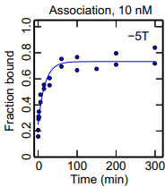
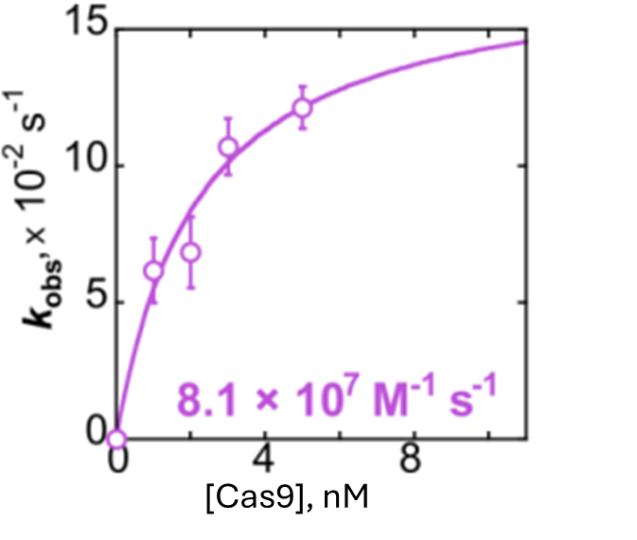

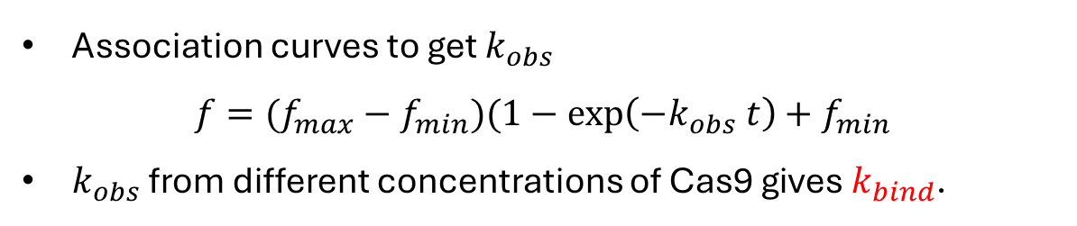
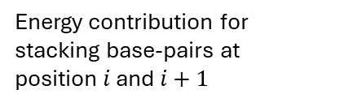

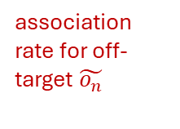
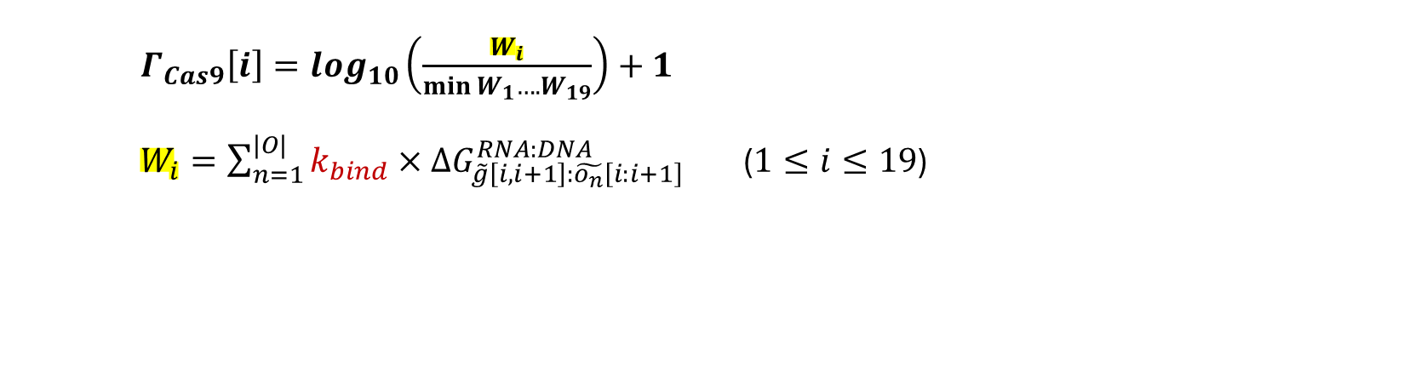
Binding stability: How is it determined?
$$\text{D}\text{ifferent} \text{positions} \text{influence} \text{binding} \text{stability}\text{ (}Γ_{Cas}\text{)}$$
Association curves to get $k_{obs}$
$$f=(f_{max}−f_{min})(1−\exp\left(−k_{obs} t\right)+f_{min}$$
$k_{obs}$ from different concentrations of Cas9 gives $k_{bind}$.
$Γ_{Cas9}\left[i\right]=log_{10}\left(\frac{W_{i}}{\min{W_{1}….W_{19}}}\right)+1$
$W_{i}=\sum_{n=1}^{|O|}{k_{bind}×∆G_{\tilde{g}\left[i,i+1\right]:\tilde{o_{n}}\left[i:i+1\right]}^{RNA:DNA}}$ ($1≤i≤19$)
$$k_{obs}$$
.
association rate for off-target $\tilde{o_{n}}$
Energy contribution for stacking base-pairs at position $i$ and $i+1$
$Γ_{Cas9}$={1.80, 1.96, 1.90, 2.13, 1.38, 1.46, 1.00, 1.39,…., 1.94, 2.15, 2.04, 2.2}
Boyle et al., 2017; Strohkendl et al.,2018
Notes:
Base pair stability at different positions impacted by Cas protein conformation.
The association rate of each off-target site ​, which reflects how strongly each off-target site interacts with the gRNA.
Logarithmic scaling compresses large differences, making the range of normalized weights easier to interpret. For instance, if one position has a much higher WiW_iWi​ than others, the logarithmic transformation reduces its dominance while still reflecting its relative importance. Normalization makes the scores more interpretable by setting the lowest WiW_iWi​ as a baseline and scaling other positions relative to it.

Slide 6
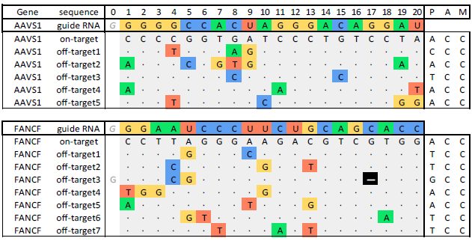
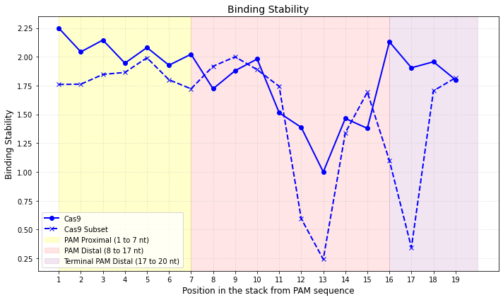

Binding stability: How is it determined?
$Γ_{Cas}$ from a small subset of data
Overall dataset: 84,554 sequences.
This subset: 4 target sequences and 16 off-target sequences.
Can a small subset reproduce the same binding stability? To some extent.
Pacesa et al.,2022

Slide 7
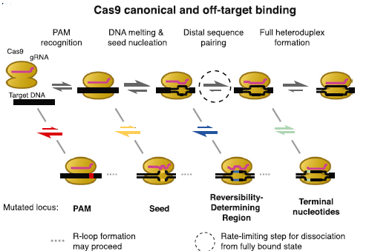
Kinetic binding/unbinding for Cas9
Seed region or PAM-Proximal(positions 1 to 7)
PAM-distal(8 to 20); terminal nucleotides(17 to 20)
Alkan et al.,2018
Notes:
Cas9/dCas9 binds to the PAM and the guide RNA invades into the PAM-adjacent protospacer duplex. During this strand invasion, the guide RNA must displace the complementary strand of the protospacer. Competition between invasion and re-annealing(break most of its hydrogen bonds) of the duplex results in a dynamic (‘breathing’) R-loop structure. The stability of the 14th–17th sites of the protospacer-guide RNA interaction, which is dramatically increased by binding at the 19th and 20th sites, promotes a conformational change in the Cas9/dCas9 that authorizes DNA cleavage in Cas9

Slide 8
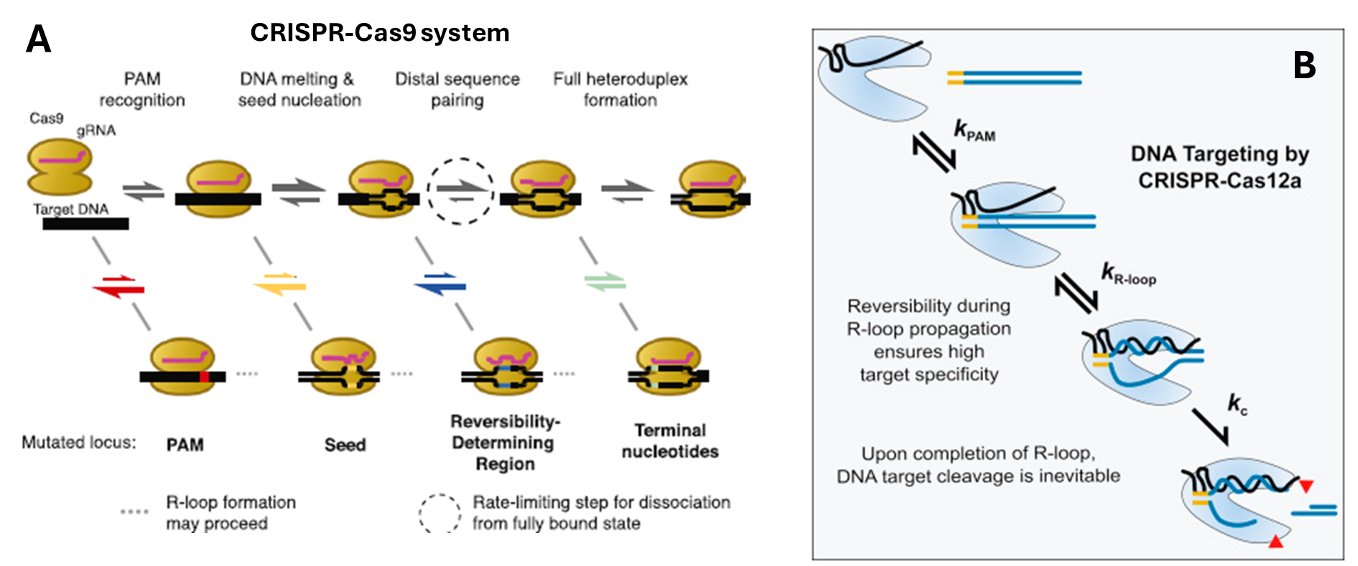

Slide 9
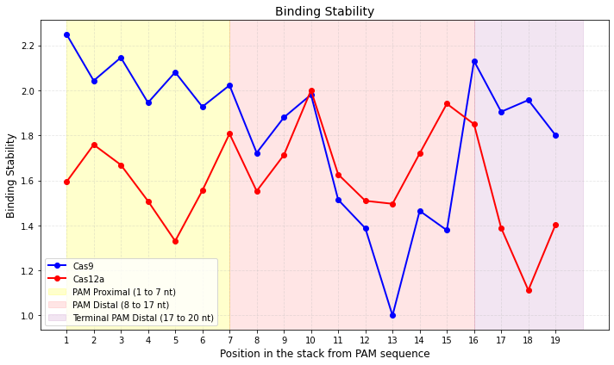
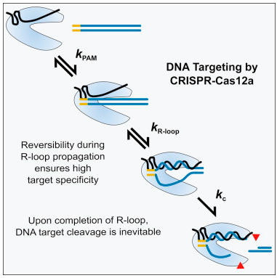
Kinetic binding/unbinding for Cas12a
Cas12a: 1 sequence ☹ and 22 off-target sequences
Cas12a: Sensitive to mismatches throughout
Cas9: Sensitive to mismatches in PAM-proximal region
Strohkendl et al.,2018
Notes:
AsCas12a RNP first binds dsDNA and then diffuses along it (facilitated target searches including 1D diffusion). When an AsCas12a RNP encounters its target site, PAM-induced local unwinding by AsCas12a mediates DNA–RNA base pairing for checking complementarity (R-loop initiation). If the length of the R-loop is not sufficient (<17 bp), the AsCas12a RNP easily comes off the DNA (low stability under partial R-loop formation). Once a sufficiently long R-loop is formed (≥17 bp), the AsCas12a RNP strongly holds the DNA and is ready for DNA cleavage. After stable R-loop formation, AsCas12a sequentially cleaves the DNA, first the non-target strand and then the target strand, regardless of the presence of a PAM (PAM-independent sequential DNA cleavage). After successful DNA cleavage, AsCas12a quickly releases the PAM-distal DNA fragment but continues to hold the other fragment that contains both the PAM and protospacer

Slide 10
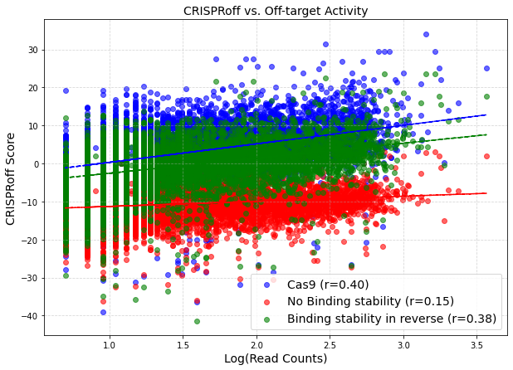
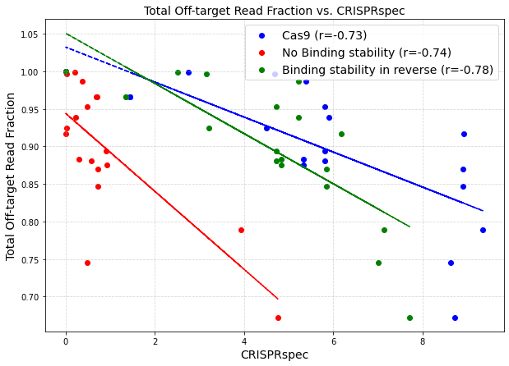
Effect of binding stability: Cas9
CIRCLE-seq database: 18 gRNAs and total 7200 off-targets.

Slide 11
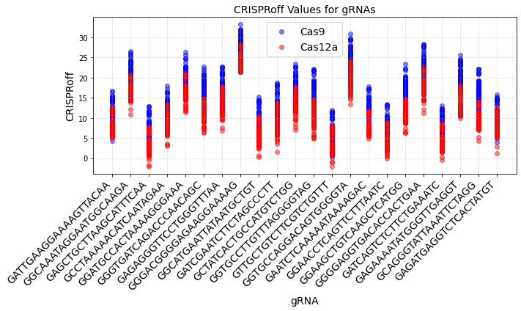
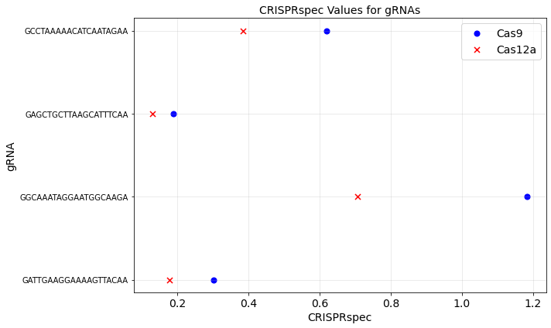
Effect of binding stability: Cas9 and Cas12a
21 gRNA common for both Cas9 and Cas12a
400,000 possible off-targets for each (randomly generated)
Cas9 is more target specific than Cas12a

Slide 12
Questions?

Slide 13
Bulge loops: Few expt
How much less can they be trusted? We are assuming linearity. How confident are we?
Multibranch loops: Less agreement. Model not well developed and not studied.
Put a maximum on how much the parameter Can get.
Not exclude motifs from training set.
Github page: For parameters
Polymer theory: For hairpin initiation

