Slide 1
DOI-OHTA model
CL651 Course project by
Ashwin Amalaruban – 193020020
Instructor:Prof. Jyoti Seth
Date: 13-05-2021

Slide 2
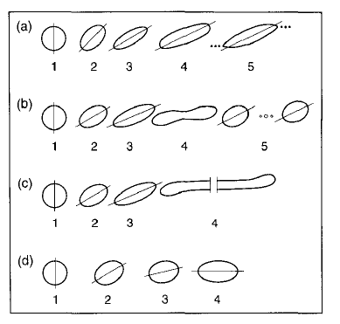

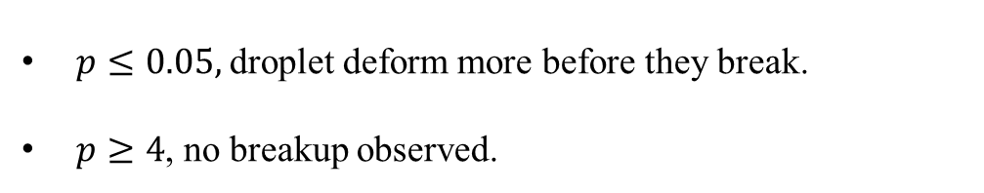
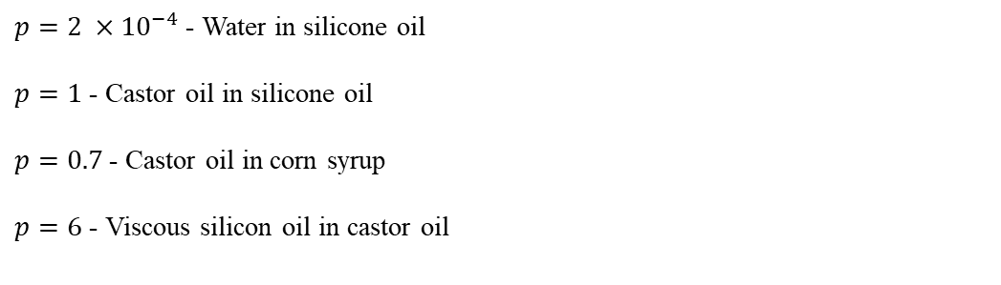
Introduction
Mixing two immiscible fluids → Droplets → Deform, break or coalesce
Various physical states → Different rheological response
Theoretically there weren’t many results to determine stress in such systems.
Deformation of a single droplet by Taylor
Pressure difference inside and outside the droplet$∆p= Δp_{G}+\frac{2Γ}{b}$
Breakup characterised by two parameters: Capillary number and viscosity ratio(p)
$p≤0.05,$droplet deform more before they break.
$p≥4$, no breakup observed.
$p=2 ×{10}^{−4}$ - Water in silicone oil
$p=1$ - Castor oil in silicone oil
$p=0.7$- Castor oil in corn syrup
$p=6$ - Viscous silicon oil in castor oil
Fig 1: Droplet shapes in shearing flows

Slide 3
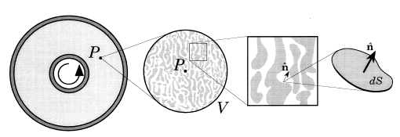
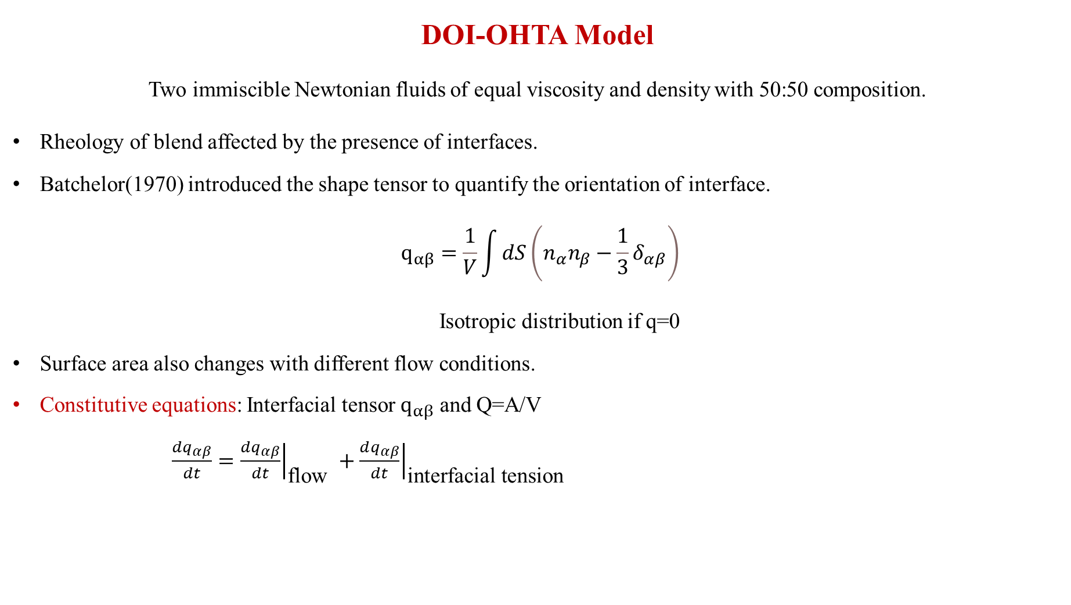


DOI-OHTA Model
Two immiscible Newtonian fluids of equal viscosity and density with 50:50 composition.
Rheology of blend affected by the presence of interfaces.
Batchelor(1970) introduced the shape tensor to quantify the orientation of interface.
$$q_{αβ}=\frac{1}{V}\int{dS\left(n_{α}n_{β}−\frac{1}{3}δ_{αβ}\right)}$$
Isotropic distribution if q=0
Surface area also changes with different flow conditions.
Constitutive equations: Interfacial tensor $q_{αβ}$ and Q=A/V
$\frac{dq_{αβ}}{dt}={\left.\frac{dq_{αβ}}{dt}\right|}_{\text{flow} }+{\left.\frac{dq_{αβ}}{dt}\right|}_{\text{interfacial} \text{tension} }$
$$Γ=0$$
$$κ=0$$
Fig 2: Representation of normal and surface of an interface for blends

Slide 4
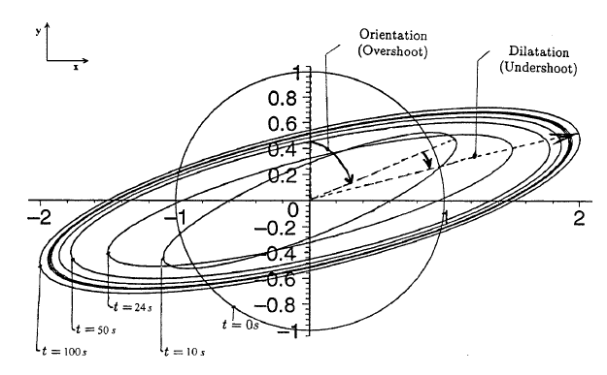

Deformation by flow
Transformation of surface element of the interface during flow.
Time evolution of interfacial tensor due to flow
$${\left.\frac{dq_{αβ}}{dt}\right|}_{\text{flow} }=−q_{αγ}κ_{γβ}−q_{βγ}κ_{γα}+\frac{2}{3}δ_{αβ}κ_{μν}q_{μν}−\frac{Q}{3}\left(κ_{αβ}+κ_{βα}\right)+\frac{κ_{μν}q_{μν}}{Q}q_{αβ}$$
Time evolution of area of interface per unit volume
$${\left.\frac{dQ}{dt}\right|}_{\text{flow} }=−κ_{αβ}q_{αβ}$$
Stress tensor: Stress contributions from isotropic pressure, the flow and interfacial tension.
$σ_{αβ}=−pδ_{αβ}+η_{0}\left[κ_{αβ}+κ_{βα} \right]−Γq_{αβ}$

Slide 5
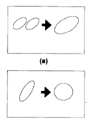

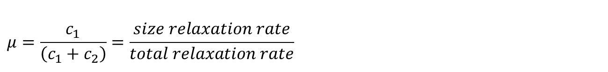



Relaxation by Interfacial tension
First order kinetics for the relaxation process
Relaxation of Q: Characterised by a single relaxation rate.
$${\left.\frac{∂}{∂t}Q\right|}_{\text{relax} } =−r_{1}Q$$
$${\left.\frac{∂}{∂t}\left(\frac{q_{αβ}}{Q}\right)\right|}_{\text{relax} }=−r_{2}\left(\frac{q_{αβ}}{Q}\right)$$
Size
$${\left.\frac{∂}{∂t}Q\right|}_{\text{relax} }=−λμQ^{2}$$
$$r_{1}=c_{1}\frac{ΓQ}{η_{0}}$$
$$λ=\left(c_{1}+c_{2}\right)Γ/η_{0}$$
$$r_{2}=c_{2}\frac{ΓQ}{η_{0}}$$
$${\left.\frac{∂}{∂t}q_{αβ}\right|}_{\text{relax} }=−λQq_{αβ}$$
Shape
Two ways to relax Q: Droplet becomes spherical. Coagulation to form large droplet.
$$μ=\frac{c_{1}}{\left(c_{1}+c_{2}\right)}=\frac{size relaxation rate}{total relaxation rate}$$
If $μ$=0, Size relaxation is quick: Q is constant.
If $μ$=1, Size relaxation is slow.

Slide 6
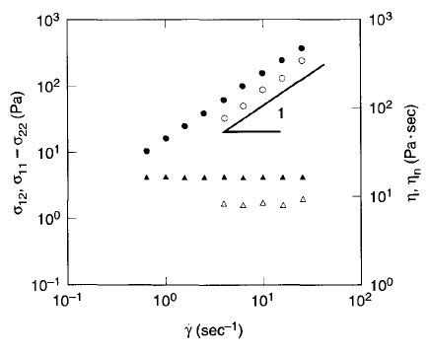
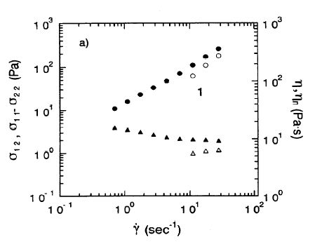

Scaling laws
$q$and $Q$ → Functions of $κ\left(t\right) →velocity gradient$
$$q=q(t;[κ(t)]),Q=Q(t;[κ(t)])$$
New velocity gradient at time ct, $\tilde{κ}(t)=c⁡κ(ct$)
$$q\left(t;\left[\tilde{κ}\left(t\right)\right]\right)=cq\left(ct;\left[κ\left(t\right)\right]\right) Q(t;[\tilde{κ}(t)])=cQ(ct;[κ(t)]$$
New stress can be $σ(t;[\tilde{κ}(t)])=cσ(ct;[κ(t)])$
Stress and first normal stress difference are linear in shear rate.
$$σ(c\dot{γ})=cσ(\dot{γ})$$
Slope not exactly equal to 1 → Non-Newtonian effects
Inability to explain shear thinning behaviour.

Slide 7

Modifications
Changes to the relaxation rate($r_{1})$ - Guenther and Baird(1996)
For 1:1 mixture, Q → 0 at no flow conditions.
Not 1:1 mixture, Q $≠$ 0.
Relaxation of Q should stop as drops become spherical.
$${\left.\frac{∂}{∂t}Q\right|}_{\text{relax} }=−r_{1}Q r_{1}=c_{1}\frac{ΓQ}{η_{0}} →→ r_{1}=c_{1}\frac{Γ}{η_{0}}{\left(∑q_{αβ}^{2}\right)}^{1/2}$$
As droplets become spherical, $q_{αβ}=0$ and $r_{1}$→0. Relaxation stops.
Still fails to explain the shear thinning behaviour of the blend
Scaling relationship appears to hold for shear stress.

Slide 8
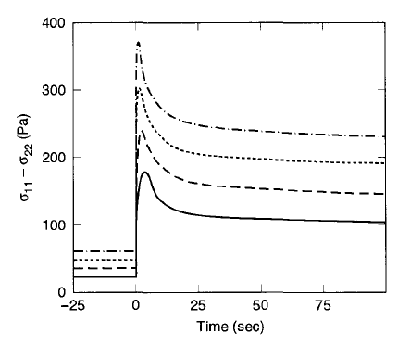
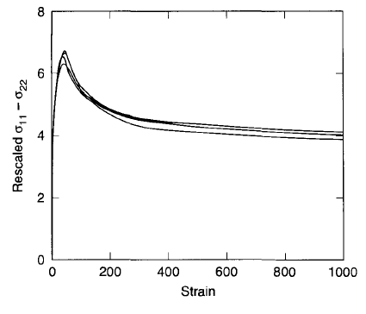
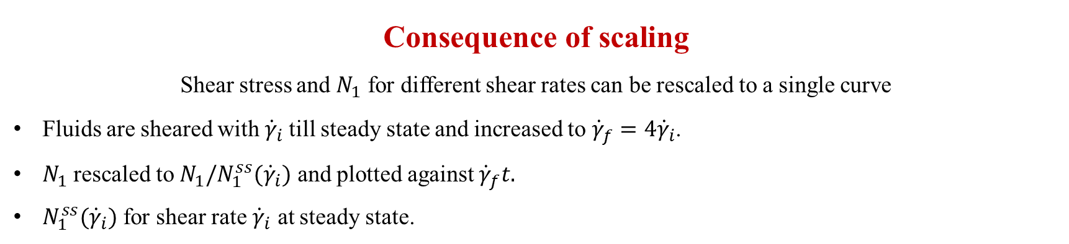
Consequence of scaling
Shear stress and $N_{1}$ for different shear rates can be rescaled to a single curve
Fluids are sheared with ${\dot{γ}}_{i}$till steady state and increased to ${\dot{γ}}_{f}=4{\dot{γ}}_{i}$.
$N_{1}$ rescaled to $N_{1}/N_{1}^{ss}({\dot{γ}}_{i})$ and plotted against ${\dot{γ}}_{f}t.$
$N_{1}^{ss}({\dot{γ}}_{i})$ for shear rate ${\dot{γ}}_{i}$ at steady state.
The shear rates for the four curves are $\left({\dot{γ}}_{i},{\dot{γ}}_{f}\right)=\left(3,12\right),\left(4,16\right),\left(5,20\right)$ and $(6,24)$ sec⁻¹ from the bottom curve to top
Scaling relations consistent even for different compositions

Slide 9
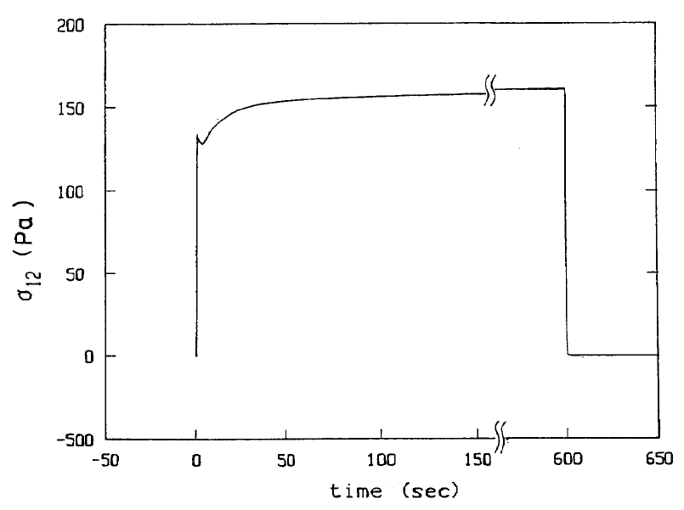
Shear stress in steady shear flow
Shearing → Shear stress develops
Sharp undershoot as flow is starting.
Then increases before reaching steady-state value
Stress relaxes as soon as flow is stopped.
Stress developed sensitive to flow history.
Undershoot depth: Depends on time between experiments

Slide 10
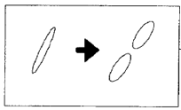


Lee-Park model
Viscosity ratio $≠$ 1 and volume fractions different than 1:1
Doi-Ohta theory applicable when viscosity ratio → 0.15 to 2.3
Stress tensor is modified to include the viscosities of both the phases.
$$σ_{\text{Lee}\text{−}\text{Park} }=σ_{\text{Doi}\text{−}\text{Ohta} }+σ_{e}\left(φ,η_{i},η_{m}\right)$$
$φ$ is the volume fraction of the dispersed phase
$$σ_{αβ}=−pδ_{αβ}+\left(1+\frac{3(η_{i}−η_{m})}{5(η_{i}−η_{m})}φ\right) η_{m}\left[κ_{αβ}+κ_{βα} \right]−Γq_{αβ}$$
Relaxation process: Accounts for breakup of droplets which Doi-Ohta theory fails.
$$−\frac{c_{3}Γ}{η_{m}}q_{αβ}q_{αβ}$$
→ Another dimensionless parameter, $ν=\frac{c_{3}}{c_{1}+c_{2}}$

Slide 11
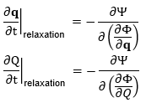





Bousmina’s approach
Variables$(f)$ under consideration: u(r), $q_{αβ}$ and Q
Functions of free energy and dissipation potential.
$$Φ=\int{d}r{ u}^{2}{\left(r\right)}/2ρ+d_{1}\int{d}r Q\left(r\right)+d_{2}\int{d}rq_{ij}\left(r\right)q_{ij}\left(r\right)$$
Difference from Doi-Ohta theory: Free energy included explicitly
Dissipative potential $Ψ$ →function of $\frac{∂Φ}{∂f}$
Original model
$${\left.\frac{∂}{∂t}Q\right|}_{\text{relax} }=−λμQ^{2}$$
$${\left.\frac{∂}{∂t}q_{αβ}\right|}_{\text{relax} }=−λQq_{αβ}$$
Changes
$${\left.\frac{∂}{∂t}Q\right|}_{\text{relax} }=−λμQq−λQν(1−μ)q$$
$${\left.\frac{∂}{∂t}q_{αβ}\right|}_{\text{relax} }=−λQq_{αβ}+λμq_{αβ}(Q−q)$$
$$q=\sqrt{\sum_{α,β}{ }q_{α,β}^{2}}$$

Slide 12
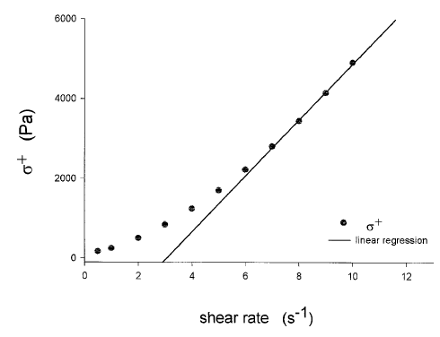
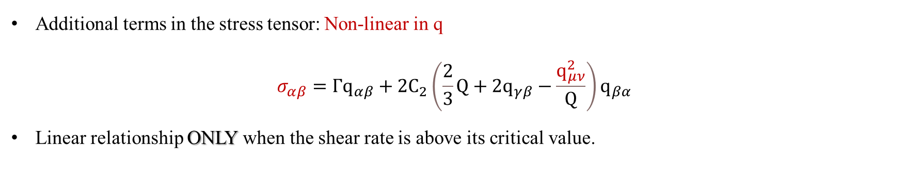
Additional terms in the stress tensor: Non-linear in q
$$σ_{αβ}=Γq_{αβ}+2C_{2}\left(\frac{2}{3}Q+2q_{γβ}−\frac{q_{μν}^{2}}{Q}\right)q_{βα}$$
Linear relationship ONLY when the shear rate is above its critical value.
Stress developed for different shear rates

Slide 13
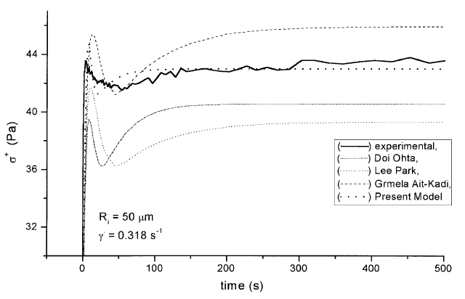
Comparison with experimental results
Mixture of PDMS (polydimethylsiloxane) and PIB (polyisobutene) with ratio 1:1
Magnitude of overshoot and steady state stress underestimated by Doi-Ohta and Lee-Park models.
Grmela-Ait Kadi model overestimated the overshoot, time corresponding to it and the steady state value.
Bousmina’s model overestimated the overshoot but with small errors.
Steady-state value and the time corresponding to overshoot are obtained accurately.

Slide 14
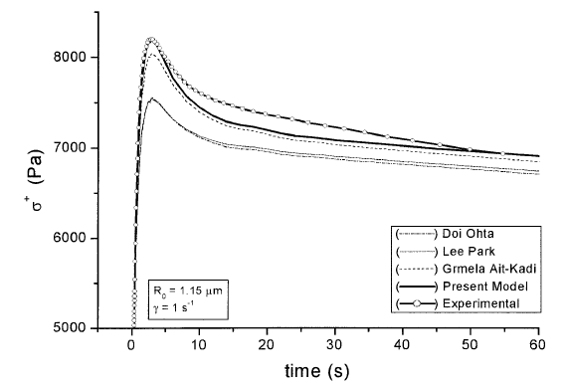
Comparison with experimental results
PP/PS mixture with compositions of 90/10
Bousmina’s model better results compared to other models.
Able to capture both the overshoots and undershoots accurately
Value of steady state stress as well as the magnitude of overshoot are close.
Fails in the time-evolution of stress.
.

Slide 15

Summary of Doi-Ohta model
Assumptions
Viscosities of both the phases are equal.
First order kinetics used for relaxation.
Relaxation of Q given by a single rate.
Results
Steady shear flow: $σ$ and $N_{1}$ are almost proportional to $\dot{γ}$.
Transient $σ$ & $N_{1}$: $\frac{σ\left(t;{\dot{γ}}_{i}→{\dot{γ}}_{f}\right)}{σ\left({\dot{γ}}_{i}\right)}$ universal function of strain ${\dot{γ}}_{f}t$. Similar for $N_{1}$.
Modifications required for relaxation equations. → To account for breakup of droplets
→ Relaxation to stop as drops are spherical
But, $σ(t)$ observed different than predicted. → Need to account for diff visosity ratios.

Slide 16
Thank you

Slide 17

Structural changes – Single droplet
Upon deformation, the sphere →→ ellipsoid/rod-like structure
Drop deforms slowly and tends to orient in the flow direction with angle $θ$.
Slight breakup or deformation: Overshoot/Undershoot
Later, it obtains its maximum orientation and elongates along the major axes.
Simple shear decomposed into pure rotation and uniaxial extension.
Then when the drops undergo breakup or coalescence, effect of orientation is small.

Slide 18
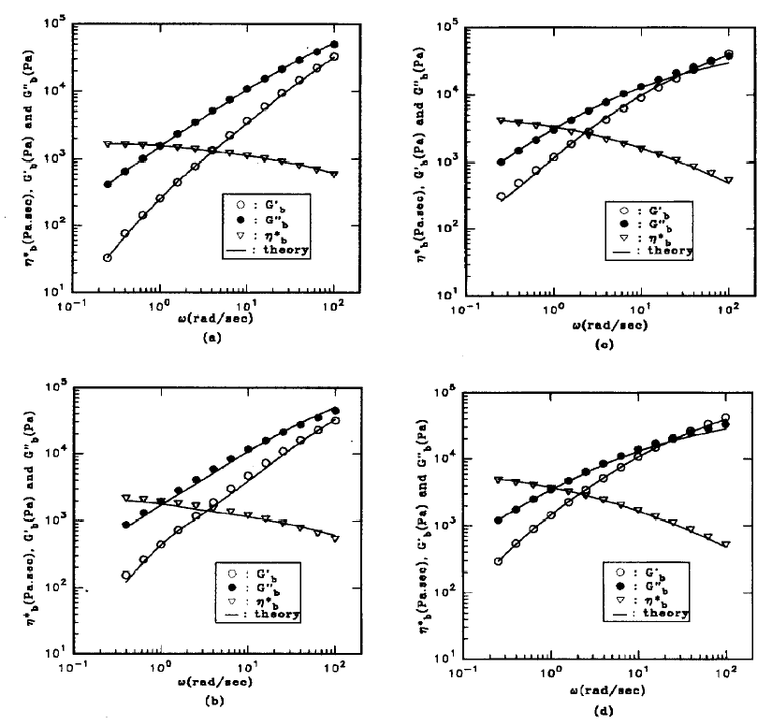
Experimental verification-Lee & Park Model
Polystyrene(PS) and linear low-density polyethylene(LLDPE)
Dynamic oscillatory flow
PS more viscous than LLDPE.
PS10: No changes in the size of droplet.
PS30: Shape of droplets are more irregular: Breakup and coagulation.
PS70: LLDPE forms the lamellar: Larger deformation
PS90: LLDPE droplets experience very high stress creating yet smaller droplets.
PS70, PS90: Error in loss moduli at high frequency.
PS10 PS70
PS30 PS90

Slide 19

Constrained volume model
Droplet volume remains constant when there is no breakup and coagulation taking place.
Interfacial tensor predicted by Doi-Ohta theory does not match exactly with the experimental results.
$${\hat{q}}_{αβ}=\frac{1}{V_{d}}\int{n_{α}n_{β}dS_{d}}$$
$$σ_{αβ}=η\left(κ_{αβ}+κ_{βα}\right)−φΓ\left({\hat{q}}_{αβ}−\frac{1}{3}I_{q}δ_{αβ}\right)−pδ_{αβ}$$
This is attributed to the fact that Doi-Ohta theory does not have an intrinsic length scale.
Performs excellent for single droplets
Less satisfactory for concentrated blends when the rates of deformation is high.

Slide 20

Deformation by flow
Change in position vector $r$ as a result of flow, $r^{′}=E\left(t^{′}\right)⋅r$ E-> Deformation gradient tensor
Volume of the new region after a deformation E changes as $∆V→∆V^{′}; ∆V^{′}=∆V.\det\left(E\right)$
Area of the interface after transformation, $ΔS^{′}=ΔS\frac{det⁡(E)}{\left|E^{+}⋅n^{′}\right|}$
$f(n)$→Interface density function
$$Q=∫dnf\left(n\right)$$
$f(n)dn$ be the area of interface whose normal is the solid angle $dn$.
$$\frac{f^{′}\left(n^{′}\right)dn^{′}}{f\left(n\right)dn}=\frac{ΔS^{′}}{ΔS}$$
Time evolution of interface density function, $\frac{∂f}{∂t}=R⋅\left[n×\left(κ^{T}⋅n\right)f\right]−κ:nnf$
Multiplying by $n_{α}n_{β}$ and integrating with respect to n
$$\frac{∂}{∂t}\int{dn}f\left(n,t\right)n_{α}n_{β}=∫dn n_{α}n_{β}R⋅\left[n×\left(κ^{T}⋅n\right)f\right]−\int{dn κ:nnf}n_{α}n_{β}$$

Slide 21


$$\begin{aligned}\frac{∂}{∂t}\overline{n_{α}n_{β}}=&∫dnn_{α}n_{β}R⋅\left[n×\left(κ^{T}⋅n\right)f\right]−\overline{n_{α}n_{β}n_{μ}n_{ν}}κ_{μv} \\ where \overline{... }= \int{dn f\left(n,t\right)…}\end{aligned}$$
$$\begin{aligned}\frac{∂}{∂t}\overline{n_{α}n_{β}}=&∫dnn_{α}n_{β}R⋅\left[n×\left(κ^{†}⋅n\right)f\right]−\overline{n_{α}n_{β}n_{μ}n_{ν}}κ_{μv} \\ =−\overline{n_{α}n_{γ}}κ_{γβ}−\overline{n_{β}n_{γ}}κ_{γα}+\overline{n_{α}n_{β}n_{μ}n_{ν}}κ_{μν}\end{aligned}$$
$$\overline{n_{α}n_{β}n_{μ}n_{ν}}κ_{μν}=A\overline{n_{α}n_{β}}⋅\overline{n_{μ}n_{ν}}κ_{μν}$$
$$\overline{n_{α}n_{β}n_{μ}n_{ν}}κ_{μν}=\frac{1}{Q}\overline{n_{α}n_{β}}⋅\overline{n_{μ}n_{ν}}κ_{μν}$$
$$\overline{n_{α}n_{β}}=q_{αβ}+\frac{Q}{3}δ_{αβ}$$
Time evolution of interfacial tensor due to flow is
$${\left.\frac{dq_{αβ}}{dt}\right|}_{\text{flow} }=−q_{αγ}κ_{γβ}−q_{βγ}κ_{γα}+\frac{2}{3}δ_{αβ}κ_{μν}q_{μν}−\frac{Q}{3}\left(κ_{αβ}+κ_{βα}\right)+\frac{κ_{μν}q_{μν}}{Q}q_{αβ}$$
Time evolution of area of interface per unit volume is
$${\left.\frac{dQ}{dt}\right|}_{\text{flow} }=−κ_{αβ}q_{αβ}$$

Slide 22
