Slide 1
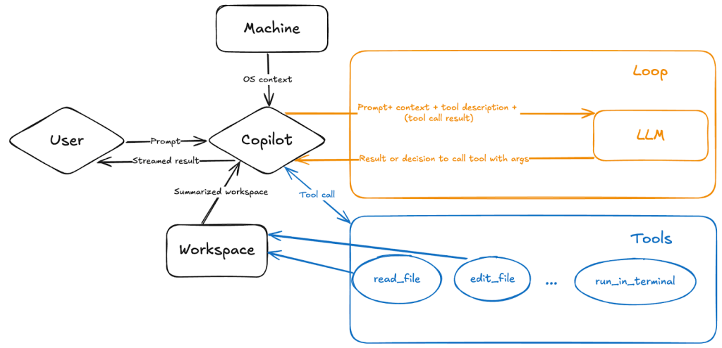
GitHub Copilot 101
Ashwin Amalaruban
BIM189C Fall 2025
Instructor: Dr. Sharon Aviran
Notes:
Copilot is like an AI “lab partner” for coding — it suggests, explains, and helps debug code.
You prompt Copilot with clear requirements on the end result you want. There is also an agent mode that autonomously uses various tools to get to the end result.
Copilot parses the question and asks an AI language model how to resolve the task, then begins working.
Copilot monitors the first iteration for errors and determines how to fix them.
Based on the results, it then determines how to course-correct, whether that’s by making additional edits, terminal commands, or performing tool calls.
The LLM has an ever-expanding set of tools to call—and you’re in charge of which tools you want agent mode to use. These tools allow Copilot to search your workspace, read file contents, run terminal commands, get errors from the editor and apply proposed changes, and more.

Slide 2

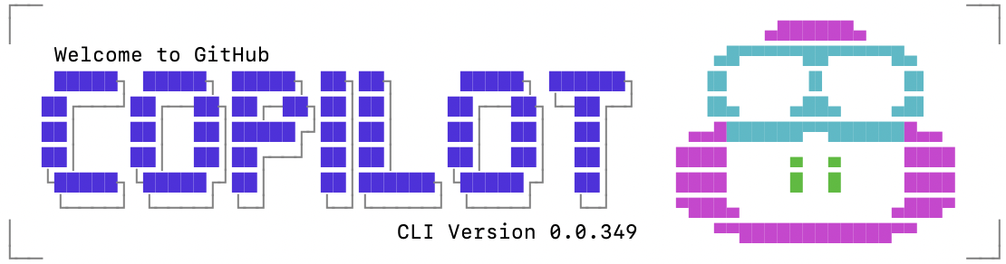

Agenda
Copilot Basics
On the Terminal
Custom Instructions
4 slides
6 slides
3 slides
Notes:
1. Learn how Copilot works in your editor.
2. How to use it on the command line.
3. Learn how to personalize its behavior.

Slide 3
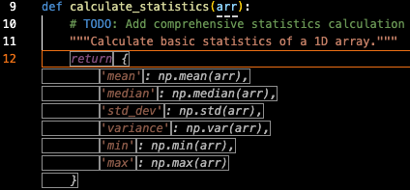
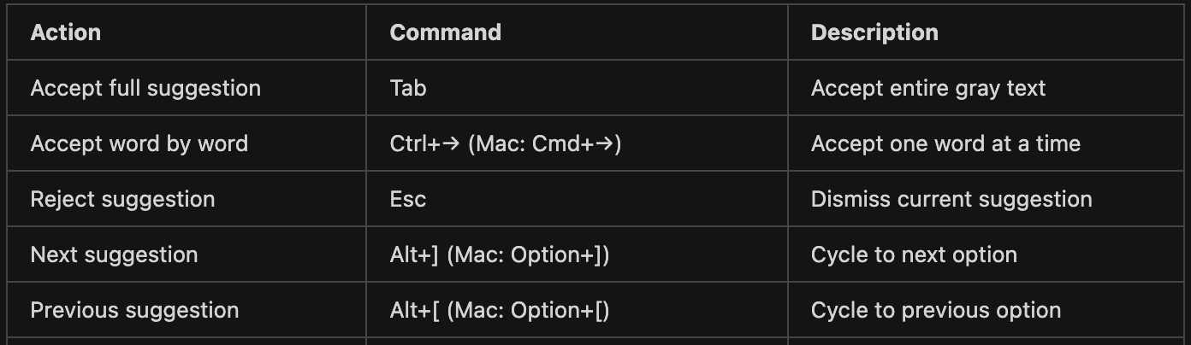
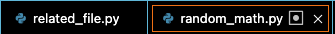

Basics
Ghost Text commands
Providing context helps generate code on its own.
Fig: Commands to aid auto-completion
For auto-completion, better to have related files open in tab.
Copilot gives an array based on the name of the variable.
Notes:
how Copilot predicts code. It is important to provide clear context -clear variable names, comments, or partially written code improve suggestions.
Copilot isn’t psychic — it relies on the clues you give in your code.

Slide 4
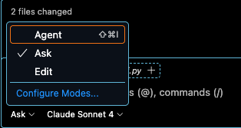

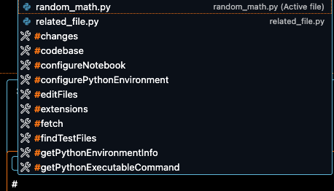
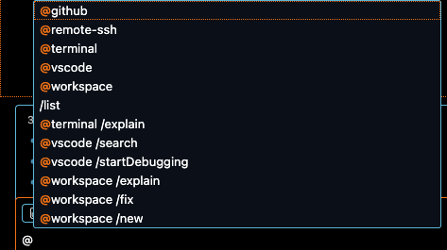
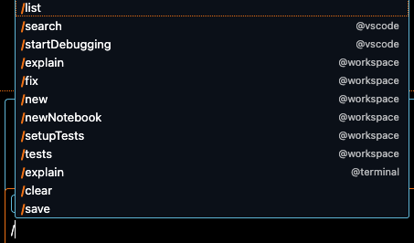



Basics Chat options
Helps us get more specific about what we want
Chat sidebar has three modes
What?
Where?
Slash commands
Terminal output
Getting more specific

Slide 5
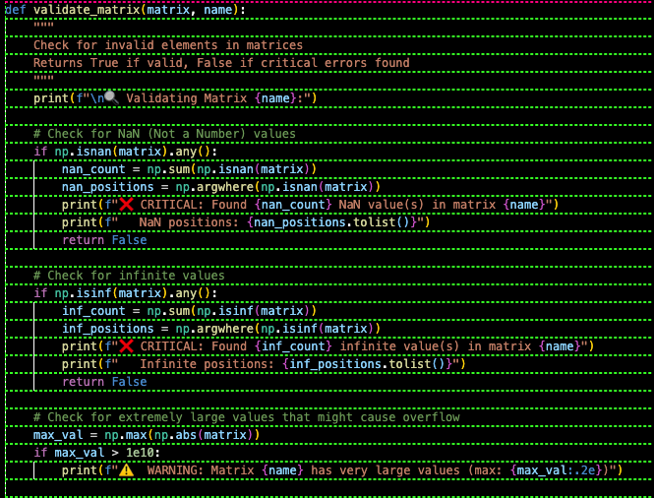
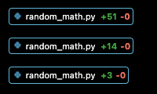
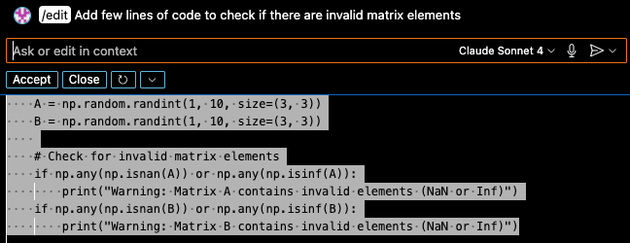
Basics Some example: Too much code
On the chat
Matrices A, B and operations on them.
Generates too many lines of code
We can do this instead (Ctrl + I) on
Selected lines of code
Notes:
Open ended questions get open ended answers. It can sometimes over-generate code and more code it writes, more chances for errors → Hallucinations. Sometimes makes up when it doesn’t know an answer. You will be fixing errors.

Slide 6
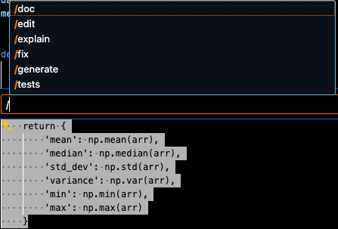
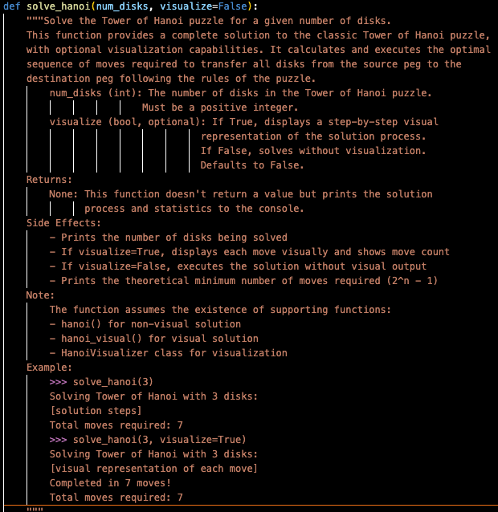
Basics
Inline chat & Slash commands
Ctrl + I (or Command + I) on selected code.
/doc without context on a random function
Be more specific: ‘/fix the --- error’ instead of just using ‘/fix’.

Slide 7
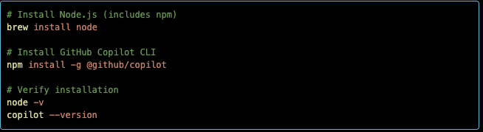

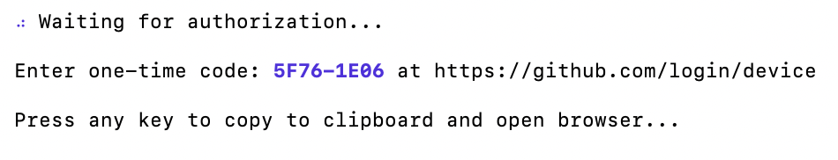
Copilot CLI on Terminal
Installation
npm on MacOs
npm on Linux
Login using github account

Slide 8
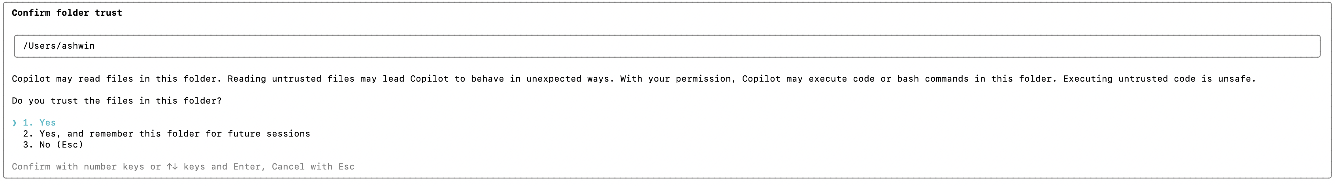
Copilot CLI: Trusted directories
Warning
Only launch Copilot CLI from directories that you trust.
CLI from a directory with sensitive or confidential data, or files you don't want to be changed, you could expose those files to risk.
Should not launch Copilot CLI from your home directory.

Slide 9
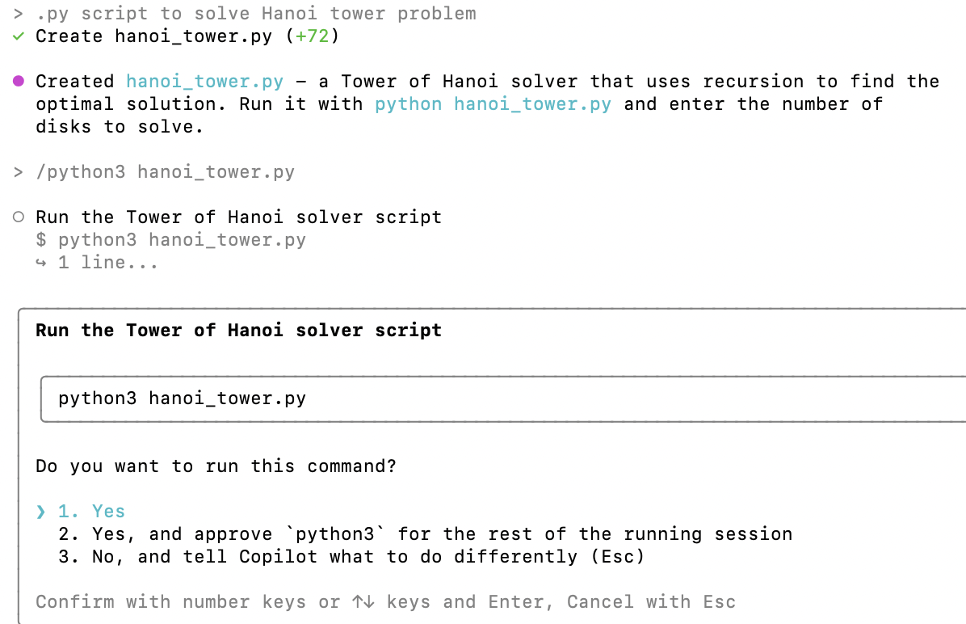
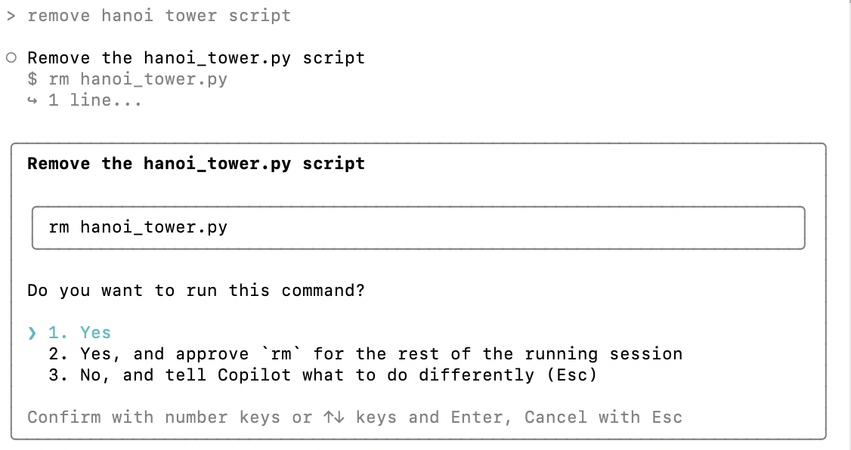
Copilot CLI : Allowed Tools Copilot asks for permission first time a tool is used.
Caution when running Yes, and approve ’tool’ for the rest of the running session
Some examples on first time usage
Creates and runs a python script
Remove some file

Slide 10
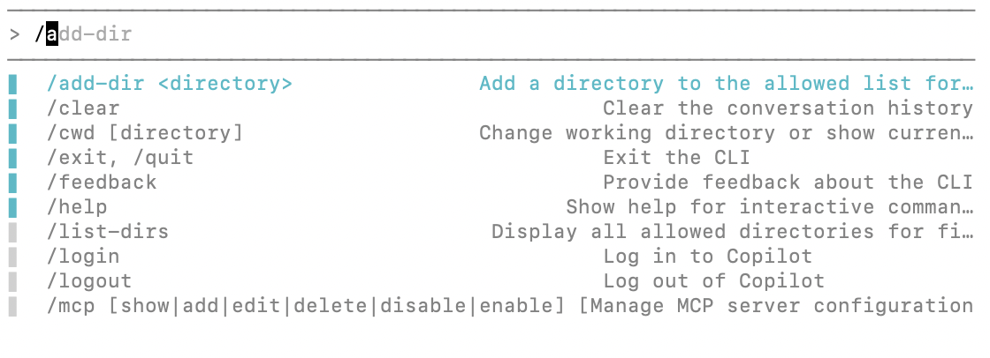
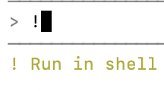
Copilot CLI: Slash commands
This is how I run my commands

Slide 11
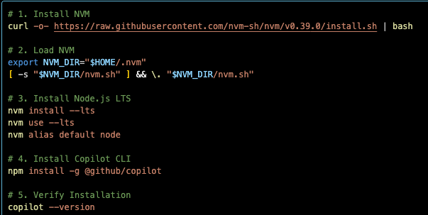
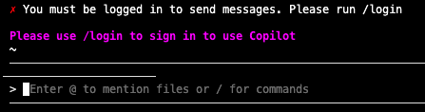

Copilot CLI on Anvil
Installation
npm (&Node.js) to install github copilot.
System Node.js is too old
Cluster has Node.js v10.24.0
GitHub Copilot CLI requires Node.js ≥22.
NVM to resolve this.
To get started

Slide 12
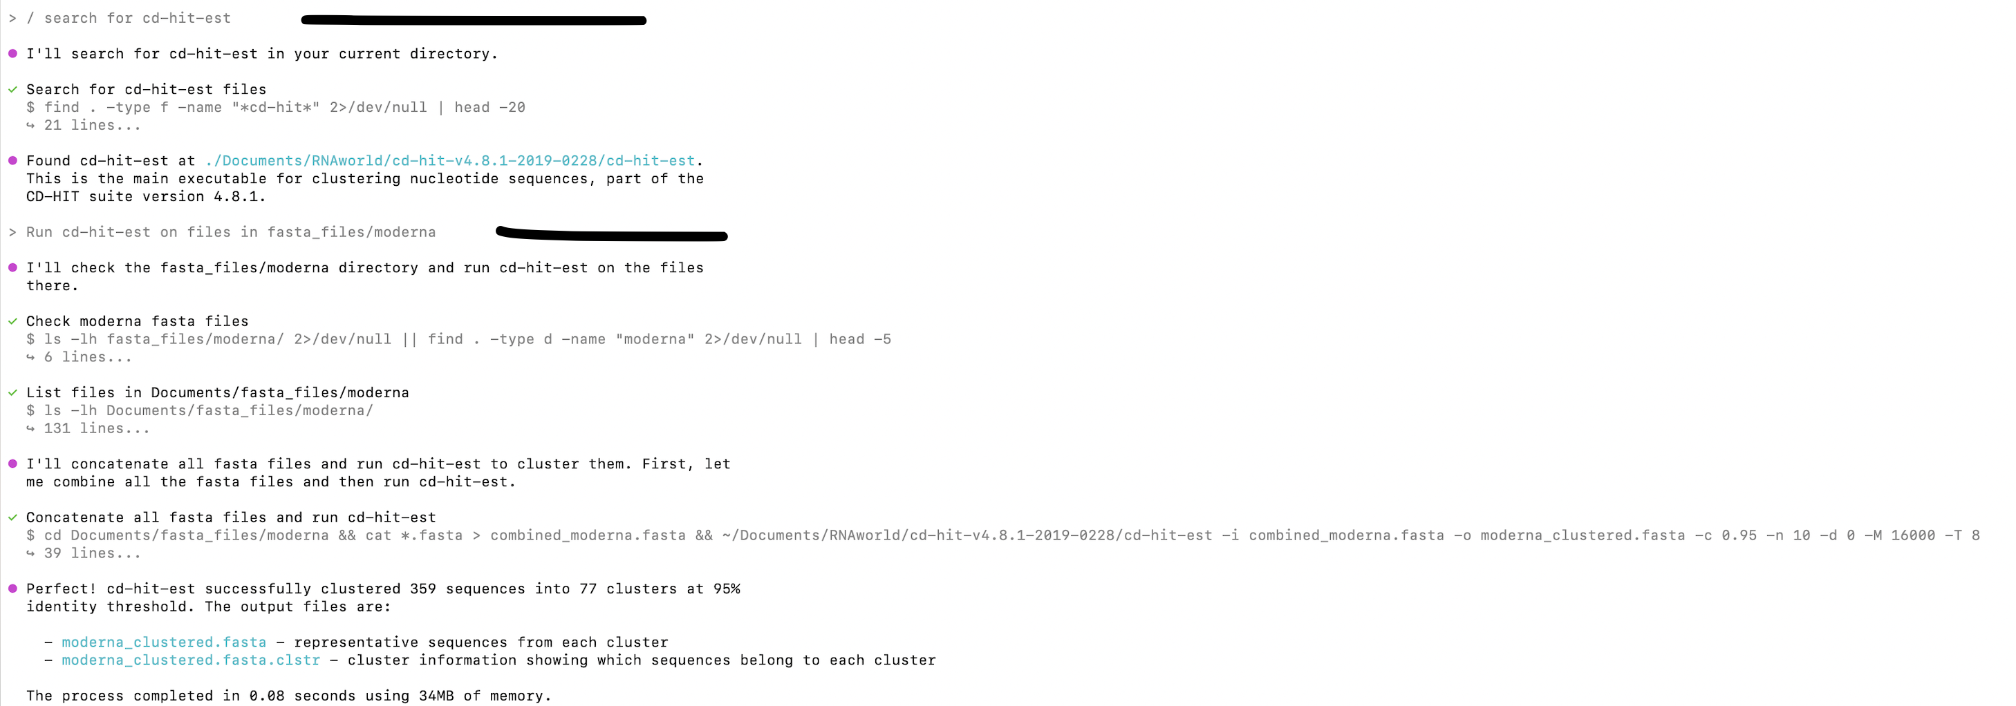
Copilot CLI on Terminal
Example: run cd-hit-est

Slide 13
Custom Instructions and why you should use it
YOU DON’T HAVE TO REPEAT EVERYTIME.

Slide 14
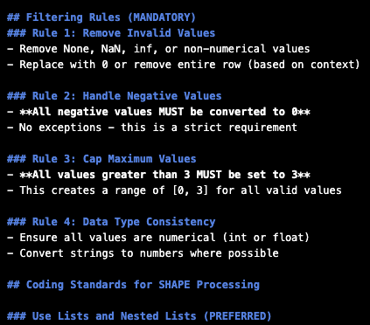
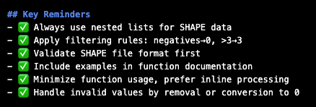
Custom Instructions and why you should use it
SHAPE_PROCESSING_INSTRUCTIONS.md to handle SHAPE preprocessing
Let Copilot generate instructions.md → Make changes to it and remove unwanted instructions.
When needed, direct towards #file: INSTRUCTIONS.md

Slide 15
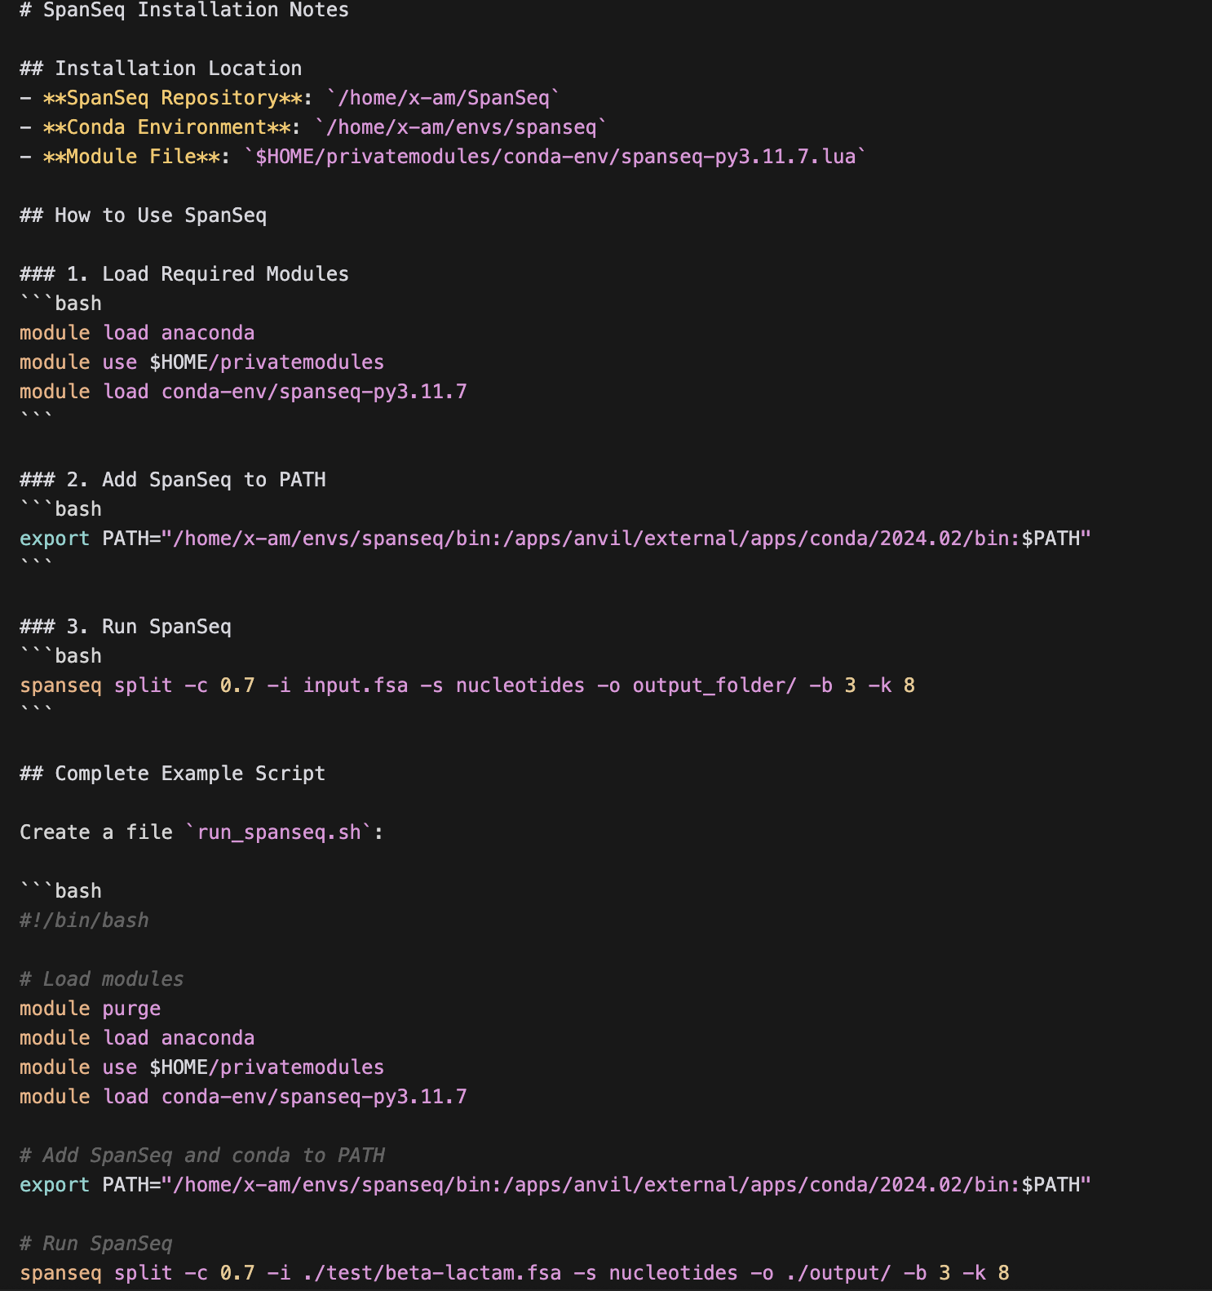
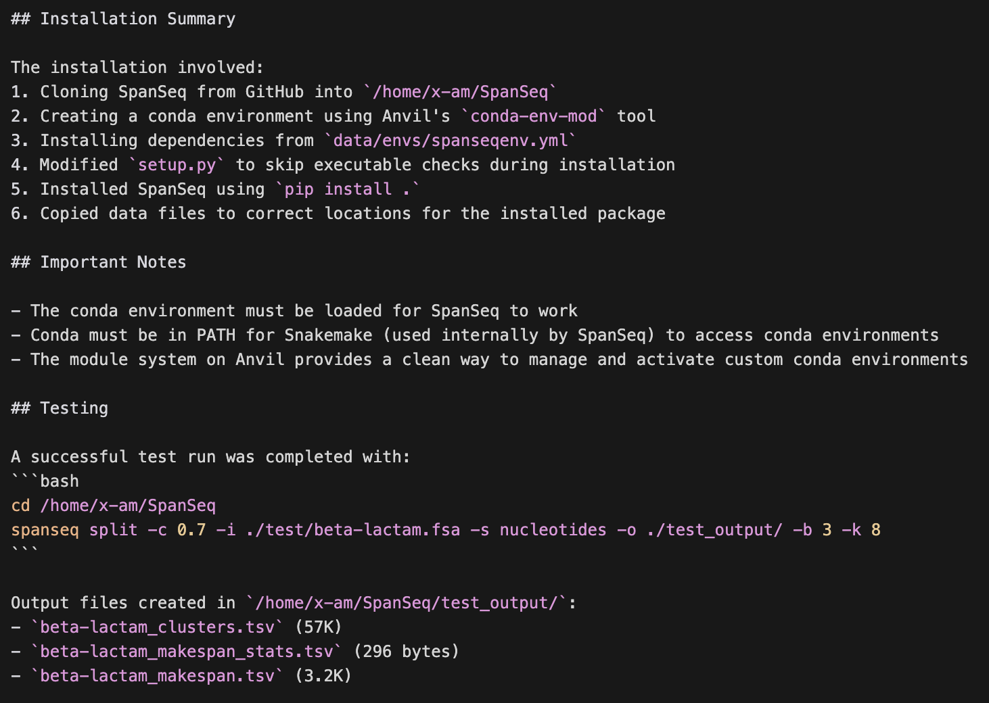
Custom Instructions Example: SpanSeq installation

