Slide 1


Slide 2


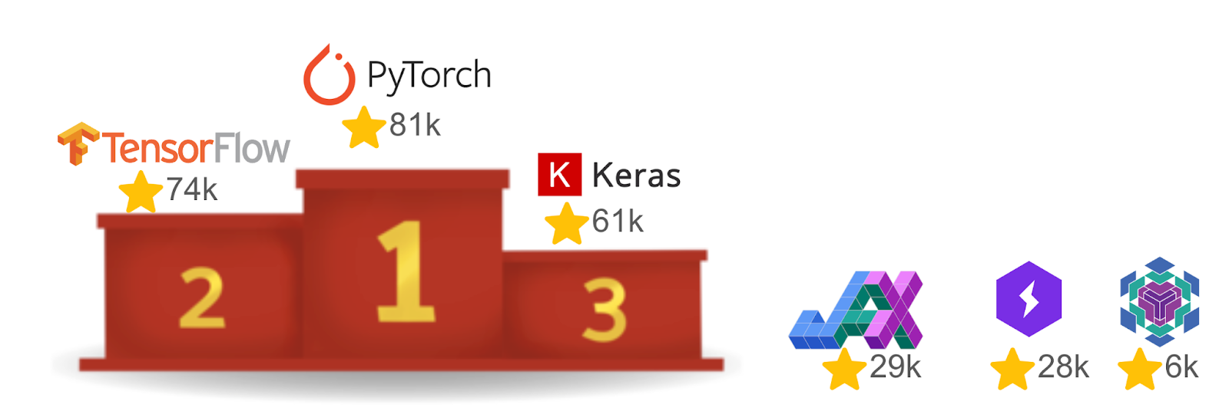
JAX
Python library developed by Google
Python/Numpy
For high-performance array computing and large-scale machine learning.
Numpy-like API: import jax.numpy as jnp
Easy parallelization.
Works via composable function transformations.
Python/Numpy with JAX
Simple transformations
Notes:
If you are familiar with NumPy, you will find JAX very easy to use. Since JAX imitates the NumPY API, you can use the same syntax you’re already familiar with. It shouldn’t be surprising that matrix multiplication run faster on accelerators like GPUs and TPUs. What JAX offers in this case is the ability to automatically leverage accelerators with no changes made to the code!
JAX works via composable function transformations, this means that JAX takes a function and produces a new function that is interpreted differently and that multiple transformations can be chained together. Through these transformations JAX allows the programmer to stay in the high-level Python world and let the compiler do the hard work by generating the highly efficient code needed to train complex models. PyTorch’s longer tenure and larger community translate to more available resources for optimizing performance. JAX has an easy-to-use interface because it is very similar to NumPy

Slide 3
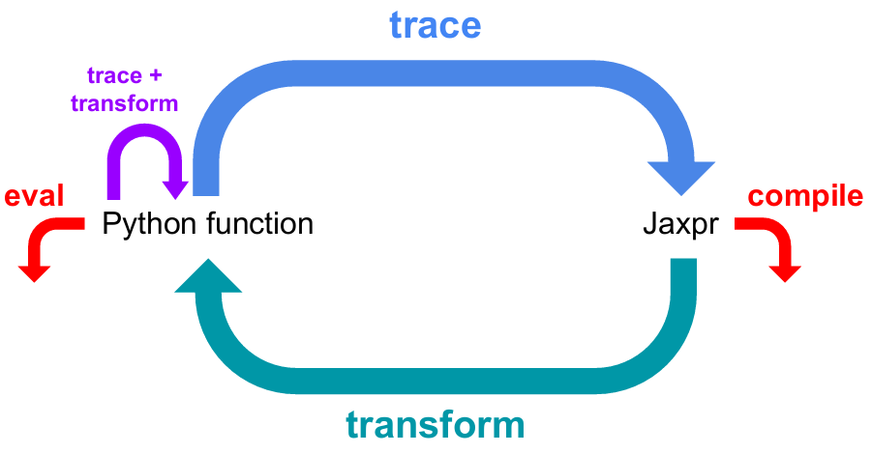
Overview
JAX’s core idea: “Trace ➜ Compile➜ Transform.”
Capture its computation graph.
@jit
XLA to run efficiently on CPUs, GPUs, and TPUs.
grad (automatic differentiation)
vmap (batching)
pmap (multi-device parallelism).
Just After eXecution
Notes:
First invocation → JAX traces the function, building a high-level graph (JAXpr).
JAX hands that graph to XLA, which returns machine code.
That compilation happens “just-in-time”—immediately before the first result is needed—and the binary is cached.
The acronym JAX stands for “just after execution”, since to compile a function we first monitor its execution once in Python.
Later calls with the same shape/dtype signature jump straight into the cached executable; only new signatures trigger another JIT→XLA round.

Slide 4
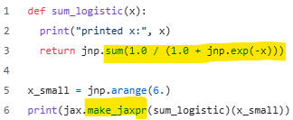
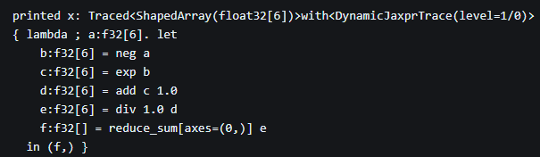
Just-in-time compilation
To jit or not to jit
Generating the machine code but at runtime.
Python functions → jaxpr (JAX Expression) → HLO graph → To XLA
Intermediate Representation
Tracer object
Python code with function
jaxpr
Notes:
JAX creates the jaxpr through tracing. Each argument in the function is wrapped with a tracer object. The purpose of these tracers is to record all JAX operations performed on them when the function is called. JAX uses the tracer records to rebuild the function, which leads to jaxpr. Python side-effects don't show up in the jaxpr because the tracers do not record them.

Slide 5
Just-in-time compilation
To jit or not to jit
def some_function(x):
print("Executing function") # This is a side-effect
return x
print ("First call: ", jit(some_function)(4.))
print ("Second call: ", jit(some_function)(5.))
print ("Third call, different type: ", jit(some_function)(jnp.array([5.])))
Executing function
First call: 4.0
Second call: 5.0
Executing function
Third call, different type: [5.]
Removes redundant calculations.
Notes:
Python si
Print statement# This is a side-effect
# The side-effects appear during the first run # Subsequent runs with parameters of same type and shape may not show the side-effect
# This is because JAX now invokes a cached compilation of the function # JAX re-runs the Python function when the type or shape of the argument changes
de-effects don't show up in the jaxpr because the tracers do not record them.

Slide 6
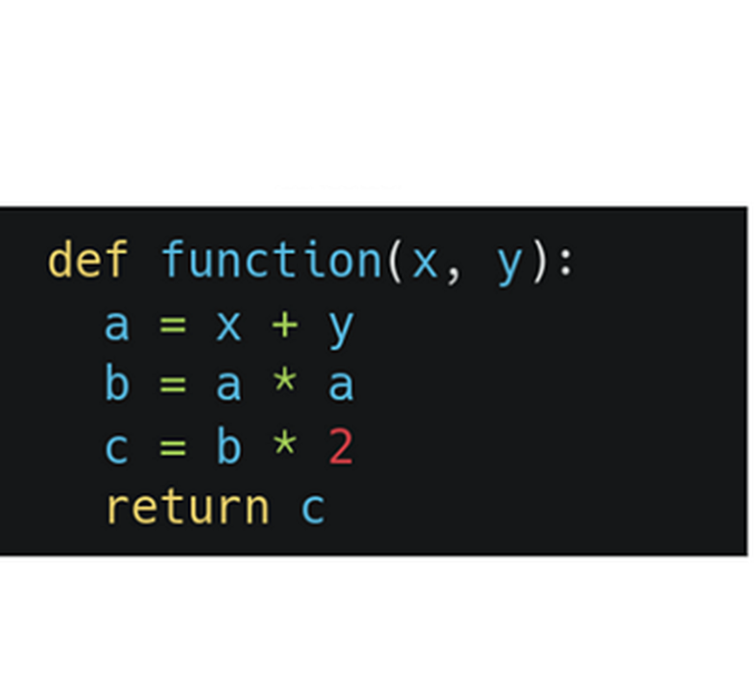
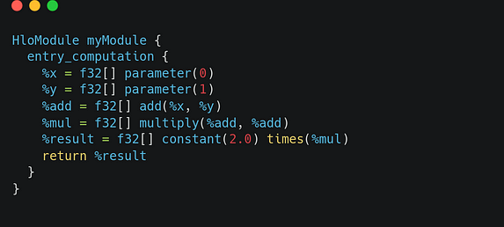
Just-in-time compilation
To jit or not to jit
Not all JAX code can be JIT compiled.
Eager execution: JAX without jit
To XLA
HLO code
Python function
HLO(High Level Operations): Program “between” the source and target languages.
Notes:
“run every operation immediately, right here in Python.” You write a function, call it, and each primitive (add, sin, matmul, etc.) fires off to the XLA backend (or CPU/GPU) one at a time, returning real arrays. There is no up-front graph compilation A pure function will always return the same result if invoked with the same inputs.
Compiled languages are fast to execute, but it’s difficult to write efficient compilers, which can make compiled languages cumbersome. In the middle between interpretation and compilation, we have just-in-time (JIT) compilation. We can think of JIT compilation as a hybrid of the two paradigms discussed above.
Interpreted languages are easier to write and more flexible in some situations, but are slower to execute.
XLA takes HLO code as input, performs optimizations, and generates optimized low-level machine code for execution on different hardware architectures. straightforward mathematical computation: the addition of two numbers, followed by squaring the result and multiplying it by a constant value. Each node in the graph represents an operation, and the edges represent the data flow between these operation.

Slide 7
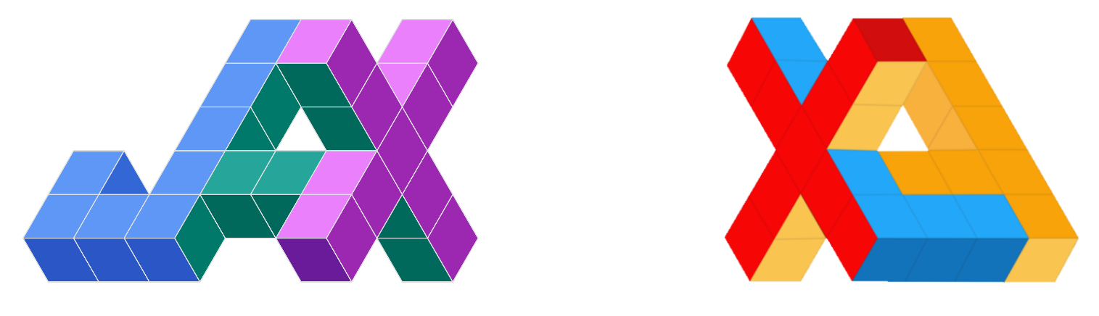
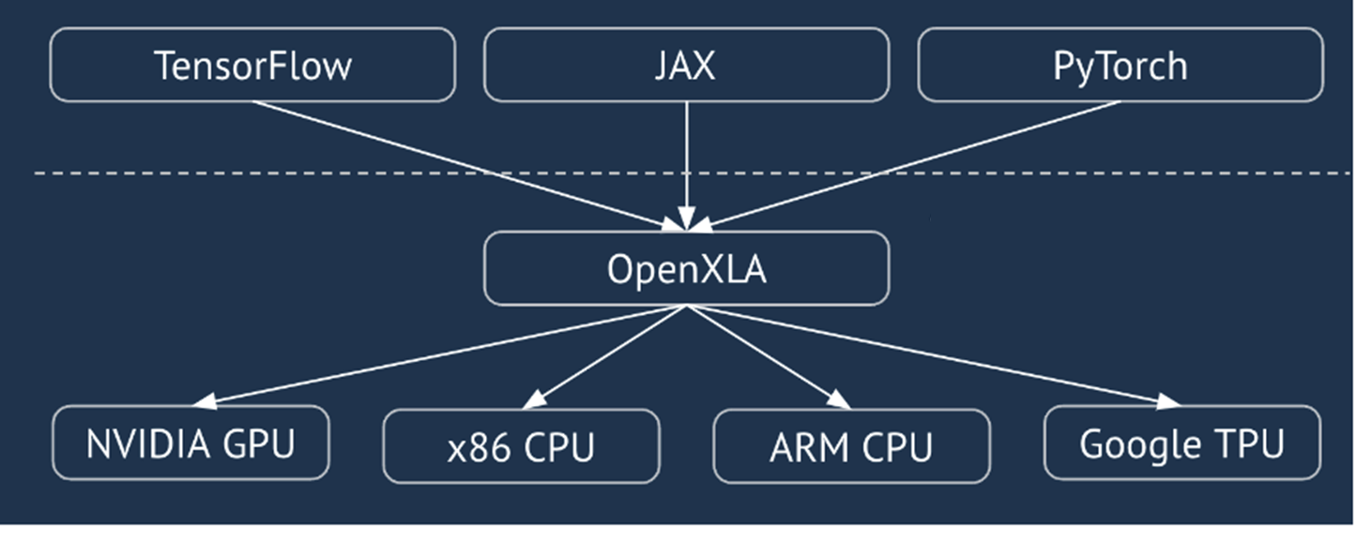
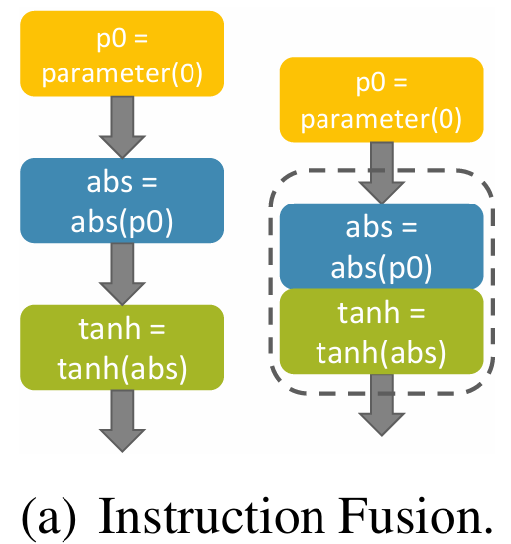
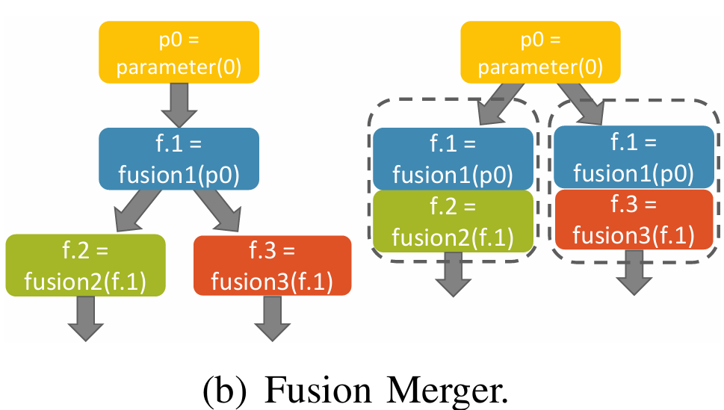
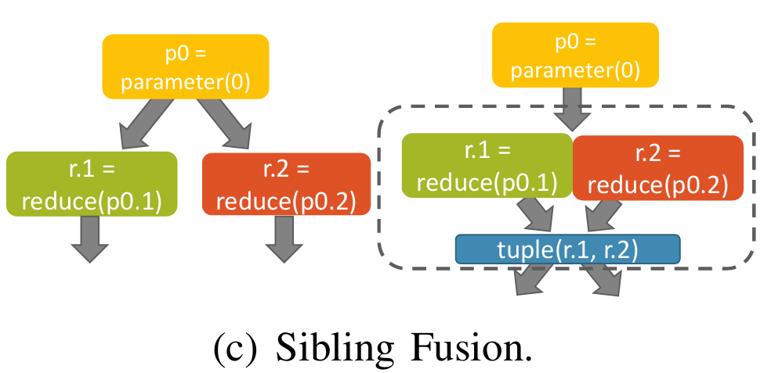
XLA: Accelerated Linear Algebra
Most widely-used ML optimization compiler
Compiler to convert code with linear algebra operations into efficient one.
Two steps of optimizations: target-independent and target-dependent optimizations.
Example: Reduce amount of memory access required.
Operation Fusion
Snider et al.,2023
Notes:
XLA is baked into the very DNA of JAX - from their logos alone you can see how much the successes of JAX rely on XLA. designed to optimize the performance of machine learning models that heavily rely on linear algebra operations. All the input data is passed through the function parameters, all the results are output through the function results.

Slide 8
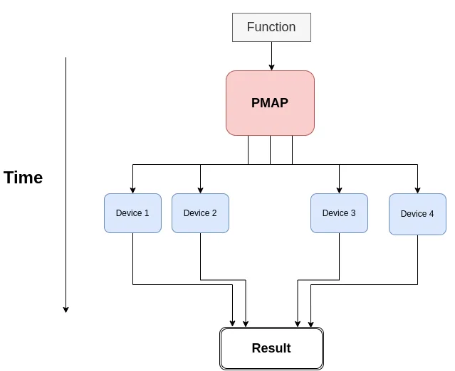
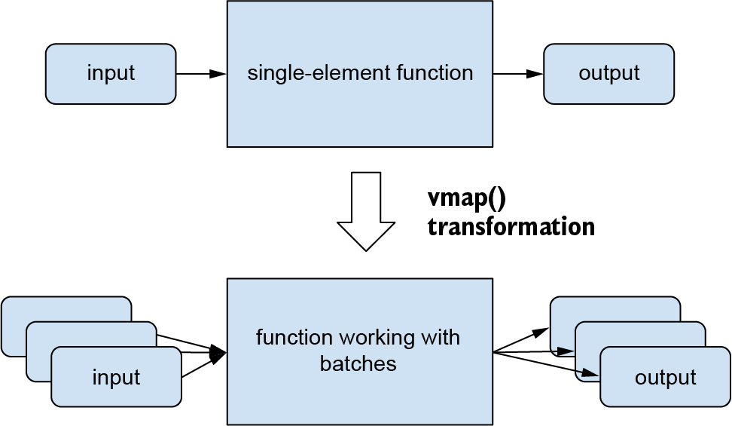
JAX Transformations
Automatic vectorization (vmap)
Parallelization (pmap)
Automatically converting scalar operations into vector operations.
VMAP works on one device at a time.
To execute single-program multiple-data (SPMD) programs.
PMAP can communicate between the devices
Notes:
Vmap: This avoids the overhead associated with repeated Python function calls and interpreter interactions. While vmap can significantly speed up computations, it can also increase peak memory usage compared to a sequential loop. When you apply a vmapped function, JAX often needs to create intermediate arrays that hold results for the entire batch simultaneously.

Slide 9
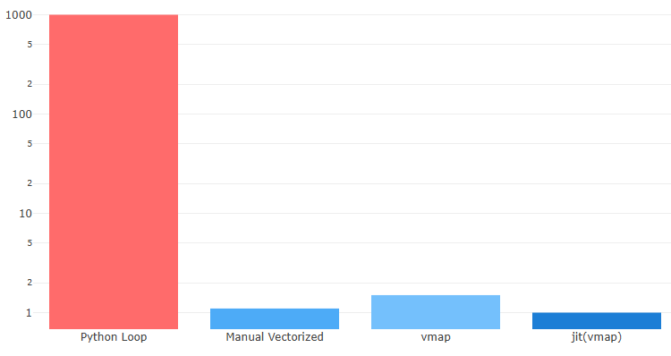
JAX Transformations - vmap
batch_size = 1000
a = jnp.ones(batch_size)
b = jnp.arange(batch_size, dtype=jnp.float32)
# 1. Manual Vectorization
def manual_vectorized_add(x_batch, y_batch):
return jnp.add(x_batch, y_batch)
# jnp.add directly handles arrays
# 2. Using vmap
def scalar_add(x, y):
return x + y v
mapped_add = jax.vmap(scalar_add)
# 3. Python Loop (Generally inefficient for numerical tasks)
def loop_add(x_batch, y_batch):
results = []
for i in range(len(x_batch)):
results.append(scalar_add(x_batch[i], y_batch[i]))
return jnp.stack(results)
Relative execution time for adding two vectors

Slide 10
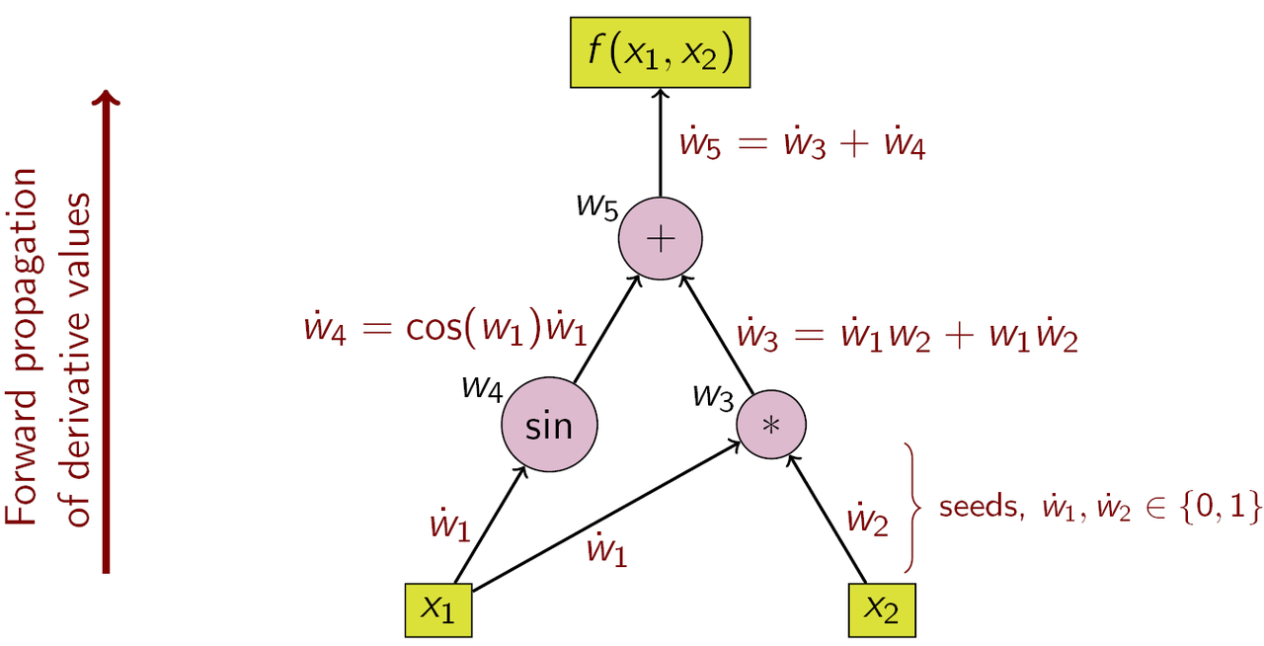
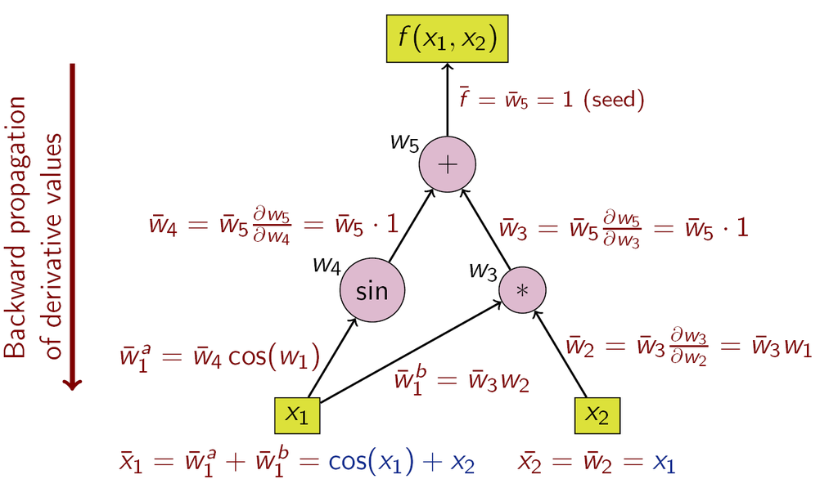
JAX Transformations
Automatic differentiation
Exact derivatives of function - jax.grad(some_function)
Using chain rule: Any complex function is a nested function of simpler ones.
$$y=f\left(x_{1},x_{2}\right)=x_{1}x_{2}+\sin{x_{1}}$$
Forward mode
Backward mode
JAX: Both forward mode and backward mode
Others: Only back propogation
Notes:
a derivative measures how a function changes when its input changes. Derivatives come in handy in machine learning because they allow us to adjust parameters like weights and biases in our models to make better predictions. This can get quite cumbersome for complex functions and you can’t possibly write out the analytical form of the derivative of a deep neural network. The approximation form is not very friendly when we have a lot of independent variables. Here comes automatic differentiation. The basic idea is that you tell each basic operation (addition, multiplication) on how to compute its own derivative.
Backward mode: First you evaluate the function from inputs to outputs, but you (or the AD system) keep a record (a “tape”) of all the intermediate steps of the computation; then, you run the computation in reverse (“play the tape backwards”) to backpropagate the derivatives.

Slide 11



Conclusion
Disadvantages
Limited higher-level libraries
Per-op dispatch overhead not fully optimized.
Transforms only work on pure functions.
Debugging tricky if JIT-compiled.
Notes:
JAX has an easy-to-use interface because it is very similar to NumPy. If you are familiar with NumPy, you will find JAX very easy to use. Since JAX imitates the NumPY API, you can use the same syntax you’re already familiar with. It shouldn’t be surprising that matrix multiplication run faster on accelerators like GPUs and TPUs. What JAX offers in this case is the ability to automatically leverage accelerators with no changes made to the code!
You can’t always just wave your magic wand at your code and suddenly make it run faster when using JAX. The acronym JAX stands for “just after execution”, since to com pile a function we first monitor its execution once in Python.

