Slide 1
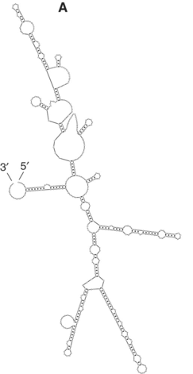
Minimum Free Energy (MFE) structure prediction
Ashwin Amalaruban

Slide 2
Predicting RNA structure from
Faster
Our interest
Computational structure prediction
Al-Khatib et al., Evolutionary Bioinformatics, 2010
Vicens et al., PNAS, 2022
Notes:
a GC pair in one sequence is replaced by an AU pair in another sequence. Comparative analysis is quite robust when a number of homologous sequences are available. Over 97% of base-pairs predicted for ribosomal RNA were demonstrated in subsequent crystal structures.

Slide 3
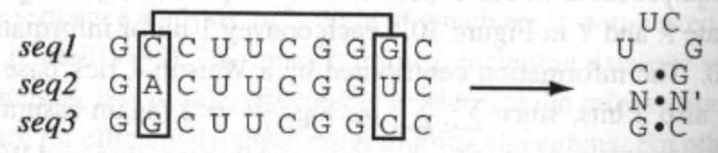
Predicting RNA structure from
Faster
Our interest
Computational structure prediction
Comparative Analysis
Structures for similar RNAs (from different species) can be obtained.
Al-Khatib et al., Evolutionary Bioinformatics, 2010
Vicens et al., PNAS, 2022
Notes:
a GC pair in one sequence is replaced by an AU pair in another sequence. Comparative analysis is quite robust when a number of homologous sequences are available. Over 97% of base-pairs predicted for ribosomal RNA were demonstrated in subsequent crystal structures.

Slide 4
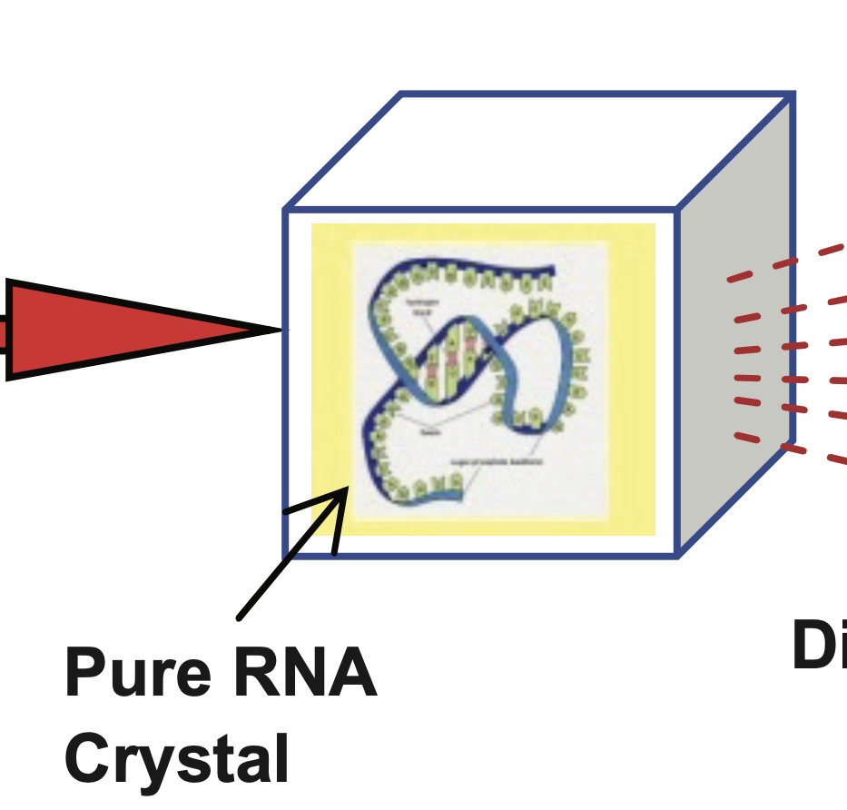
Predicting RNA structure from
Faster
Our interest
Computational structure prediction
Comparative Analysis
Structures for similar RNAs (from different species) can be obtained.
Experiments
More accurate
X-ray crystallography
Processing
Structure
X-ray
Al-Khatib et al., Evolutionary Bioinformatics, 2010
Vicens et al., PNAS, 2022
Notes:
a GC pair in one sequence is replaced by an AU pair in another sequence. Comparative analysis is quite robust when a number of homologous sequences are available. Over 97% of base-pairs predicted for ribosomal RNA were demonstrated in subsequent crystal structures.

Slide 5
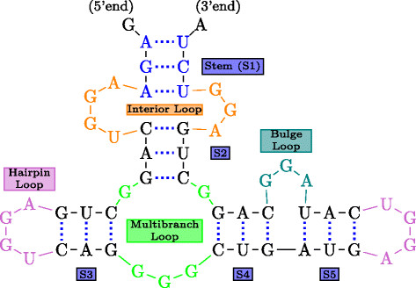
Recap: Free Energy Parameters
Dangling end
Consists of multiple
Helical stacks
Internal loop
Mismatch
Notes:
a GC pair in one sequence is replaced by an AU pair in another sequence. Comparative analysis is quite robust when a number of homologous sequences are available. Over 97% of base-pairs predicted for ribosomal RNA were demonstrated in subsequent crystal structures.

Slide 6
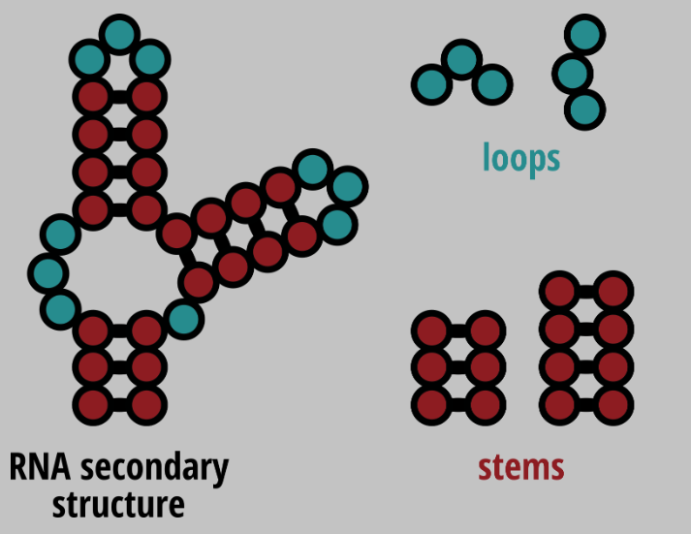
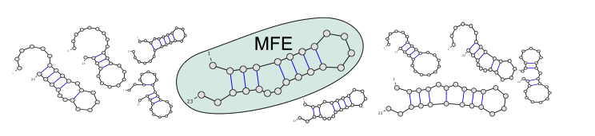


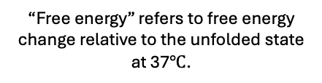







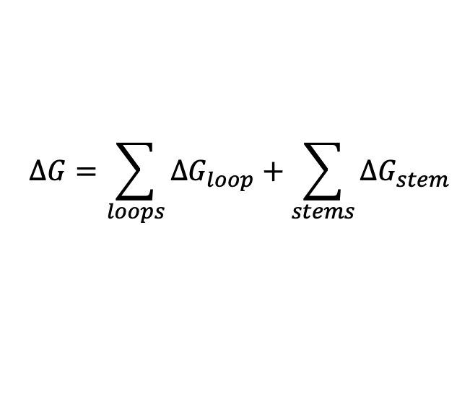


Minimum Free Energy Structure (MFE) structure prediction
1 Free energy of structure is the sum of free energy of individual motifs.
“Free energy” refers to free energy change relative to the unfolded state at 37$℃$.
$$∆G=\sum_{loops}{∆G_{loop}}+\sum_{stems}{∆G_{stem}}$$
2 Minimum free energy = Most stable = Most likely
$$∆G=−16$$
$$∆G=−30.8$$
$$∆G=−32$$
$$∆G=−26$$
$$∆G=−23$$
$$∆G=−21$$
Units of $∆G$ is kcal/mole.
$$∆G=−29.9$$
$$∆G=−28$$
$$∆G=−24$$
$$∆G=−31.8$$
Vicens et al., PNAS, 2022
Notes:
they bias it toward structures that the RNA actually occupies in solution, which substantially improves prediction accuracy

Slide 7
Goal: Find the secondary structure with minimum free energy.
Challenge: Too many structures to enumerate.

Slide 8
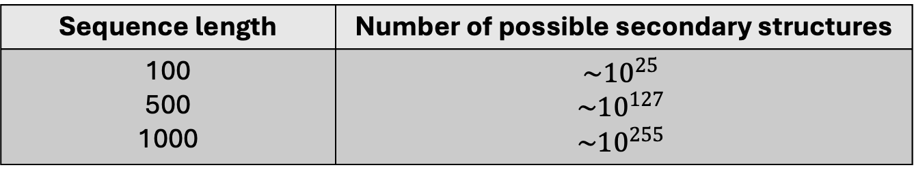

Goal: Find the secondary structure with minimum free energy.
Challenge: Too many structures to enumerate.
Sequence length | Number of possible secondary structures
100 500 1000 | $$\sim {10}^{25}$$ $$\sim {10}^{127}$$ $$\sim {10}^{255}$$
Exponential growth$(\sim {1.8}^{N})$
Notes:
On the experimental side, there are hundreds of optical melting experiments—on the order of 800 constructs.
Those are fit to recover roughly 300 nearest-neighbor parameters: helical stacking, dangling ends, terminal mismatches, hairpins, internal loops, multibranch loops, etc.
These core parameters are then expanded into lookup tables—about 10–15k table entries in tools like RNAstructure.
When you give RNAstructure a sequence, it decomposes every candidate structure into motifs, pulls the corresponding numbers from these tables.

Slide 9
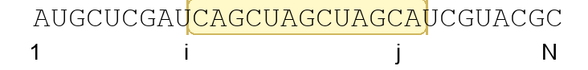
Goal: Find the secondary structure with minimum free energy.
Challenge: Too many structures to enumerate.
Sequence length | Number of possible secondary structures
100 500 1000 | $$\sim {10}^{25}$$ $$\sim {10}^{127}$$ $$\sim {10}^{255}$$
Exponential growth$(\sim {1.8}^{N})$
Solution: Dynamic Programming
Break the RNA into overlapping subsequences (i, j) and compute optimal energies bottom-up, from short intervals to the full sequence.
But how?? Next few slides.
Notes:
On the experimental side, there are hundreds of optical melting experiments—on the order of 800 constructs.
Those are fit to recover roughly 300 nearest-neighbor parameters: helical stacking, dangling ends, terminal mismatches, hairpins, internal loops, multibranch loops, etc.
These core parameters are then expanded into lookup tables—about 10–15k table entries in tools like RNAstructure.
When you give RNAstructure a sequence, it decomposes every candidate structure into motifs, pulls the corresponding numbers from these tables.

Slide 10
RNA folding problem
Dynamic programming
RNA sequence
Structure with minimum free energy
Thermodynamic parameters
Let us start with a simplified folding model
Dynamic programming
RNA sequence
Structure with maximum number of base pairs
Thermodynamic parameters
Notes:
On the experimental side, there are hundreds of optical melting experiments—on the order of 800 constructs.
Those are fit to recover roughly 300 nearest-neighbor parameters: helical stacking, dangling ends, terminal mismatches, hairpins, internal loops, multibranch loops, etc.
These core parameters are then expanded into lookup tables—about 10–15k table entries in tools like RNAstructure.
When you give RNAstructure a sequence, it decomposes every candidate structure into motifs, pulls the corresponding numbers from these tables.

Slide 11
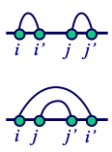

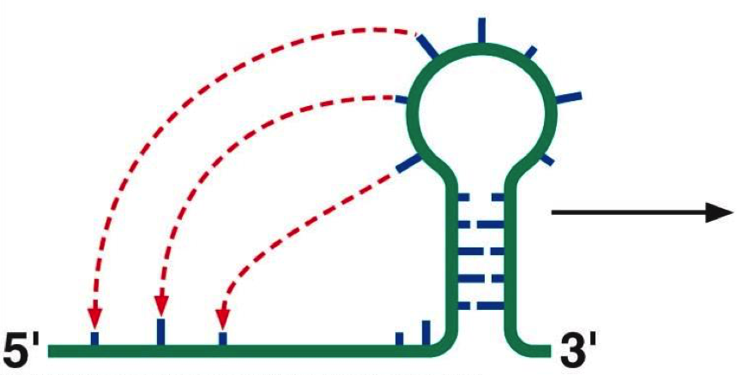
RNA folding assumption
For base-paired positions (i, i’) and (j, j’), we must have either
Base pairs not nested
Nested base pairs
The algorithms we’ll consider assume that base pairs do not cross.
Can’t have
Including pseudoknots greatly increases computational complexity.
Pseudoknots
Image adapted from Pearson Education, Inc., 2008.
Notes:
On the experimental side, there are hundreds of optical melting experiments—on the order of 800 constructs.
Those are fit to recover roughly 300 nearest-neighbor parameters: helical stacking, dangling ends, terminal mismatches, hairpins, internal loops, multibranch loops, etc.
These core parameters are then expanded into lookup tables—about 10–15k table entries in tools like RNAstructure.
When you give RNAstructure a sequence, it decomposes every candidate structure into motifs, pulls the corresponding numbers from these tables.

Slide 12
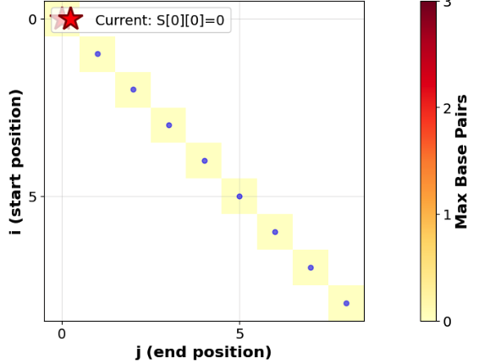
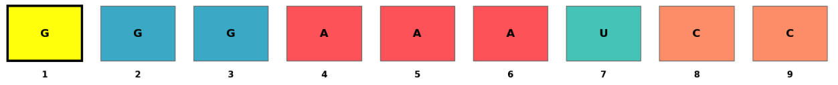
Base-pair Maximization
Dynamic programming setup
Define S(i,j): maximum number of base pairs that the subsequence i…j can form
Subsequence length: d=j−i
Fill diagonally by increasing d (Bottom-up)
3
Notes:
Compares a sequence against itself in a nxn matrix

Slide 13
Base-pair Maximization
Dynamic programming setup
Define S(i,j): maximum number of base pairs that the subsequence i…j can form
Subsequence length: d=j−i
Fill diagonally by increasing d (Bottom-up)
3
A DEMO for a sequence
Notes:
Compares a sequence against itself in a nxn matrix

Slide 14
Base-pair Maximization
Dynamic programming setup
Define S(i,j): maximum number of base pairs that the subsequence i…j can form
Subsequence length: d=j−i
Fill diagonally by increasing d (Bottom-up)
3
A DEMO for a sequence
Notes:
Compares a sequence against itself in a nxn matrix

Slide 15
Base-pair Maximization
Dynamic programming setup
Define S(i,j): maximum number of base pairs that the subsequence i…j can form
Subsequence length: d=j−i
Fill diagonally by increasing d (Bottom-up)
3
A DEMO for a sequence
Okay, but how do we compute the value in one cell S(i,j)?
Notes:
Compares a sequence against itself in a nxn matrix

Slide 16
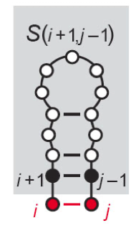

How do we compute the value in one cell, S(i,j)?
For each index, choose option that yields max score
$$S\left(i,j\right)=max \left\{\begin{aligned}S\left(i+1,j−1\right)+1 if i,j can pair \\ \\ \begin{matrix} \\ \end{matrix}\end{aligned}\right.$$
 | j-1 | j
i |  | S(i,j)
i+1 | S(i+1,j-1)
Pair rna[i] and rna[j] and attach to best structure for rna[i+1:j-1]
Eddy, Nature Biotechnology, 2004
Notes:
On the experimental side, there are hundreds of optical melting experiments—on the order of 800 constructs.
Those are fit to recover roughly 300 nearest-neighbor parameters: helical stacking, dangling ends, terminal mismatches, hairpins, internal loops, multibranch loops, etc.
These core parameters are then expanded into lookup tables—about 10–15k table entries in tools like RNAstructure.
When you give RNAstructure a sequence, it decomposes every candidate structure into motifs, pulls the corresponding numbers from these tables.

Slide 17
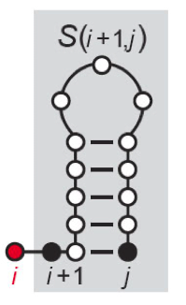

How do we compute the value in one cell, S(i,j)?
For each index, choose option that yields max score
$$S\left(i,j\right)=max \left\{\begin{aligned}S\left(i+1,j−1\right)+1 if i,j can pair \\ S\left(i+1,j\right) given i is unpaired \\ \begin{matrix} \\ \end{matrix}\end{aligned}\right.$$
Pair rna[i] and rna[j] and attach to best structure for rna[i+1:j-1]
 | j-1 | j
i |  | S(i,j)
i+1 | S(i+1,j-1) | S(i+1,j)
Add rna[i] to best structure of rna[i+1:j]
Eddy, Nature Biotechnology, 2004
Notes:
On the experimental side, there are hundreds of optical melting experiments—on the order of 800 constructs.
Those are fit to recover roughly 300 nearest-neighbor parameters: helical stacking, dangling ends, terminal mismatches, hairpins, internal loops, multibranch loops, etc.
These core parameters are then expanded into lookup tables—about 10–15k table entries in tools like RNAstructure.
When you give RNAstructure a sequence, it decomposes every candidate structure into motifs, pulls the corresponding numbers from these tables.

Slide 18
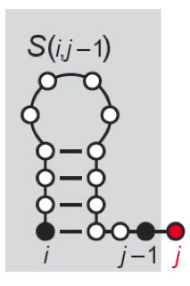

How do we compute the value in one cell, S(i,j)?
For each index, choose option that yields max score
$$S\left(i,j\right)=max \left\{\begin{aligned}S\left(i+1,j−1\right)+1 if i,j can pair \\ S\left(i+1,j\right) given i is unpaired \\ \begin{matrix}S\left(i,j−1\right) given j is unpaired \\ \end{matrix}\end{aligned}\right.$$
Pair rna[i] and rna[j] and attach to best structure for rna[i+1:j-1]
Add rna[i] to best structure of rna[i+1:j]
 | j-1 | j
i | S(i,j-1) | S(i,j)
i+1 | S(i+1,j-1) | S(i+1,j)
Add rna[j] to best structure of rna[i:j-1]
Eddy, Nature Biotechnology, 2004
Notes:
On the experimental side, there are hundreds of optical melting experiments—on the order of 800 constructs.
Those are fit to recover roughly 300 nearest-neighbor parameters: helical stacking, dangling ends, terminal mismatches, hairpins, internal loops, multibranch loops, etc.
These core parameters are then expanded into lookup tables—about 10–15k table entries in tools like RNAstructure.
When you give RNAstructure a sequence, it decomposes every candidate structure into motifs, pulls the corresponding numbers from these tables.

Slide 19
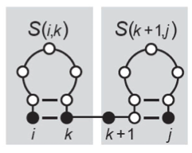
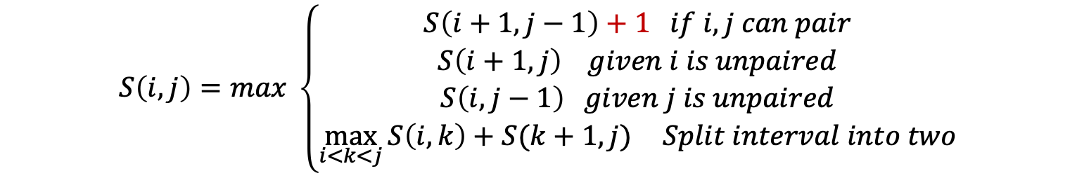
How do we compute the value in one cell, S(i,j)?
$$S\left(i,j\right)=max \left\{\begin{aligned}S\left(i+1,j−1\right)+1 if i,j can pair \\ S\left(i+1,j\right) given i is unpaired \\ \begin{matrix}S\left(i,j−1\right) given j is unpaired \\ \max_{i<k<j}{S\left(i,k\right)+S(k+1,j)} Split interval into two\end{matrix}\end{aligned}\right.$$
Pair rna[i] and rna[j] and attach to best structure for rna[i+1:j-1]
Add rna[i] to best structure of rna[i+1:j]
Add rna[j] to best structure of rna[i:j-1]
Combine two optimal structures for rna[i:k] and rna[k+1:j]
Eddy, Nature Biotechnology, 2004
Notes:
On the experimental side, there are hundreds of optical melting experiments—on the order of 800 constructs.
Those are fit to recover roughly 300 nearest-neighbor parameters: helical stacking, dangling ends, terminal mismatches, hairpins, internal loops, multibranch loops, etc.
These core parameters are then expanded into lookup tables—about 10–15k table entries in tools like RNAstructure.
When you give RNAstructure a sequence, it decomposes every candidate structure into motifs, pulls the corresponding numbers from these tables.

Slide 20
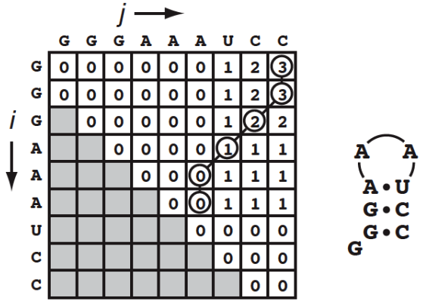
How do we recover the structure? Traceback.
S(1,N)
To obtain the structure
Start from final cell: S(1,N).
Eddy, Nature Biotechnology, 2004
Notes:
Without this step, the algorithm only provides a score (the maximum number of base pairs or minimum energy).
Once the matrix is completely filled and the maximum score for the entire sequence (cell S(1, n)) is found, the backtracking step begins. It "traces back" through the matrix, starting from the final cell, to identify the specific choices made at each step of the forward pass that led to that optimal score. If a cell's value came from a case where two nucleotides were paired, that pair is added to the predicted structure, and the backtracking continues from the new, smaller segment(s).

Slide 21
How do we recover the structure? Traceback.
S(1,N)
To obtain the structure
Start from final cell: S(1,N).
Follow which case achieved this optimal result.
Eddy, Nature Biotechnology, 2004
Notes:
Without this step, the algorithm only provides a score (the maximum number of base pairs or minimum energy).
Once the matrix is completely filled and the maximum score for the entire sequence (cell S(1, n)) is found, the backtracking step begins. It "traces back" through the matrix, starting from the final cell, to identify the specific choices made at each step of the forward pass that led to that optimal score. If a cell's value came from a case where two nucleotides were paired, that pair is added to the predicted structure, and the backtracking continues from the new, smaller segment(s).

Slide 22
How do we recover the structure? Traceback.
S(1,N)
To obtain the structure
Start from final cell: S(1,N).
Follow which case achieved this optimal result.
When a “paired case” is chosen, output base pair.
Eddy, Nature Biotechnology, 2004
Notes:
This DP + traceback pipeline is exactly what we’ll reuse for free energy minimization.

Slide 23
How do we recover the structure? Traceback.
S(1,N)
To obtain the structure
Start from final cell: S(1,N).
Follow which case achieved this optimal result.
When a “paired case” is chosen, output base pair.
Eddy, Nature Biotechnology, 2004
Notes:
This DP + traceback pipeline is exactly what we’ll reuse for free energy minimization.

Slide 24
From maximizing base pairs to minimizing free energy
$$E^{P}\left(i,j\right)=min⁡\{E_{case1}^{P},E_{case2}^{P},E_{case3}^{P},E_{case4}^{P}\}$$
Minimum free energy for subsequence i….j where (i,j) is paired.
Ward et al., Briefings in Bioinformatics, 2025
Notes:
Once the matrix is completely filled and the maximum score for the entire sequence (cell S(1, n)) is found, the backtracking step begins. It "traces back" through the matrix, starting from the final cell, to identify the specific choices made at each step of the forward pass that led to that optimal score. If a cell's value came from a case where two nucleotides were paired, that pair is added to the predicted structure, and the backtracking continues from the new, smaller segment(s).

Slide 25




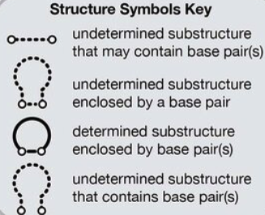
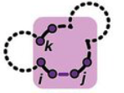

From maximizing base pairs to minimizing free energy
$$E^{P}\left(i,j\right)=min⁡\{E_{case1}^{P},E_{case2}^{P},E_{case3}^{P},E_{case4}^{P}\}$$
An example of how this works
Problem: Determine the minimum free energy for a subsequence 5 to 17 in a sequence of length 20.
Known: All subsequences inside (5, 17) have already been solved.
Hairpin loops
Stacking base pair
5
$$E^{P}\left(i,j\right)=min$$
Bulge or internal loop
17
Multibranch loops
($≥2$ branches)
1
20
Ward et al., Briefings in Bioinformatics, 2025
Notes:
Once the matrix is completely filled and the maximum score for the entire sequence (cell S(1, n)) is found, the backtracking step begins. It "traces back" through the matrix, starting from the final cell, to identify the specific choices made at each step of the forward pass that led to that optimal score. If a cell's value came from a case where two nucleotides were paired, that pair is added to the predicted structure, and the backtracking continues from the new, smaller segment(s).

Slide 26

From maximizing base pairs to minimizing free energy
$$E^{P}\left(i,j\right)=min⁡\{E_{case1}^{P},E_{case2}^{P},E_{case3}^{P},E_{case4}^{P}\}$$
For example
$$∆G=7 kcal/mole$$
Hairpin of length 11 (j-i-1)
$$∆G=−1.4 kcal/mole$$
(5,17) pair stacked with (6,16)
$$∆G=−0.6 kcal/mole$$
(5,17) pair and another pair within to form bulge or internal loop
N/A
Not sufficient nucleotides for a multibranch loop
5
Which of these has the lowest free energy?
17
1
20
Ward et al., Briefings in Bioinformatics, 2025
Notes:
Once the matrix is completely filled and the maximum score for the entire sequence (cell S(1, n)) is found, the backtracking step begins. It "traces back" through the matrix, starting from the final cell, to identify the specific choices made at each step of the forward pass that led to that optimal score. If a cell's value came from a case where two nucleotides were paired, that pair is added to the predicted structure, and the backtracking continues from the new, smaller segment(s).

Slide 27


From maximizing base pairs to minimizing free energy
Best case for this example is
For example
$$∆G=7 kcal/mole$$
$$∆G=−1.4 kcal/mole$$
$$∆G=−0.6 kcal/mole$$
$$∆G=0.6 kcal/mole$$
6
$E^{P}\left(5,17\right)=−1.4$
5
16
17
1
20
Fill till E(1,N).
Traceback for MFE structure.
Ward et al., Briefings in Bioinformatics, 2025
Notes:
Once the matrix is completely filled and the maximum score for the entire sequence (cell S(1, n)) is found, the backtracking step begins. It "traces back" through the matrix, starting from the final cell, to identify the specific choices made at each step of the forward pass that led to that optimal score. If a cell's value came from a case where two nucleotides were paired, that pair is added to the predicted structure, and the backtracking continues from the new, smaller segment(s).

Slide 28
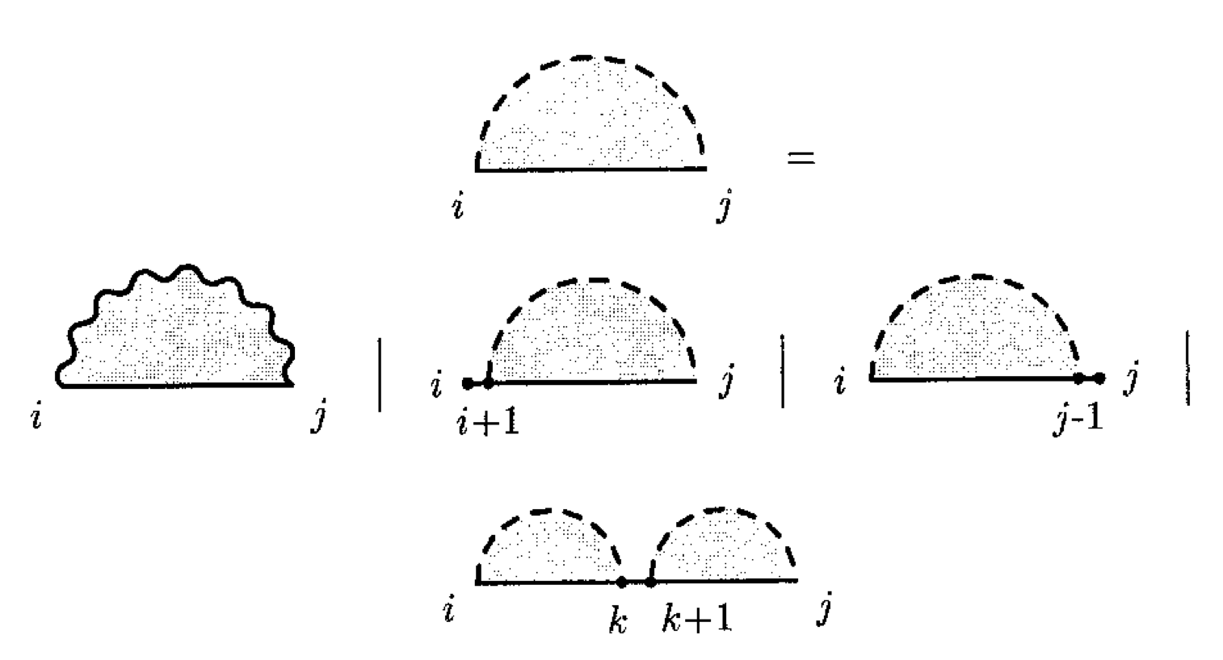




From maximizing base pairs to minimizing free energy
Define E(i,j): Minimum Free Energy of the structure for the sequence starting at i and ending at j (i<j).
Cases and free energies associated
Can be (i,j) closing a
Hairpin loop
Stacked base pair
Internal or bulge loop
Multibranch loop
$$E^{P}(i,j)$$
$$i,j are a base pair$$
$$E^{5′}(i,j)$$
$$i is unpaired$$
$$added to the structure i+1…j$$
E$\left(i,j\right)=min$
$$E^{3′}(i,j)$$
$$j is unpaired$$
$$added to the structure for i….j−1$$
$$E^{split}(i,j)$$
$$Split interval into two$$
Notes:
Once the matrix is completely filled and the maximum score for the entire sequence (cell S(1, n)) is found, the backtracking step begins. It "traces back" through the matrix, starting from the final cell, to identify the specific choices made at each step of the forward pass that led to that optimal score. If a cell's value came from a case where two nucleotides were paired, that pair is added to the predicted structure, and the backtracking continues from the new, smaller segment(s).

Slide 29
Completing MFE prediction
Fill the Dynamic Programming table (Bottom-up)
Compute E(i,j): the minimum free energy for every subsequence i…ji…j, from short intervals to longer ones.
Store the optimal decision at each cell
For each (i,j), record which option achieved the minimum (i–j paired with the best case (can be hairpin, stack, other loops), i unpaired, j unpaired, or split at k).
Traceback to recover base pairs
Start at E(1,N) and follow the stored decisions to output the set of base pairs that forms the minimum free energy structure.
Notes:
Once the matrix is completely filled and the maximum score for the entire sequence (cell S(1, n)) is found, the backtracking step begins. It "traces back" through the matrix, starting from the final cell, to identify the specific choices made at each step of the forward pass that led to that optimal score. If a cell's value came from a case where two nucleotides were paired, that pair is added to the predicted structure, and the backtracking continues from the new, smaller segment(s).

Slide 30
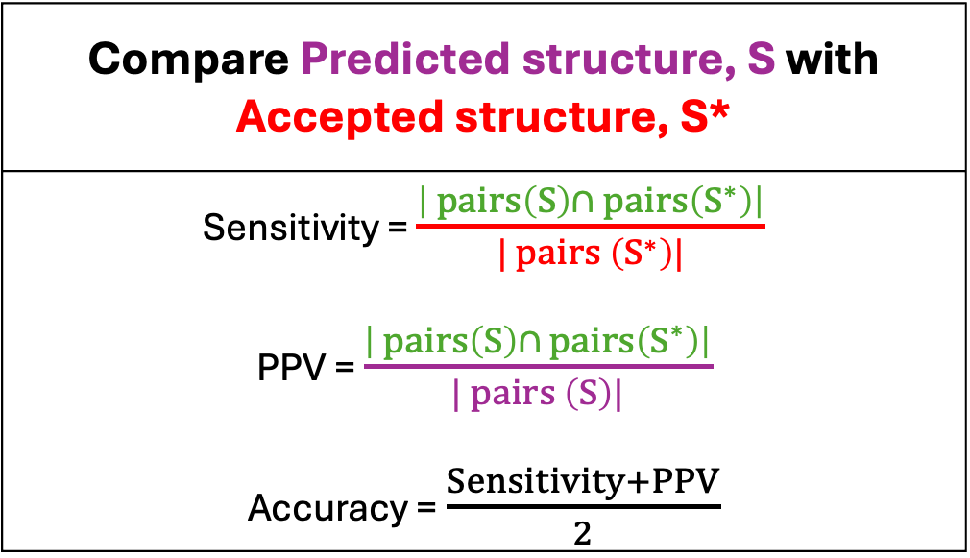
Prediction performance
Compare Predicted structure, S with Accepted structure, S*
Sensitivity = $\frac{\left| pairs\left(S\right)∩ pairs\left(S^{∗}\right)\right|}{| pairs \left(S^{∗}\right)|}$ PPV = $\frac{\left| pairs\left(S\right)∩ pairs\left(S^{∗}\right)\right|}{| pairs \left(S\right)|}$ Accuracy = $\frac{Sensitivity+PPV}{2}$
Leonard et al.,Biochem, 2013
Notes:
Anfinsen’s well accepted thermodynamic hypothesis, posits that biological molecules are often in an MFE state in vivo. Sensitivity - what percentage of known pairs
occur i n the predicted structure.
• Positive Predictive Value (PPV) - what
percentage o f predicted pairs occur in the known
s t r u c t u r e .
• P P V ≤ Sensitivity because the structures
determined by comparative sequence analysis do
not have all pairs and there i s a tendency t o over-
predict base pairs by free energy minimization.

