Slide 1
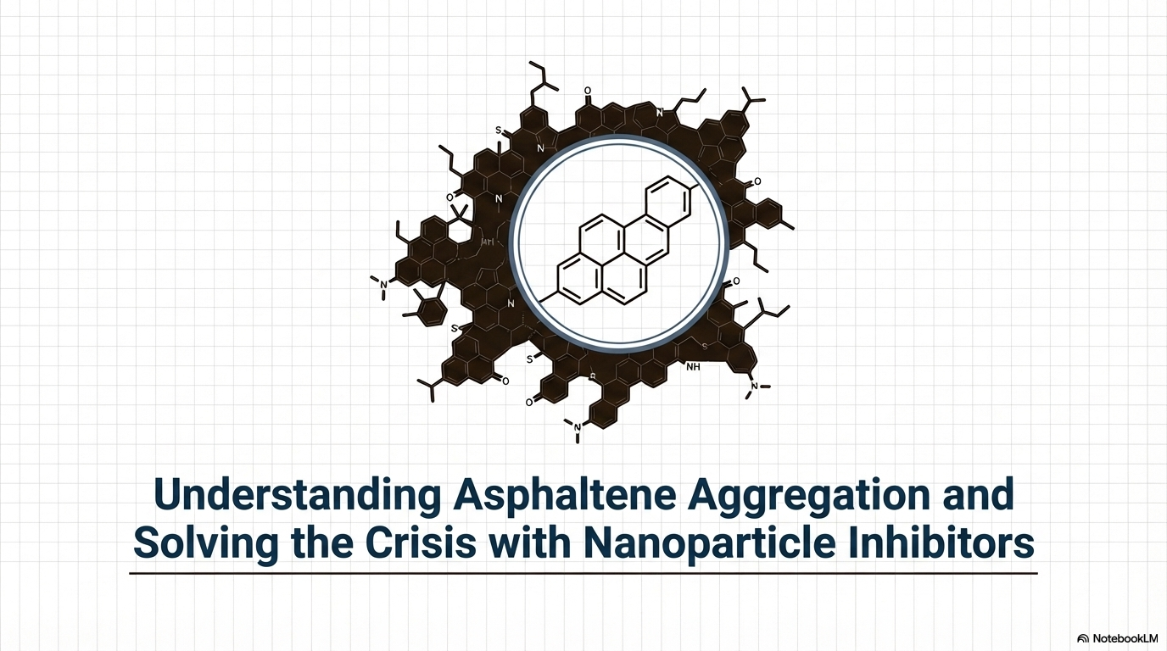

Slide 2
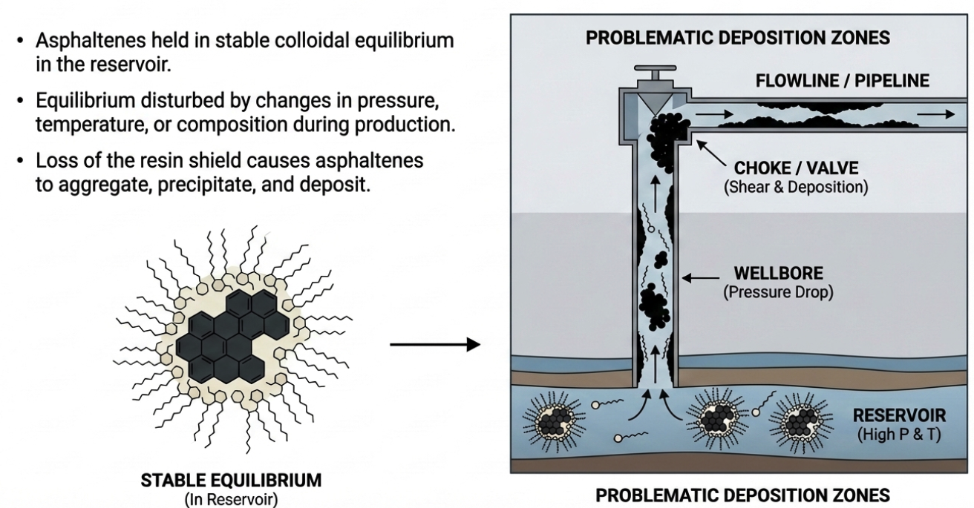
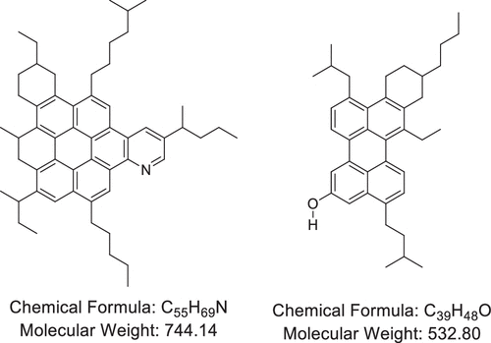
Why asphaltene in crude oil can be problematic?
Different molecular structures exist for asphaltene

Slide 3
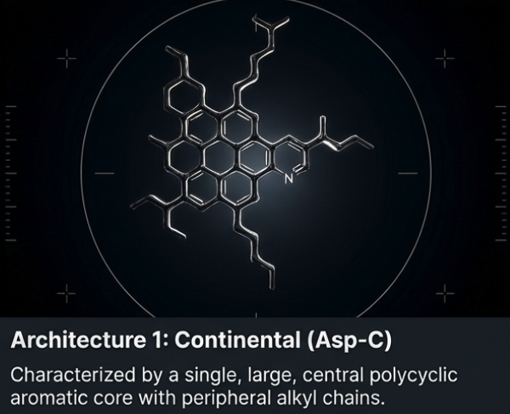
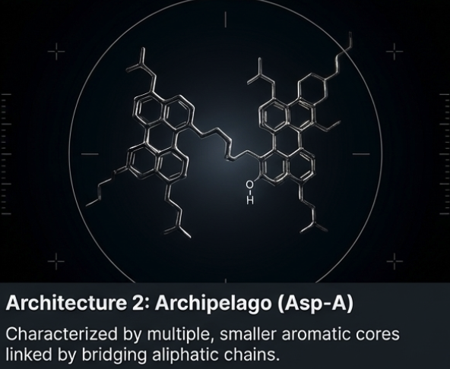
Architecture of asphaltene

Slide 4
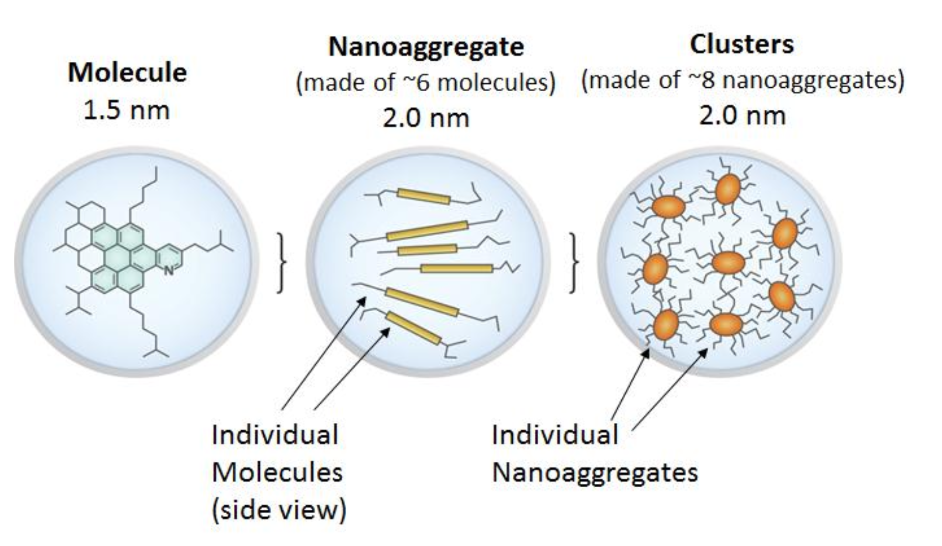
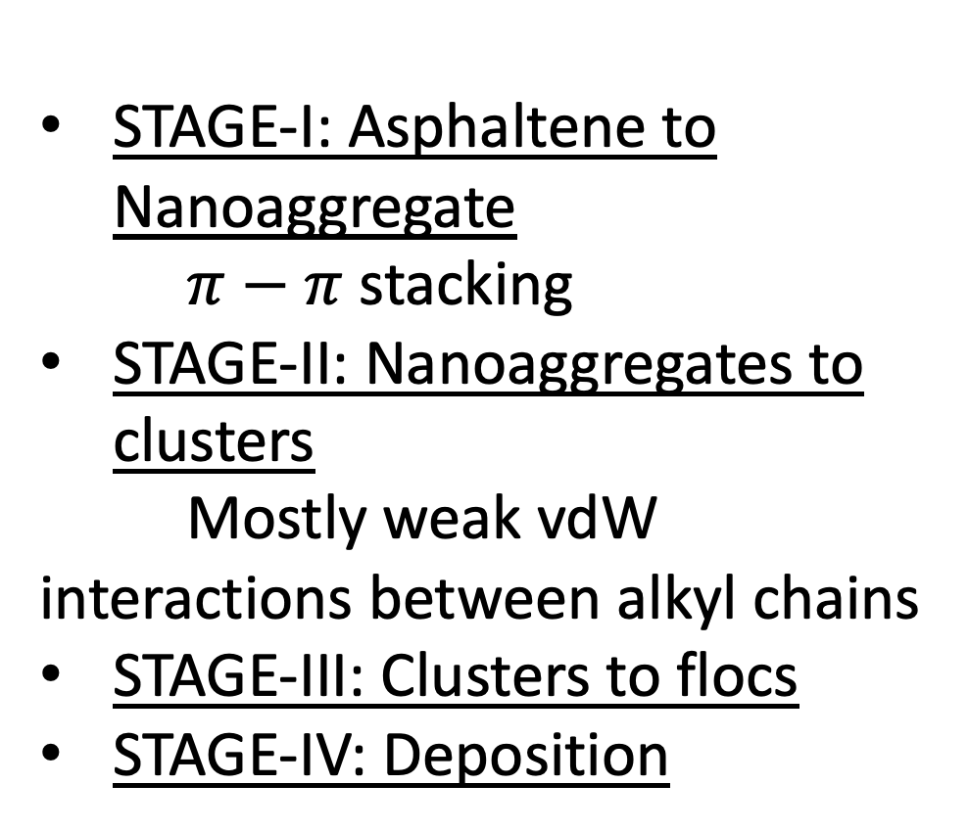
Theoretical Models to understand molecular assemblies
1. Yen-Mullins model (2011): Proposes a hierarchial order
MW: 500 to 1000 g/mol
>5 aromatic rings
STAGE-I: Asphaltene to Nanoaggregate
$π−π$ stacking
STAGE-II: Nanoaggregates to clusters
Mostly weak vdW interactions between alkyl chains
STAGE-III: Clusters to flocs
STAGE-IV: Deposition
Mullins et al., 2011

Slide 5
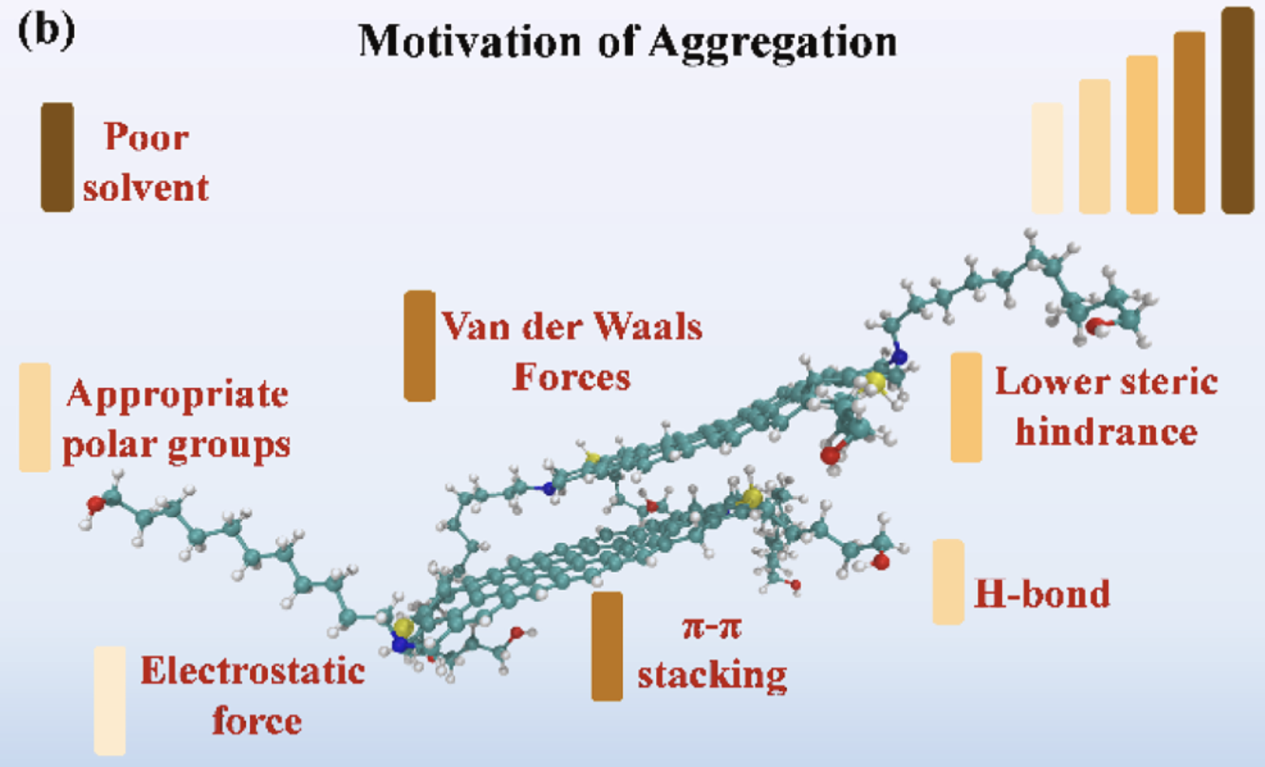
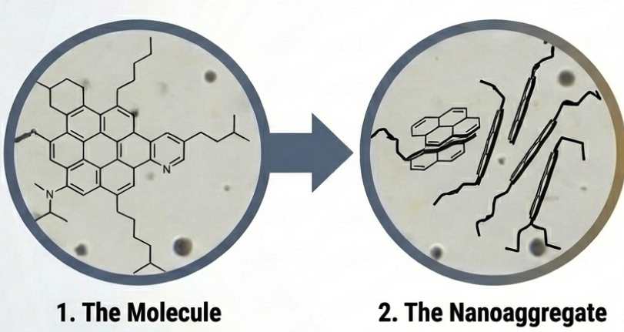
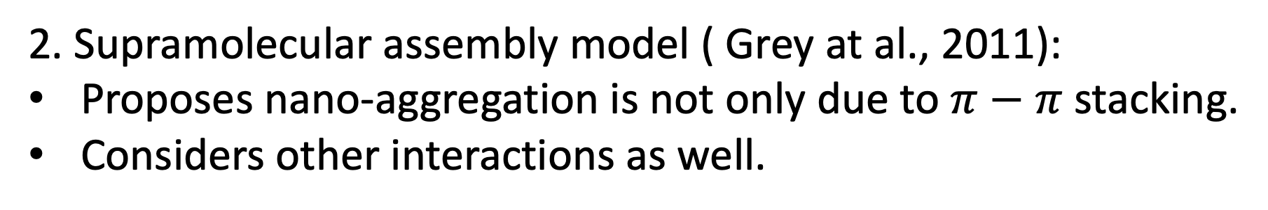
Theoretical Models to understand molecular assemblies
2. Supramolecular assembly model ( Grey at al., 2011):
Proposes nano-aggregation is not only due to $π−π$ stacking.
Considers other interactions as well.
Wang et al., Fuel, 2025

Slide 6
What simulations have been performed?
Solvents commonly used: Toluene( asph soluble) and n-heptane or n-pentane (asph less soluble).
ATOMISTIC MD
Headen et al., 2017: How asp molecules aggregate in good solvent vs bad solvent
27 asp molecules at 7 wt% per system
Standard runs: 80 ns
Longest asphaltene simulation at the time: 500 ns (single run)
Average cluster size was still increasing at this point: Not yet in equilibrium.
Suggests atomistic MD cannot access timescale for complete aggregation.
Force field: OPLS
Key results and simulations
Cluster size distribution was continuous
Mixed Asp-A and Asp-C
Identified role of resins in aggregate density
2. Wang et al., 2024: Established the driving force hierarchy
22 asp molecules per system
Standard runs: 100 ns as aggregation in heptane takes 20-50s
Force field: OPLS

Slide 7
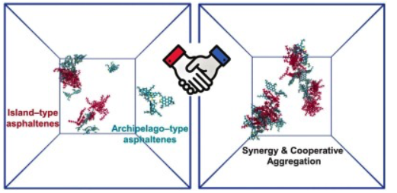
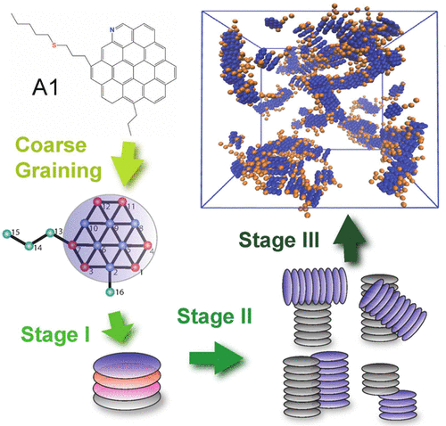
What simulations have been performed?
ATOMISTIC MD
3. Xiang et al., 2026: Heterogenous co-aggregation
7 asp per system: 2 of Asp-A and 5 of Asp-C
Standard runs: 500 ns
Key result: Asp-A act as nucleation centers with Asp-C assembling around them.
Force field: GAFF
Mesoscale simulations
Wang & Ferguson (2016)
First paper to show multiple stages and suggested a kinetic model(binding and fragmentation rate for Stage-I).
Wang & Ferguson (2018)
Shows contradicting results from 2016 paper.
Discovered protein folding like conformational landscapes using snapshots of trajectories.
Wang et al., 2016

Slide 8
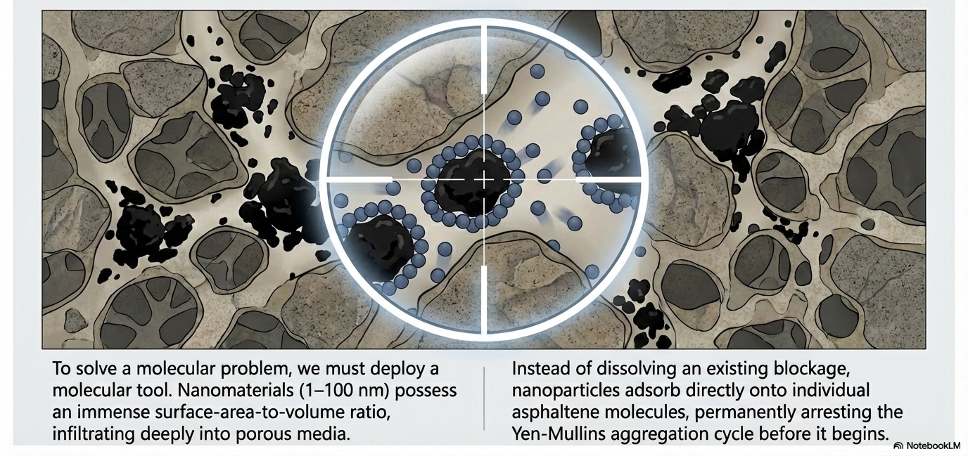
Intercepting nano-aggregate formation with nano-particles

Slide 9
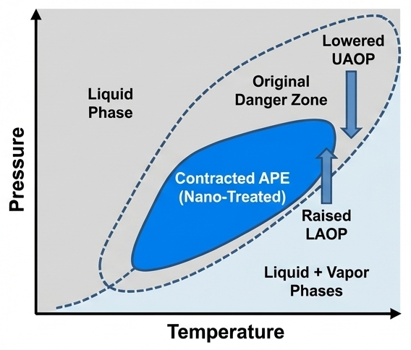
Nano-particle inhibitors reduces the Asphaltene Precipitation Envelope
Example reservoir condition (somewhere outside the envelope)

Slide 10
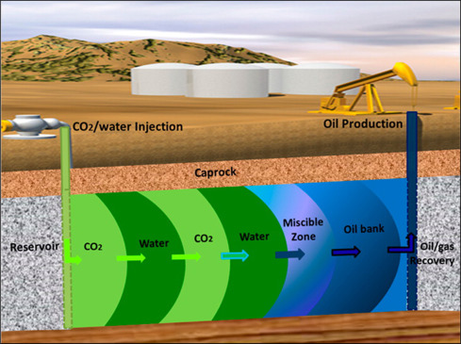
Asphaltene Rheology in water-oil emulsions
Where is water introduced into the crude oil?

Slide 11
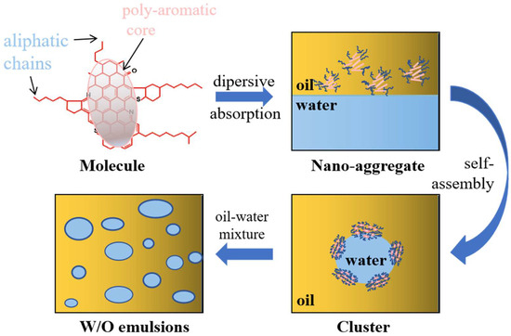
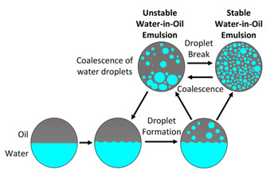
Role of asphaltene in W/O emulsions and water-oil seperation
adsorption
Stable W/O emulsions can raise apparent crude viscosity.
Varies with %water cut
Ostwald ripening → Flocculation of droplets → Coalescence → Phase separation

Slide 12
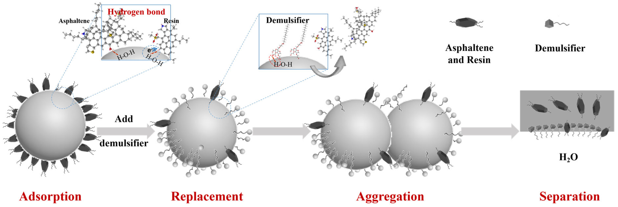
What happens to asphaltene-laden interfaces of water-oil emulsion
Demulsification mechanism by demulsifiers
Sun et al., Processes, 2025

Slide 13
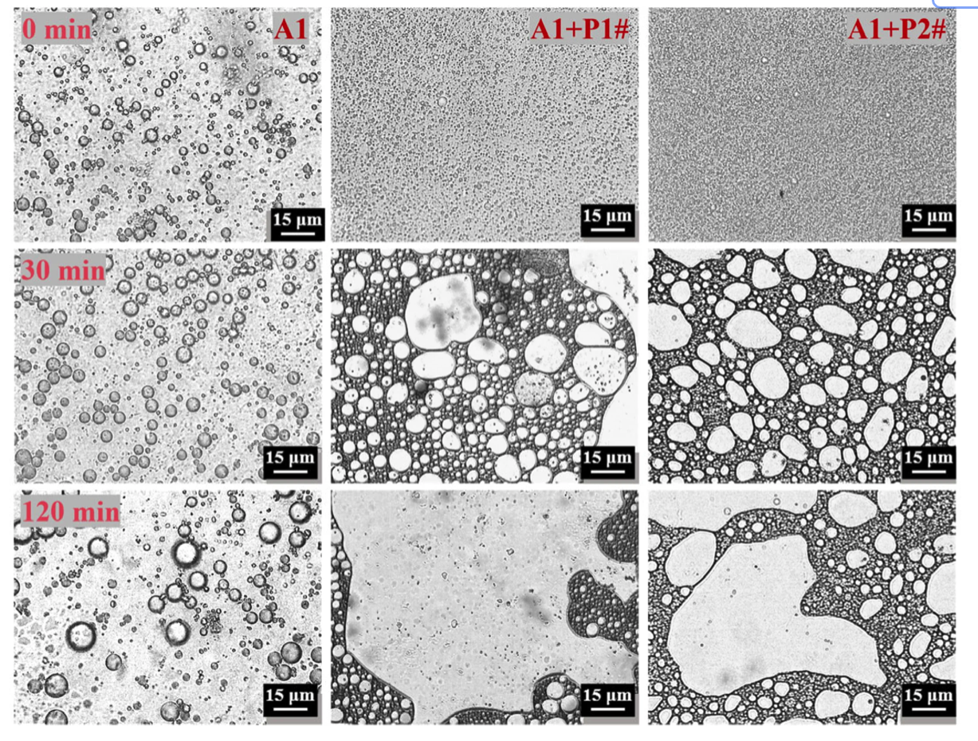
Without demulsfiers vs With demulsifiers (P1# and P2#)
Chemical demulsification
Competitive adsorption between asphaltene and demulsifiers to ensure droplets coalesce.
Factors involved in demulsification
Asphaltene concentration
Concentration of demulsifiers
Temperature & Pressure
Mixing conditions before Phase separation(Shear during flow)
Interfacial film aging
Oil composition
Temporal evolution of the microstructure of the emulsions
Sun et al., Processes, 2025

Slide 14
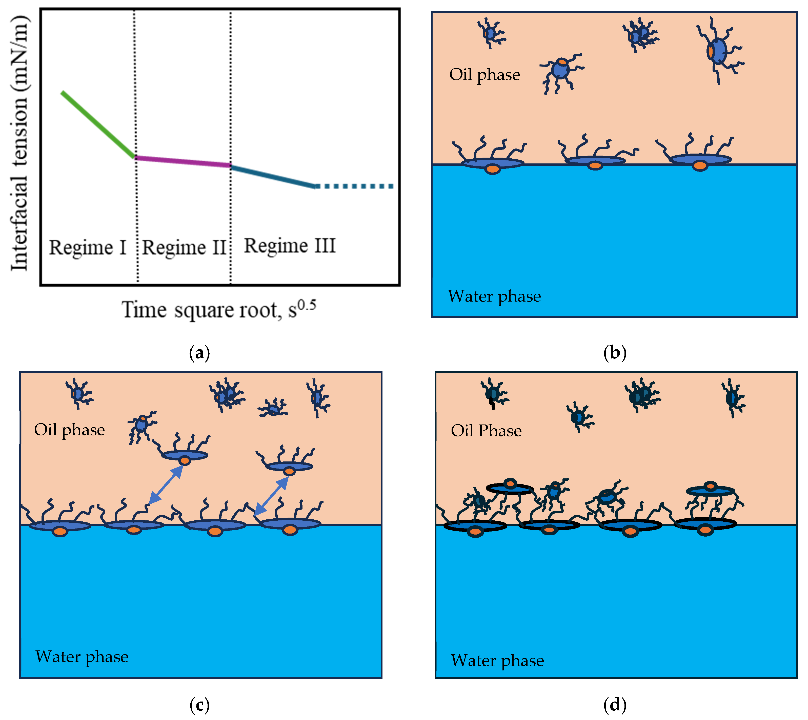
Role of interfacial tension
IFT with asphaltene laden film scales with square root of time.
IFT keeps on decreasing even in Regime 3 due to restructuring of the asphaltene structure on the interface.
IFT decreases further when demulsifies are introduced.
Martinez et al., Materials, 2025

Slide 15
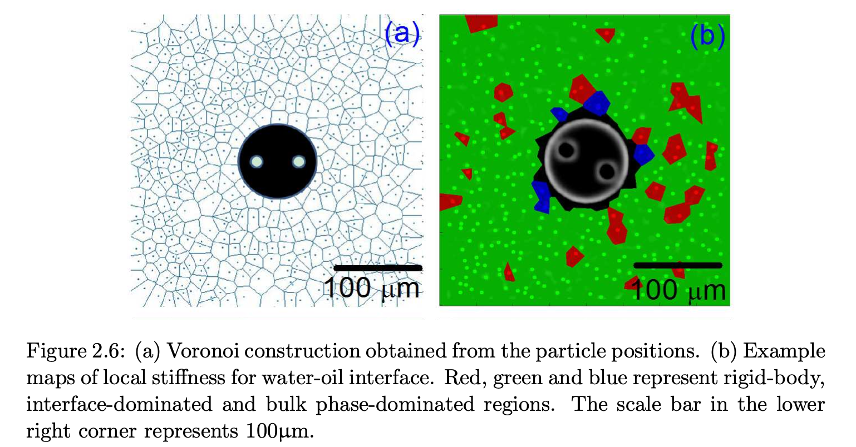
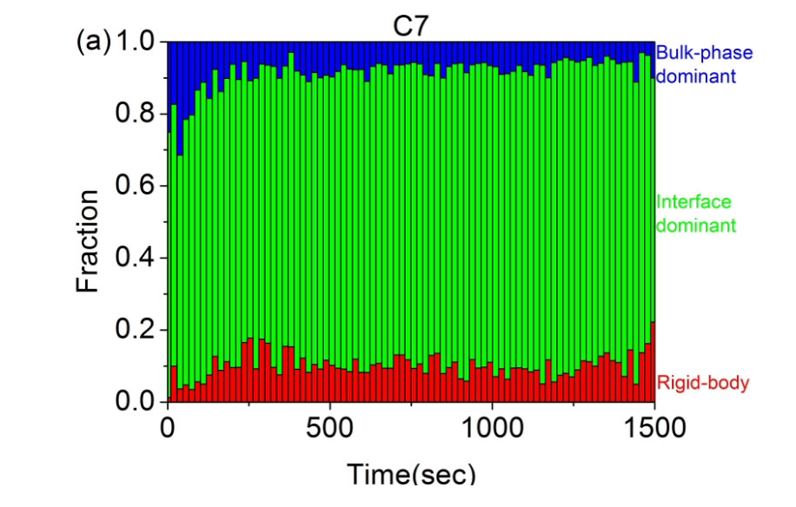
Interface is heterogeneous and rigidity keeps on increasing
What about W/O emulsions and the role of asphaltene?

