Slide 1
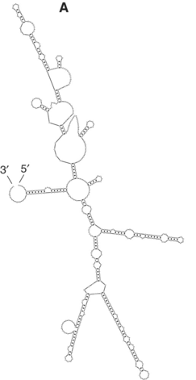
Partition function and how to compute it
Ashwin Amalaruban

Slide 2
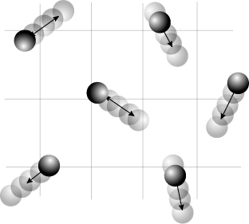
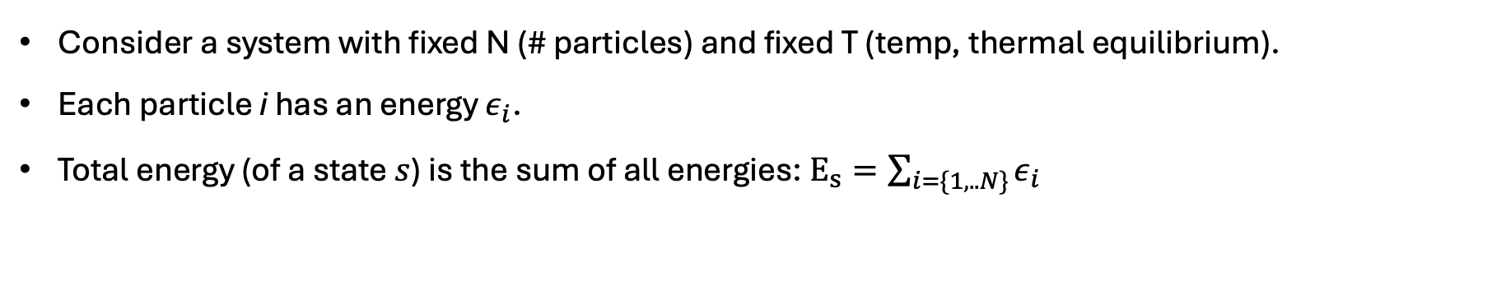
What is partition function?
Consider a system with fixed N (# particles) and fixed T (temp, thermal equilibrium).
Each particle i has an energy $ε_{i}$.
Total energy (of a state $s$) is the sum of all energies: $E_{s}=\sum_{i=\{1,..N\}}{ε_{i}}$
Notes:
the goal of predicting RNA structure and function is shifting from predicting a single lowest energy structure to the identification of functional structural features in an ensemble of RNA structures.
it sums over all possible secondary structures, weighting each one by its Boltzmann factor, exp(−ΔG/RT). That connects the free energy of a structure directly to its equilibrium probability in the ensemble.
From that partition function we can marginalize over structures and compute base-pairing probabilities—for every i, j pair we know how often they’re paired across the ensemble. Those probabilities can be used to pick a most probable or maximum-expected-accuracy structure

Slide 3
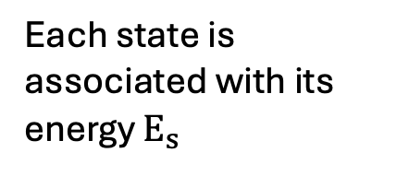
What is partition function?
Consider a system with fixed N (# particles) and fixed T (temp, thermal equilibrium).
Each particle i has an energy $ε_{i}$.
Total energy (of a state $s$) is the sum of all energies: $E_{s}=\sum_{i=\{1,..N\}}{ε_{i}}$
Each state is associated with its energy $E_{s}$
Statistical thermodynamics
Properties of the system
Notes:
the goal of predicting RNA structure and function is shifting from predicting a single lowest energy structure to the identification of functional structural features in an ensemble of RNA structures.
it sums over all possible secondary structures, weighting each one by its Boltzmann factor, exp(−ΔG/RT). That connects the free energy of a structure directly to its equilibrium probability in the ensemble.
From that partition function we can marginalize over structures and compute base-pairing probabilities—for every i, j pair we know how often they’re paired across the ensemble. Those probabilities can be used to pick a most probable or maximum-expected-accuracy structure

Slide 4
What is partition function?
Consider a system with fixed N (# particles) and fixed T (temp, thermal equilibrium).
Each particle i has an energy $ε_{i}$.
Total energy (of a state $s$) is the sum of all energies: $E_{s}=\sum_{i=\{1,..N\}}{ε_{i}}$
Each state is associated with its energy $E_{s}$
Statistical thermodynamics
Properties of the system
How to account for each state?
i) Are they equal? NO
ii) How to weigh each state?
Energy of the system
Depends on
Temperature T
Use Boltzmann weight for each state: $e^{−E_{s}/k_{B}T}$
$$k_{B}→Boltzmann constant$$
Notes:
the goal of predicting RNA structure and function is shifting from predicting a single lowest energy structure to the identification of functional structural features in an ensemble of RNA structures.
it sums over all possible secondary structures, weighting each one by its Boltzmann factor, exp(−ΔG/RT). That connects the free energy of a structure directly to its equilibrium probability in the ensemble.
From that partition function we can marginalize over structures and compute base-pairing probabilities—for every i, j pair we know how often they’re paired across the ensemble. Those probabilities can be used to pick a most probable or maximum-expected-accuracy structure

Slide 5

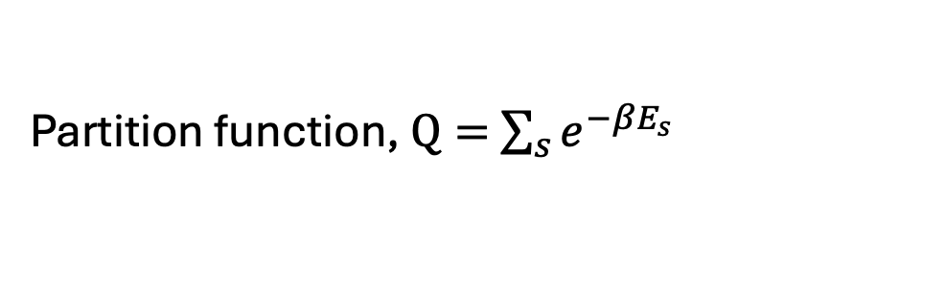

What is partition function?
Consider a system with fixed N (# particles) and fixed T (temp, thermal equilibrium).
Each particle i has an energy $ε_{i}$.
Total energy (of a state $s$) is the sum of all energies: $E_{s}=\sum_{i=\{1,..N\}}{ε_{i}}$
What is partition function? Sum of Boltzmann factors over all possible states.
$$β=\frac{1}{k_{B}T};k_{B}→Boltzmann constant$$
Boltzmann weight
Partition function, $Q=$ $\sum_{s}{e^{−βE_{s}}}$
This sum runs over all the states.
Probability of any state, $P\left(s_{1}\right)=\frac{e^{−βE_{s_{1}}}}{Q}$
& other statistical properties
Notes:
the goal of predicting RNA structure and function is shifting from predicting a single lowest energy structure to the identification of functional structural features in an ensemble of RNA structures.
it sums over all possible secondary structures, weighting each one by its Boltzmann factor, exp(−ΔG/RT). That connects the free energy of a structure directly to its equilibrium probability in the ensemble.
From that partition function we can marginalize over structures and compute base-pairing probabilities—for every i, j pair we know how often they’re paired across the ensemble. Those probabilities can be used to pick a most probable or maximum-expected-accuracy structure

Slide 6
What is partition function?
Consider a system with fixed N (# particles) and fixed T (temp, thermal equilibrium).
Each particle i has an energy $ε_{i}$.
Total energy (of a state $s$) is the sum of all energies: $E_{s}=\sum_{i=\{1,..N\}}{ε_{i}}$
What is partition function? Sum of Boltzmann factors over all possible states.
$$β=\frac{1}{k_{B}T};k_{B}→Boltzmann constant$$
Boltzmann weight
Partition function, $Q=$ $\sum_{s}{e^{−βE_{s}}}$
This sum runs over all the states.
Probability of any state, $P\left(s_{1}\right)=\frac{e^{−βE_{s_{1}}}}{Q}$
& other statistical properties
Notes:
the goal of predicting RNA structure and function is shifting from predicting a single lowest energy structure to the identification of functional structural features in an ensemble of RNA structures.
it sums over all possible secondary structures, weighting each one by its Boltzmann factor, exp(−ΔG/RT). That connects the free energy of a structure directly to its equilibrium probability in the ensemble.
From that partition function we can marginalize over structures and compute base-pairing probabilities—for every i, j pair we know how often they’re paired across the ensemble. Those probabilities can be used to pick a most probable or maximum-expected-accuracy structure

Slide 7
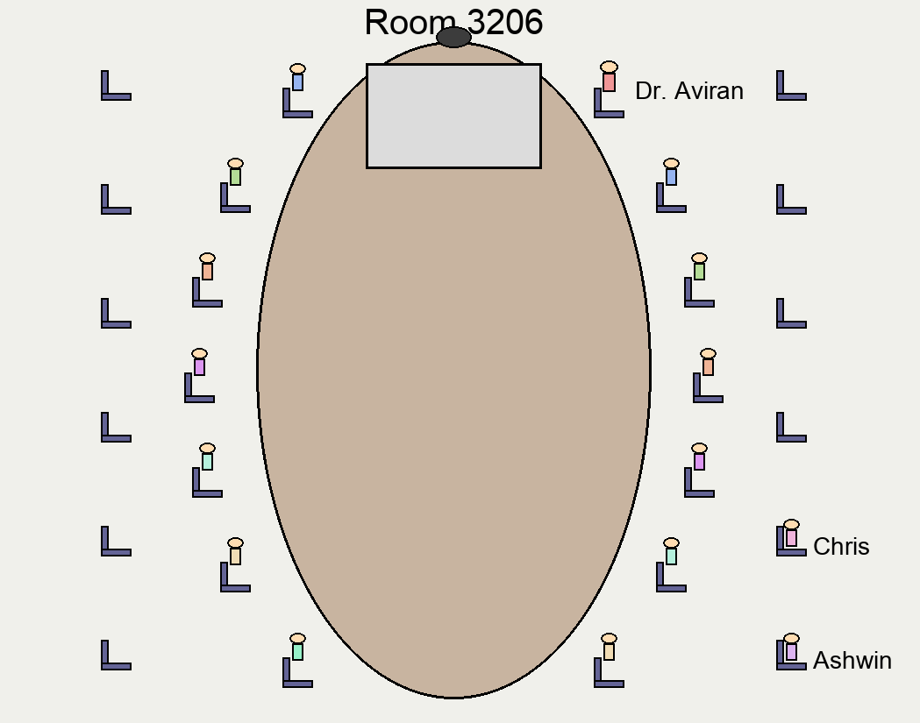





Let us consider a random system
…..
Many possible states
$$E_{case 1}$$
$$≪$$
$$E_{case 2}$$
$$≤$$
…..
$$E_{case n}$$

Slide 8











Partition function
…..
Many possible states
$$E_{case 1}$$
$$≪$$
$$E_{case 2}$$
$$≤$$
…..
$$E_{case n}$$
$$Q=e^{−E_{case 1}/RT}+e^{−E_{case 2}/RT}+…+e^{−E_{case n}/RT}$$
$$P(case 1)$$
$$≫$$
$$P(case 2)$$
$$≥$$
$$P(case n)$$
$$e^{−E_{case 1}/RT}/Q$$

Slide 9
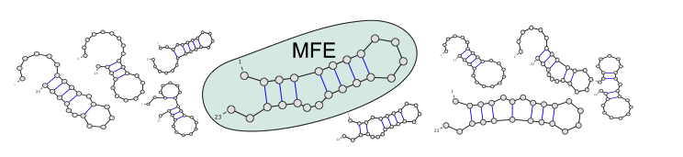
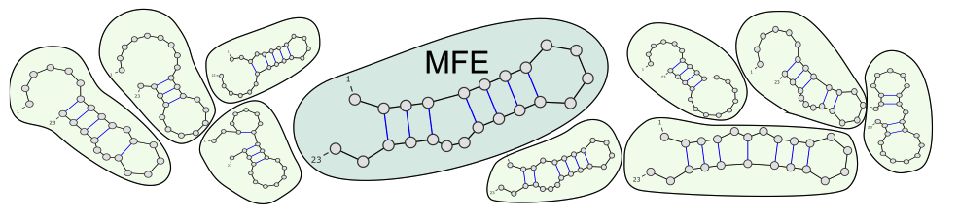




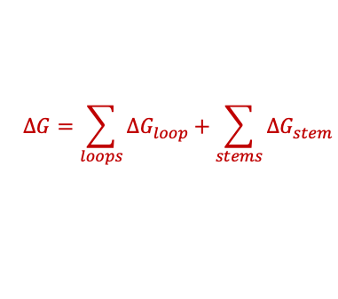







RNA can adopt multiple structures (=states)
1 Free Energy Minimization (single state): One best structure.
$$∆G=−16$$
$$∆G=−30.8$$
$$∆G=−32$$
Units of $∆G$ is kcal/mole.
$$∆G=−23$$
$$∆G=−26$$
$$∆G=−21$$
$$∆G=\sum_{loops}{∆G_{loop}}+\sum_{stems}{∆G_{stem}}$$
2 But each RNA molecule can adopt multiple structures (not simultaneously).
$$∆G=−29.9$$
$$∆G=−28$$
$$∆G=−24$$
$$∆G=−31.8$$
Each structure, S has a probability $P\left(S\right)$ depending on its ‘free-energy change’: $P\left(S\right)∝e^{−β∆G}$
Images from - Yann Ponty
Notes:
All we need is a way to write down the system as a collection of different configurations parts, and some way to describe the probability of observing the system in one or more of these individual configurations.

Slide 10


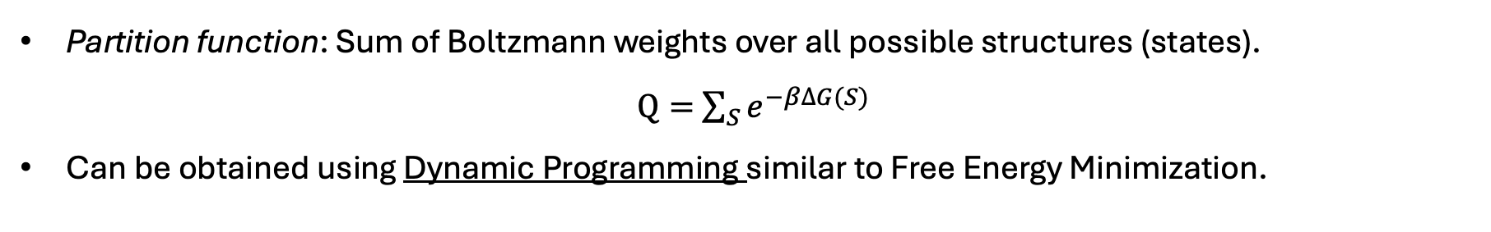
From Free Energy Minimization to Partition Function
Partition function: Sum of Boltzmann weights over all possible structures (states). $Q=$ $\sum_{S}{e^{−β∆G(S)}}$
Can be obtained using Dynamic Programming similar to Free Energy Minimization.
E(i,j): Minimum Free Energy of the structure for the sequence starting at i and ending at j (i<j).
$E\left(i,j\right)=min⁡\{E_{1},E_{2},E_{3},…\}$
What are $E_{1},E_{2},E_{3}$ here? Free energies associated with possible structures between (i, j).
Notes:
On the experimental side, there are hundreds of optical melting experiments—on the order of 800 constructs.
Those are fit to recover roughly 300 nearest-neighbor parameters: helical stacking, dangling ends, terminal mismatches, hairpins, internal loops, multibranch loops, etc.
These core parameters are then expanded into lookup tables—about 10–15k table entries in tools like RNAstructure.
When you give RNAstructure a sequence, it decomposes every candidate structure into motifs, pulls the corresponding numbers from these tables.

Slide 11
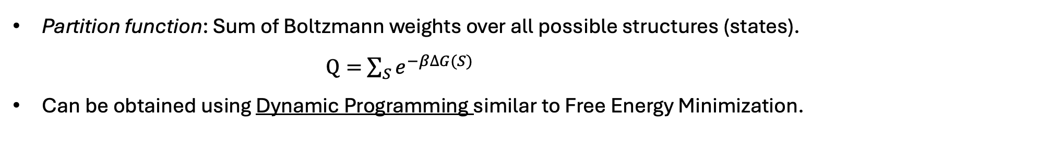
From Free Energy Minimization to Partition Function
Partition function: Sum of Boltzmann weights over all possible structures (states). $Q=$ $\sum_{S}{e^{−β∆G(S)}}$
Can be obtained using Dynamic Programming similar to Free Energy Minimization.
E(i,j): Minimum Free Energy of the structure for the sequence starting at i and ending at j (i<j).
Q(i,j): Partition function for the set of all secondary structures on [i,j].
Replace min with sum of Boltzmann-weighted contributions.
$E\left(i,j\right)=min⁡\{E_{1},E_{2},E_{3},…\}$
$$Q\left(i,j\right)=\operatorname{sum}\left\{e^{−βE_{1}},e^{−βE_{2}},e^{−βE_{3}},…\right\}$$
What are $E_{1},E_{2},E_{3}$ here? Free energies associated with possible structures between (i, j).
Notes:
On the experimental side, there are hundreds of optical melting experiments—on the order of 800 constructs.
Those are fit to recover roughly 300 nearest-neighbor parameters: helical stacking, dangling ends, terminal mismatches, hairpins, internal loops, multibranch loops, etc.
These core parameters are then expanded into lookup tables—about 10–15k table entries in tools like RNAstructure.
When you give RNAstructure a sequence, it decomposes every candidate structure into motifs, pulls the corresponding numbers from these tables.

Slide 12
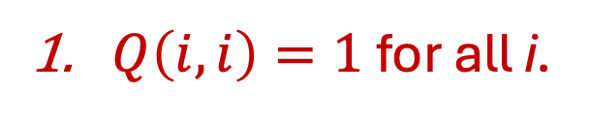
McCaskill’s algorithm
How do we start?
Q(i,j): Partition function for all possible structures for the sequence starting at i and ending at j (i<j).
j
Q
 | G | G | G | A | A | A | U | C | C
G | 1
G | 1 | 1
G |  | 1 | 1
A |  |  | 1 | 1
A |  |  |  | 1 | 1
A |  |  |  |  | 1 | 1
U |  |  |  |  |  | 1 | 1
C |  |  |  |  |  |  | 1 | 1
C |  |  |  |  |  |  |  | 1 | 1
i
$Q\left(i,i\right)=1$for all i.
Notes:
On the experimental side, there are hundreds of optical melting experiments—on the order of 800 constructs.
Those are fit to recover roughly 300 nearest-neighbor parameters: helical stacking, dangling ends, terminal mismatches, hairpins, internal loops, multibranch loops, etc.
These core parameters are then expanded into lookup tables—about 10–15k table entries in tools like RNAstructure.
When you give RNAstructure a sequence, it decomposes every candidate structure into motifs, pulls the corresponding numbers from these tables.

Slide 13

McCaskill’s algorithm
How do we start?
Q(i,j): Partition function for all possible structures for the sequence starting at i and ending at j (i<j).
j
Q
 | G | G | G | A | A | A | U | C | C
G | 1
G | 1 | 1
G |  | 1 | 1
A |  |  | 1 | 1
A |  |  |  | 1 | 1
A |  |  |  |  | 1 | 1
U |  |  |  |  |  | 1 | 1
C |  |  |  |  |  |  | 1 | 1
C |  |  |  |  |  |  |  | 1 | 1
i
$Q\left(i,i\right)=1$for all i.
No structure→ Zero energy→ $e^{0}=1$
Notes:
On the experimental side, there are hundreds of optical melting experiments—on the order of 800 constructs.
Those are fit to recover roughly 300 nearest-neighbor parameters: helical stacking, dangling ends, terminal mismatches, hairpins, internal loops, multibranch loops, etc.
These core parameters are then expanded into lookup tables—about 10–15k table entries in tools like RNAstructure.
When you give RNAstructure a sequence, it decomposes every candidate structure into motifs, pulls the corresponding numbers from these tables.

Slide 14
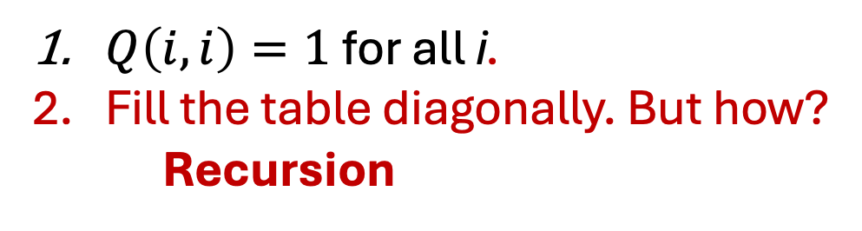
McCaskill’s algorithm
How do we fill cells?
Q(i,j): Partition function for all possible structures for the sequence starting at i and ending at j (i<j).
j
Q
 | G | G | G | A | A | A | U | C | C
G | 1
G | 1 | 1
G |  | 1 | 1
A |  |  | 1 | 1
A |  |  |  | 1 | 1
A |  |  |  |  | 1 | 1
U |  |  |  |  |  | 1 | 1
C |  |  |  |  |  |  | 1 | 1
C |  |  |  |  |  |  |  | 1 | 1
i
$Q\left(i,i\right)=1$for all i.
Fill the table diagonally. But how?
Recursion
Just like Base Pair Maximization and Free Energy Minimization.
Raden et al., NAR, 2018
Notes:
On the experimental side, there are hundreds of optical melting experiments—on the order of 800 constructs.
Those are fit to recover roughly 300 nearest-neighbor parameters: helical stacking, dangling ends, terminal mismatches, hairpins, internal loops, multibranch loops, etc.
These core parameters are then expanded into lookup tables—about 10–15k table entries in tools like RNAstructure.
When you give RNAstructure a sequence, it decomposes every candidate structure into motifs, pulls the corresponding numbers from these tables.

Slide 15
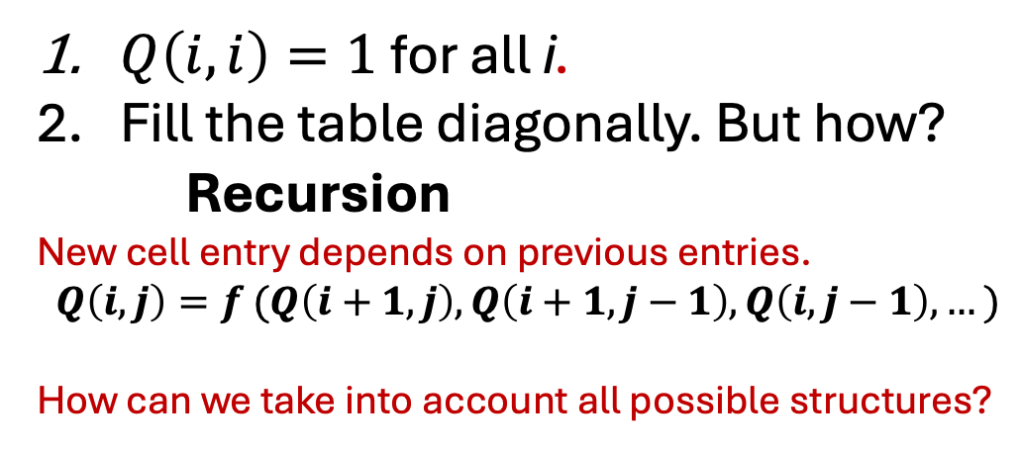
McCaskill’s algorithm
How do we fill cells?
Q(i,j): Partition function for all possible structures for the sequence starting at i and ending at j (i<j).
j
Q
 | G | G | G | A | A | A | U | C | C
G | 1
G | 1 | 1
G |  | 1 | 1
A |  |  | 1 | 1
A |  |  |  | 1 | 1
A |  |  |  |  | 1 | 1
U |  |  |  |  |  | 1 | 1
C |  |  |  |  |  |  | 1 | 1
C |  |  |  |  |  |  |  | 1 | 1
i
$Q\left(i,i\right)=1$for all i.
Fill the table diagonally. But how?
Recursion
New cell entry depends on previous entries.
$$Q\left(i,j\right)=f (Q\left(i+1,j\right), Q\left(i+1,j−1\right),Q\left(i,j−1\right),…)$$
How can we take into account all possible structures?
Notes:
On the experimental side, there are hundreds of optical melting experiments—on the order of 800 constructs.
Those are fit to recover roughly 300 nearest-neighbor parameters: helical stacking, dangling ends, terminal mismatches, hairpins, internal loops, multibranch loops, etc.
These core parameters are then expanded into lookup tables—about 10–15k table entries in tools like RNAstructure.
When you give RNAstructure a sequence, it decomposes every candidate structure into motifs, pulls the corresponding numbers from these tables.

Slide 16
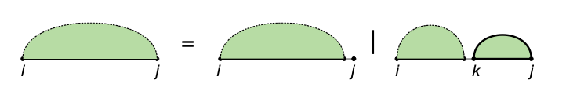
McCaskill’s algorithm
Decomposition of structures for subsequence between i and j
j unpaired
k and j paired
Image – MIT lecture notes

Slide 17
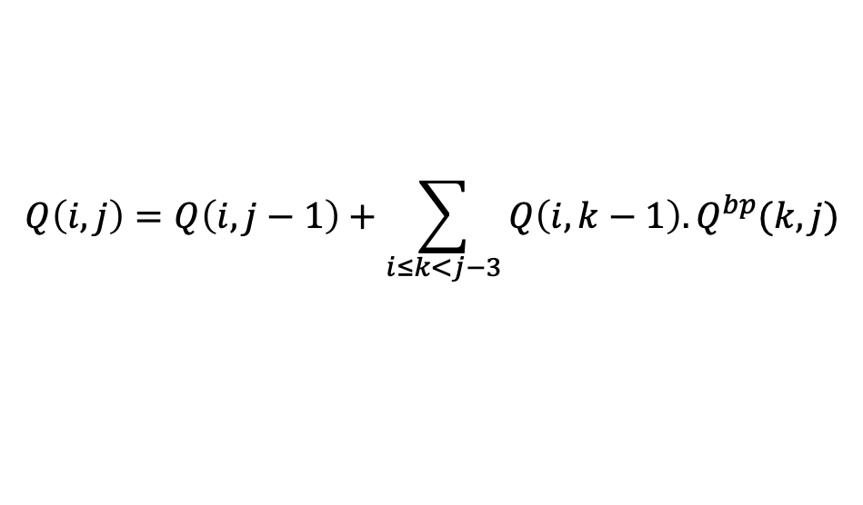
McCaskill’s algorithm
Decomposition of structures for subsequence between i and j
j unpaired
k and j paired
$$Q\left(i,j\right)=Q\left(i,j−1\right)+\sum_{i≤k<j−3}{Q\left(i,k−1\right).Q^{bp}(k,j)}$$
Image – MIT lecture notes

Slide 18
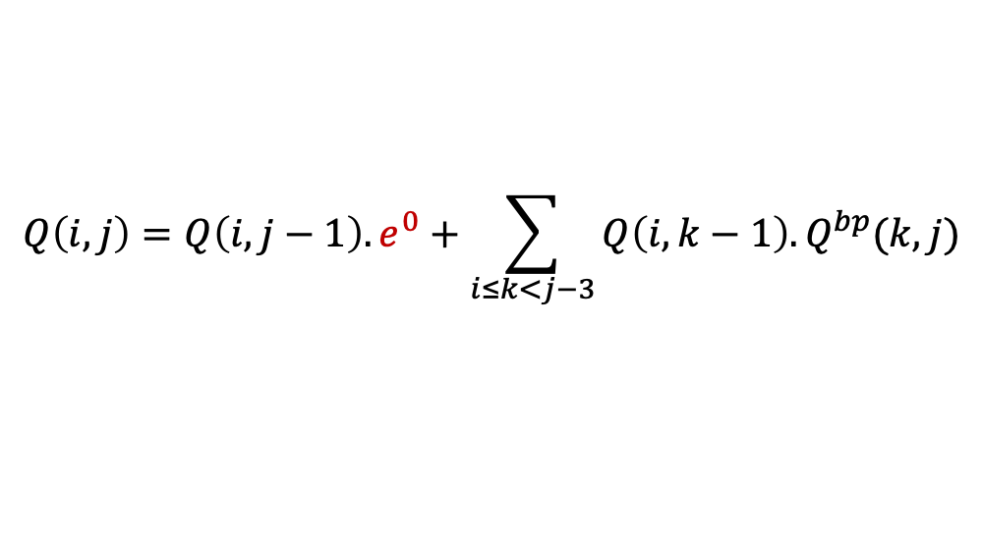
McCaskill’s algorithm
Decomposition of structures for subsequence between i and j
j unpaired
k and j paired
$$Q\left(i,j\right)=Q\left(i,j−1\right).e^{0}+\sum_{i≤k<j−3}{Q\left(i,k−1\right).Q^{bp}(k,j)}$$
With j unpaired, zero energy contribution
Image – MIT lecture notes

Slide 19
McCaskill’s algorithm
Decomposition of structures for subsequence between i and j
j unpaired
k and j paired
$$Q\left(i,j\right)=Q\left(i,j−1\right).e^{0}+\sum_{i≤k<j−3}{Q\left(i,k−1\right).Q^{bp}(k,j)}$$
Case where (k,j) is strictly paired.
Image – MIT lecture notes

Slide 20

McCaskill’s algorithm
Decomposition of structures for subsequence between i and j
j unpaired
k and j paired
$$Q\left(i,j\right)=Q\left(i,j−1\right).e^{0}+\sum_{i≤k<j−3}{Q\left(i,k−1\right).Q^{bp}(k,j)}$$
If a structure decomposes into two independent parts with energies $E_{1}$ and $E_{2}$
$$e^{−(E_{1}+E_{2})/RT}=e^{−E_{1}/RT}.e^{−E_{2}/RT}$$
Image – MIT lecture notes

Slide 21
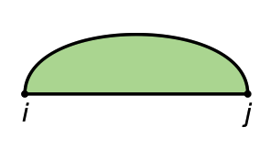
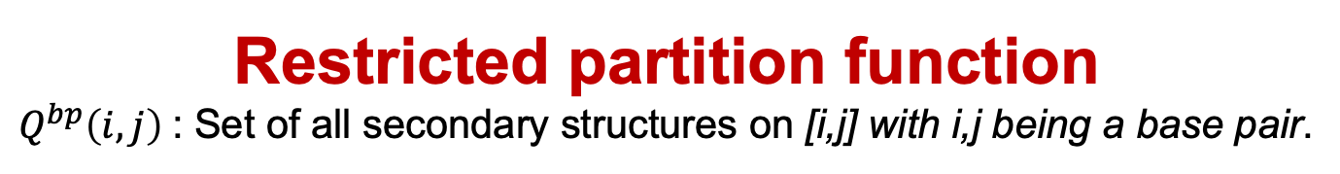

Restricted partition function
$Q^{bp}\left(i,j\right)$: Set of all secondary structures on [i,j] with i,j being a base pair.
$$Q^{bp}\left(i,j\right)=sum\{…\}$$
Actual recursions involving loop types
Image – MIT lecture notes
Notes:
On the experimental side, there are hundreds of optical melting experiments—on the order of 800 constructs.
Those are fit to recover roughly 300 nearest-neighbor parameters: helical stacking, dangling ends, terminal mismatches, hairpins, internal loops, multibranch loops, etc.
These core parameters are then expanded into lookup tables—about 10–15k table entries in tools like RNAstructure.
When you give RNAstructure a sequence, it decomposes every candidate structure into motifs, pulls the corresponding numbers from these tables.

Slide 22
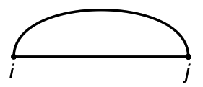
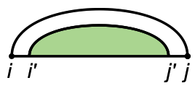
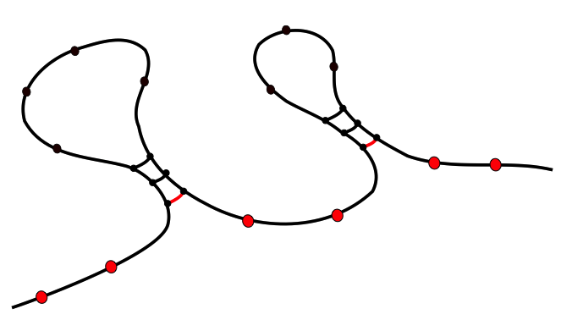
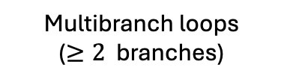
Restricted partition function
$Q^{bp}\left(i,j\right)$: Set of all secondary structures on [i,j] with i,j being a base pair.
$$Q^{bp}\left(i,j\right)=sum\{…\}$$
Actual recursions involving loop types
k
Multibranch loops
($≥2$ branches)
l
Hairpin loop
Stacking base pair
Internal loop
Bulge loop
Image – MIT lecture notes
Notes:
On the experimental side, there are hundreds of optical melting experiments—on the order of 800 constructs.
Those are fit to recover roughly 300 nearest-neighbor parameters: helical stacking, dangling ends, terminal mismatches, hairpins, internal loops, multibranch loops, etc.
These core parameters are then expanded into lookup tables—about 10–15k table entries in tools like RNAstructure.
When you give RNAstructure a sequence, it decomposes every candidate structure into motifs, pulls the corresponding numbers from these tables.

Slide 23




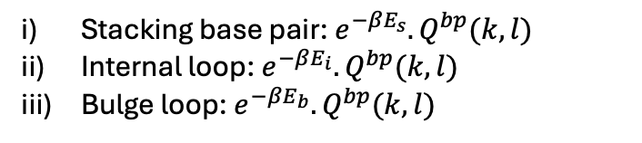
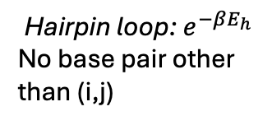
Restricted partition function
$Q^{bp}\left(i,j\right)$: Set of all secondary structures on [i,j] with i,j being a base pair.
$$Q^{bp}\left(i,j\right)=sum\{…\}$$
Actual recursions involving loop types
k
Multibranch loops
($≥2$ branches)
l
Hairpin loop: $e^{−βE_{h}}$
No base pair other than (i,j)
Stacking base pair: $e^{−βE_{s}}.Q^{bp}(k,l)$
Internal loop: $e^{−βE_{i}}.Q^{bp}(k,l)$
Bulge loop: $e^{−βE_{b}}.Q^{bp}(k,l)$
Ensure that structures are not double counted.
Image – MIT lecture notes
Notes:
On the experimental side, there are hundreds of optical melting experiments—on the order of 800 constructs.
Those are fit to recover roughly 300 nearest-neighbor parameters: helical stacking, dangling ends, terminal mismatches, hairpins, internal loops, multibranch loops, etc.
These core parameters are then expanded into lookup tables—about 10–15k table entries in tools like RNAstructure.
When you give RNAstructure a sequence, it decomposes every candidate structure into motifs, pulls the corresponding numbers from these tables.

Slide 24
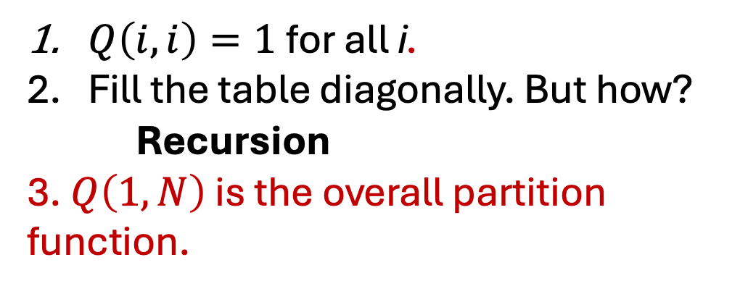
McCaskill’s algorithm
What do we get at the end?
Q(i,j): Partition function for all possible structures for the sequence starting at i and ending at j (i<j).
j
Q
i
 | G | G | G | A | A | A | U | C | C
G | 1 | 1 | 1 | 1 | 1 | 1 | 9.1 | 39.5 | 112.1
G | 1 | 1 | 1 | 1 | 1 | 1 | 6.4 | 19.3 | 39.5
G |  | 1 | 1 | 1 | 1 | 1 | 3.7 | 6.4 | 9.2
A |  |  | 1 | 1 | 1 | 1 | 1 | 1 | 1
A |  |  |  | 1 | 1 | 1 | 1 | 1 | 1
A |  |  |  |  | 1 | 1 | 1 | 1 | 1
U |  |  |  |  |  | 1 | 1 | 1 | 1
C |  |  |  |  |  |  | 1 | 1 | 1
C |  |  |  |  |  |  |  | 1 | 1
$Q\left(i,i\right)=1$for all i.
Fill the table diagonally. But how?
Recursion
3. $Q\left(1,N\right)$ is the overall partition function.
Structures with lower free energy contribute more.
Raden et al., NAR, 2018
Notes:
Instead of one ‘best’ structure, we now have a probability distribution over structures.

Slide 25
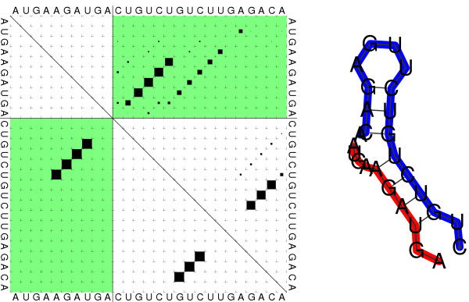
Conclusion
Partition function used to obtain base pair probabilities (To be discussed next week).
MFE structure
Dot plots that show the probability of base pairing
Larger the squares: Higher the probability
Base pairs in the MFE structure
Bernhart et al., Algorithms for Molecular Biology, 2006

