Slide 1
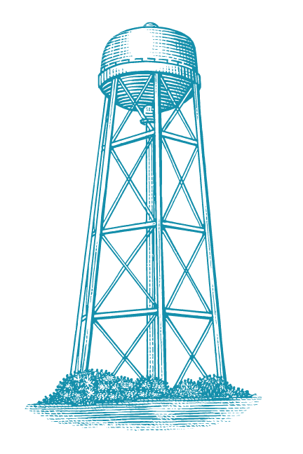
Catalytic enzymes are active matter
Preliminary exam: 06/07/2024
Ashwin Amalaruban

Slide 2
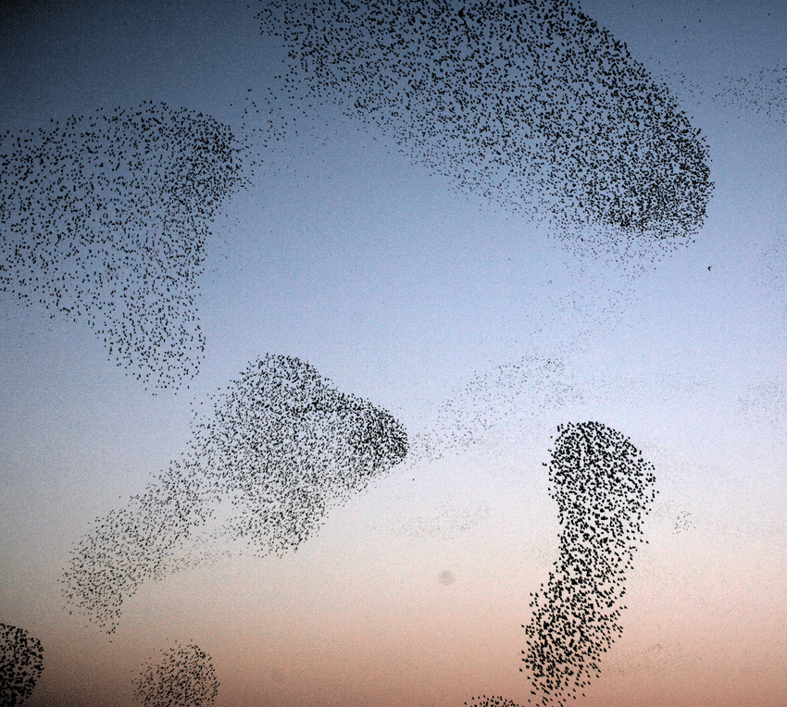
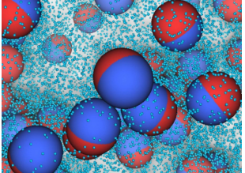
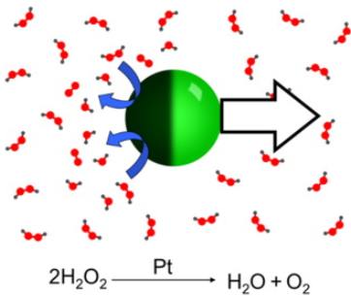
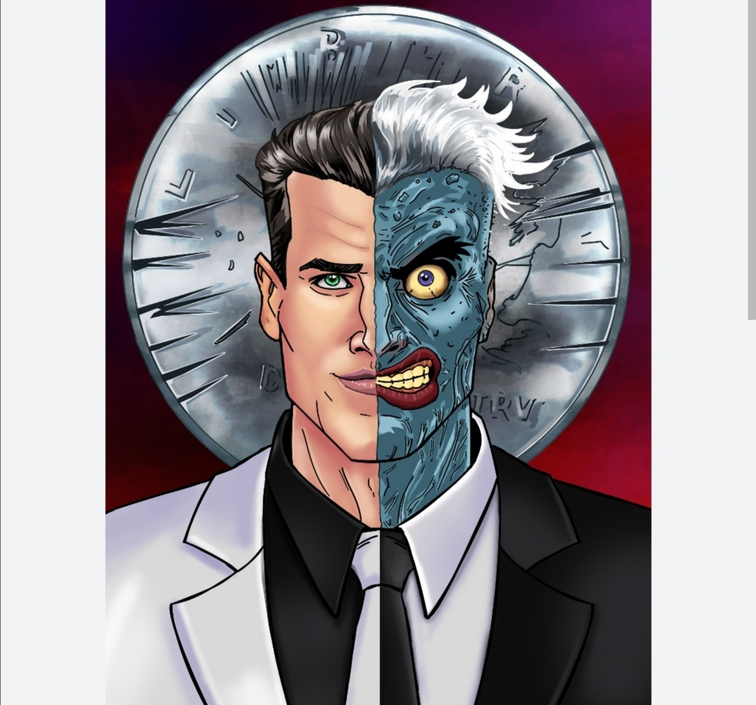
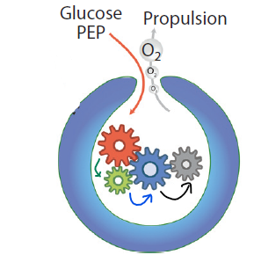
ACTIVE MATTER AND WHY IT MATTERS
It’s a bird. It’s a plane..It’s active matter.
a) Collective behaviour
b) Janus colloids
c) Self-propulsion
d)“Two-face”
Self-Propulsion: Ability to move on its own by consuming energy.
ENZYMES ARE ACTIVE MATTER?
Understanding principles of self-assembly.
Conversion of substrate by the confined catalysts.
e) Enzyme cascade
Self-propulsion + Collective behaviour ?
Ebbens, S. J. (2016). Active colloids: Progress and challenges towards realising autonomous applications. Current opinion in colloid & interface science, 21, 14-23.

Slide 3
PRESENTATION OUTLINE
Paper #1 – Catalytic Enzymes are active matter
CONTINUUM APPROACH
Enhanced diffusion
Directional mobility
Limitations outweigh the positives?
With and without substrate
Towards or away from high substrate concentration.
Substrate: Reactants in enzymatic reactions
PNAS; 125 Citations; Nov 2018
Paper #2 – Direct single molecule imaging of enhanced enzyme diffusion
Enhanced diffusion
MOLECULAR APPROACH
What causes the enhancement? X factor
Compare with previous study.
Phys Rev Letter; 63 Citations; Sep 2019
Jee, A. Y., Cho, Y. K., Granick, S., & Tlusty, T. (2018). Catalytic enzymes are active matter. Proceedings of the National Academy of Sciences, 115(46), E10812-E10821.
Xu, M., Ross, J. L., Valdez, L., & Sen, A. (2019). Direct single molecule imaging of enhanced enzyme diffusion. Physical review letters, 123(12), 128101.

Slide 4
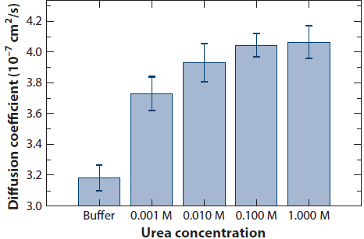
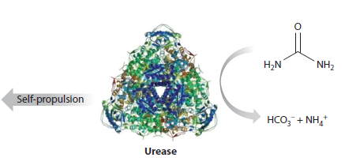
Paper #1 – Catalytic Enzymes Are Active Matter
Reinterpretation of the principle of catalysis (Reaction + motion)
“Catalysis and mobility of reactants in fluid are normally thought to be decoupled.
Violating this classical paradigm, this paper presents the catalyst laws of motion.”
Enhanced diffusion: Increases with substrate* concentration.
*Substrate: Reactants in enzymatic reactions
0 M urea
Catalytic conversion of urea by urease
b) Increase in diffusivity with urea concentration
Jee, A. Y., Cho, Y. K., Granick, S., & Tlusty, T. (2018). Catalytic enzymes are active matter. Proceedings of the National Academy of Sciences, 115(46), E10812-E10821.
Ghosh, S., Somasundar, A., & Sen, A. (2021). Enzymes as active matter. Annual Review of Condensed Matter Physics, 12, 177-200.

Slide 5
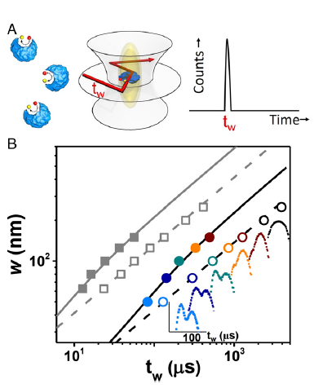
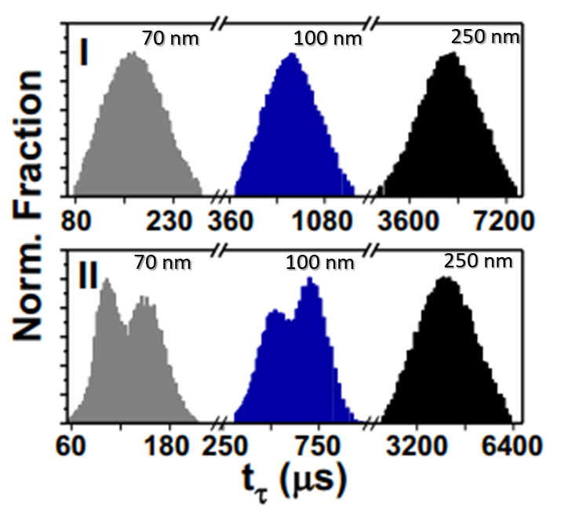
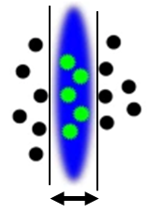

Evidence of Enhanced Motion
Using Superresolution microscopy and Flourescence Correlation Spectroscopy(FCS)
Upto 50 nm observation region compared to 200 nm (FCS only)
Boosted timescale
Enhanced diffusion, $D_{E}=D_{O}+D_{B}$ where $D_{B}=f(τ_{B},τ_{R})$
a) FCS setup
Rotational timescale
Mean Square Displacement$∝w^{2}$ with beam waist,w.
Without reaction: Gaussian distribution
Brownian diffusion, $D_{o} from w^{2}=αD_{o}t_{w}$
With reaction(w$≤$100 nm): Bimodal distribution
Parameters($τ_{R},τ_{B}$) for Boosted diffusion.
“Run-and-tumble” mechanism
b) Time distribution with width
Jee, A. Y., Cho, Y. K., Granick, S., & Tlusty, T. (2018). Catalytic enzymes are active matter. Proceedings of the National Academy of Sciences, 115(46), E10812-E10821.

Slide 6
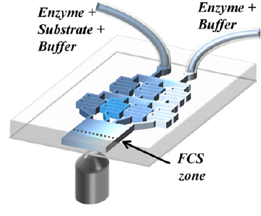
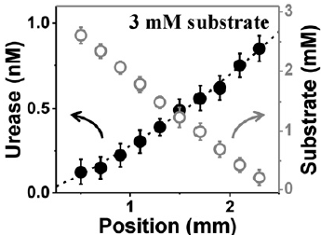
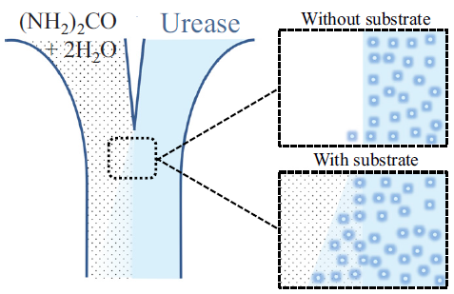
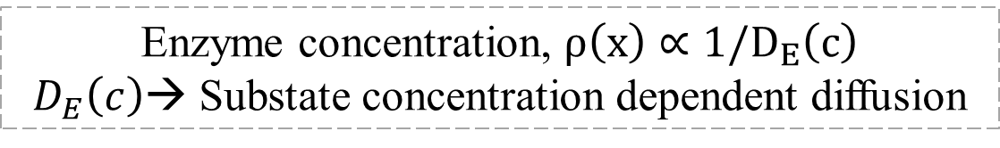
Anti-chemotaxis
Enzymes moving away from high substrate concentration
Microfluidic assays with FCS
All other groups have tagged these enzymes as Chemotaxis.
(width=2.5mm)
a) Setup
b) Concentration of enzyme and substrate downstream
c) 2-inlet 1-outlet microfluidic device:
Enzyme migration with substrate
Enzyme concentration, $ρ\left(x\right)∝1/D_{E}\left(c\right)$
$D_{E}\left(c\right)$→ Substate concentration dependent diffusion
Jee et al. calls this “Chemokinesis”, not Chemotaxis.
Dey, K. K., Das, S., Poyton, M. F., Sengupta, S., Butler, P. J., Cremer, P. S., & Sen, A. (2014). Chemotactic separation of enzymes. ACS nano, 8(12), 11941-11949.
Jee, A. Y., Cho, Y. K., Granick, S., & Tlusty, T. (2018). Catalytic enzymes are active matter. Proceedings of the National Academy of Sciences, 115(46), E10812-E10821.

Slide 7
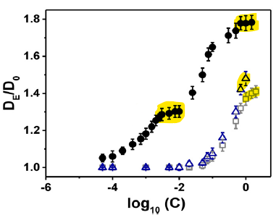
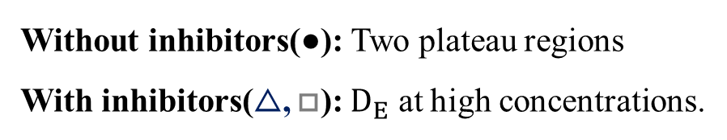
Paper #1 - Conclusion
Michaelis-Menten kinetics
Limitations
Dissociation of enzymes?
Signals from several particles.
Potential Artifacts in FCS
● Enzyme
△, □ Enzyme + Inhibitor
Mechanism: UNCLEAR.
0.01 M
1 M
Assumptions for theoretical models may not hold in all biological contexts.
Enhanced diffusion vs substrate concentration
Without inhibitors(●): Two plateau regions
With inhibitors(△, □): $D_{E}$ at high concentrations.
Jee, A. Y., Cho, Y. K., Granick, S., & Tlusty, T. (2018). Catalytic enzymes are active matter. Proceedings of the National Academy of Sciences, 115(46), E10812-E10821.

Slide 8
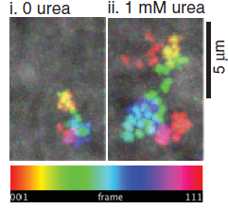
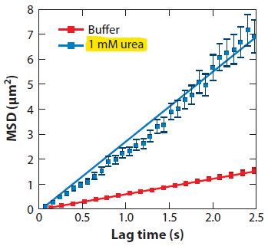
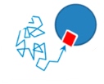
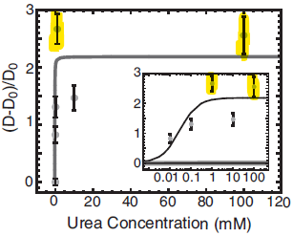
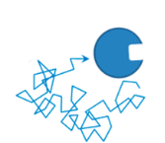
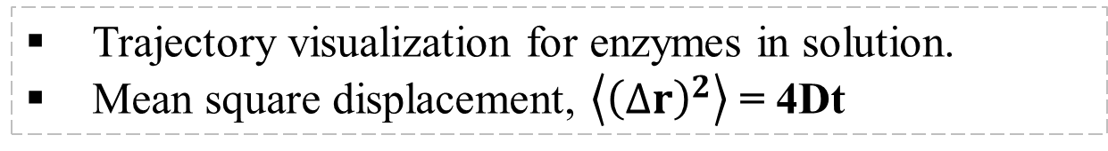
Paper #2 - Direct Single Molecule Imaging of Enhanced enzyme diffusion
2.5x increase compared to 1.6x
a) Trajectory of a single enzyme
b) MSD with and without substrate
Trajectory visualization for enzymes in solution.
Mean square displacement, $\left\langle {\left(∆r\right)}^{2}\right\rangle$ = 4Dt
II. Does enzyme dissociate ?
I. Diffusion is enhanced ✔
c) Enhanced diffusion with urea concentration
Xu, M., Ross, J. L., Valdez, L., & Sen, A. (2019). Direct single molecule imaging of enhanced enzyme diffusion. Physical review letters, 123(12), 128101.

Slide 9
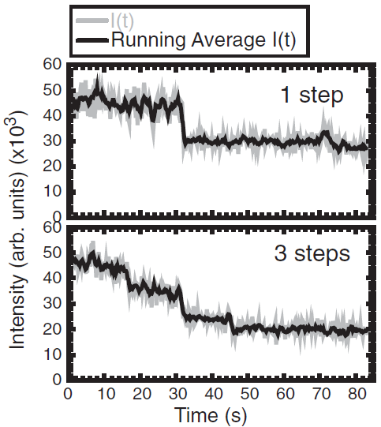
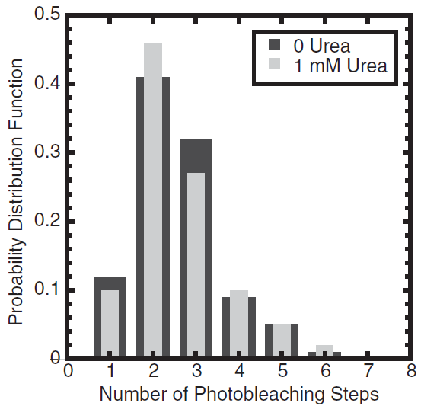

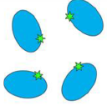
Photobleaching experiments
To reveal the number of urease monomers.
Urease: Hexamer → Maximum number of photobleaching steps: 6
Each monomer labeled with one fluorophore.
Fluorescence intensity decrease: Photobleaching
No difference in distribution with and without substrate
Enhanced diffusion NOT due to dissociation.
a) Intensity traces
b) Distribution of Photobleaching steps
Xu, M., Ross, J. L., Valdez, L., & Sen, A. (2019). Direct single molecule imaging of enhanced enzyme diffusion. Physical review letters, 123(12), 128101.

Slide 10
PAPER #2 - CONCLUSION
Addresses the limitations of Fluorescence Correlation spectroscopy
Limitations
Experimental uncertainty from the 2D projection of the 3D Brownian paths.
Mechanism: STILL UNCLEAR
Conformational changes cannot be probed.
Needs better spatial and temporal resolution.
Xu, M., Ross, J. L., Valdez, L., & Sen, A. (2019). Direct single molecule imaging of enhanced enzyme diffusion. Physical review letters, 123(12), 128101.

Slide 11
EXTRAS

Slide 12

Anti-chemotaxis: Theory
Diffusion equation
$$\frac{∂ρ\left(r,t\right)}{∂t}=−∇J_{E}=∇^{2}[D_{E}(C\left(r,t\right).ρ\left(r,t\right)]$$
Assumptions
Steady state
Depends only on the direction, $x$
Overall flux = 0
$$J_{E}=−∇\left[ρ\left(x\right)D_{E}\left(C\right)\right]=0$$
$$ρ\left(x\right)∝\frac{1}{D_{E}\left(C\right)}=\frac{1}{D_{O}+αV\left(C\left(x\right)\right)}$$
Jee, A. Y., Cho, Y. K., Granick, S., & Tlusty, T. (2018). Catalytic enzymes are active matter. Proceedings of the National Academy of Sciences, 115(46), E10812-E10821.

Slide 13
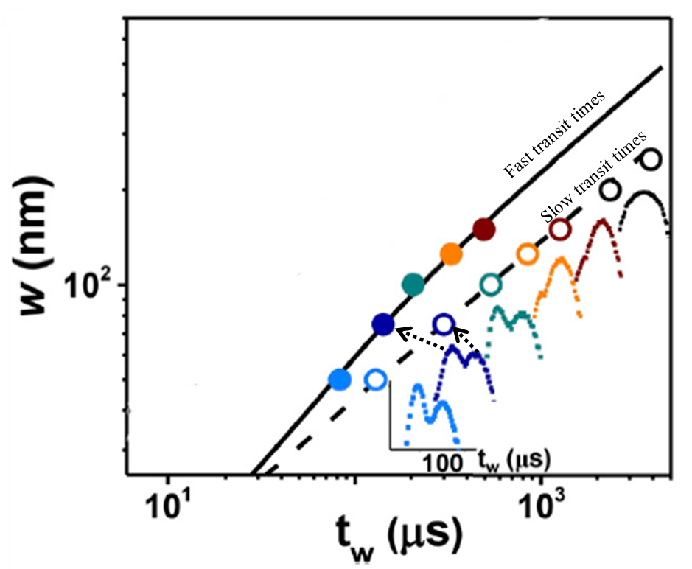


Evidence of Ballistic Motion
Performance of enzyme with and without substrate are compared
Using STED microscopy and Flourescence Correlation Spectroscopy(FCS)
Upto 50 nm observation region compared to 800 nm (FCS only)
Enhanced diffusion, $D_{E}=D_{O}+D_{B}=D_{o}+\frac{V}{3}{\left(\frac{f_{B}τ_{B}}{γ}\right)}^{2}\left(e^{− \frac{τ_{B}}{τ_{R}}}−1+\frac{τ_{B}}{τ_{R}}\right)$
$V=\frac{k_{cat}c}{K_{M}+c}$
Boosted Diffusion from transit time
Parameters for $D_{B}$ by fitting w vs. $t_{w}$
$$MSD ∝w^{2}$$
Standard Brownian Motion – Without substrate
$$w^{2}=α6D_{O}t_{w}=A.t_{w}$$
Fast component
$w^{2}=A.t_{w}+B.\left[\exp\left(−\frac{t_{w}}{τ_{R}}\right)−1+\frac{t_{w}}{τ_{R}}\right]$
Slow component
$$w^{2}=A.t_{w}+B.V.\left[\exp\left(−\frac{τ_{B}}{τ_{R}}\right)−1+\frac{τ_{B}}{τ_{R}}\right].t_{w}$$
a) Time distribution with width
b) Beam waist vs transit time
Jee, A. Y., Cho, Y. K., Granick, S., & Tlusty, T. (2018). Catalytic enzymes are active matter. Proceedings of the National Academy of Sciences, 115(46), E10812-E10821.

