Slide 1
Turner Model: Thermodynamics for RNA Secondary Structure
Ashwin Amalaruban

Slide 2
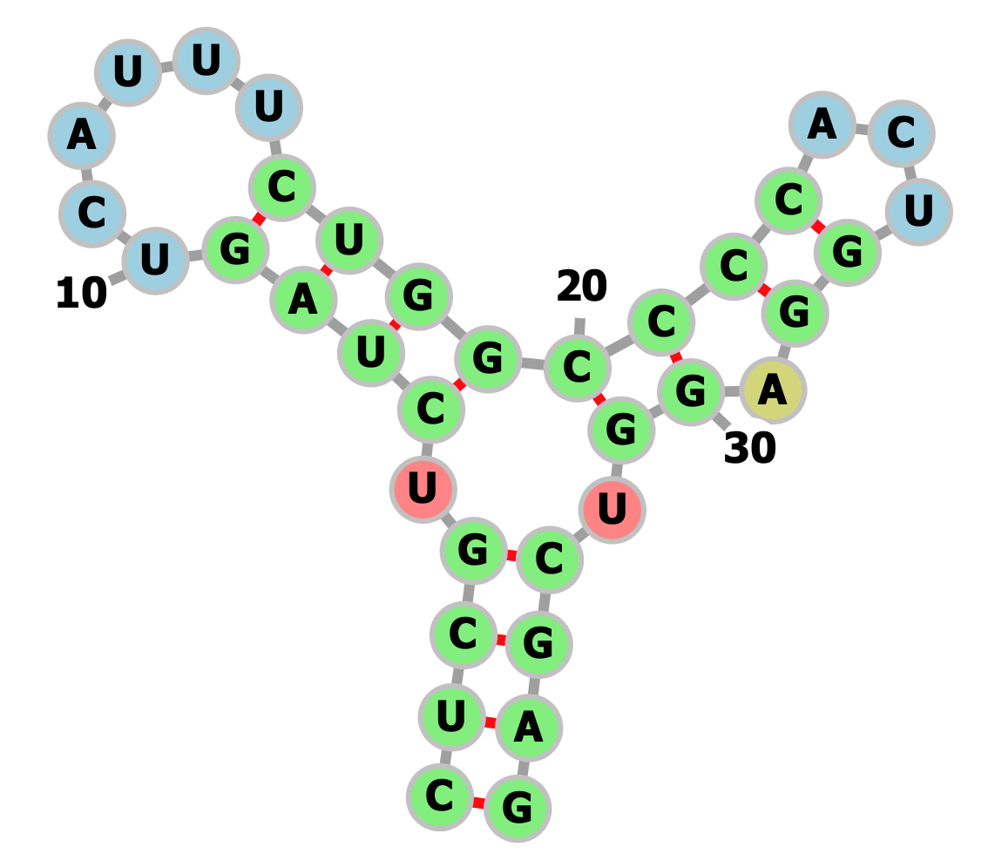
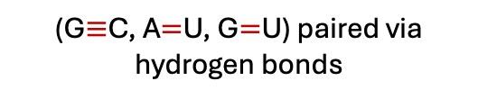
Sequence to structure
Secondary structure
RNA sequence
CUCGUCUAGUCAUUUCUGGCCCCACUGGAGGUCGAG
(G$≡$C, A$=$U, G$=$U) paired via hydrogen bonds

Slide 3
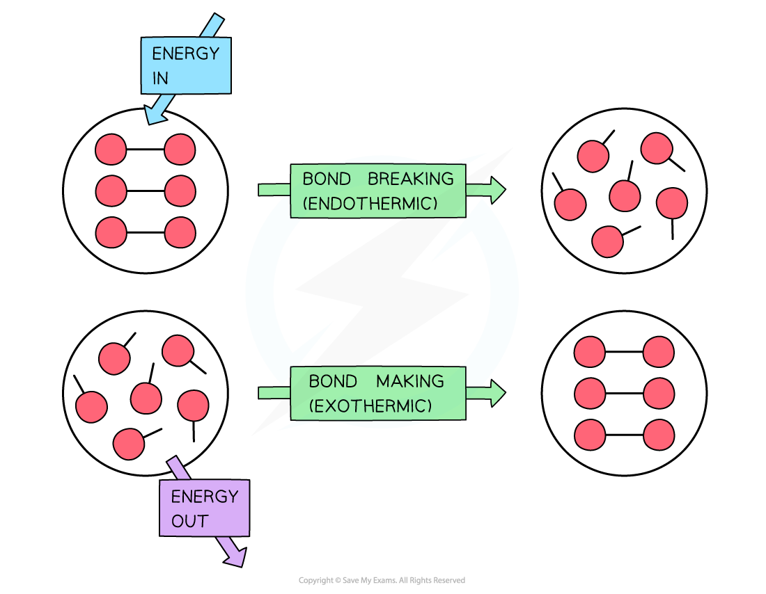



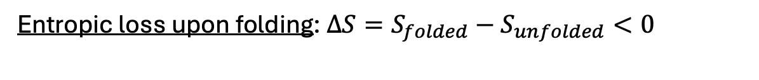
What physical effects matter when RNA folds?
1
Enthalpy changes ($∆H$) when hydrogen bonds form and break.
Exothermic: $∆H<0$
Endothermic: $∆H>0$
2
Entropic loss upon folding: $∆S=S_{folded}−S_{unfolded}<0$
More conformations: Higher the entropy
3
Free energy change, $∆G=∆H−T∆S$
$$G_{folded}−G_{unfolded}$$
Carroll, C. (2025, June 18). Enthalpy & bond energies: Revision note. Save My Exams.
Notes:
The heat that passes into or out of the system during a reaction is the enthalpy change. Whether the enthalpy of the system increases (i.e. when energy is added) or decreases (because energy is given off) is a crucial factor that determines whether a reaction can happen.

Slide 4
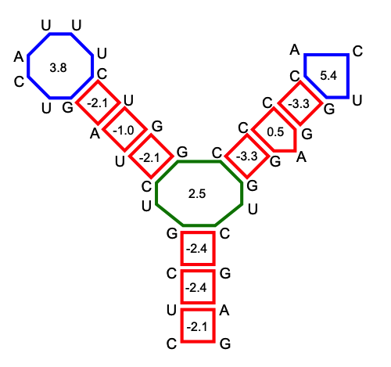

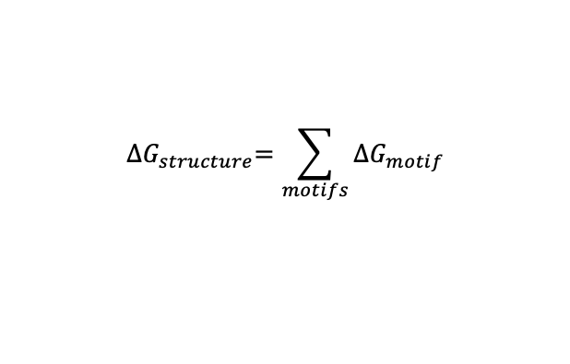
Why do we need the thermodynamic model?
Secondary structure
RNA sequence
CUCGUCUAGUCAUUUCUGGCCCCACUGGAGGUCGAG
$${∆G}_{structure}$$
$=$ some value
(G$≡$C, A$=$U, G$=$U) paired via hydrogen bonds
Each substructure (MOTIF) contributes to the structure’s free energy change.
$${∆G}_{structure}=\sum_{motifs}{∆G_{motif}}$$
Turner model: For each motif, a set of thermodynamic parameters + rules.
Lorenz et al., Algorithms for molecular biology, 2011.

Slide 5
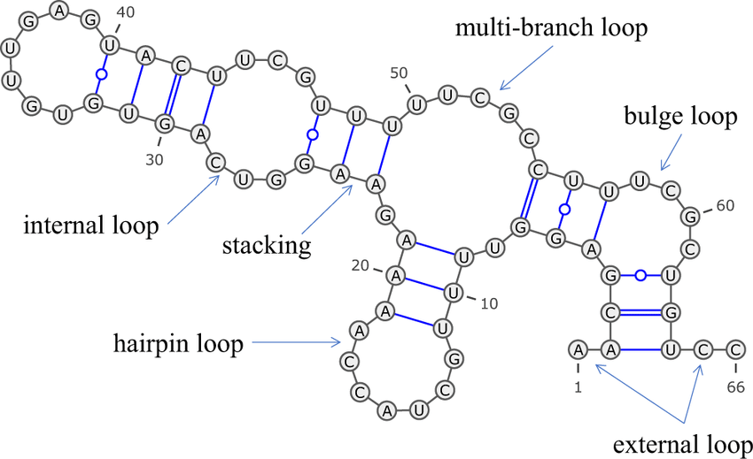
Turner Model aka Nearest Neighbor Model
Secondary structure
1. Base pair stacked over another base pair
1
Sato et al., Nat Comm, 2021
Dutta et al., Phys Chem, 2024
Notes:
The dominant thermodynamic model for RNA secondary structure is the Turner model.
any RNA secondary structure can be broken into a small set of motifs: helices, hairpins, internal loops, bulges, multibranch loops, dangling ends.

Slide 6
Turner Model aka Nearest Neighbor Model
Factors affecting stability of any loop or stem.
Secondary structure
1. Base pair stacked over another base pair
2
1
2. Loop stability depends on closing base pair.
Sato et al., Nat Comm, 2021
Dutta et al., Phys Chem, 2024
Notes:
The dominant thermodynamic model for RNA secondary structure is the Turner model.
any RNA secondary structure can be broken into a small set of motifs: helices, hairpins, internal loops, bulges, multibranch loops, dangling ends.

Slide 7
Turner Model aka Nearest Neighbor Model
Factors affecting stability of any loop or stem.
Secondary structure
1. Base pair stacked over another base pair
3
2
1
2. Loop stability depends on closing base pair.
3. Loop stability also depends on pair of nucleotides next to closing base pairs (mismatch).
Sato et al., Nat Comm, 2021
Dutta et al., Phys Chem, 2024
Notes:
The dominant thermodynamic model for RNA secondary structure is the Turner model.
any RNA secondary structure can be broken into a small set of motifs: helices, hairpins, internal loops, bulges, multibranch loops, dangling ends.

Slide 8
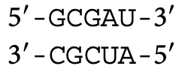
Thermodynamic parameters from Turner model
Optical melting experiments on constructs
Linear regression
Free energy parameters
Several duplexes
Stacking parameters
(Basic building blocks for an RNA structure)
Region of interest
Notes:
To learn those contributions, the Turner lab did optical melting experiments on lots of short RNAs that isolate a particular motif or base-stacking pattern.

Slide 9
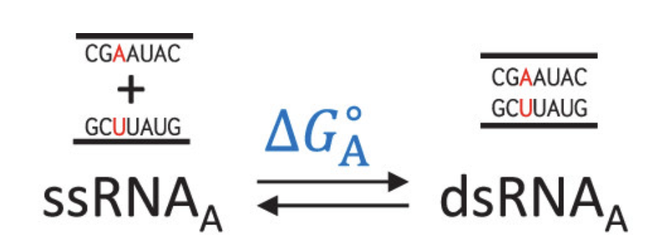
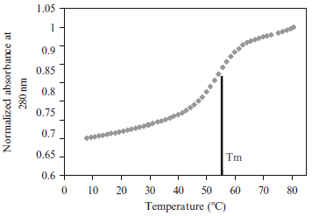
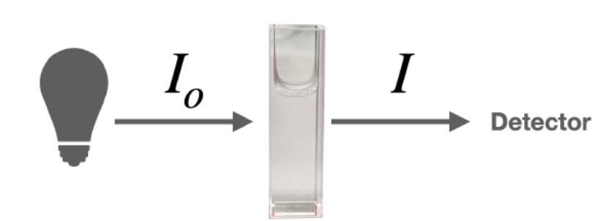
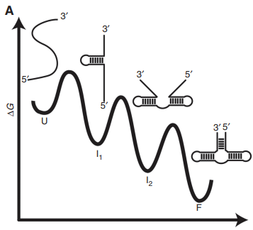
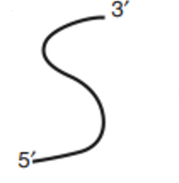

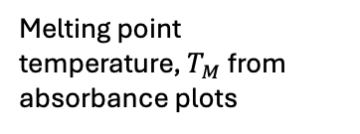

Optical melting experiments
Assumption: Two-state folding model (fully folded or unfolded).
Halfway in the Folded to Unfolded transition
UV absorbance vs Temperature
Melting point temperature, $T_{M}$ from absorbance plots
1) Plot $T_{M}$ vs concentration.
2) $∆H$ and $∆S$ → Slope and intercept from the above plots.
3) $∆G=∆H−T∆S$ with T =37 °C
UV Absorbance
Temperature $(℃)$
Temperature increases
Loss of base-pairing
Increase in UV absorbance

Slide 10
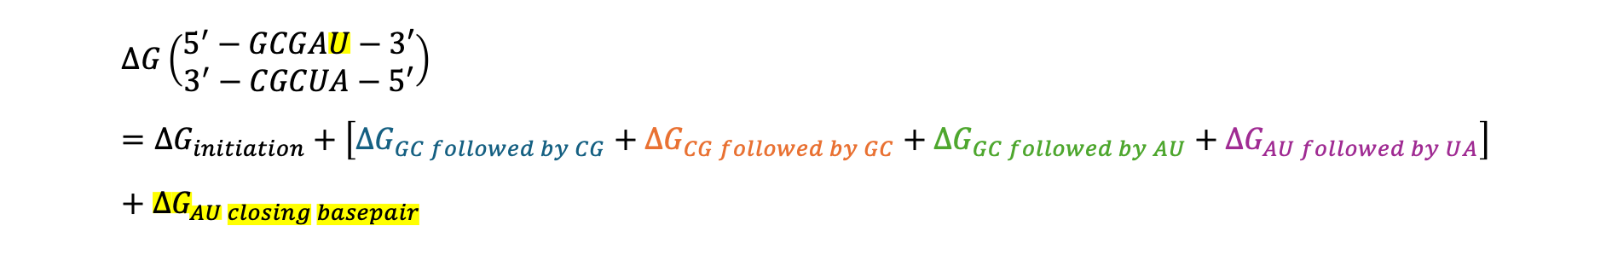
Thermodynamic parameters from Turner model
Optical melting experiments on constructs
Linear regression
Free energy parameters
Several duplexes
Stacking parameters
Stacking parameters in a duplex
$$∆G\left(\begin{matrix}5^{′}−GCGAU−3′ \\ 3^{′}−CGCUA−5′\end{matrix}\right)=∆G_{initiation}+\left[∆G_{GC followed by CG}+∆G_{CG followed by GC}+∆G_{GC followed by AU}+∆G_{AU followed by UA}\right]+∆G_{AU closing basepair}$$
Notes:
To learn those contributions, the Turner lab did optical melting experiments on lots of short RNAs that isolate a particular motif or base-stacking pattern.

Slide 11
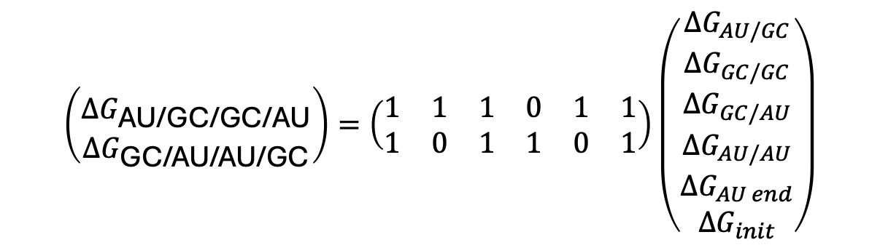
Stacking parameters
Matrix representation ${∆G}_{duplex}=C.\left({∆G}_{stack}\right)$ is a $AX=B$problem solving for $X$.
counts
A couple of duplexes and the stacks associated with it
$$\left(\begin{matrix} \\ ∆G_{\text{AU}\text{/}\text{GC}\text{/}\text{GC}\text{/}\text{AU}} \\ ∆G_{\text{GC}\text{/}\text{AU}\text{/}\text{AU}\text{/}\text{GC}}\end{matrix}\right)=\left(\begin{matrix}\begin{matrix}1 & 1 & 1\end{matrix} & \begin{matrix}0 & 1 & 1\end{matrix} \\ \begin{matrix}1 & 0 & 1\end{matrix} & \begin{matrix}1 & 0 & 1\end{matrix}\end{matrix}\right)\left(\begin{matrix}∆G_{AU/GC} \\ \begin{aligned}∆G_{GC/GC} \\ ∆G_{GC/AU}\end{aligned} \\ \begin{aligned}∆G_{AU/AU} \\ ∆G_{AU end} \\ ∆G_{init}\end{aligned}\end{matrix}\right)$$
5’-AGGA-3’
3’-UCCU-5’
5’-GAAG-3’
3’-CUUC-5’
Experimentally determined values
Occurrences of each stack
Energy parameters
Xia et al., Biochemistry, 1998

Slide 12
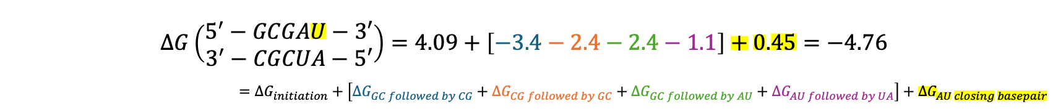
Thermodynamic parameters from Turner model
Optical melting experiments on constructs
Linear regression
Free energy parameters
Several duplexes
Stacking parameters
Stacking parameters
$$∆G\left(\begin{matrix}5^{′}−GCGAU−3′ \\ 3^{′}−CGCUA−5′\end{matrix}\right)=4.09+\left[−3.4−2.4−2.4−1.1\right]+0.45=−4.76$$
$$=∆G_{initiation}+\left[∆G_{GC followed by CG}+∆G_{CG followed by GC}+∆G_{GC followed by AU}+∆G_{AU followed by UA}\right]+∆G_{AU closing basepair}$$
Notes:
To learn those contributions, the Turner lab did optical melting experiments on lots of short RNAs that isolate a particular motif or base-stacking pattern.

Slide 13

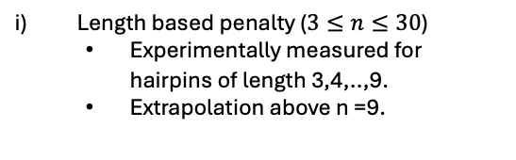
Thermodynamic parameters from Turner model
Optical melting experiments on constructs
Several duplexes
Linear regression
Stacking parameters
Duplexes with hairpin
n=5
Hairpin loop parameters
n=7
Length based penalty ($3≤n≤30$)
Experimentally measured for hairpins of length 3,4,..,9.
Extrapolation above n =9.
n=3
n$→$#unpaired nucleotides
Notes:
They assume a simple two-state model: each construct is either folded or unfolded.
From the melting curve you get a ΔG° for folding at 37 °C.

Slide 14

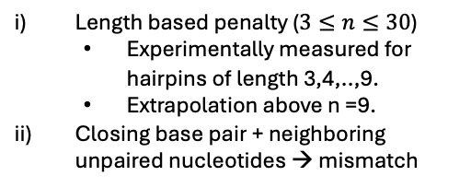
Thermodynamic parameters from Turner model
Optical melting experiments on constructs
Several duplexes
Linear regression
Stacking parameters
Duplexes with hairpin
Hairpin loop parameters
Length based penalty ($3≤n≤30$)
Experimentally measured for hairpins of length 3,4,..,9.
Extrapolation above n =9.
Closing base pair + neighboring unpaired nucleotides → mismatch
n$→$#unpaired nucleotides
Notes:
They assume a simple two-state model: each construct is either folded or unfolded.
From the melting curve you get a ΔG° for folding at 37 °C.

Slide 15
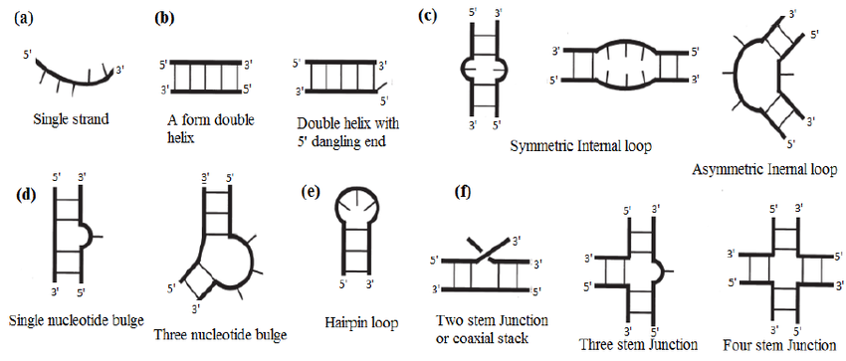
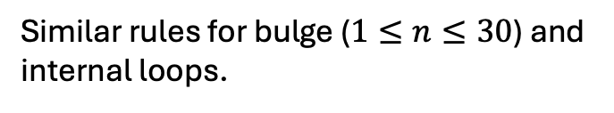

Thermodynamic parameters from Turner model
Optical melting experiments on constructs
Linear regression
Stacking parameters
Internal loops
n $→$#unpaired nucleotides
Similar rules for bulge ($1≤n≤30$) and internal loops.
Bulge loops
…...
Notes:
They assume a simple two-state model: each construct is either folded or unfolded.
From the melting curve you get a ΔG° for folding at 37 °C.

Slide 16
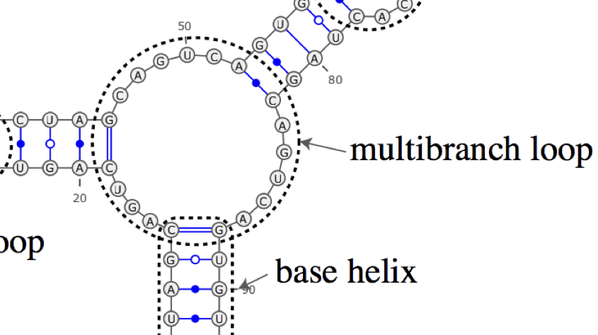
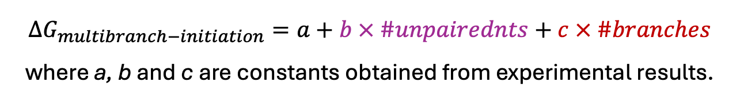
Multibranch loop
Junction of two or more helix branches
$$∆G_{multibranch−initiation}=a+b × \#unpairednts+c × \#branches$$
where a, b and c are constants obtained from experimental results.
Least accurate component of the model.
Sato et al., Nat Comm, 2021
Notes:
They assume a simple two-state model: each construct is either folded or unfolded.
From the melting curve you get a ΔG° for folding at 37 °C.

Slide 17
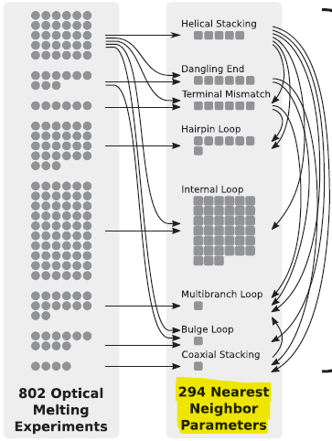
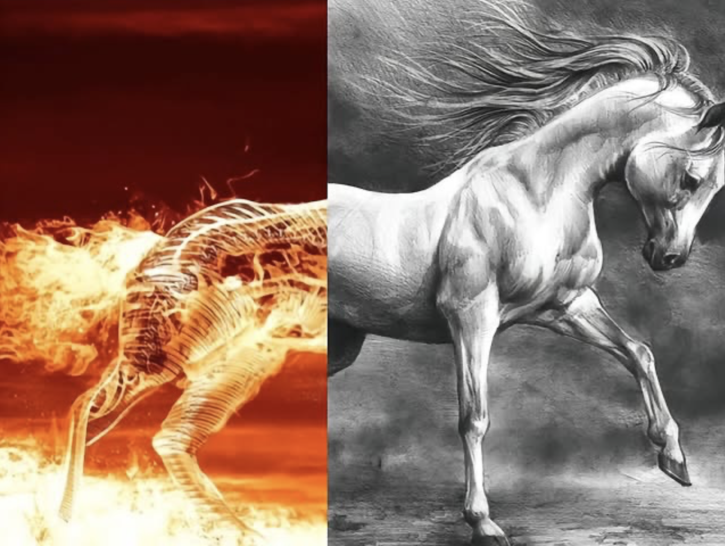
Overview of parameters in Turner model
Stacking parameters
Other loop-based parameters
Optical Melting Experiments
Nearest Neighbor Parameters
Zuber et al., NAR, 2018
Notes:
On the experimental side, there are hundreds of optical melting experiments—on the order of 800 constructs.
Those are fit to recover roughly 300 nearest-neighbor parameters: helical stacking, dangling ends, terminal mismatches, hairpins, internal loops, multibranch loops, etc.
These core parameters are then expanded into lookup tables—about 10–15k table entries in tools like RNAstructure.
When you give RNAstructure a sequence, it decomposes every candidate structure into motifs, pulls the corresponding numbers from these tables.

