Slide 1
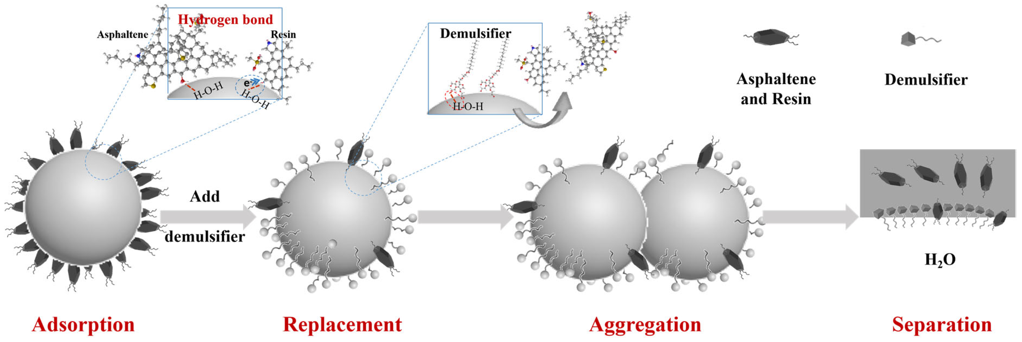
What happens to asphaltene-laden interfaces of water-oil emulsion
Demulsification mechanism by demulsifiers
Attempted to do this using MD
Sun et al., Processes, 2025

Slide 2
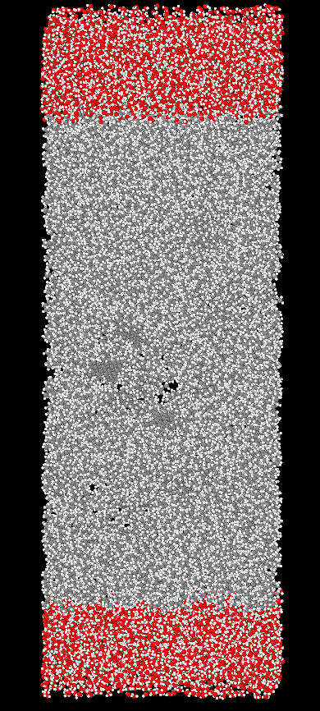
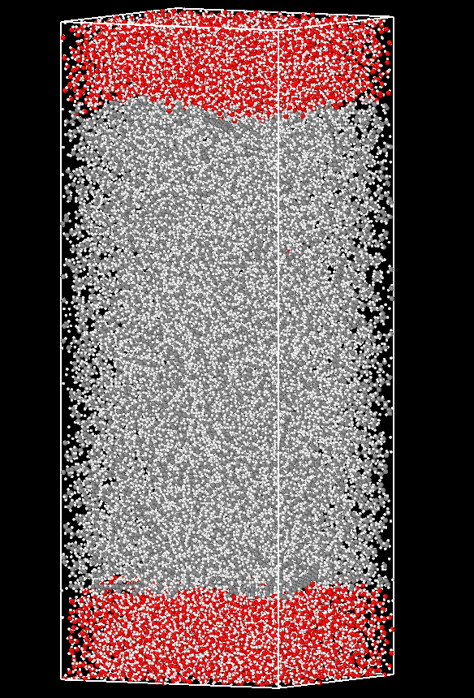
Adsorption of asphaltene molecules on water-oil interface using MD(gromacs)
Systems considered for 50 ns simulations
Water-Hexane-water(W-O-W)
#molecules: 4000 W-3000 O-4000 W
Box dimensions(in A): 70 x 70 x 200
i) 10 asphaltene molecules dispersed in oil
ii) 20 asphaltene molecules dispersed in oil
Water-Decane-Water(W-O-W)
#molecules: 4000 W-3000 O-4000 W
Box dimensions(in A): 80 x 80 x 200
i) 40 asphaltene molecules dispersed in oil
Representative figures at t=0ns and t=50ns
And end up with >50% of asphaltene molecules getting adsorbed in a 50ns simulation (2 fs timestep)
Systems that start like this
Asphaltene molecules shown in circles

Slide 3
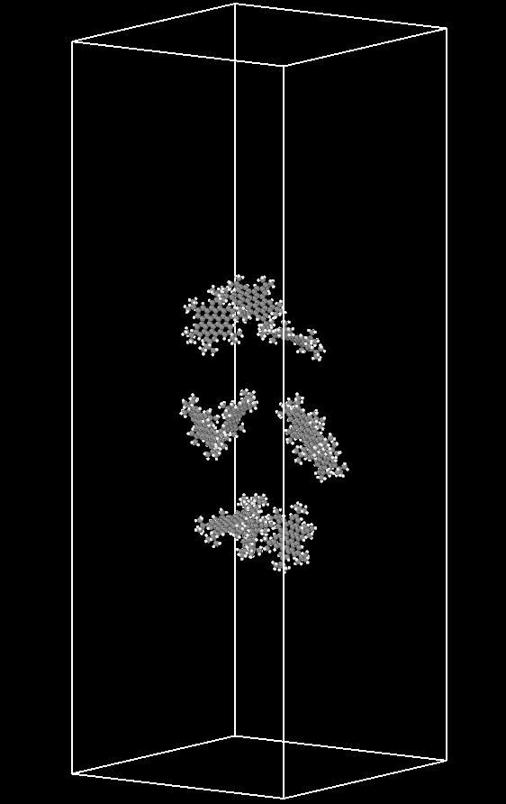
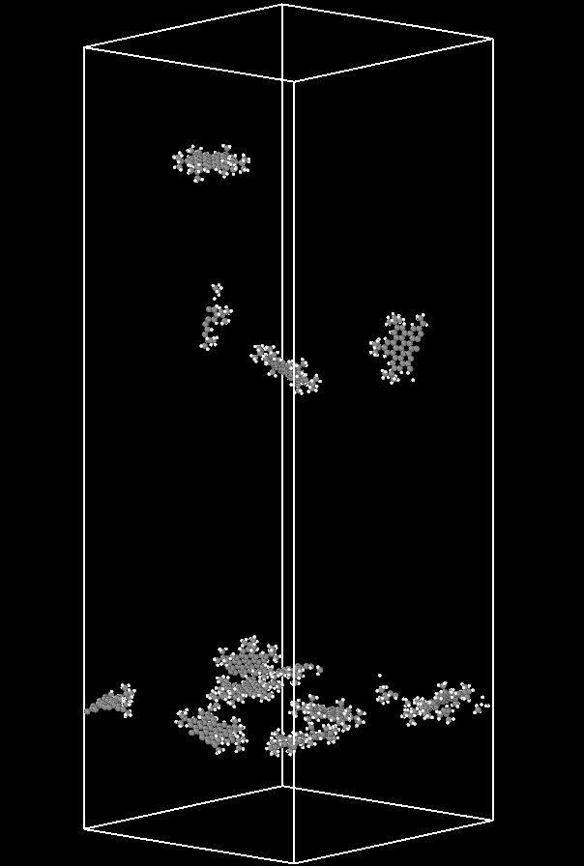
Water-Hexane-water(W-O-W)
#molecules: 4000 W-3000 O-4000 W
Box dimensions(in A): 70 x 70 x 200
10 asphaltene molecules dispersed in oil
t=0 ns
t=50 ns
Only asphaltene molecules shown here
Adsorbed asphaltene molecules

Slide 4
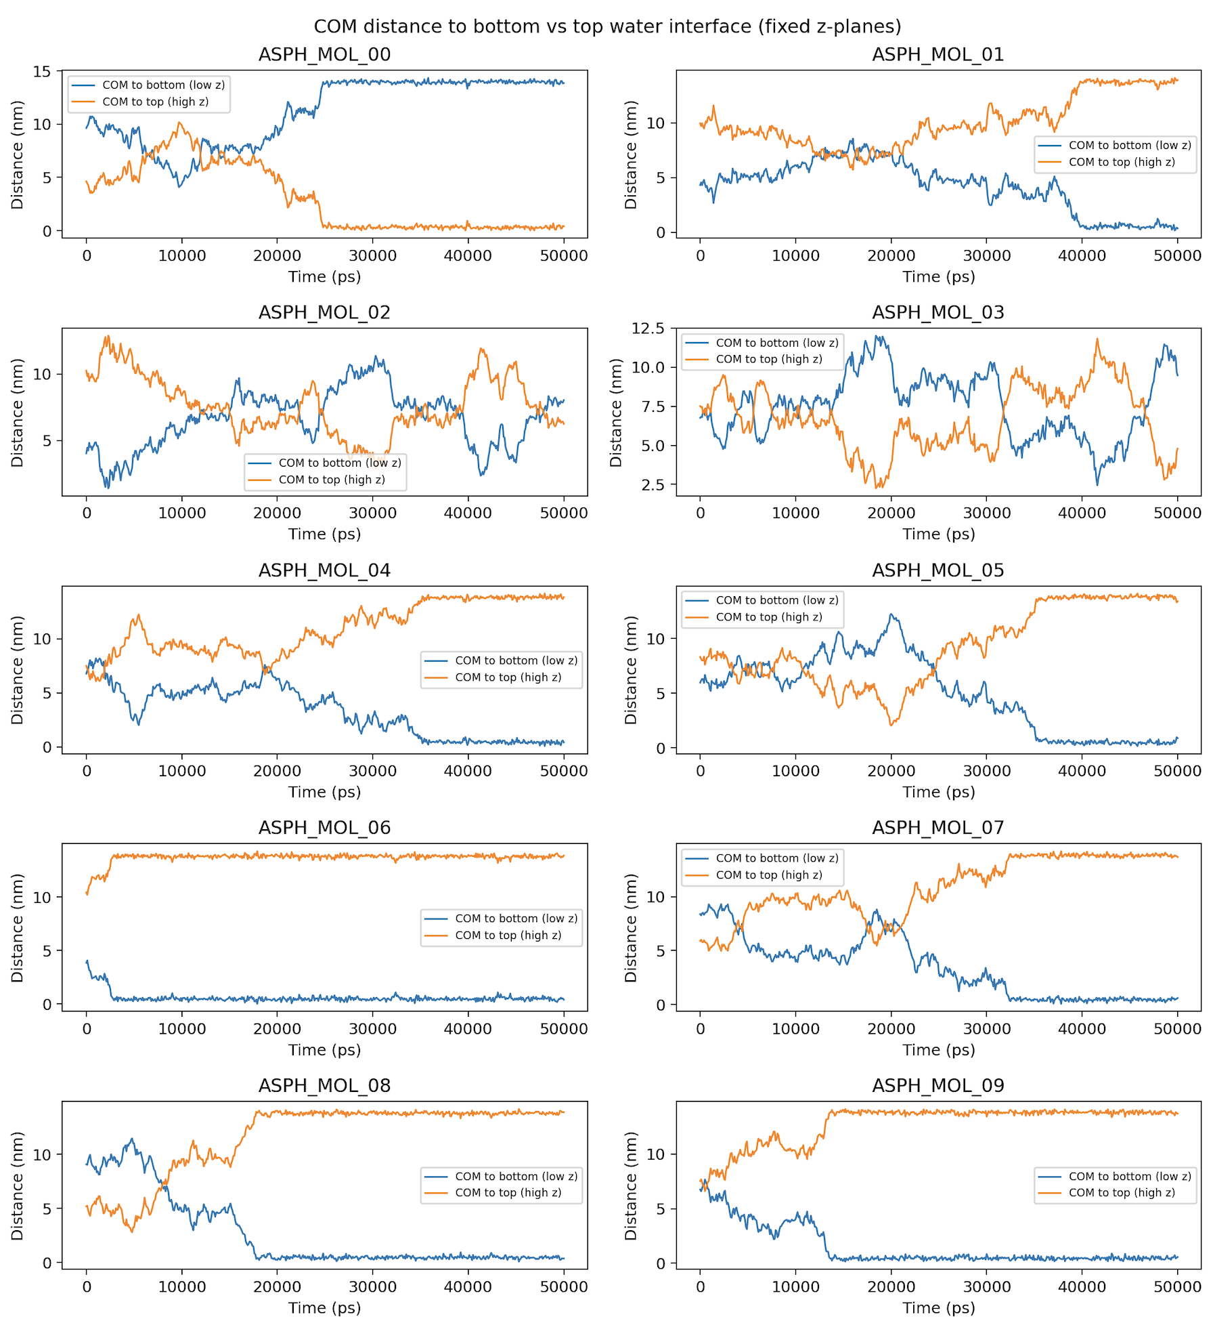
Distance of COM(y-axis; in nm) for all 10 asphaltene molecules(10 subplots) with the top and bottom oil-water interface with time(x-axis; 0 to 50000 ps or 50 ns)
2 molecules not adsorbed at the water interface; still drifting.
Distance of COM from the top interface
Sticking to either ends of y-axis shows asphaltene molecules being adsorbed at that particular time.
Distance of COM from the bottom interface
Considering PBC

Slide 5
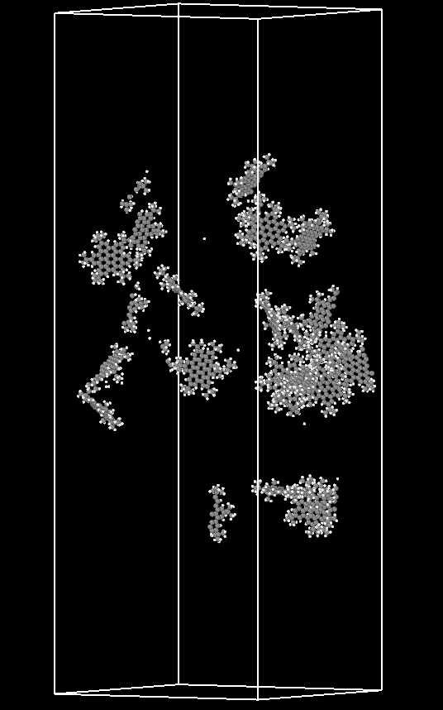
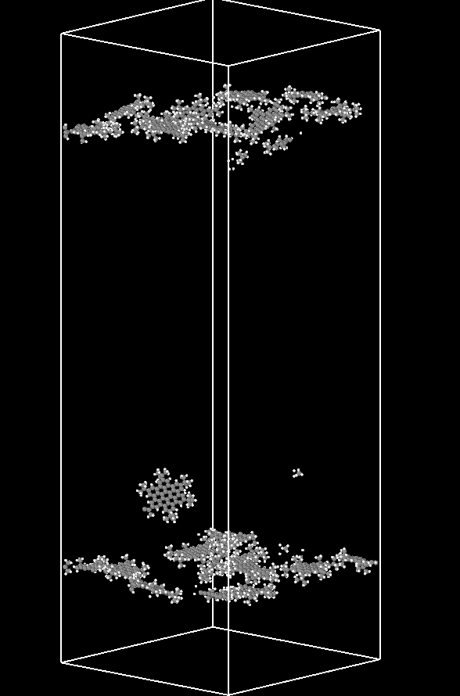
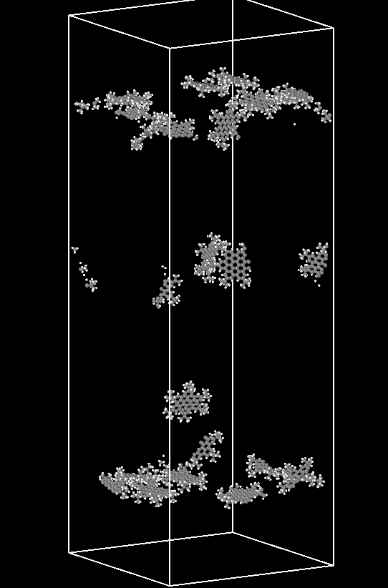
Water-Hexane-water(W-O-W)
#molecules: 4000 W-3000 O-4000 W
Box dimensions(in A): 70 x 70 x 200
20 asphaltene molecules dispersed in oil
t=0 ns
t=50 ns
t=100 ns
Only asphaltene molecules shown here
Adsorbed asphaltene molecules

Slide 6
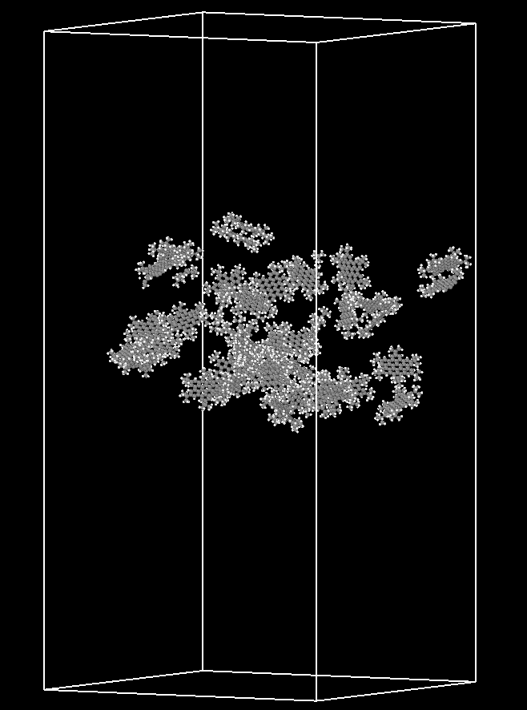
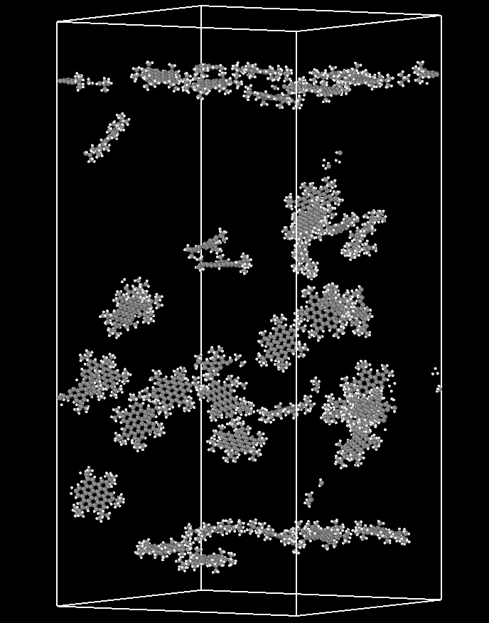
Water-Decane-Water(W-O-W)
#molecules: 4000 W-3000 O-4000 W
Box dimensions(in A): 80 x 80 x 200
40 asphaltene molecules dispersed in oil
More asphaltene molecules considered, so need to run longer.
But expect asphaltene to diffuse relatively slow compared to hexane(even with same number of molecules).
t=0 ns
t=50 ns
Only asphaltene molecules shown here
Adsorbed asphaltene molecules

Slide 7
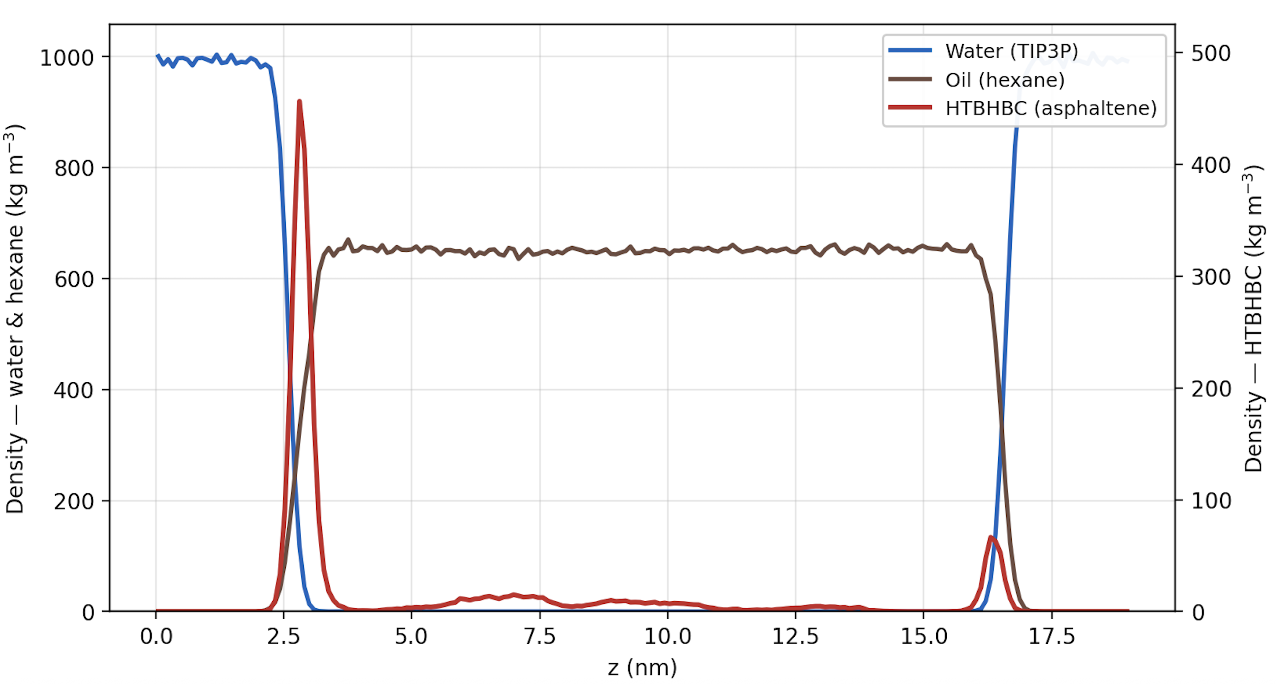
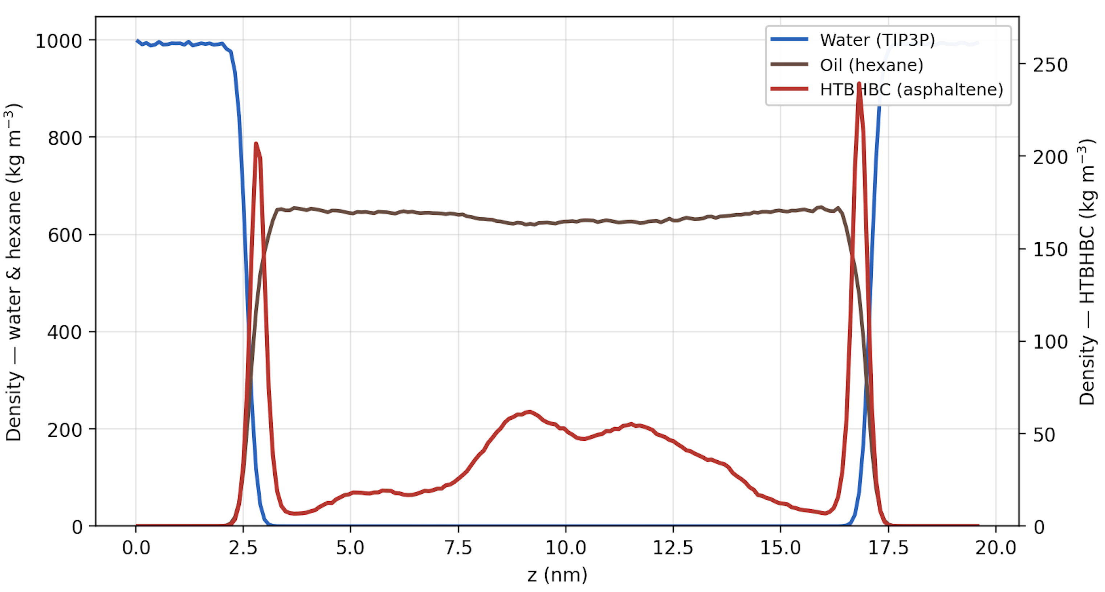
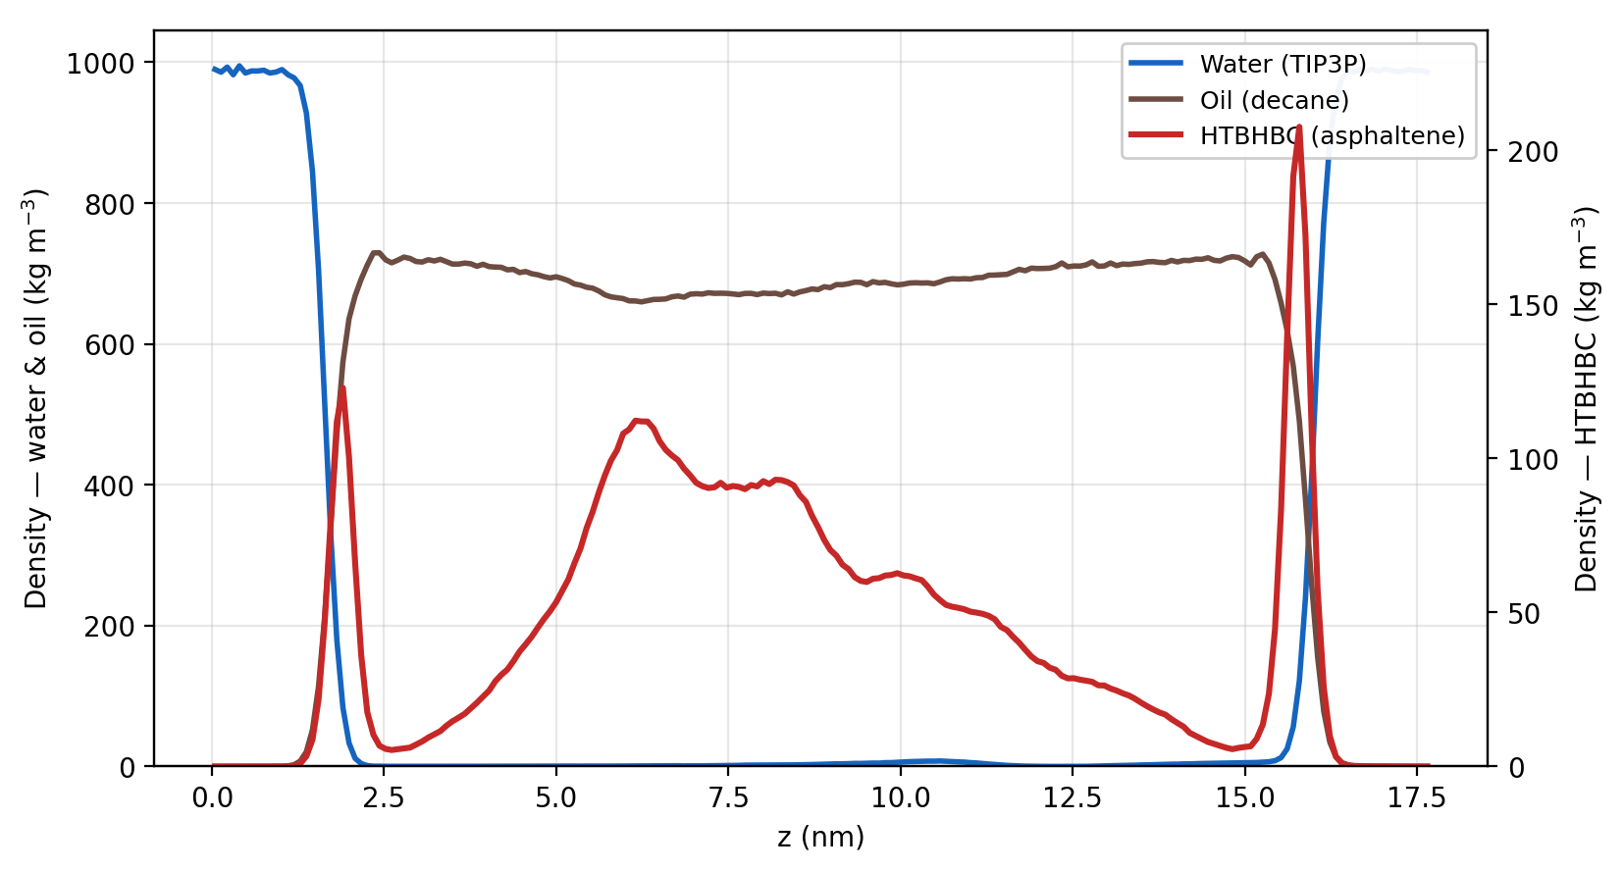
Density plots across z-axis (Water-Oil-Water) with asphaltene molecule adsorbed at t= 50 ns
Water-Hexane-water(W-O-W)
#molecules: 4000 W-3000 O-4000 W
Box dimensions(in A): 70 x 70 x 200
10 asphaltene molecules dispersed in oil
20 asphaltene molecules dispersed in oil
Water-Decane-Water(W-O-W)
#molecules: 4000 W-3000 O-4000 W
Box dimensions(in A): 80 x 80 x 200
40 asphaltene molecules dispersed in oil
More asphaltene molecules remain dispersed in the oil phase

Slide 8
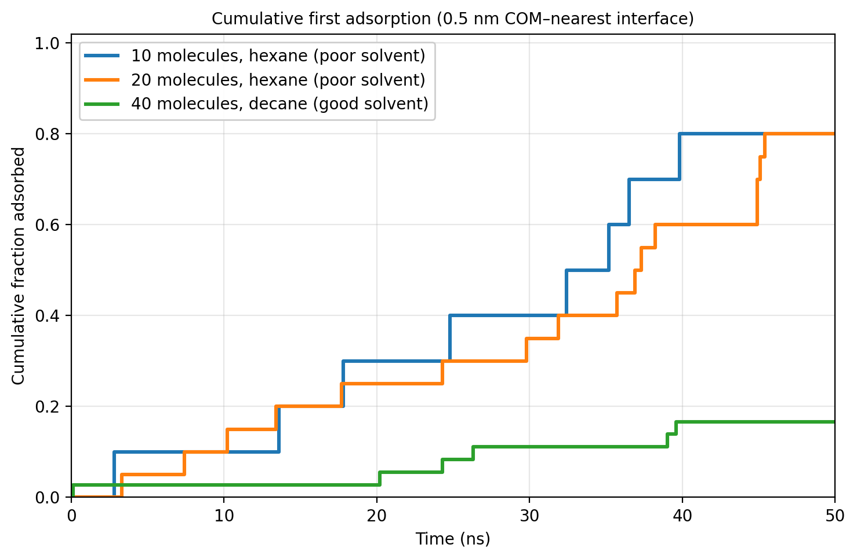
Fraction of molecules adsorbed over time for all three cases
Around 80% of molecules get adsorbed with 50 ns.
More asphaltene molecules remain dispersed in the oil phase

Slide 9
What happens to asphaltene-laden interfaces of water-oil emulsion
Demulsification mechanism by demulsifiers
What next?
Crude oil: Initial setup
Heptane/Hexane vs Decane/Toluene
Dectol (60%Decane and 40% Toluene; Chang et al., 2018)
Asphaltene molecules
HTHBC from Costa et al., 2016
C7 asphaltene (Chang et al., 2018) used to study aged asphaltene film.
Longer simulations with increasing concentration of asphaltene → More interactions that stabilize the emulsion.
Not just $π−π$ stacking at the interface, Van der Waals interactions, H-bonds, role of heteroatoms, steric interactions with varying orientation of the asphaltene molecules.
Competitive adsorption: More experimental papers that speculate how demulsifiers weaken the asphaltene laden interface.
Weighted Ensemble here?
Identify potential coordinate variables with longer runs.
Sun et al., Processes, 2025

