Slide 1
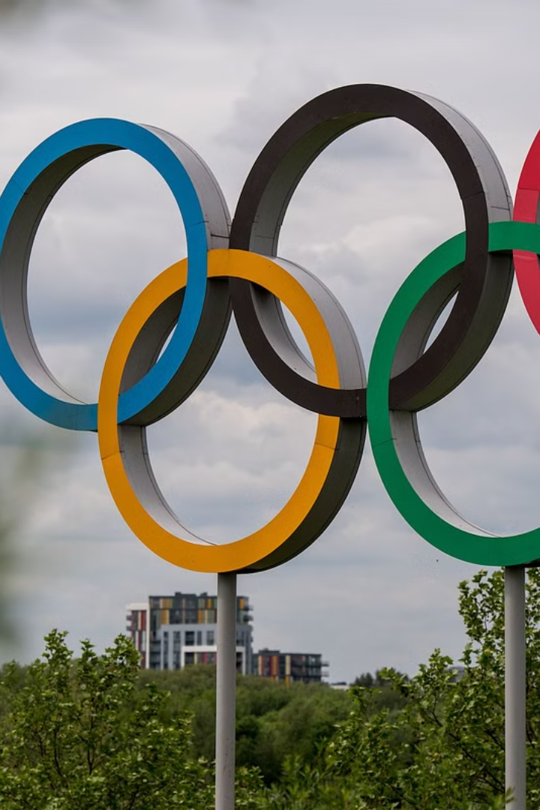
CAPSTONE PROJECT
Problem Statement : “Explore the Olympic Games dataset to understand athlete performance, participation patterns, and seasonal influences through statistical analysis and visualization.”
DONE BY: Brand Builders Members: ASHWIN B
B L N WAJITH ALI
MOHD ZAID

Slide 2



Nature of the Dataset
Data Filers Overview
Key Attributes
Analytical Foundation
"Athlete Events File": Contains detailed information about athletes, including their names, countries, sports, events participated in, and medals won.
"NOC Regions File": Provides data on National Olympic Committees (NOCs) and their respective regions.
Athlete demographics: Age, gender, nationality.
Sports and events: Variety of sports, number of events, participation rates.
Medal distribution: Distribution of medals across different sports, countries, and events.
Enables deep analysis of athletic performance, participation dynamics, and socio-economic implications.
Serves as a rich source for uncovering trends, patterns, and insights related to the Olympic Games.

Slide 3
Approach for Data Analysis
1
Descriptive Statistics
Provides a summary of key characteristics of the dataset, such as central tendency, variability, and distribution.
2
Data Visualization
Utilizes graphs, charts, and maps to visually represent trends, patterns, and relationships in the data.
3
Predictive Modeling (Medal Success Rate)
Employing machine learning algorithms to predict medal success rates based on various factors.
4
Comparative Analysis
Analyzing and comparing performance metrics across different teams, nations, and sports to identify trends and patterns.

Slide 4
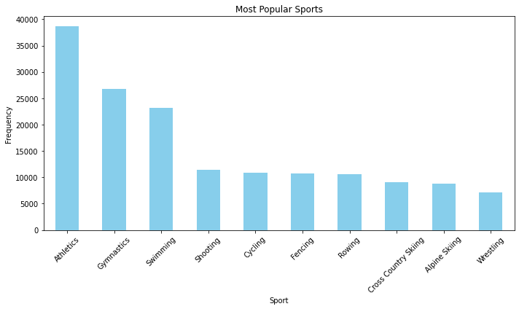
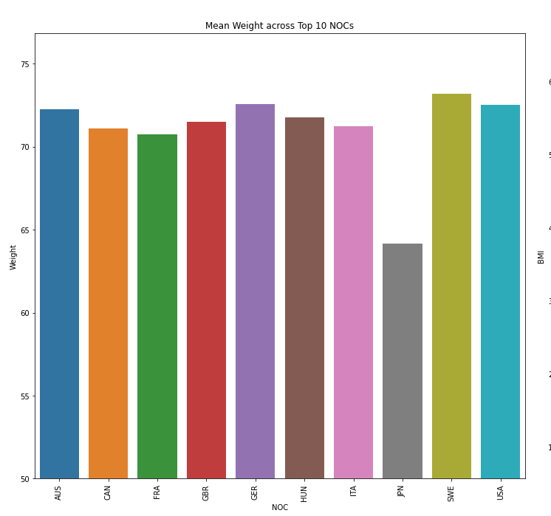
Graph Analysis and Insights
Bar Chart - Total Medals Won (Teams/NOCs):
Bar Chart - Team/NOC Performance Comparison
Purpose: Visualize the total number of medals won by TOP 10 National Olympic Committee (NOC).
Insights: Provides insights into the distribution of medals among different NOCs, highlighting top-performing nations and disparities in medal counts.
Purpose: Compare the medal counts between different teams or NOCs.
Insights: Helps identify performance disparities and trends, showcasing which teams or NOCs have won more medals and their relative positions in the medal standings.

Slide 5
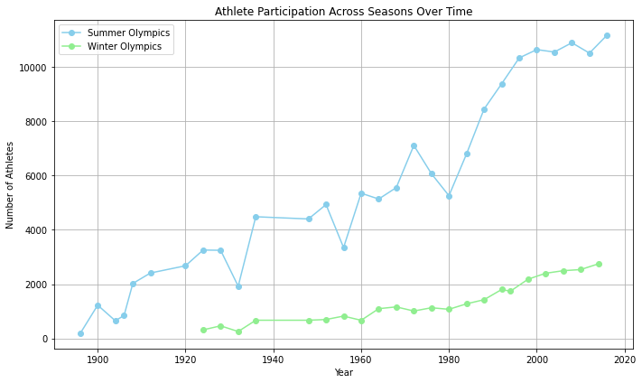
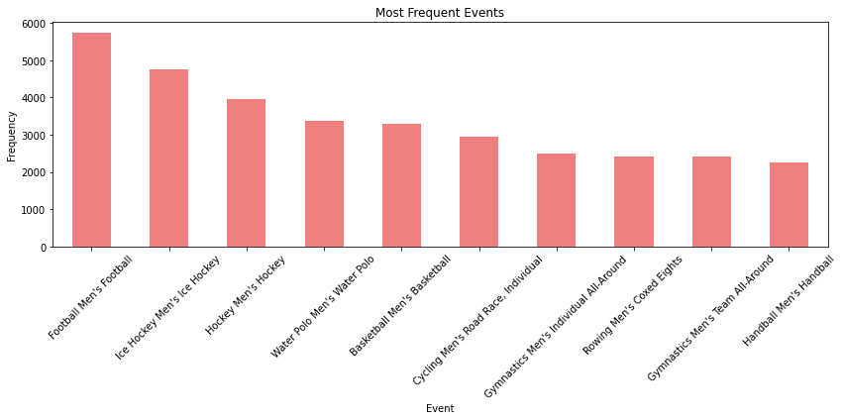
Graph Analysis and Insights
Bar Chart - Medal Success Rate
Line Chart - Performance Over Time
Purpose: Display the medal success rates normalized by the number of participants for each NOC.
Insights: Offers insights into the efficiency and effectiveness of each NOC in converting participation into medal success, identifying high-performing nations relative to their athlete pool.
Purpose: Track the changes in medal counts and success rates across multiple Olympic Games.
Insights: Reveals trends and patterns in the performance evolution of different NOCs over time, highlighting periods of dominance, decline, or emergence in Olympic competition.

Slide 6
Key Observations
Medal Distribution Across Seasons
Participation Trends
Summer seasons generally see a higher number of medals awarded compared to winter seasons, indicating a seasonal trend in athletic performance.
Analysis reveals fluctuations in athlete participation across different Olympic seasons, reflecting changes in global sporting interests and socio-economic factors.
Emerging Sports
Medal Success Rate
Certain sports show a rising popularity trend over the years, suggesting shifts in athletic preferences and the evolution of the Olympic Games' sporting landscape.
Examination of medal success rates provides insights into the effectiveness of training programs, national sporting policies, and the overall competitiveness of participating nations.
Performance Over Time
Tracking performance trends over time unveils the ebb and flow of national athletic dominance, showcasing the dynamic nature of Olympic competition and the evolving prowess of competing nations.

Slide 7



Challenges Faced
Talent Scouting
Identify promising young athletes and provide targeted training and development support.
Event Optimization
Focus resources on sports and disciplines where the country has the best chance of medal success.
Sponsorship Strategy
Invest in athletes and teams with the highest potential for media exposure and commercial impact.

Slide 8




Future Scope
Predictive Modeling
Enhanced Data Visualization
Socio-Economic Impact Assessment
Implement predictive modeling techniques to forecast future trends in athlete performance, medal distributions, and emerging sports.
Develop interactive data visualization tools for user-friendly access to comprehensive Olympic Games insights.
Conduct a detailed assessment of the Olympic Games' socio-economic impact on national development and societal well-being.
Longitudinal Studies
Global Sporting Policy Evaluation
Undertake longitudinal studies to assess the long-term impact of Olympic Games participation on athletes' careers and post-athletic life trajectories.
Develop interactive data visualization tools for user-friendly access to comprehensive Olympic Games insights.

Slide 9

Thank You

