Slide 1

Selenium
Browser Automation

Slide 2
Course Contents
Why Selenium?
1
2
Architecture
Selenium Components
3
DOM basics, Locators & Actions
4
Page object modeling
5

Slide 3
Selenium – an Introduction
Selenium is an open-source framework that is used for automating the tests carried out on web browsers
Before you get carried away, let me re-iterate that, only testing of web applications is possible with Selenium
OPEN SOURCE
CROSS PLATFORM
WEB AUTOMATION
Framework is fully open source & supported by large community
Allowing test to run in different OS & Browsers
Automating web applications for testing purposes
MULTI LANGUAGE
MULTI BROWSER
MULTI FRAMEWORK
Write your test n favorite language (Java, C#, Python etc.,)
One Selenium script for all browsers. Supporting various modern browsers
Most flexible and usable with any framework.

Slide 4
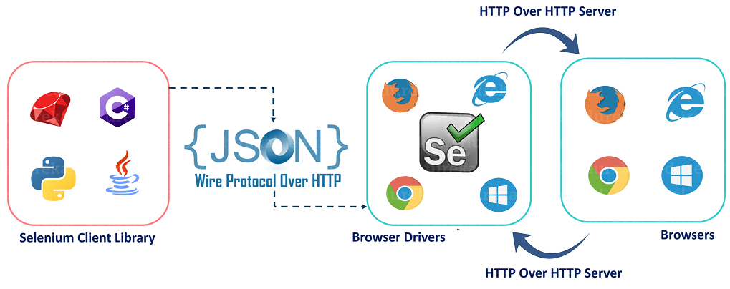

Selenium Architecture
HTTP Transmission
Browser Drivers
Browsers
SELENIUM CLIENT LIBRARY
HTTP Transmission

Slide 5




Before we proceed
How to install?
How to setup?
Documentation
Get community support

Slide 6
Selenium Components
Selenium IDE
Used to capture/record the user actions in the web browser and playback the scripts
WebDriver
Programming interface that helps create & run test cases. Interacts directly with browser and doesn’t require an additional server
Grid
Cross-Platform testing at the same time in multiple browsers

Slide 7


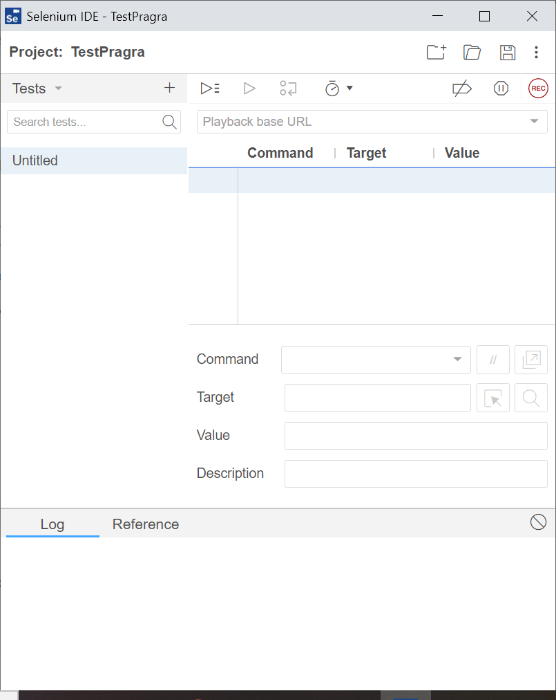
Selenium IDE
Record and Playback tool
Capture/record the user actions in the web browser and playback the scripts.
Available as Extensions in the browsers
Can be downloaded from https://www.selenium.dev/selenium-ide/
Selenium IDE
Record and Playback tool
Capture/record the user actions in the web browser and playback the scripts.
Available as Extensions in the browsers
Can be downloaded from https://www.selenium.dev/selenium-ide/

Slide 8


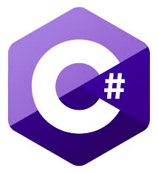




Selenium WebDriver
Blah blah blahBlah blah blah
Blah blah blah
Blah blah blah
Blah blah blah
Blah blah blah
Font: Century Gothic size 18-24
Supported languages

Slide 9
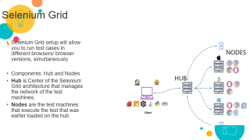
Selenium Grid
Selenium Grid is a component in Selenium that allows you to run test cases in different machines across different browsers.
It uses hub-node architecture.
Hub - Central and Controller part of Selenium Grid architecture. Tests are stored here and distributed to nodes for execution.
Node - Worker part of Selenium Grid architecture. Tests are executed here as administered by Hub.
Why Selenium Grid?
Run test on different platforms/browsers.
Run parallelly.

Slide 10
DOM – Document Object Model
DOM -Simple set of interfaces standardized among web developers to access and manipulate documents in HTML or XML using JavaScript
Structural representation of HTML elements
4 ways to identify and locate an element using DOM:
getElementById
getElementsByName
dom:name (applies only to elements within a named form)
dom:index
DOM

Slide 11
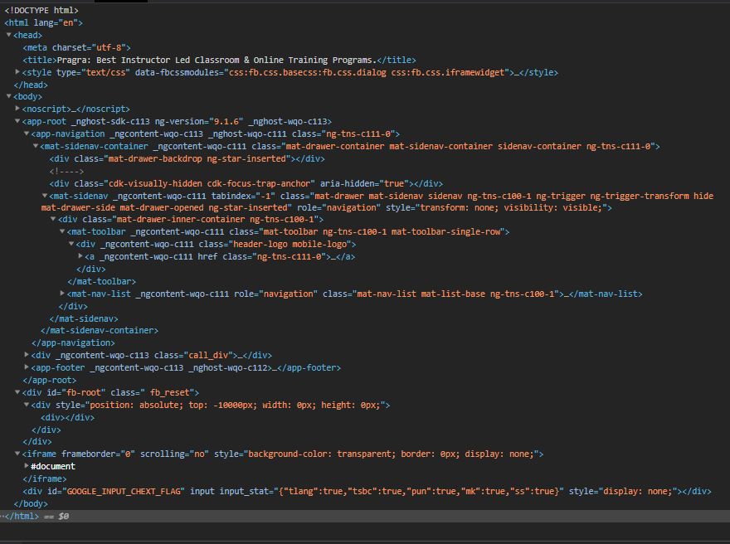

DOM – Document Object Model
1
Document
Root Element <HTML>
3
Element <HEAD>
3
2

Slide 12
DOM – Document Object Model
Document
Structural representation of HTML elements
Root Element <HTML>
Element <HEAD>
DOM
4 ways to identify and locate an element using DOM:
getElementById
getElementsByName
dom:name (applies only to elements within a named form)
dom:index

Slide 13
By CSS ID: find_element_by_id
By CSS class name: find_element_by_class_name
By name attribute: find_element_by_name
By DOM structure or xpath: find_element_by_xpath
By link text: find_element_by_link_text
By partial link text: find_element_by_partial_link_text
By HTML tag name: find_element_by_tag_name

Slide 14
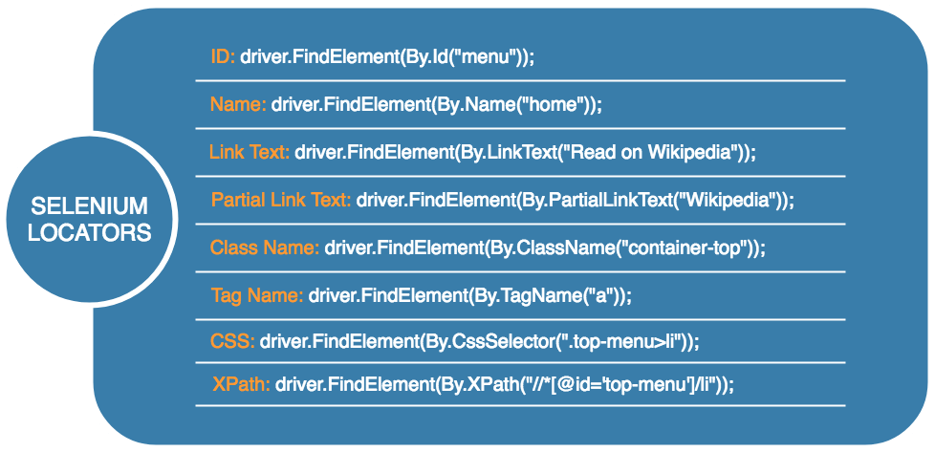
Element Locators

Slide 15
Actions classes
click() – clicks at the current location
doubleClick() – performs a Double click at the current mouse location
contextClick() – performs a Right click at the current mouse location
dragAndDrop(WebElement source, WebElement target) – drags an element from the source location and drops in target location
moveToElement(WebElement target) – moves to the target element
keyUp(WebElement target, java.lang.CharSequence key) – performs a key release after focusing on the target element
keyDown(WebElement target, java.lang.CharSequence key) – performs a key press after focusing on the target element
sendKeys(WebElement target, java.lang.CharSequence… keys) – types the value.
Mouse Interactions
Keyboard Interactions

Slide 16
Waits
Selenium wait commands instruct the test execution to hold/pause for a certain length of time before executing the next step.
Implicit Wait Exceptions:
Throws a NoSuchElementException when the element is not present in the DOM
Throws a ElementNotVisibleException when element is present in the DOM, however, it is hidden and cannot be interacted with.
Explicit Wait Exceptions(Default):
Throws a WebDriverTimeoutException, depending on our expected condition
Implicit Default Timeout (sec) – 0
Explicit Default Timeout (sec) – .5
PageLoadTimeout
Implicit Wait
setScriptTimeout
Expected conditions
Explicit Wait
Thread.sleep()

Slide 17
Javascript executor and Selenium
What is JavaScriptExecutor?
JavaScriptExecutor is an interface that provides a mechanism to execute Javascript through selenium driver.
It provides “executescript” & “executeAsyncScript” methods, to run JavaScript in the context of the currently selected frame or window.
What we can do with JavaScript Executor in Java?
Evaluating Xpaths
Finding Element
Changing style attribute of the elements
Getting Element Attributes
Adding an Element in DOM
Size of Window
Click Action

Slide 18
Desired Capabilities
Desired Capabilities is a class in Selenium used to set properties of browsers to perform cross browser testing of web applications.
Different types of Desired Capabilities Methods
getBrowserName()
setBrowserName()
getVersion()
setVersion()
getPlatform()
setPlatform()

Slide 19
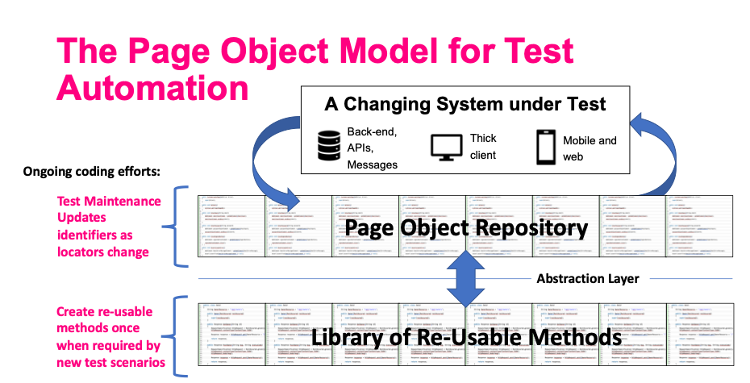
Page object Modelling
POM is a design pattern which is commonly used in Selenium for Automating the Test Cases.
Design Pattern is used in Selenium where web pages are represented by a corresponding class and web elements are represented by the variables of the class and all interactions are possible through the methods or say functions of the class.
Advantages of POM model:
Reusability
Maintainability
Readability

Slide 20
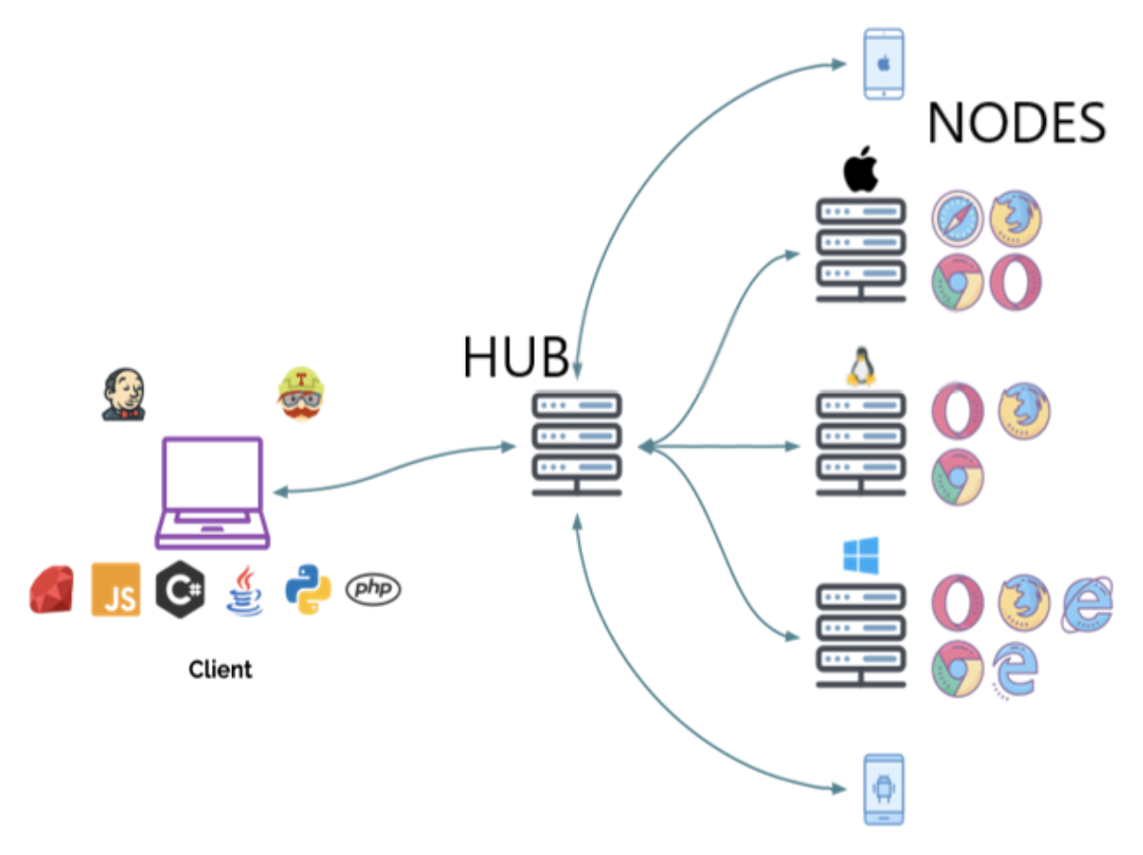
Selenium Grid
Selenium Grid setup will allow you to run test cases in different browsers/ browser versions, simultaneously
Components: Hub and Nodes
Hub is Center of the Selenium Grid architecture that manages the network of the test machines.
Nodes are the test machines that execute the test that was earlier loaded on the hub

Slide 21
Q&A

