Slide 1

API 101
Learn and test APIs

Slide 2
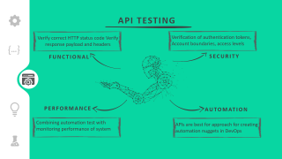
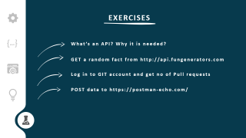
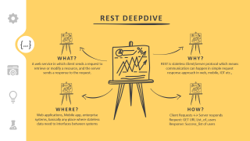
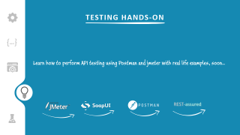
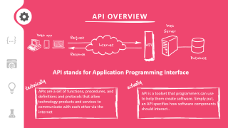
INDEX

Slide 3













API OVERVIEW
API stands for Application Programming Interface
technically
actually
APIs are a set of functions, procedures, and definitions and protocols that allow technology products and services to communicate with each other via the internet
API is a toolset that programmers can use to help them create software. Simply put, an API specifies how software components should interact..

Slide 4
API EXAMPLE
request
Do I need umbrella today?
Application 1
Application 2
Weather App
weather.com/
response
Rain expected today

Slide 5

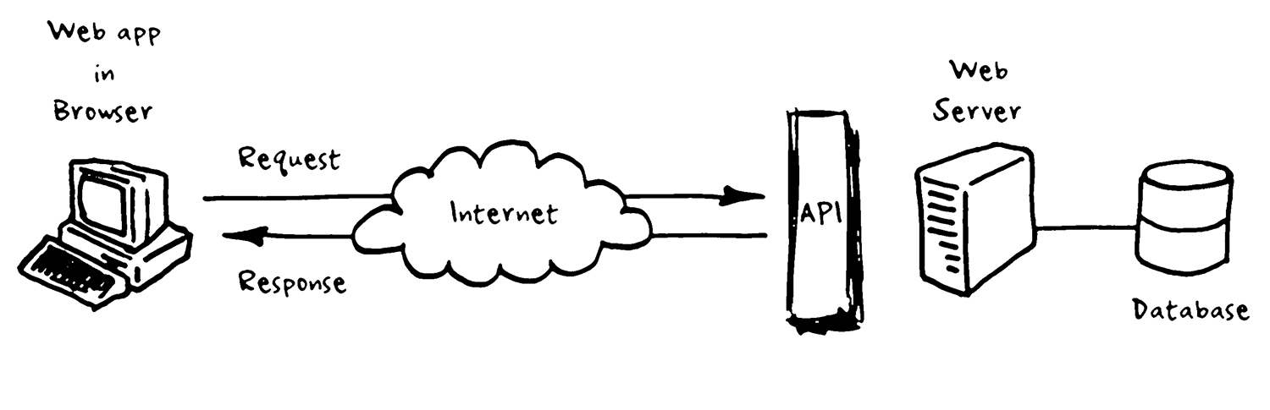
API CATEGORIES
OPEN API
PRIVATE API
APIs that are publicly available with no restriction to use such as Google, weather, NASA etc.,
APIs created to be consumed within a system/application.
Ex: Facebook APIs to retrieve no of likes
PARTNER API
COMPOSITE API
APIs between allowed partners.
Ex: Uber/Grab utilizing Google Maps APIS
Design approach to batch API requests sequentially into a single API call

Slide 6


TYPES OF APIs
{…}
SOAP
REST
RPC
Simple Object Access Protocol
A standard communication protocol over HTTP. Uses an XML data format to declare its request and response messages
Representational State Transfer
Simple API form. Provide interoperability between applications over network. Mainly used in web and mobile apps
Remote Procedure Call
Earliest & simplest form of API. It is about executing a block of code on another server, and when implemented in HTTP or AMQP it can become a Web API.

Slide 7
REST ARCHITECTURE
Learn some awesome stuff here, soon..

Slide 8
HOW TO CHOOSE?
Learn some awesome stuff here, soon..

Slide 9

REST DEEPDIVE
WHAT?
WHY?
A web service in which client sends a request to retrieve or modify a resource, and the server sends a response to the request.
REST is stateless Client/server protocol which means communication can happen in simple request response approach in web, mobile, IOT etc.,
WHERE?
HOW?
Web applications, Mobile app, enterprise systems, basically any place where stateless data need to interfaces between systems
Client Requests ↔ Server responds
Request: GET URL List_of_users
Response: Success_list of users

Slide 10

REST DEEPDIVE
REST basically works on HTTP protocols with method based communication
You make a call from the client to the server, and you get the data back over the http protocol
API Server - Place From where information is needed
Additional information on request such as token, content-type etc.,
HTTP REQUEST
SERVER URL
HEADER
METHOD
BODY
Type activity which is being performed (GET, POST, DELETE etc)
Typically JSON or XML data which needs to be processed in server

Slide 11
REST DEEPDIVE
A typical REST URL
http://api.fungenerators.com/v1/fact/random?category=Countries&subcategory=USA
SERVER URL
What it implies?
{baseURL} /{version} /{end point}?{query parameters}/

Slide 12

REST DEEPDIVE
Lets look at some commonly used methods
GET
Get data about an object or resource
METHOD
Create new resource
POST
Update existing resource
PUT
Delete existing resource
DELETE

Slide 13
REST DEEPDIVE
The REST headers provides additional information about request and response such as content type, token etc.,
Some of the frequently used headers are
HEADERS
Content-Type
Type of request content (JSON, XMl, YAML etc)
Authentication
Authentication info (token, credentials, key)
Accept
indicates type of content they expect in response
Indicates where a fetch originates from
Origin

Slide 14
REST DEEPDIVE
Data to send with REST request. Typically used in POST and PUT
POST /api/2.2/auth/signin HTTP/1.1
HOST: my-server
Content-Type:application/json
Accept:application/json
{
"credentials": {
"name": "administrator",
"password": "passw0rd",
"site": {
"contentUrl": ""
}
}
}
METHOD & URL
BODY
HEADER
BODY

Slide 15

API TESTING
Verify correct HTTP status code Verify response payload and headers
Verification of authentication tokens, Account boundaries, access levels
FUNCTIONAL
SECURITY
PERFORMANCE
AUTOMATION
Combining automation test with monitoring performance of system
APIs are best for approach for creating automation nuggets in DevOps

Slide 16
API TESTING
test early With API testing, all test are isolated and once logic is designed, testing can be done
fully agile Testing APIs are one of most agile activity in SDLC. Any component can be test independently and released to production
automation Fully CI/CD friendly, API test can be easily automatized and extending the framework to performance test is seamless
tools A wide rage of testing and automation tools for APIs are easily available. Ex: Postman, SOAP UI, jmeter, REST-assured etc.,

Slide 17




TESTING HANDS-ON
Learn how to perform API testing using Postman and jmeter with real life examples, soon..

Slide 18
EXERCISES
What’s an API? Why it is needed?
GET a random fact from http://api.fungenerators.com
Log in to GIT account and get no of Pull requests
POST data to https://postman-echo.com/

