Slide 1
Title: Beyond Prompt Engineering: Building Practical Testing Workflows with MCP
Sarim & Ashwin

Slide 2
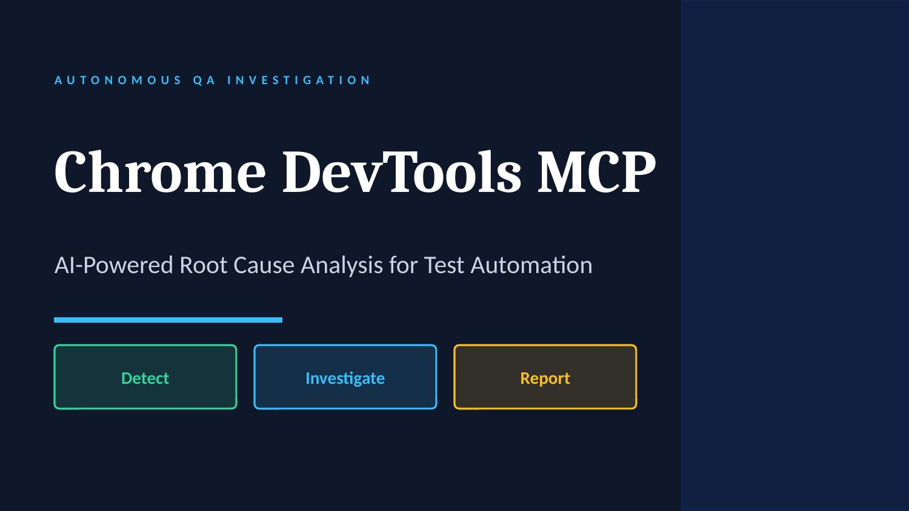

Slide 3
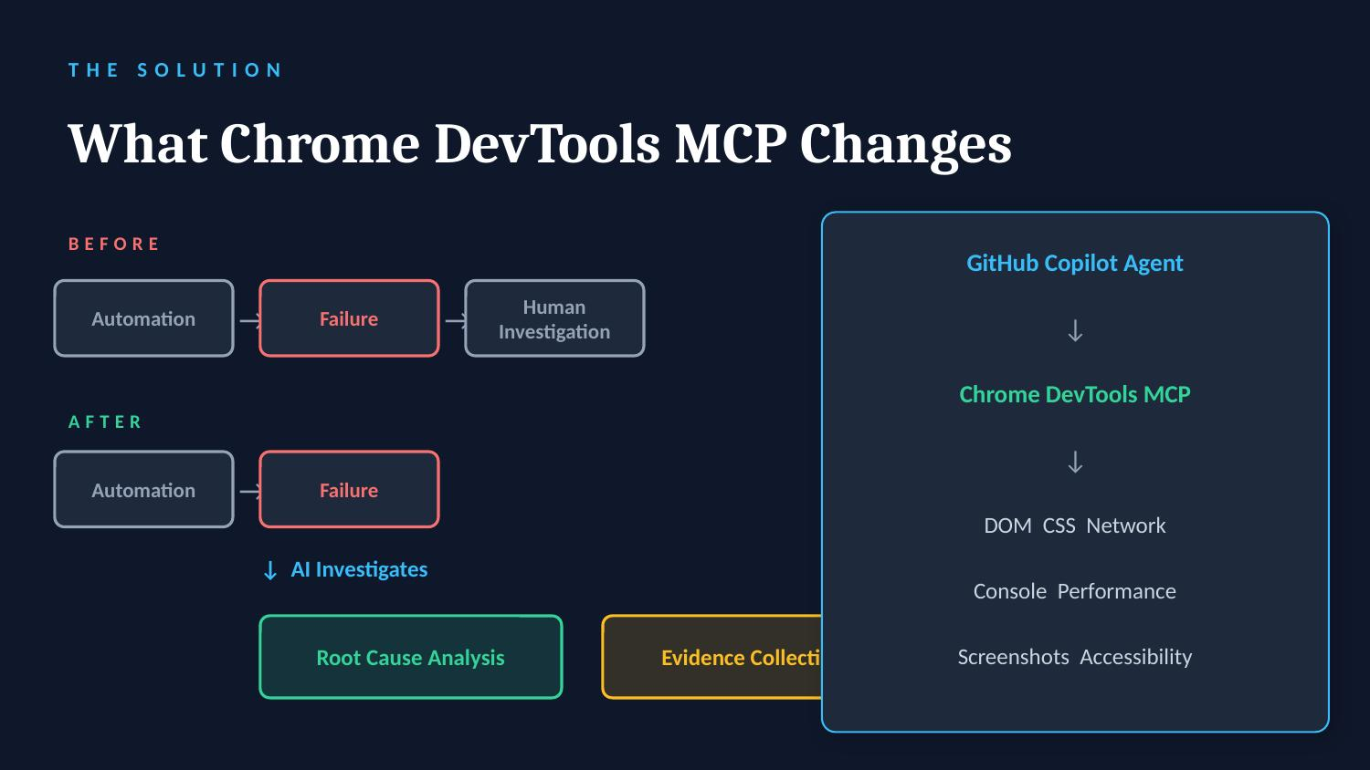

Slide 4
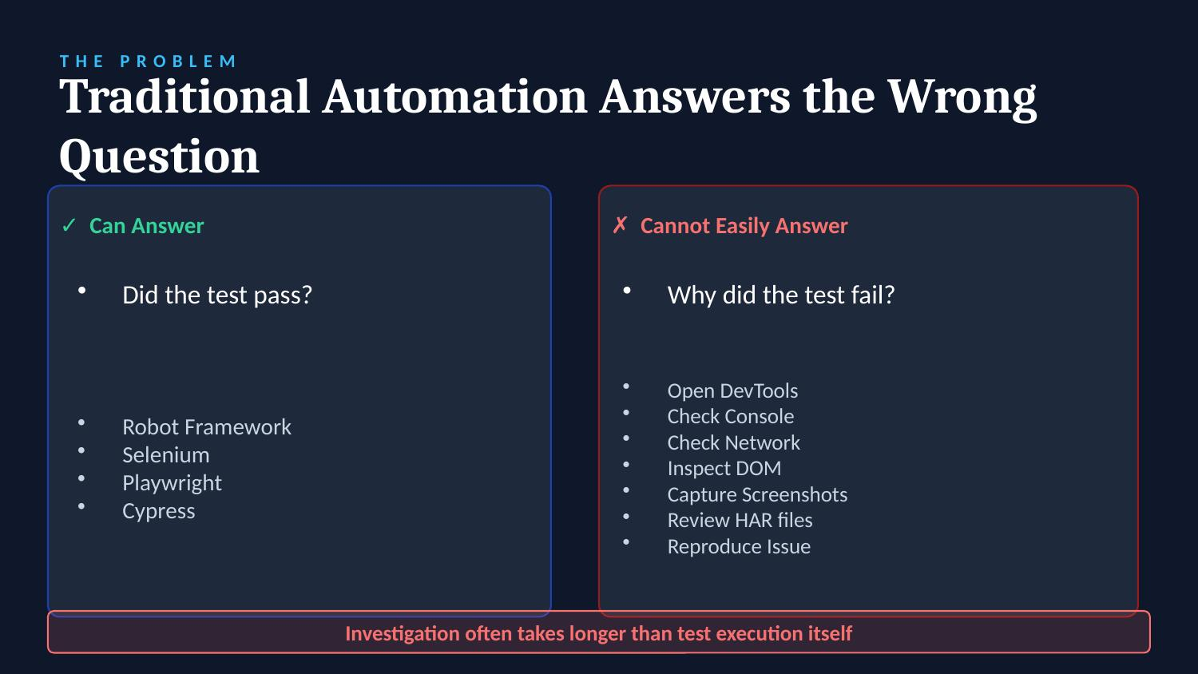

Slide 5
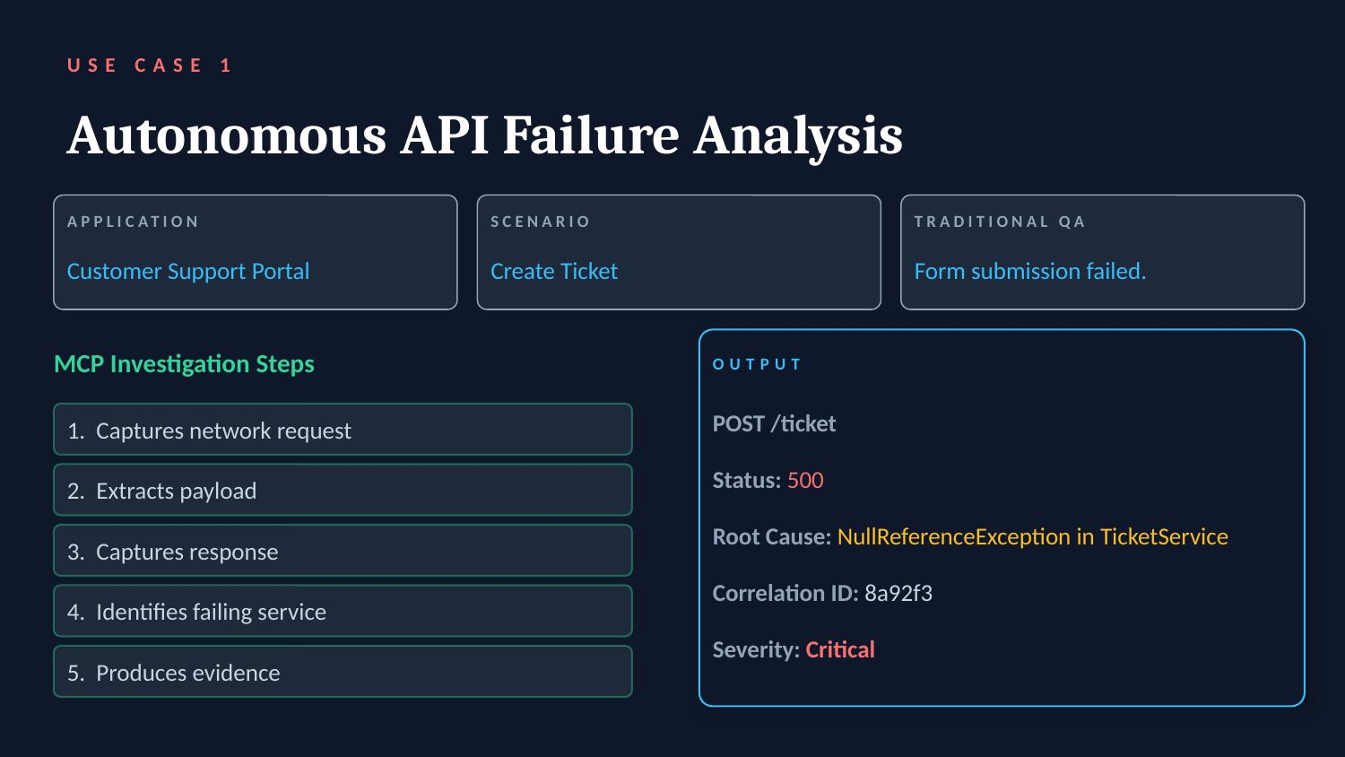

Slide 6
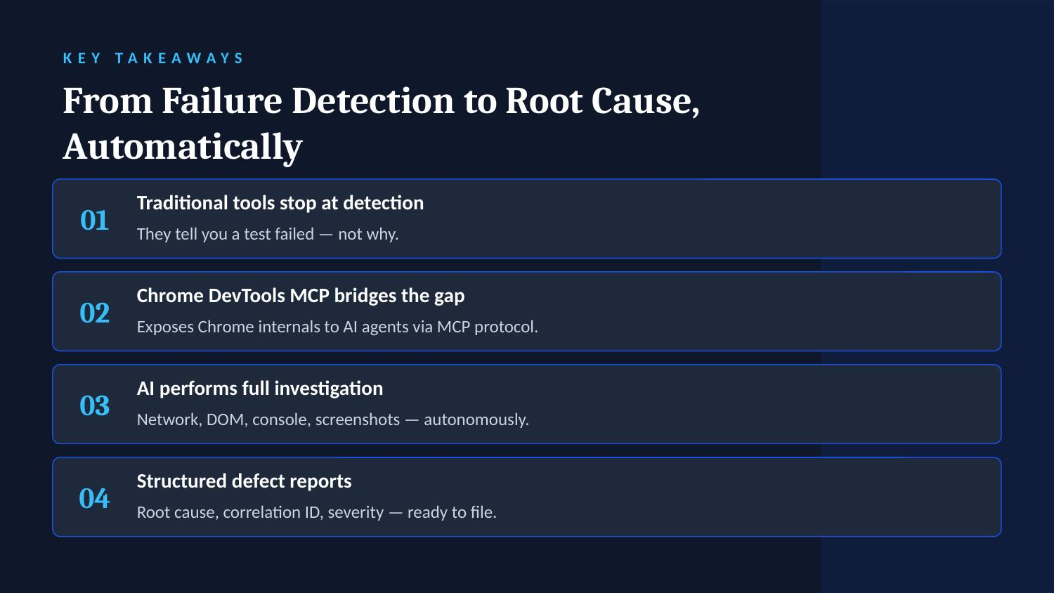

Slide 7
